Slide 1
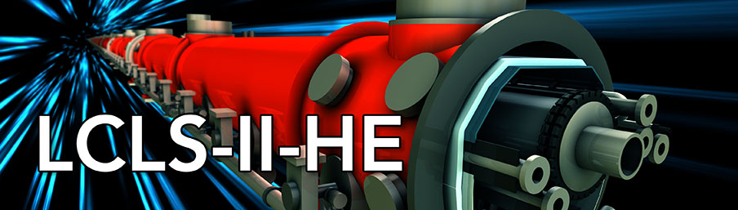
Lessons Learned from L2 Nb mat’l HT
Ari D. Palczewski
C. Reece
L2 CM Performance Wkshp for HE
04/25/2019

Slide 2
Summary of lessons learned
The material sensitivity that we are focused on now is its "flux pinning" strength. Crystal defects resist "sweeping" residual flux out via Meissner effect and local thermal gradient @ T_{c}.
Remaining pinned flux after cooldown contributes to and can easily dominate the "residual" losses, limiting Q₀ and creating the dominant cryogenic load, absent field emission.
There is a "natural" variation in grain size and roughly-associated defect density in the production methods of all Nb suppliers. Current QA checks, the interstitial content/RRR, in the current specification are not adequate to explain/predict the defect density at the sheet level.
All suppliers can and have delivered “high-performing” (easy flux-expelling, in this context) material, but not consistently.
April 25-26, 2019
HE CM Perf Wkshp

Slide 3
Summary of lessons learned
With different temperature and duration heat treatment "any" material can be made "low loss", but
  Too much HT can soften the material and lead to detuning issues in handling. How much is too much is poorly understood and different for different batches – quite detailed material history dependent.
Thus, at present, we target different cavity heat treatments for each lot, to realize adequate flux sweeping while minimizing risk of sloppy tuning control.
  This partially comes from the fact we do not know how to write the specification without batch testing, especially for the small grain size material, i.e., ASTM 7.
  Even when we clarify a desirable material specification – we have no assurance that material suppliers will have the means to target that product other than by post-production filtering. (Such would have significant cost implications.)
Enlarging the grain size in the Nb specification at this time on the sheet level, i.e., going from [ASTM 6 and no ASTM 8] to [ASTM 5 with no ASTM 7] might increase the cost by a significant amount and could add machining and yield strength issues of their own. The trade-offs are not clear at this time.

Slide 4
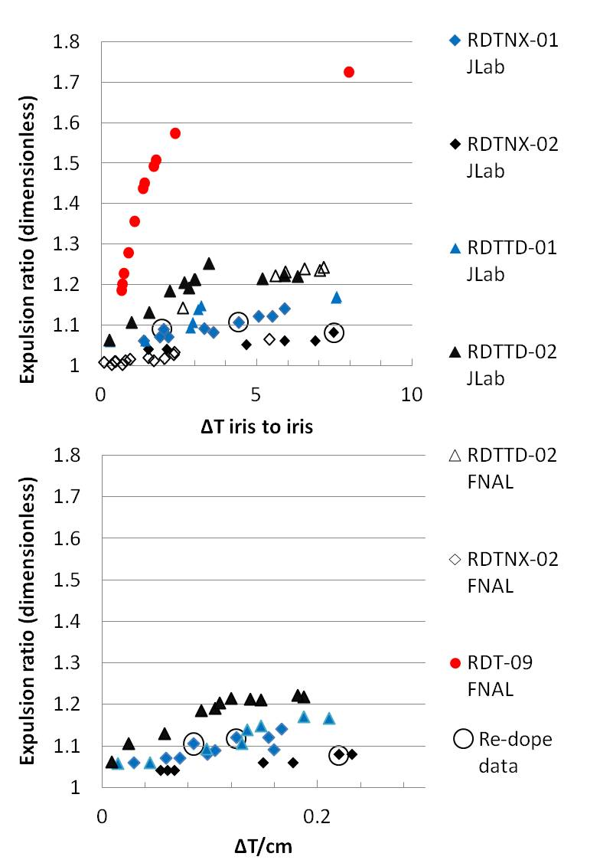
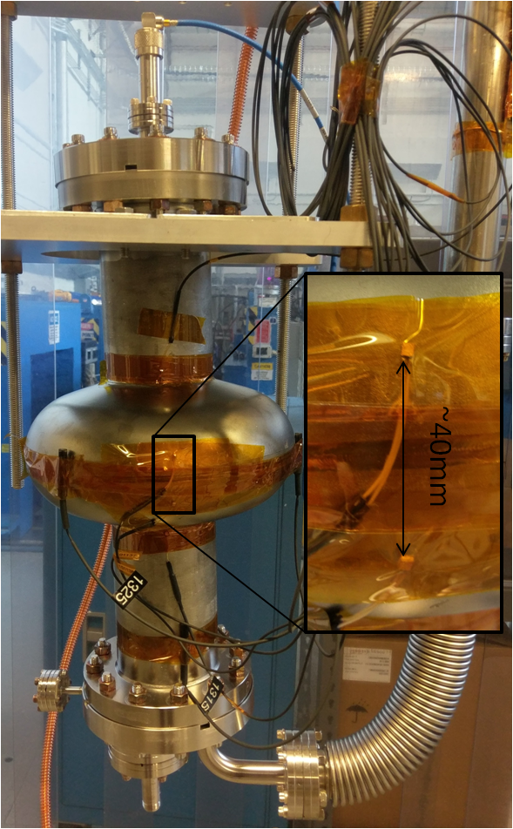
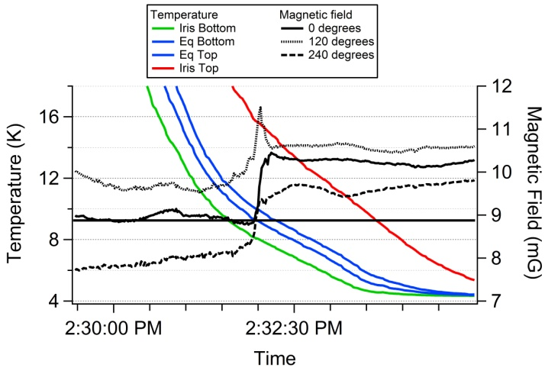
Flux expulsion – Definition and Example
Niobium cavity sensors
4 calibrated Cernox
Upper iris
20mm above the equator
20mm below the equator
Lower iris
Calculated ideal ~1.65-1.75*
3 calibrated fluxgate magnetometers
All on equator
All aligned axially to the cavity
Each 120 degrees apart
LCLS-II spec
Cool down curve
$$Flux expulsion rato= \frac{magetic field above Tc}{magnetic field below Tc}$$
*S. Posen http://lss.fnal.gov/archive/2016/conf/fermilab-conf-16-367-td.pdf

Slide 5
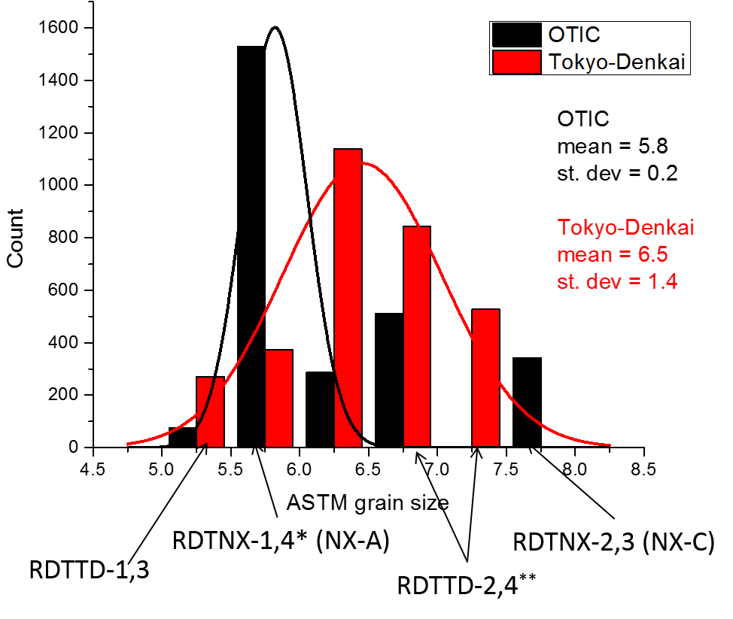
Initial LCLS-II Material
Parameter | Unit | E-XFEL / LCLS II
Year | - | 2007&2010 / 2014
RRR | - | > 300
CHEMICAL COMPOSITION
Ta | % or weight ppm | ≤ 0.05 %
W | % or weight ppm | ≤ 0.007%
Ti | % or weight ppm | ≤ 0.005%
Fe | % or weight ppm | ≤ 0.003%
Si | % or weight ppm | ≤ 0.003%
Mo | % or weight ppm | ≤ 0.005%
Ni | % or weight ppm | ≤ 0.003%
H₂ | % or weight ppm | ≤ 2 w-ppm
N₂ | % or weight ppm | ≤ 10 w-ppm
O₂ | % or weight ppm | ≤ 10 w-ppm
C | % or weight ppm | ≤ 10 w-ppm
MICROSTRUCTURE |  | 100% recrystallized. Uniform size and equal-axed grains
Grain size | ASTM µm | Predominantly ≥ 6 ≤ 45
Maximal grain size | ASTM µm | > 4 < 90
MECHANICAL PROPERT.
Tensile strength, Rm * | N/mm² | > 140
Yield strength, Rp0.2 * | N/mm² | 50 < Rp0.2 < 100
Elongation, AL 30 * | % | ≥ 30
Hardness, HV (min. load 10 N) | - | ≤ 60
26 Total heat lots from Tokyo Denkai (TD) material - 3155 sheets
16 heat lots from Ningxia Orient Tantalum industry co ltd (OTIC or Ningxia or NX) - 2745 sheets
Compiled by Jacek Sekutowicz DESY/LCLS-II
5

Slide 6
LCLS-II material studies
2015/2016 – Flux expulsion in niobium cavities began to be investigated after a failure to get high Qo after doping – initial research done at FNAL.
LCLS-II niobium flux expulsion effort initiated at JLab along with FNAL – rapid manufacturing of 8 single cell initiated at JLab made out of select batches of production niobium in parallel with production of the 9 cells at the two cavity manufactures Zanon (Italy) and Research Instruments (Germany).
4 unique recipes developed depending on the where the niobium was manufactured and the initial crystal structure.
Replacement new material from the higher performing niobium supplier (Tokyo Denkai) was ordered as contingency if the recipes failed.
64 new cavities order – to be made from new material.
A single cell for each ingot lot of the new material produced to validate every batch of 9 cells – 13 single cells needed for 64 - 9 cells - data analysis underway.
April 25-26, 2019
HE CM Perf Wkshp

Slide 7
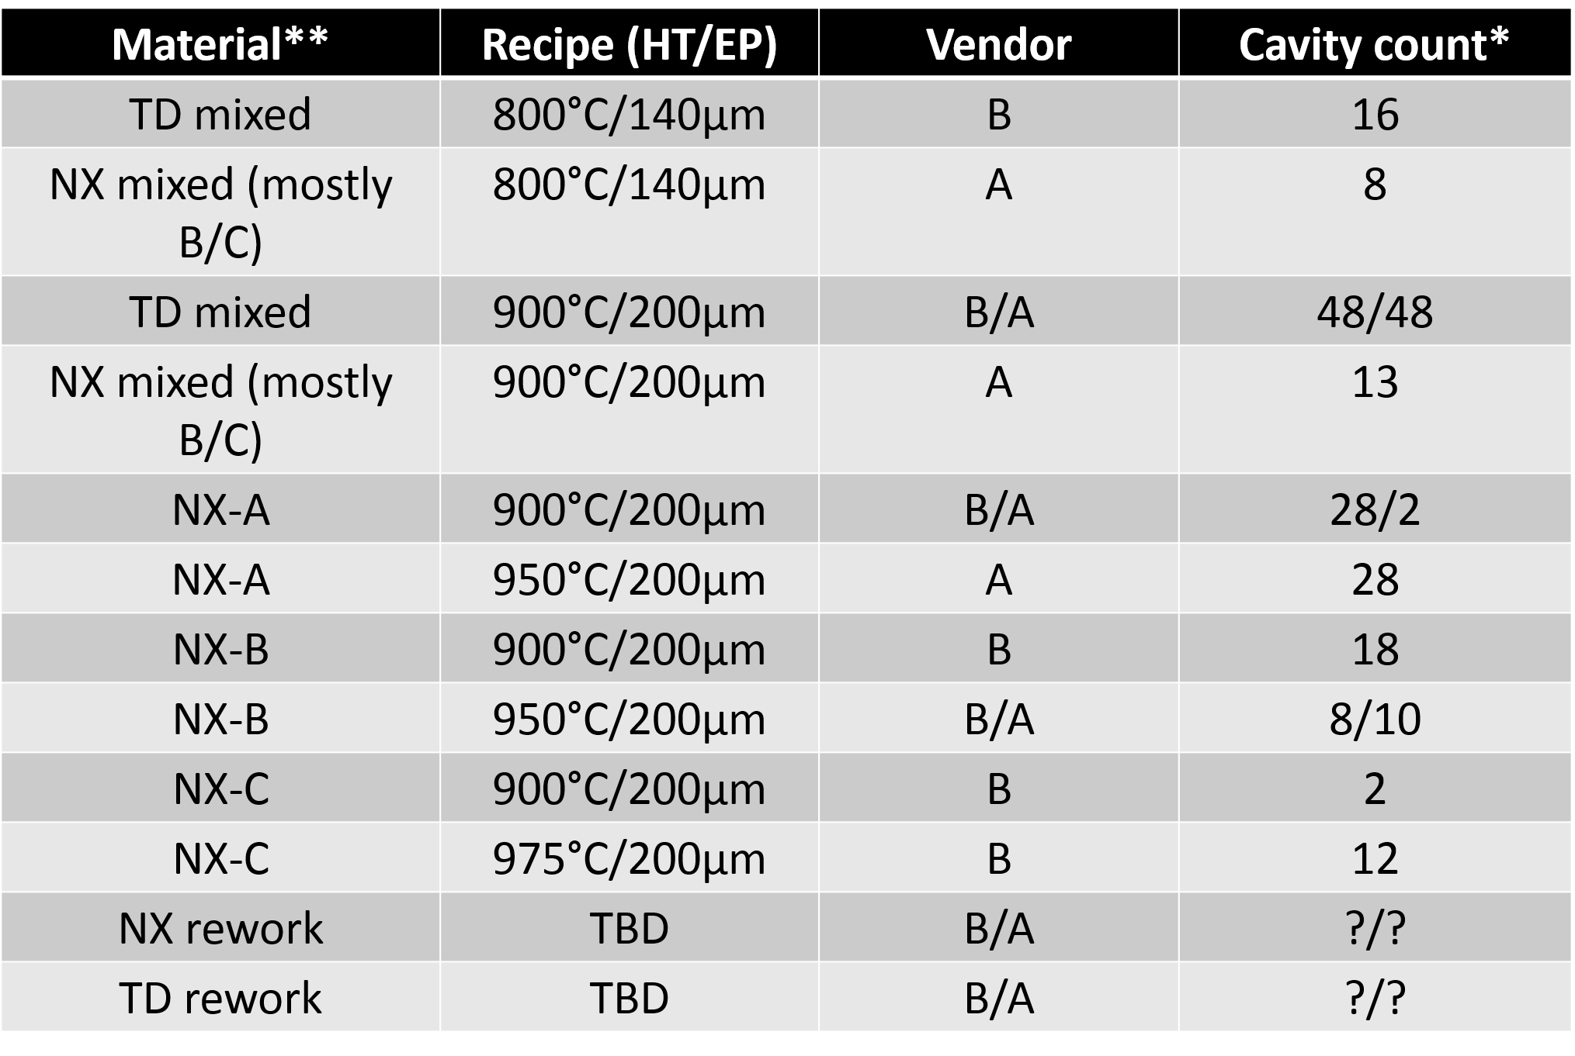
Material/recipe for LCLS-II by cavity count
LCLS-II recipe by cavity vendor, material vendor, heat treatment/EP recipe by cavity counts

Slide 8
Lot validation single cells for new 9 cells
Sorted every production sheet by heat lot (containing 2 ingots).
Pull 2 random sheets from each heat lot from the highest ASTM ingot and make into a single cell.
The single cell must pass the flux expulsion and Q₀ specification for the 9 cells to be heat treated
Pure 9 cell cavities must be made, no mixing of lot sheet until the very end.
No 9 cell can be heat treated until the single cell from the lot is validated.
Lots that are questionable will be heat treated at 925, or 950 if the single cell is revalidated
annealing lot | lot | ingot | ingot RRR | astm
HT9-1052 | 99 | NC-2107 | 425 | 7
 |  | NC-2108 | 389 | 6
HT9-1065 | 100 | NC-2124 | 399 | na
 |  | NC-2125 | 395 | 6,7
HT9-1074 | 101 | NC-2126 | 446 | 6
 |  | NC-2143 | 373 | 7
HT9-1081 | 102 | NC-2150 | 340 | 6,6
 |  | NC-2151 | 339 | na
HT9-1093 | 103 | NC-2152 | 364 | 6
 |  | NC-2155 | 336 | 6
HT9-1101 | 104 | NC-2159 | 410 | 6
 |  | NC-2145 | 433 | 7
TH9-1002 | 94 | NC-2075 | 339 | 7
 |  | NC-2085 | 345 | 5
HT9-1012 | 95 | NC-2086 | 319 | 5
 |  | NC-2137 | 341 | 5
HT9-1013 | 96 | NC-2087 | 322 | 6
 |  | NC-2137 | 341 | 5
HT9-1025 | 97 | NC-2092 | 331 | 6
 |  | NC-2099 | 396 | 6
HT9-1046 | 98 | NC-2092 | 331 | 6
 |  | NC-2099 | 396 | 6
HT9-1052 | 99 | NC-2107 | 425 | 7
 |  | NC-2100 | 398 | 7
HT9-773 | 92 | NC-2096 | 379 | 7
 |  | NC-2100 | 398 | 6
HT9-982 | 93 | NC-2060 | 433 | 6
 |  | NC-2135 | 515 | 6

Slide 9
Summary of lessons learned
April 25-26, 2019
HE CM Perf Wkshp

Slide 10
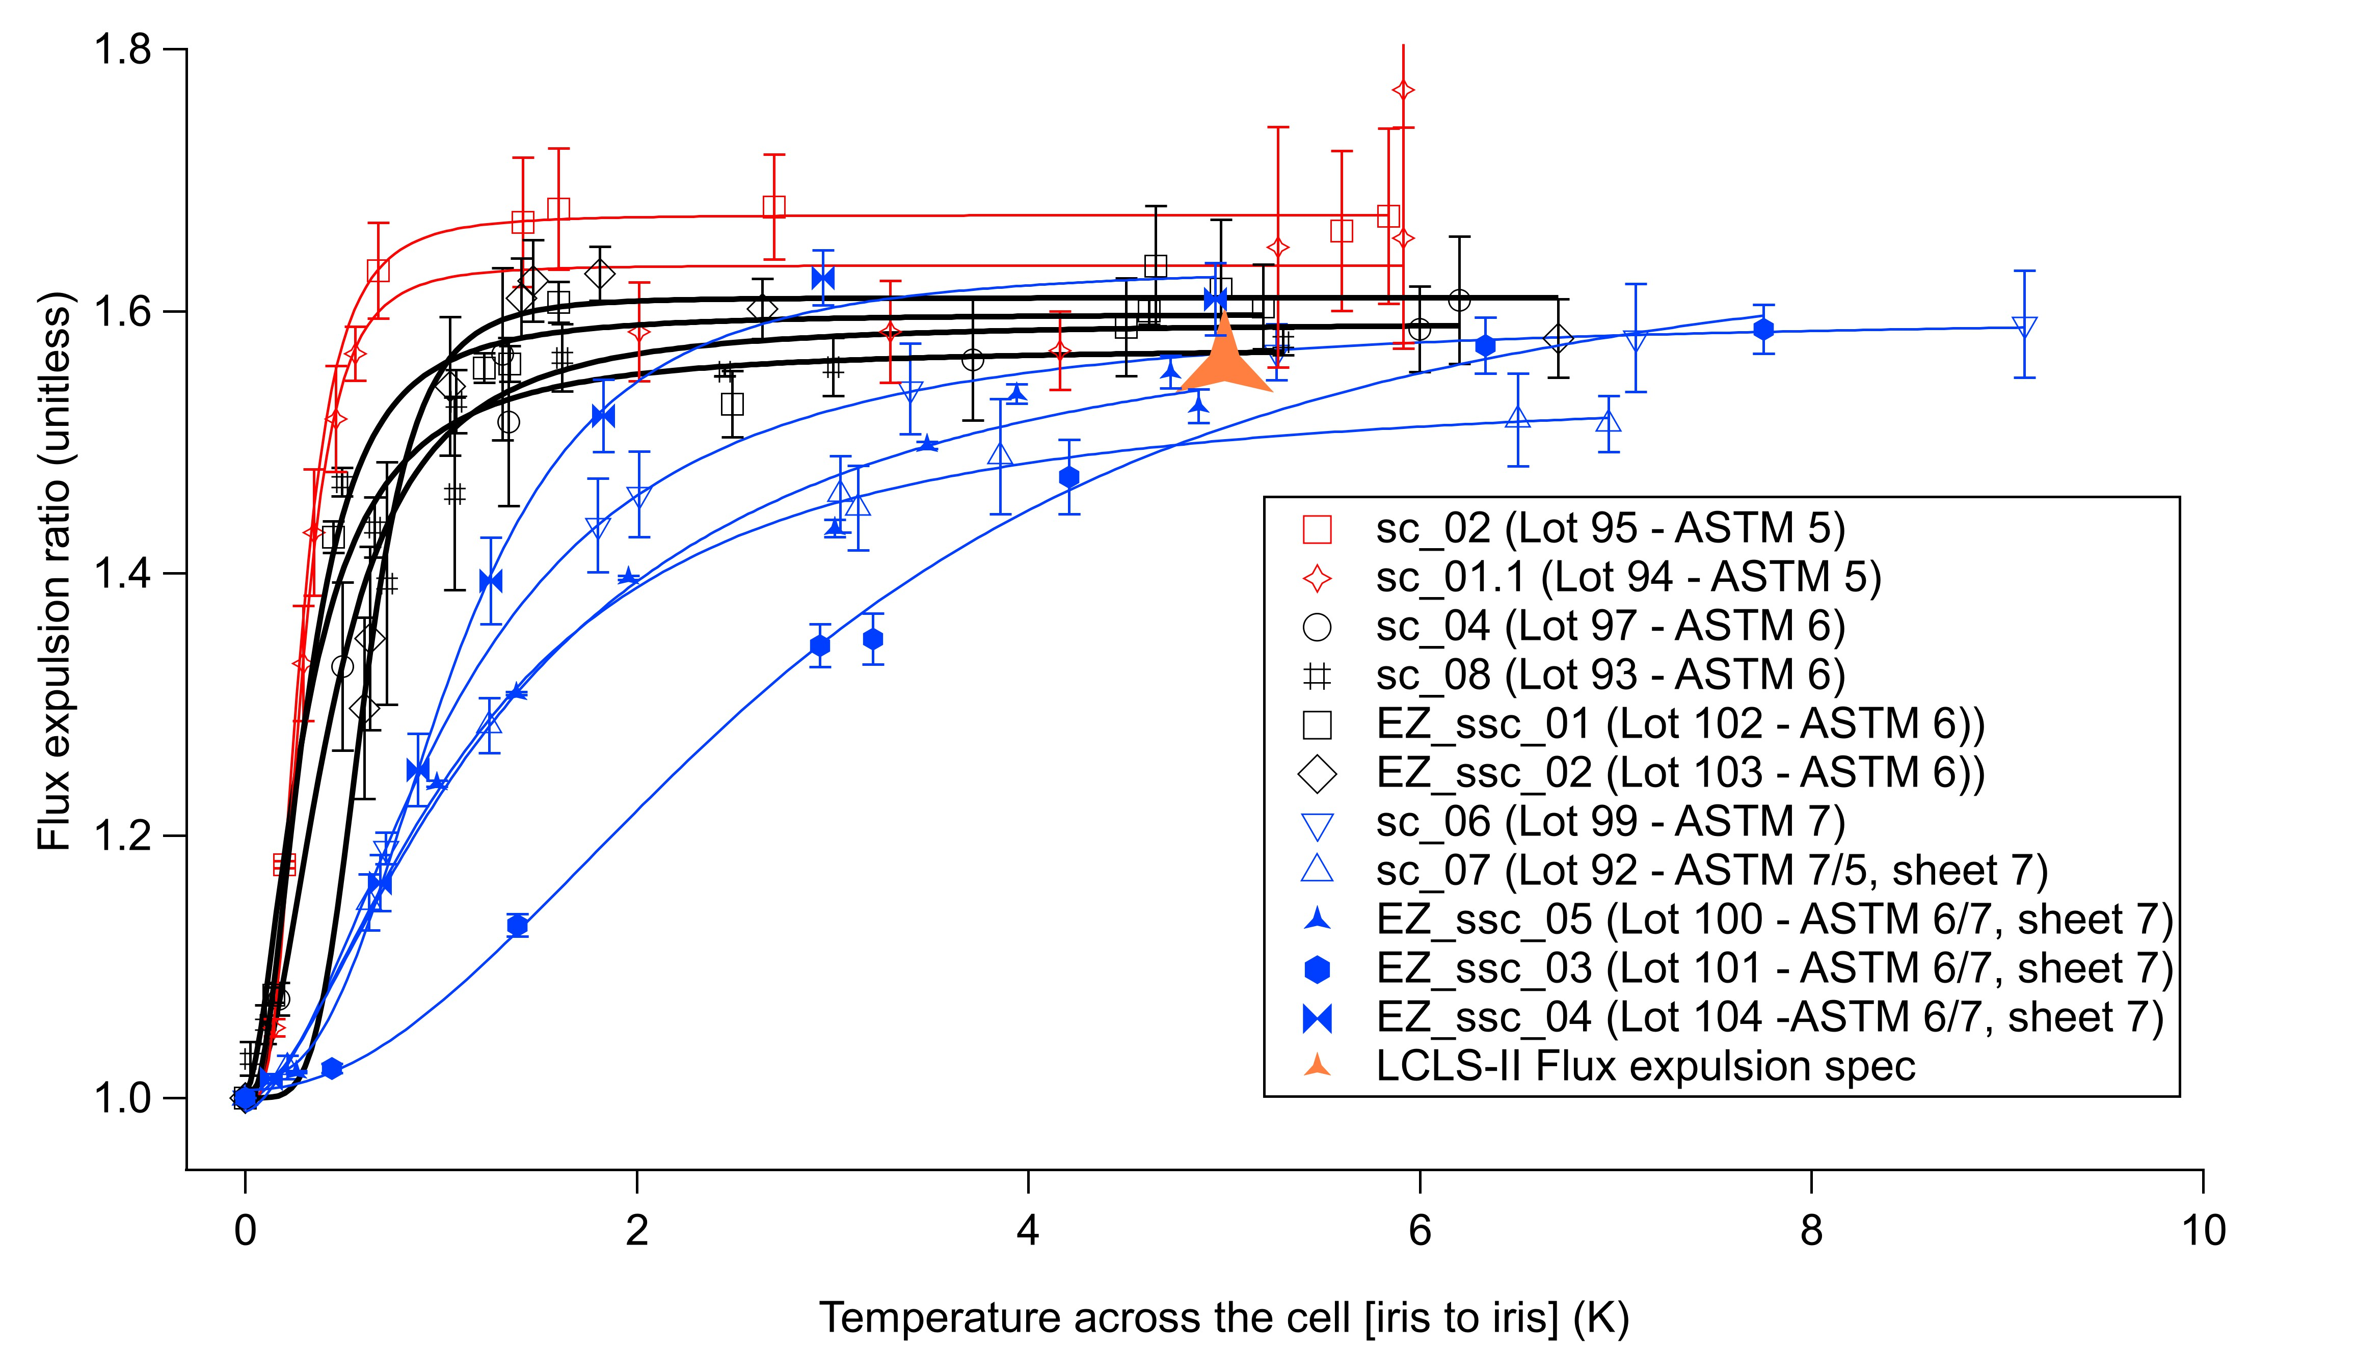
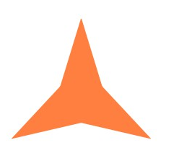
Flux expulsion of new material – Tokyo Denkai niobium cavities all @ 900°C 3 hours
Red – ASTM 5
Black - ASTM 6
Blue - ASTM 7
Unprecedented material analysis to ensure each 9 cell will have optimal recipe at the ingot batch level:
13 single cells for Qt. 64 – 9-cells
One ASTM 7 ingot lot temperature raised to 950°C the other ASTM 5 ingot left at 900°C
Time allowed extra sorting to pure ingots within lots
Lot 99 left alone with knowledge it will just meet the specification – all other lots expected to exceed specification
Lot 100 raised to 925°C as it is a mixed lot
Lot 101 – EZ_SSC_03 – was heat treated at 925°C with no change – lot at 975°C
LCLS-II specification comes from the cooldown and magnetic field specification for the cryomodules

Slide 11
Half cell made from LCLS-II material – Analysis by FSU
Evaluation of strain on grain grown and re-nucleation using LCLS-II provided material (free).
Analysis done my FSU under collaboration with JLab.
Shreyas Balachandran, Pashupati Dhakal, David C. Larbalestier, Peter J. Lee, Microstructural studies of Flux Expulsion and Entry in LCLS-II Material, TTC 2018 Riken Nishina Center Japan , 26-29 2018 https://indico.desy.de/indico/event/20010/session/34/contribution/39
April 25-26, 2019
HE CM Perf Wkshp

Slide 12
Half cell made from LCLS-II material – Analysis by FSU Cont.
Lower stain areas do not show the same grain growth and therefore reduced flux expulsion.
From study:
“Can we start with cold worked Nb sheet to form the initial cavity structure?
  These results suggest that a critical level of cold work present throughout the sheet would lead to a more complete and uniform recrystallization. “
Shreyas Balachandran, Pashupati Dhakal, David C. Larbalestier, Peter J. Lee, Microstructural studies of Flux Expulsion and Entry in LCLS-II Material, TTC 2018 Riken Nishina Center Japan , 26-29 2018 https://indico.desy.de/indico/event/20010/session/34/contribution/39
April 25-26, 2019
HE CM Perf Wkshp

Slide 13
Summary 2
Unprecedented levels of material analysis through batch testing cavities are underway to ensure LCLS-II 9-cells cavities have the highest possible operating Q₀, even with non-optimal cryomodule cool downs.
HE will need to do the same.
Research on creative solutions to manage this phenomenon other than by brute force is just beginning.

