Slide 1
Field Emission, Multipacting and Q-factor degradation due to quench at FNAL’s VTS
Mattia Checchin
LCLS 2-HE CM Performance Workshop, JLab, Newport News, VA
11 Apr 2019

Slide 2
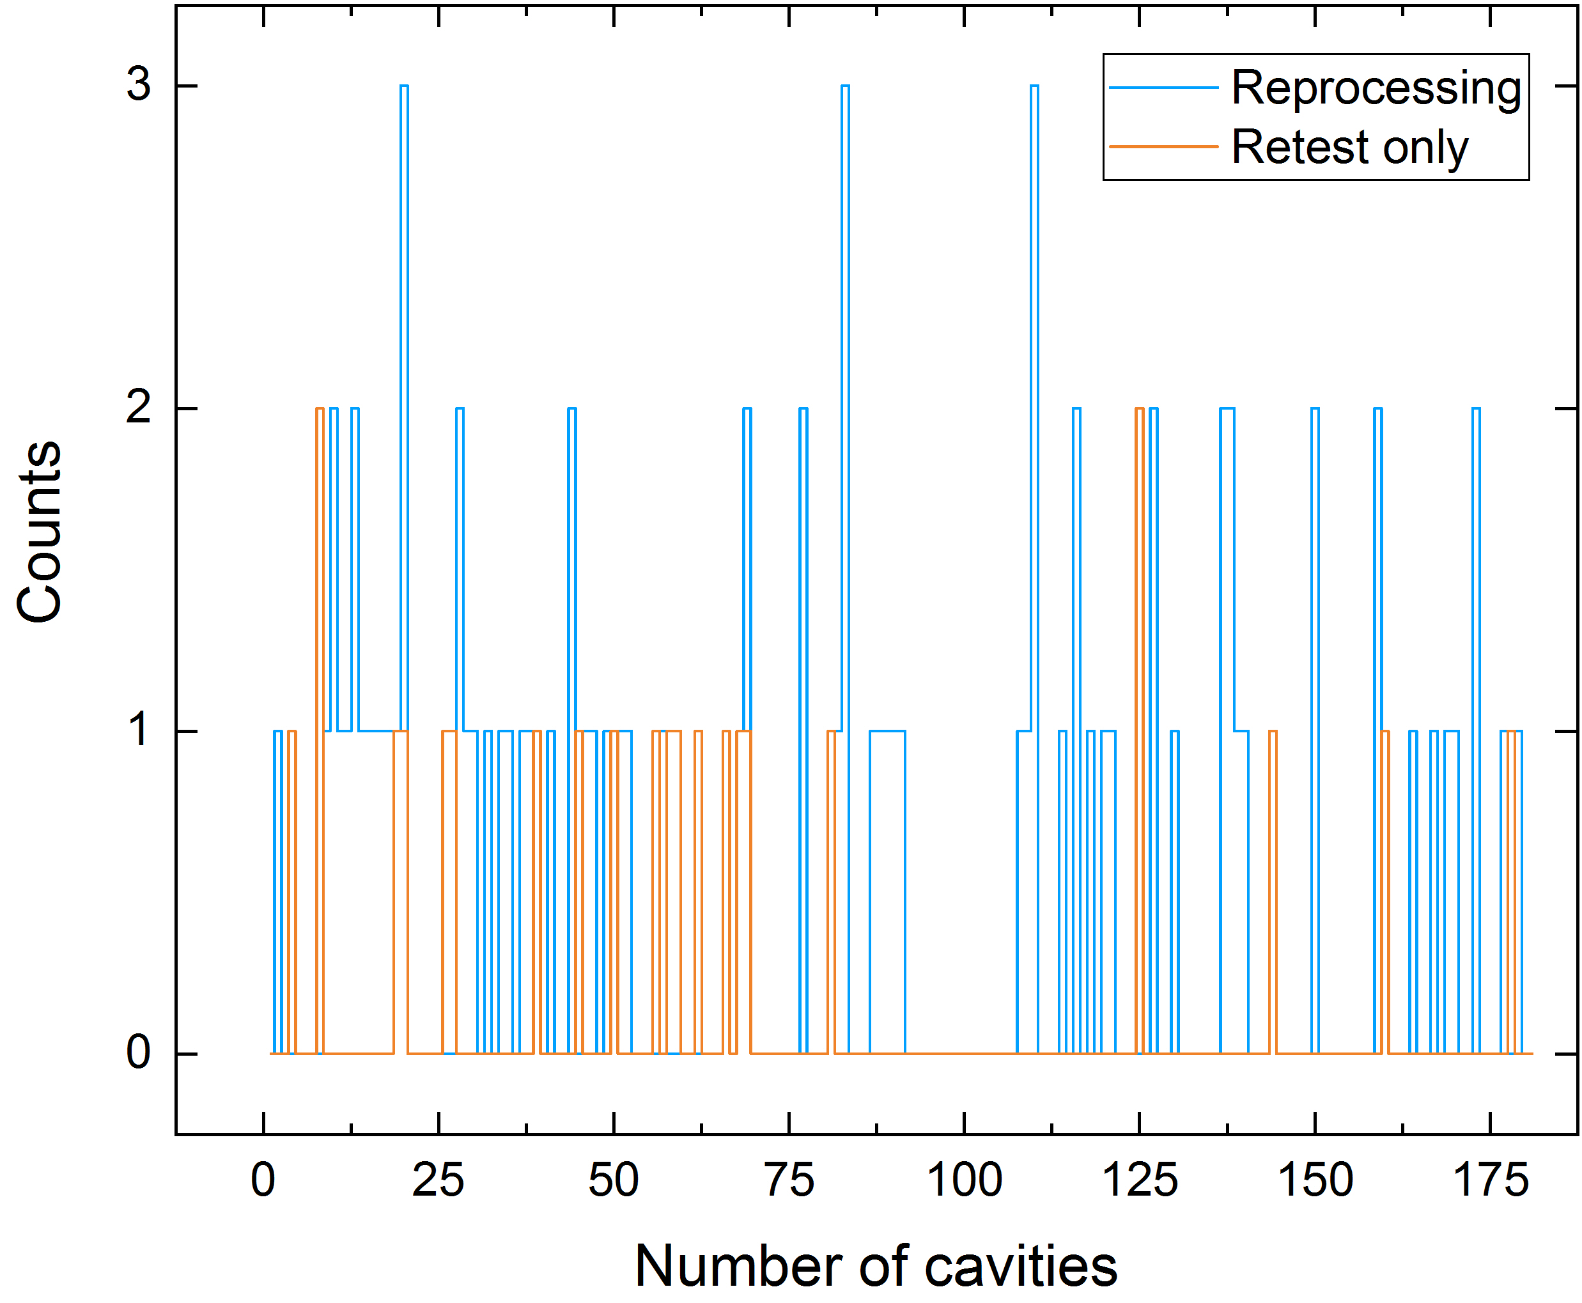
LCLS-II cavities tested at FNAL as of 02/27/2019
Cavities tested: 181
VTS tests: 291
Reprocessing*: 87
Retests**: 23
* reprocessing: cavities are processed and retested at Fermilab
** retest: cavities are reprocessed at the vendor and retested at Fermilab

Slide 3
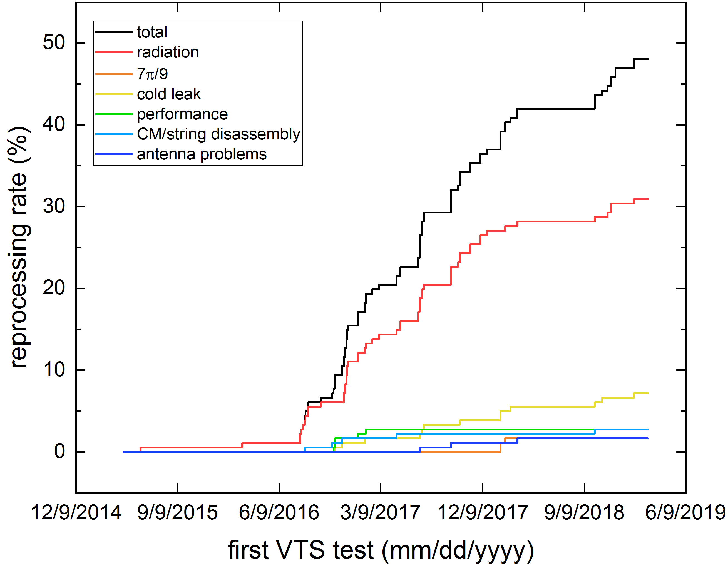
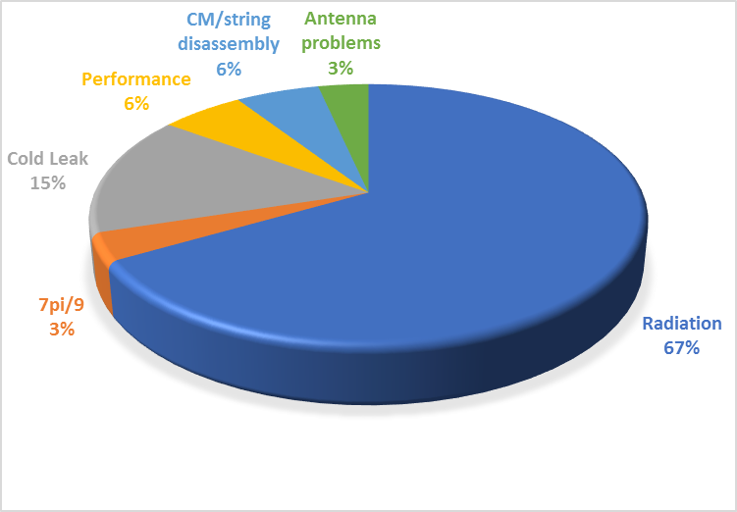
Reprocessing rate
As of 02/27/2019, the total reprocessing rate is 48.1%
Reprocessing rate by cause

Slide 4
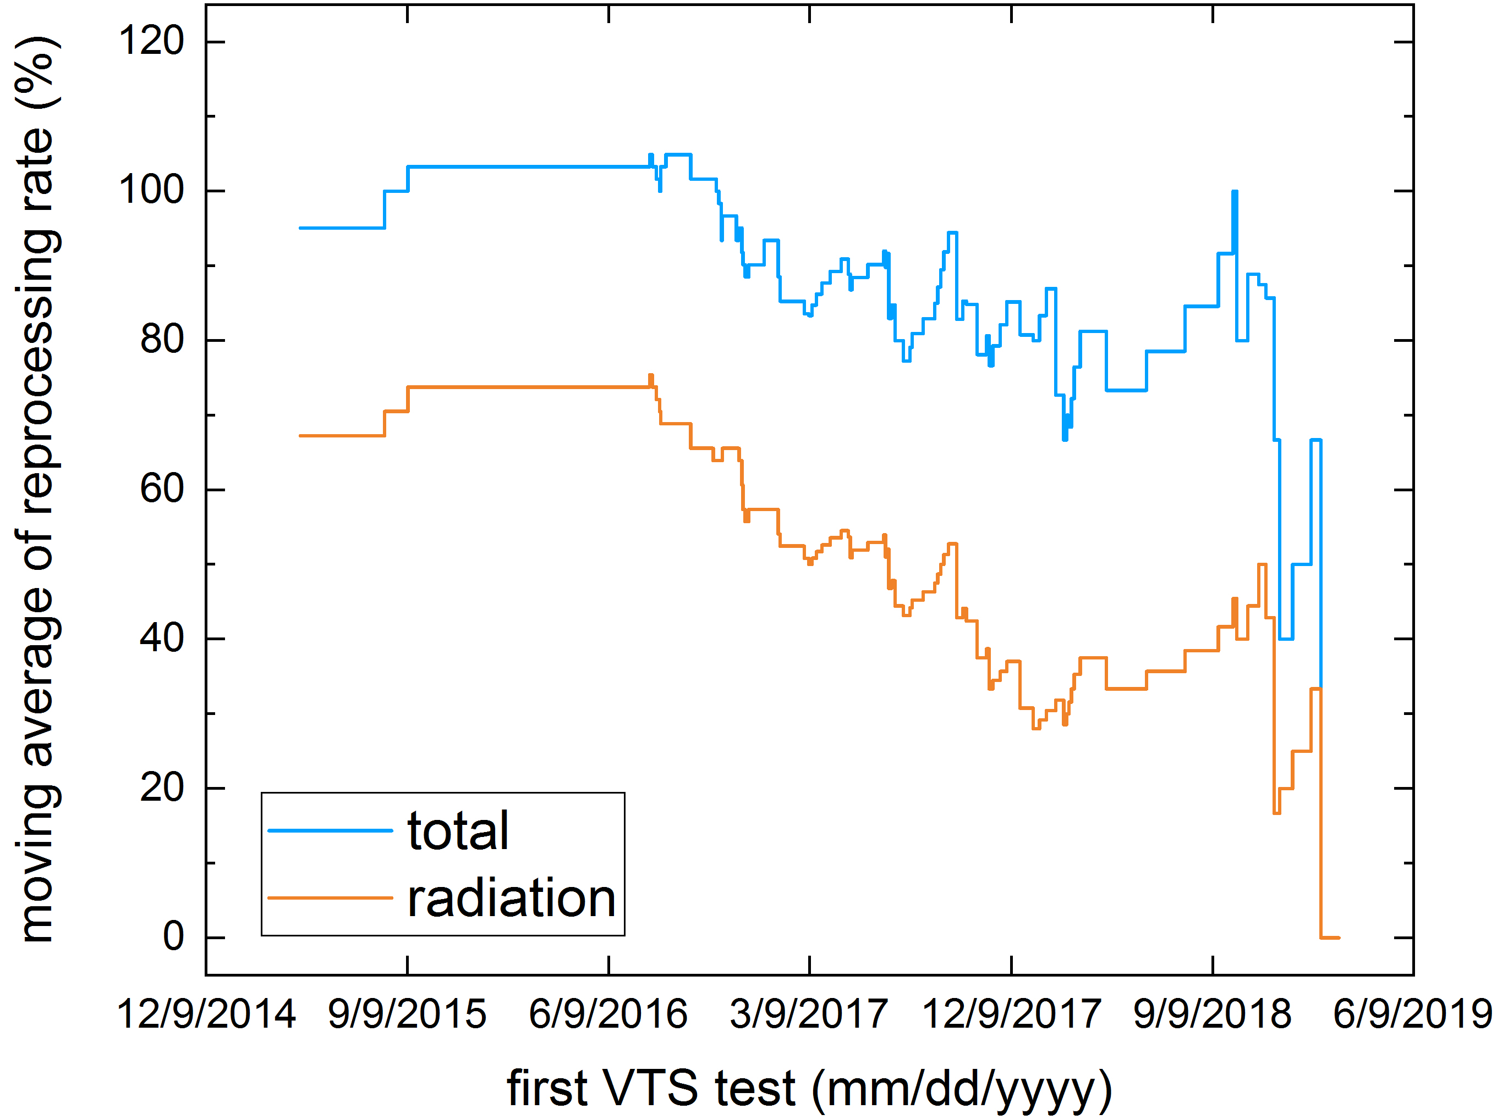
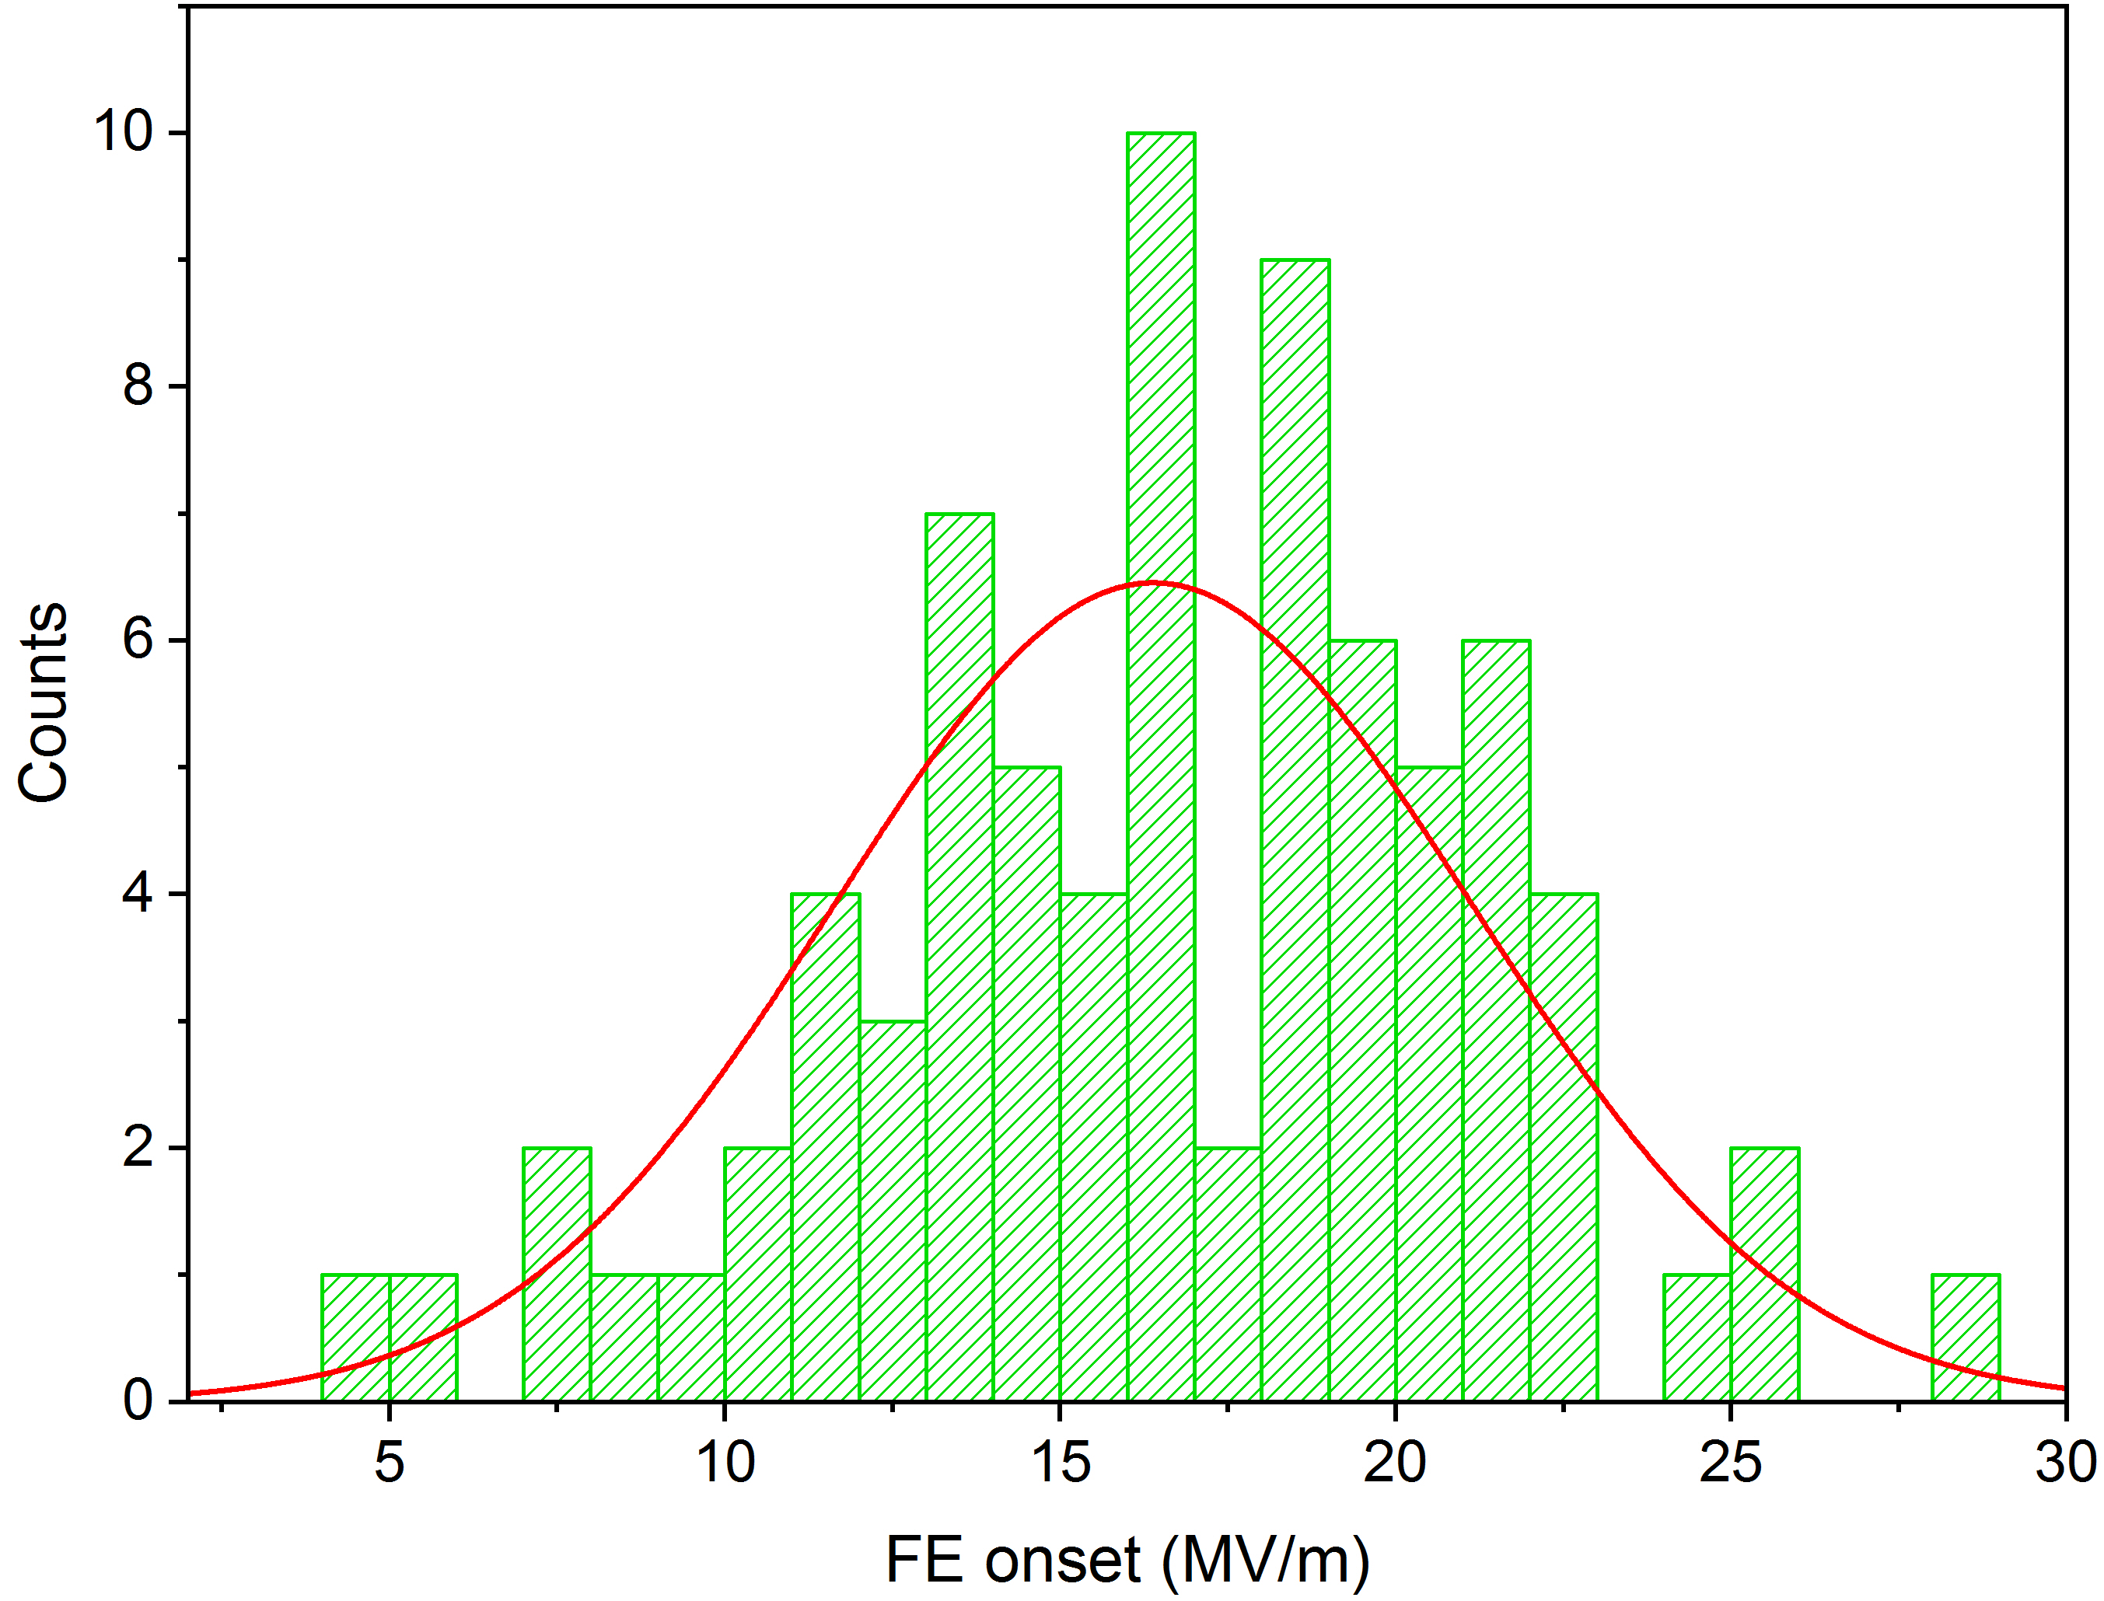
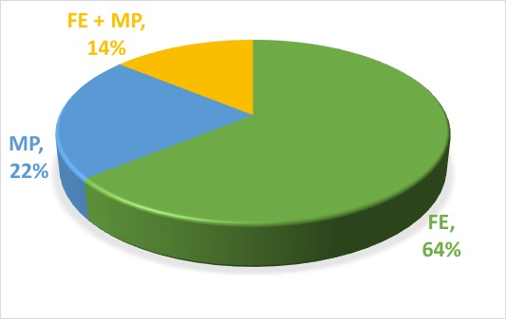
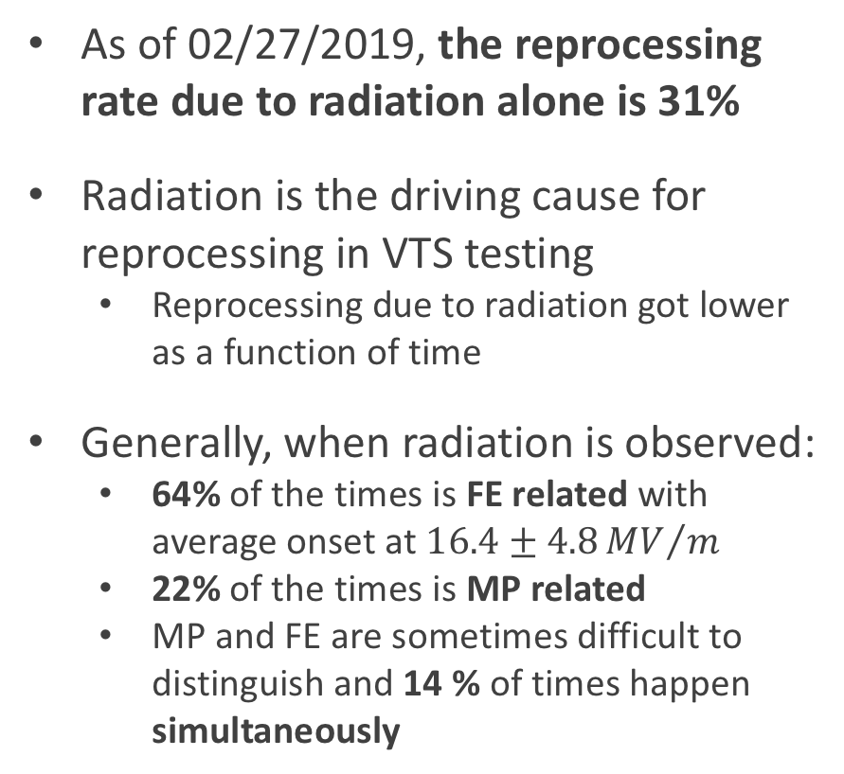
Radiation in VTS
As of 02/27/2019, the reprocessing rate due to radiation alone is 31%
Radiation is the driving cause for reprocessing in VTS testing
  Reprocessing due to radiation got lower as a function of time
Generally, when radiation is observed:
  64% of the times is FE related with average onset at $16.4±4.8{MV}/m$
  22% of the times is MP related
  MP and FE are sometimes difficult to distinguish and 14 % of times happen simultaneously

Slide 5
Q-degradation due to quench

Slide 6
Q-degradation due to quench – facts
Absence of MP/FE
  If remnant magnetic field is compensated, no degradation due to quench is observed
  If there is remnant magnetic field during quench, the Q-factor is degraded
  The Q-factor can be recovered if the cavity is re-quenched in compensated field
  [M. Checchin et al., Phys. Rev. Applied 5, 044019 (2016)]
With MP/FE
  Not studied in detail yet
    Some evidence of degradation due to MP- related quenches even in compensated field
  Situation might be different, the stream of electrons generates magnetic field that might be trapped during quench event

Slide 7
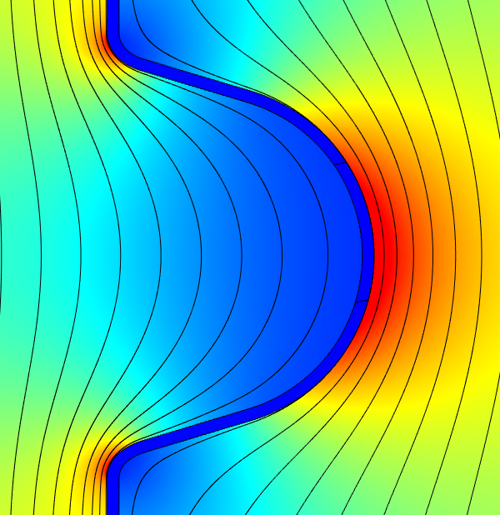
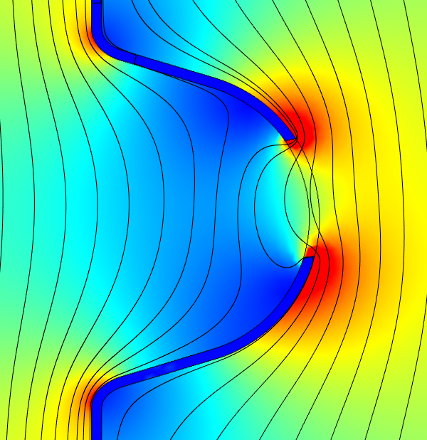
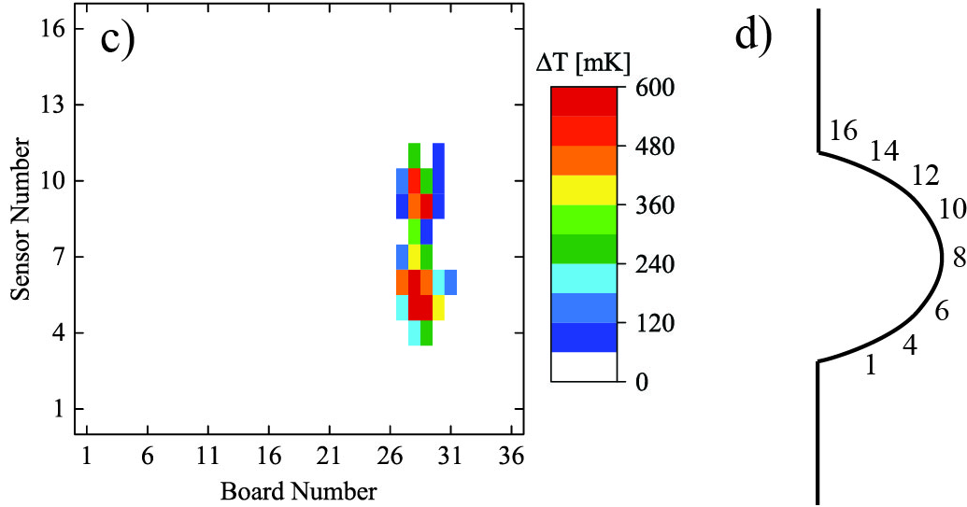
Magnetic flux trapping dynamics
How the magnetic flux is trapped?
  It creates a semi-loop at the quench spot

Slide 8
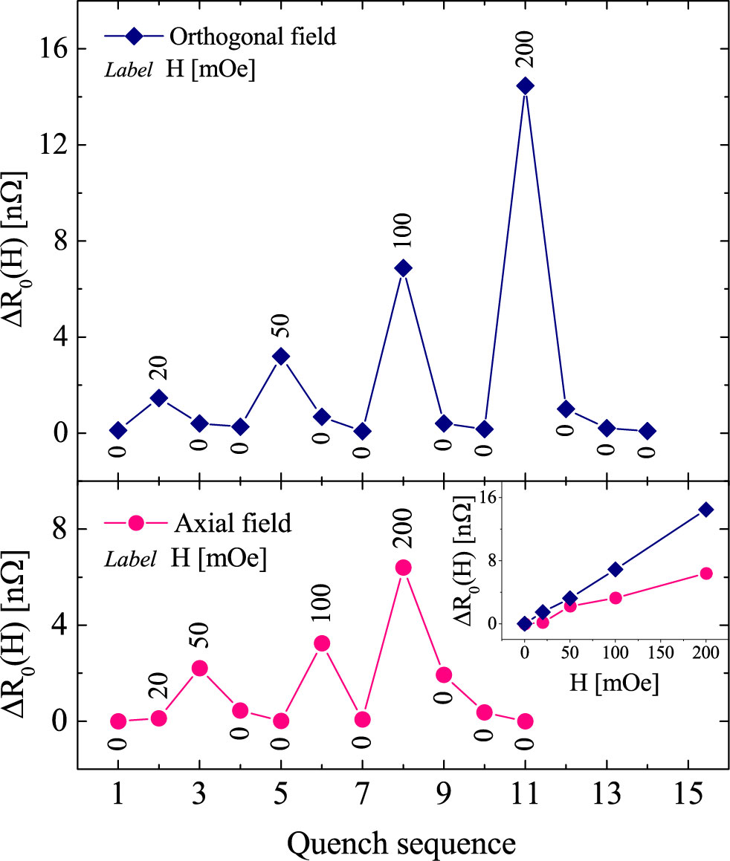
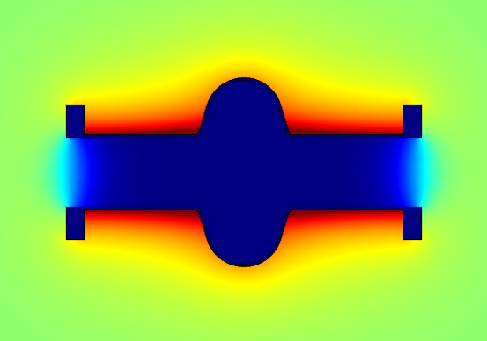
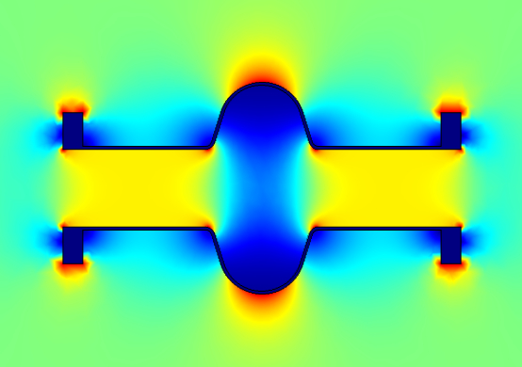
Q-factor degradation and recovery vs field orientation
Orthogonal
Axial

Slide 9
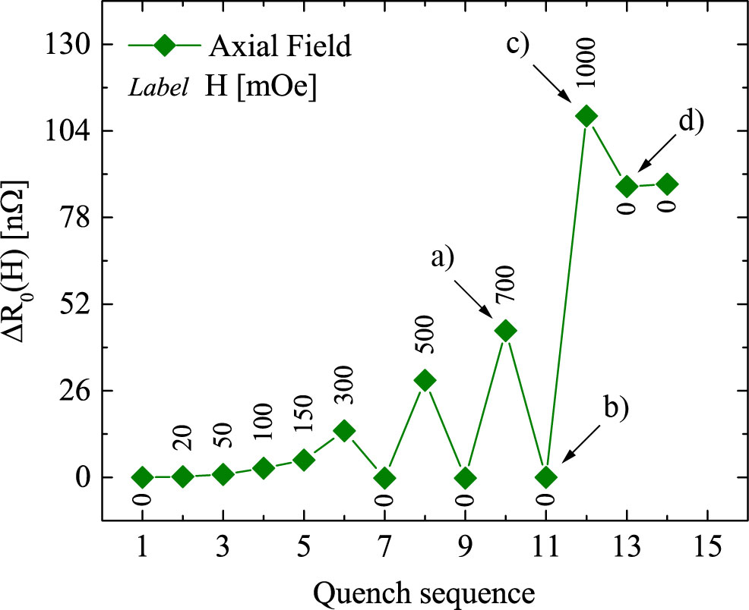
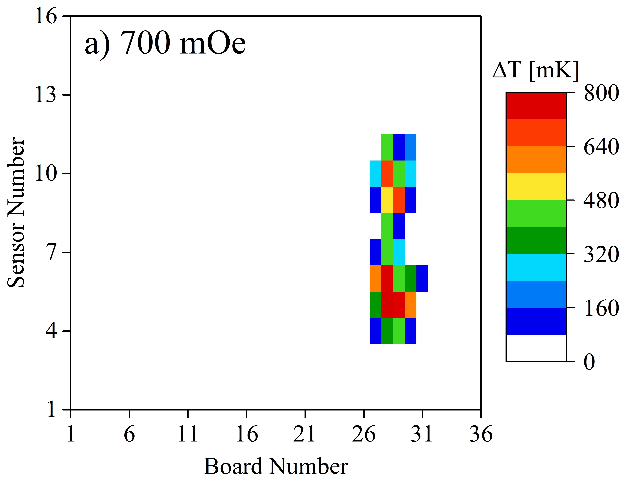
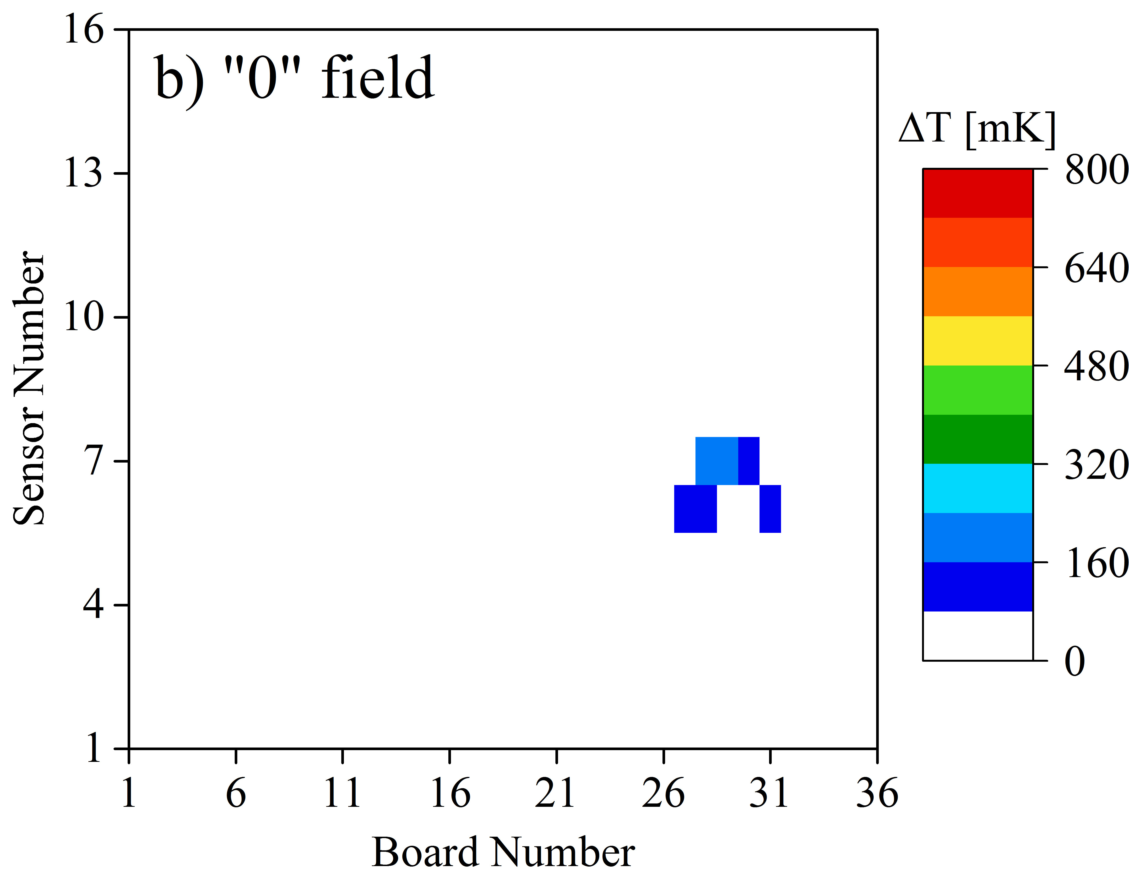
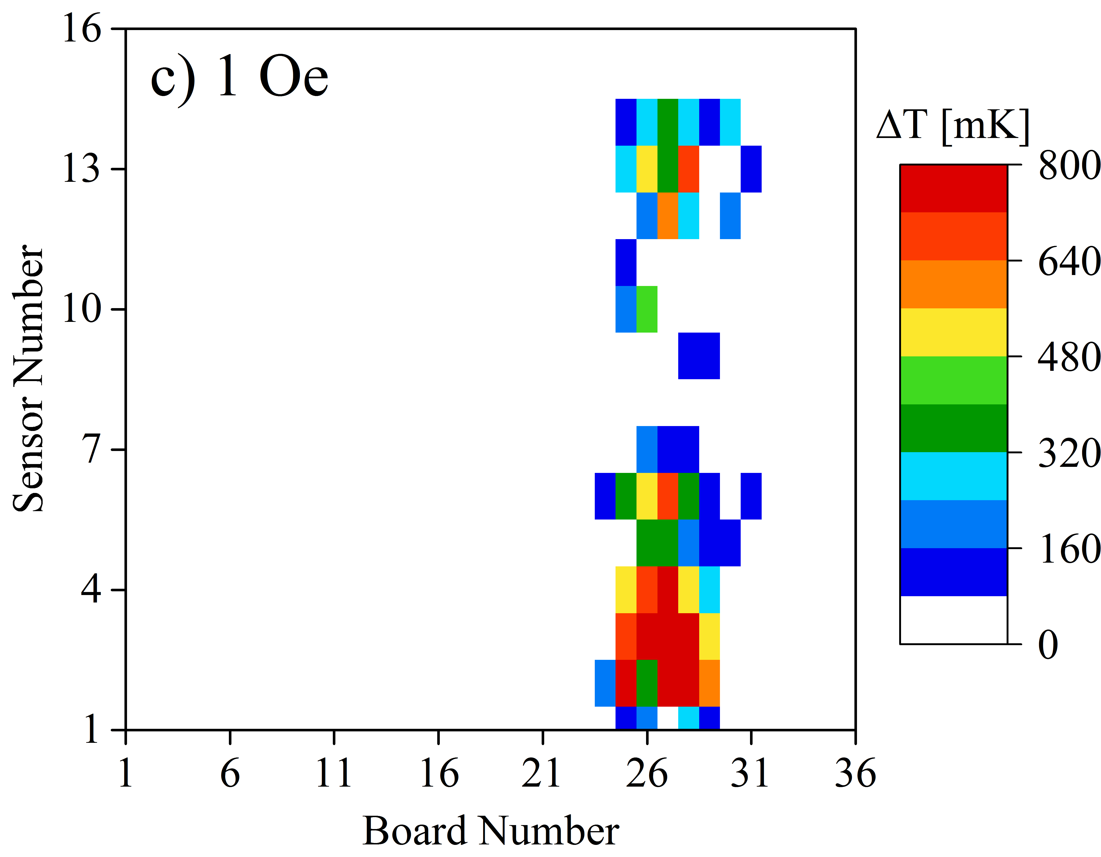
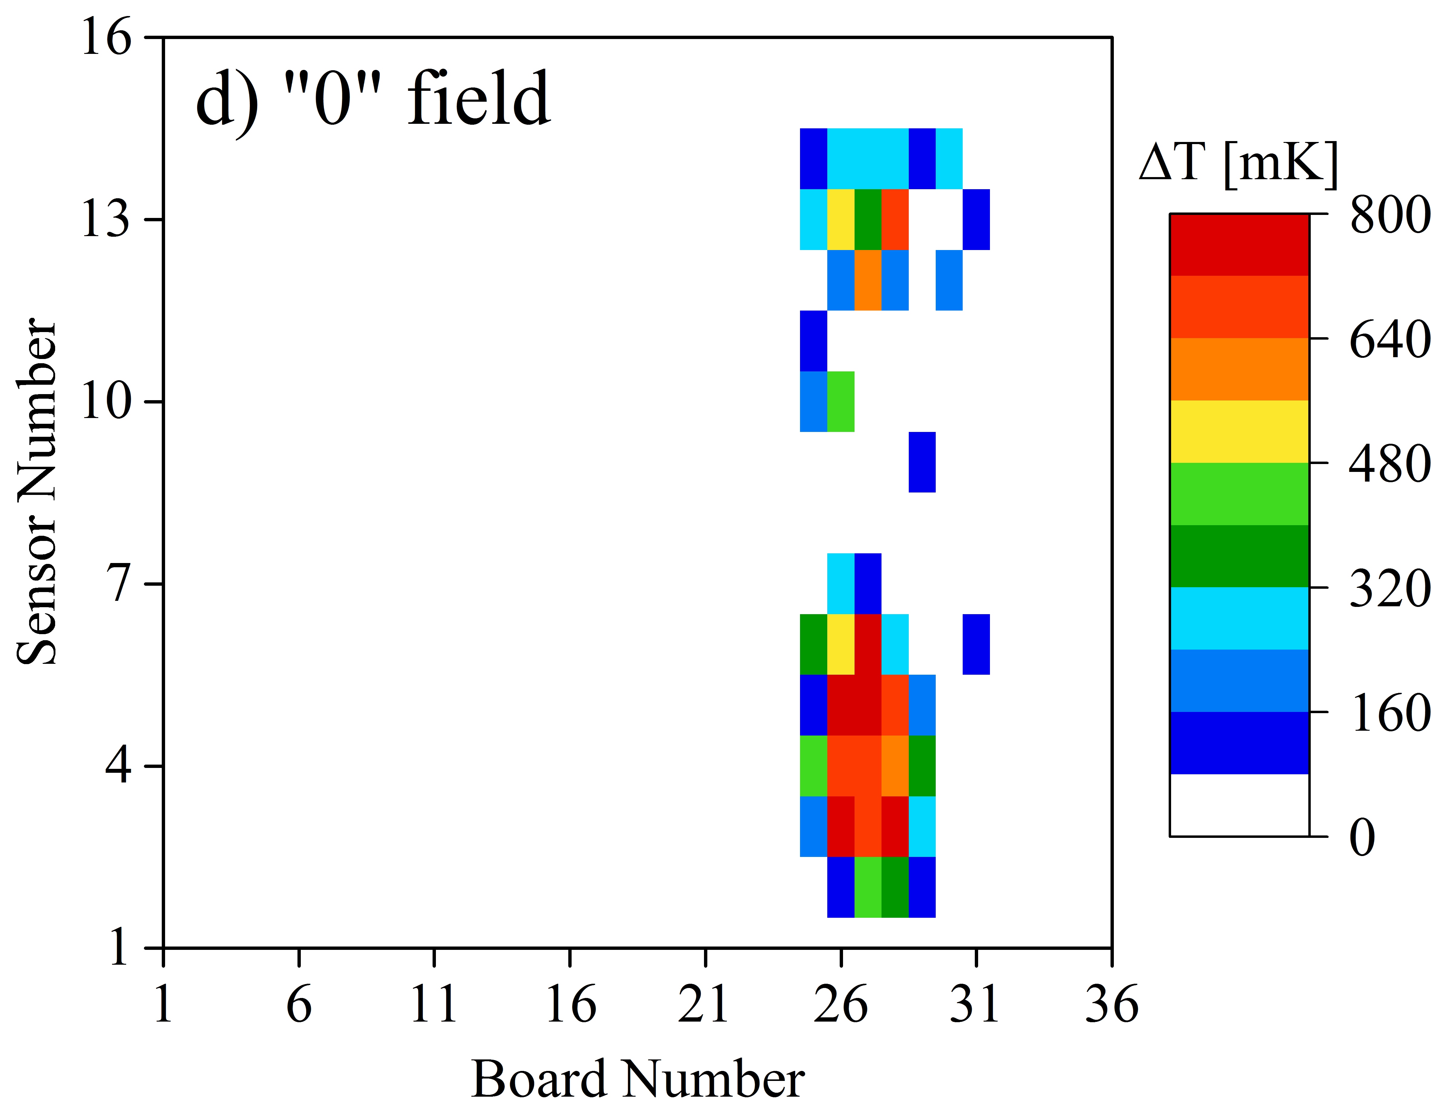
Not complete recovery of Q-factor
Above a certain field value threshold the trapped field migrates and recovery is not possible anymore

Slide 10
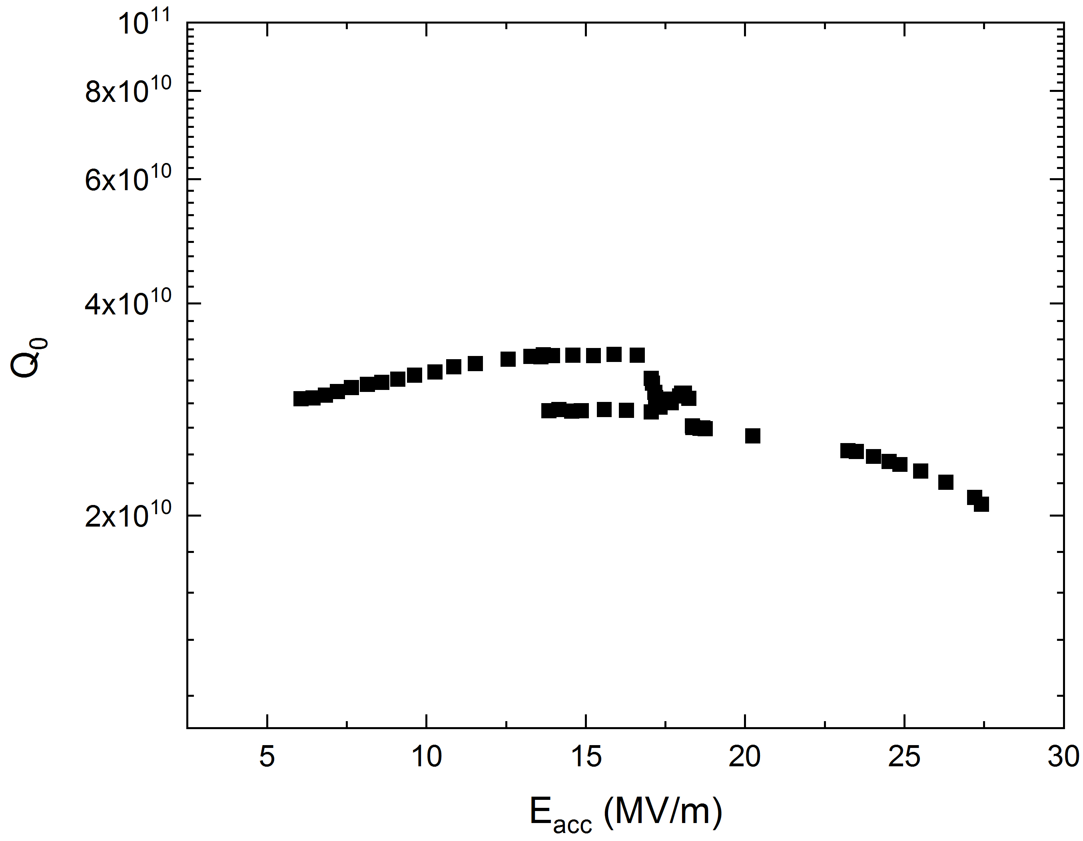
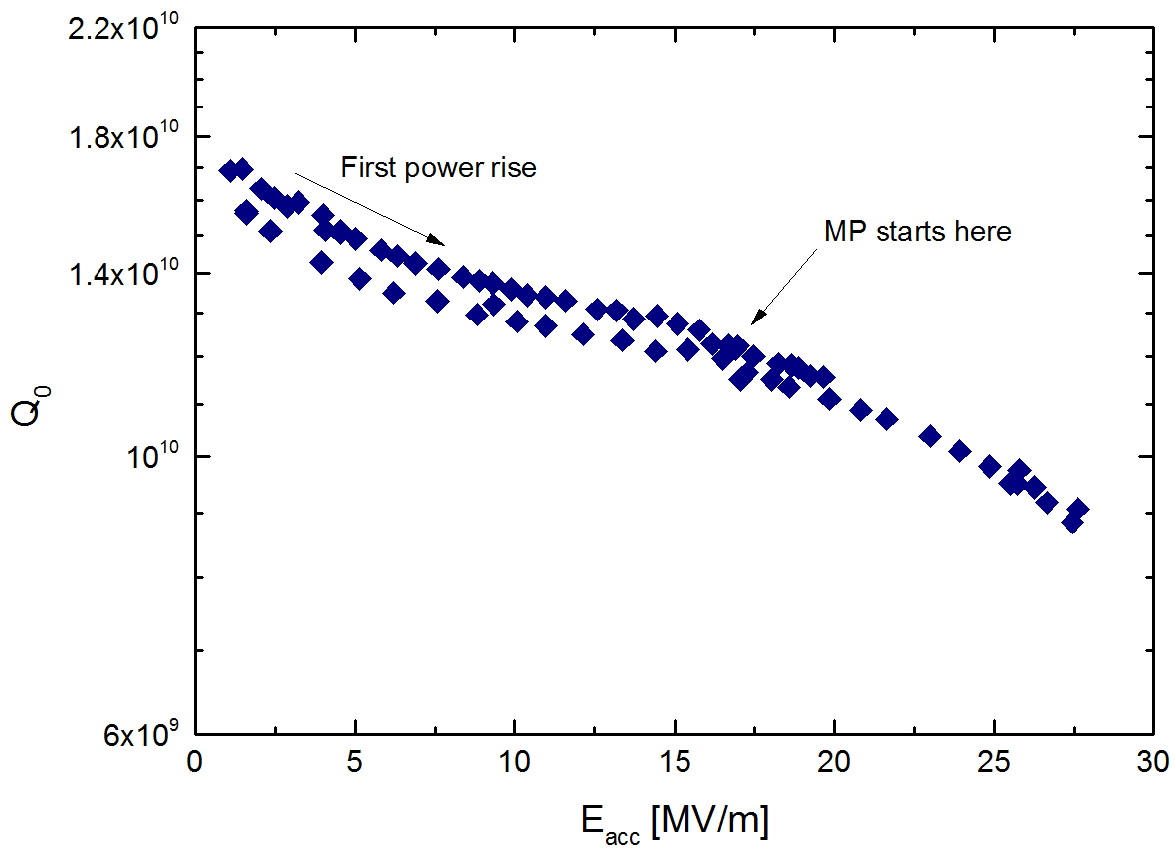
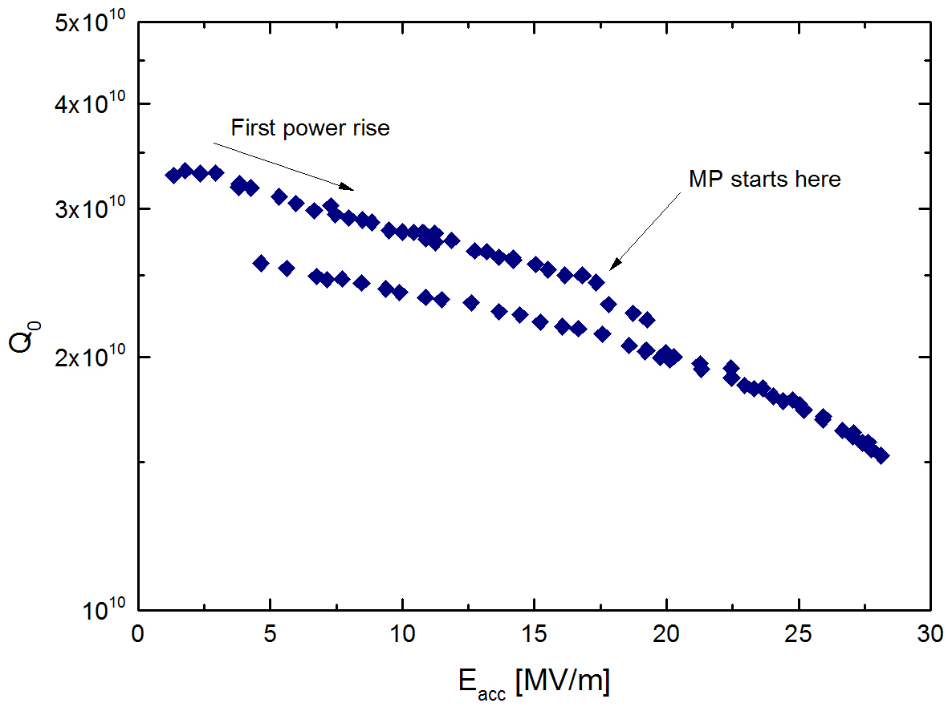
Q-factor degradation due to MP-driven quench
MP-induced quenches can affect the Q-factor even in compensated field (in all cases B < 5 mG)
Same cavity, different cooldowns
Cavity was not open between tests
Fast from 300 K
Fast from 300 K
Slow

Slide 11
Multipacting enhanced by trapped field
during quench

Slide 12
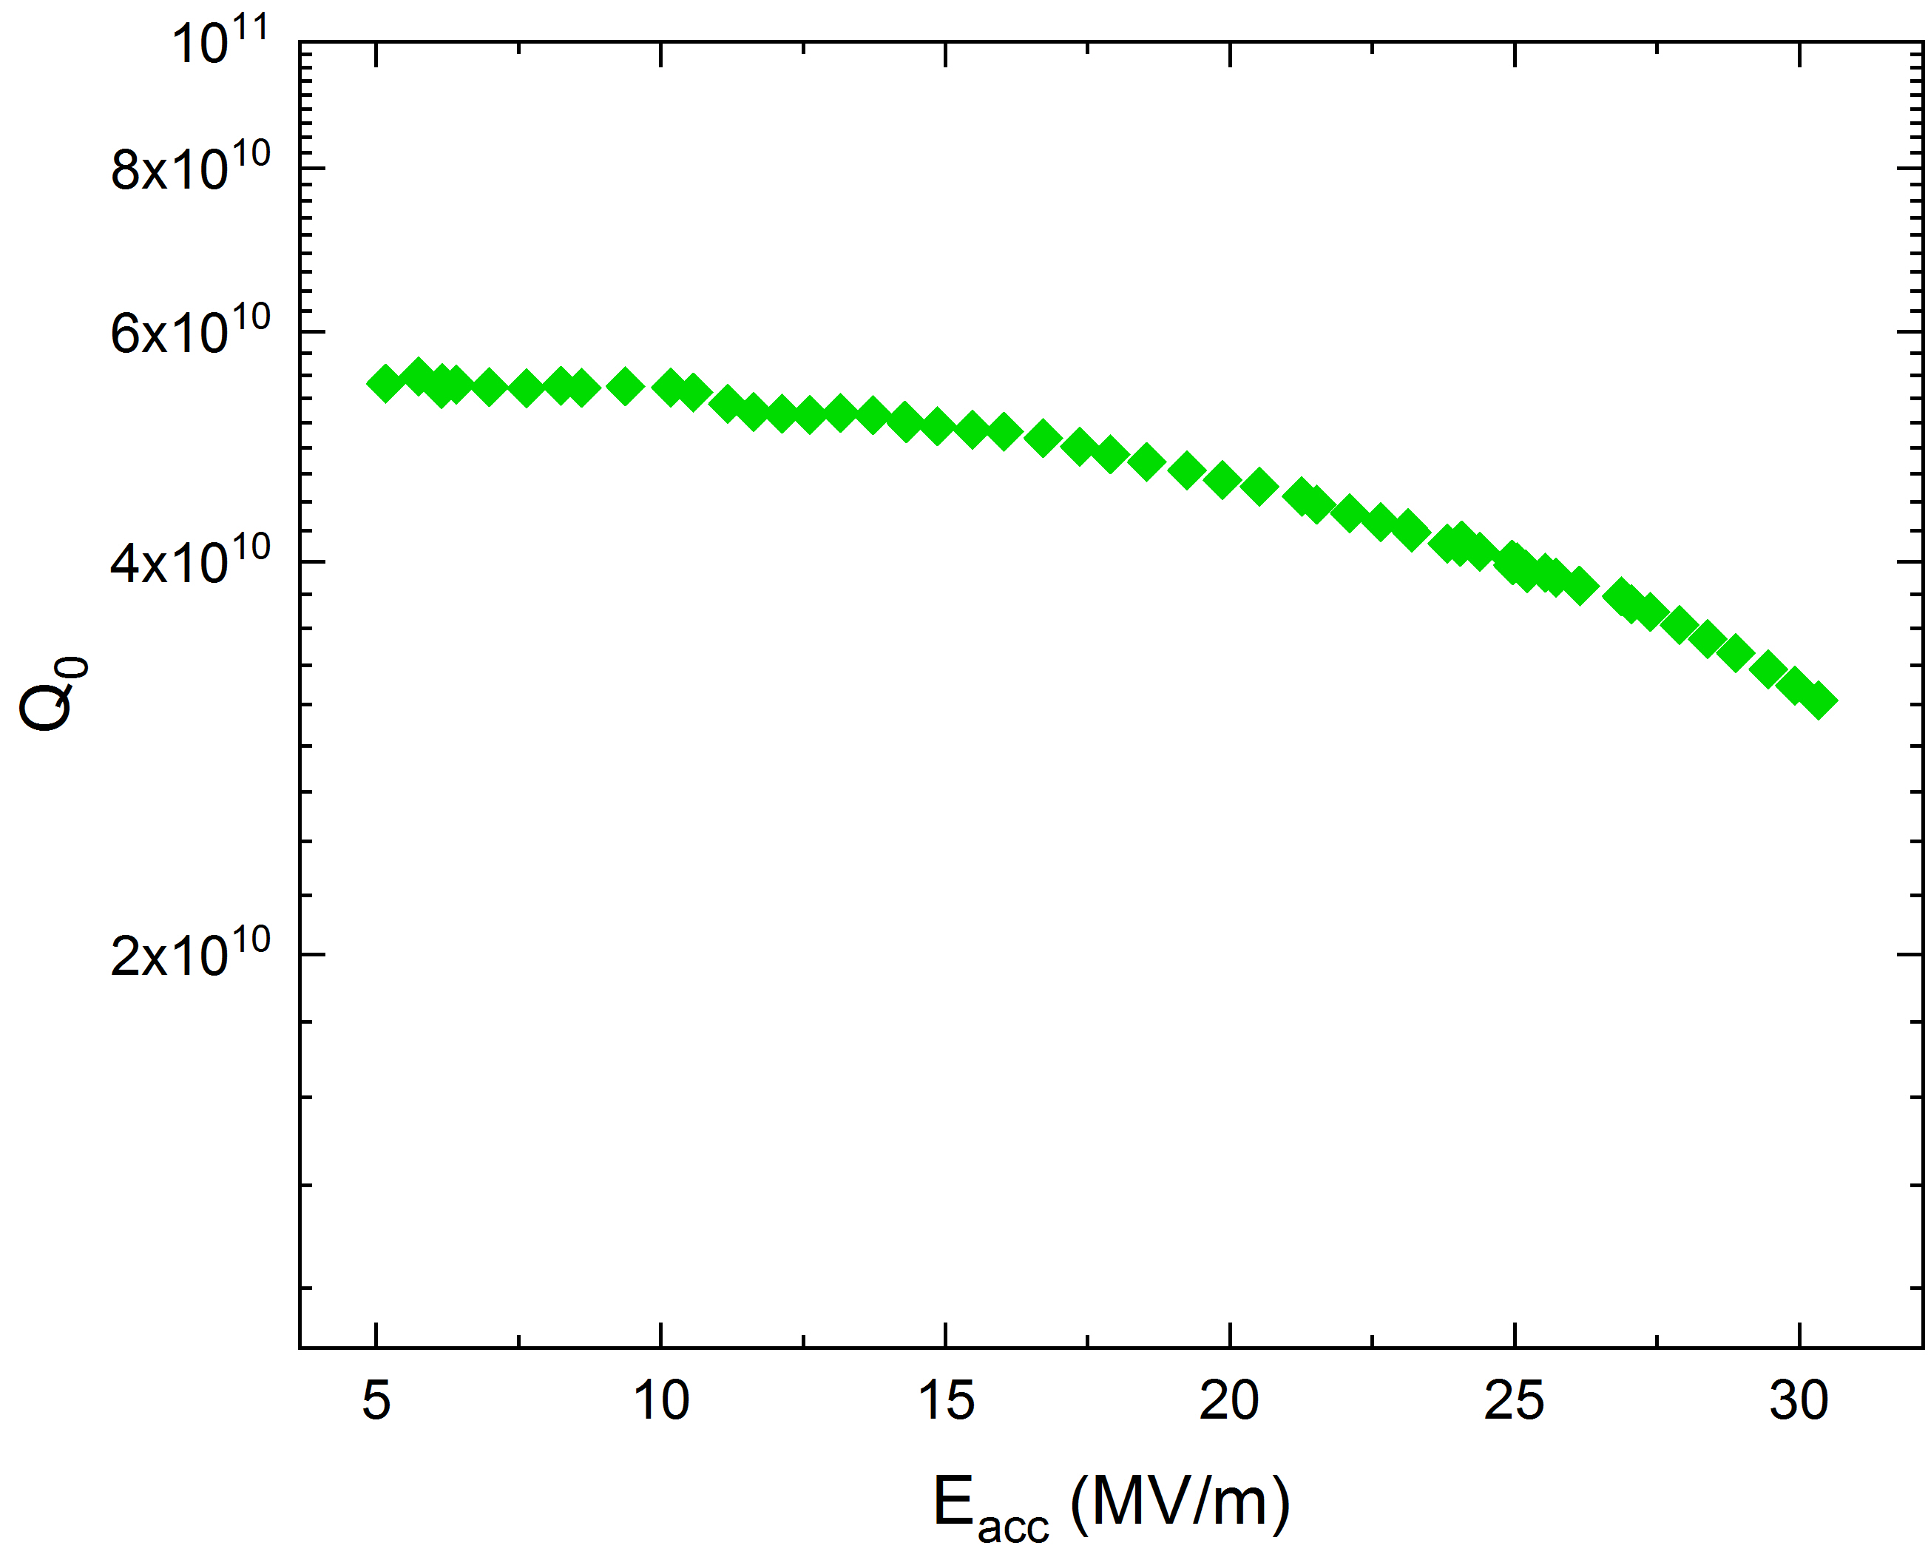
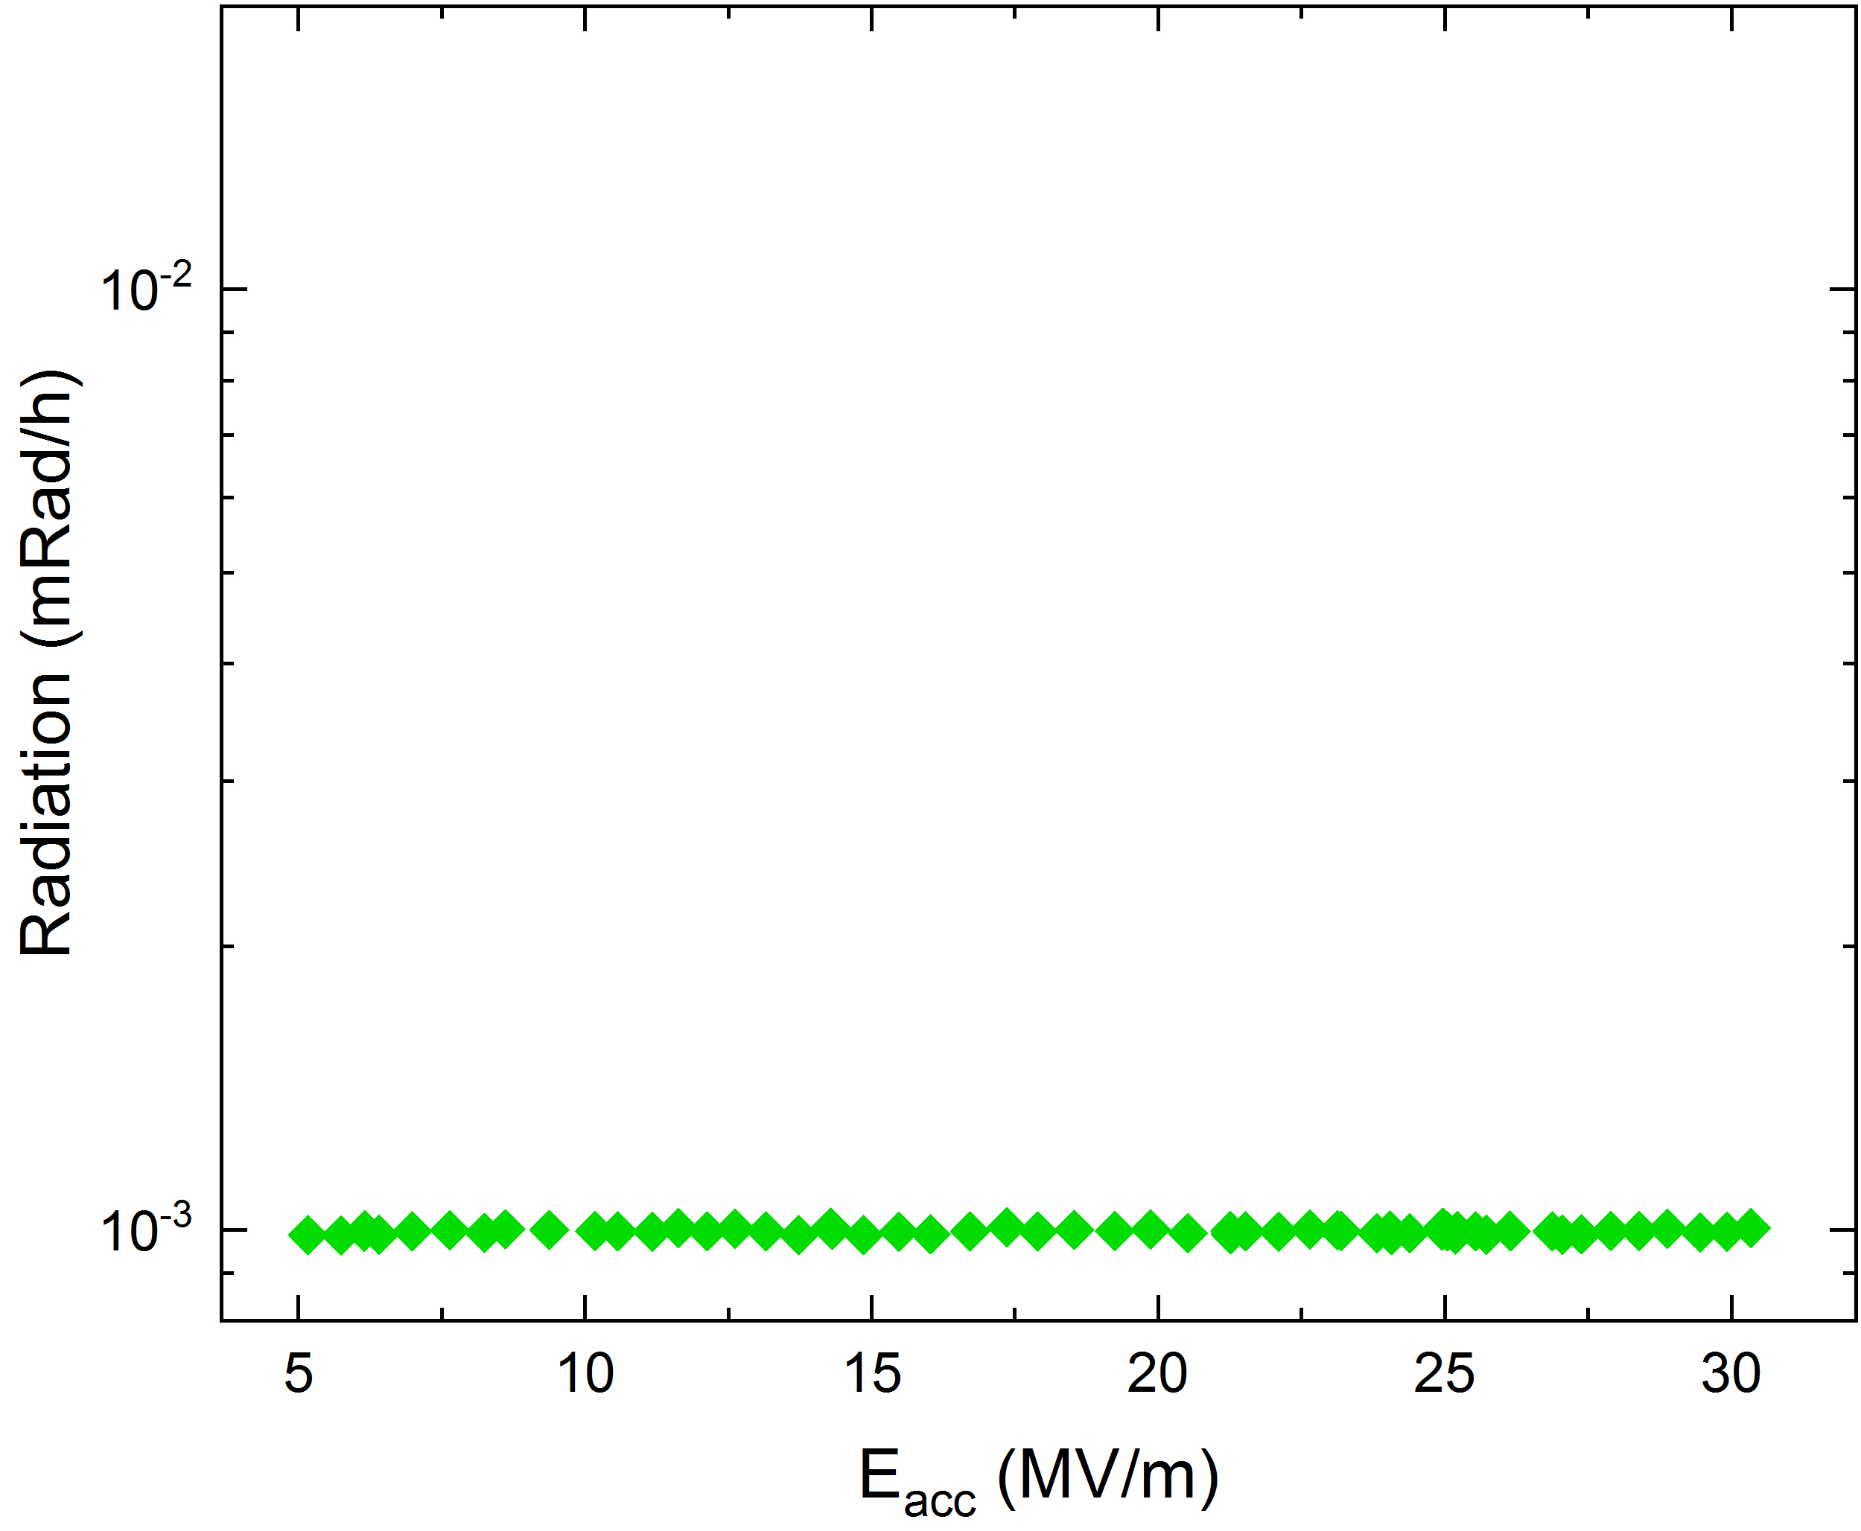
First power rise
No multipacting observed up to quench
After quench in compensated field, no MP
1.5 K
quench

Slide 13
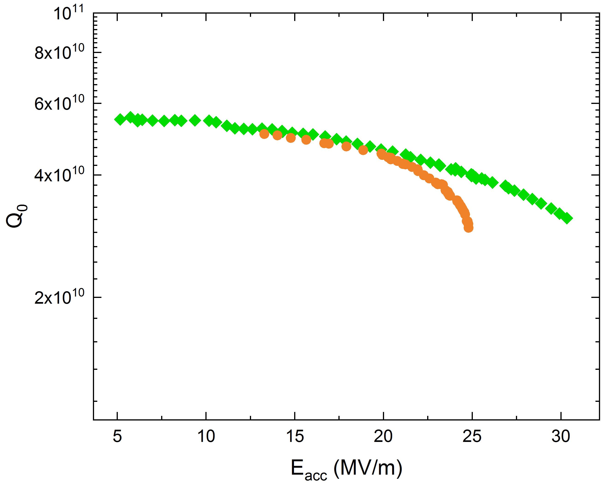
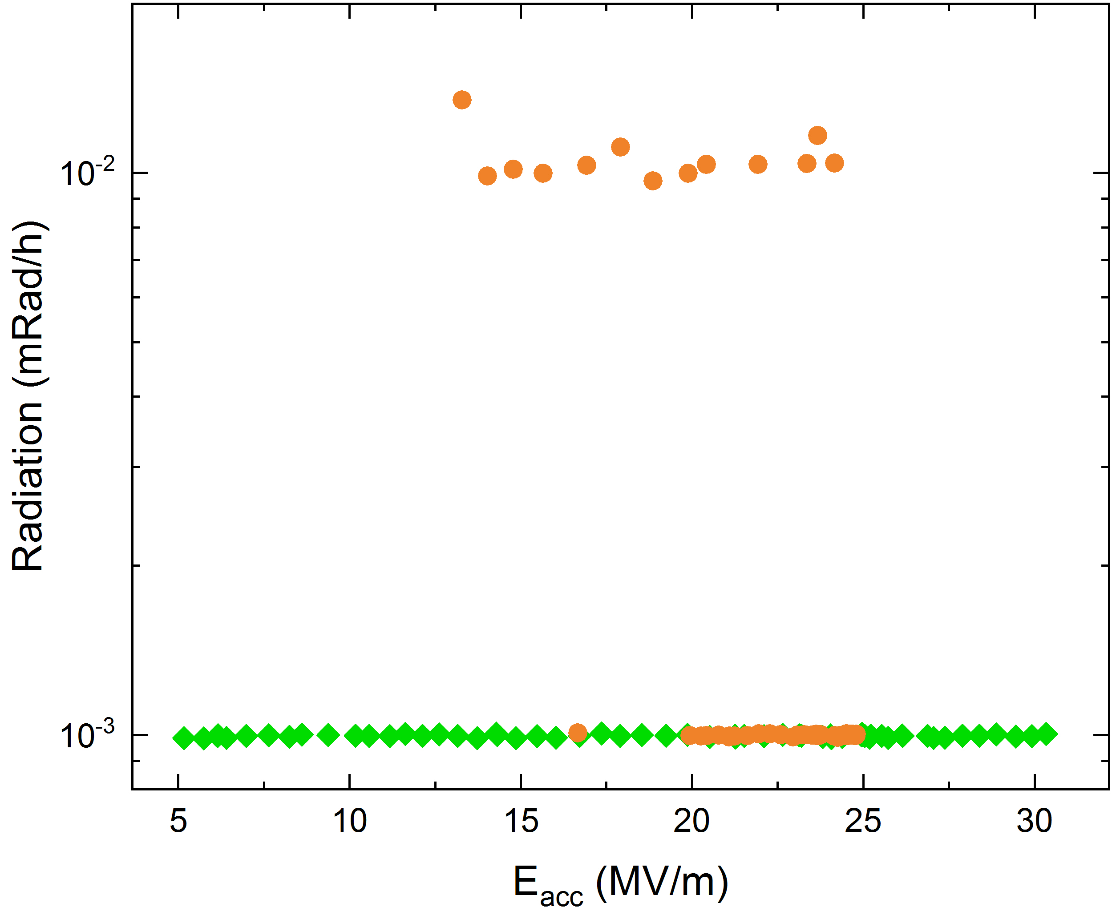
Second power rise after quenching in 20 to 40 mG
Cavity was quenched in 20 to 40 mG
MP and radiation observed starting from ~ 14 MV/m
1.5 K
After quench
in 20 to 40 mG

Slide 14
Cavity was quenched in compensated field
Cavity was quenched in compensated field
MP disappeared and Q-factor recovered
1.5 K
By quenching in compensated field MP disappeared and Qo was recovered

Slide 15
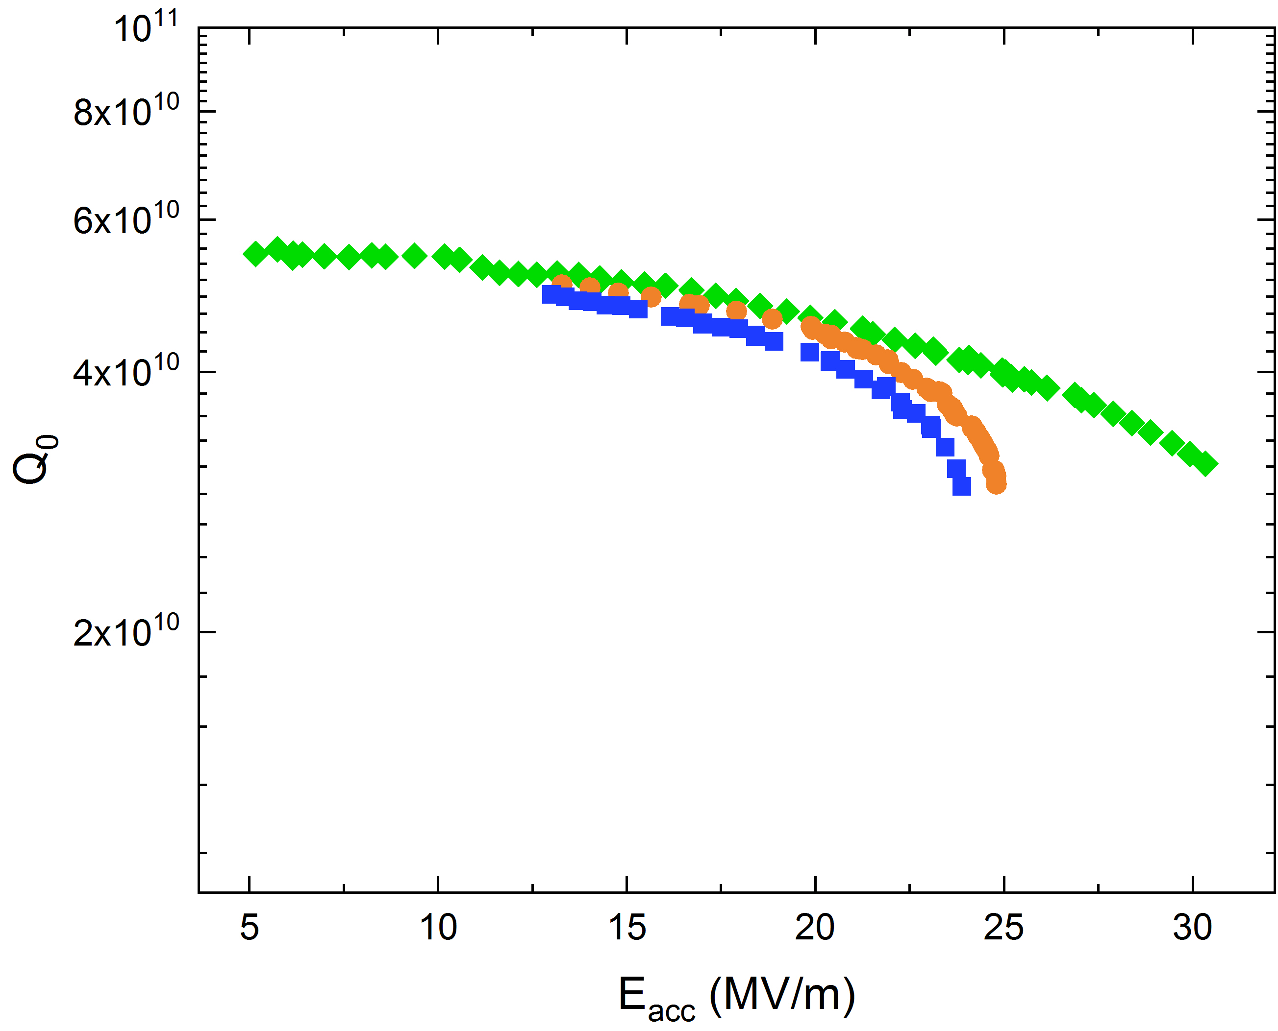
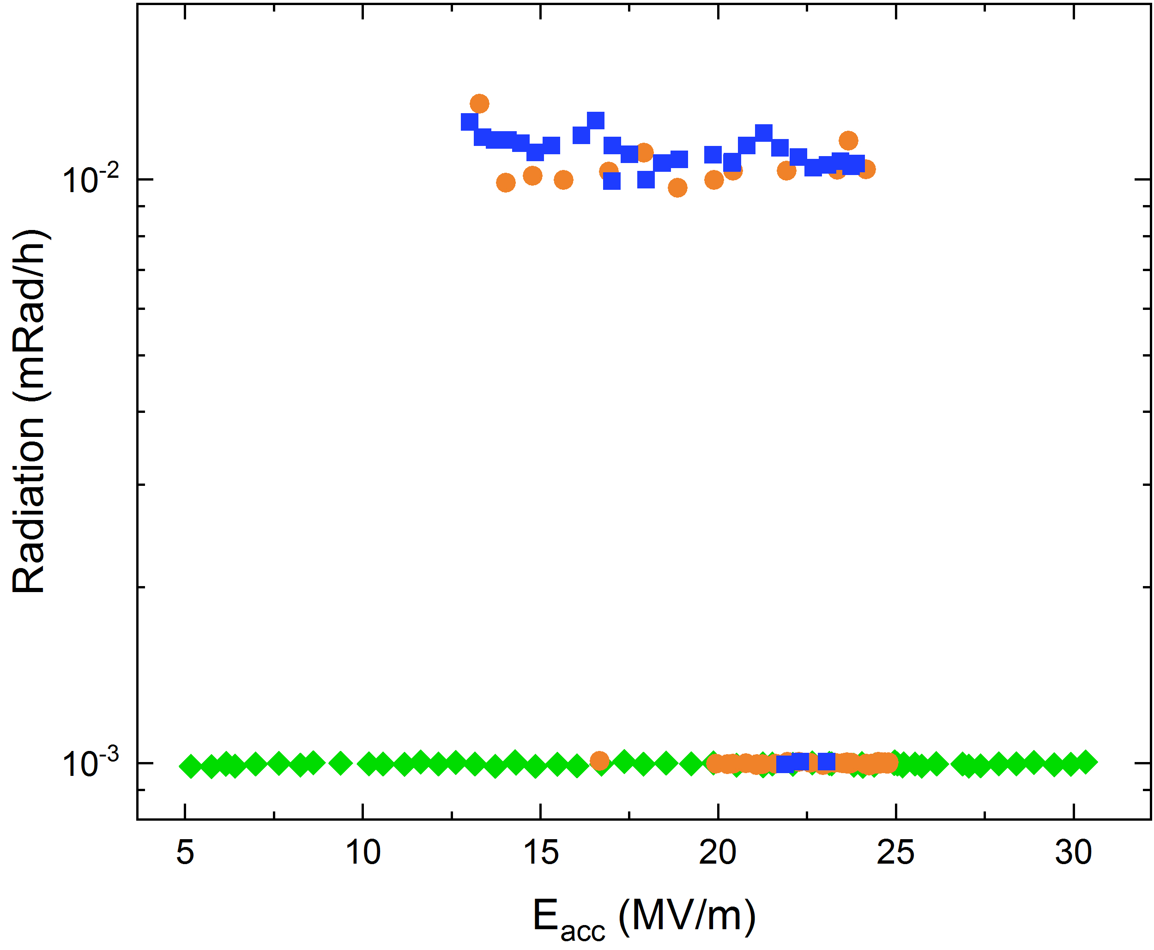
Third power rise after quenching in 100 mG
Cavity was quenched in 100 mG
MP and radiation observed starting from ~ 14 MV/m
1.5 K
After quench
in 100 mG

Slide 16
Summary
The effect was studied on this cavity only
  I have no knowledge that this effect was observed elsewhere
MP can be ignited by magnetic field loops trapped in the resonator during quench
In this instance, MP could not be processed away
MP could be removed (and Q-factor recovered) if the cavity was quenched in compensated field

Slide 17
Cooldown might enhance multipacting in
horizontally-cooled cavities

Slide 18
Set up of the experiment
Several cooldowns were done with same cavity
BOARD 13
RTD 8
Tmap boards position
Cooling direction
BOARD 31
RTD 8

Slide 19
First power rise
1.5 K

Slide 20
Just before MP quench
1.5 K

Slide 21
MP quench
1.5 K

Slide 22
Power rise after MP processing
1.5 K

Slide 23
Ultimate quench
1.5 K

Slide 24
Summary
Effect observed three times on same cavity after different cooldowns (every time Tmap was used, MP-related quenches were observed on bottom part of the equator)
What is possibly going on? Due to the cooldown gases may preferentially condense on the bottom part of the equator, the colder part of the cavity
  In vertical configuration the colder part is the bottom flange
    → effect not observed
  Adsorbates increase the SEY enhancing MP
Similar behavior might be expected in CM where the cavity is cooled horizontally
    → see Sam’s presentation on gradient limitation in CM

Slide 25
Conclusions
The reprocessing rate at FNAL as of 02/27/2019 is 48.1%
Radiation is the principal cause of reprocessing, 31% of times
MP-driven quench can degrade the Q-factor even if ambient field is minimized
MP might be enhanced by the cooldown condition
  Horizontal cooldown might enhance MP on bottom part of equator
  We plan to repeat the horizontal cooldown study in VTS to acquire more statistics and define cavity operation stability against MP
MP might be ignited by trapped magnetic field loops generated by quenching the cavity in ambient field

