Slide 1
CM test procedures and microphonics/unit test measurements
E. Harms on behalf of the Fermilab Cryomodule Testing Team
LCLS-II HE Cryomodule Performance Workshop
25-26 April 2019 at Jefferson Lab

Slide 2
Talking points
’This talk should cover procedures for cooldown, thermal cycles, initial power rises, Q0 measurements, microphonics, GDR measurements, and unit test procedures.
The goal of this workshop is to compare 1) specifications and achieved performance for LCLS-II cavities and cryomodules and
2) list expectations and challenges for LCLS-II-HE. From the list we will develop plans for improvements and mitigations and discuss how to apply these to the planned LCLS-II-HE prototype cryomodule.’
  Acceptance criteria
  Test procedures
    Gradient
    FE/Dark current
    Q0
    Unit test
  Test duration
  Overall experience & lessons learned
  Performance to date
  Summary

Slide 3
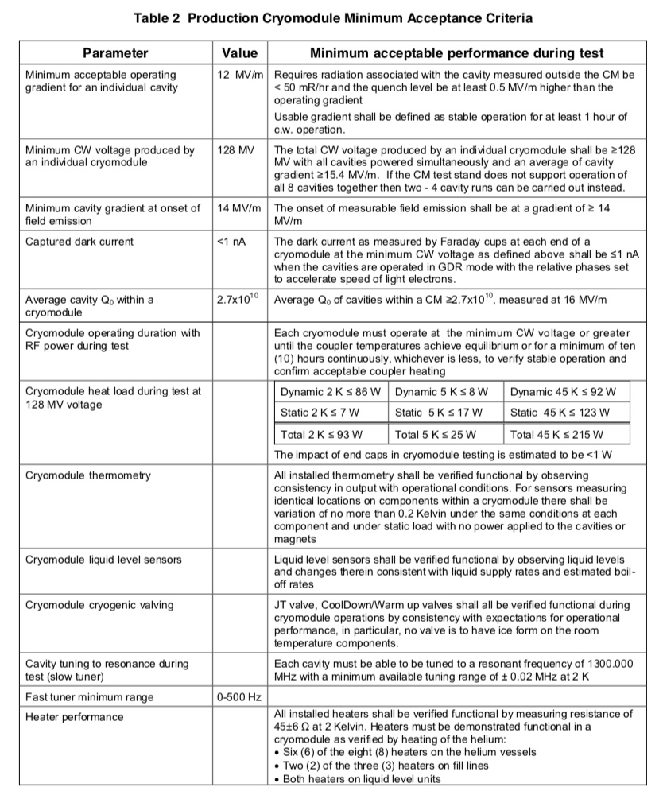
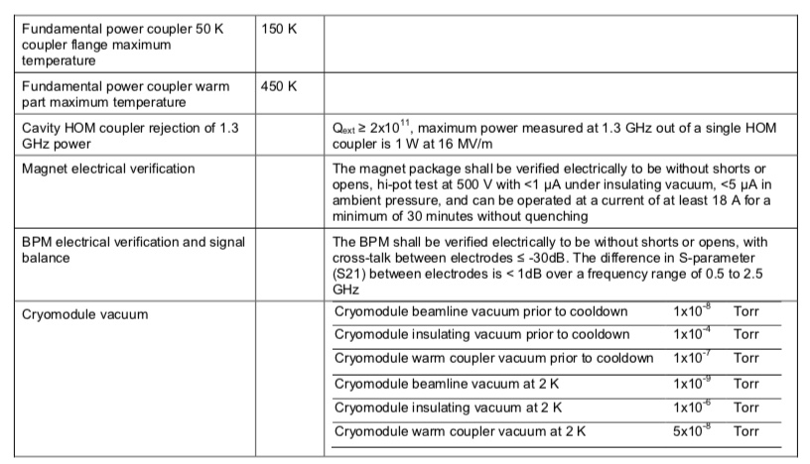
Acceptance criteria
-

Slide 4
Acceptance criteria - summary
 | F-01 | F-02 | F-03 | F-04 | F-05 | F-06 | F-07 | F-08 | F-09 | F-10 | F-11 | F-12 | F-13 | F-14 | F-15 | F-16 | F-17
Gradient | x | 👍 | x | 👍 | 👍 | 👍 | 👍 | 👍 | 👍 | 👍 | 👍 | 👍 | 👍 | 👍 | 👍 | 👍 | n/a
CW Volts | 👍 | 👍 | 👍 | 👍 | 👍 | 👍 | 👍 | 👍 | 👍 | 👍 | 👍 | 👍 | 👍 | 👍 | 👍 | 👍 | n/a
FE onset | 👍 | x | x | x | x | x | 👍 | 👍 | x | 👍 | 👍 | 👍 | 👍 | 👍 | 👍 | 👍 | n/a
Q0 | 👍 | 👍 | 👍 | x | 👍 | x | 👍 | x | 👍 | 👍 | 👍 | 👍 | 👍 | 👍 | 👍 | 👍 | n/a
Unit Test | 👍 | 👍 | x | 👍 | x | 👍 | 👍 | 👍 | 👍 | 👍 | 👍 | 👍 | 👍 | 👍 | 👍 | 👍 | n/a
Instr. | 👍 | 👍 | 👍 | 👍 | 👍 | 👍 | 👍 | 👍 | 👍 | 👍 | 👍 | 👍 | 👍 | 👍 | 👍 | 👍 | n/a
Tuners | 👍 | 👍 | 👍 | 👍 | 👍 | 👍 | 👍 | 👍 | 👍 | 👍 | 👍 | 👍 | 👍 | 👍 | 👍 | 👍 | n/a
Couplers | 👍 | 👍 | 👍 | 👍 | x | 👍 | 👍 | 👍 | 👍 | 👍 | 👍 | 👍 | x | 👍 | 👍 | 👍 | n/a
HOMs | 👍 | x | 👍 | 👍 | x | 👍 | 👍 | 👍 | 👍 | 👍 | 👍 | x | 👍 | 👍 | 👍 | 👍 | n/a
Magnet | 👍 | 👍 | 👍 | 👍 | 👍 | 👍 | 👍 | 👍 | 👍 | 👍 | 👍 | 👍 | 👍 | 👍 | 👍 | 👍 | n/a
BPM | 👍 | 👍 | 👍 | 👍 | 👍 | 👍 | 👍 | 👍 | 👍 | 👍 | 👍 | 👍 | 👍 | 👍 | 👍 | 👍 | n/a
Vacuum | 👍 | x | 👍 | 👍 | 👍 | 👍 | 👍 | 👍 | 👍 | 👍 | 👍 | 👍 | 👍 | 👍 | 👍 | 👍 | n/a
-

Slide 5
Test Checklist
Install (11 days)
  Align
  Cabling
  Waveguide
  Roof on
  Warm frequency spectra
  Leak Check
Pre-test Checks (in parallel)
  ORC sign-off
  Jumpers removed, HOM attenuators proper
  Config Control locks
  LOTO locks removed
  Digitizers running
  Tuners powered
Demagnetization (just before cooldown)
50 K/4 K cooldown (3 days)
  Stabilize/soak (10 hours)
  Enable alarms
Pumpdown to 2 K (1/2 day)
Stabilize/soak
RF compensation heaters off
During soak (or prior) (~ 1day)
Roof blocks & gate locked
Cave secure
Cavities on resonance/HOMs
Microphonics assessment
Q_{ext} set to 4.1E7
RF calibration + Initial power rise to 16 MV/m (1/2 day)
Power rise/processing to 21 MV/m (1-2 days)
    60-minute run at peak gradient (Usable Gradient)
    FE & Dark current evaluation
    Check DecaRad response
    Quench detection/protection development
  BPM check (parasitic)
  LLRF
  GDR operation
  Magnet check – once leads are cold enough
HOMs spectra (2-3 days parasitically)
50 K warm up, fast cooldown (≥32 g/s), pump down to 2K, soak (1 day)
  RF compensation heaters on
Unit test (1 day)
  Cavities at 16 MV/m
  Magnet coils at nominal current
  Field Emission/Dark current
  GDR
  ~12 hour run, until coupler temperatures reach equilibrium

Slide 6
Test Checklist (2)
Single cavity Q0 (1-2 days)
  RF Compensation off
  Determine optimum JT valve position
  Heater run
  No power run
  Set constants for real-time Q0
  Cavities at 16 MV/m one at a time
  No power run in-between
Pre warm-up review
Test complete/Warm-up (3-4 days)
  Detune cavities back to warm frequency (+40,000 steps)
  Static Heat Load

Slide 7
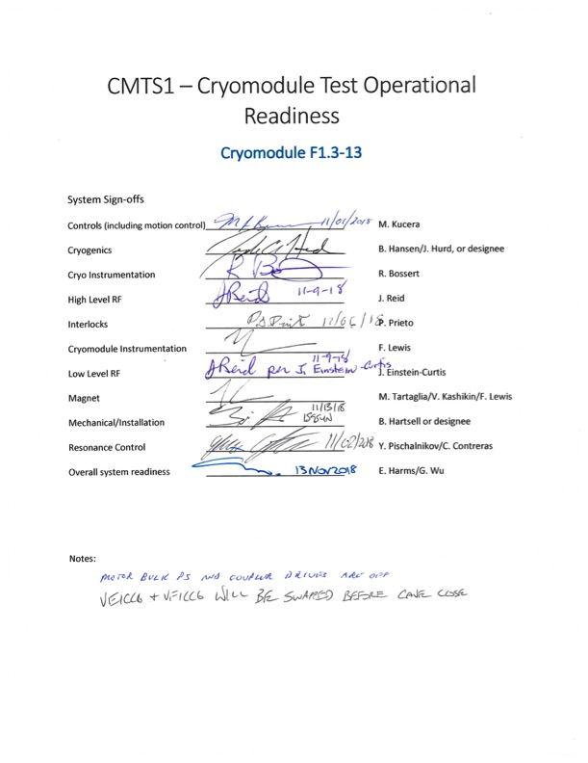
Operational Readiness Clearance
Prior to every test 2 ORC’s are required
  Cooldown
  Cold powered operation
  Some delays have resulted
Cryo ORC
  requires all necessary Engineering Notes are reviewed and approved
  Final approval by Cryo dept. head
Cold powering ORC
  Initially carried out by ESH&Q representatives
  Delegated to test lead since F1.3-03
  Hardcopy sign-off prior to cryomodule being powered
  Ensure each system leader physically comes to CMTF

Slide 8
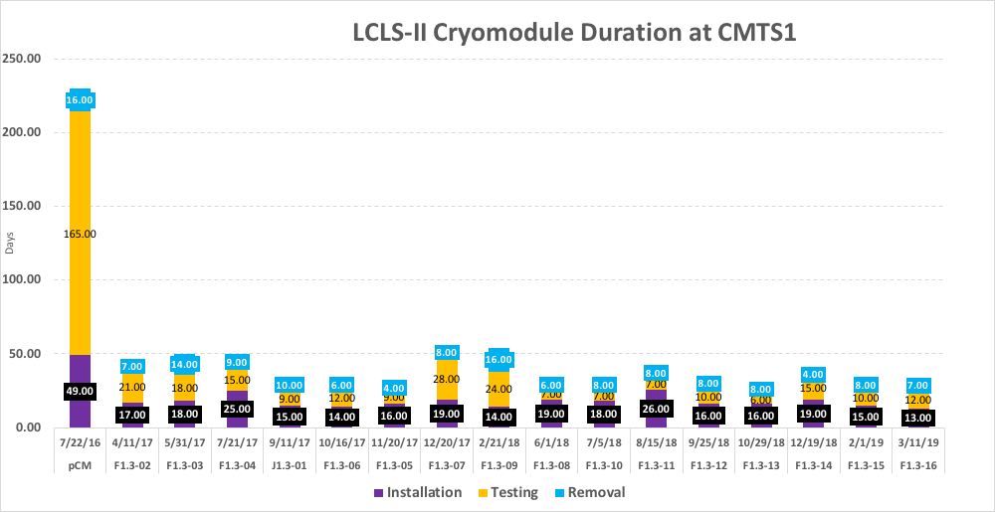
Duration
  Average
    Install: 18 (14) days
    Test: 13 (7) days
    Warmup & remove: 8 (7) days
    Idle: 18 (0) days
50 days at CMTS1

Slide 9
Cooldown
  300 – 100 K rate limited
  Thereafter as fast as possible
  Cooldown complete doesn’t mean COLD
Ten days of F1.3-14 Cooldown
20 – 2 K
300 – 2 K

Slide 10
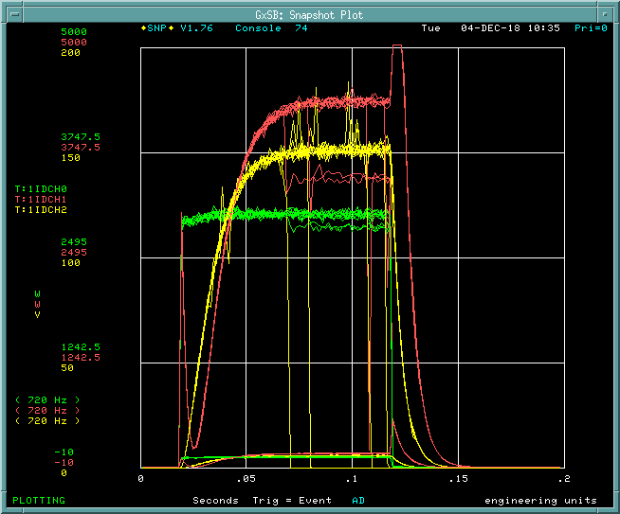
Power rise - (Usable) Gradient
  Gradient defined
    P_{Forward}
    P_{Transmitted}
  $$E_{acc}=\frac{1}{L}\sqrt{P_{t}Q_{t}(\frac{R}{Q})}$$
  We use
    Forward power technique
      more accurate for us
    Cross-checks
      VTS
      J-01
      Calibration run every test
  ‘Usable’ gradient
    1 hour, < 50 mR/hr
  Quench. Bad.
Nearly perfect Usable Gradient run
Good - QL
Bad - Quench
PULSED operation

Slide 11
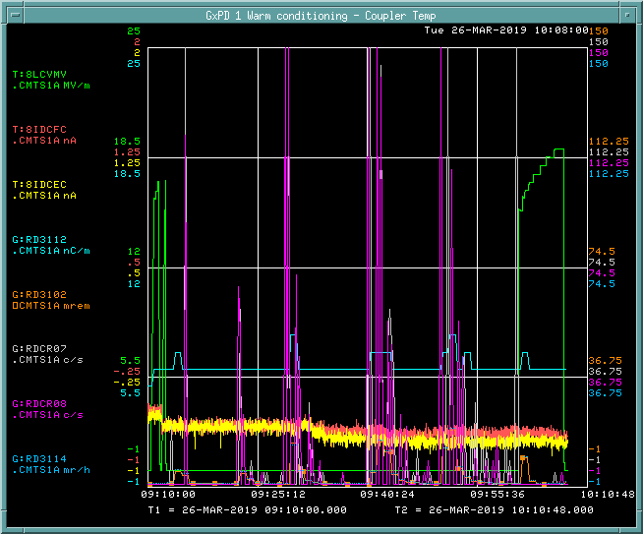
Power rise - pulsed processing
  Many cavities initially quench @17-18 MV/m
  Presumably multipacting
  Pulsed processing
    40 msec pulse width
    10’s of minutes
    Progressively higher gradient
  Can achieve up to 21 MV/m stably
    Rad safety Administrative limit
F1.3-16 Cavity #8
Improved from 17.5 to 19+ MV/m
Gradient
Radiation
Pulsed Processing
~40 minutes

Slide 12
Gradient comparison
 | VTS | CMTF Test
Cryomodule | Eacc* [MV/m] | Max** Gradient [MV/m] | Usable Gradient*** [MV/m]
F1.3-01 | n/a | 19.1 | 18
F1.3-02 | 23.4 | 20.48 | 20.4
F.13-03 | 24.5 | 18.8 | 17.6
F1.3-04 | 23.4 | 20.6 | 19.2
F1.3-06 | 22.6 | 20.8 | 20.1
F1.3-05 | 21.3 | 20.8 | 18.8
F1.3-07 | 23.1 | 20.1 | 19.8
F1.3-09 | 24.3 | 21.0 | 20.6
F1.3-08 | 23.7 | 19.5 | 18.9
F1.3-10 | 23.8 | 20.8 | 20.4
F1.3-11 | 24.5 | 20.5 | 19.6
F1.3-12 | 24.9 | 20.5 | 19.7
F1.3-13 | 25.2 | 20.3 | 19.4
F1.3-14 | 22.9 | 19.4 | 18
F1.3-15 | 24.3 | 19.6 | 18.3
F1.3-16 | 23.3 | 19.8 | 18.2
Average | 23.7 | 20.1 | 19.2

Slide 13
Field emission & dark current
  Strong indicator of cavity cleanliness
  Activation during operation
  Feedback on assembly techniques
    e.g. BPM fastener
Beamline vacuum event
Cavity
Gradient
Pulsed Processing
Onset at 14 MV/m
Dark current
0-10 mrem/hr
F1.3-14 cavity 7 FE onset
Adjacent Radiation
Detectors
A processing event – F1.3-09 cavity 8
10-20 MV/m

Slide 14
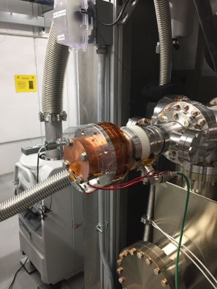
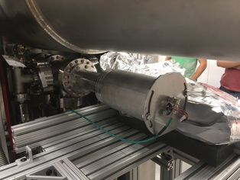
Rad detector layout
FOX (x-ray) detectors
DecaRad locations (mounted on each coupler) F1.3-10 and beyond
Faraday cup (at each end)
a Total Loss Monitor (TLM) and SLAC fiber optic cable detector run below and the length of the cryomodule stand
Dosimetry is mounted on each cryomodule at each cavity location (x3 – east, west, bottom) to record integrated dose

Slide 15
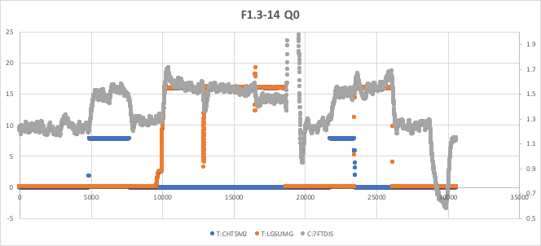
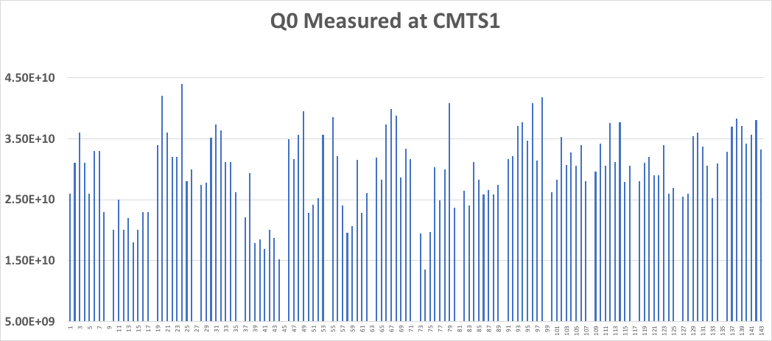
Q0 measurements
Mass flow technique
  Δp/Δt technique attempted
Thermal bump
3-fold independent analyses
Low Q0 correlated to cavity material with know poor flux expulsion/low results from VTS
Determine P_{C} by
  Lock JT valve
  Measure mass flow with no heat load
  Measure mass flow with heater on
  Measure mass flow with each cavity at 16 MV/m
  Compare mass flows and subtract static load
  Challenges are stable mass flow & JT valve position
mass flow - 1-2 g/s
cavity gradient – 16 MV/m
heater power ~8 Watts)
spec = 2.7E+10

Slide 16
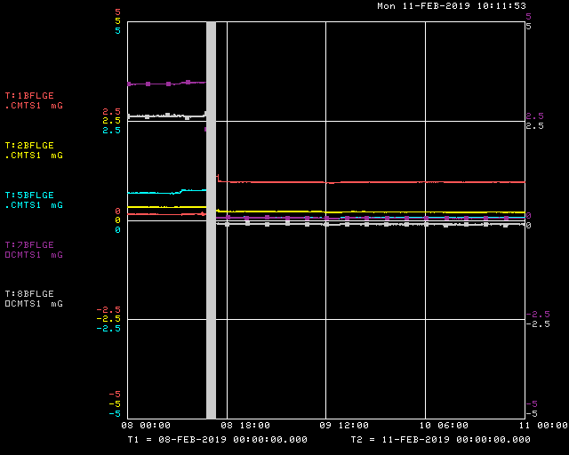
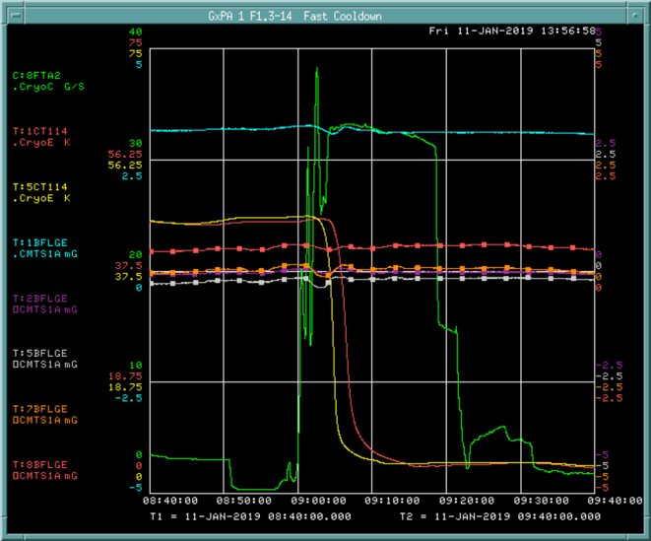
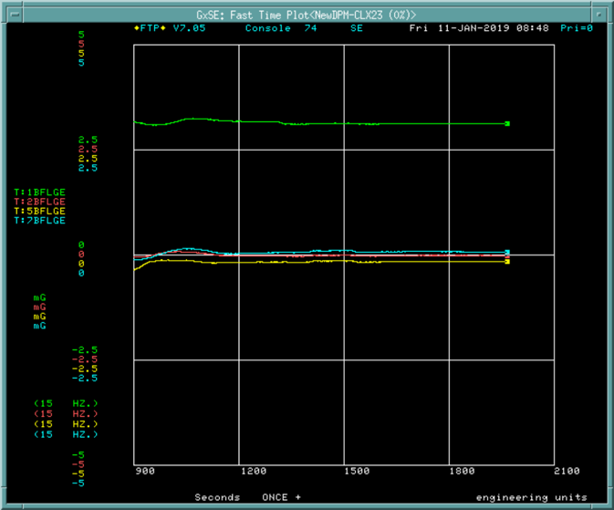
Q0 measurements – minimal magnetic field
Practice magnetic hygiene
  Girders are non-magnetic
Demagnetization just before cooldown
  < 2.5 mGauss goal, less is routine
  2 hour process
  External Coils
  5 Internal fluxgates
Thermal bump/flux expulsion
  Warm to 45 K
  45-60 minutes >45K as measured on helium vessels
  ‘Fast’ (32 g/s) cooldown
  Thermalize for 24 hours
  Avoid quenching

Slide 17
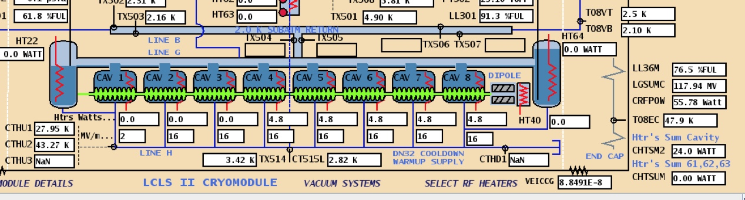
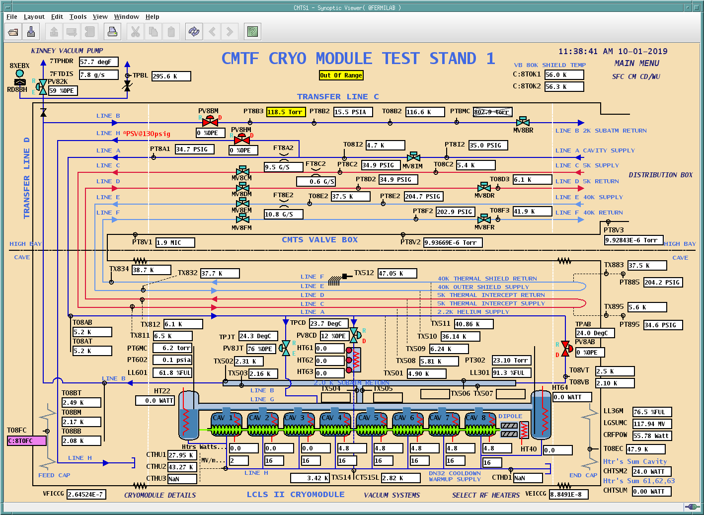
Unit test – RF heater compensation

Slide 18
Unit test - RF output/GDR
SSA output
all cavities @ 16 MV/m
Cavities 1, 4, 7 in GDR
Cavities are NOT identical

Slide 19
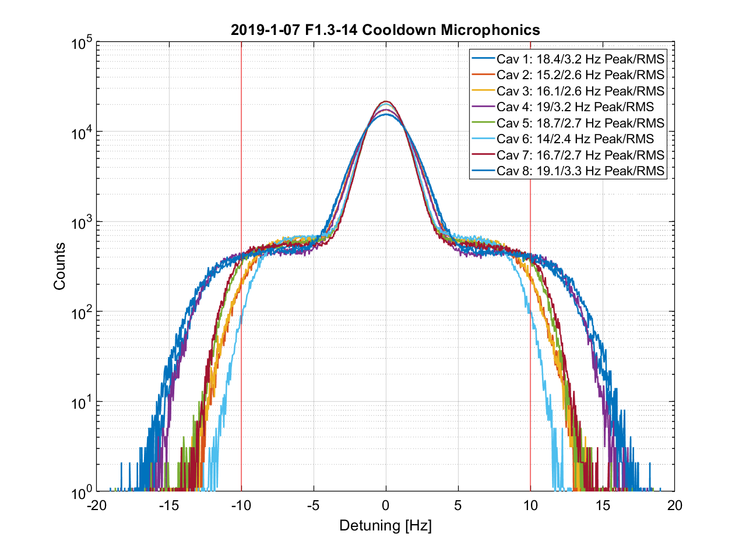
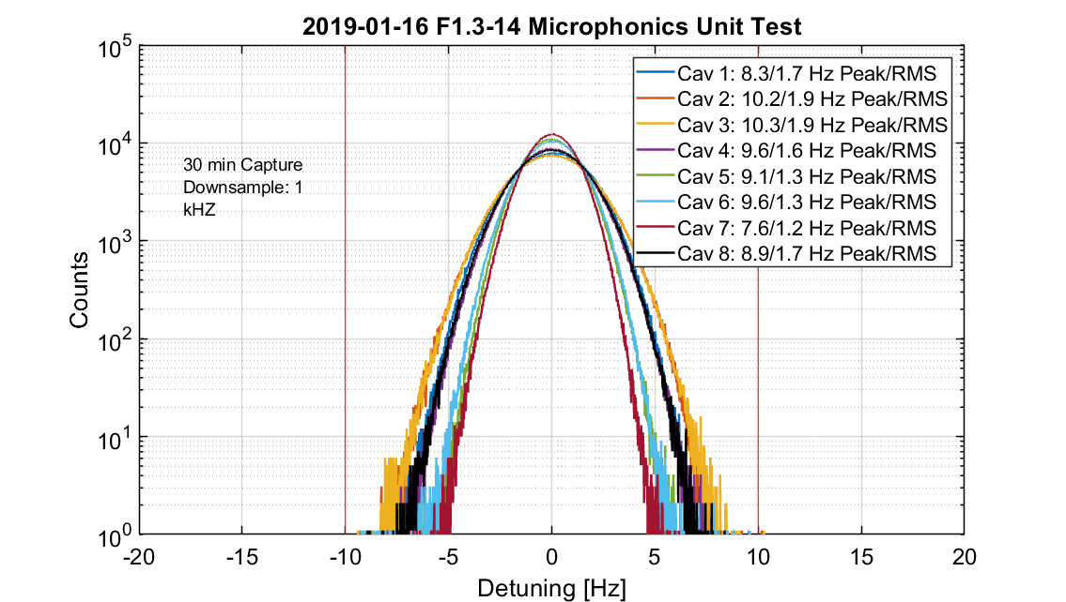
Microphonics
Acceptance limit is 10 Hz peak
Early issues with thermoacoustic oscillation induced microphonics
Thermalization has an effect – a few days to reach equilibrium and minimize
Data capture typically for at least 30 minutes
  Shortly after cooldown complete
  Unit test
  Prior to warmup
F1.3-14
After cooldown
7 Jan 2019
F1.3-14
Unit test
17 Jan 2019
courtesy Contreras-Martinez

Slide 20
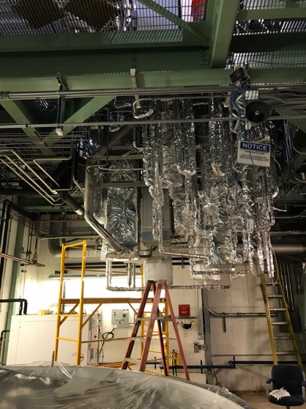
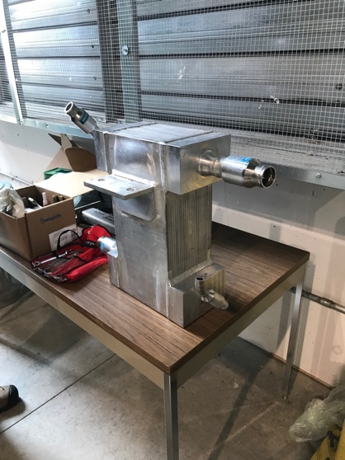
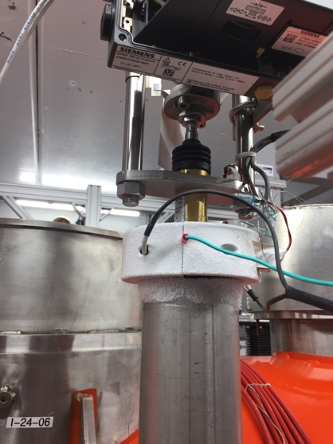
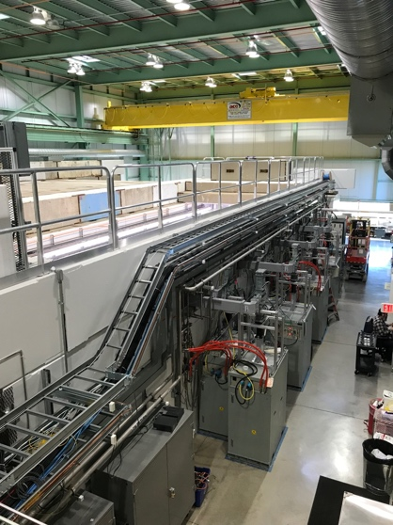
Operational Experience
  Reliability
    Largely excellent
  What interrupts testing?
    Vacuum (gauge lifetime)
    Cryo trips
    Rogue RF antenna trips
    Cryo plant trip
      up to many weeks interruption
    SSA’s – pretty good!
    Magnet – conductively cooled
    LLRF hiccups
    Minor Controls outages
    Quench detection – developing; nearly complete
  Restore (some) thermometry?
    Fluxgates
    Thermometry

Slide 21
Summary (of summaries)
 | VTS |  | CMTF Test
Cryomodule | Eacc* [MV/m] | Q0@16MV/m | Max** Voltage [MV] | Usable Voltage*** [MV] | Q0 @16MV/m | Cavities not meeting FE onset spec (14 MV/m) | Cavities with FE limiting the usable gradient to <16 MV/m
F1.3-01 | n/a | n/a | 153 | 149.7 | 3.0E+10 | #5, #7 | none
F1.3-02 | 194.6 | 2.4E+10 | 170 | 169.6 | 2.1E+10 | #5 | none
F.13-03 | 203.1 | 3.4E+10 | 155.9 | 146 | 3.5E+10 | #3, #4, #7 | #3, #4
F1.3-04 | 170 | 3.4E+10 | 170.7 | 164 | 3.1E+10 | #3, #6 | #3
F1.3-06 | 180.7 | 2.8E+10 | 172.4 | 167.1 | 2.03E+10 | #2 | none
F1.3-05 | 221.7 | 3.1E+10 | 163.9 | 156.1 | 3.1E+10 | #2 | none
F1.3-07 | 191.7 | 2.8E+10 | 167.2 | 164.6 | 2.6E+10 | none | none
F1.3-09 | 202 | 3.5E+10 | 174 | 171.3 | 3.3E+10 | #5, #6 | none
F1.3-08 | 196.8 | 2.8E+10 | 162 | 157.7 | 2.5E+10 | none | none
F1.3-10 | 197.5 | 3.2E+10 | 172.6 | 168 | 2.7E+10 | #2 | none
F1.3-11 | 203.4 | 3.5E+10 | 170.5 | 162.7 | 3.6E+10 | none | none
F1.3-12 | 207.2 | 3.49E+10 | 170.7 | 164 | 3.1E+10 | none | none
F1.3-13 | 209.9 | 3.5E+10 | 169.1 | 161.5 | 3.27E+10 | none | none
F1.3-14 | 190.1 | 3.4E+10 | 161.8 | 150.0 | 3.1E+10 | none | none
F1.3-15 | 202.4 | 3.4E+10 | 163.4 | 152 | 3.04E+10 | none | none
F1.3-16 | 194.2 | 3.57E+10 | 165 | 151.5 | 3.58E+10 | none | none
Average | 197.7 | 3.21E+10 | 166.3 | 159.7 | 2.98E+10

Slide 22
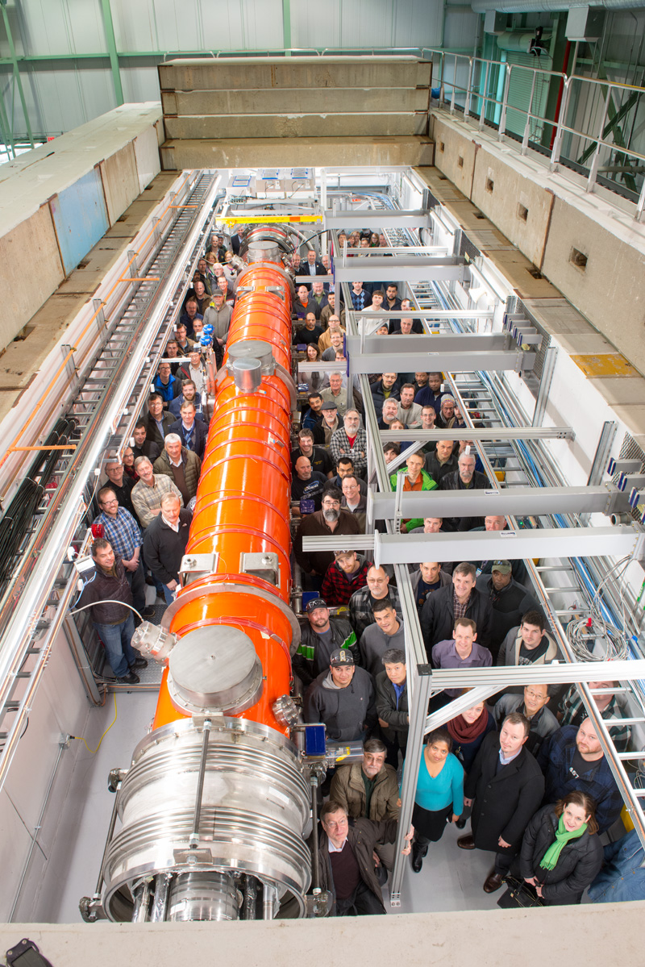
Summary
  Excellent results
    Bodes well for LCLS-II operation
    … and HE
  Testing is mature
    It took ~10 test cycles
    ever evolving
    always surprises
    R&D ➤ production not easy
  A great team
    Partner labs
    Fermilab

Slide 23
Thanks for your attention – Questions?

Slide 24
Cavity Performance Measurement - Calibration
RF calibration
  Forward power at SSA output before the circulator
    Minimize the directional coupler signal deviation due to reflected power
    Calibration using calorimetric load
  Transmitted power and HOM power
    Network analyzer for warm and cold transmission lines
  Qext1
    Fast oscilloscope for decay time
    RF power decay
Heatload
  Massflow vs. known heater power

Slide 25
LLRF Power Measurement Linearity Measurement

Slide 26
Directional Coupler Forward Power
Data from John Reid and Co.

Slide 27
Cavity Performance Measurement - Gradient
Method A – Forward Power (Production method)
  Measure FPC Qext and forward power
  $E_{acc}=\frac{1}{L}\sqrt{4P_{for}Q_{ext1}(\frac{R}{Q})}$
Method B – Transmitted Power
  Measure transmitted power and field probe Qt (using VTS Qt)
  $E_{acc}=\frac{1}{L}\sqrt{P_{t}Q_{t}(\frac{R}{Q})}$

Slide 28
Cavity Gradient Measurement - Comparison
Method A – Forward Power (Production method)
  Waveguides assembly does not change
  Calibration is stable
  Less affected by environment
Method B – Transmitted Power
  Transmission line less rigid
  May require configuration changes due to signal levels
  More connections/disconnections
  VTS to cryomodule changes can happen
  VTS measurement error propagation

Slide 29
Gradient Measurement
Gradient comparison as of 2016-09-19
CAVITY | Name | % of Forward method over Pt method
1 | TB9AES021 | 4.2%
2 | TB9AES019 | 5.8%
3 | TB9AES026 | -5.8%
4 | TB9AES024 | -0.8%
5 | TB9AES028 | -4.5%
6 | TB9AES016 | 1.1%
7 | TB9AES022 | -3.3%
8 | TB9AES027 | 7.2%
 | Average | 0.5%
Note: | Mostly compared at low field

Slide 30
Coupler Heating Effect
The FPC antenna moves into the cavity as the coupler warms up.
Pfor increased by 4%-7% for the same gradient.
Two hours to stabilize.

Slide 31


Error Analysis - Eacc
Pt Method
$∆$_Eacc | $∆$_Pt | $∆$_Qt
7% | 8% | 12%
Pt calibrated by insertion loss
Qt using VTS measured data
Pf Method similar to Pt Method
$∆$_Eacc | $∆$_Pf | $∆$_Q1
3% | 5% | 2%
Pf calibrated by calorimetric load
Q1 by 100%-50% transmitted power decay

Slide 32
Gradient Measurement during Production Testing
Measure decay time (Qext1) at low power (6-8 MV/m) in the beginning of the power rise.
Calibrate the transmitted power to the Eacc determined by the Pf.
Measure Pt to determine the Eacc. (Avoids the coupler heating effect).
Verify the Eacc is consistent at 16 MV/m between LLRF power measurement and agilent power meter

Slide 33
Usable gradient
Determine maximum gradient each cavity can operate at for 1 hour continuously
  Previously – top down strategy beginning with maximum achieved
  Now – begin at 18 MV/m and work up towards maximum achieved gradient, extra processing may be beneficial.
  Take credit for time at previous (lower) gradient
  More efficient use of time
Most cavities Usable < Maximum Achievable
  Many quench 10’s of minutes (up to 50!) after beginning of run
  Cause? end group heating, multipacting, etc. – requires study time
  Risk vs. benefit to deliver cryomodules that already meet spec
Likely a quench in a cell
From Elog (3/26)
Cavity #2:
19.5 MV/m at 1430
- Quenched at 1436
19.0 MV/m at 1442
- Quenched at 1529, (47 minutes)
- Cavity #5 quenched at this time as well
18.75 MV/m at 1548
- Quenched at 1624 (36 minutes)
Usable gradient day 1
From Elog (3/27)
Starting with cavity #6 this morning.
Begin at 19.5 MV/m - quickly quenches
19 MV/m - ditto
18.5 MV/m - ditto
18.25 MV/m - 1 minute
18 MV/m begun at 0743, ended at 0747
17.8 MV/m begun at 0748, ended at 0749
17.5 MV/m begun at 0751, ended at 0808.
17.25 MV/m begun at 0809 and off right away.
Let's try some processing. (40 minutes at 21 MV/m, see plot)
18 MV/m begun at 0936, and remained stable to 1036 (1 hr)
18.5 MV/m :1036-1136 (1 hr )
19 MV/m: 1136-1236 (1hr)
Tripped on the way to 19.5.
Attempting bottoms up approach on #6
Usable gradient day 2

Slide 34
Dosimetry
Worst
Best
closest to
typical

Slide 35
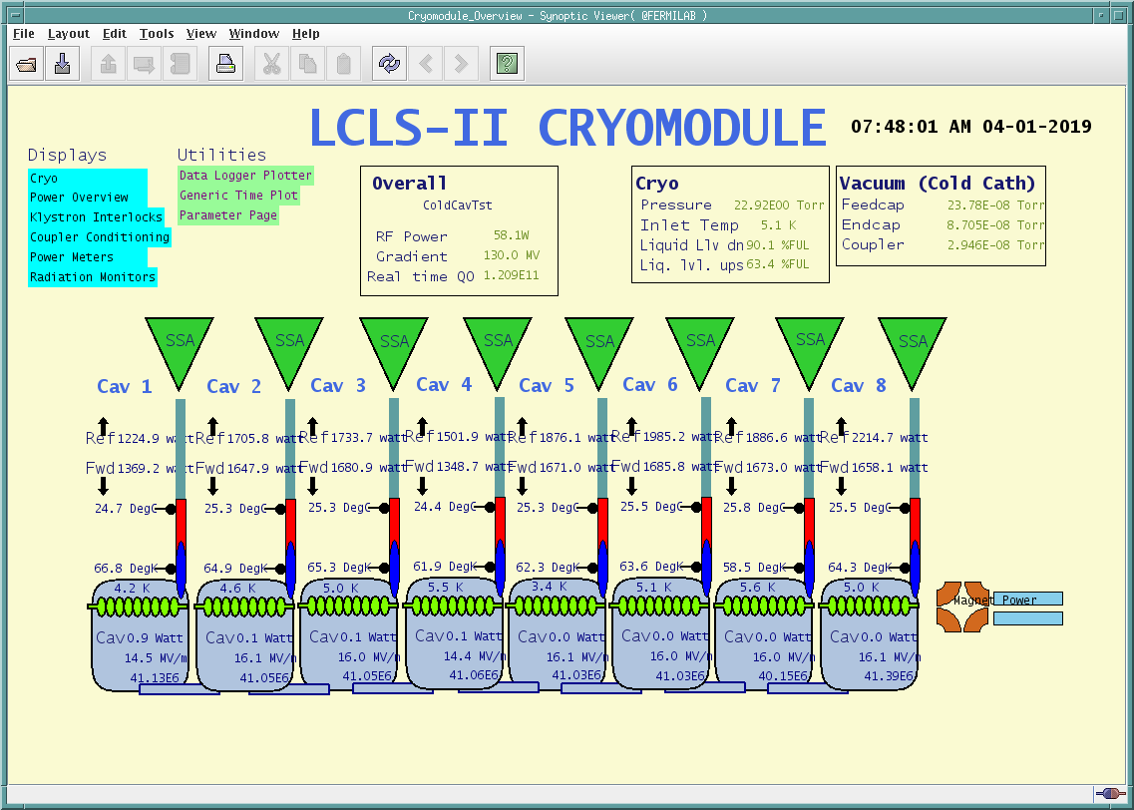
Unit test
  Unit test
    Completed Monday
    10-hour duration
    130+ MV sum achieved & maintained
    Magnet coils at 20 A
    Couplers well below 150 K limit
    3 cavities at GDR for several hours
    Some extra heating on #1 due to GDR operation
    Coupler vacuum early on from #1, #4
Coupler Inner Conductor Temperatures
Coupler 50 K Temperatures
Cavity #1 during Unit Test
50 C
130 K
SSA forward power
Cavities 1, 7 in GDR
Cavity 1 in GDR
Gradient
Coupler
Temperatures
GDR enabled
16 hours
16 hours
Coupler Vacuum
20 C
60 K

