Slide 1
Source of Gradient Limitations in Fermilab Cryomodules
Sam Posen
LCLS II HE Cryomodule Performance Workshop
25 April 2019

Slide 2
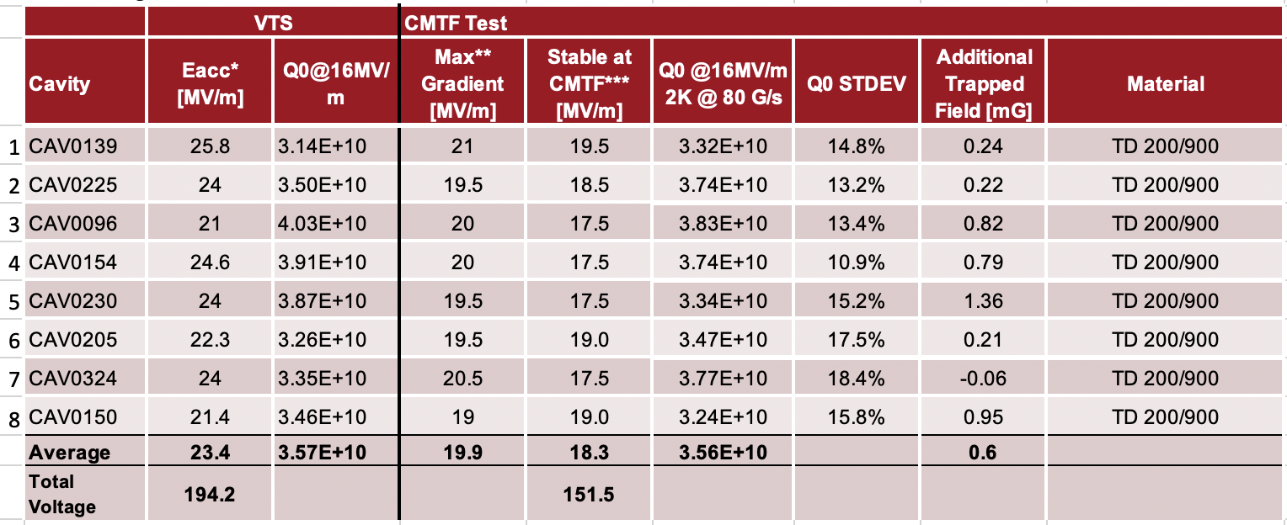
Usable Gradient Limitation Mechanism at FNAL
We regularly see usable gradients in the 17.5-18.5 MV/m range when the maximum gradient is closer to 20-21 MV/m
Usable gradient requires 1 hour without quench, but regularly see cavities stable for many minutes then suddenly quench
What could be causing these “sporadic” quenches?

Slide 3
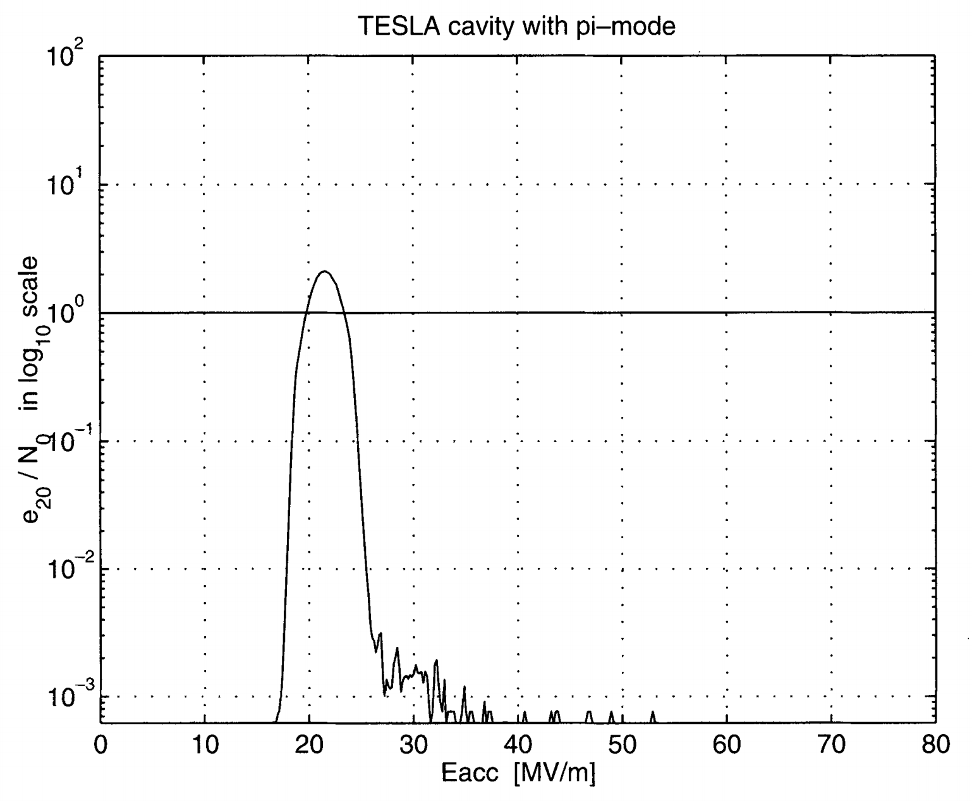
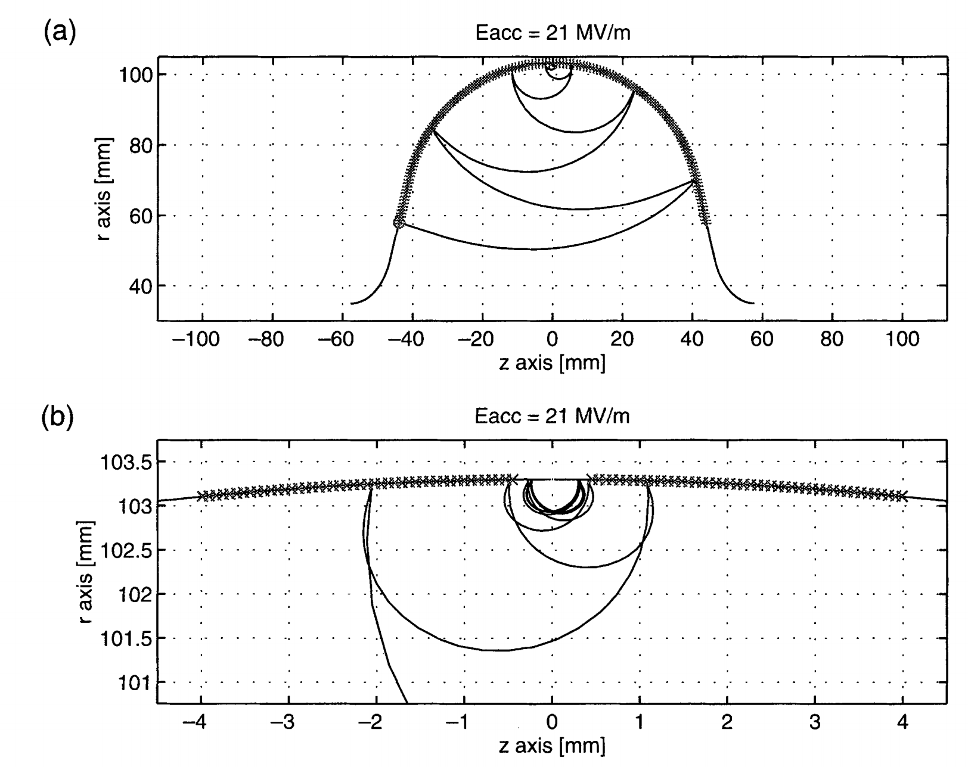
Possible Cause of Quench: Multipacting
Electron hits surface. >1 electron is ejected. Repeat.
Range of fields in which quenches are observed is right where multipacting band is for this cavity shape
Multipacting band: E_{acc} range where resonant condition is met for electron impacts at equator (depends on SEY)
Processing is expected to reduce SEY and therefore reduce multipacting
Pasi Yla-Oijala, “Electron multipacting in TeSLA cavities and input couplers,” Particle Accelerators, Vol. 63, pp. 105-137 (1999)

Slide 4
Possible Cause of Quench: Overheating
Endgroups heat up from RF dissipation, and if the heat power is greater than the conductive cooling power, thermal runaway can occur
Depends on thermal strapping of endgroups
Dissipation in endgroups is far smaller, but cooling is indirect via conduction
Heat dissipated in cells is cooled directly by liquid helium in tank

Slide 5
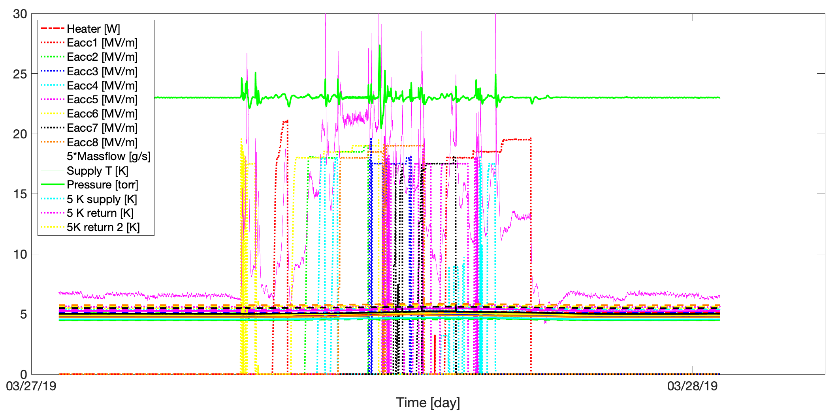
Usable Gradient Determination – March 27, 2019

Slide 6
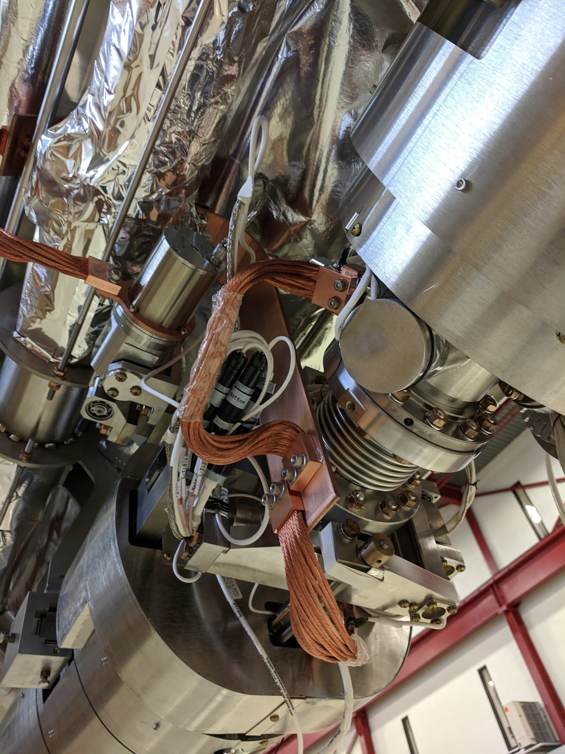
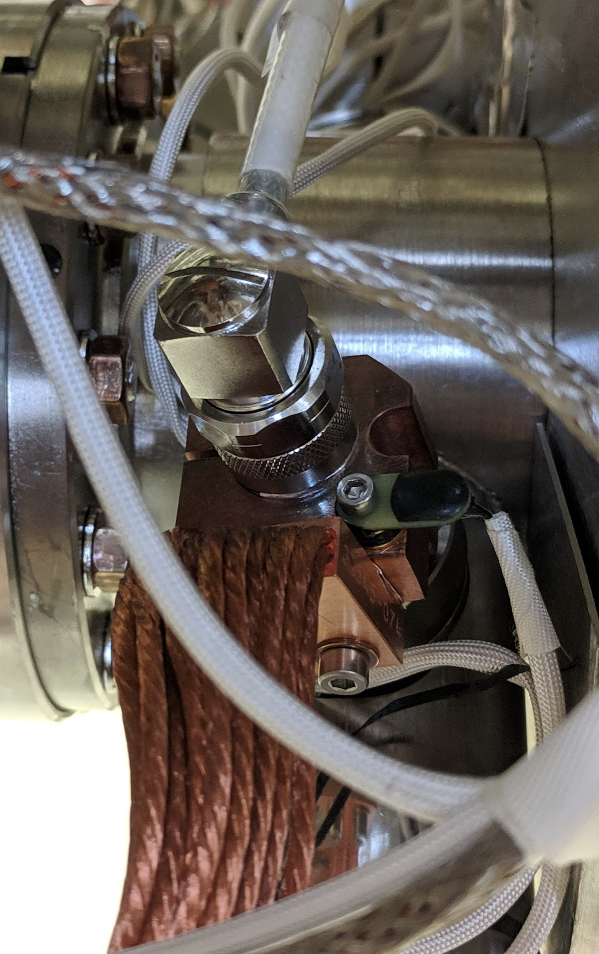
HOM antenna temperature sensor

Slide 7
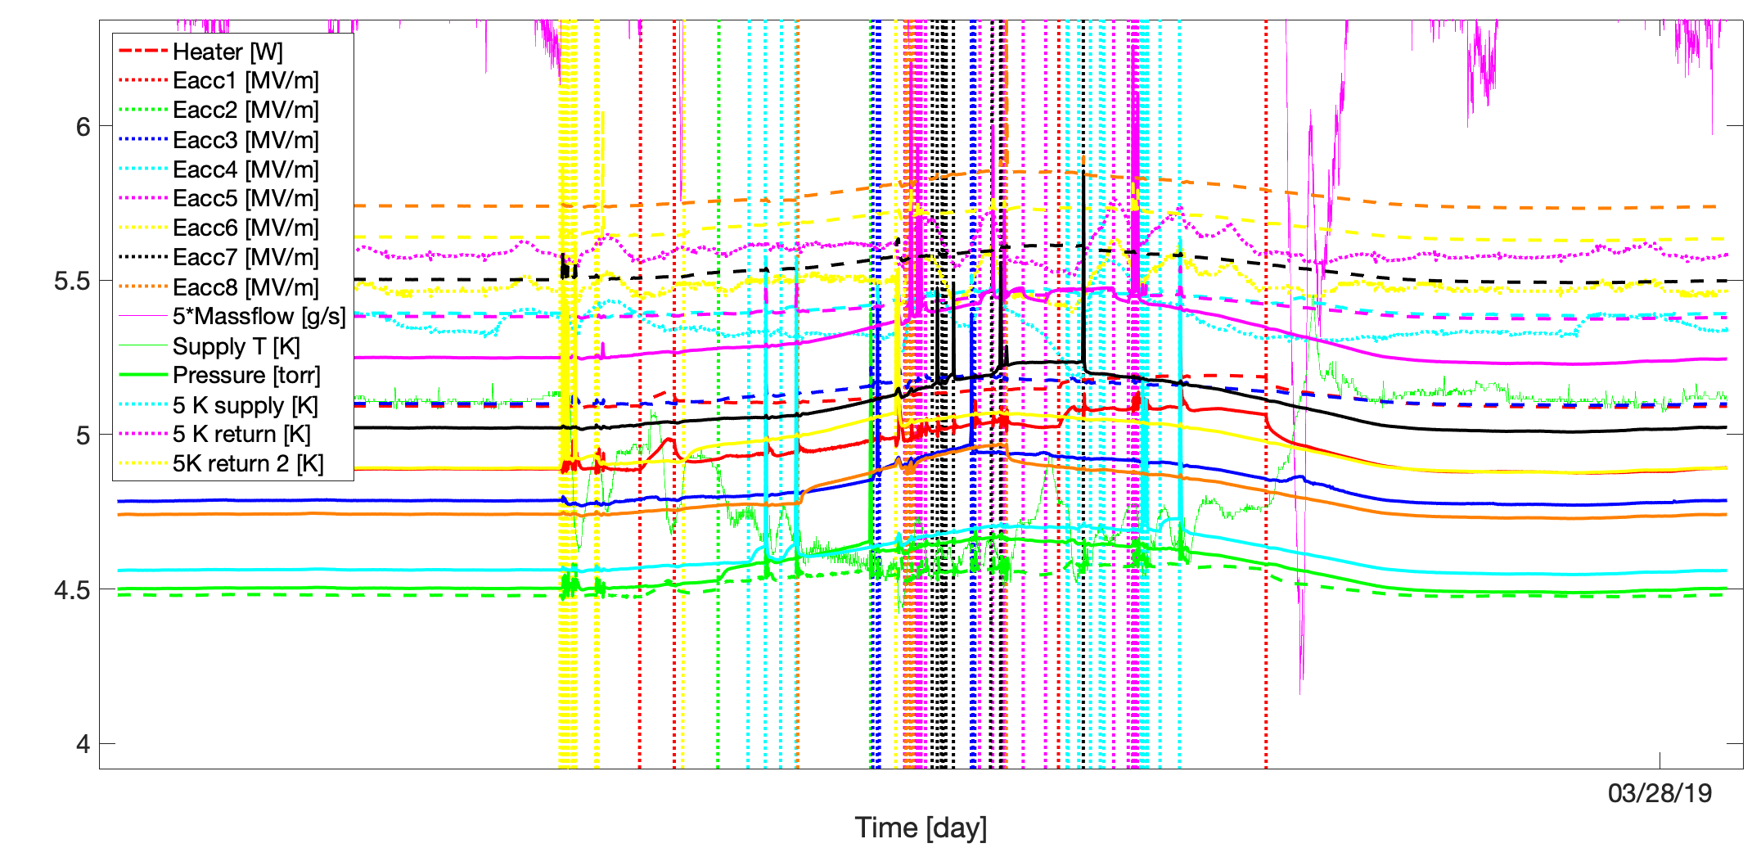
HOM antenna Temperatures (2 per cavity)
Cavity 8 upstream HOM
Cavity 8 downstream
Cernox sensors calibrated at Fermilab
>1 K temperature variation – inconsistent thermal strapping? Or variation in HOM cable length?

Slide 8
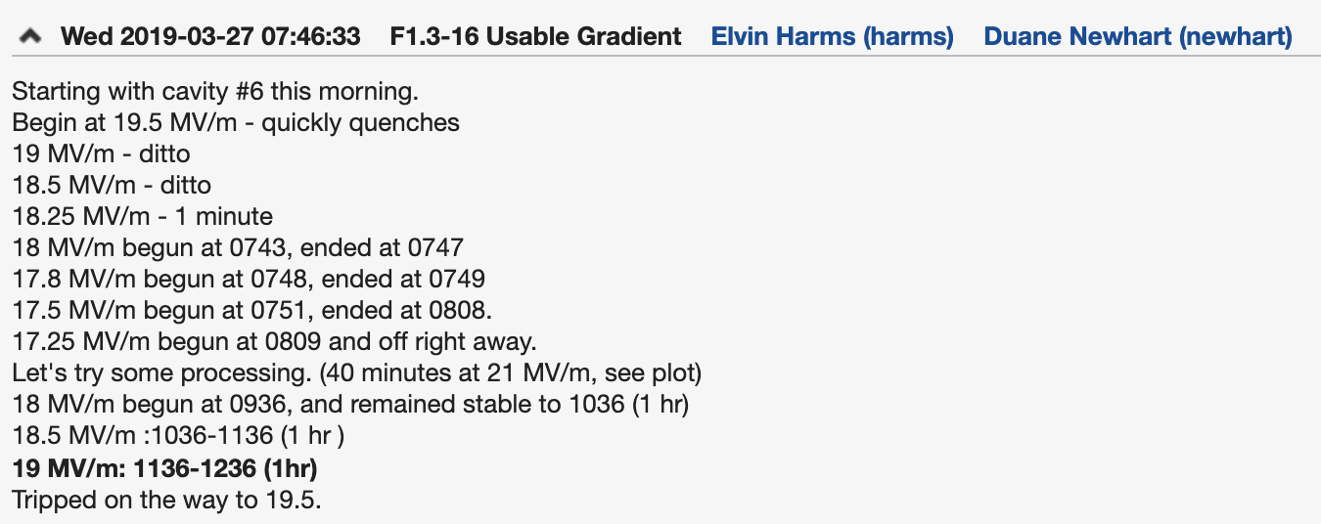
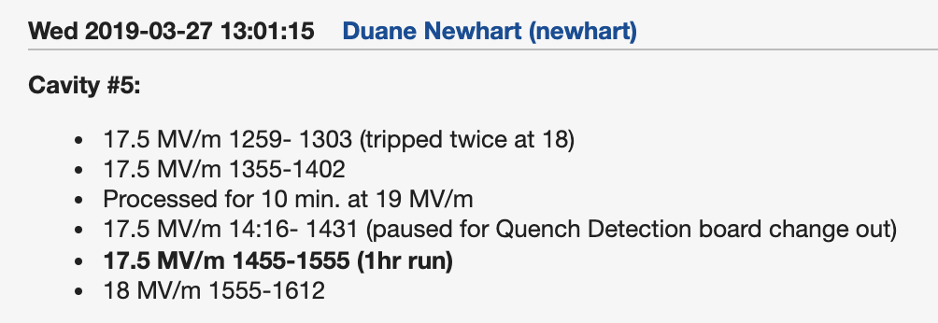
Processing Helps When it is Applied

Slide 9
Processing Example

Slide 10
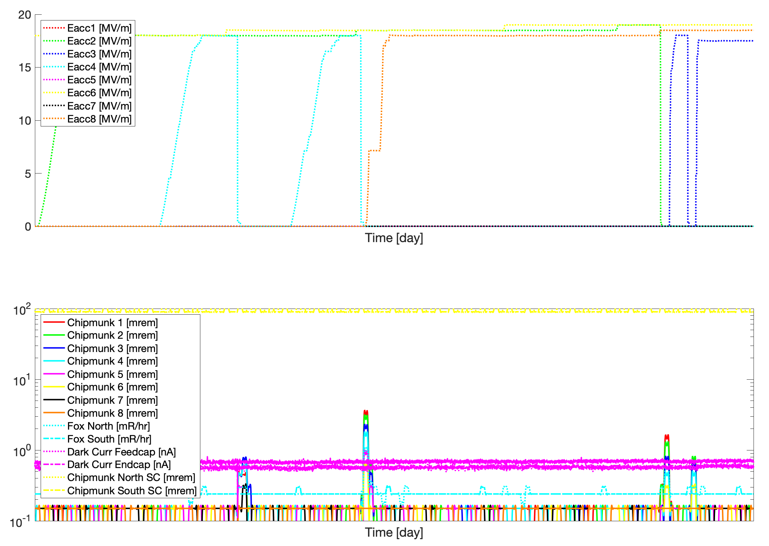
Strong correlation between quench and x-ray burst on chipmunks

Slide 11
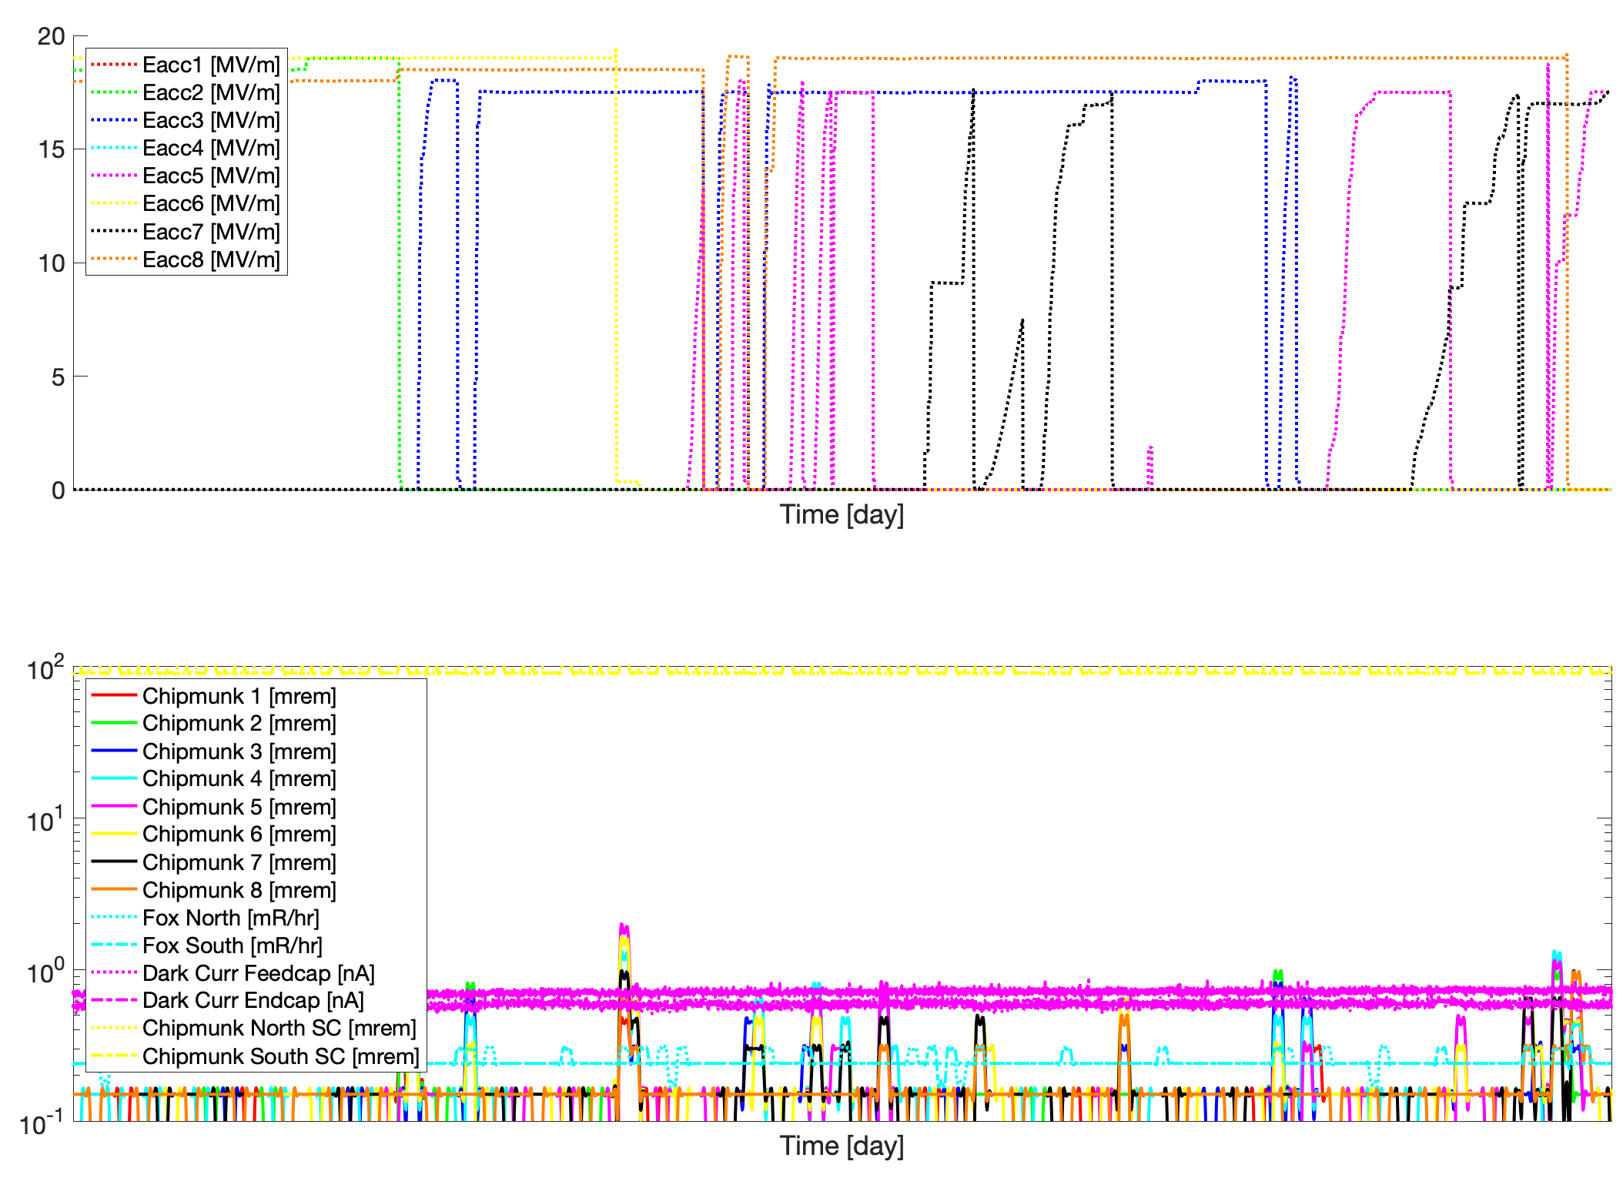
Strong correlation between quench and x-ray burst on chipmunks

Slide 12
Decarads not as sensitive to this

Slide 13
Case Studies
CM16 is not ideal for case studies – for previous CMs, they would start at the maximum gradient, then work backwards as they tried to find usable gradient. For CM16, they started at ~17 MV/m at each cavity, then proceeded upwards till they reached a gradient at which they quenched prior to reaching 1 hour of operation, or else ran out of time for the shift
CM15 problem with file I/O from Matlab. Couldn’t access data in the Backup logger
CM14 has some useful examples

Slide 14
F1.3-14 performance
 | VTS |  |  | CMTF Test
Cavity | Eacc* [MV/m] | FE onset | Q0@16MV/m | Max** Gradient [MV/m] | Usable Gradient*** [MV/m] | FE onset [MV/m] | Q0 @16MV/m 2K @ 30 g/s | Material
CAV0139 | 26 | none | 2.9E+10 | 19.9 | 17.5 | none | 2.9E+10 | TD, 200/900
CAV0225 | 24.5 | 24 | 3.5E+10 | 20.5 | 18.3 | none | 3.1E+10 | TD, 200/900
CAV0096 | 21 | none | 3.5E+10 | 20.5 | 18.7 | none | 4.2E+10 | NX-B, 200/950
CAV0154 | 28 | none | 3.7E+10 | 21 | 18.5 | none | 2.9E+10 | TD, 200/900
CAV0230 | 18.7 | none | 3.6+10 | 17.5 | 17 | none | 2.9E+10 | NX-B, 200/900
CAV0205 | 18.5 | none | 4E+10 | 17 | 16.5 | none | 3.5E+10 | NX, 200/950
CAV0324 | 24 | none | 3.1E+10 | 21 | 20.5 | 14 | 2.6E+10 | TD, 200/900
CAV0150 | 22.5 | none | 3.1E+10 | 18.5 | 17.5 | none | 2.8E+10 | TD, 200/900
Average | 22.9 |  | 3.4E+10 | 19.4 | 18.0 |  | 3.1E+10
Total Voltage | 190.1 |  |  | 161.8 | 150
*No VTS administrative limit
**21 MV/m is CMTF administrative limit
***50mR/h wall radiation detector and/or 0.5 MV/m below quench limit
Q0 measurements started xx hours after thermal bump

Slide 15
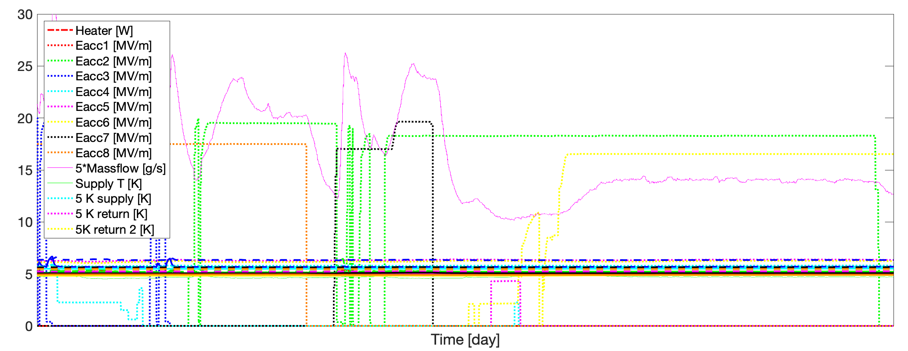
Case Study – CM14, Cavity #2

Slide 16
Case Study – CM14, Cavity #2
Duration at gradient not correlated with gradient – stable at 19.5 MV/m for 25 minutes then quench very quickly at 18.5 and 19.0
15:00
17:00

Slide 17
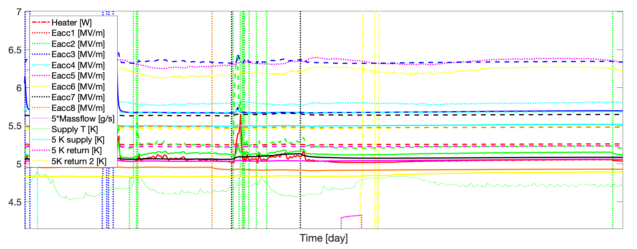
Case Study – CM14, Cavity #2
15:00
17:00

Slide 18
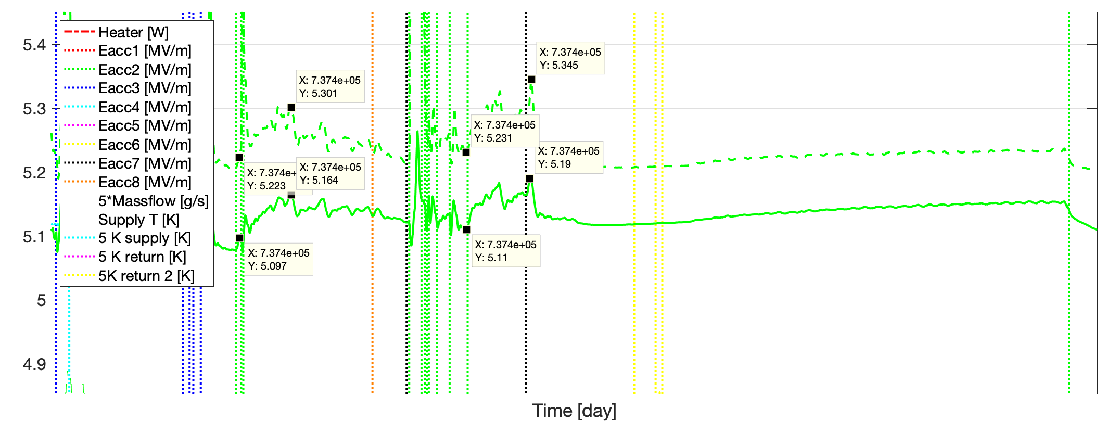
HOM antenna temperatures not correlated with quench – much higher T seen during stable times than during quench
Stable
Stable
Quench
Quench

Slide 19
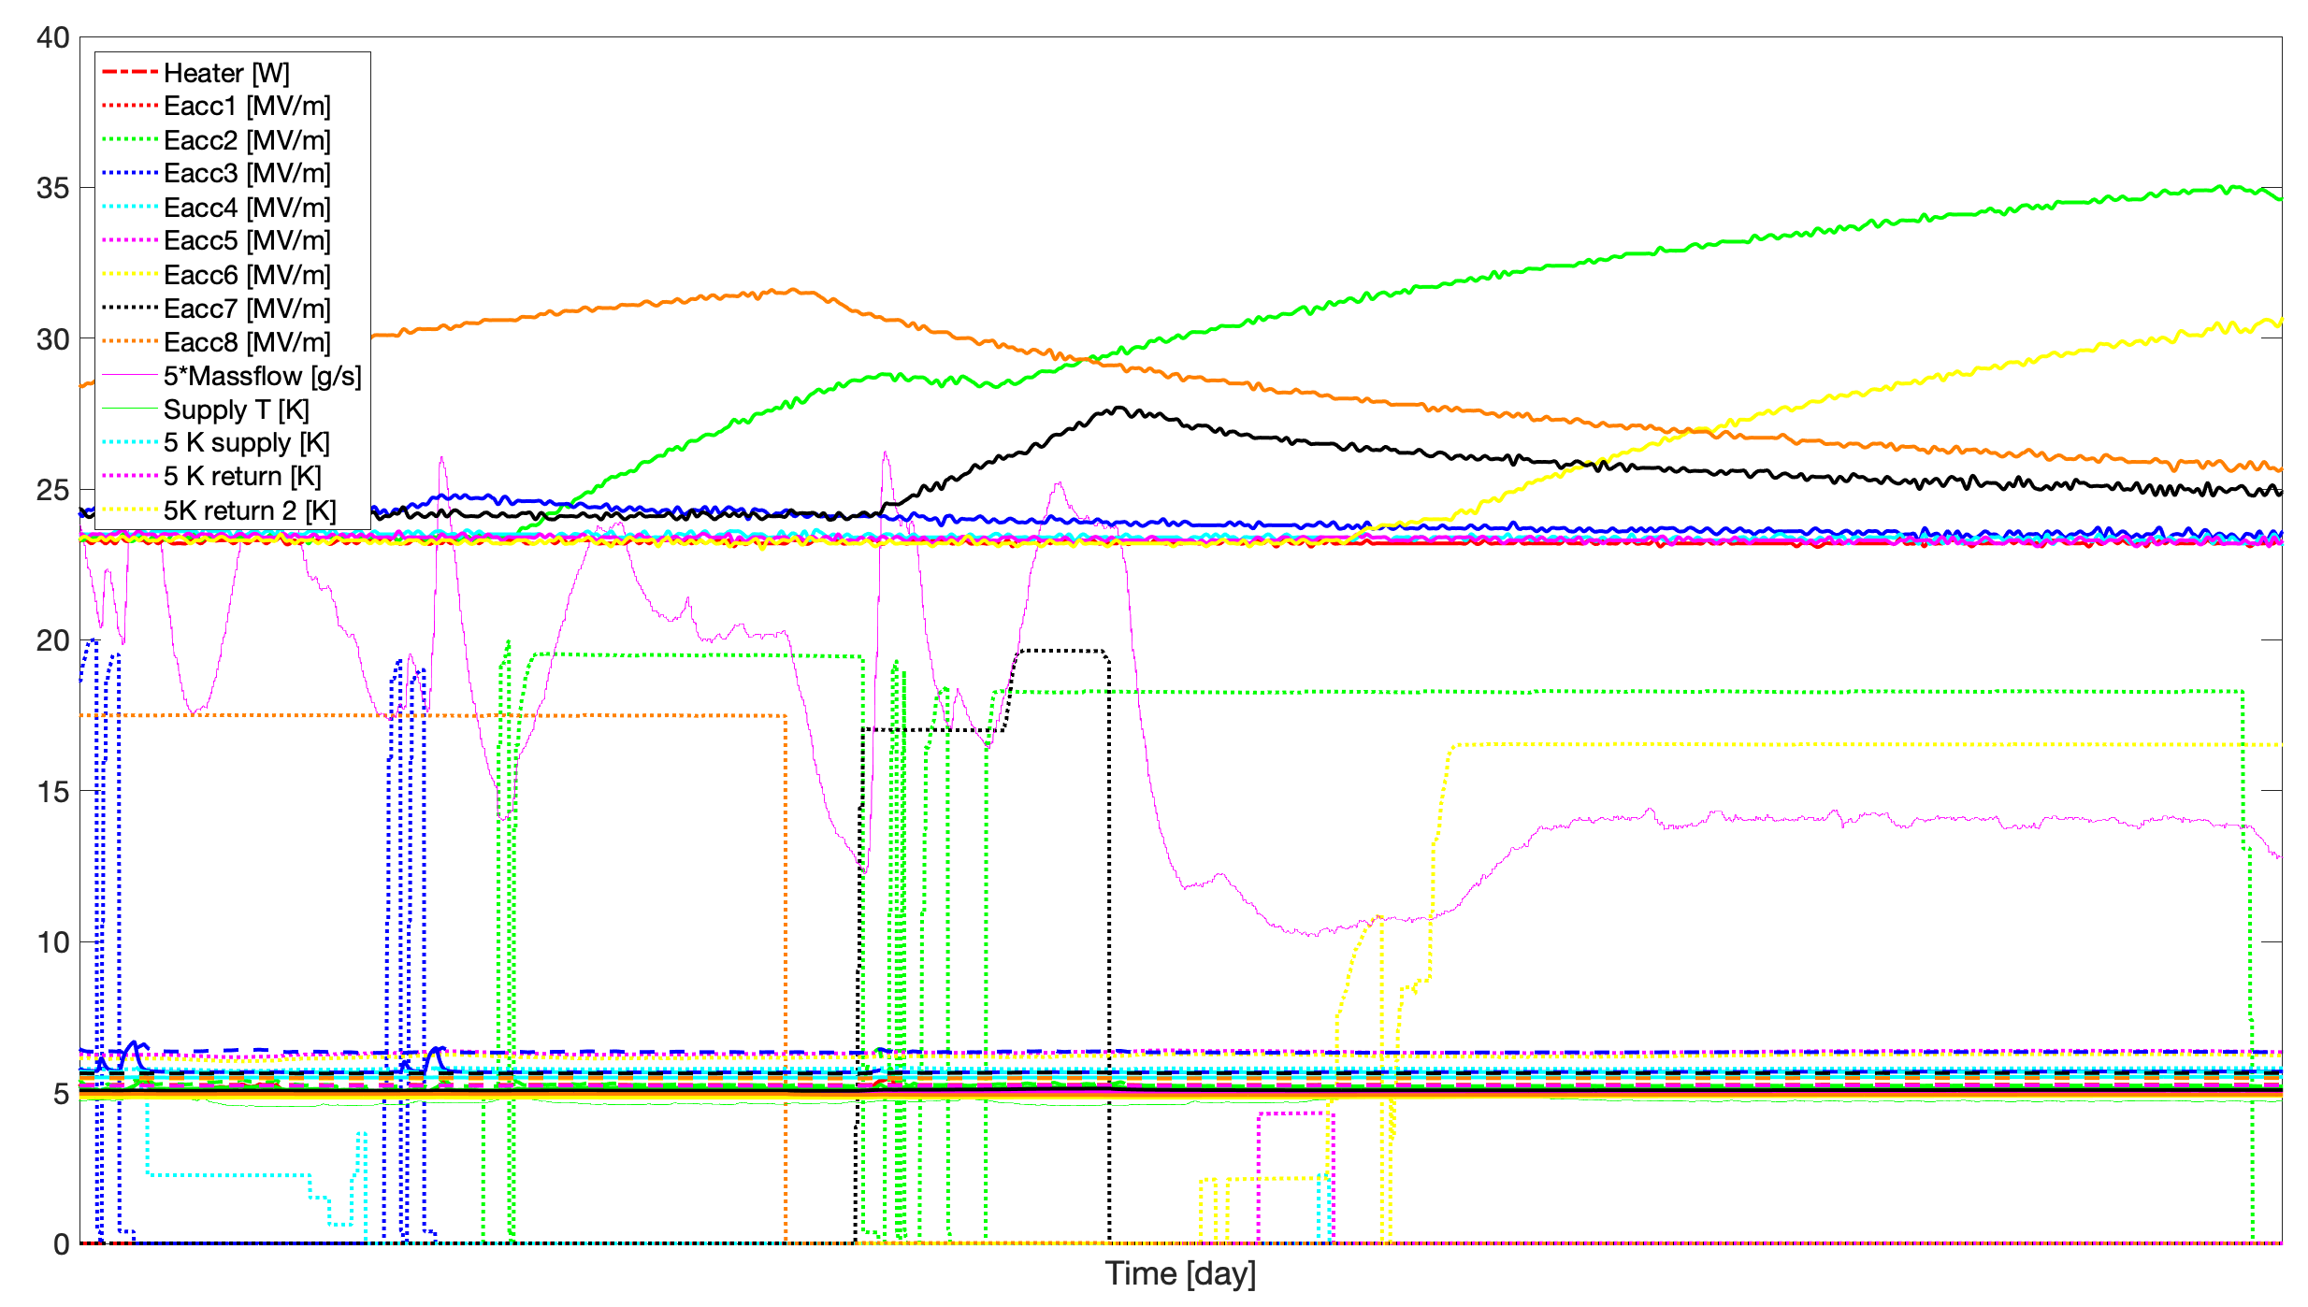
Coupler temperatures not correlated with quench – higher T seen during stable times than during quench

Slide 20
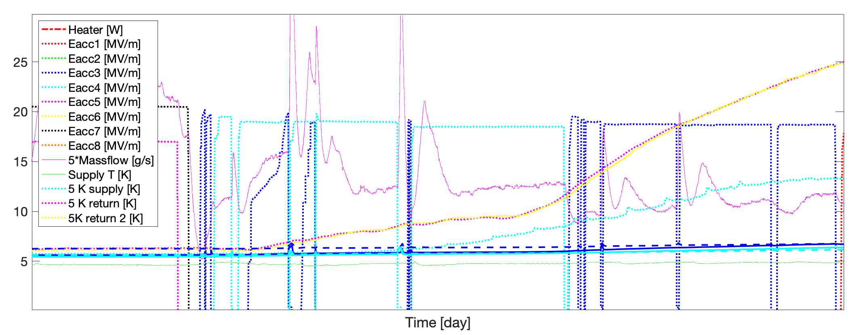
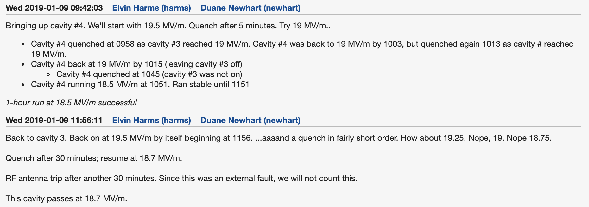
Case Study – CM14, Cavities #3 & 4
5 K circuit temperature excursion!
8:30
13:45

Slide 21
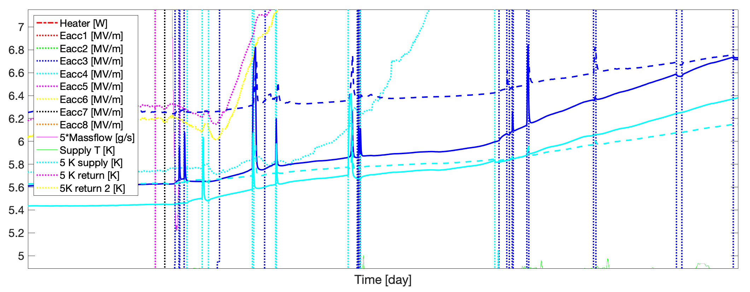
HOM antenna and 5 K circuit temperatures not correlated with quench – much higher T seen during stable times than during quench – But cavity turn-on may influence quench?

Slide 22
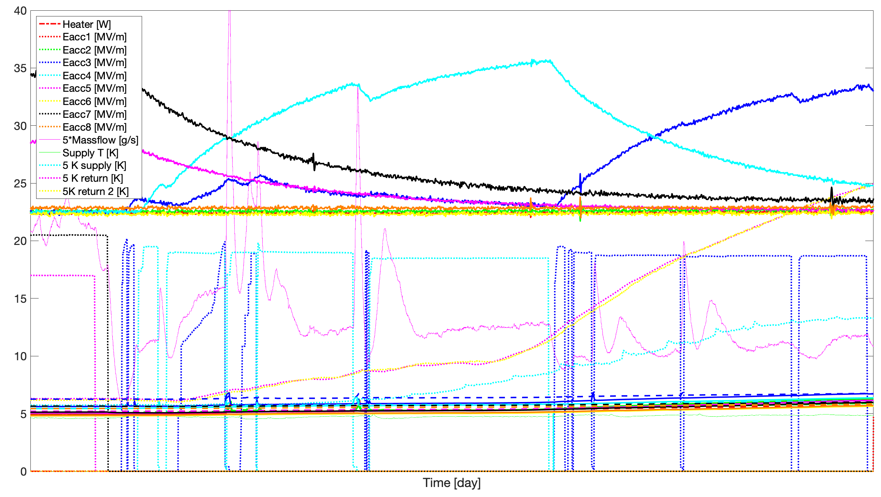
Coupler temperatures not correlated with quench – higher T seen during stable times than during quench

Slide 23
Summary
Observations that suggest quench is related to multipacting
Processing helps increase quench field
Quench strongly correlated with x-ray bursts
Observations that suggest quench not caused by overheating
Anticorrelations observed with time to quench
Anticorrelations observed with HOM antenna temperature and coupler temperature
In one case, usable gradient achieved during a time when 5 K circuit temperature was increasing substantially
Some preliminary correlations between quench of one cavity and bringing up E_{acc} of another

Slide 24
Next Steps
Experiments at CMTF (LCLS-II CM if possible, HE pCM)
Attempt to process multipacting to improve maximum gradient and reduce quench frequency
Measure Q₀-degradation from flux trapping after 1 quench; multiple quenches
Perform thermal bump to recover Q₀-degradation – does it reset multipacting? If so, could be major problem
Perform unit test at 18 MV/m to evaluate higher gradient operation for LCLS-II CM; higher gradient?
Development of rapid quench detection to shut off RF power and prevent excessive boiling of helium in tank
Experiments in VTS
Do we see this in VTS if we hold for ~1 hour plus in MP band?

