Slide 1
LCLS-II Microphonics
Lessons Learned for LCLS-II HE
J.P. Holzbauer on behalf of the Microphonics Working Group
LCLS-II HE Cryomodule Performance Workshop
Monday, April 15, 2019

Slide 2
Changes lead to Issues
LCLS-II cryomodules are being produced and tested at FNAL and JLab, in general with great success
One notable exception was the resonance stability (150 Hz instead of 10 Hz)
This was not a completely unanticipated problem; significant changes had been made to the XFEL cryomodule design for LCLS-II
Cryogenic Values on the Cryomodule
Cavity 1 Support was changed (not that the XFEL support was optimal)
Cryo flow paths in the module (fast cooldown, tunnel pitch, etc.)
The size and complexity of the microphonics (observed at both JLab and FNAL) required a significant response to mitigate
Working group formed at FNAL (representatives from Resonance Control, LLRF, Cryogenics, Cryomodule Design, Operations) to guide testing and determine solutions
Devoted extensive test time to microphonics studies

Slide 3
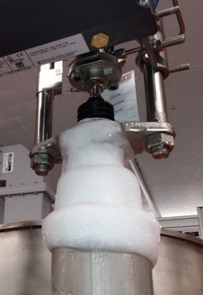
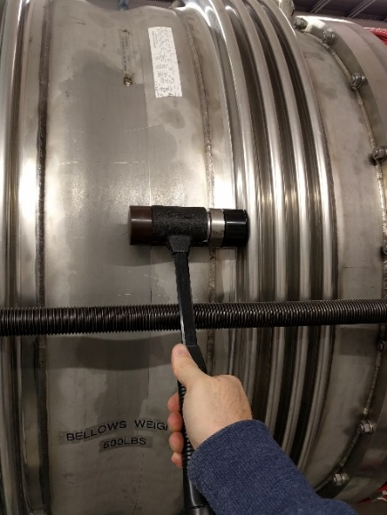
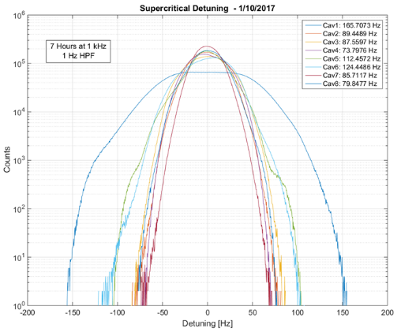
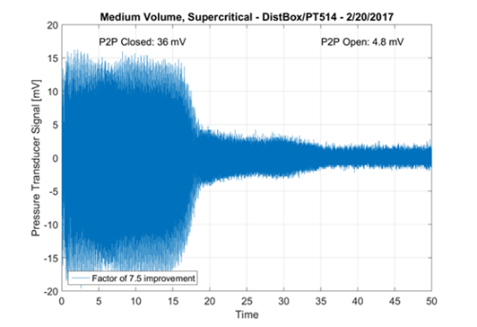
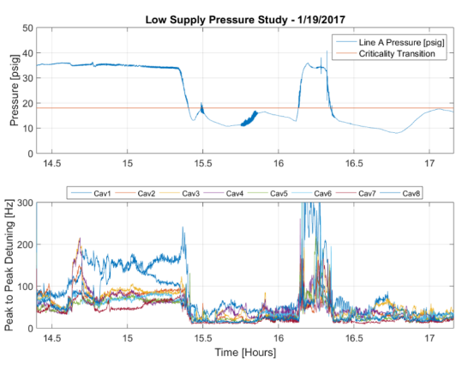
Mitigation Diagnostic Tools
Significant testing effort was spent on microphonics mitigation
This effort built up a sizable infrastructure of testing tools and techniques
LLRF data capture system allows capture of simultaneous detuning on all cavities for long times
Scripting has been built out significantly to process and analyze this data, and expertise has been spread to multiple people
Can be correlated many sources of data via ACNET:
Impact/Vibration Measurements
Temperatures, Pressures, etc. from instrumentation
On-site, expert cryogenics support and flexibility are powerful diagnostic tools, allows testing in different cryogenics configurations
Leveraged significant work done at both labs on vibrational design and testing as a baseline

Slide 4
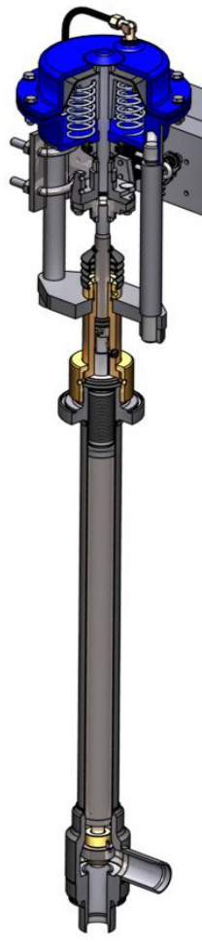
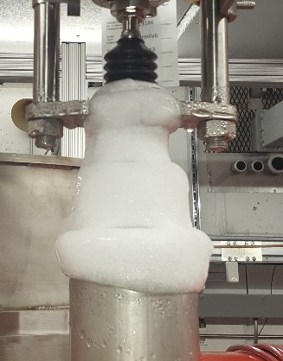
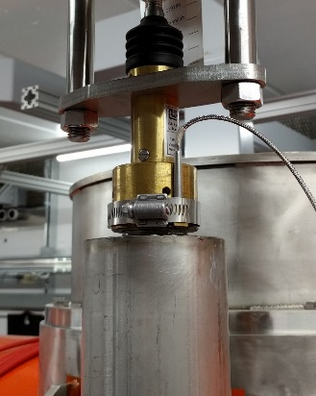
Cryogenic Valve Plumbing – Improved Valve Stems
TAOs are a pressure/temperature oscillation in cryogenic lines (in this case, valve stems)
During testing, wipers were added to close space in valve stem, acting as a damping term for the TAOs
Significant improvement in heat load and microphonics levels and stability
Optimized valve stems with wipers were used on all cryomodules
4-5 wipers, positioned to keep temperature ratio <4 as recommended by literature
Radiation hard material (PEEK)
Before
After
DN6
DN10
Optimized wiper placement going forward

Slide 5
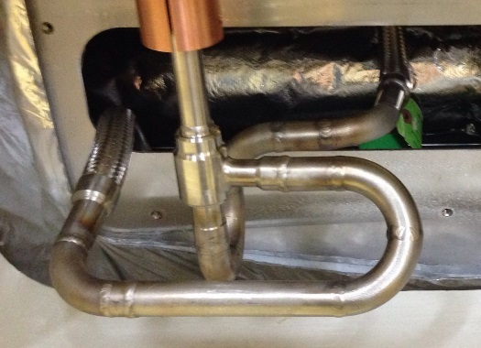
Cryogenic Valve Plumbing – Reverse Flow Path
Test results show valve reversal (lower press in stem) significantly reduces/eliminate TAOs there
F1.3-01 configuration has valve stem at supply pressure (~3 bar)
Reversing flow will lower this pressure to sub-atmospheric, requiring guard gas to prevent contamination
All cryomodules will have guard gas, reversed valves
Additional effort to mitigate TAOs in cryogenic distribution system should improve inlet temperature at test stand
Reversed additional valve on the FNAL test stand (bypass) after latest test
pCM Flow Pattern
3 bar Supply
Reversed Flow Pattern (CM2)
3 bar Supply
~23 Torr
~23 Torr

Slide 6
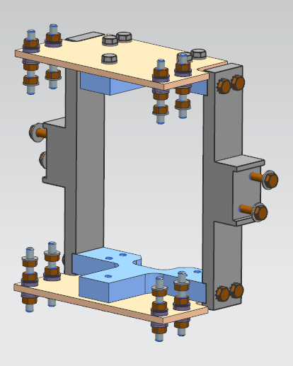
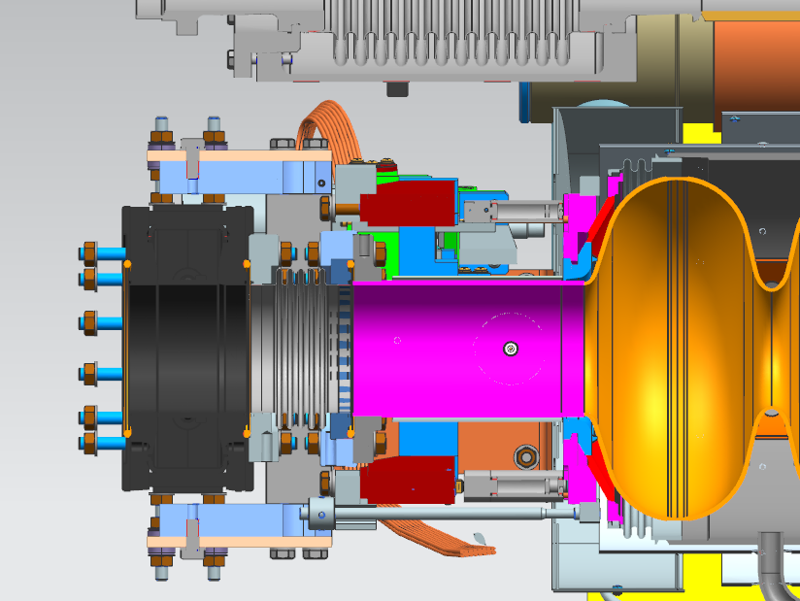
Cavity 1 Mechanical Connections – Mitigation Beamline Gate Valve Bellows
Replacing spool piece between cavity 1 and gate valve with a bellows is non-trivial
Corrective fix includes extending tuner arms with fixture to connect to gate valve
When replacing spool piece with bellows, fixture fully supports gate valve
Current supports are long arms connected to the 300 mm pipe with needle bearing for the longitudinal motion
With gate valve is supported by frame/helium vessel, the spool piece can be replaced with a bellows to separate mass from cavity/tuner system
Two cryomodules with bellows have been tested at FNAL (F1.3-06/07)
Extended Tuner Arms
Fixture with Bellows

Slide 7
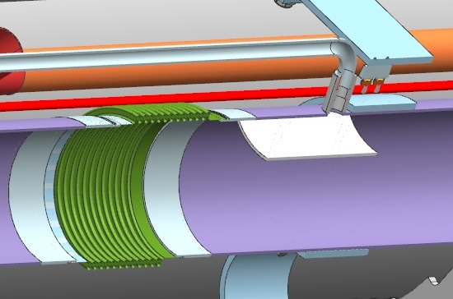
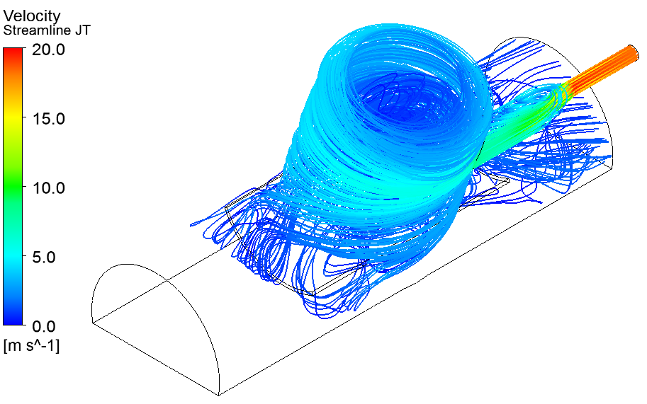
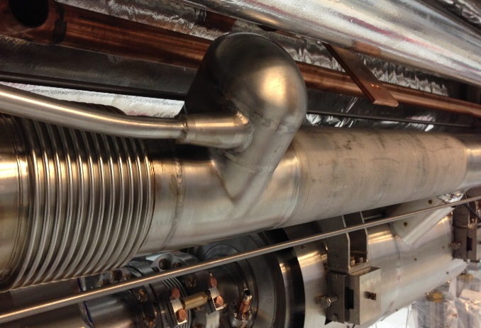
Mitigation Steps in Cryomodule Design – 2 Phase Injection
Liquid level control was coupled to input flow rate and the amount of flash gas generated across JT valve
Helium injection line impinged on liquid surface
Flash gas from JT caused liquid dragging
CM2 has baffles to protect liquid surface
CM3 has tangential injection into cap to reduce velocity and allow phase separation in addition to baffles
Should greatly reduce liquid dragging and improve liquid level stability, especially at high flow rates
Fluid simulation gives good confidence in improved injection behavior
CM2
CM3

Slide 8
Design Changes Moving from LCLS-II to HE
Valve Modifications (wipers, plumbing, guard gas, etc.)
Critical changes that provide real valve
Cavity 1 Bellows/Cold Gate Valve Support
Clear improvement to cavity 1 microphonics
Difficulty introduced with interconnects
Myriad of other changes including Injection Tee
Best practices followed, but no concrete evidence of improvement but no reason to suspect negative impact
Overall, no reason to make changes for microphonics sake, i.e., there are no clear drivers for design changes to improve microphonics (include new changes or rollback of changes)
Only potential change to be considered would be cavity 1 gate valve support because of interconnect interference
Mechanical support could be modified to ease interference without compromising microphonics improvement
Critical to Remember: Tunnel inlet temperature will be lower! Tunnel vibrational environment will be better (at least different)

Slide 9
Ongoing Microphonics Monitoring
Module testing at CMTF includes routine microphonics monitoring
Generally 30 minute captures
Right after cooldown
Unit Testing
Other times as desired
Thermalization effects are significant, overall significant noise seen early in test cycle that cleans up over time
No extra time is given to allow thermalization (not that it’s asked for)
Small investigations of these effects have been done, but these effects are not seen as critical, difficult to diagnose, and likely unrepresentative of tunnel performance
Unit tests are mostly performed without microphonics interference (but not always)

Slide 10
Summary
Test stands are well-equipped to monitor cryomodule microphonics for LCLS-II HE
Functionality, scripting, know-how, effort all in place
Changes have led to issues in the past, no reason to expect further changes to not cause issues, and little reason to justify making further changes
Cautious changes to cavity 1 support to remove interferences is one potential item
Every other change must be reviewed for potential microphonics implication (higher gradient counts as a change)
Intriguing mysteries remain, but no real justification to devote necessary resources to identify/mitigate them

