Slide 1
NuMI-AIP Target Systems Updates
Yun He
TSD Topical Meeting
April 18, 2019

Slide 2
Outline
Project Plan approved Dec. 18, 2018
12 tasks, managed mostly within TSD
Introduction
  Project scope, issues to be addressed, and schedule
  Prior to & after funds approval
Project implementation
  Project organization chart and WBS
  Project schedule and phased installation
  SharePoint site for documentation and communication
Project technical details and status
  2019 summer shutdown tasks and job schedule
  Rest tasks not tied to 2019 summer shutdown
Summary

Slide 3
Introduction
  Project scope, issues to be addressed, and schedule
  Prior to & after funds approval
Project implementation
  Project organization chart and WBS (people & funds)
  Project schedule and phased installation (schedule)
  SharePoint site (documentation and communication)
Project technical details and status
  2019 summer shutdown tasks and job schedule
  Remaining tasks for 2020 summer shutdown or not involving shutdowns
Summary

Slide 4
Project Scope, Issues to be Addressed, and Schedule
Beam Power | 1 MW | 700 kW | Rate of change
Proton beam energy | 120 GeV |  | ----
Protons per spill | 6.5E13 | 4.9E13 | 32.7%
Main injector cycle time | 1.2 sec | 1.33 sec | 10.8%
Beam pulse width | 10 microsec |  | ----
Horn current/pulse width | 200 kA / 2.3 msec |  | ----
Beam acceptance capabilities
  maximum beam power to target of 1 MW
Reliability
  maintain 85% availability for HEP at full proton delivery
Lifetime
  minimally through 2025
Temperatures and stresses due to beam heating | Increased radio-activation | An aging infrastructure in radiative environment
MARS simulation Pre-target beam window Target core and baffle Horn 1 stripline cooling Radioactive water (RAW) systems Target chase air handling, chiller Hadron absorber temperature monitoring | 8. Additional shielding to target chase 9. Tritium mitigation upgrade 10. New radiation-hard hadron Monitors | 11. Decay pipe window repair plan 12. Target/horn 1 module positioning drives
12 upgrade tasks were identified
Starts – Dec. 2018
Ends – April 2021

Slide 5
Prior to & After Funds Approval
FY19 Q1
Prior to funds approval
System assessment & preliminary design with TSD Operations funds
Cory Crowley / Katsuya Yonehara
FY19 Q2
Funds received Dec. 2018
Project implementation
Yun He / Marty Murphy
Tasks identified | Status prior to re-start | Current status
MARS simulations | Preliminary simulations | Re-run for new changes
Pre-target window | Installation | Spare fabrication
Target baffle & core | Preliminary design and FEA | Final design and FEA, fabrication
Horn 1 | Preliminary design and FEA | Final design and FEA, fabrication
Stripline air diverter T-block | Scope defined | Design
Target and horn 1 module drives | Preliminary design | Final design, fabrication
RAW skids | Design | Procurement
Target hall chiller/air handling | Scope defined | Procurement
Target chase shielding | Design | Fabrication
Tritium mitigation | Scope defined | Re-define scope
Decay pipe window | Preliminary design and FEA | Final design and FEA, test welding
Hadron beam monitor & absorber | Scope defined | Design

Slide 6
Introduction
  Project scope, issues to be addressed and schedule
  Prior to & after funds approval
Project implementation
  Project organization chart and WBS (people & funds)
  Project schedule and phased installation (schedule)
  SharePoint site (documentation and communication)
Project technical details and status
  2019 summer shutdown tasks and job schedule
  Remaining tasks for 2020 summer shutdown or not involving shutdowns
Summary

Slide 7
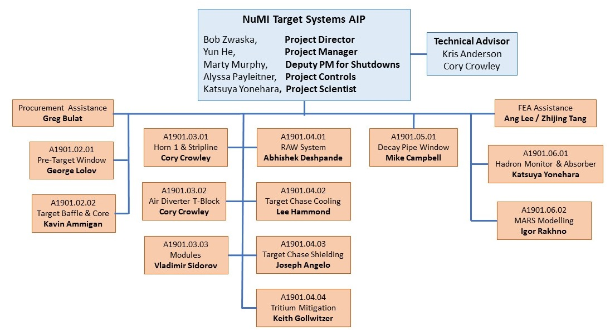
Project Organization Chart and WBS
12 Control accounts
The work presented here are team work led by people in this org chart

Slide 8
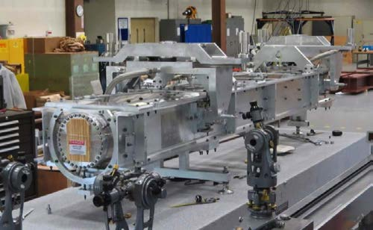
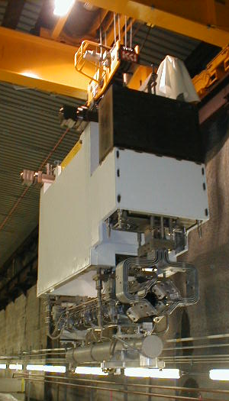
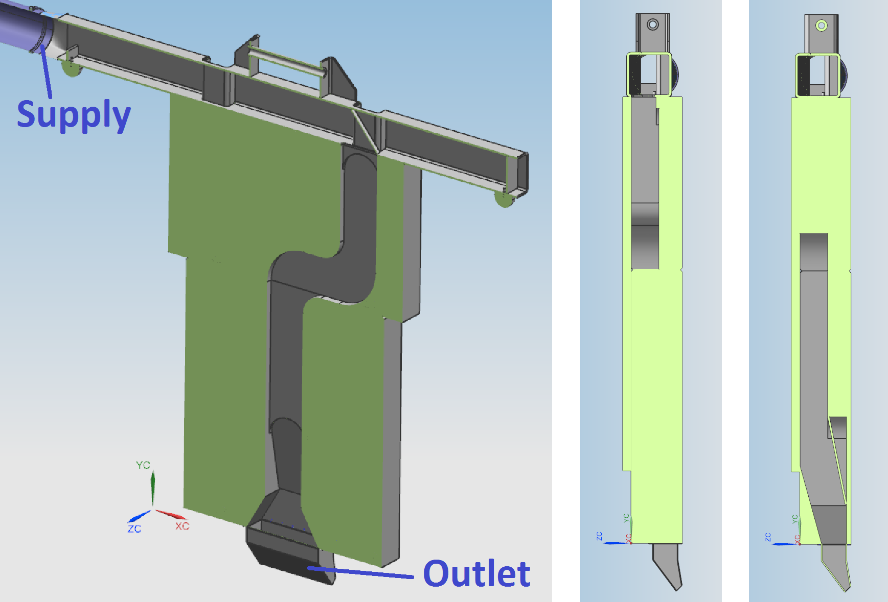
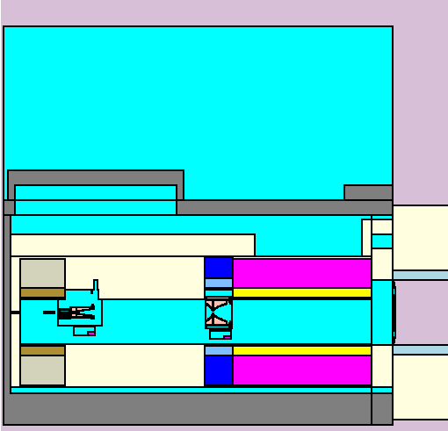
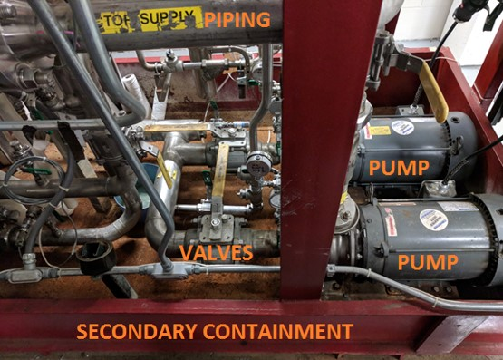
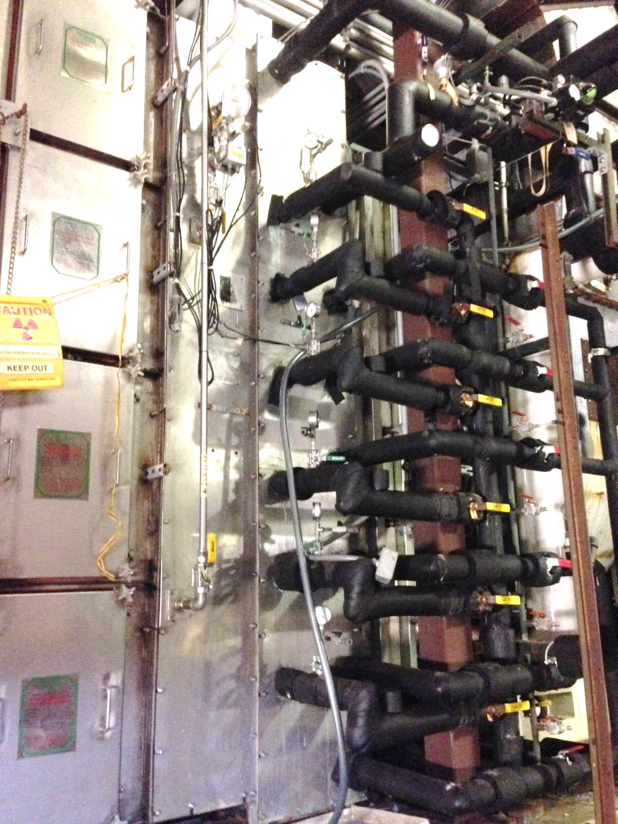
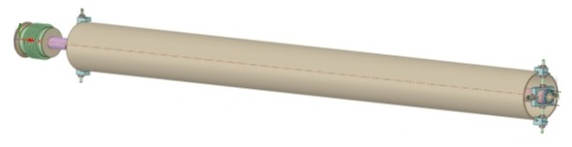
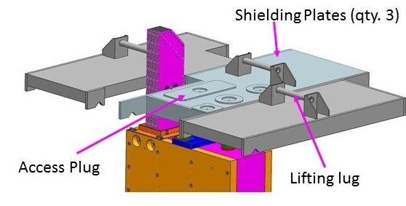
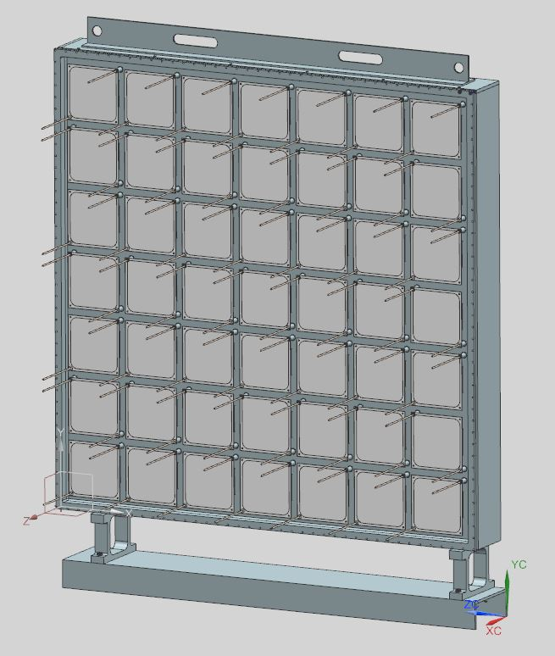
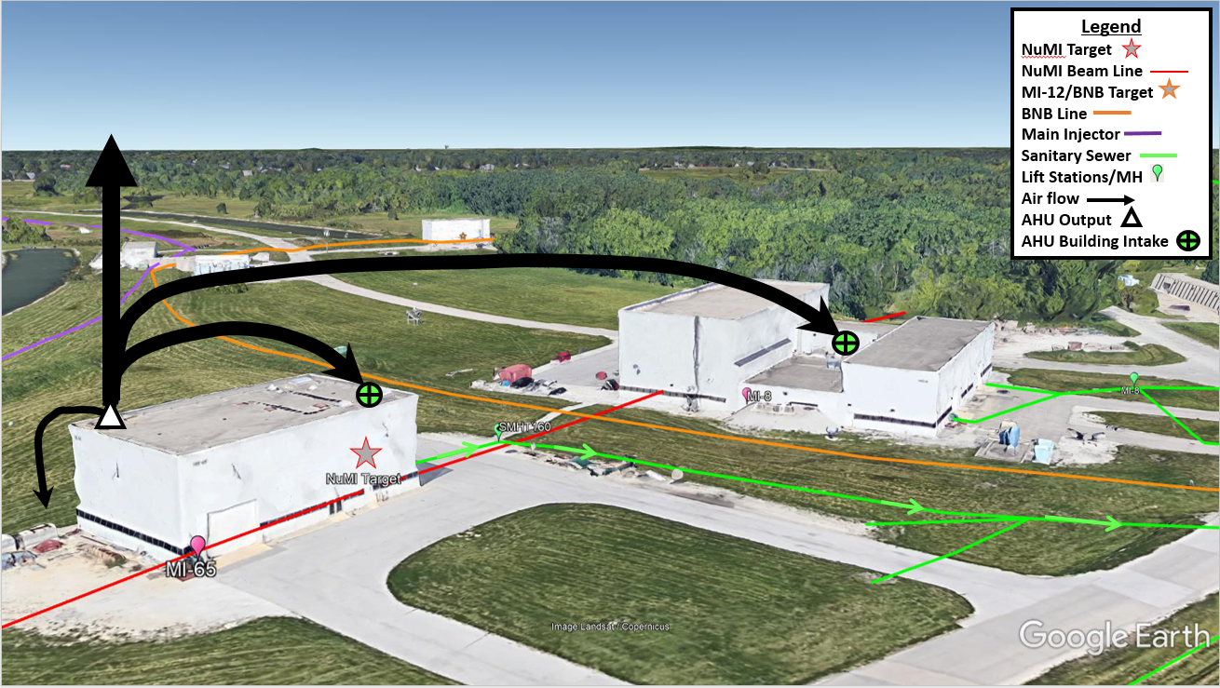
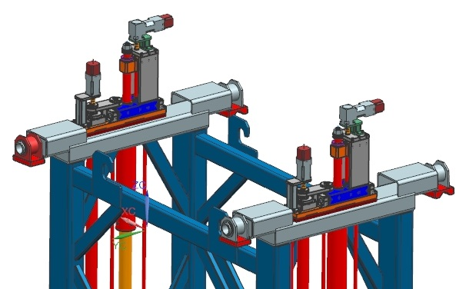
Project Schedule and Phased Installation
2019 summer shutdown | 2020 summer shutdown | Tasks not involving summer shutdowns
1 MW target installation | 1 MW horn 1 installation | MARS simulations
Target & Horn 1 RAW upgrade | Stripline air diverter T-block | Pre-target vacuum pipes
Target chase cooling / air unit upgrade | Target and horn 1 module drives | Decay pipe window
Target chase supplemental shielding | Hadron beam monitor | Tritium mitigation

Slide 9
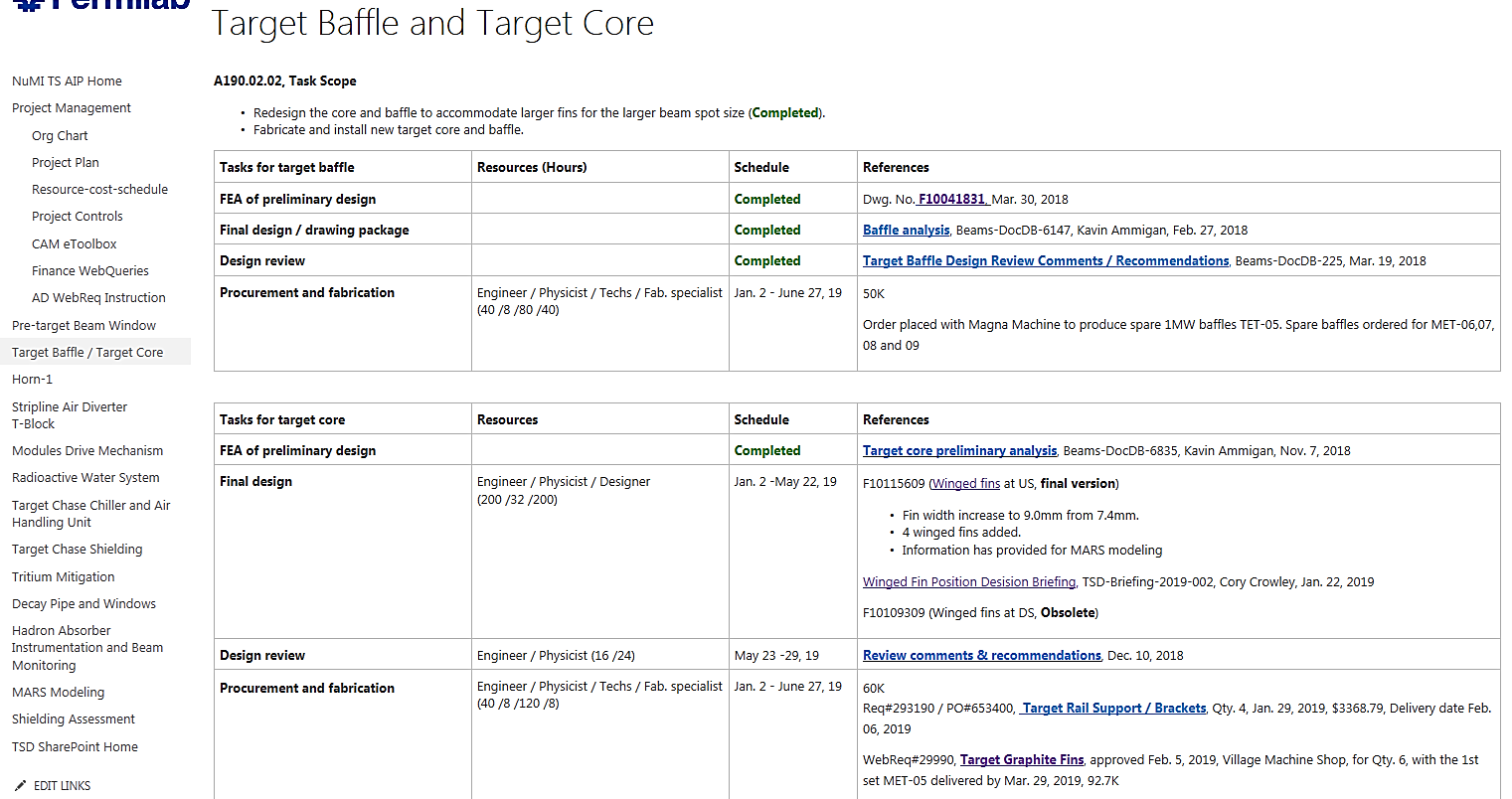
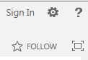
SharePoint for Documentation and Communication
https://web.fnal.gov/project/TargetSystems/NuMI-AIP/
(An example)
(A1901.02.02)
With your Fermilab Service account password
Status /Schedule
Drawing in TeamCenter
Analysis report in Beams DocDB
Budgeted resource
Design review comments
Budgeted M&S cost
Break-down activities
Procurement Req# / PO#, Delivery date

Slide 10
Introduction
  Project scope, issues to be addressed, and schedule
  Prior to & after funds approval
Project implementation
  Project organization chart and WBS (people & funds)
  Project schedule and phased installation (schedule)
  SharePoint site (documentation and communication)
Project technical details and status
  2019 summer shutdown tasks and job schedule
  Rest tasks not tied to 2019 summer shutdown
Summary

Slide 11
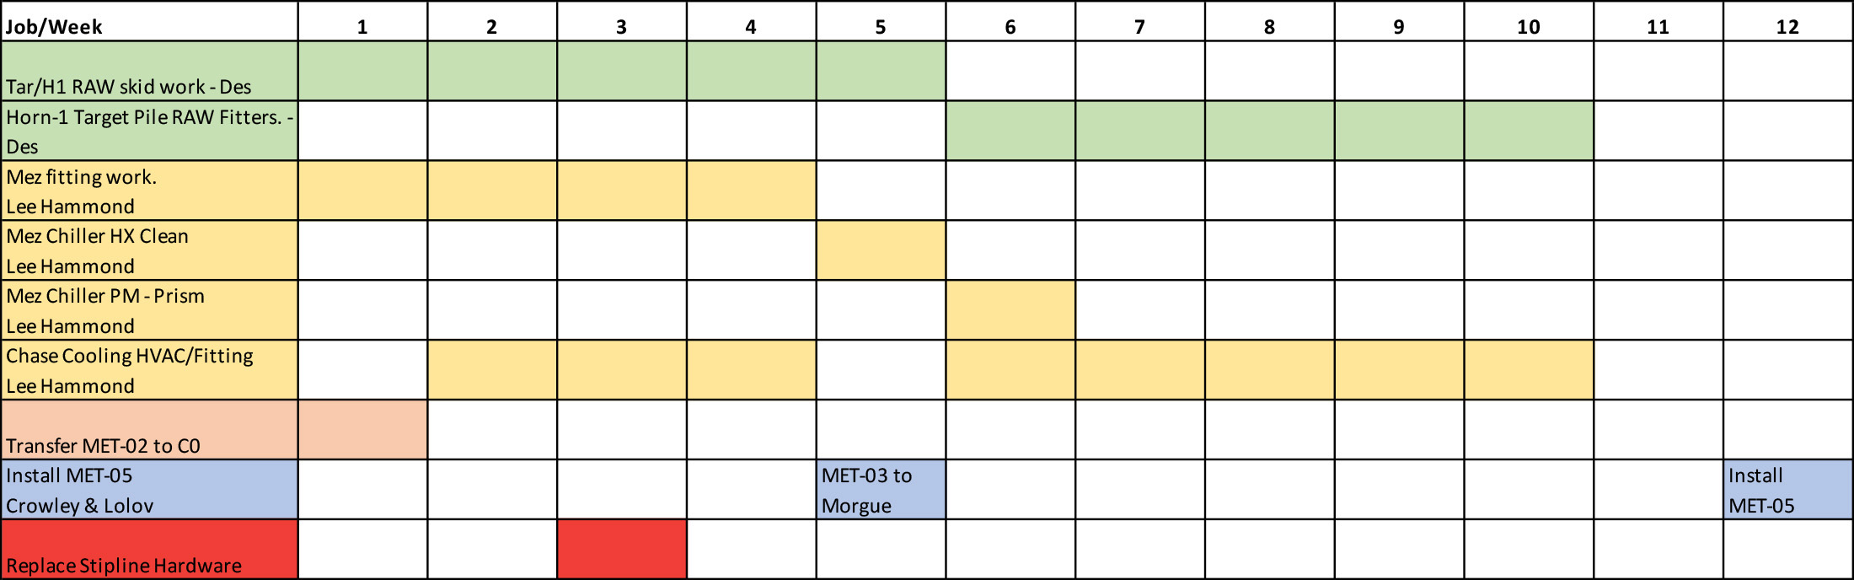
2019 Shutdown NuMI-AIP Job Schedule (Marty Murphy)
4 Tasks
Cool down time before target chase can be opened
Pipefitter T&M Contractor teams have worked on similar NuMI jobs in the past
Target installation
Next 4 slides will cover these 4 tasks with more technical details and status

Slide 12
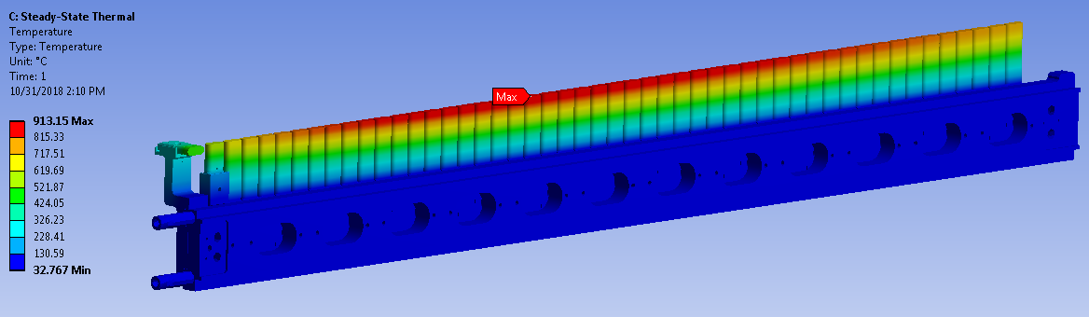
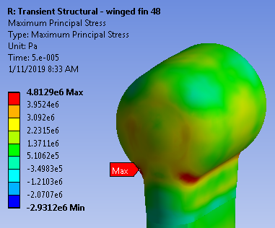
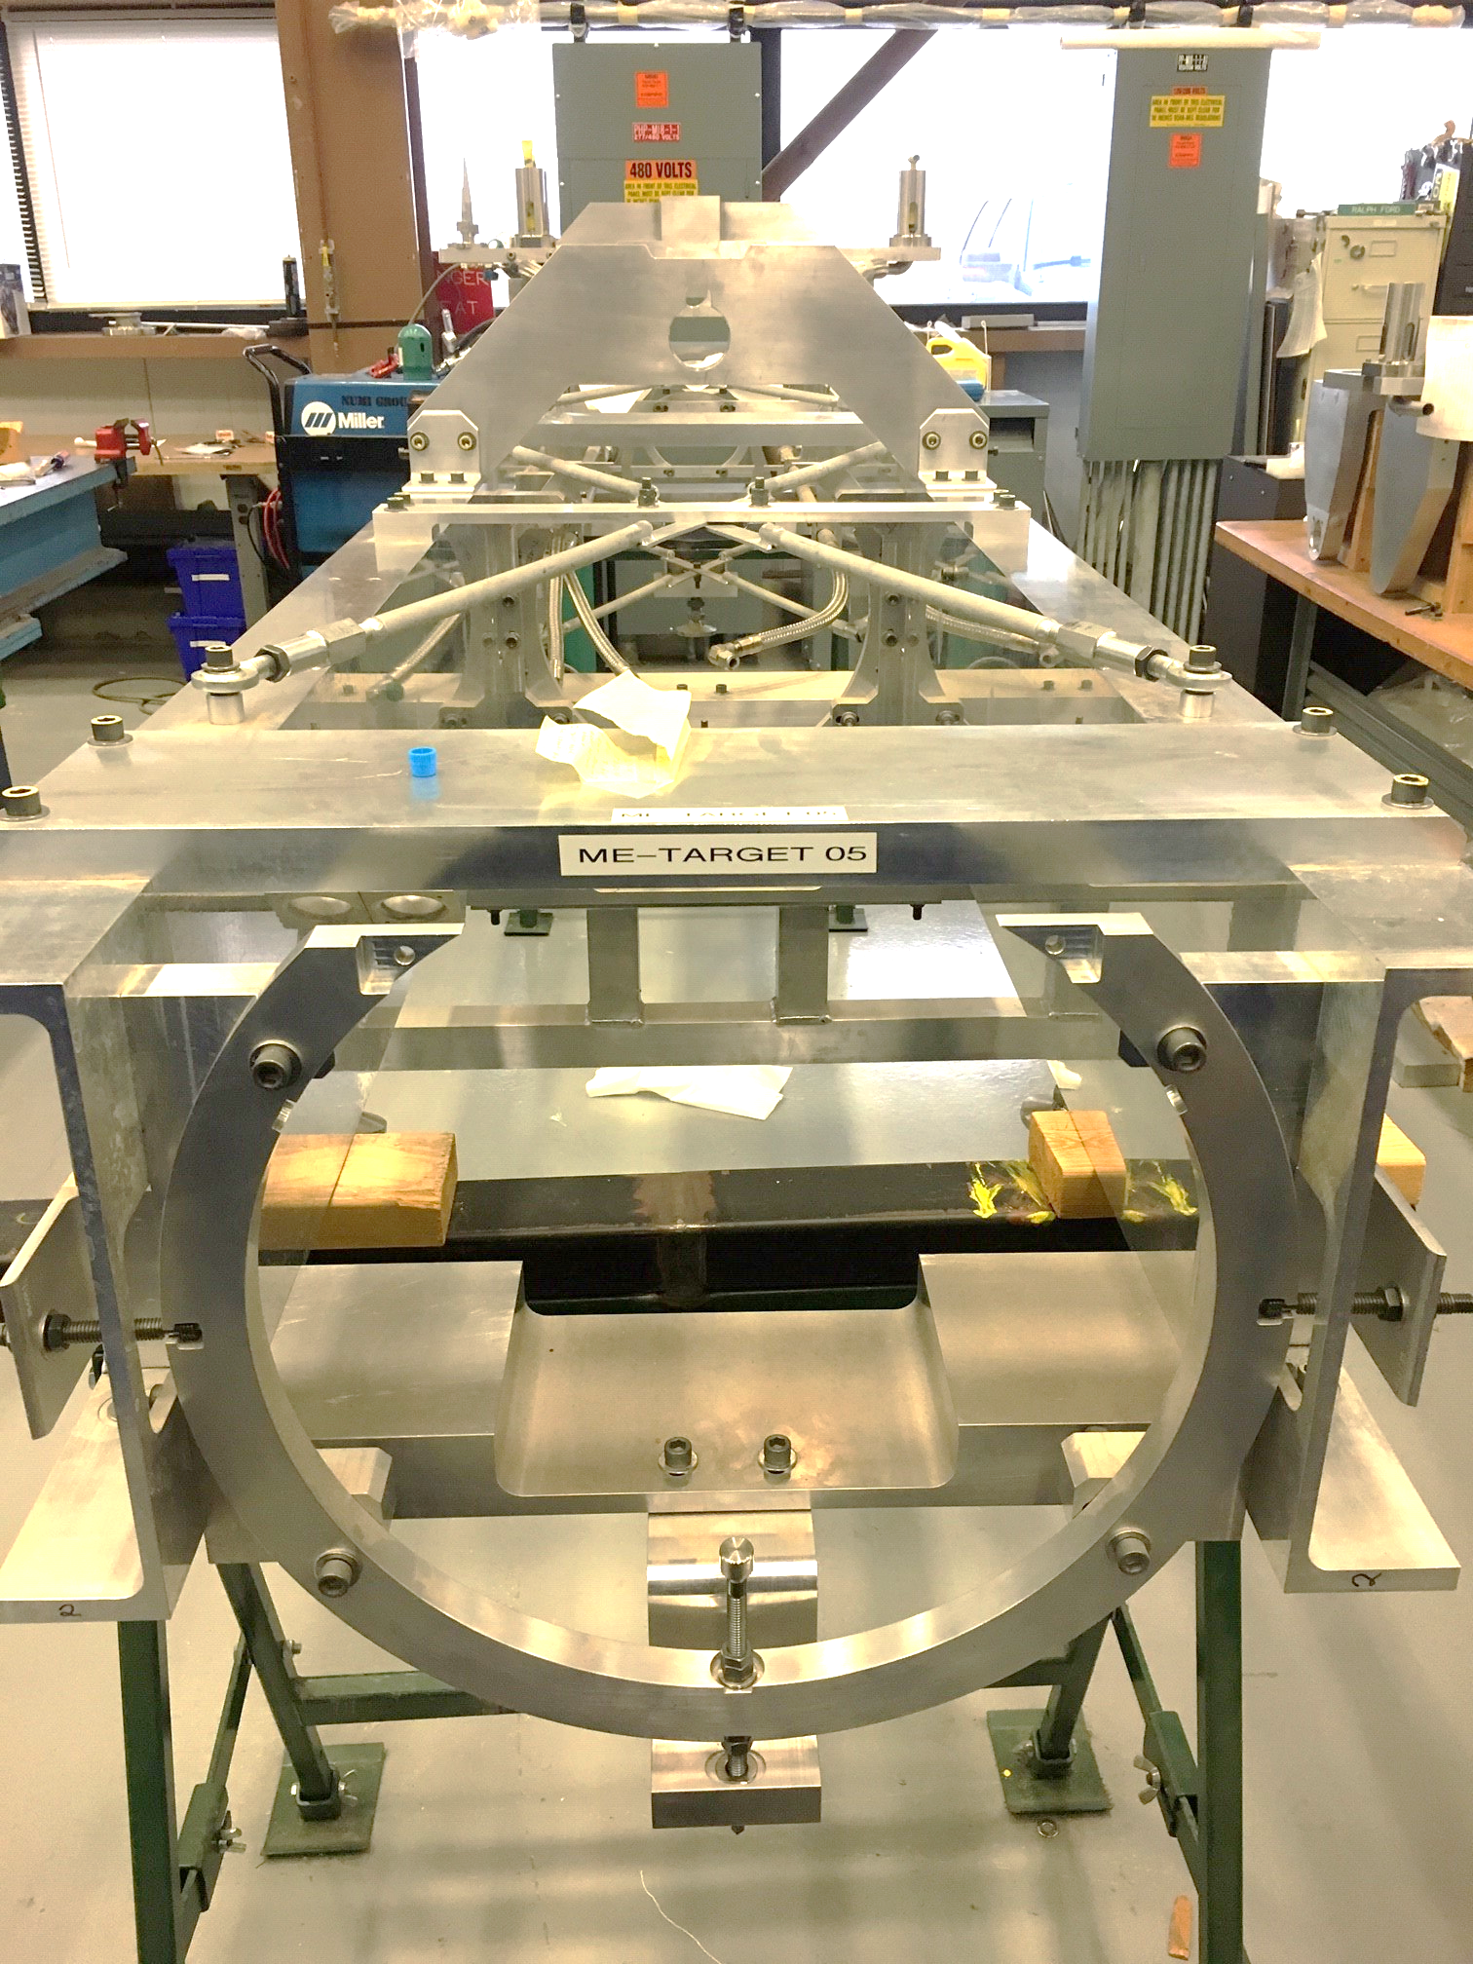
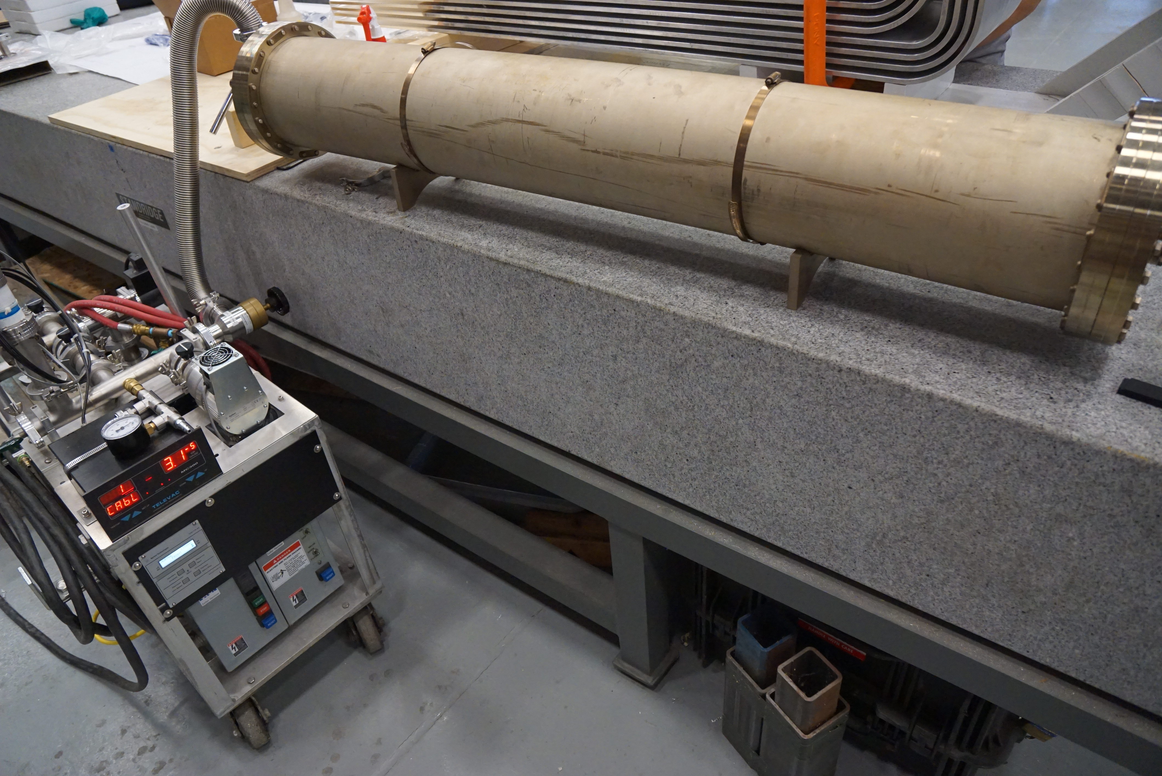
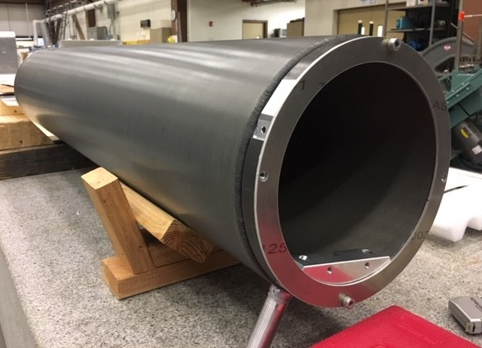
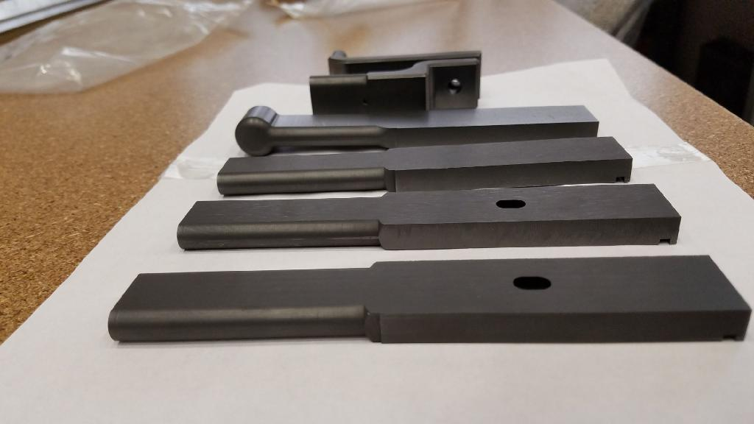
1a). 1 MW Target (A1901.02.02 / Kavin Ammigan)
Redesigned the target core fins and baffle per increased beam spot size
Design & FEA completed | Fabrication status | Plans for next quarter
Addition of U.S. winged fins provide protection per mis-steered beam Extensive FEA performed Additional cooling to DS Be window (next slide) | Target canister and carrier are ready Baffle on hand Bake graphite fins in vacuum oven | Inspect baffle straightness Start assembling process in late April

Slide 13
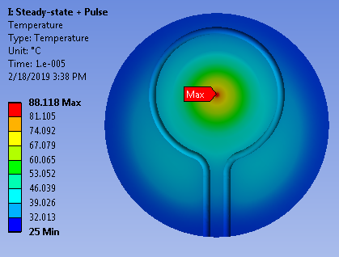
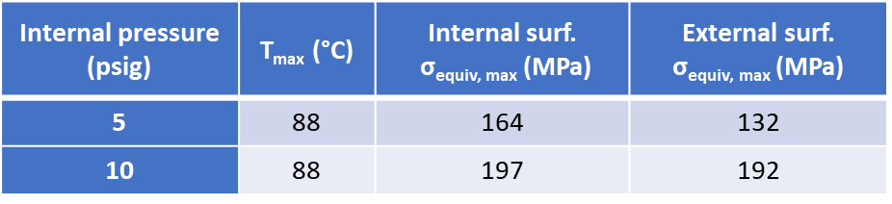
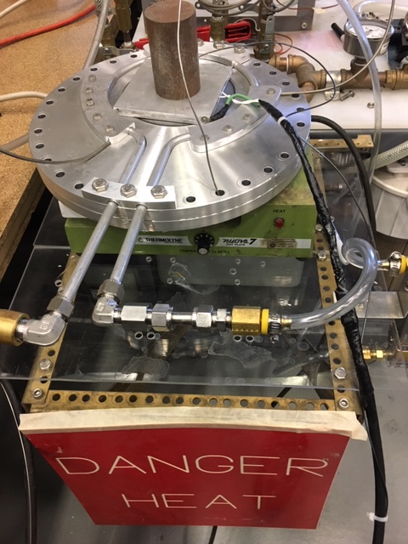
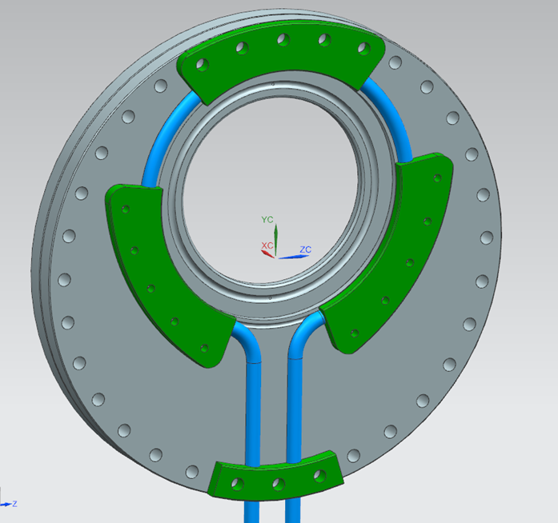
1b). Target DS Beryllium Window (A1901.02.02 / Kavin Ammigan & Cory Crowley)
FEA results indicated D.S Be window temperatures and stresses were higher than originally envisioned and were marginal to the material allowable strength
Additional cooling loop was designed and tested.
With cooling loop:
Fabrication is not an issue, Loop fitment is good
Temperature measurements, average heat transfer coefficient from 3 tests: 2550 W/m².C
Cooling loop does not require additional target RAW skid revisions.
Effectively reduces maximum window temperature and stresses to within acceptable limits.
Modification to real window and water line revisions to Target assembly started
Can be accommodated in overall target schedule
C. Crowley

Slide 14
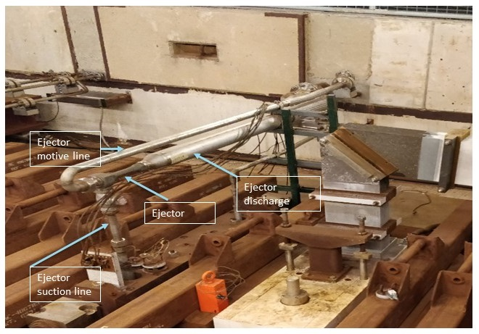
2). Target & Horn 1 RAW System Upgrade (A1901.04.01 / Dez)
Upgrade RAW pumps, heat exchangers, piping and instrumentation, to handle extra cooling required
  Heat exchangers, centrifugal pumps, valves and instrumentation parts are on hands
  PO for Horn 1 RAW ejector pump and piping are complete
  Pipefitter T&M requisitions were approved – two jobs
Modifications in RAW room
Piping modifications in Target Hall

Slide 15
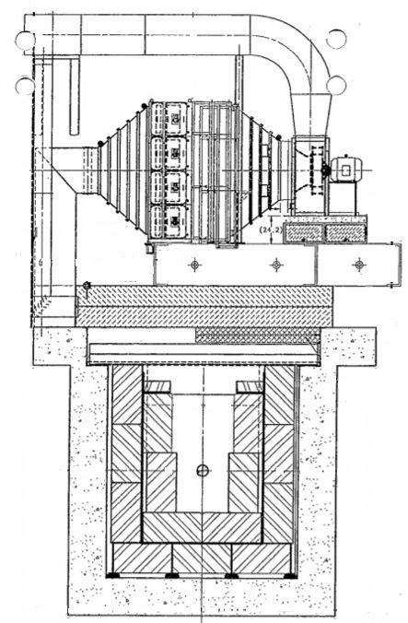
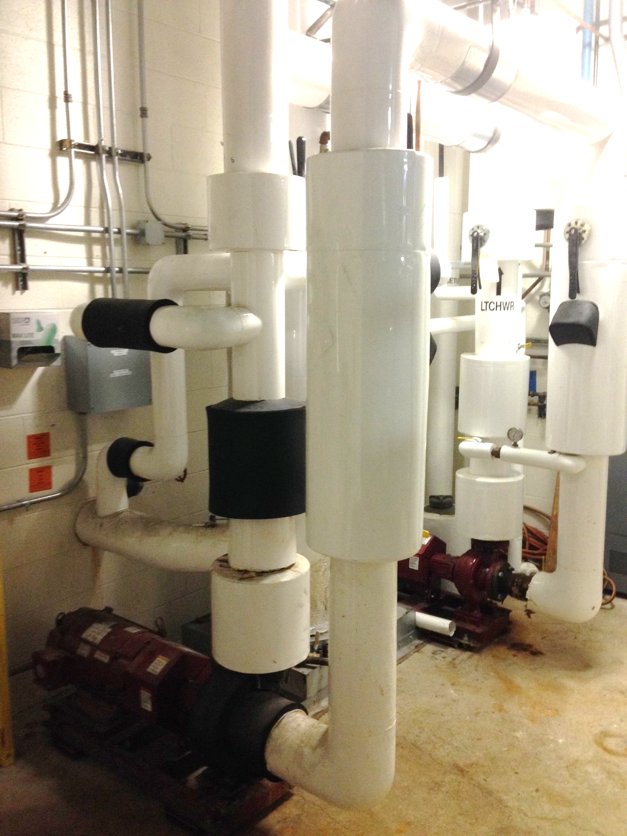
3). Target Chase Cooling & Air (A1901.04.02 /Lee Hammond & Cory Crowley)
Upgrade pumps, add 3 cooling coils to the target chase cooling circuit
  POs for pump and cooling coilscomplete
  Pipefitter T&M requisitions were approved -- two jobs
New coils to be inserted
Existing piping of 3-sets of cooling coils
Air
Pump to be replaced
Target chase

Slide 16
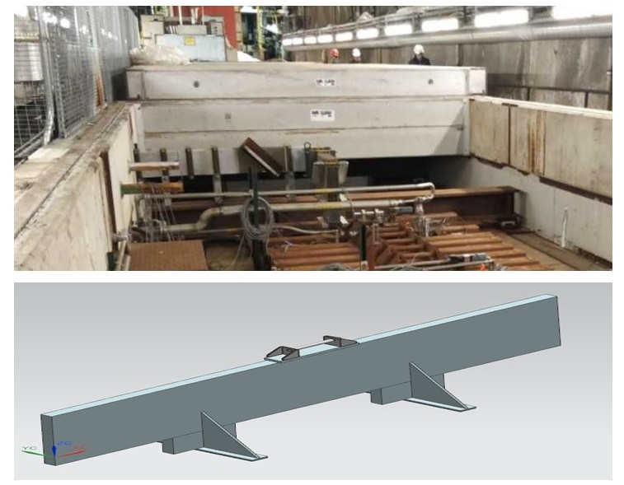
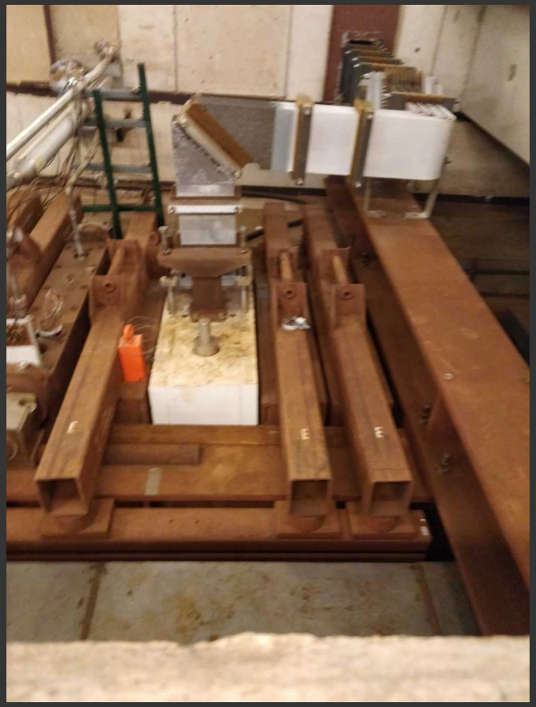
4). Target Chase Supplemental Shielding (A1901.04.03 / Joe Angelo)
Increases in residual radiation due to higher beam power will significantly increase the cool-down time needed before maintenance or changeout activities can start
  Supplemental shielding for Horn 2 stripline block
  Shield curtain between the steel shield pile and the concrete cap downstream of Horn 1
Procurement complete, delivery date May 1st

Slide 17
Status of Rest Tasks (not Tied to 2019 Summer Shutdown)
Major activities: review preliminary design, finalize design and generate drawing package
# | Tasks | Activities | Complete %
5 | 1 MW horn 1 5a) Horn 1 conductors PH1-05 ready and tested 5b) Horn 1 stripline | Wind tunnel test | 100%
 |  | FEA of conductors & stripline | 100%
 |  | Stripline fabrication | 60%
 |  | Air diverter fabrication | 90%
6 | Stripline air diverter T-block | Design and drawing package | 60%
7 | Target & Horn 1 module drive mechanism | Design and drawing package | 50%
8 | Hadron beam monitor & absorber | R&D, prototyping | 70%
 |  | Design | 30%
9 | MARS modelling | Additional information provided, re-run
10 | Pre-target window | Spare fabrication | 40%
11 | Decay pipe window | Test welding gets started
12 | Tritium mitigation | Redefine scope due to recent new findings
Next a few slides will cover these tasks with more technical details

Slide 18
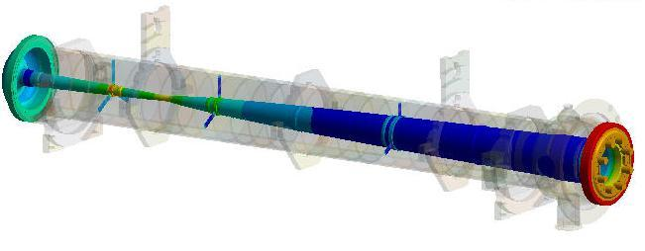
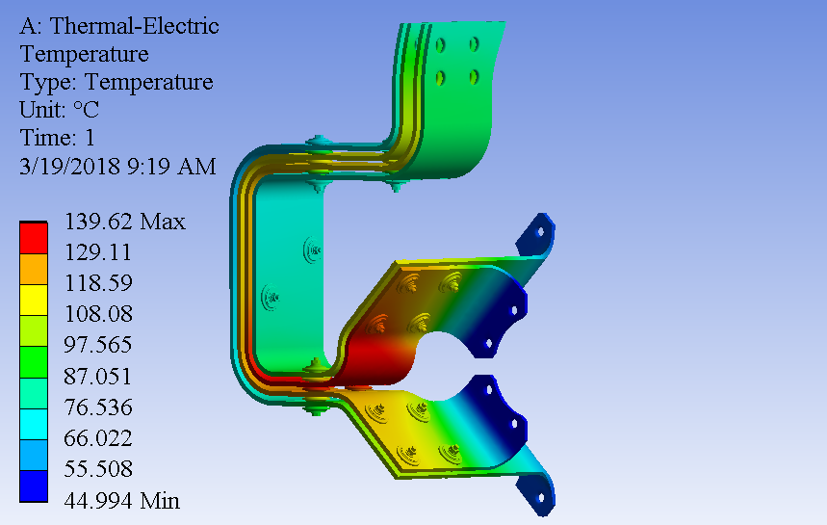
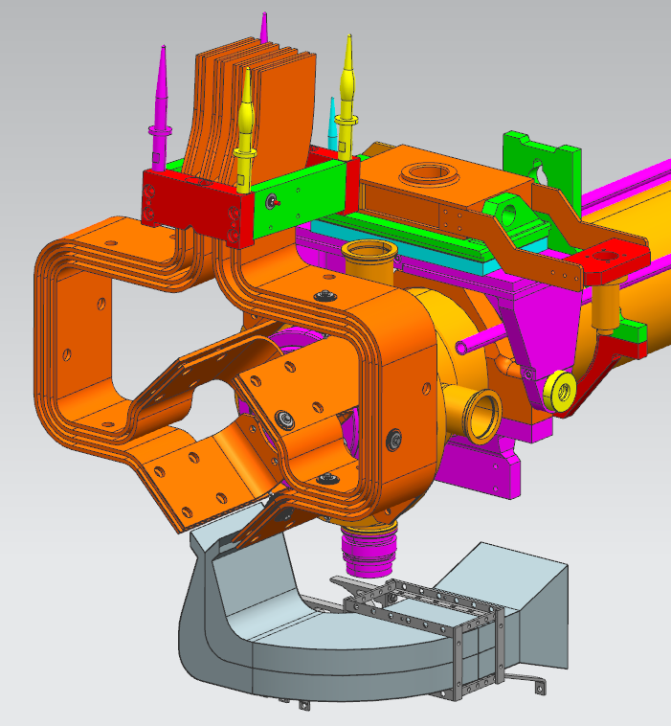
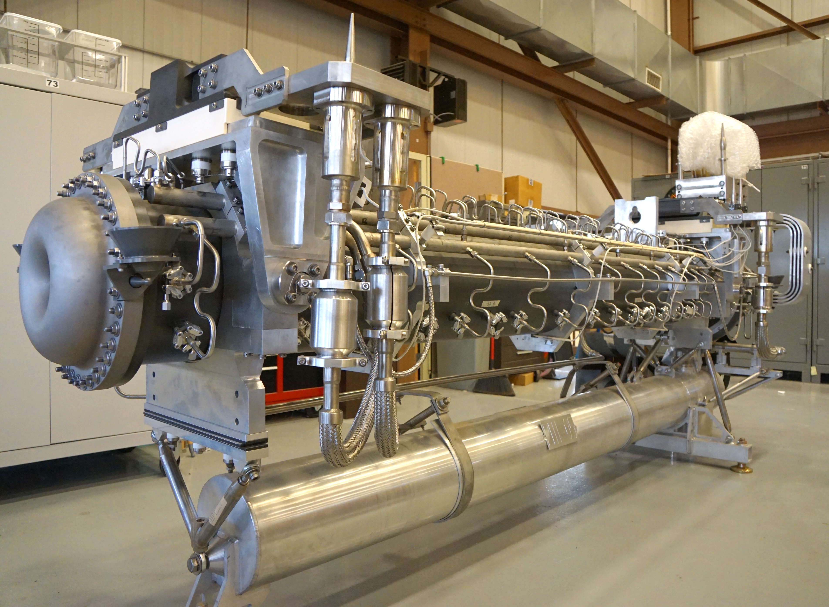
5). Horn 1 Conductors & Stripline (A1901.03.01 / Cory Crowley)
Design & FEA completed | Fabrication status | Plans for next quarter
Cooling improvement to Horn 1 inner conductor (RAW upgrade) Design improvements to stripline (w/ air diverter) Wind tunnel test Extensive FEA | PH1-05 ready and tested Stripline fabrication 50% Air diverter fabrication 90% | Continue stripline fabrication Test air diverter with Horn 1

Slide 19
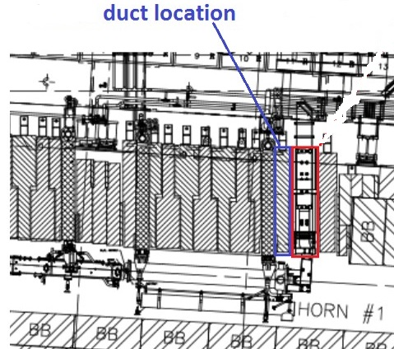
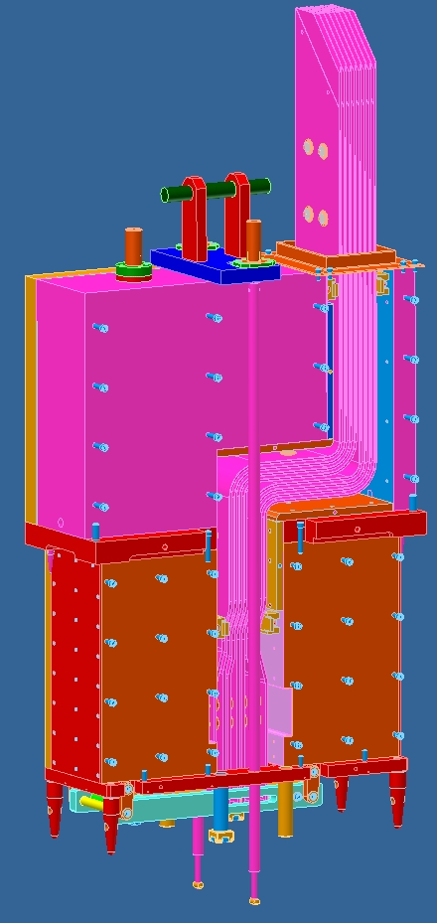
6). Stripline Air Diverter T-block (A1901.03.02 / Cory Crowley)
Dedicated air cooling to upper end of Horn 1 electrical bus stripline
through an adjacent shielding block with new air supply installation through battlement
Design and drawing package 60%

Slide 20
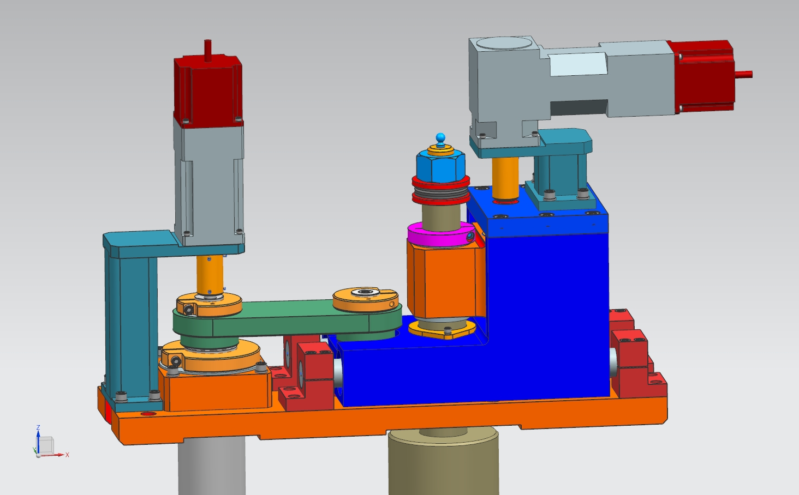
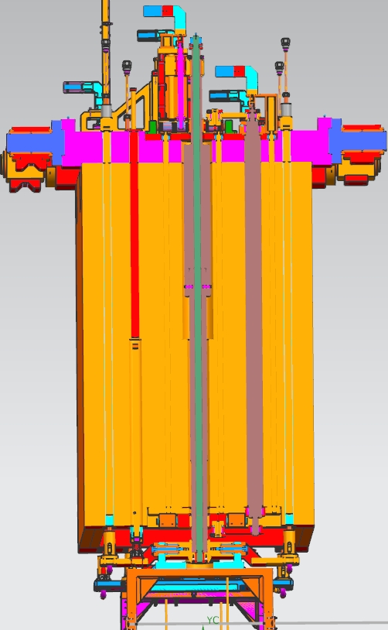
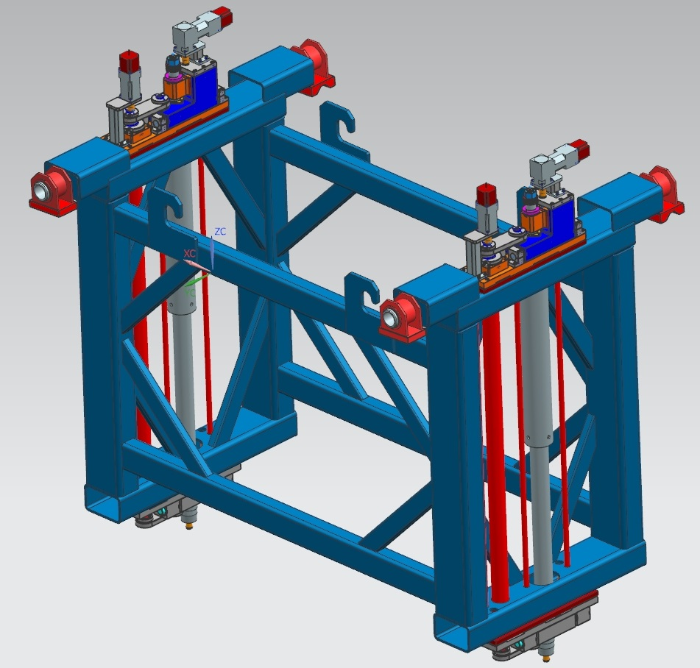
7). Target & Horn 1 Module Drive Mechanism (A1901.03.03 /Vladimir Sidorov)
Module are corroded, motion control on Target & Horn 1 is failing
Target horizontal motion is frozen
Redesigned drives and linkages with corrosion resistant materials SS
Target module | Horn 1 module | Mock-up frame
Released in 2018 Under review | Design, simpler | Fabrication at MAB
Upper drive sub-asm
Modifications:
Graphalloy bushings and washers
More powerful motors with stainless steel gear box
Al anodized bushings in lower linear block
Transverse link shaft design
Vertical shaft support block
Modules | Vertical motion | Horizontal motion
Target | +8 mm to -200 mm | +/- 8mm
Horn 1 | +/- 3 mm | +/- 3 mm
Lower drive sub-asm

Slide 21
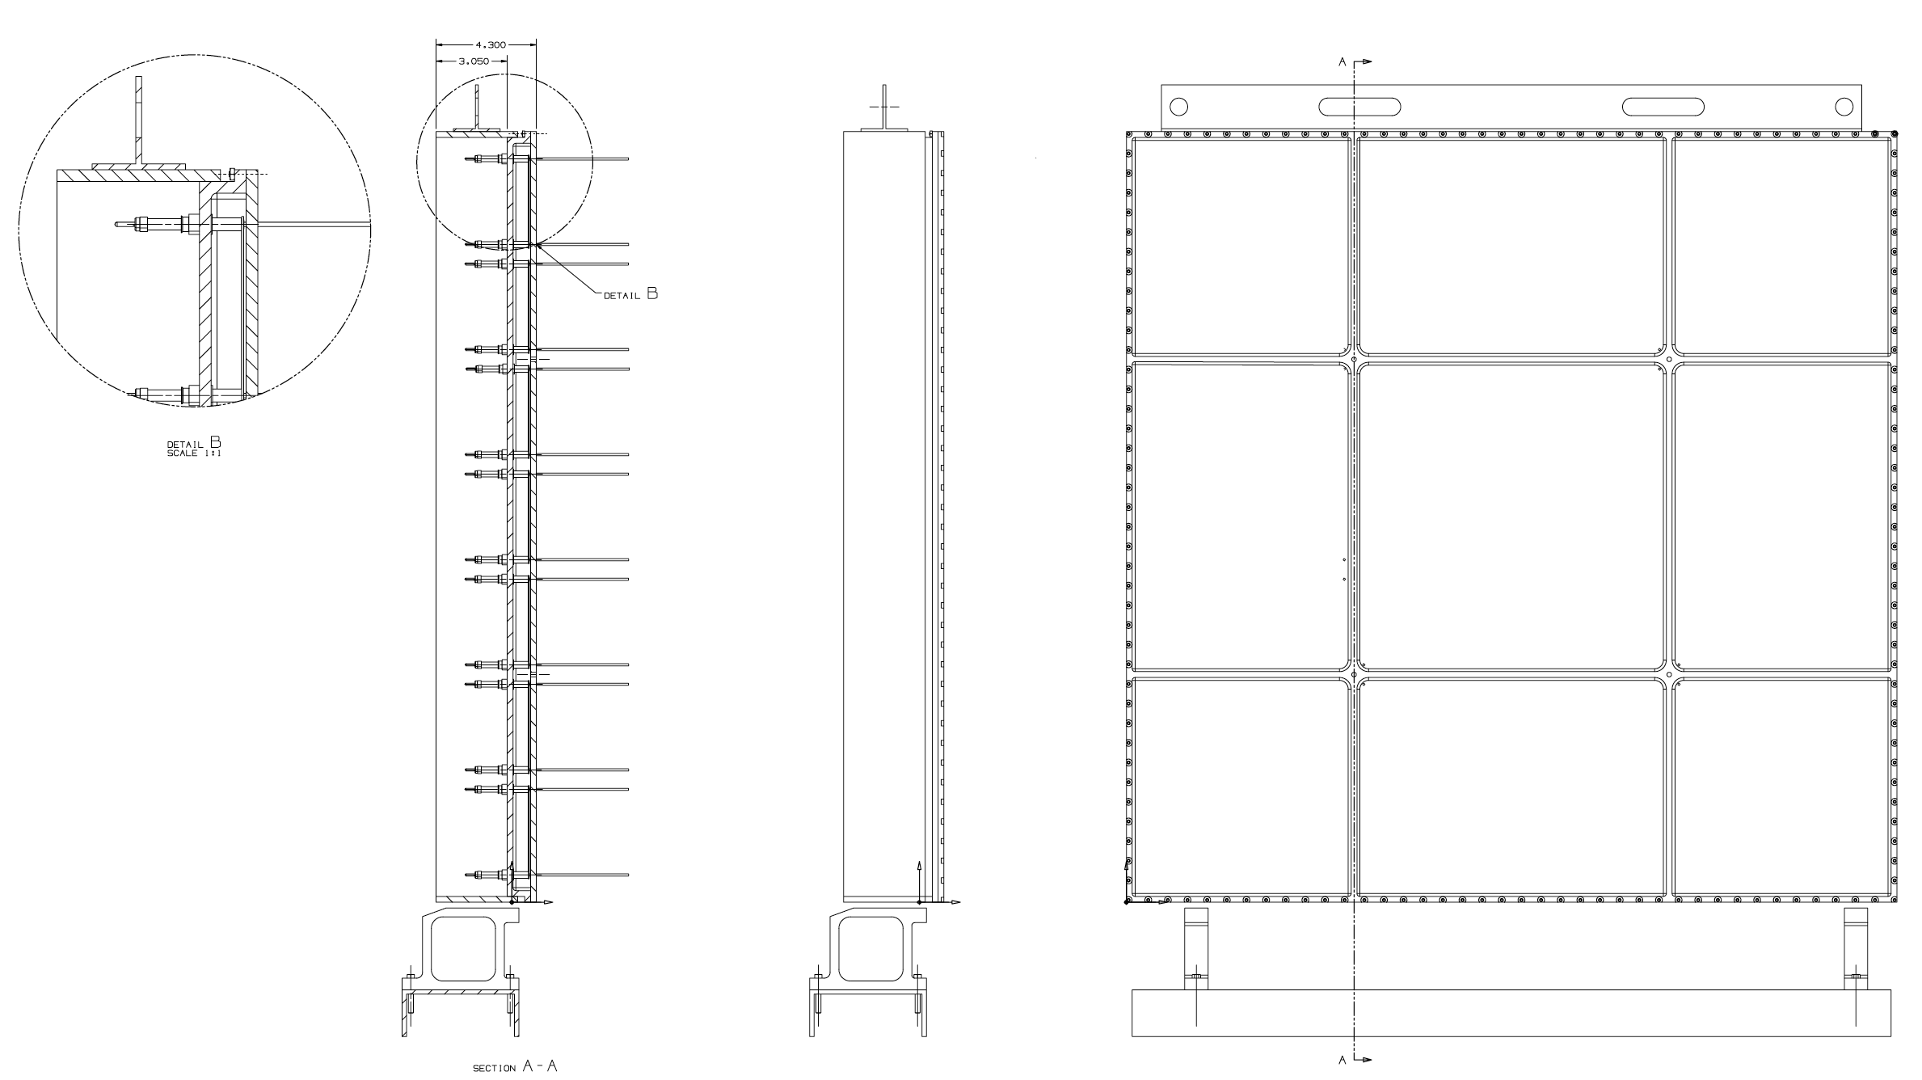
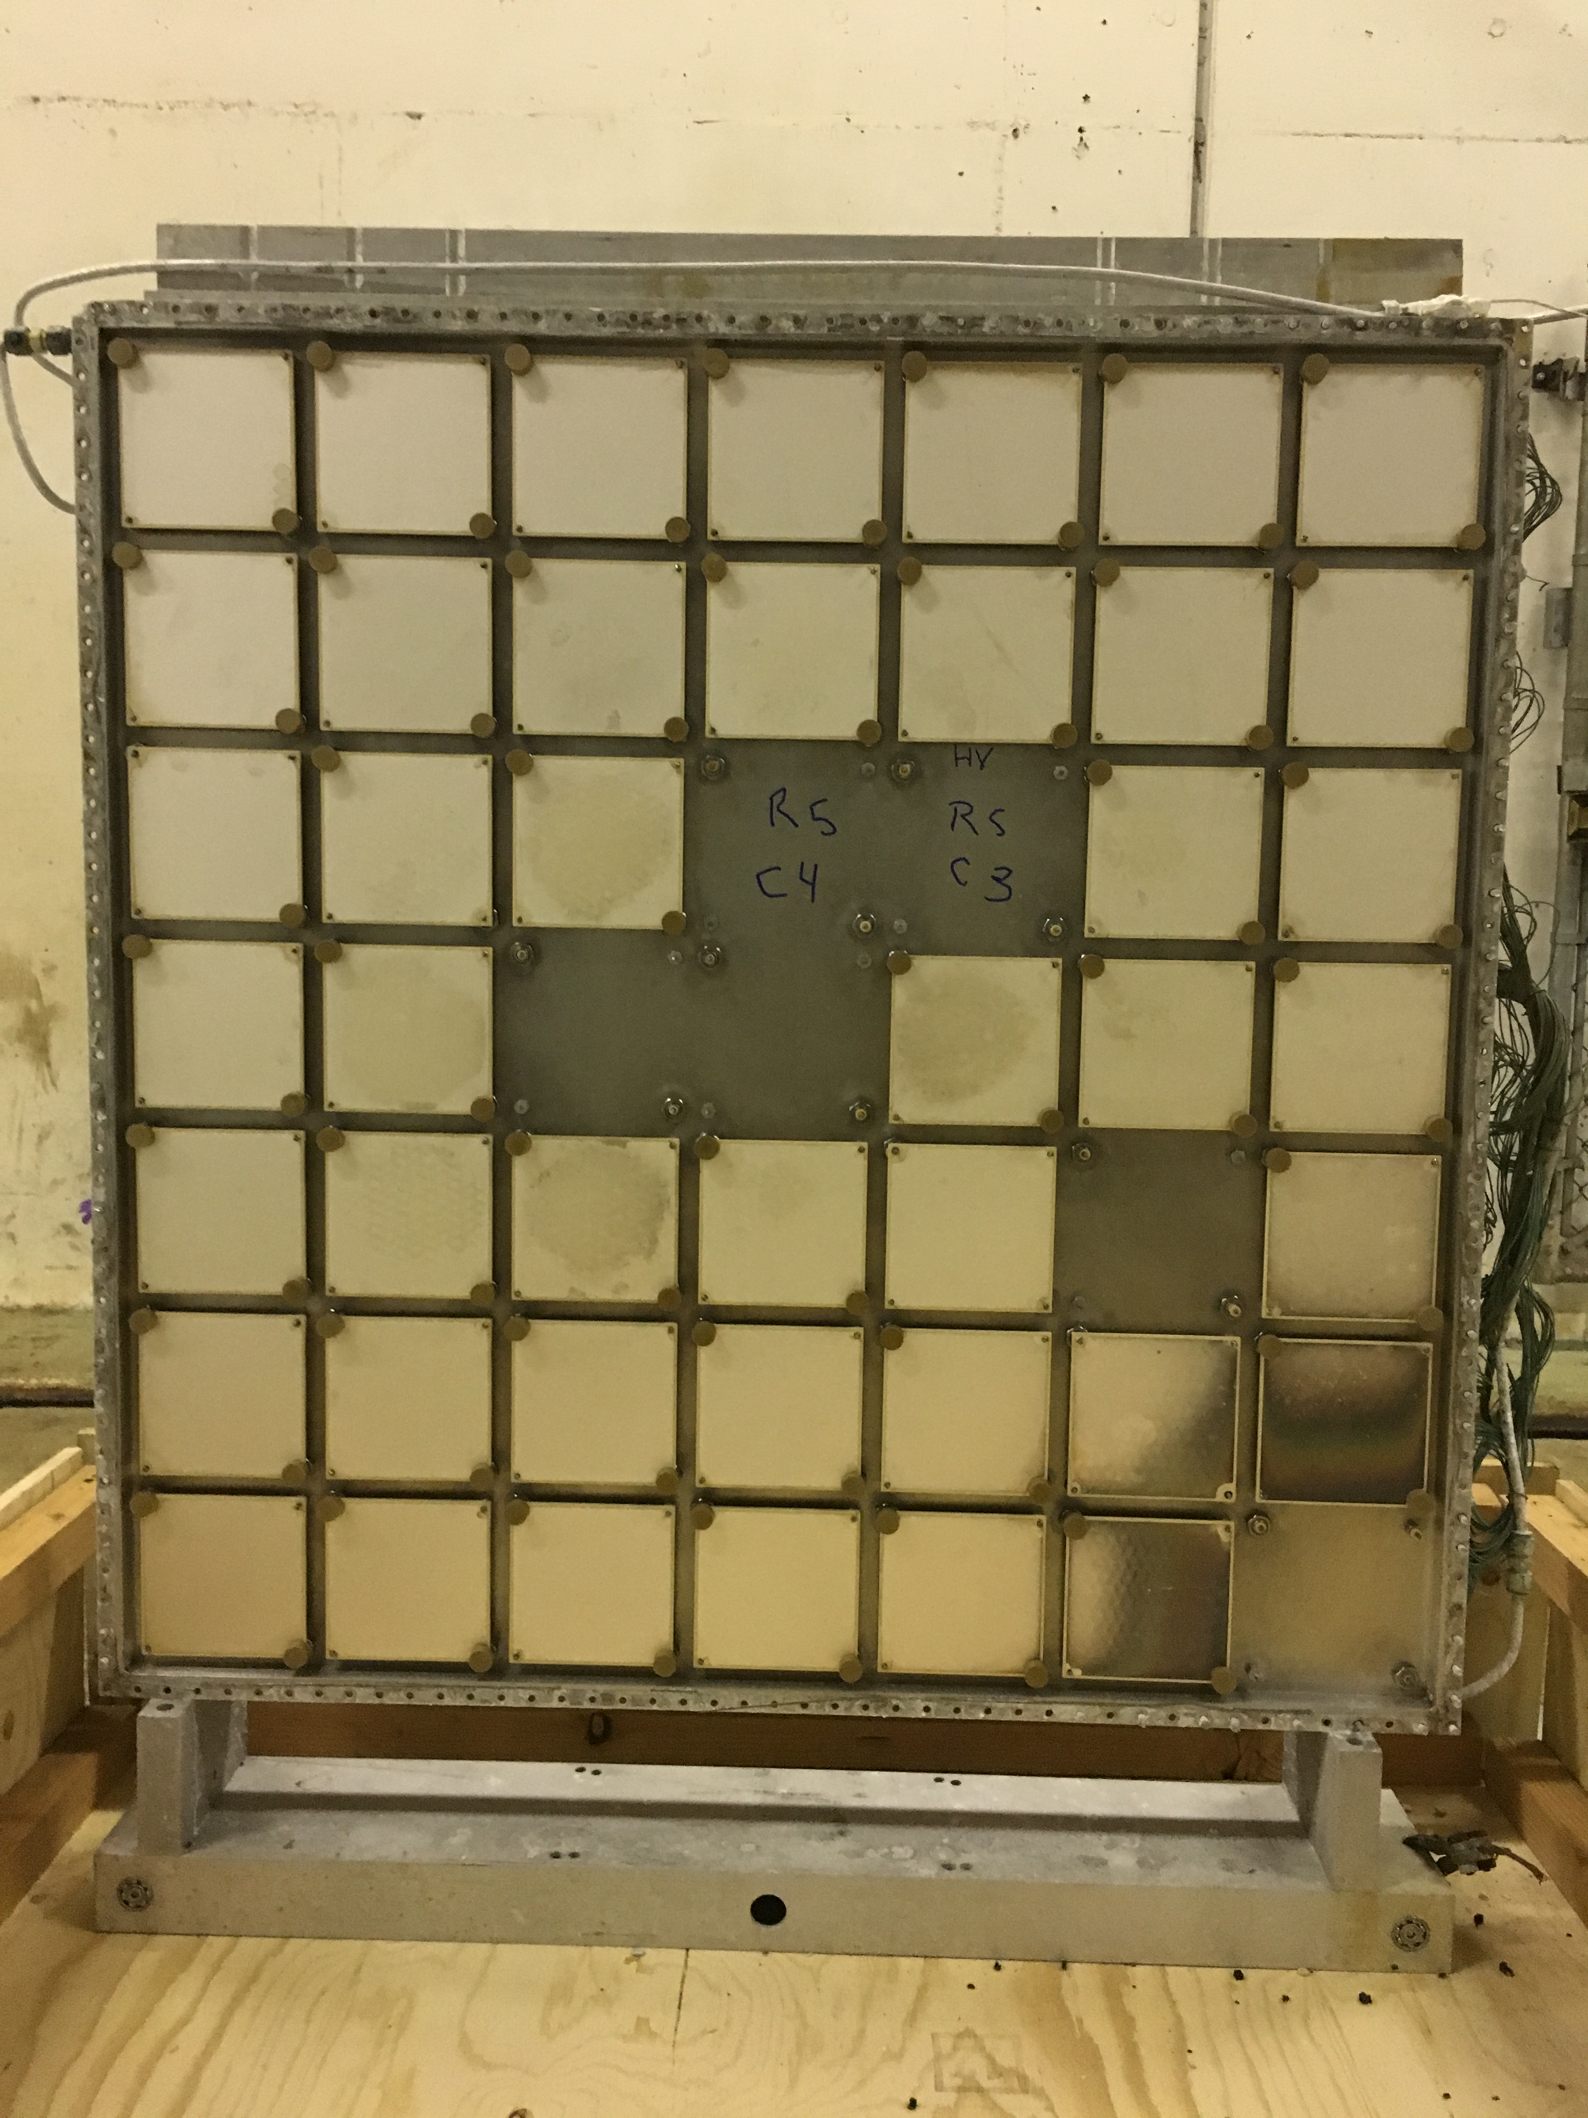
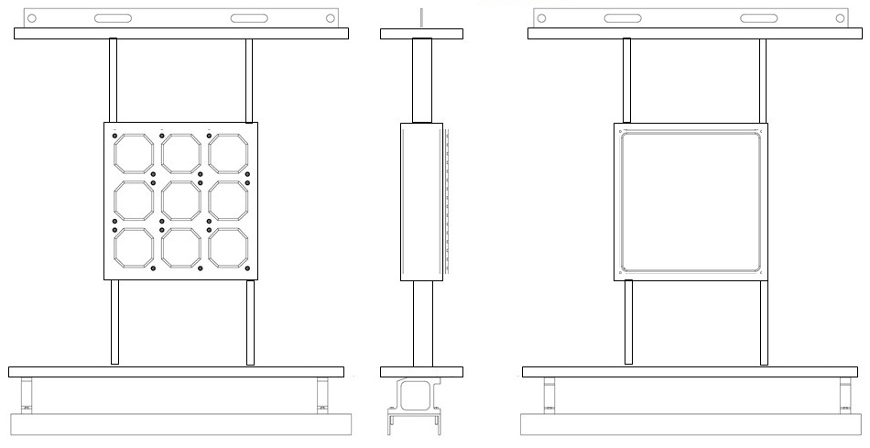
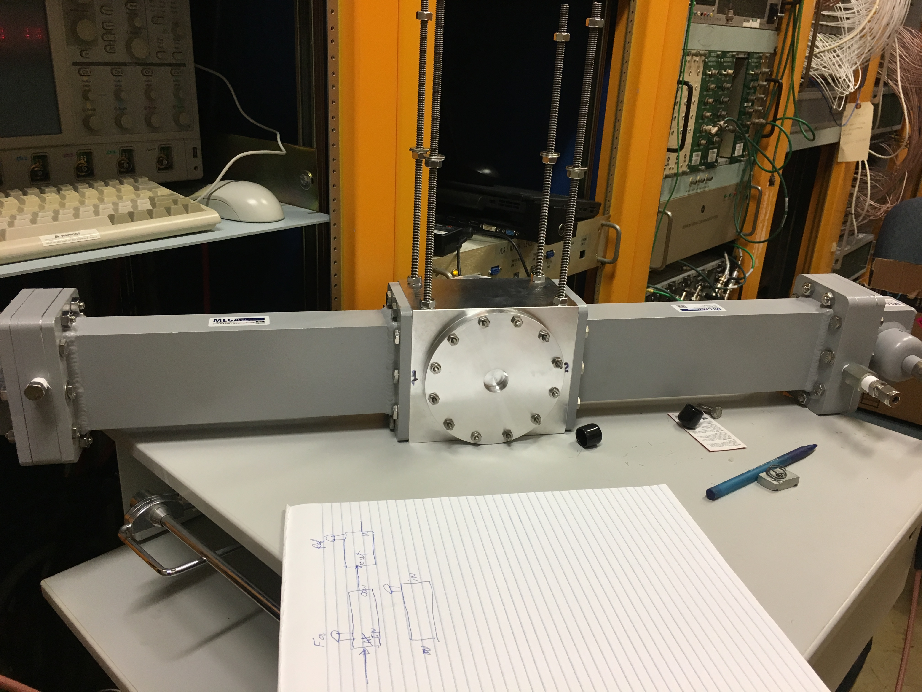
8) Hadron Beam Monitor (A1901.06.01 / Katsuya Yonehara)
Experiencing pixel failure from radiation damage
Inspected 1st and 2nd retired hadron beam monitors
  Performed dimensional measurements and reproduce drawings
Design simplified robust hadron monitor (3x3 array) with radiation hard materials
  Seeking collaboration with U. of Texas
R&D alternative detectors
    RF detector
    SEM
RF detector

Slide 22
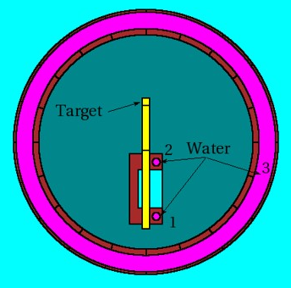
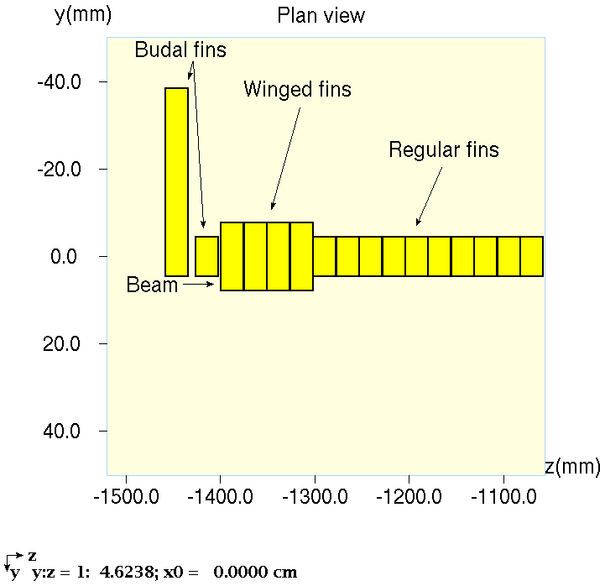
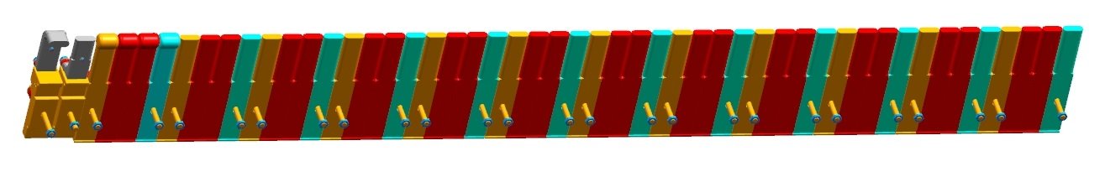
9). MARS Simulations (A1901.06.02 / Igor Rakhno)
Calculated distributions of star density, hadron flux, prompt and residual dose, and energy deposition for:
  Target chase
  Decay pipe
  Absorber Hall and Muon Alcoves
Shielding and environmental assessments
Preliminary FEA thermal and structural analysis
The following information were provided for MARS model updates:​
New target core changes with winged fins placed upstream
Target DS window cooling loop
Decay pipe repair patch
MARS re-run for:
Target DS Be window​
Decay pipe window
Hadron absorber
Normal operation, and ​accident condition with a 6mm beam offset.
Winged fins

Slide 23
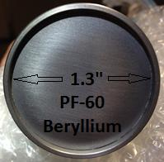
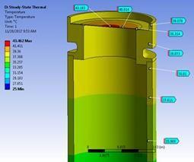
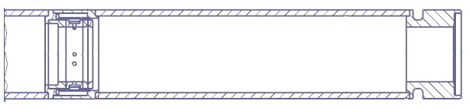
10) Pre-target Vacuum Pipe (A1901.02.01 / George Lolov)
Pre-target vacuum pipe with improved Beryllium window was installed in summer 2018
Pre-target Be window
  Slightly domed and thicker
  Improved brazing joint design
  Thermal-structural analysis
Fabrication of pre-target vacuum pipe spares (qty. 3)
80% parts on hand
EB-welding
Assembly welding

Slide 24
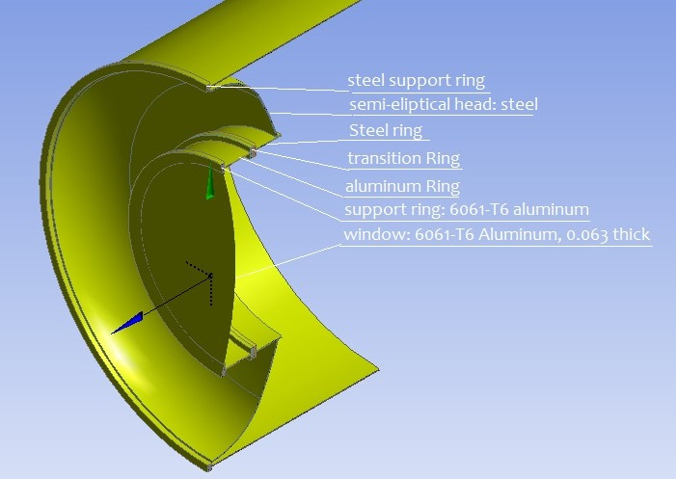





11) Decay Pipe Window (A1901.05.01 / Mike Campbell)
Evaluation and possible solutions in event window needs to be replaced
  Preliminary FEA analysis
  Weld repair patch (Al 5086 or 5052) over failed section (Al 6061)
  Repair mechanism concept developed
Suspected corrosion was found on the window at beam spot center in 2007
(heat or corrosion?)
Weld testing (Robot laser ablation welding)
  Material selection (Al 5052, Al 5086, with Al 6061)
  Samples, welding, testing & characterize properties
MARS and FEA with new parameters and beam accident conditions

Slide 25

12) Tritium Mitigation (A1901.04.04 / Keith Gollwitzer)
Tritium is nearly all produced by spallation in the shielding, increases exponently with beam power
  Baseline scope: extend chimney stack for an improved evaporative disbursement
  Recent measurements:
    spikes in sewer higher than expected after rain
    under investigation
  Intend to redefine the task scope in collaboration with Tritium Task Force

Slide 26
Summary
Most tasks are on schedule
  1 MW target fabrication, requires alignments during shutdown time, but it is scheduled to be installed in the last week of summer shutdown.
  Schedule & quality control (George Lolov):
  https://web.fnal.gov/project/TargetSystems/Devices/MET-05/
  DS Be window additional cooling is an extra activity In Target Core A1901.02.02, it is addressed and on schedule
Next quarter will be busy – preparing for summer shutdown

