Slide 1

Fully integrated quantum computing SOC in 22nm FD-SOI
Dirk Leipold (1), Hannes Leipold (3), Lutz Leipold (1), Elena Blokhina (2), Panagiotis Giounanlis (2), Krzysztof Pomorski (2), Robert Staszewski (2), Imran Bashir (1), George Maxim (1), Mike Asker (1), Cagri Cetintepe (2), Ali Esmailiyan, Hongying Wang (2), Teerachot Siriburanon (2)
Equal1.labs, Inc. Fremont CA, USA www.equal1.com
University College Dublin, Ireland
University of Southern California, USA
International Workshop on Cryogenic Electronics for quantum Systems, Fermilab June 19, 2019

Slide 2

Team is based out of Silicon Valley & Dublin, Ireland
Dublin, Ireland
Bogdan Staszewski - CSO
Cagri Cetintepe - SOC integration
Panagiotis Giounanlis – Q-modeling
Elena Blokhina – Physical-modeling
Krzysztof Pomorski - Cryogenic Design
Teerachot Siriburanon - SOC Design
Hongying Wang – SOC Design
Ali Esmailiyan – SOC Design
Silicon Valley
Dirk Leipold - CEO
George Maxim - CTO
Mike Asker - CIO
Imran Bashir – SOC Design
International Workshop on Cryogenic Electronics for quantum Systems, Fermilab June 19, 2019

Slide 3
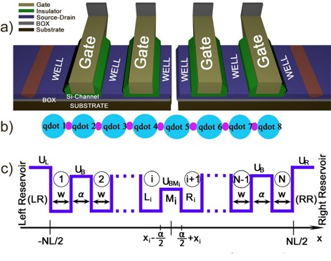
Silicon based charge qubit based approach with spin twist
Localized electron
Occupancy (Rabi)
Oscillations
Localized electron
© 2019 Equal 1 Inc.
International Workshop on Cryogenic Electronics for quantum Systems, Fermilab June 19, 2019

Slide 4
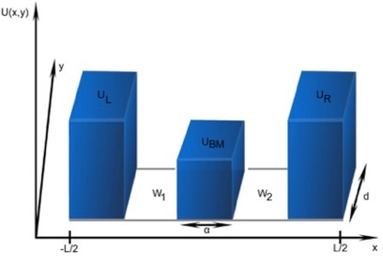
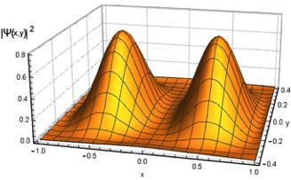
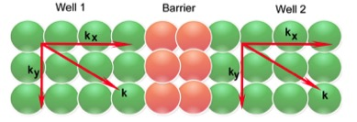
WKB Schrodinger formalism: Chord line 3D to 1D reduction
2D Problem: Potential Function
2D (Time-Independent) Equation:
2D Wave-Function:
1D (Time-Independent) Equation:
Displacement of the Wave-Function
1D Reduction:
International Workshop on Cryogenic Electronics for quantum Systems, Fermilab June 19, 2019

Slide 5
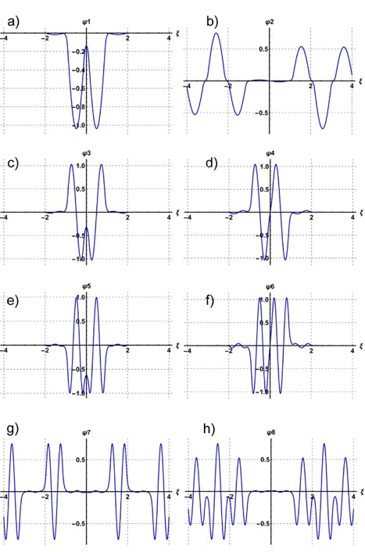
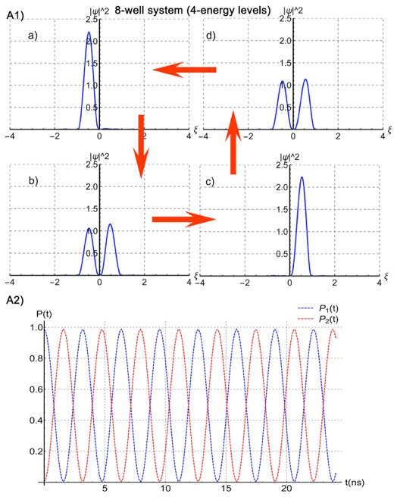
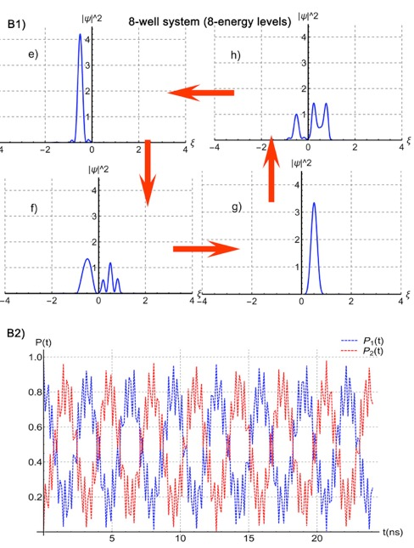
Schrodinger formalism: analysis of 8-well system
Eigen-functions:
Occupancy (Rabi) Oscillations:
Occupancy (Rabi) Oscillations if more energy levels are involved:
Pairs of eigenfunction show energy level splitting in magnetic field -> spin correctly captured and can be used
Because charge domain switching can be performed with 20-50 psec time constant short coherence times are acceptable
Magnetic field can be generated by slow resonate RF filed (10 MHz in macro resonator structure (cryostat)
© 2019 Equal 1 Inc.
International Workshop on Cryogenic Electronics for quantum Systems, Fermilab June 19, 2019

Slide 6
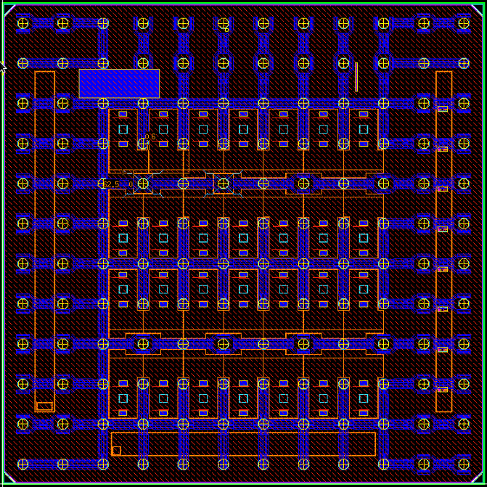
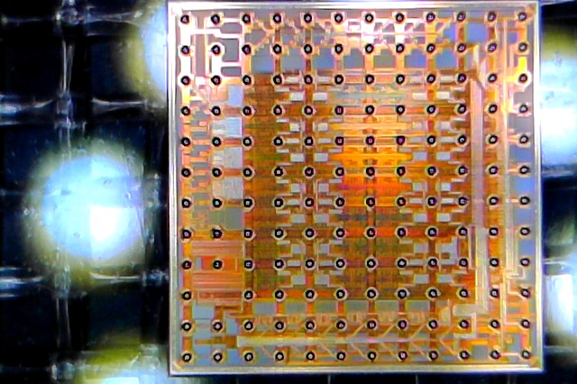
Quantum computing SOC die photogragh
Layout view
Die Photograph
Digital pattern memory
Device characterization module
1 core
400 Mbyte/sec 8+2 bit interface
Analog IO interface
28 test cells
Analog
International Workshop on Cryogenic Electronics for quantum Systems, Fermilab June 19, 2019

Slide 7
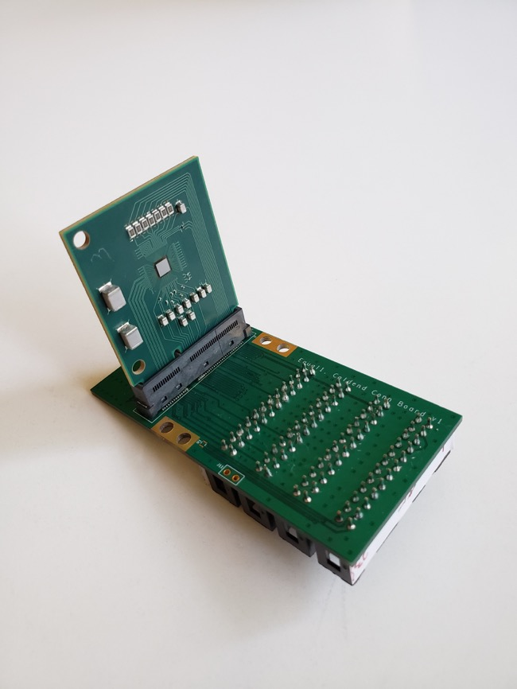
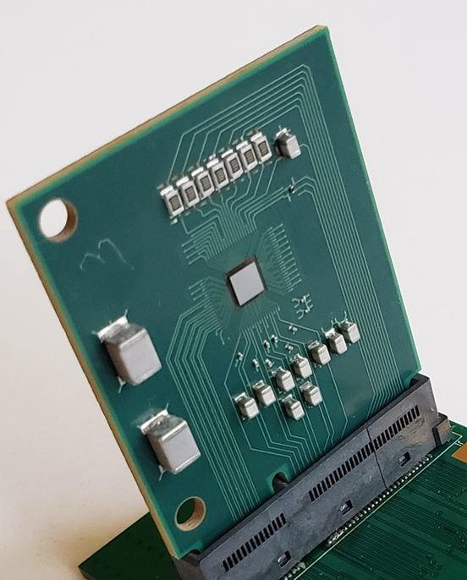
Equal1 QPU SoC daughter-board assembly
Equal1 22FDX QPU SoC
3x3 mm^2 QPU with 28 experimental cells
143 pin uBGA with 250um pitch
fully verified design
International Workshop on Cryogenic Electronics for quantum Systems, Fermilab June 19, 2019

Slide 8
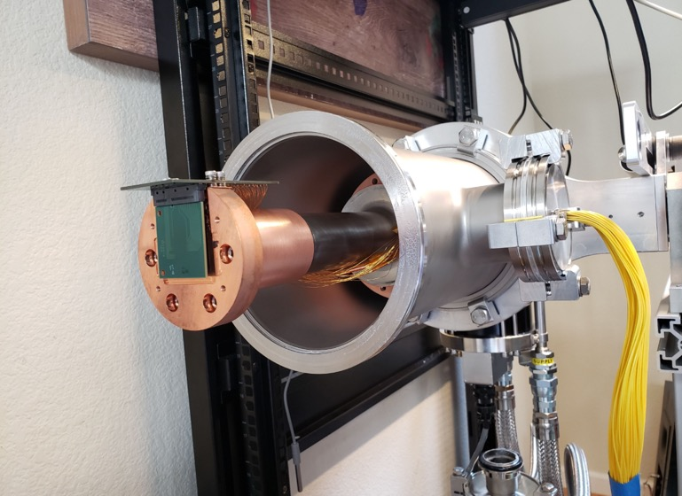
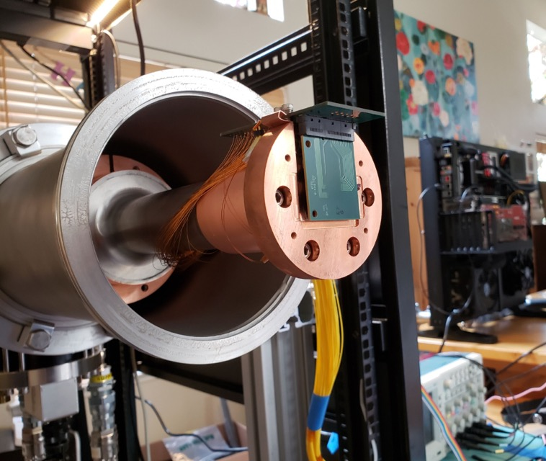
Cryo-Finger Assembly
International Workshop on Cryogenic Electronics for quantum Systems, Fermilab June 19, 2019

Slide 9
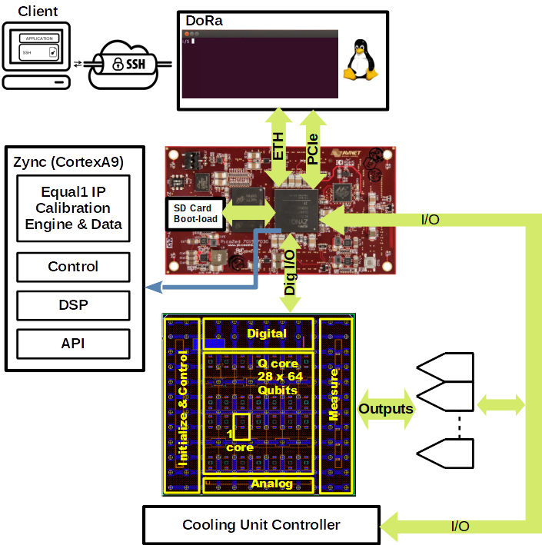
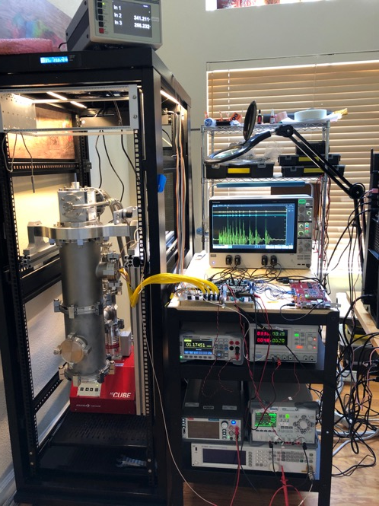
Full system integration is single 32U 19 inch rack
4K operation allow compact cryo setup with large cooling capacity
© 2019 Equal 1 Inc.
International Workshop on Cryogenic Electronics for quantum Systems, Fermilab June 19, 2019

Slide 10
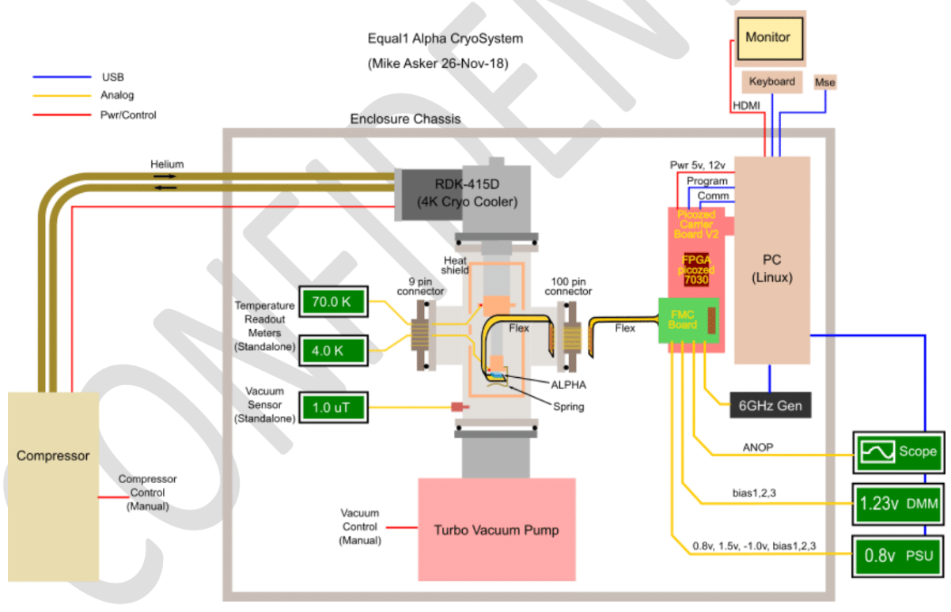
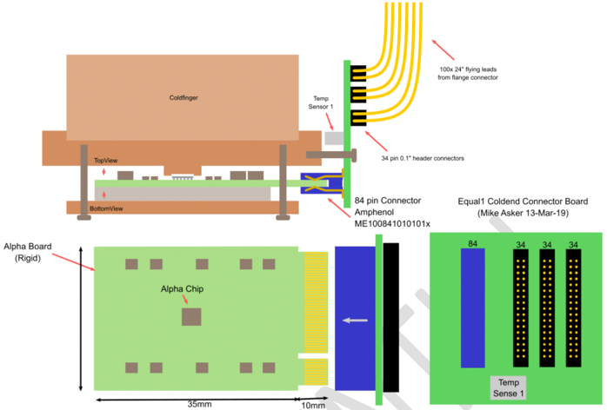
Equal1 Cryo Measurement Machine

Slide 11
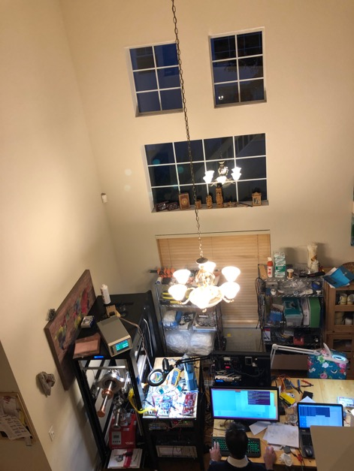
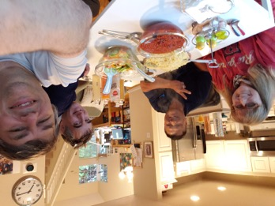

equal1.labs: all for one and one for all!
True silicon valley garage (i.e. living room) start-up operation
Culmination of 3 years successful design operation in Ireland, India and US
International Workshop on Cryogenic Electronics for quantum Systems, Fermilab June 19, 2019

Slide 12
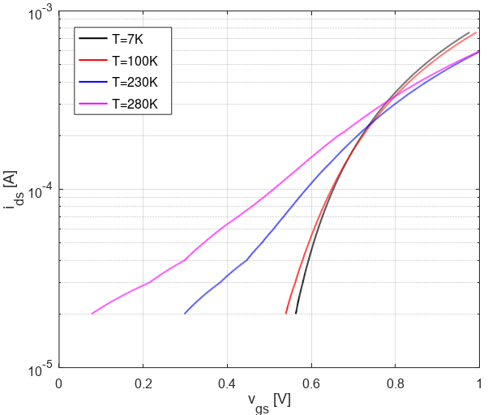
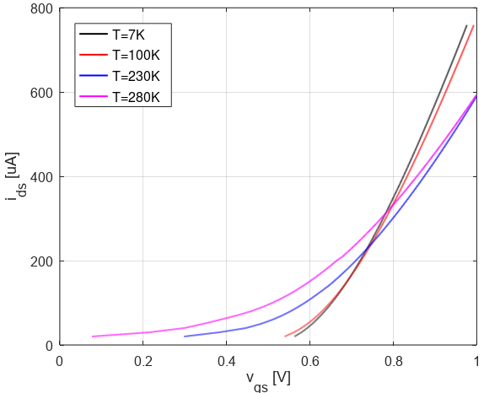
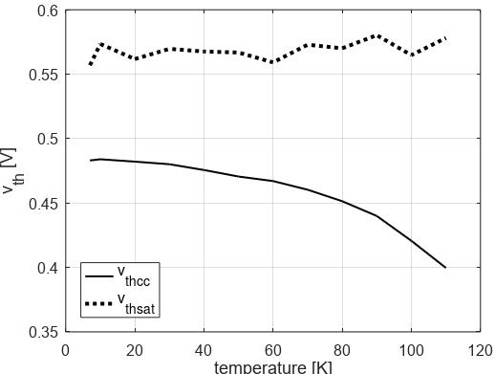
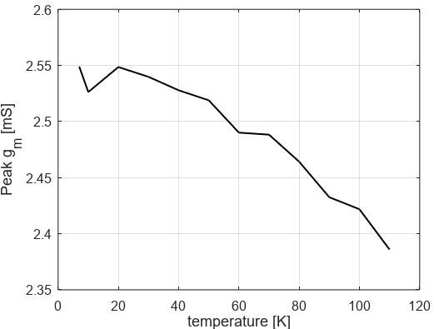
Early observations of transistor behavior
Our current setup had only one SMU so initial snapshot is based on diode connected measurements
Constant current density Vth measurement method shows 70 mV Vth shift from room temp to 5.2 K
Maximum gm quadratic region Vth extrapolation shows very little Vth shift
For most analog and digital design it makes sense to use Maximum gm Vth definition
When using subthreshold design constant current density method makes sense
For this case very little shift between 100K and 5.2K -> use 100K as fudge temp
© 2019 Equal 1 Inc.
International Workshop on Cryogenic Electronics for quantum Systems, Fermilab June 19, 2019

Slide 13
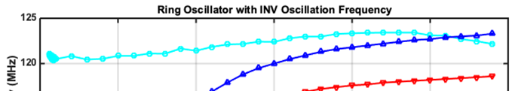
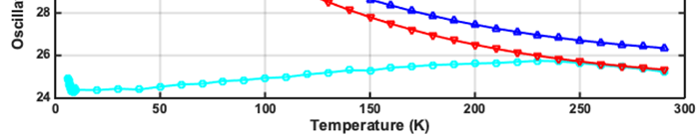
Key 22FDX Advantage for Cryogenic Electronics
3% for 285K
3% for 285K
INV NAND NOR timing have 2.5% total temperature variation from 300K to 4K !!!
22FDX experiences very small timing variation from room temperature (300K) down to cryogenic (4K) – 22FDX is very suitable for digital design at 5k
© 2019 Equal 1 Inc.
International Workshop on Cryogenic Electronics for quantum Systems, Fermilab June 19, 2019

Slide 14
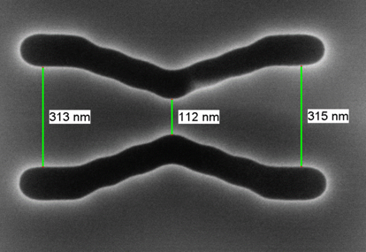
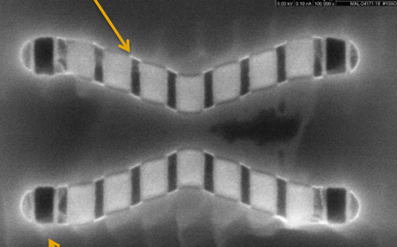
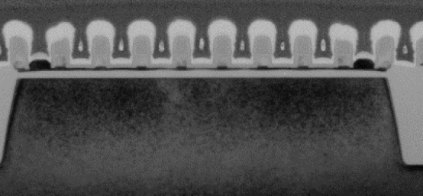
entangled quantum aperture logic 1 dimensional = equal1
TEM picture of 4 qubit equal1 structure
Structure is realized in Global Foundry 22nm FD-SOI process
Very good cooperation with GF in getting optimizing structure
5 nm Silicon film with high K gate oxide and thick gate oxide on back side allow near zero threshold voltage structure (= near zero gate oxide leakage current)
Electron injection and readout structure have 4mV per electron sensitivity
With integrated amplifier 50mV per electron output signal
Silicided gate
High k gate oxid isolation
5 nm silicon film
Thick oxid isolation
Backside gate
© 2019 Equal 1 Inc.
International Workshop on Cryogenic Electronics for quantum Systems, Fermilab June 19, 2019

Slide 15
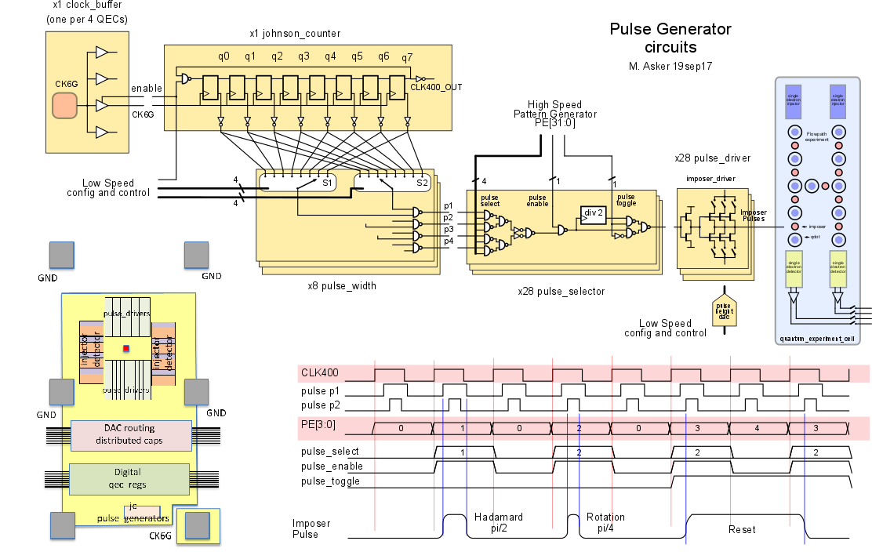
QC SOC block diagram
Key building blocks:
  On chip 1k x 64 pattern memory
    External addressable pattern sequences
    1.6 mW power dissipation at 400 MS/s with 6 GHz clock
    0.3 mm area consumption
  8 bit capacitive DAC
    50 mV swing with 0.2mV resolution with
    50 uV noise 0.1-100 MHz
    150 psec minimum pulse width
    0.9uW power dissipation
    3 x 30 um size
  100 MHz correlated double sampled detector
    4mV/e input sensitivity
    50mV/e output signal
    0.4 mV input noise 0.1-100MHz
International Workshop on Cryogenic Electronics for quantum Systems, Fermilab June 19, 2019

Slide 16
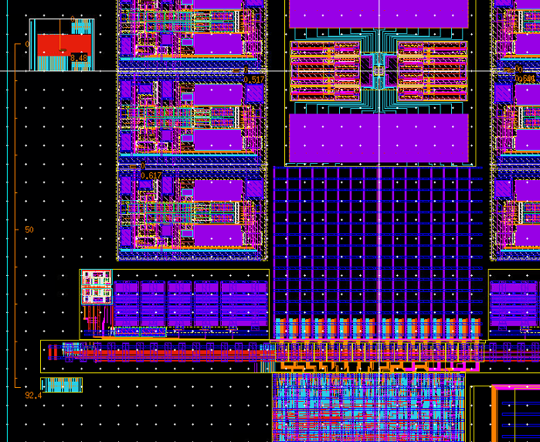
Floorplan of QC electronics and qubit cell
Quantum cell
  (2 x 8 qubit max on this chip)
  Integrated 2 x 2 readout source follower, bootstrapped
  4 mV per electron, 1uA
Preamp for source follower
  10 dB gain with 10uA, 2 GHz bandwidth
  Biased at -1V to shift qubit Vth to 100 mV
  Eliminates gate leakage in qubit
Correlated double sampler
  15 dB gain, 10uA, 2.5 nsec sample time
  100 MHz readout speed
8 bit cdac
  50mV, 200uV resolution, 150 psec pulse width
  Zero DC current, 60uA current during pulse
128 bit wide pulse train bus
  150psec min pulse
Low speed clock gating logic

Slide 17
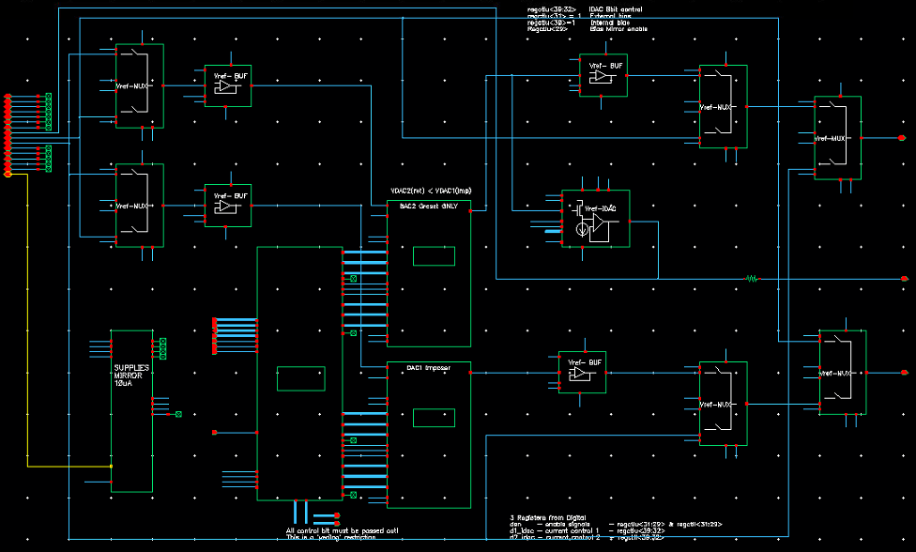
Reference voltage generations
Two sigma delta 2nd order capacitive DACs
  generate 16 bit reference voltage between 0 and 200 mV
Voltage gets sampled to 30pF holding DAC and buffered by unity gain buffers
  SD process stopped after voltage is sampled on CDAC, no switching noise in QC operation
Diode connected quantum cell reset device with 1:10^5 area ratio is used to generate reset source potential for quantum cell

Slide 18
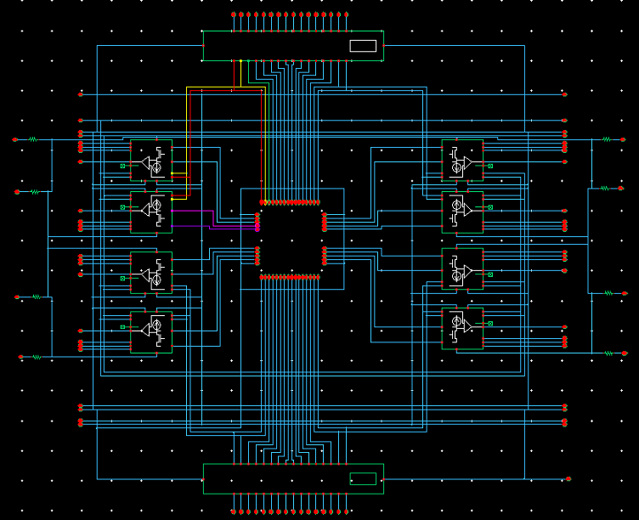
qd_frame integrates qd_frame_10
8 correlated double sampler switch cap amplifiers are connecting to 8 single electron source followers in qubit cell
  In first tape out only 4 detector where used
Preamp current can be changed between 10nA and 1uA
Boot-strapping of SF device increases SF conversion gain by 1.6x
Pulse shape filter in specialized RC MOM filter

Slide 19
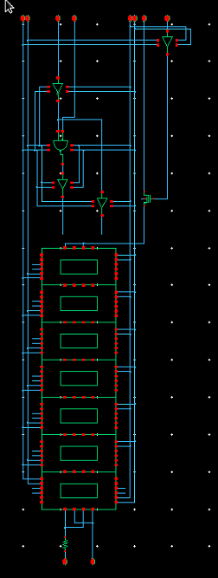
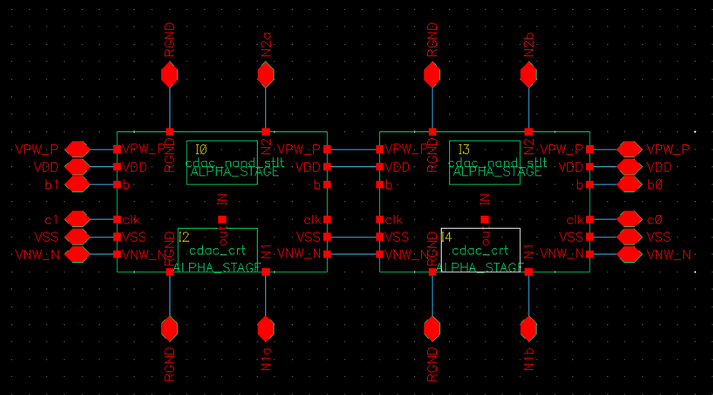
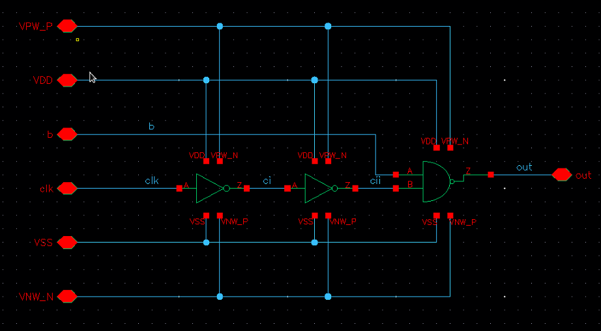
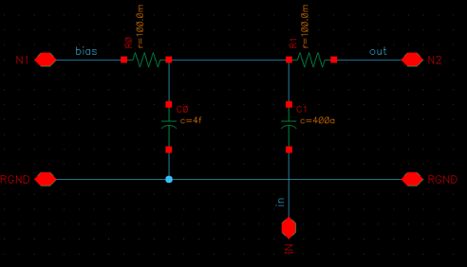
cdac_8bt inverter switched-cap CDAC Extraction
Capacitive division based capacitor
Reference capacitor is sampled from vref system
Only needed inverters receiving pulse
Charge is conserved on holding cap
First stage driver is injecting pulse compensation
Cdac_nand_c1t
PC pre-charge
CDAC binary units
NAND driver
Capacitor ratio

Slide 20
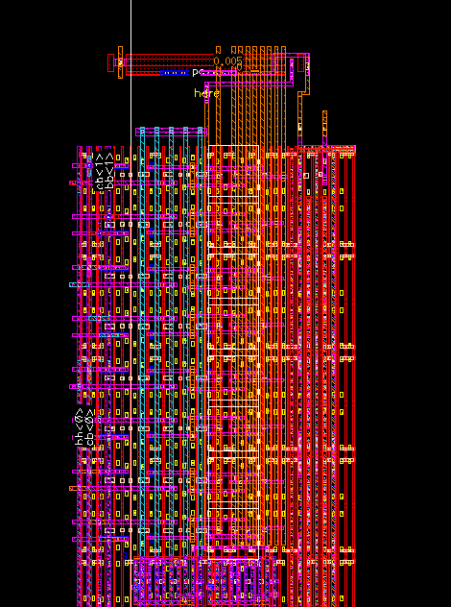
CDAC design layout
Capacitor is stacked and embedding with logic
Decoupling cap is integrated with CDAC via the metallization as MOM cap
Pulses are gated at remote edge of CDAC
Area is 3x30 um^2

Slide 21
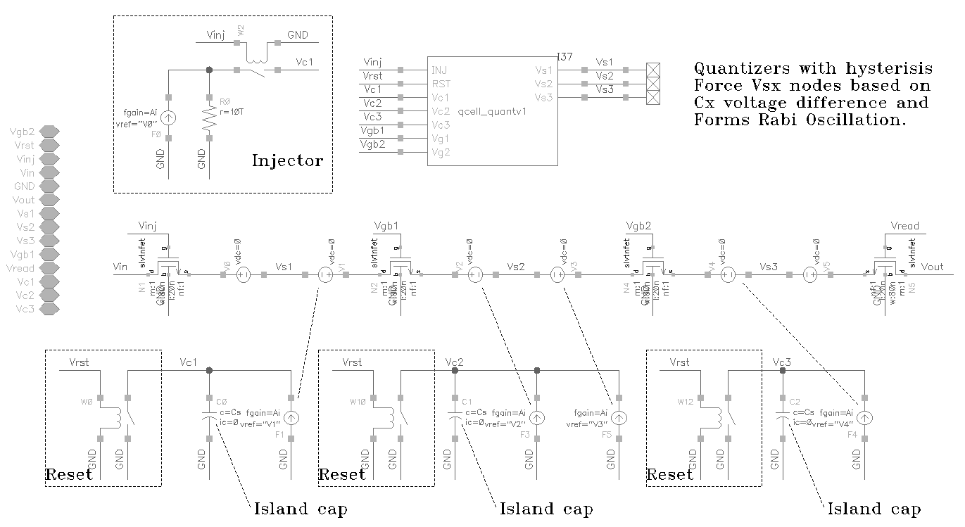
Veriloga Qcell Model for system level verification
International Workshop on Cryogenic Electronics for quantum Systems, Fermilab June 19, 2019

Slide 22
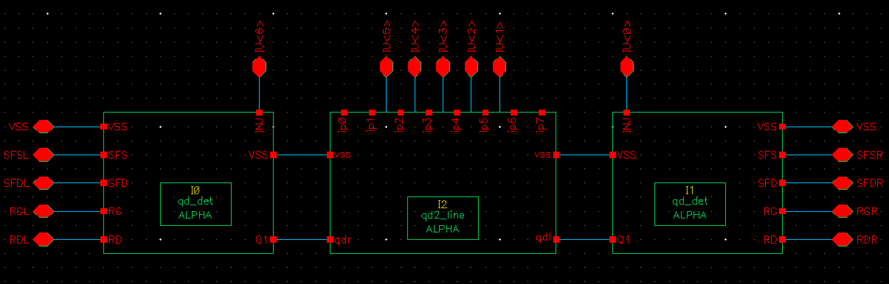
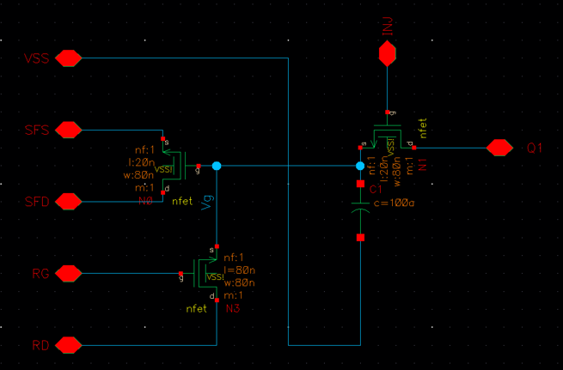
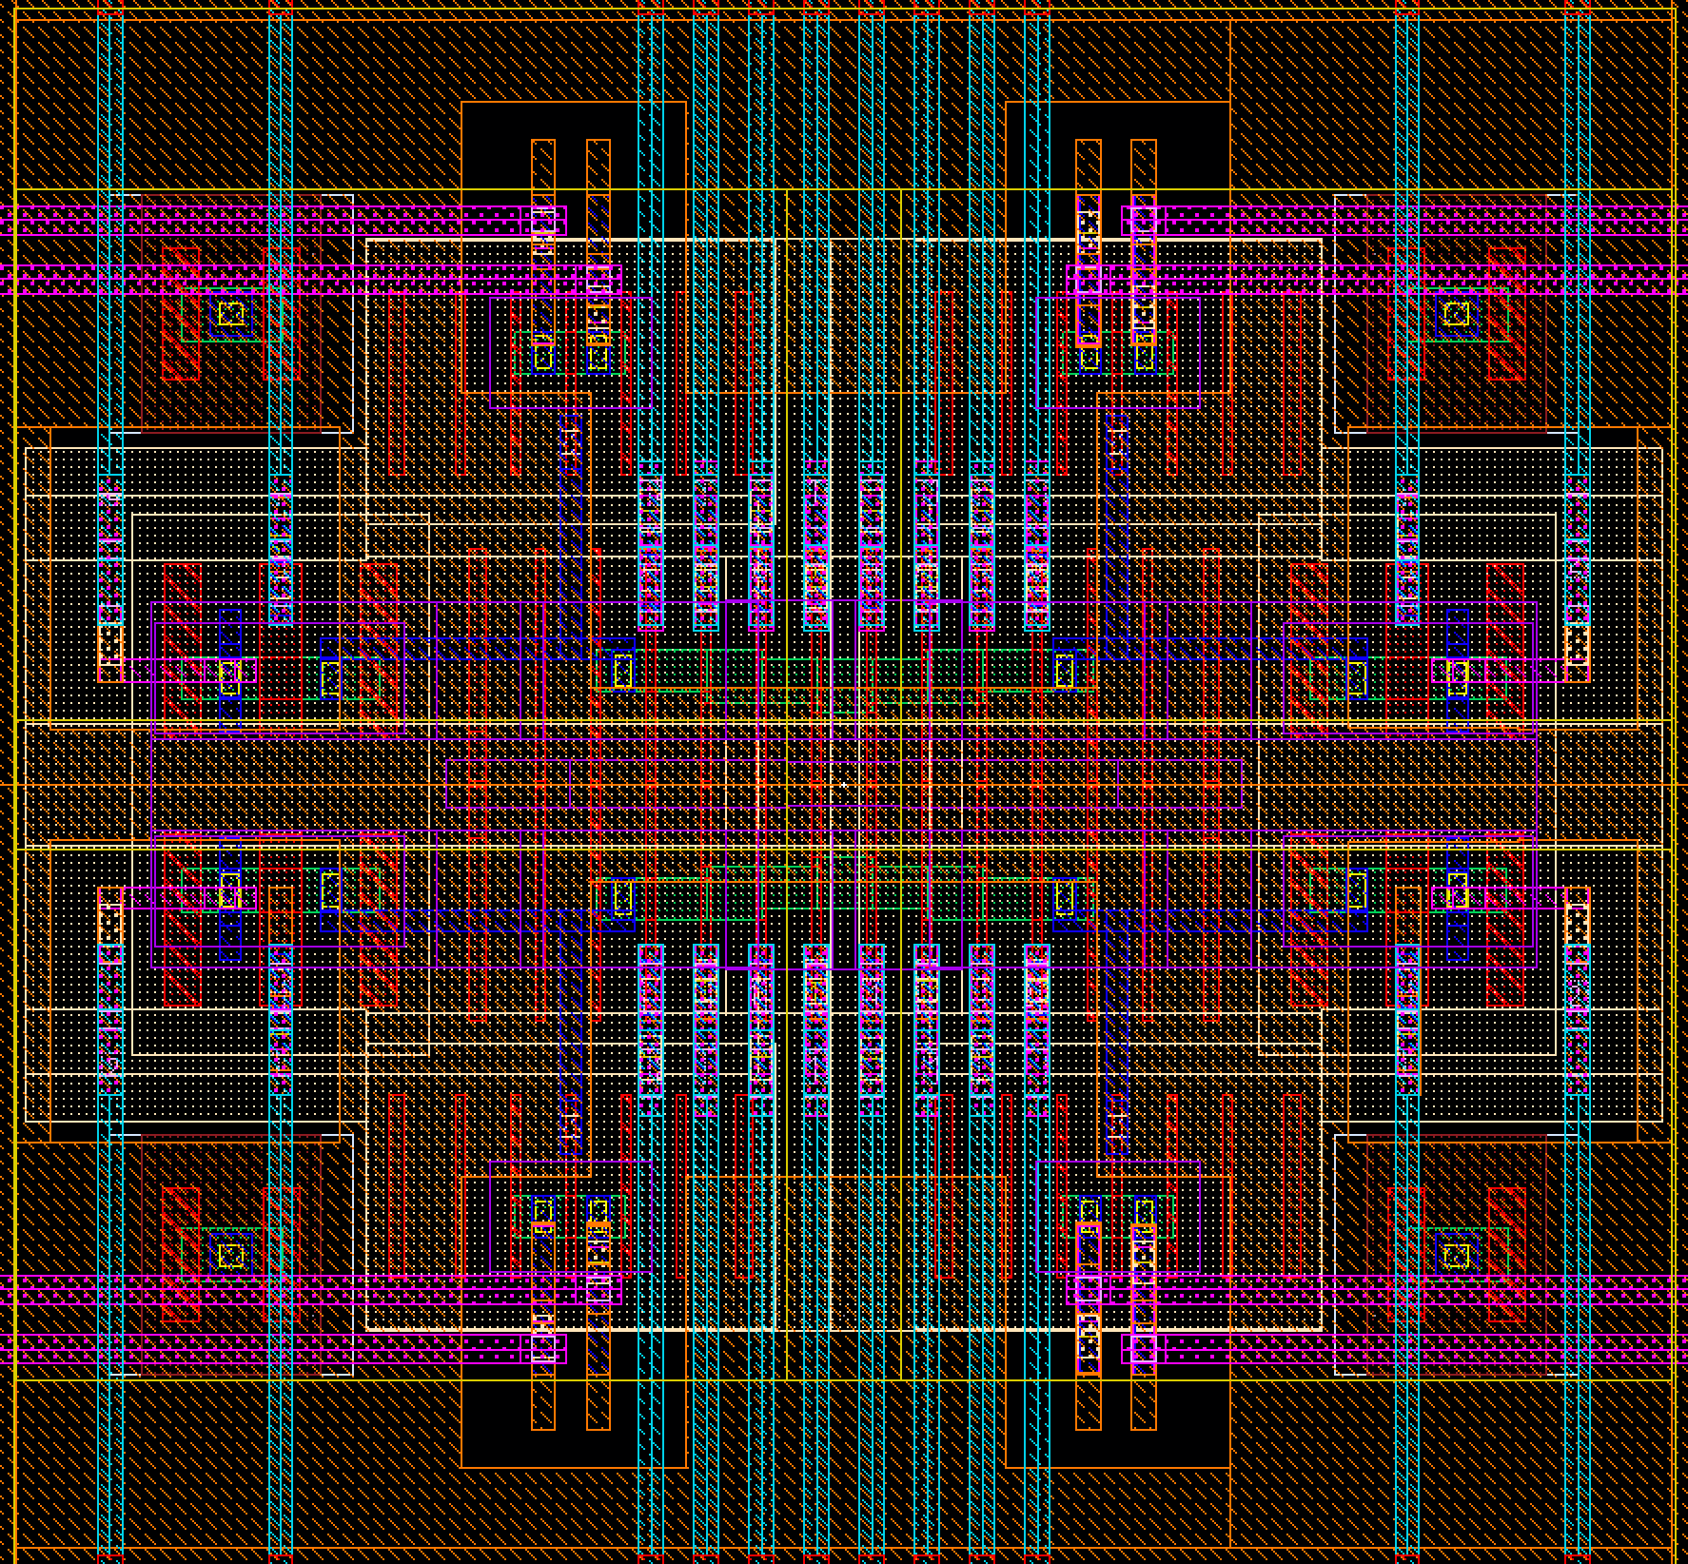
Quantum core schematic and layout
Readout via source follower connected to last SET transistor
Reset device and imposer quantum cell gates have gate voltage close to channel potential by using 0V backgate bias but using negative channel potential
International Workshop on Cryogenic Electronics for quantum Systems, Fermilab June 19, 2019

Slide 23
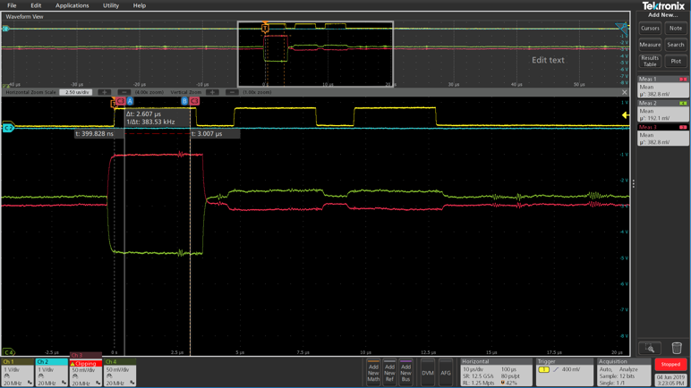
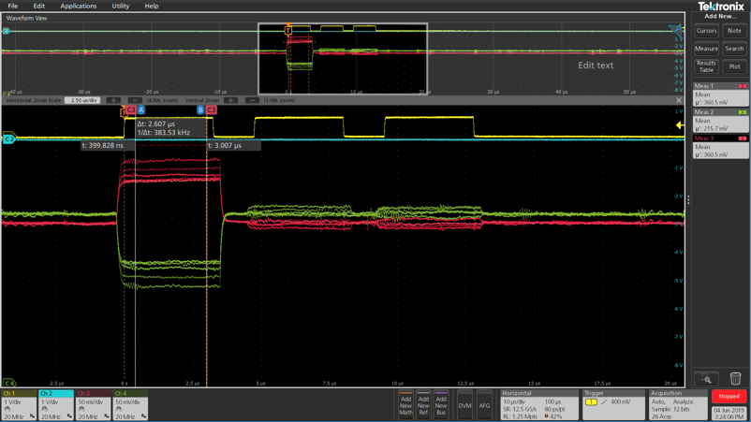
Single electron detector readout
Full signal chain with on chip pattern generation, clock pulse generation and single electron correlated double sampler readout
Full design verification including electron transport in quantum structure
2x CDS readout without electron injection
Single trace
CDS reset
CDS readout with electron injection
Noise dominated by bias generation and wiring solution
Flex board solution and local high density decoupling capacitors on flex board will improve noise performance
Noise on 0.8 V supply dominates working on improved supply decoupling
16x trace
International Workshop on Cryogenic Electronics for quantum Systems, Fermilab June 19, 2019

Slide 24

Single electron operation on Quantum cell verified
single electron detection in analog chain verified
Electron transport through quantum structure verified
Verification of intentional design rule violation in quantum structures
Imposer gate
Readout node
Transport channel
Transport channel
Pictures courtesy Global Foundry
We like to thank Global foundry from their continuing development support
Readout node
International Workshop on Cryogenic Electronics for quantum Systems, Fermilab June 19, 2019

Slide 25
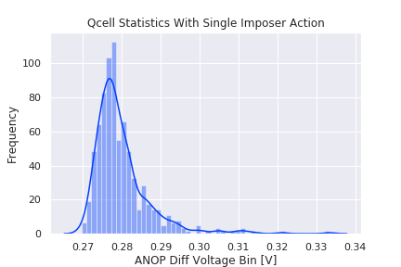
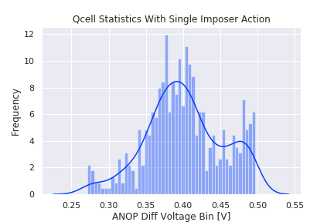
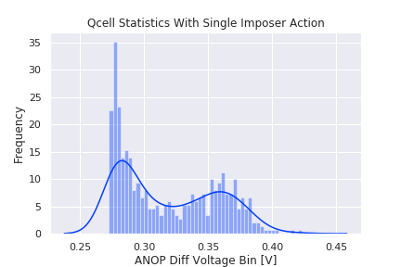
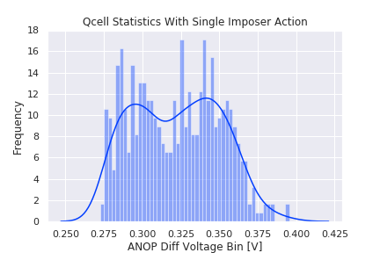
Single electron detector statistics
0 electrons
1 electrons
0 electrons
2 electrons
0 electrons
0 electrons
1 electrons
1 electrons
Detector signal about 4mV per electron
Full signal chain gain about 100mV per electron
International Workshop on Cryogenic Electronics for quantum Systems, Fermilab June 19, 2019

Slide 26
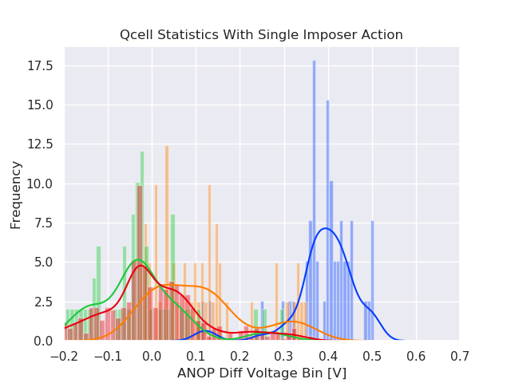
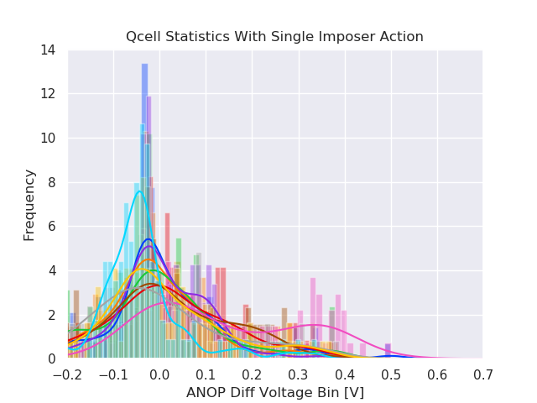
Current state of qubit measurements
We don’t claim positive confirmation of Rabi Oscillations (yet), but we do see non-trivial behavior of detector readout with pulse width
We are confident that noise can be reduced by room temperature technical measures

Slide 27
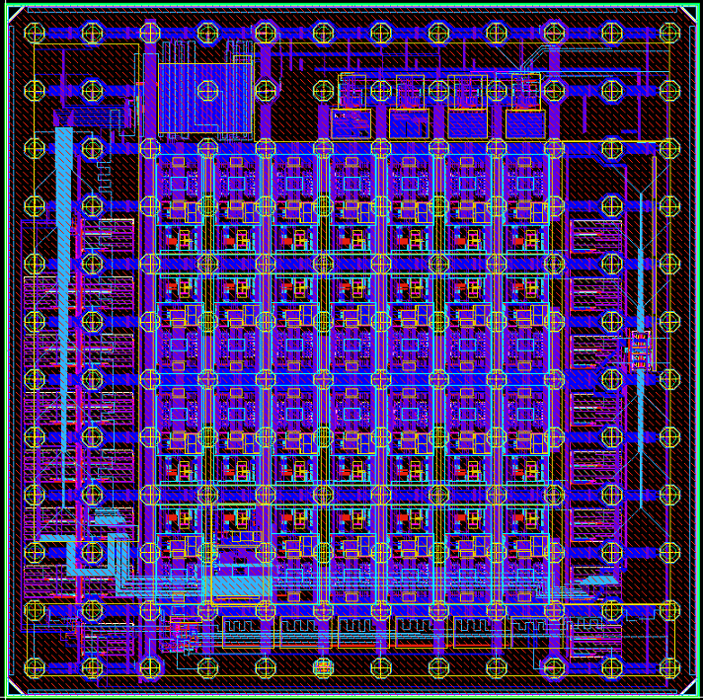
Alpha2 test chip
Tape out June 26
Correct any deficiencies on Alpha 1
  Improve VDAC reset
GF suggested additions
  Add metal resistance test structures on GF demand
  Add additional Ring oscillator types for digital library verification
  Improve RF transistor test structures
Use all resource on Alpha 1 to boost QC to 219 Qbit
QEC200
QEC204
QEC204
QEC206
QEC201
QEC203
QEC205
QEC207
QEC209
QEC211
QEC213
QEC208
QEC210
QEC204
QEC214
QEC216
QEC227
QEC204
QEC215
QEC226
QEC204
QEC204
QEC204
QEC204
QEC204
QEC204
QEC204
QEC204
International Workshop on Cryogenic Electronics for quantum Systems, Fermilab June 19, 2019

Slide 28



Alpha2: 219 qubit SOC-QC system
Classic Transport
Large barrier CCD op
Quantum gate
Localized gate control
Quantum annealling
Collective gate contol
Classic transport & detection
Electrons can be shifted into correct position in Array by CCD like transport
Partial readout and re-injection
Quantum gate operation using localized barrier control
Pulse width and shape control allows generation of controlled R(π /64)
Quantum like transport using concatenated R(π/2) operation
Collective qubit operations by common barrier control
Realizes quantum annealing operation
Realizes global optimization
International Workshop on Cryogenic Electronics for quantum Systems, Fermilab June 19, 2019

Slide 29

219 Qbit structure
AI optimized tensor flow neural network processor cell
Will allow first testing of AI tensor flow with build in quantum annealing error correction
International Workshop on Cryogenic Electronics for quantum Systems, Fermilab June 19, 2019

Slide 30
Summary
We have successfully designed and manufactured a SOC to characterize charge based quantum qubits
Full system was build with cryocooler and FPGA control
All signal generation and detection is performed at cryo temperature (5.2K currently)
All electronics is fully functional at 5.2K
System level power consumption is 1.6mW for 8 detectors and 32 x 150 psec 8 bit CDACs with 6GHz clock speed, on chip pattern generator and reference voltage generation
Quantum bit cell allow successful single electron injection and transport through the quantum cell with 8 quantum wells
Non-trivial electron distribution with respect to CDAC pulse width is observed and could indicate Rabi oscillation, would be consistent with 30 nsec coherence time
Technology offers potential allow integration of 10-100 kgates within 1-2 year time horizon
International Workshop on Cryogenic Electronics for quantum Systems, Fermilab June 19, 2019

