Slide 1
High-efficient low voltage supply signal processing based on quantized amplification
Antonio Liscidini
antonio.liscidini@utoronto.ca

Slide 2
Outline
Power efficiency of analog and digital signal processing
(thermodynamic limit)
Quantized-Analog (QA) Amplification
(liquid bits)
Characteristics of the QA
(noise, distortion, design)
Example of QA RX front-end
(low supply and key features of QA systems)

Slide 3
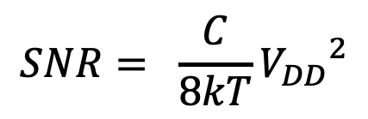
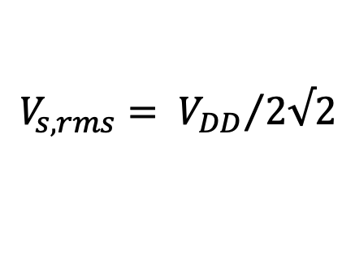
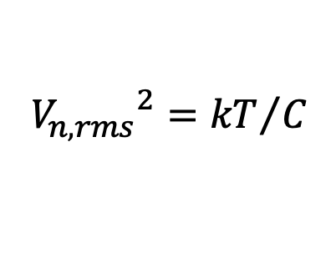


CMOS amplifier power efficiency
[Vittoz ISSCC ‘94]
$$V_{s,rms}= {V_{DD}}/{2√2}$$
$${{ V}_{n,rms}}^{2}={kT}/C$$
$$SNR= \frac{C}{8kT}{V_{DD}}^{2}$$
$$P=fCV_{DD}^{2}$$
$$P=8kTfSNR$$
The analysis assumes a linear amplifier. In presence of distortions, SNDR achievable for a given power is even lower

Slide 4

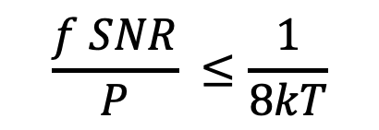
A Figure of Merit for all the seasons
$$\frac{f SNR}{P} ≤\frac{1}{8kT}$$
$$FoM=\frac{f SNR}{P}$$
The relationship between bandwidth, SNR and Power is very straightforward and superiorly limited* to 1/(0.033 aJ) (or 195dBJ⁻¹).
This figure of merit is a thermodynamic FoM and it is a the base of several figure of merit present in literature (Filters, ADC, Amplifiers).
* This FoM upper bound is valid only if in a cyclo-stationary process all power is dissipated in a period.

Slide 5
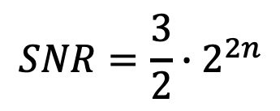

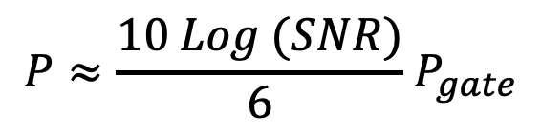

Digital gate power efficiency
[Vittoz ISSCC ‘94]
$$SNR=\frac{3}{2}∙2^{2n}$$
$$P=n P_{gate}$$
$$2^{n}$$
$$P≈\frac{10 Log (SNR)}{6}{ P}_{gate}$$
The digital power grows less with the SNR by making digital signal processing more attractive for large SNR

Slide 6
Power efficiency – Analog vs. Digital
[ E. Vittoz, ISSCC ’94]
The power consumed by a digital filter depends on the # of operations required per cycle and on the energy required for each operation
In digital Energy for each operation is reduced by scaling.
For small dynamic range analog is better than digital
Digital (1984)
Digital (2018)
Analog Limit

Slide 7
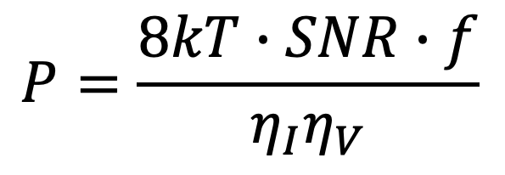
Dynamic range vs. power
[A-.J. Annema et al. JSSC 2005]
Signal-to-noise ratio
Bandwidth
$$P=\frac{8kT∙SNR∙f}{η_{I}η_{V}}$$
Power
Current efficiency
(signal amplitude / dc current)
Voltage efficiency
(signal amplitude / voltage supply)
This equation has been found by several authors for several analog building blocks and it appears to be more general than its derivation could suggest
For analog signal processing, voltage and current efficiency are “typically” smaller than one

Slide 8
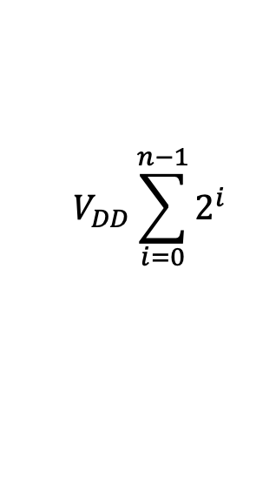
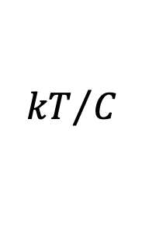



Upper and lower bounds in the DR
Analog
Digital
$$V_{DD}$$
$$V_{DD}\sum_{i=0}^{n−1}{2^{i}}$$
$${kT}/C$$
$V_{DD}$
$$0$$
In voltage analog signal processing the maximum signal amplitude is limited to the supply (i.e. η_{V}=1)
Dynamic range is increased lowering the noise, which is done bu reducing the impedance level (i.e. kT/C)
In digital the minimum signal amplitude is one bit (i.e. V_{DD})
The maximum signal amplitude rises exponentially with the number of lines (binary weighted)
The binary weight increases voltage and power efficiency

Slide 9

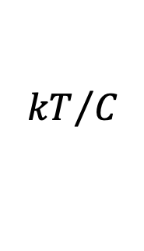


Voltage supply and efficiency
Voltage supply is a key element in the power/area optimization:
  It defines the power dissipation in digital
  It defines the maximum signal that the analog section can handle
  For a given input signal the voltage supply defines the voltage efficiency and with it the minimum theoretical power dissipation
  It define the impedance levels and thus the area
$${2^{n−1} V}_{DD}$$
$${kT}/C$$
$$V_{DD}$$
$$0$$
GOAL: increase voltage efficiency of analog signal processing above one

Slide 10
Dynamic Range limitation in an amplifier
If no inductors are used, in a amplifier the maximum swing at the output is limited by the adopted supply
The gain of the amplifier sets the maximum signal that can be handled at the input, and thus the dynamic range

Slide 11
Quantized Analog Amplification Principle
Each unit is dedicated to amplify only a portion of the signal
The original amplifier is sliced in N identical units each consuming 1/N of the original current
Voltage efficiency increases by N and with is also the power efficiency
[J. Musayev et al., Electronic Letters 2018]
Recombination can be after filtering large signals or in digital domain

Slide 12
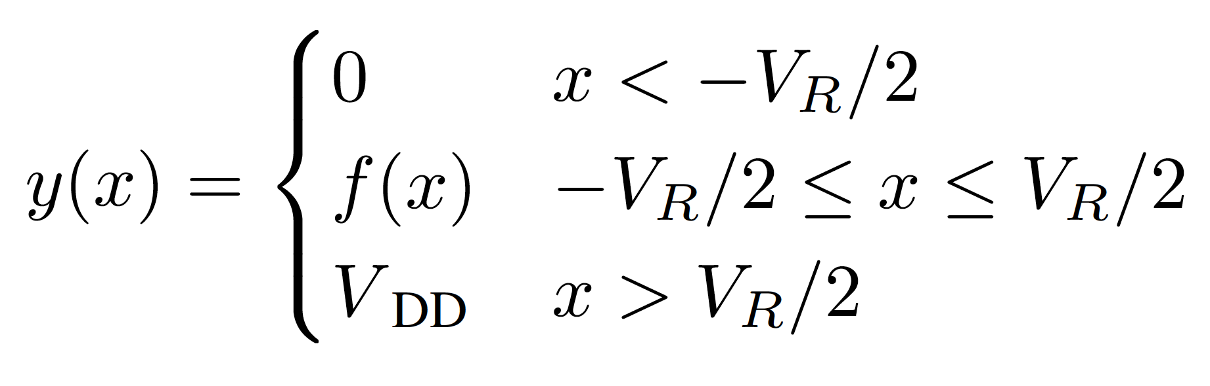
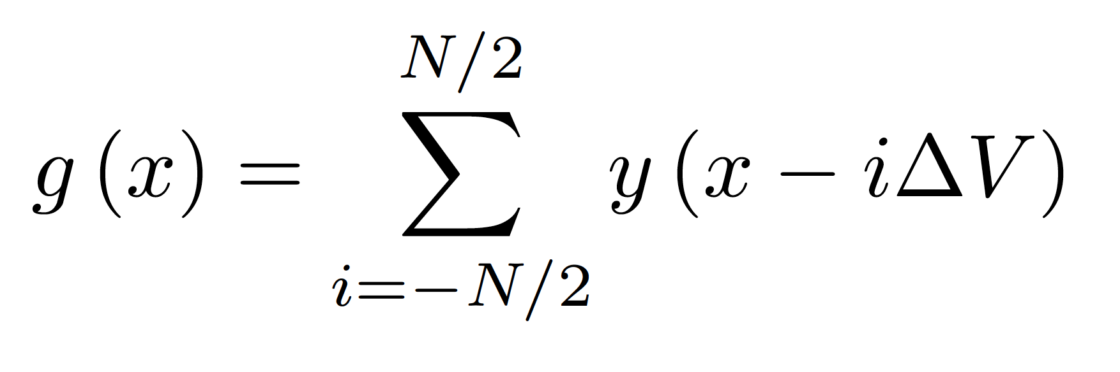
Analog quantized amplification
Since the recombiantion is a linear process, QA signal processing is compatible with ay linear operation such as filtering up/downconversion

Slide 13
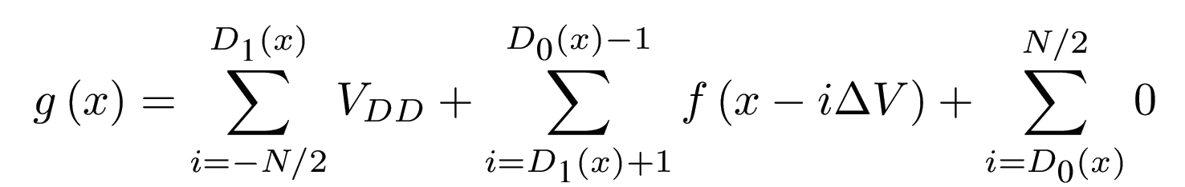
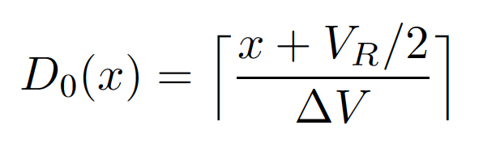
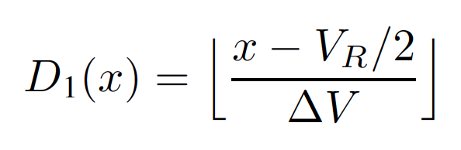
Liquid digital decomposition
For any input, all together the lines form a sort of thermometric code similar to the one produced by a flash ADC
Liquid bits
(unsaturated lines)

Slide 14
Quantized analog amplification and noise
Ideally only unsaturated slices produce analog noise at the output
Assuming to slice the original amplifier by N with 1/N of the current the input referred power noise increase by N
The voltage input range increases by N so the maximum input signal power increases by N²
The DR improves by N for a given power consumption compared to a pure analog processing

Slide 15
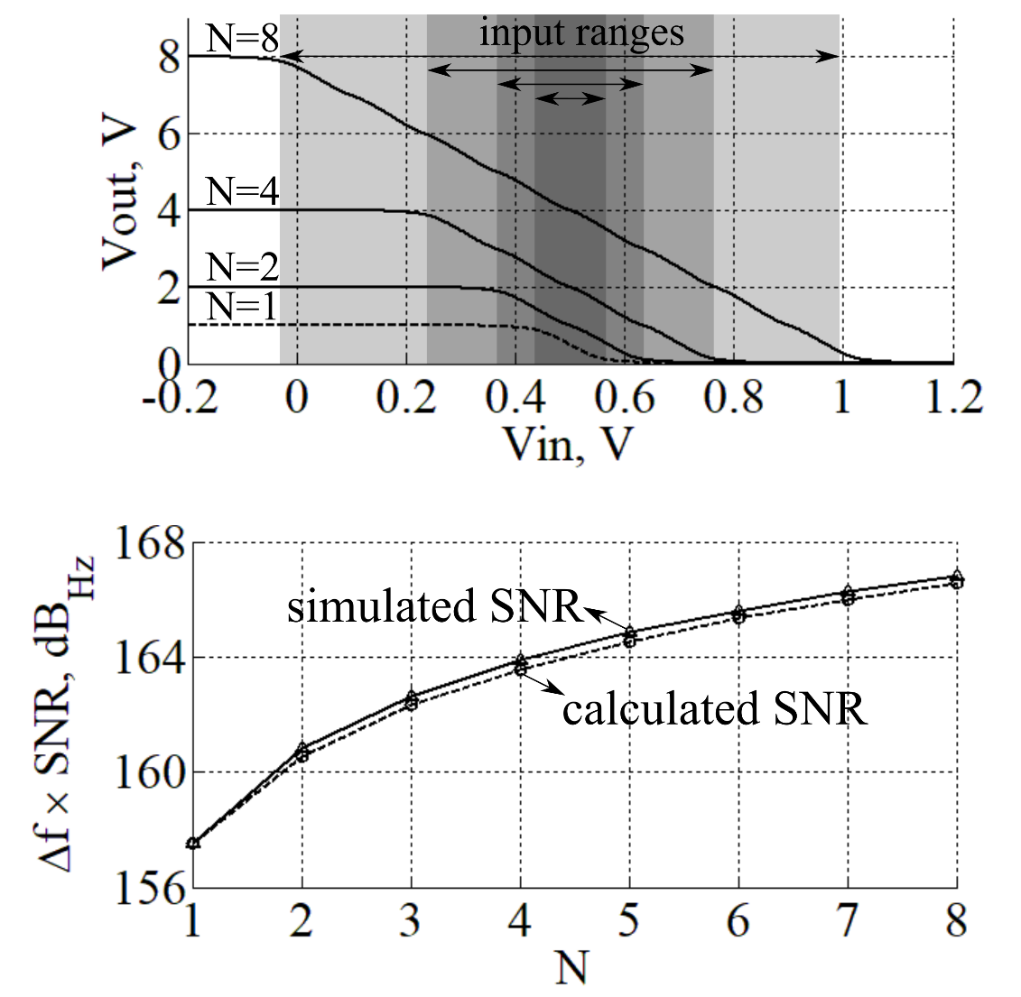
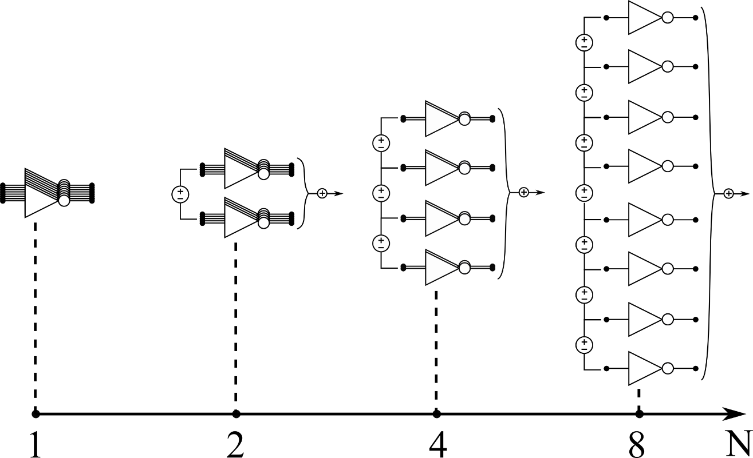
Simulation of QA inverter amplifier
For the same total size, N is swept from 1 to 8, by adding offsets equal to V_{DD}/A.
Voltage efficiency (i.e. input range) and hence DR (i.e. maximum SNR) improve N-times.
For N = 8, DR expands by 9dB as expected.
9dB

Slide 16
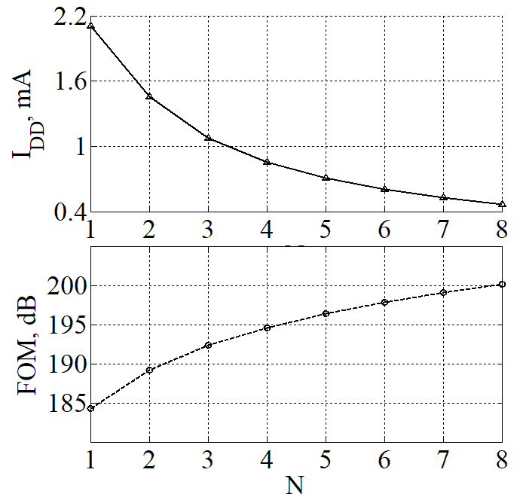
Simulation of QA inverter amplifier (2)
Average supply current reduces by 4.5-times (η_{c} improves by 6.5dB).
Overall FoM improvement becomes 15.5dB (due to η_{v} and η_{c}).
These results are obtained assuming no distortion (i.e. SNR_{max} = DR).
15.5dB

Slide 17
Analog quantized amplification efficiency
The Dynamic Range increases by N for the same power dissipation. This because the voltage efficiency increased by N
Since the liquid thermometric code generated by the QA amplifier is not binary weighted the improvement is not exponential as in digital
Digital (1984)
Digital (2018)
Analog Limit
Quantized Analog Limit (e.g. 10 lines)

Slide 18
Quantized Analog Amplification and Linearity
In a real amplifier the gain of an amplifier is not constant in the input range
A large voltage offset between the elements produces a gain variation that generates distortion
A smaller offset and a larger number of elements linearize the gain and extend the range
Linearity and input range can be controlled by acting on the number of elements and their offset

Slide 19
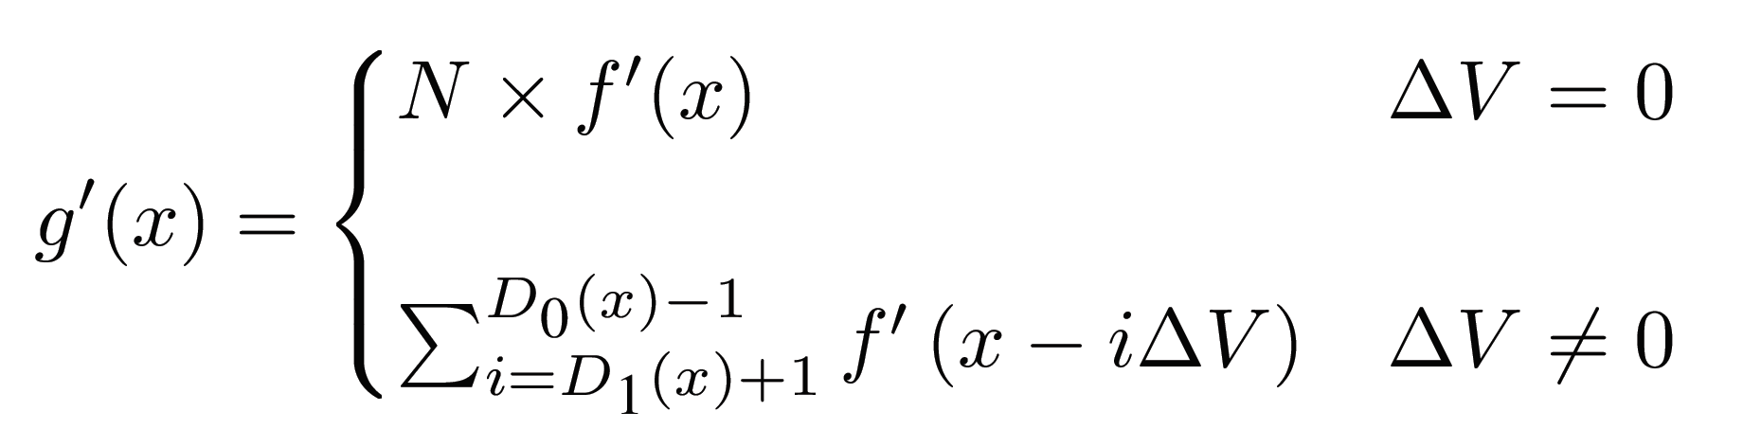
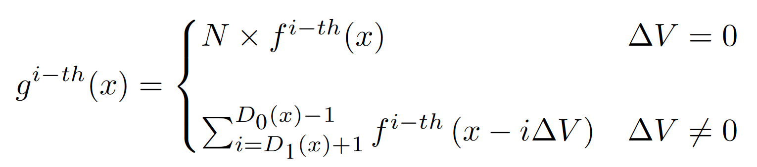
Overlap and gain linearization
Small signal gain
Higher order derivatives
If f(x) saturate at the extremes, no matter the gain shape, the higher order derivatives tend to zero if N is increased and ∆V decreased.

Slide 20
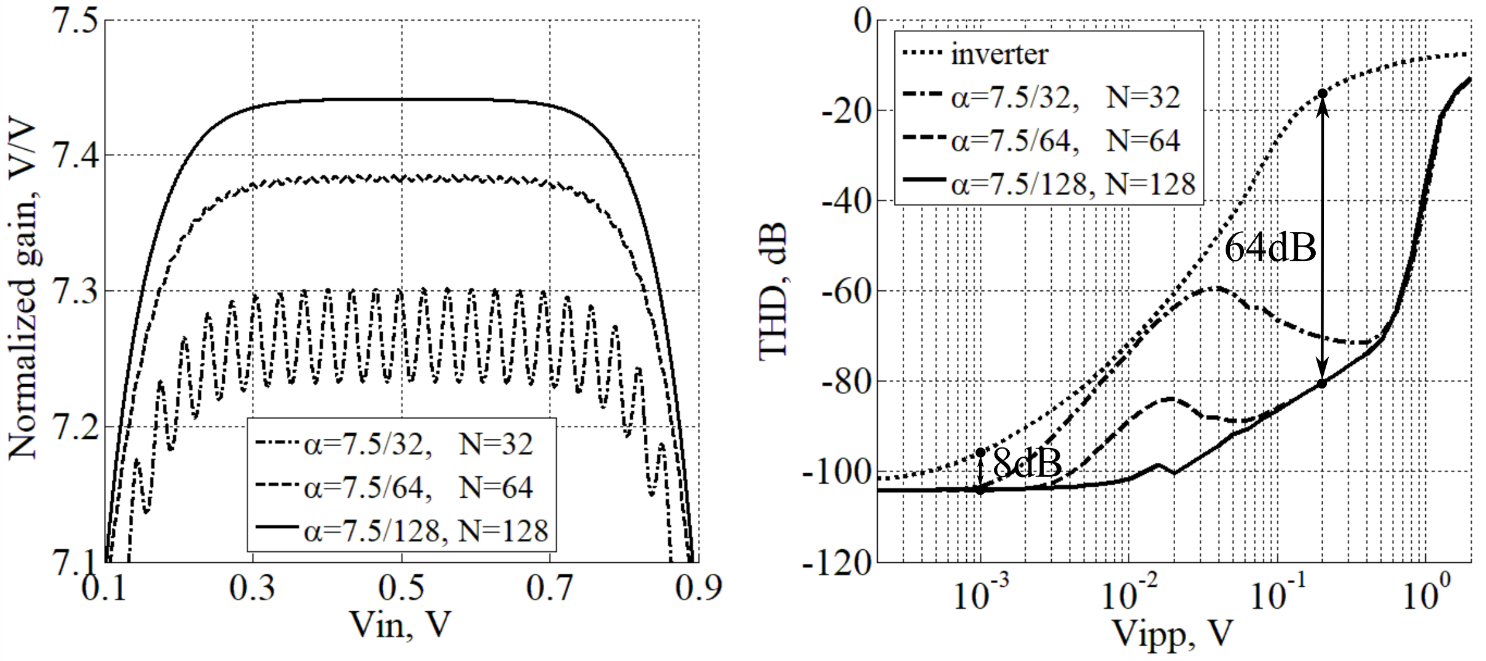
QA inverter amplifier linearity
0.0001% ripple
0.9% ripple
Ripple down to 0.0001% is obtained by 128 elements (at this point mismatches dominate).
Better linearity for both small (by 8dB) and large (by 64dB) signals is obtained.
High IIP2 with single-ended structure is possible (symmetry around mid-point).

Slide 21
Quantized Analog Amplification Design
The design of a quantized structure starts from a unit element
The multiplicity (i.e. number in parallel) defines the noise of the quantized structure
The voltage offset and the number of elements in series define linearity and input range
The overall performance in terms of noise and linearity and power are defined ONLY by the number of elements and their configuration

Slide 22
Most important feature QA signal processing
Improving current and voltage efficiency allows to lower the power dissipation for a given SNR and bandwidth
Voltage supply is not an upper bound for the voltage signal swing anymore.
Since the recombination is a linear operation, the QA signal processing can be applied to any linear circuit (e.g. filters ,up/down converters etc.)
Saturated lines do not add analog noise or distortion
Both small and large distortions are improved
QA amplification design allows a more flexible optimization of the design to reach the target specs.

Slide 23
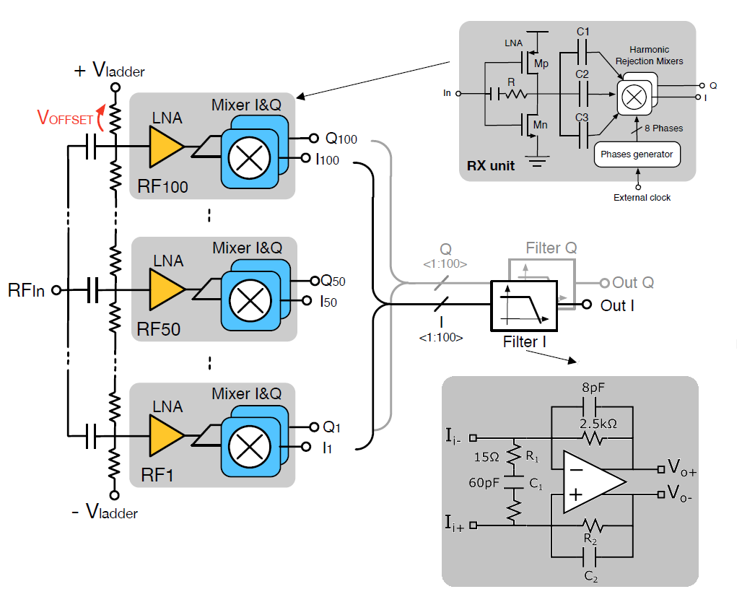
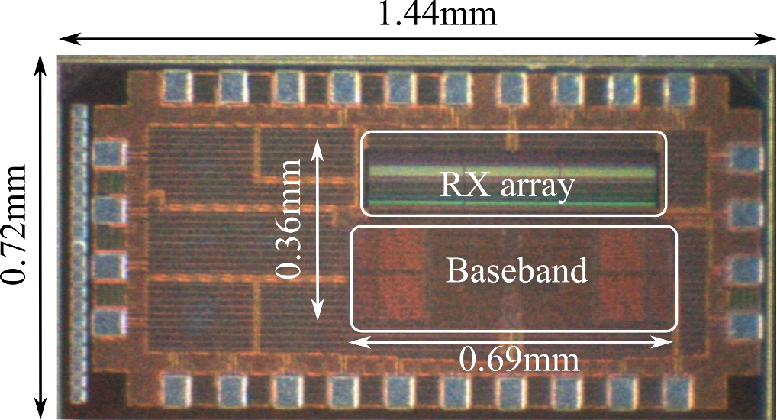
Quantized Radio
Prototype in CMOS 65nm
First quantized radio 0.9-2GHz (100 elements)
[Musayev et. ESSCIRC’18]
23

Slide 24
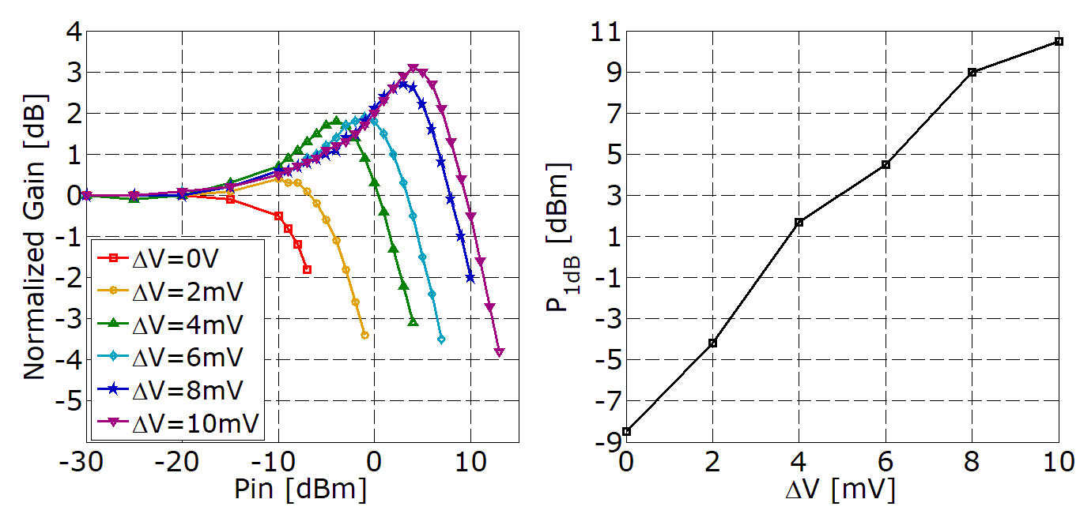
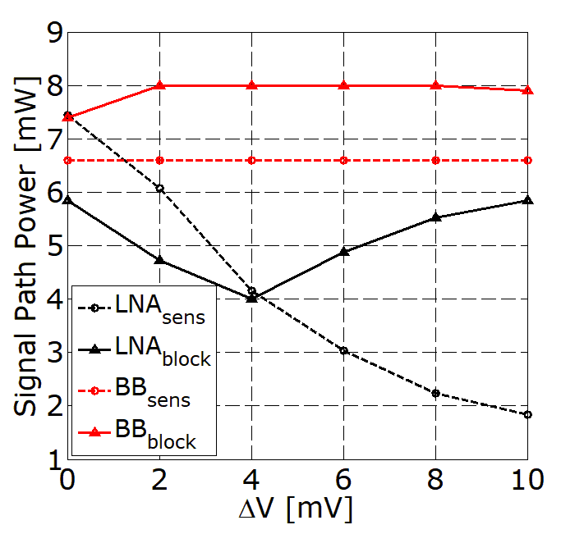
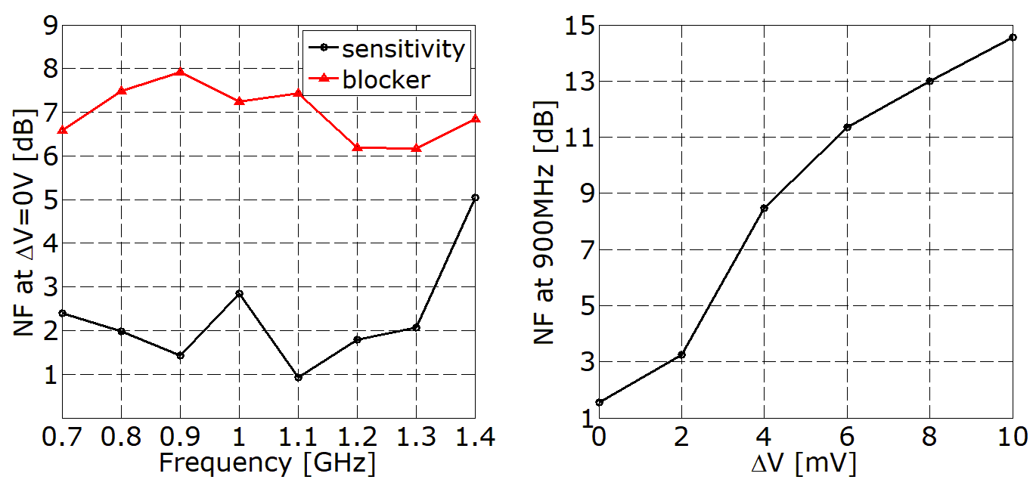
Power and DR
19dB
Compression point increases by 19dB
Noise Figure increases by 13dB
DR increases by 6dB, at almost no expense on power.
13dB

Slide 25
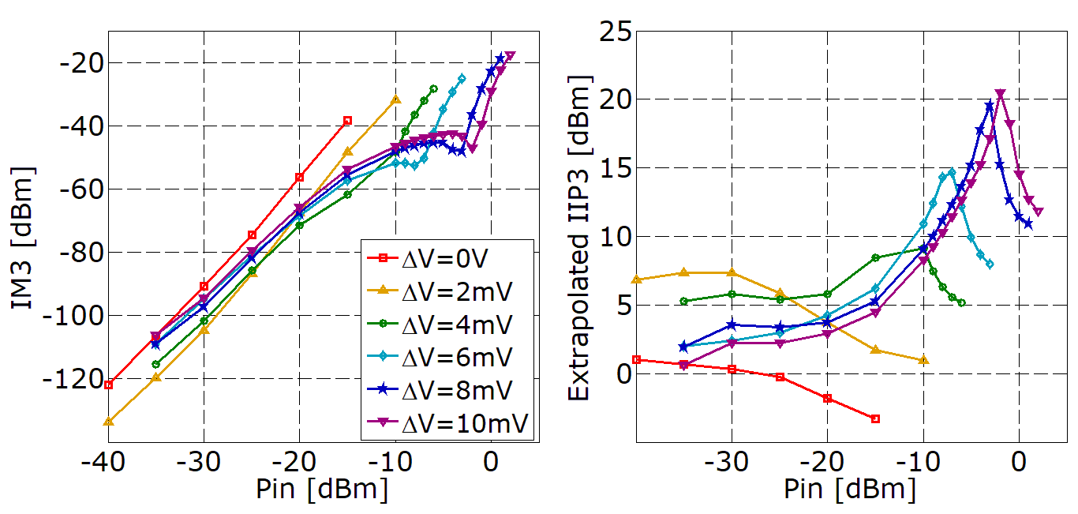
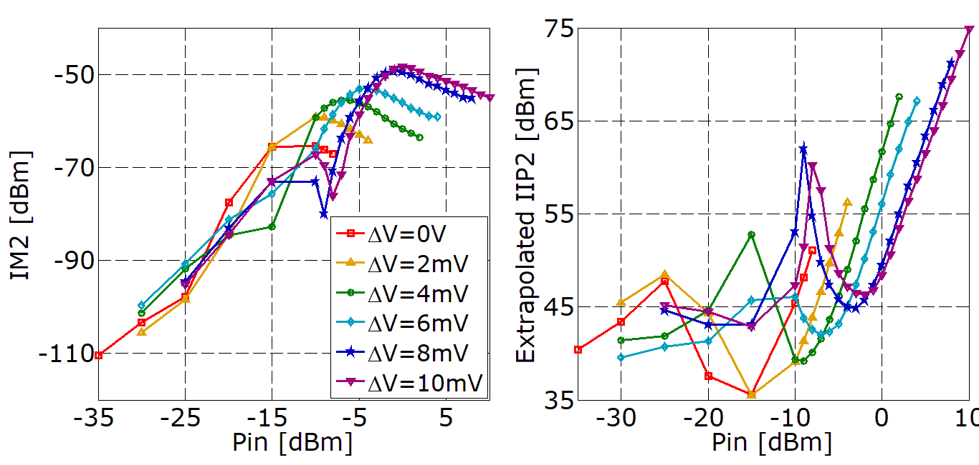
Distortion

Slide 26
Measurement Results
 | This work | Murphy, JSSS’15 [8] | Fabiano, JSSC’13 [7] | Liempd, JSSC’ 14 [9]
Topology | QA Front-End | Noise cancelling | Transformer-LNA | Voltage-modeª, HR
Gain [dB] | 20.8^{b}-36.8 | NA | 44.5ª-45.5 | 70
Frequency [GHz] | 0.7-1.4 | 0.6-3 | 1.8-2.4ª | 0.4-3
NF [dB] | 1.9-2.8 | 1.8-3^{b} | 3.8, 1.9ª | 1.8-3.1
NF_{blk} [dB] | 6.6-7.9 | 7-9 | 7.9 | 14 (10^{d})
IIP3 [dBm] | 1-20.5^{b} | 10-11.5ª | 18, 16ª | 3, 8^{d}
IIP2 [dBm] | 45-75^{b} | 49.5-55ª | 64, 66ª | 55, 80e
B_{1dB} [dBm] | -8.5 to 10.5^{b} | -6 to -1 | -1.5 | -13
HR (3rd /5th) [dB] | 40-67 / 47-70 | 52/54 | 54/65 | 40 (70)
Supply [V] | 0.8, 1, 1.2 | 1 | 1.2, 1.8 | 40 (75)
Power LO path [mW] | 37.2/GHz* | 13/GHz | 3.2/GHz | 6.8/GHz +5.4
Power LNA+BB [mW] | 13.7^{b}-14 | 30-46 | 23.4 | 14.3
Area [mm²] | 0.25 | 5 | 0.84 (0.74ª) | 0.6
Technology | 65nm | 28nm | 40nm | 28nm
* Not optimized in this work. ª Differential, ^{b} HL mode (V_{lad} = 1), ^{c} LN mode (V_{lad} = 0), ^{d} LNA optimized, ^{e} Calibrated
QA receiver achieves the highest compression and low NF at the lowest power in signal path (LNA+BB).

Slide 27
Conclusion
Analog signal processing has a lower bound in the power consumption set by the thermal noise.
Power efficiency can be improved by increasing voltage and current efficiency
A new mixed-signal processing has been presented. This merge together digital and analog without a fixed interface
The proposed quantized-analog (QA) signal processing looks promising to develop a new generation of low power circuits.
A prototype of a QA RX validated the theory

