Slide 1



The proton Electric Dipole Moment
High Precision physics in storage rings
Yannis K. Semertzidis,
IBS/CAPP & KAIST
April 16, 2019
Future planning meeting
Fermilab
The pEDM experiment at 10⁻²⁹ e-cm probes SUSY-like New Physics at the 10³ TeV scale!
A new hybrid method, provides adequate symmetries, eliminating B-field systematic error sources

Slide 2
Motivation
No clear evidence for New Physics showed up at LHC
New CP-violating source is needed to explain the matter-antimatter asymmetry mystery
Hadronic EDMs are some of the most sensitive probes we have
A natural next, after the muon g-2 experiment concludes; many techniques are similar

Slide 3
The Electric Dipole Moment precesses in an Electric field
The EDM vector d is along the particle spin direction
+
-

Slide 4
The proton EDM uses an ALL-ELECTRIC ring: spin is aligned with the momentum vector
at the magic momentum
Momentum
vector
E
Spin vector
E
E
E
Yannis Semertzidis, IBS/CAPP & KAIST
Notes:
Yannis Semertzidis, BNL
4

Slide 5
Storage Ring Electric Dipole Moments
Fields | Example | EDM term | Comments
Dipole magnetic field (B) | Muon g-2 | Tilt of the spin precession plane. (Limited sensitivity due to spin precession) | Eventually limited by geometrical alignment. Requires CW and CCW injection to eliminate systematic errors
Combination of electric and magnetic fields (E, B) | Deuteron, ³He, proton, etc. | Mainly: | Most powerful. Small ring. Need to build combined B and E-field system. Reduce vertical E-field.
Radial Electric field (E) | Proton, etc. |  | Large ring, CW & CCW storage. Simplest to achieve. Reduce radial B-field.

Slide 6
The proton EDM electric ring, 500m circ.
Two options:
All-electric: radial E-field, plus electric focusing
Hybrid: radial E-field, plus alternating magnetic focusing
We first worked on the all-electric field ring
Review of Scientific Instr. 87 (11), 115116

Slide 7

The proton EDM electric ring, 500m circ.
Current goal 10⁻²⁹e-cm; upgraded: 10⁻³⁰e-cm.
It has been approved as a PBC candidate project at CERN. A comprehensive study is underway with the conclusions to be presented at the European Strategy meeting.

Slide 8
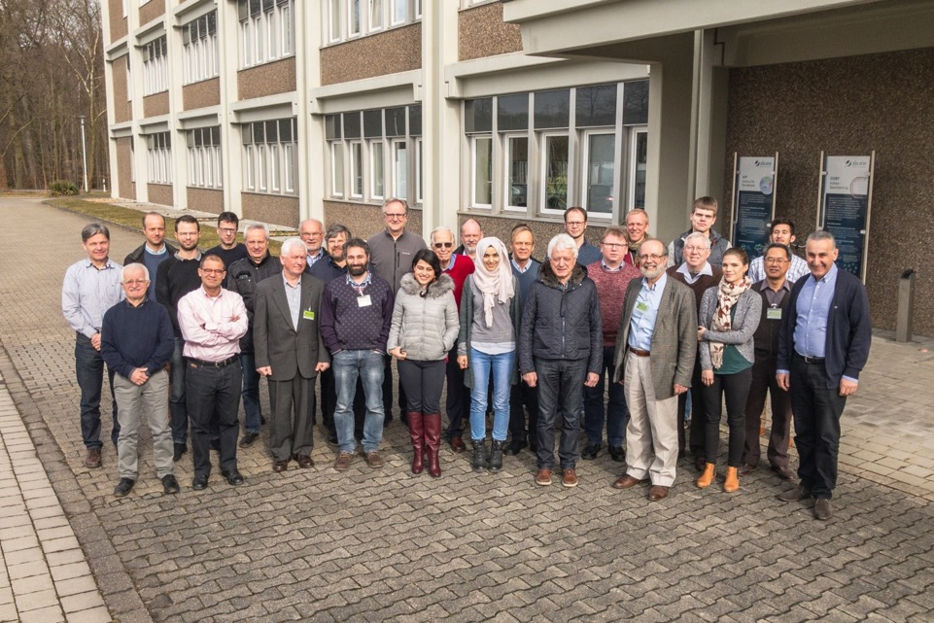
CPEDM collaboration,
Juelich, March 9, 2018

Slide 9
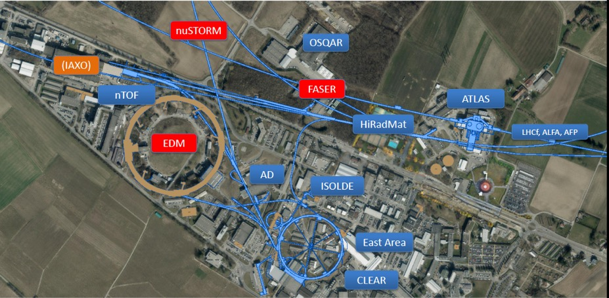
Mike Lamont, CERN

Slide 10
The current plan of CPEDM
Seek endorsement by the European strategy meeting (2018-2020)
Propose to build a combined field (radial electric and dipole magnetic) ring at COSY/Germany for low energy protons and deuterons
The all-electric proton EDM ring is scheduled for CERN after 2027 (most likely to be delayed)

Slide 11
The spin precession relative to momentum in the plane is kept near zero. A vert. spin precession vs. time is an indication of an EDM (d) signal.
E
E
E
E
Yannis Semertzidis
Notes:
Yannis Semertzidis, BNL
11

Slide 12
The spin precession relative to momentum in the plane is kept near zero. A vert. spin precession vs. time is an indication of an EDM (d) signal.
E
E
E
E
Yannis Semertzidis
Notes:
Yannis Semertzidis, BNL
12

Slide 13
The proton EDM electric ring, 500m circ.
Straight sections are instrumented
with quads, BPMs, polarimeters,
injection points, etc, as needed.
Requirements:
Below transition (reduce IBS)

Slide 14
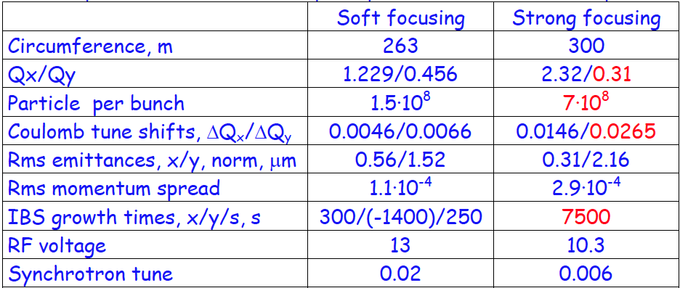
The proton EDM ring evaluation Val Lebedev (Fermilab)
Beam intensity 10¹¹ protons limited by IBS
, kV

Slide 15
Proton Statistical Error (230MeV):
τ_{p} : 10³s Polarization Lifetime (Spin Coherence Time)
A : 0.6 Left/right asymmetry observed by the polarimeter
P : 0.8 Beam polarization
N_{c} : 10¹¹p/cycle Total number of stored particles per cycle
T_{Tot}: 10⁷s Total running time per year
f : 1% Useful event rate fraction (efficiency for EDM)
E_{R} : 7 MV/m Average radial electric field strength
σ_{d} = 1.0×10⁻²⁹ e-cm / year
Notes:
Yannis Semertzidis, BNL
15

Slide 16
Important R&D projects
SQUID-based BPMs, at <10fT/sqrt(Hz) level
Magnetic field shielding <10nT
Geometrical phases: 1. magnetic, 2. electric
Study with precision simulation tools
Clearly define lattice elements specs, what is possible with beam-based alignment

Slide 17
Important R&D projects, con’d
Develop a robust polarimeter: deadtime-less, point back to origin, high efficiency, high analyzing power
what else can we do with this facility? Axion-dark matter: Axion-EDM project
Reliable, cheap E-bending plates: TiN-coated aluminum plates (follow J-LAB work & scale up)

Slide 18
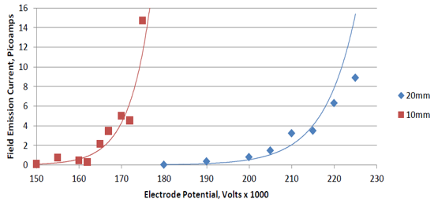
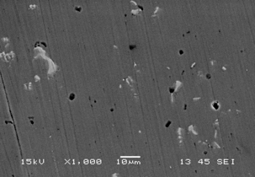
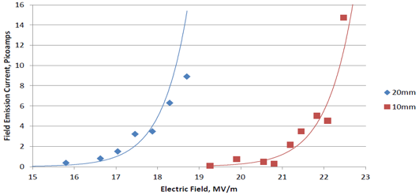
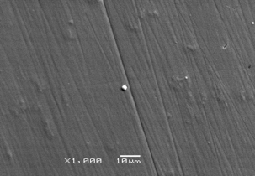
JLab results with TiN-coated Aluminum
No measureable field emission at 225 kV for gaps > 40 mm, happy at high gradient
Bare Al
Matt Poelker, JLab
TiN-coated Al
We need <10 MV/m
for 30mm plate separation
the hard coating covers defects
15 MV/m
20 MV/m
Work of Md. A. Mamun and E. Forman

Slide 19
Projects in Korea
Magnetic field shielding, SQUID-based BPMs, IBS/CAPP, KRISS, TUM, …
Teamleader: Selcuk Haciomeroglu
Goal: develop a SQUID-based BPM at the 1-10fT/sqrt(Hz) level
Characterize it at IBS/CAPP for time stability
Install it at a ring for real-time testing

Slide 20
Projects in Korea
Schedule, SQUIDs: 1 full scale unit ready for testing at IBS/CAPP: fall 2018.
Ready for installation for testing at a storage ring in 2019-2020

Slide 21
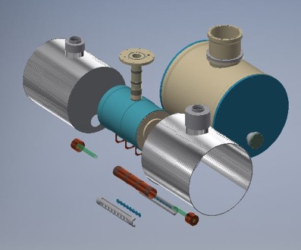
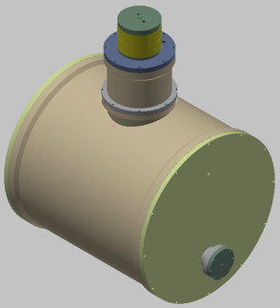
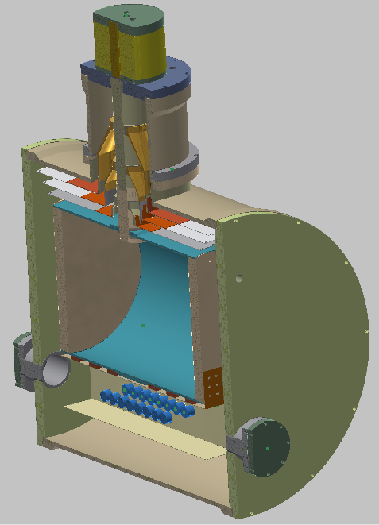
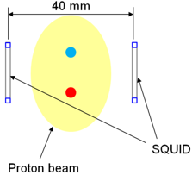
Beam position monitor: SQUID array
Liquid He
Vacuum
SQUID magnetometer
To p-beam line

Slide 22
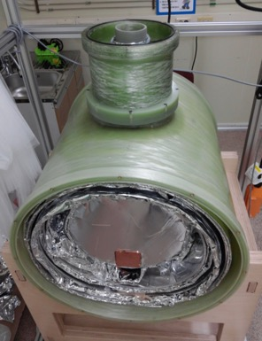
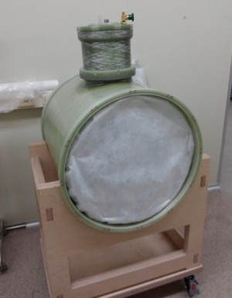
Cylindrical Dewar: under fabrication

Slide 23
SQUID-based BPMs, Korea
Selcuk Haciomeroglu, IBS/CAPP

Slide 24
All-electric field ring weakness: High sensitivity to B-fields
<10nT B-field shielding is adequate when lattice beta-functions are uniform
Much stricter specs when there’s a variation of vertical beta-function.
Confirmed specs with high-precision beam/spin simulations

Slide 25
New breakthrough idea from IBS/CAPP: hybrid storage ring
It eliminates the main systematic error sources: B-fields
Makes the ring construction simpler

Slide 26
New idea: hybrid storage ring
Use E-field for particle bending
Alternate magnetic focusing, allows simultaneous CW/CCW storage (eliminates vertical E-field issues)
It reduces the radial B-field dependence by at least five orders of magnitude

Slide 27
Hybrid storage ring lattice
Use E-field for particle bending, alternate magnetic focusing
Quads: 0.1T/m, 0.4m
Seluck Haciomeroglu’s simulation

Slide 28
Reality check:
What happens with misaligned elements?

Slide 29
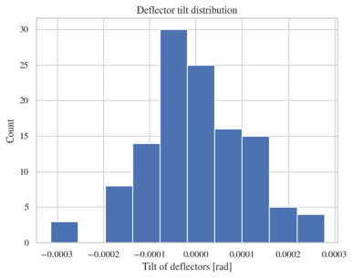
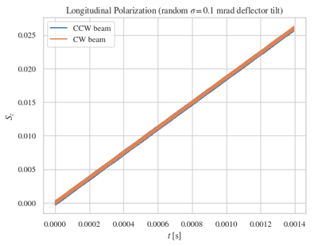
Running the EDM experiment
Potential systematic error: tilted E-field plates
Clock-wise and counter-clock-wise vertical spin precessions are equal and cancel.
Zhanibek Omarov’s simulation

Slide 30
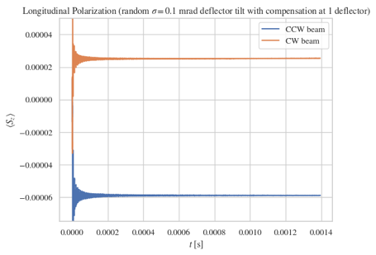
Running the EDM experiment
Potential systematic error: tilted E-field plates
Clock-wise and counter-clock-wise vertical spin precessions are equal, shown here with 1 compensating element.
Zhanibek Omarov’s simulation

Slide 31
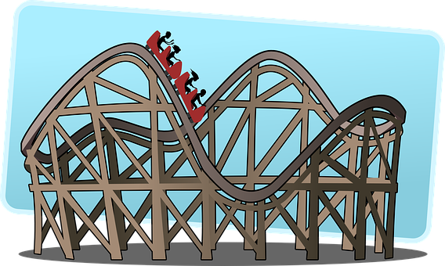
Relevant parameter:
The average vertical speed in deflectors needs to be close to zero!
Quads: 0.1T/m, 0.4m

Slide 32
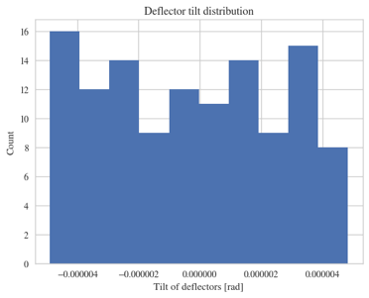
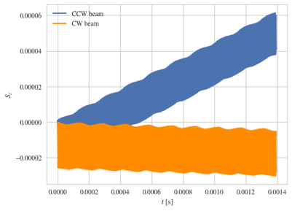
Running the EDM experiment
Probe effect with radial spin direction.
Cancel both CW and CCW vertical spin precessions with trim dipole fields
Zhanibek Omarov’s simulation

Slide 33
How about quadrupole alignment?

Slide 34
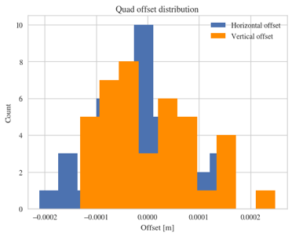
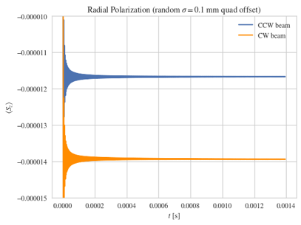
Running the EDM experiment
Potential systematic error: random positioning error of the quads
Clock-wise and counter-clock-wise vertical spin precessions are compatible with zero!
Zhanibek Omarov’s simulation

Slide 35
Our conclusions
According to our simulations all known systematic errors are cancelled
Need to confirm with independent studies by another group

Slide 36
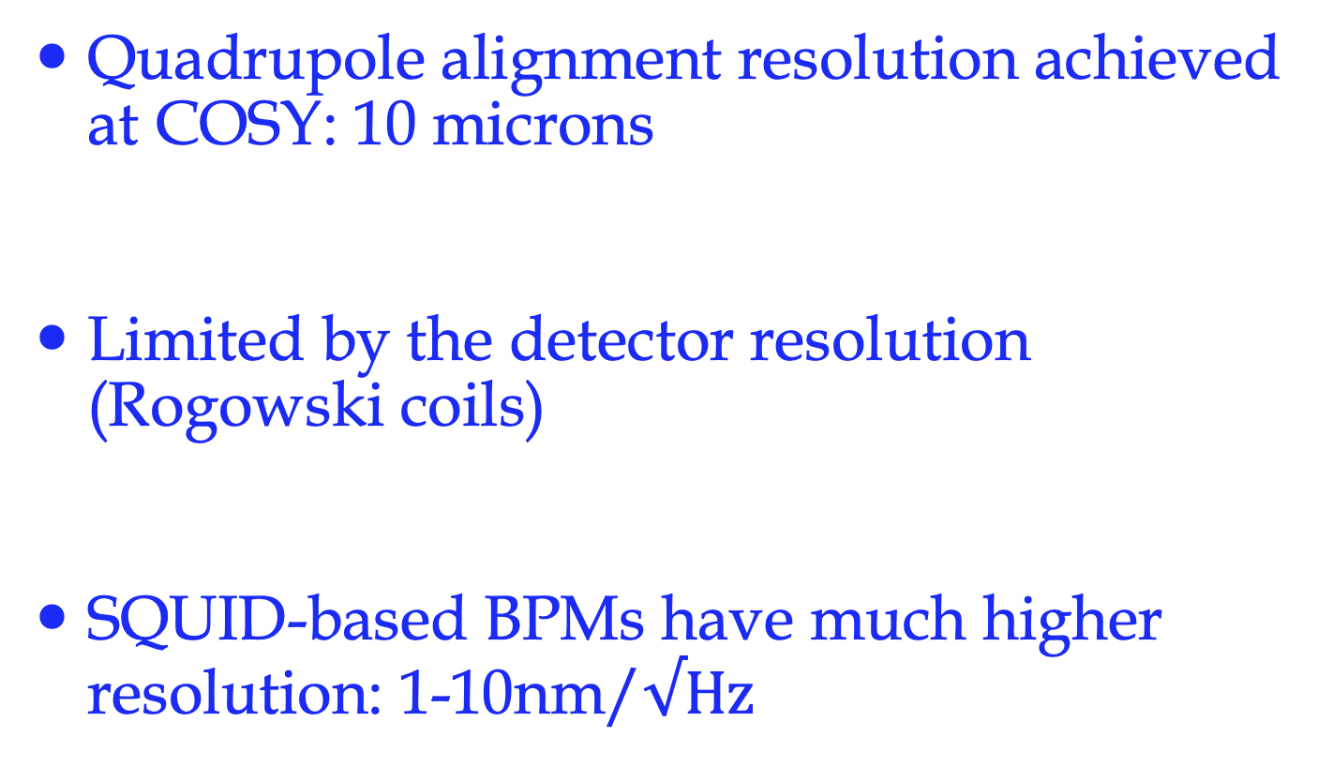
Beam-based alignment
Quadrupole alignment resolution achieved at COSY: 10 microns
Limited by the detector resolution (Rogowski coils)
SQUID-based BPMs have much higher resolution: 1-10nm/$√Hz$

Slide 37
Symmetries during run

Slide 38
Keep it symmetric
Aiming for 1-10 microns using SQUID-based BPMs. We can do better by >10³ if needed (stability?)
Run the experiment with longitudinal and radial spin directions in CW and CCW directions.
Flip the current in the magnetic quadrupoles if needed.

Slide 39
What’s next?

Slide 40
What’s next?
Form a working group to study the systematic errors. Confirm the resilience of the hybrid ring to B-fields, alignment requirements
Design a ring lattice, including injection lines
Need a high-intensity (10¹¹ protons/cycle) polarized (>80%) proton source

Slide 41
Summary
New hybrid ring design simplifies the exp.:
Possible and exciting, could explain the matter-antimatter asymmetry mystery!
Sensitive to New Physics at high scales 10³TeV, can be done at Fermilab.
Next: Complete detailed systematic error studies, proposal…

Slide 42
Extra slides

Slide 43
Competition?

Slide 44
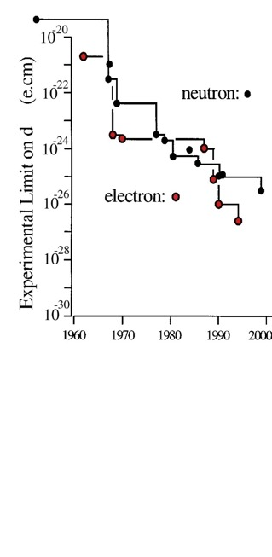
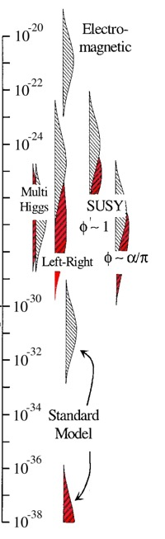
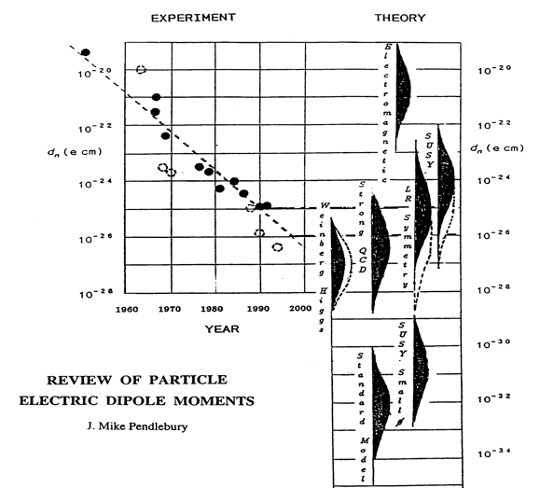
Sensitivity to Rule on Several New Models
Gray: Neutron
Red: Electron
If found it could explain
Baryogenesis
(p, d, n (or ³He))
n current
e current
GUT SUSY
Electroweak
Baryogenises
n target
p, d target
e target
2nd phase target
Statistics limited
If a pEDM is not found it can
eliminate EW-Baryogenesis
e-cm
Adopted from
J.M.Pendlebury and E.A. Hinds, NIMA 440 (2000) 471

Slide 45
Quadrupole E-field?

Slide 46
Running the EDM experiment
Potential systematic error: electric focusing!
Seluck Haciomeroglu’s simulation
P_{m}=1/Q²_{y}. Run the experiment with different magnetic strengths.
The DC offset corresponds to the EDM.
Magnetic focusing reduces the sensitivity to radial B-field by several orders of magnitude.

Slide 47
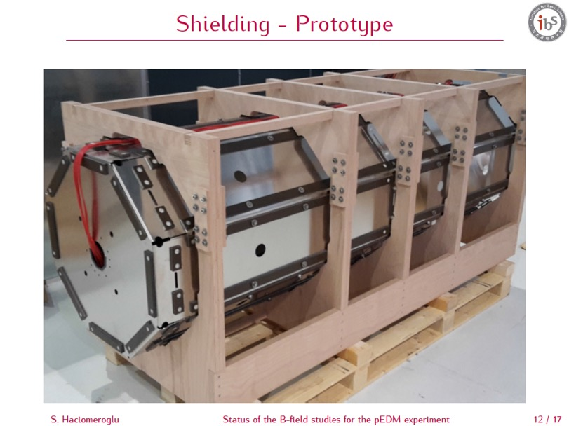
Achieved so far:
Absolute field: <1nT
Gradient field: <1nT/m

Slide 49
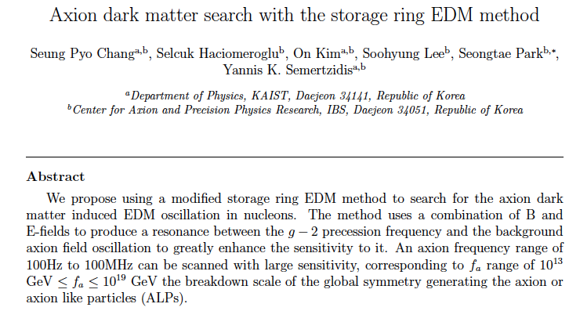
Search for axion dark matter in storage rings

Slide 50
Search for axion dark matter in storage rings
SeongTae Park, IBS/CAPP

Slide 51
Search for axion dark matter in storage rings
SeongTae Park, IBS/CAPP

Slide 52
EDMs of hadronic systems are mainly sensitive to
Theta-QCD (part of the SM)
CP-violating sources beyond the SM
Alternative simple systems are needed to be able to differentiate the CP-violating source (e.g. neutron, proton, deuteron,…).
pEDM at 10⁻²⁹e•cm is > an order of magnitude more sens. than the best current nEDM plans

Slide 53



EDMs of different systems
Measure all three: proton, deuteron and neutron EDMs to determine CPV source
Theta_QCD:
Super-Symmetry (SUSY) model predictions:
Theoretical estimation on the lattice?

Slide 54
Physics reach of magic pEDM (Marciano)
Sensitivity to new contact interaction: 3000 TeV
Sensitivity to SUSY-type new Physics:
The proton EDM at 10⁻²⁹e∙cm has a reach of >300TeV or, if new physics exists at the LHC scale, δ<10⁻⁷-10⁻⁶ rad CP-violating phase; an unprecedented sensitivity level.
The deuteron EDM sensitivity is similar.
Notes:
54

Slide 55
Spin is the only vector defining a direction of a “fundamental” particle with spin
-
+

Slide 56
Electric Dipole Moment: two possibilities
-
+
+
-

Slide 57
If we discover that the proton
Has a non-zero EDM value, i.e. prefers only one of the two possible states:
+
-
-
+
Then P and T symmetries are violated and through CPT, CP-symmetry is also violated.
CP-violation is one of three necessary conditions to obtain a matter dominated universe starting from a symmetric one…

Slide 58
A Permanent EDM Violates both T & P Symmetries:
+
T
-
+
-
P
-
+
EDM physics without spins is not important
(batteries are allowed!)

Slide 59
Spin Coherence Time: need ~10³ s
Not all particles have same deviation from magic momentum, or same horizontal and vertical divergence (all second order effects)
They cause a spread in the g-2 frequencies:
Present design parameters allow for 10³ s. Cooling/mixing during storage could prolong SCT (upgrade option?).

Slide 60
Monitoring the proton spin direction as a function of time:
Proton Polarimeter

Slide 61
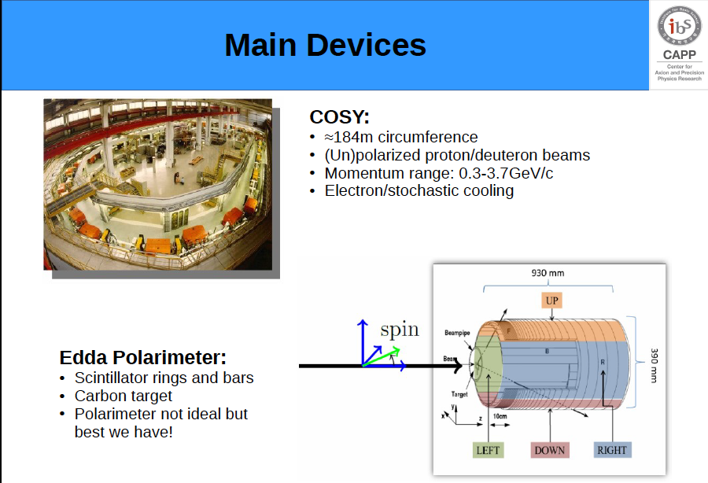
Martin Gaisser

Slide 62
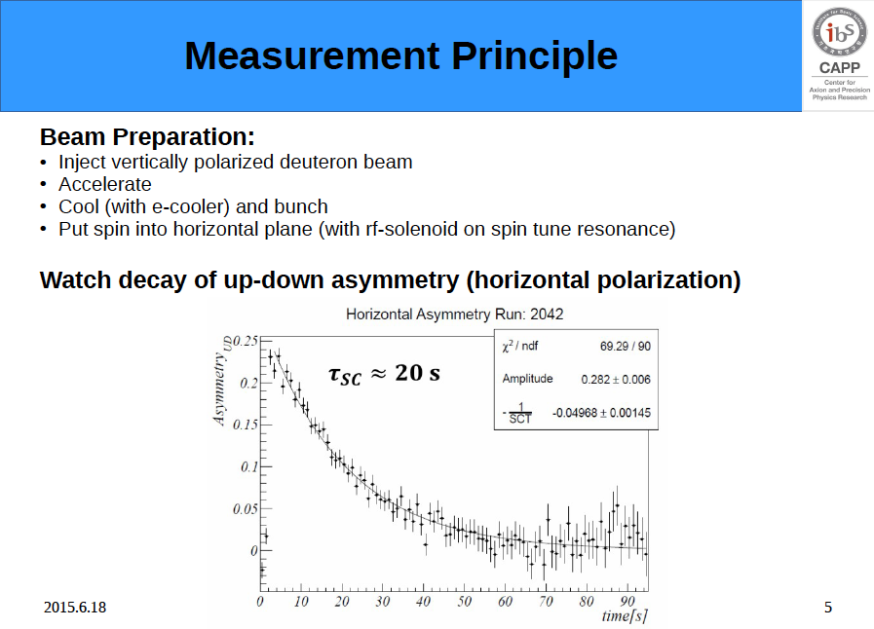
Martin Gaisser, COSY/Juelich
JEDI Collaboration

Slide 63
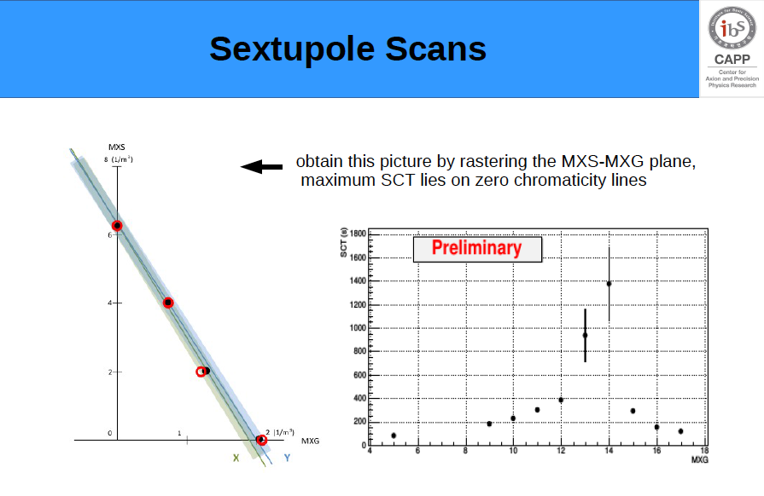
Martin Gaisser, COSY/Juelich
JEDI Collaboration
SCT goal accomplished!
Sextupole strength

Slide 64
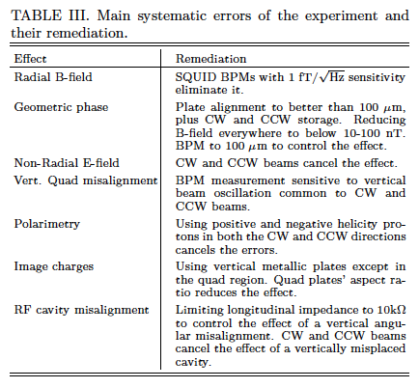
Systematic errors

