Slide 1

Design Considerations for ERLs for Hadron cooling
Speaker: Stephen Benson, Jefferson Lab
Collaborator(s): Fay Hannon, Andrew Hutton, Bob Rimmer, Chris Tennant, Erdong Wang, Haipeng Wang, Ferdinand Willeke, Yuhong Zhang
EIC Hadron Cooing Workshop October 7-8, 2019

Slide 2
Outline
Cooler design specifications
  Incoherent cooling
  Coherent cooling
Critical technologies
  Injector
  Linac
  CCR arcs
  Other
Summary of Research Needs

Slide 3
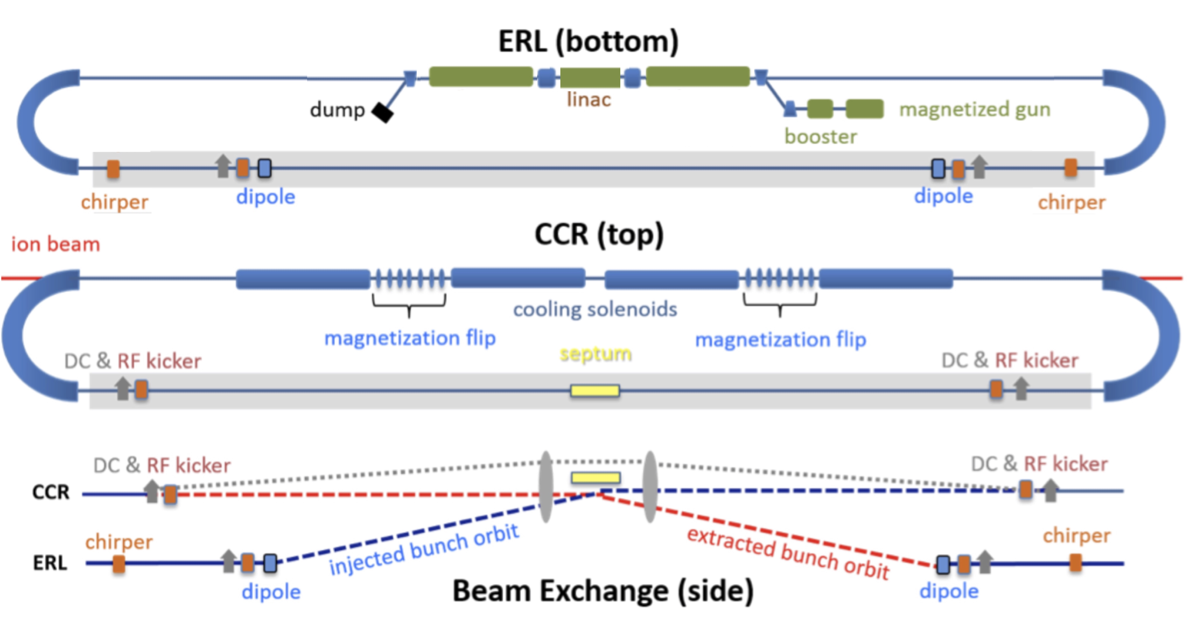
Baseline Design is Cooling Ring Fed by ERL
Same-cell energy recovery in 476.3 MHz SRF cavities with Harmonic linearizer
Uses harmonic kicker to inject and extract from CCR (divide by 11)
Assumes high charge, low rep-rate injector (w/ harmonic linearizer acceleration)
Use magnetization flips to compensate ion spin effects (may change to two 30 meter solenoids after suggestion by V. Lebedev)

Slide 4
JLEIC Incoherent Cooler Specifications
Energy 20–110 MeV
Charge 1.6 nC
CCR pulse frequency 476.3 MHz
Gun frequency 43.3 MHz
Gun current 70 mA
Bunch length (tophat) 3-5 cm (17-29°)
Thermal (Larmor) emittance <19 mm-mrad
Cathode spot radius 3.1 mm
Normalized hor. drift emittance 36 mm-mrad
rms Energy spread (uncorr.)* 3x10⁻⁴
Energy spread (p-p corr.)* <6x10⁻⁴
Solenoid field 1–2 T
Electron beta in cooler 37.6 cm
Solenoid length 4x15 m?
Bunch shape beer can

Slide 5
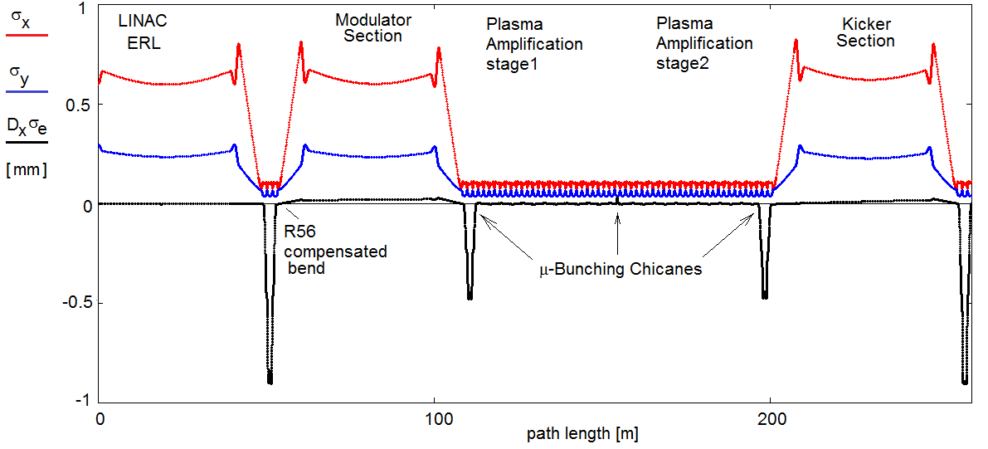
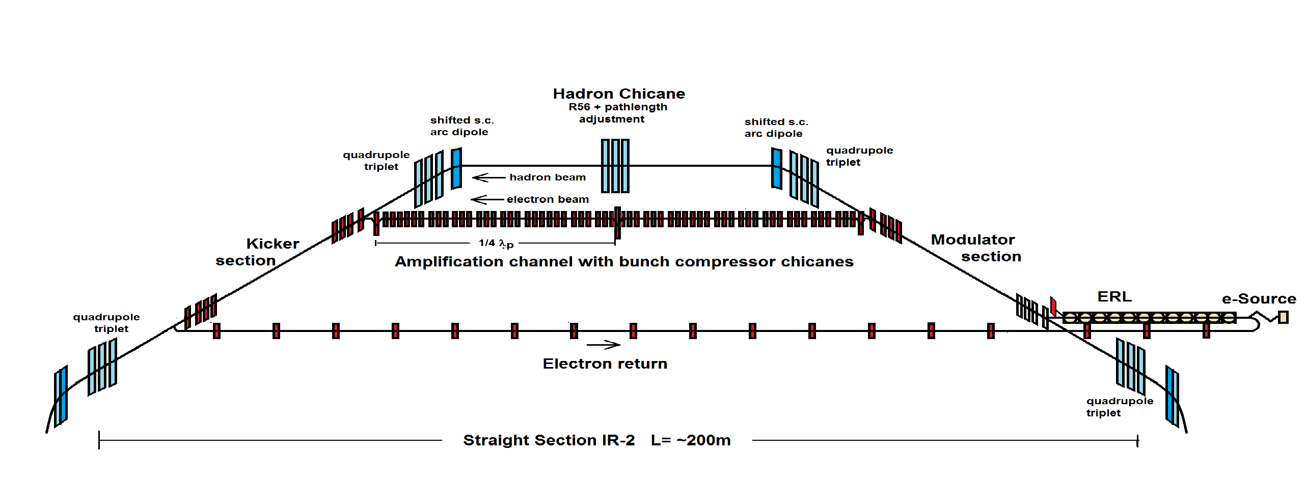
Strong Coherent Hadron Cooling for eRHIC
Coherent Electron Cooling with micro-bunching amplification
Micro-bunched cooling is a novel scheme based on available technology
Similarly as for the JLEIC scheme, this option requires electron cooling at low energy
Also similar to JLEIC, harmonic RF used to reduce the correlated energy spread.
Almost no transport between ERL and modulator to reduce microbunching gain

Slide 6
eRHIC BBU Cooler Specifications
Energy 40–150 MeV
Accelerator frequency 591 MHz
Charge 1.0 nC
Pulse frequency 118 MHz
Gun current 118 mA
rms Energy spread (uncorr.) 1x10⁻⁴
Energy spread (p-p corr.) 4x10⁻⁴
Bunch length (tophat) 1 cm (7°)
Transverse emittance 1 mm-mrad
Electron beta in cooler 37.6 cm
Cooling Insertion length 200 m

Slide 7
Critical Technologies for ERL/CCR Design (Injector)
Injector capable of high charge and high current (magnetized beam)
  DC photocathode gun
  NCRF photocathode gun
  DC thermionic RF gridded gun (better for ERL only)
  SRF photocathode gun with emittance exchange
    BNL gun demonstrated charge and beam quality. Still have to show lifetime.
  Tophat profile essential for CCR design
  All photocathode designs have to demonstrate better lifetime

Slide 8
Critical Technologies for ERL/CCR Design (Linac)
SRF cavities with strong HOM damping.
HOM loads with high power capability
BBU control and suppression
Strong reactive loading
Use harmonic RF to enhance acceptance
State of the Art already very impressive

Slide 9
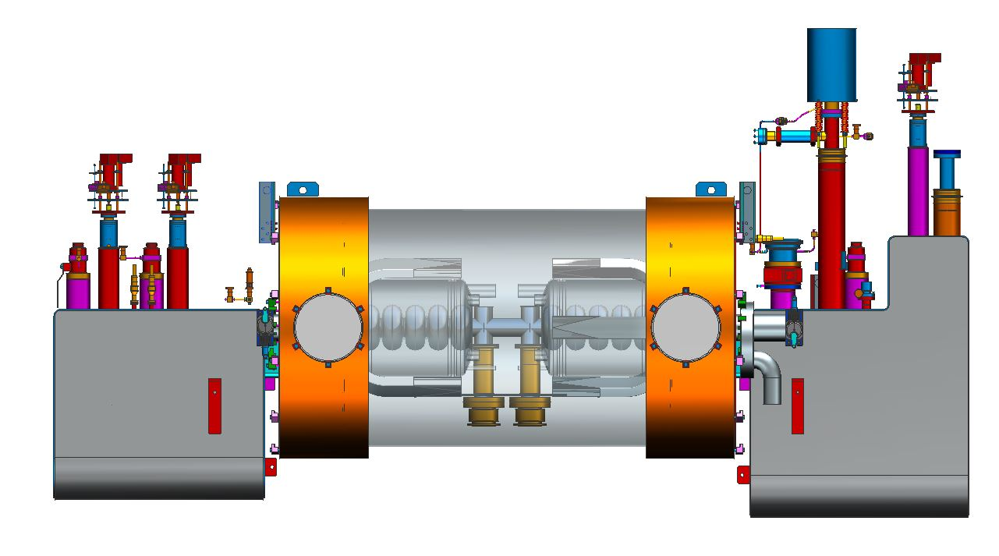
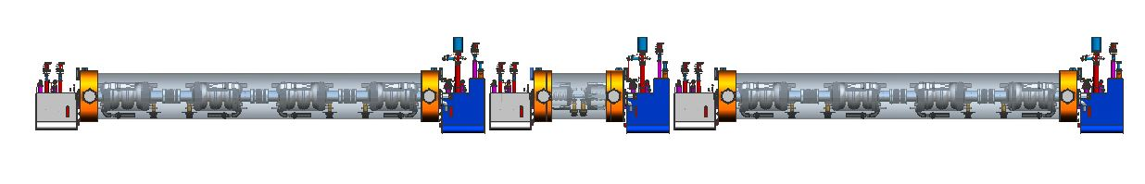
ERL Linac
Four 3-cell 476.3 MHz Cavities
Two 5-cell 1428.9 MHz Cavities

Slide 10
Critical Technologies for ERL/CCR Design (CCR arcs)
The CCR has the following requirements:
  Isochronous.
  Achromatic
  Need RF compensation to counter SC and CSR
  Moderate size
  High periodicity with rational tune
  Local axial symmetry
  Local isochronicity ⬄small compaction oscillations (for µBI)
  Local dispersion suppression
  No tune resonances except for coupling resonance
Can we take advantage of CSR shielding?

Slide 11
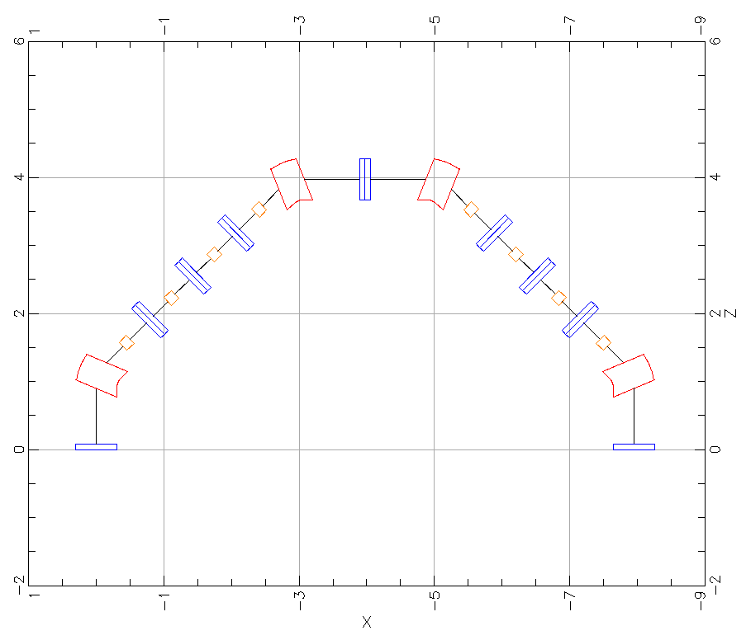
Simple Arc Layout
design by D. Douglas
dipole
quadrupole
sextupole

Slide 12
Critical Technologies for ERL/CCR Design (CCR arcs)
The CCR has the following requirements:
  Isochronous.
  Achromatic
  Need RF compensation to counter SC and CSR
  Moderate size
  High periodicity with rational tune
  Local axial symmetry
  Local isochronicity ⬄small compaction oscillations (for µBI)
  Local dispersion suppression
  No tune resonances except for coupling resonance
Can we take advantage of CSR shielding?

Slide 13
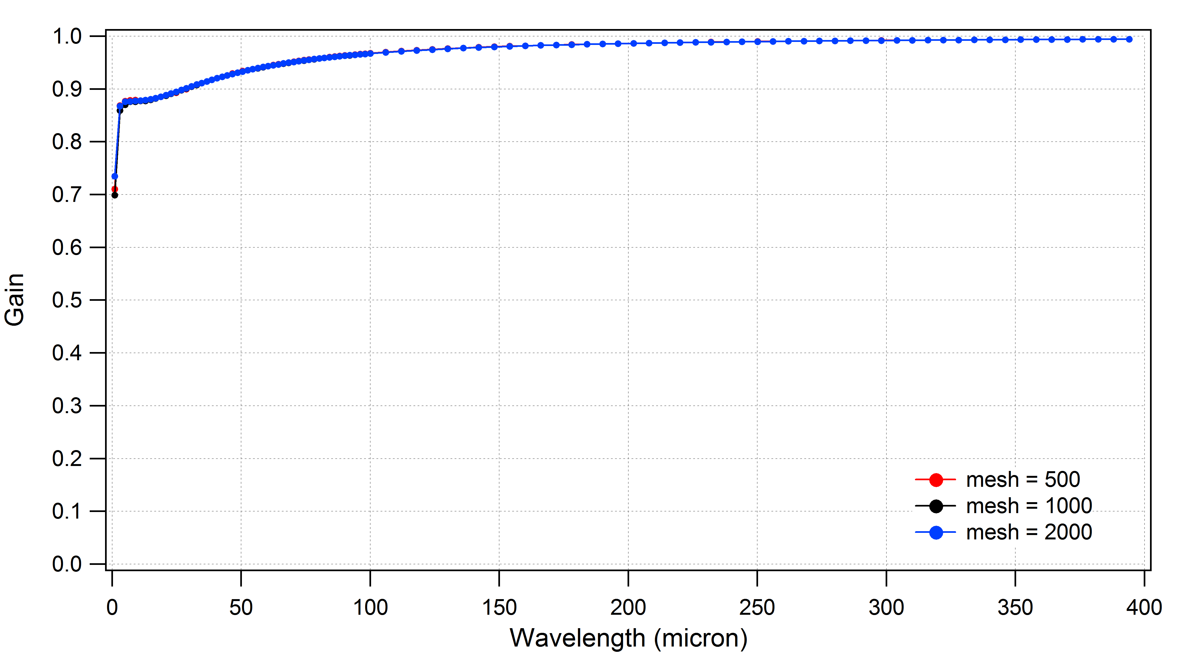
Microbunching Gain for Simple bend
μBI gain is ≤ unity
needs to be less than unity for multiple passes (gain grows exponentially)

Slide 14
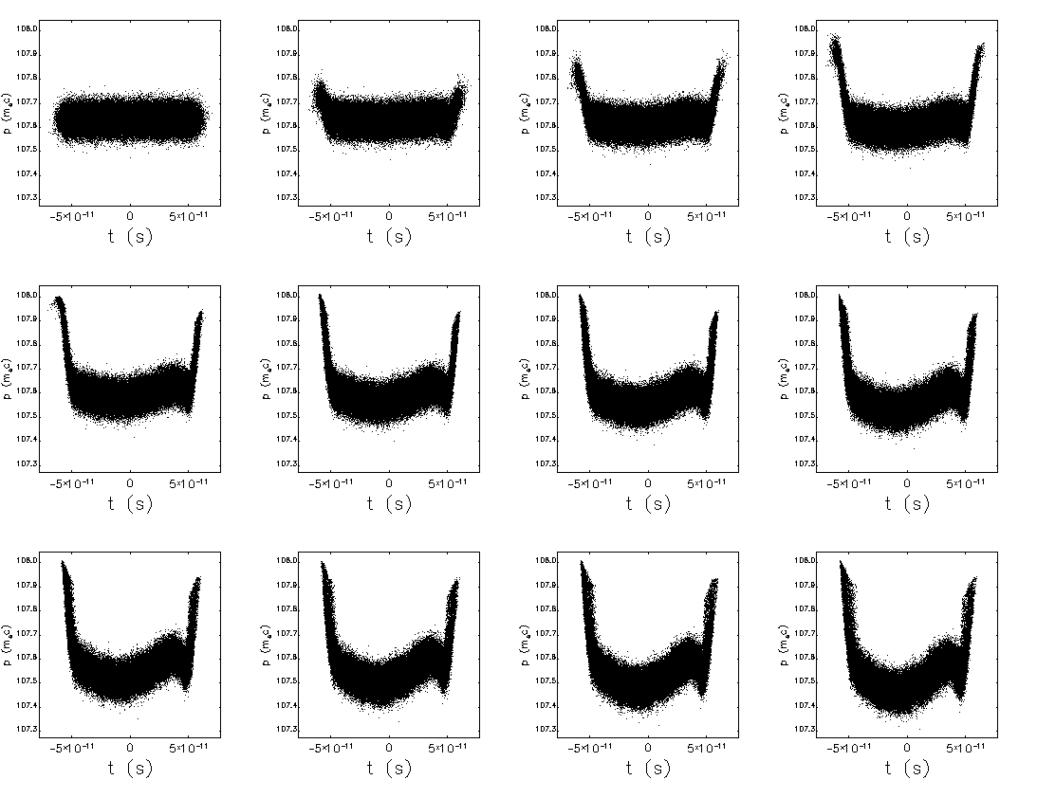
Performance of CCR at 1.6 nC, 4 cm
CSR with RF compensation keeps the core of the beam within spec but the edges are eroded and may be lost.

Slide 15
Must Preserve Magnetization

Slide 16
Effects of Shielding
Longitudinal (top) and horizontal phase space (bottom) after a single traversal through the arc without (left) and with CSR shielding (right). The full aperture is 5.08 cm. (The simulation used 500 bins and 8 image charges).
Might use flat beam transform with small vertical aperture to enhance shielding.

Slide 17
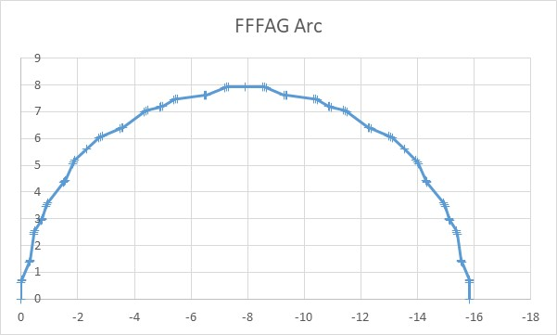
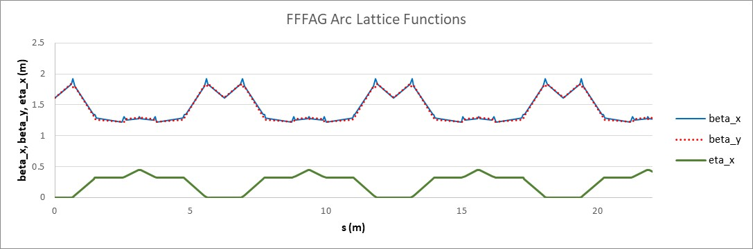
FFFAG Design
FFFAG is Faux Fixed Focus Alternating Gradient lattice
Meets most requirements of CCR but µBI gain is >1.

Slide 18
FFFAG Characteristics
The simple arc meets the following requirements:
  Isochronous.
  Achromatic
  Need RF compensation to counter SC and CSR
  High periodicity with rational tune
  Moderate size
  Local axial symmetry
  Local isochronicity ⬄small compaction oscillations (for µBI)
  Local dispersion suppression
  No tune resonances except for coupling resonance
But µBI gain is >1

Slide 19
What Else?
Halo
  Where does it come from (cathode, FE, IBS, etc.)?
  Have to have collimator design
Helicity flips – Do errors add up and scramble the beam?
Beam dump – Cornell has demonstrated viable design.
Resistive wall and wakes – peak current is low, beam pipes large.
Tolerances – even the edges of the beam must be stable.
Ions – Need ion clearing gap. How do we make it?
  Can create in the gun but then have to deal with booster transient
  Can create after the booster but need fast kicker.
Turn on transients – How much power overhead do we need?

Slide 20
Conclusion
What research do we still have to do?
Need high current tests of injectors
Still much design work to do (CCR arcs e.g.)
Prototyping is ongoing.
Definitely need ERL testbed facility for high current beams to test:
  Halo
  Beam loading
  BBU
  Transients
Full scale tests are expensive

Slide 21
Thank You

