Slide 1
SSR2 coupler discussion
IPNO/LAL/FNAL
S. Kazakov, O. Pronitchev, N. Solyak, D. Passarelli
04/19/2019

Slide 2
SSR2 Coupler Requirements
Electromagnetic | Parameter | Value
 | Frequency, MHz | 325
 | Pass band (S₁₁<0.1), MHz | > 1
 | Maximum operating power, kW (CW, <20% reflection) | 15
 | Acceptance Testing power, kW (CW, any reflection) | 18
 | Loaded Q | 5.05E+6 ± 20%
 | HV bias, kV | ± 4
 | Ceramic window dielectric loss constant | <1E-4
Mechanical | Parameter | Value
 | Input coaxial line aperture, mm | 76.9
 | Input coaxial line impedance, Ω | 50
 | Output coaxial line aperture, mm | 72.9
 | Output coaxial line impedance, Ω | 105
 | RF window | Single, RT
 | Cavity flange relative displacement, mm | ± 3
 | Vibration and shock, g (in any direction) | ≤ 3
 | Antenna tip centering, mm | < ± 1.5
 | Antenna tip vibration (by air cooling), mm | < ± 0.1
 | Vacuum leak tightness, l*Torr/s | < 2E-10
Thermal
 | Thermal intercepts (nominal), K | 5 and 50
 | Temperature at 5 K intercept, K | < 15
 | Temperature at 35-50 K intercept, K | < 125
 | Maximum 2K heat load, W | < 0.9
 | Maximum 5K heat load, W | < 3.5
 | Maximum 35-50K heat load, W | < 8.6
 | Maximum antenna tip temperature, K | < 330
 | Antenna cooling media | Air
 | Air flow rate, g/s | < 2
 | Max cooling air pressure drop, bar | < 1
 | Air output temperature, K | < 323
Diagnostics
 | Temperature sensors (per each coupler) | 7
 | E-probe current monitor | 1
 | Bias current monitor | 1
 | Bias voltage monitor | 1
 | Air output flow monitor | 1
Requirement # | Requirement Statement
F-121.2.03.03-F001 | The SSR2 input coupler shall operate at 325 MHz frequency
F-121.2.03.03-F002 | The SSR2 input coupler shall have a single RF window
F-121.2.03.03-F003 | The SSR2 input coupler shall have a fixed coupling with the cavity
F-121.2.03.03-F004 | The SSR2 input coupler shall have an air cooling of the inner conductor
F-121.2.03.03-F005 | The SSR2 input coupler shall support operation with High Voltage DC bias applied on the inner conductor
F-121.2.03.03-F006 | The SSR2 input coupler shall have an ability to control applied High Voltage DC bias in situ.
F-121.2.03.03-F007 | The SSR2 input coupler shall be able to support cavity operation at nominal gradient with 10% overhead.
Important parameters:
Maximum operating power 15 kW, CW, 20% reflection.
Acceptance test 18 kW, CW, full reflection, all phases.
Max. 2K heat load < 0.9 W.
Max. 5K heat load < 3.5 W.
Max. 35-50K heat load < 8.6 W.

Slide 3
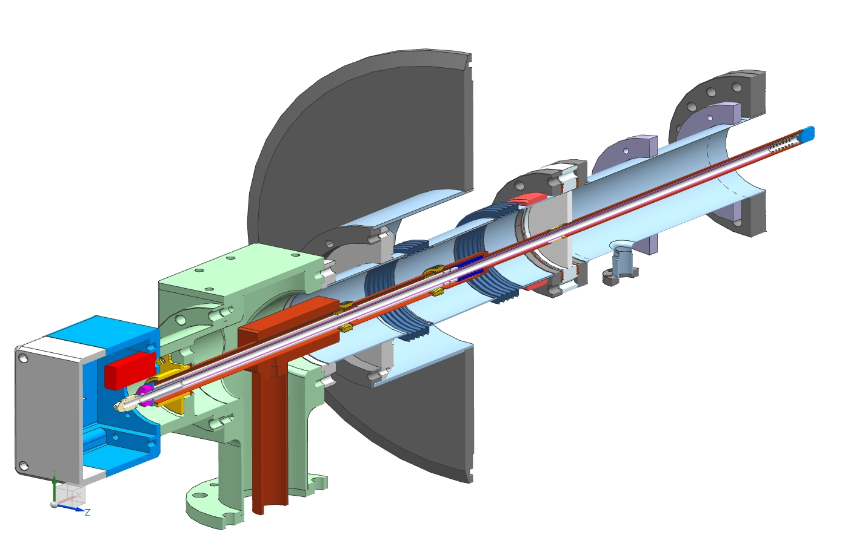
Current 325 MHz coupler (SSR1 coupler)
Cryomodule flange
Spring to compensate
thermal expansion
“5K” intercept
“80K” intercept
Ceramic window
Statistics of SSR1 coupler testing at room temperature coupler test stand:
~ 17 windows with antennas were tested at test stand, CW, full reflection, 4 phase points (90 dgr shift).
10 kW: tested - 17, no failures
20 kW: tested – 5, one failure (not good ceramics and not enough cooling for this ceramics).
30 kW: tested - 2, no failures.
47 kW: tested - 2, one failure. Not full test (it was not 4 phase points)
Antenna
Matching bump
Arc detector
Cold flange
e-pickup port
Ni-Cu bellows
3’’x 0.0158’’
stainless steel tube
Heater
Air inlet
3-1/8’’ coaxial input

Slide 4
Formally SSR1 coupler satisfy SSR2 coupler reequipments (18 kW acceptance full reflection test).
But based on experience we strongly believe that we know how to improve coupler design and make it more powerful, more reliable and simpler in production.
Main problem of current design is short copper sleeves for brazing ceramic disk to stainless steel flange and to copper antenna. As results there are difficulties during brazing and mechanical stresses is higher then they could be.
Sleeves must be changed.
Second important problem - the configuration of thermal intercepts is not convenient for connecting thermal straps.
Shapes of thermal intersects must be changed.

Slide 5
Full list of suggested changes which should be done in SSR2 coupler prototype:
Diameter of air cooling pipe should be increased. It improves air cooling. Gap between air pipe and antenna wall becomes smaller. It increases air seed, increases convection coefficient and improves cooling. Second, air piper is more rigid and supports better the copper antenna.
Tip of air cooling pipe should be pressed to surface of antenna tip. It reduce possibility of vibration.
Shapes of 5K and 50K thermal intercepts must be changed to provide better thermal contacts with thermal straps.
Copper iris should be added to outer conductor and copper disk is added to antenna. Iris reduce thermal radiation from window and protects ceramic window against charged particles. Copper disks matches Ceramic window and protect it as well.
Bayonet lock of air piper should be change to thread connection. It allows to press the tip of air pipe to surface of antenna tip and reduce the probability of oscillations (see item 2).
Diameter of ceramic window should be increased. It reduce mechanical stresses in ceramic window and in copper sleeves.
Shapes of copper sleeves must be changes. Length of sleeves must be increased. It will reduce the stresses and will make a brazing more easier.
At air side the lengths of outer conductor and inner conductor can be reduced. It will make coupler more compact and lighter. Cryomodule flange becomes lighter.
Material of outer conductor and inner conductor (with bellows) can be changed to stainless steel. It will make parts more robust and will make production easier.
Shape of matching element of T-junction can be changed. It will make the assembling simpler.
Connection between coaxial Tee and instrumental box should be changed to make assembling simpler.

Slide 6
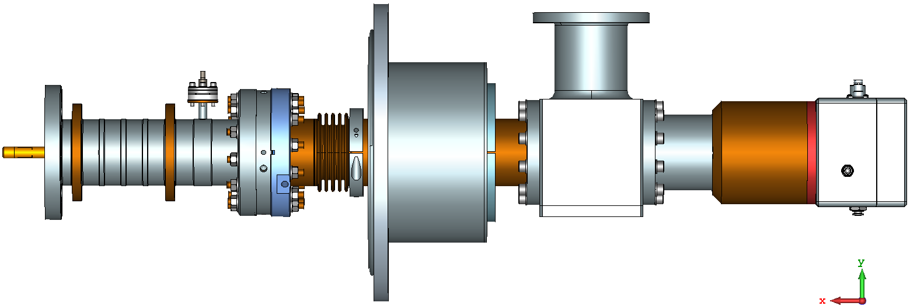
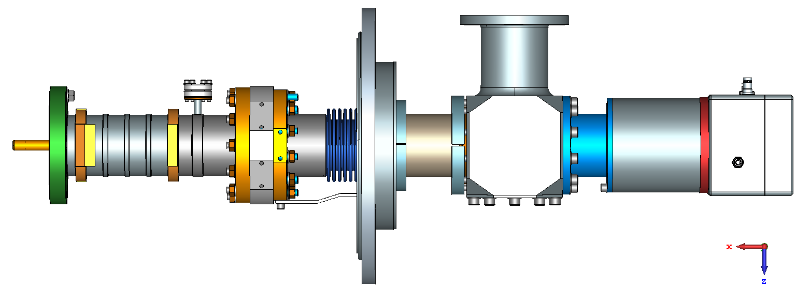
New preliminary design was made which incorporates all changes:
Old
New version is shorter and lighter.
New

Slide 7
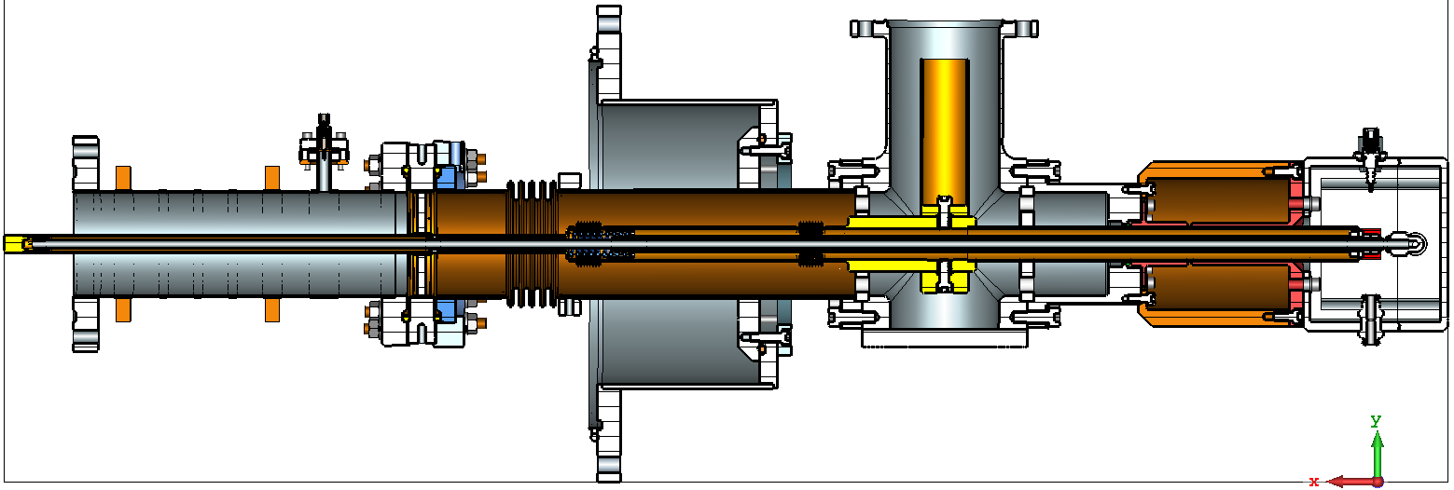
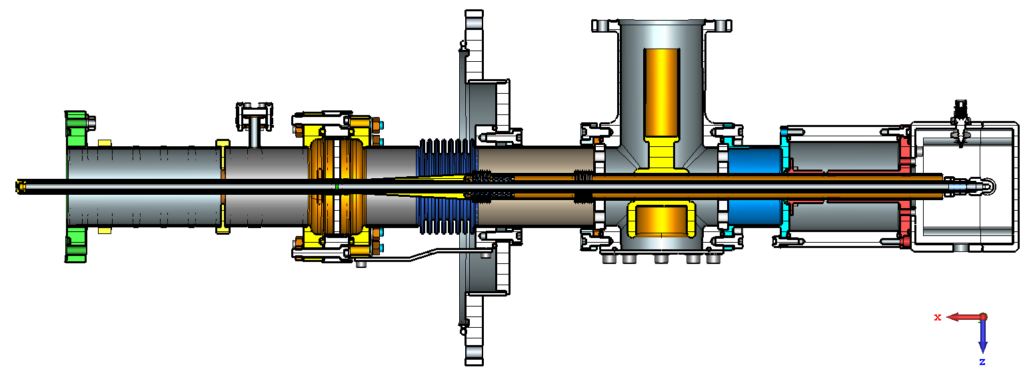
Old
New

Slide 8
Simulations show:
Mechanical stresses is ~ 2.5 less in new coupler then in old one.
Multipactor can be suppressed by 3.5 kV bias up to 100 kW, TW even with not coated ceramic window.
What need to be done else for new design:
Choose final length and thickness of vacuum outer conductor.
Check the thermal property of coupler (without and with copper coating).
Check the possibility to use thicker ceramic.
Dynamic characterization of vacuum-end coupler assembly for protection against transportation loads
What we can provide to LAL right now:
3D model of old design.
3D model of new design.
New design is strongly based on previous design and it is an improved version.
New coupler will be used for SSR2 and SSR1 cavities.
Appendix of this presentation includes slides with detail explanation of changes.

Slide 9
Appendix

Slide 10
Old
New

Slide 11
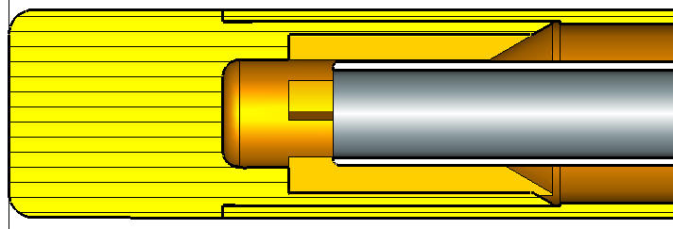
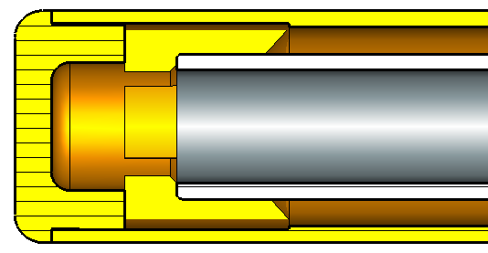
Diameter of air cooling pipe was increased.
Bayonet lock of air piper was change to thread connection.
It allows to press the tip of air pipe to surface of antenna tip and reduce the probability of oscillations.

Slide 12
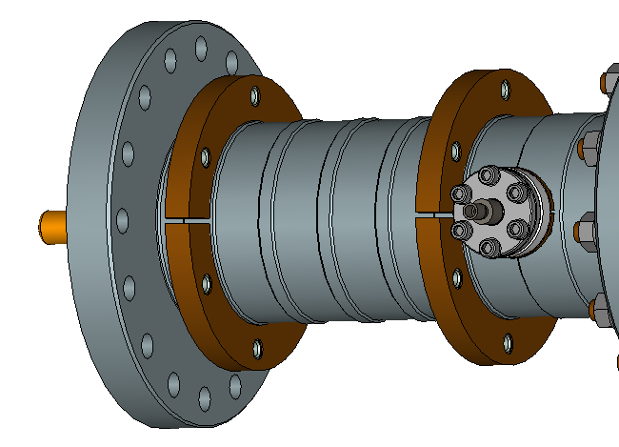
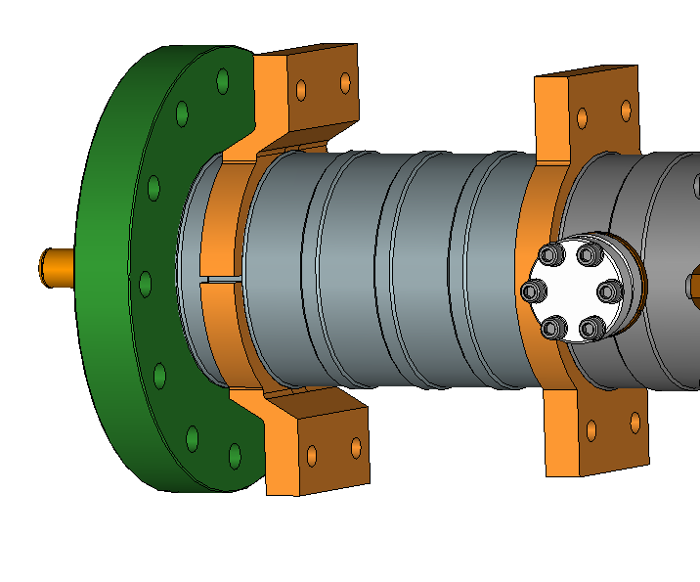
Shapes of 5K and 50K thermal intercepts were changed to provide better thermal contacts with thermal straps.

Slide 13
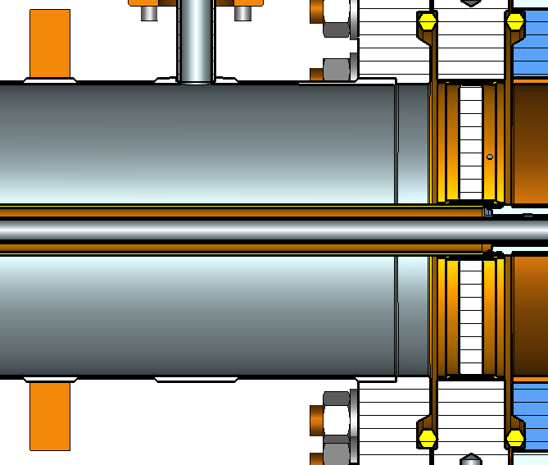
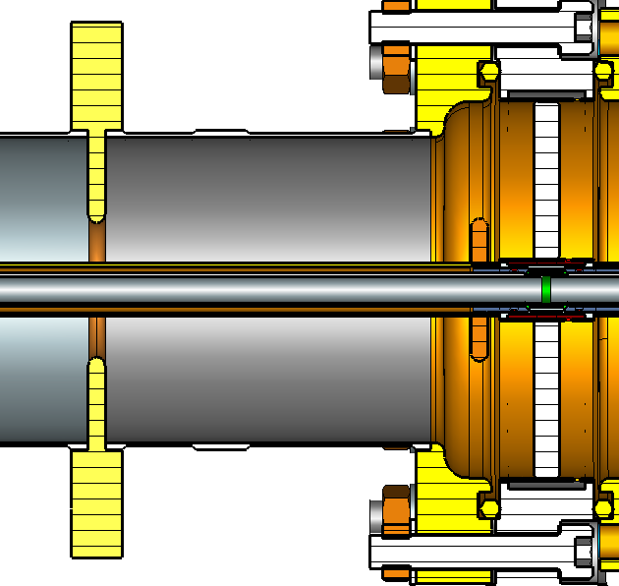
Copper iris is added to outer conductor and copper disk to antenna. Iris reduce thermal radiation from window and protects ceramic window against charged particles. Copper disks matches Ceramic window and protect it as well.

Slide 14
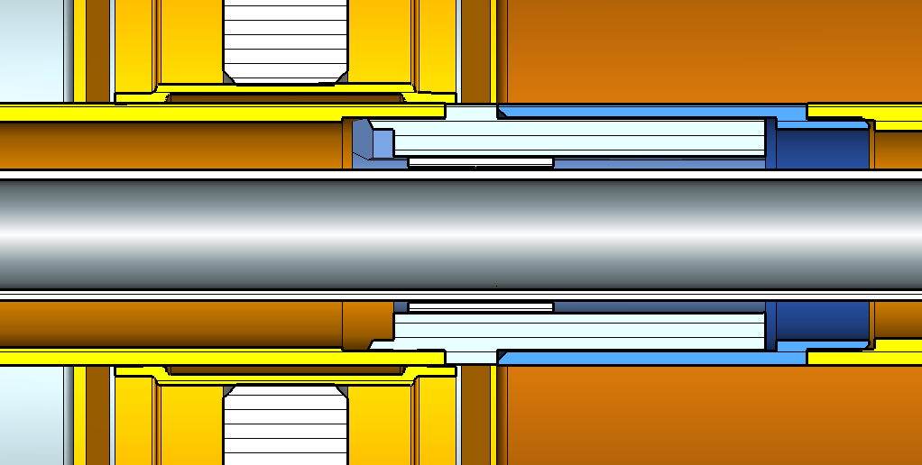
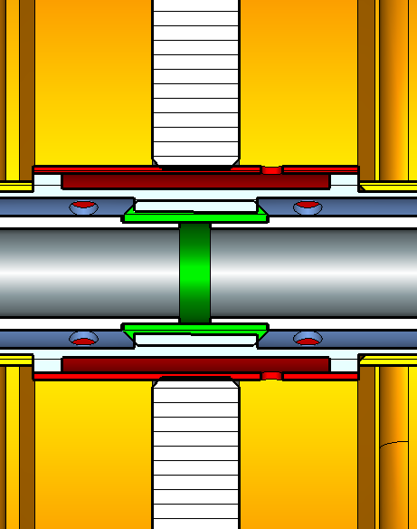
Air
Bayonet lock of air piper was change to thread connection. It allows to press the tip of air pipe to surface of antenna tip and reduce the probability of oscillations.
Air

Slide 15
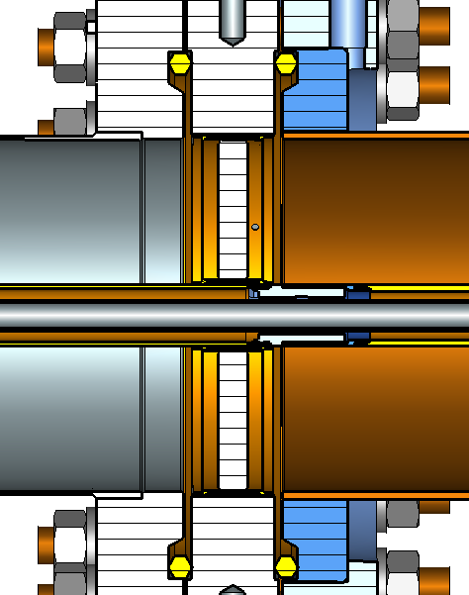
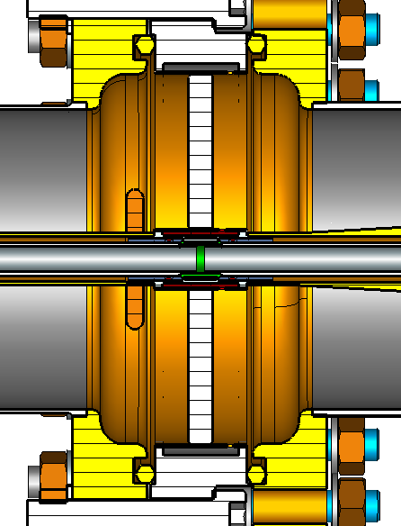
Diameter of ceramic window was increased. It reduce mechanical stresses to ceramic window and to copper sleeves.
Shape of SS flanges around ceramic window were changes. Flanges became lighter and in improves the penetration of electric filed of HV bias.

Slide 16
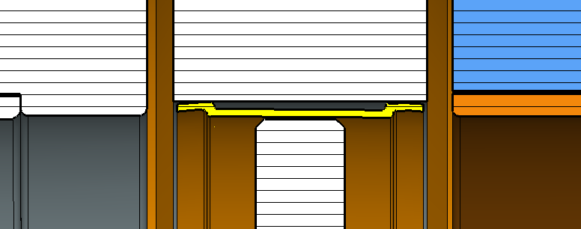
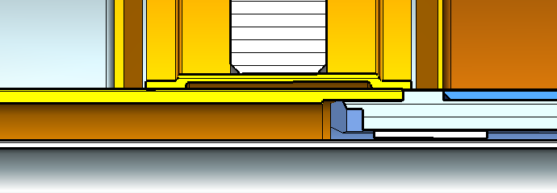
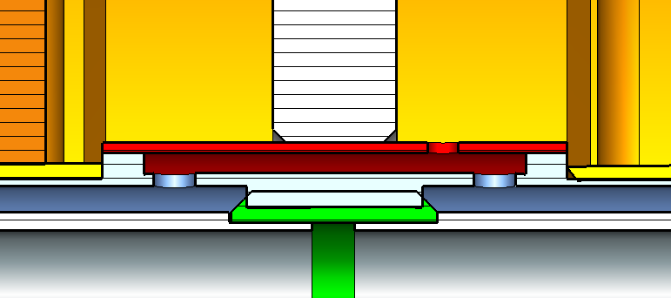
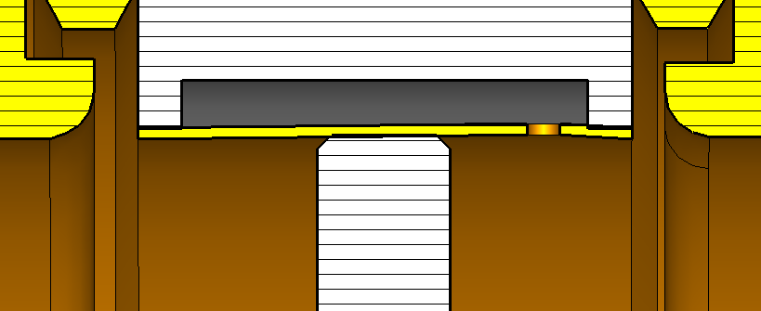
Shapes of copper sleeves were changes.
Length of sleeves were increased.

Slide 17
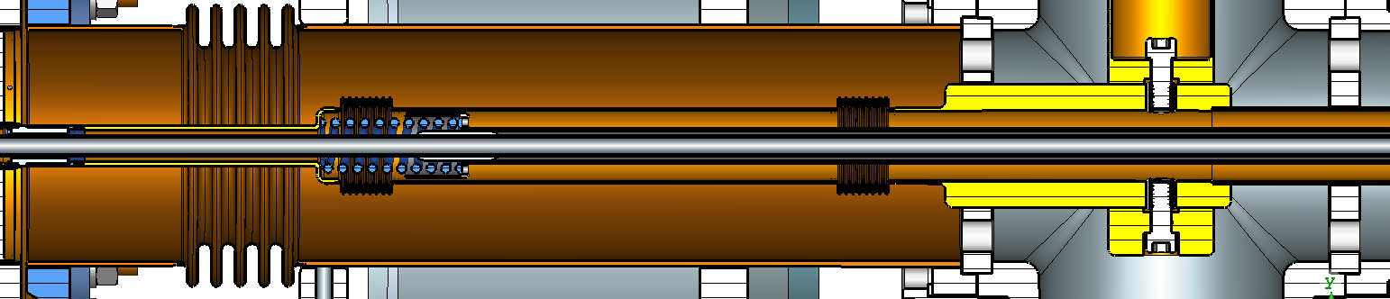
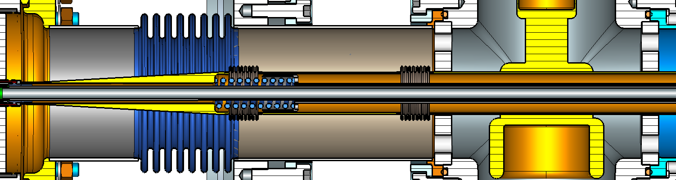
At air side the lengths of outer conductor and inner conductor were reduced. Material of outer conductor and inner conductor (with bellows) was changed to stainless steel.

Slide 18
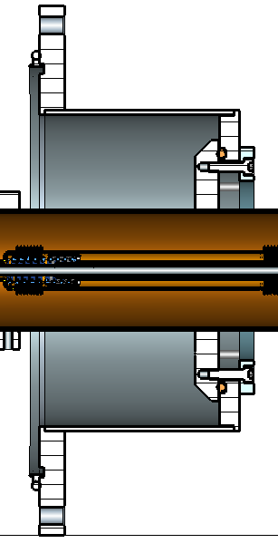
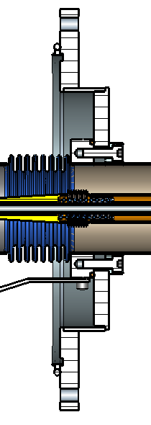
Cryomodule flange becomes lighter.

Slide 19
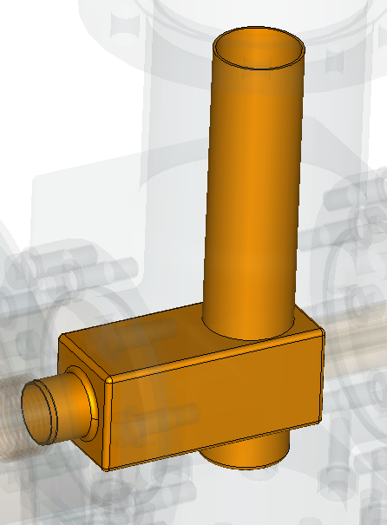
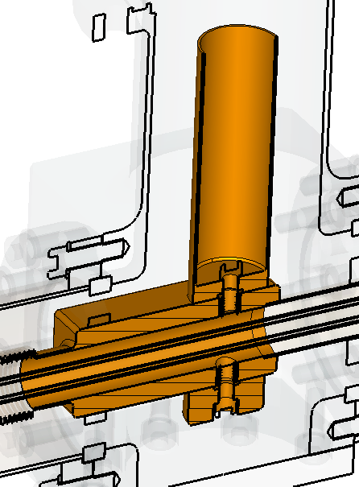
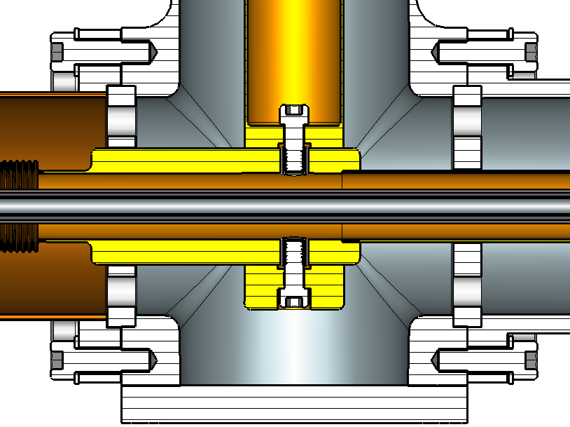
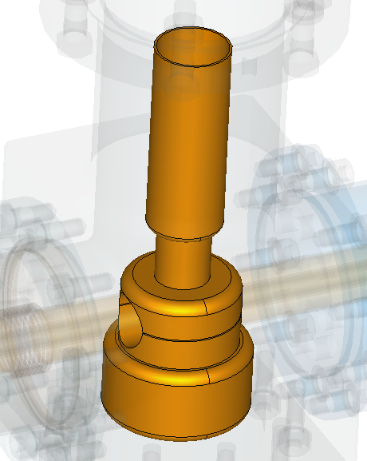
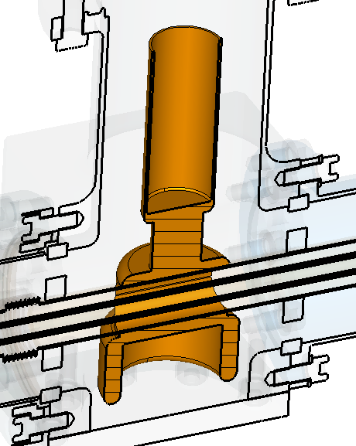
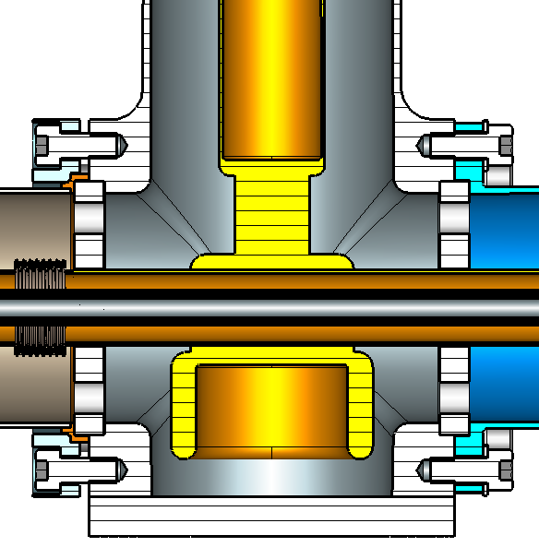
Shape of matching element of T-junction was changed. It will make the assembling simpler.

Slide 20
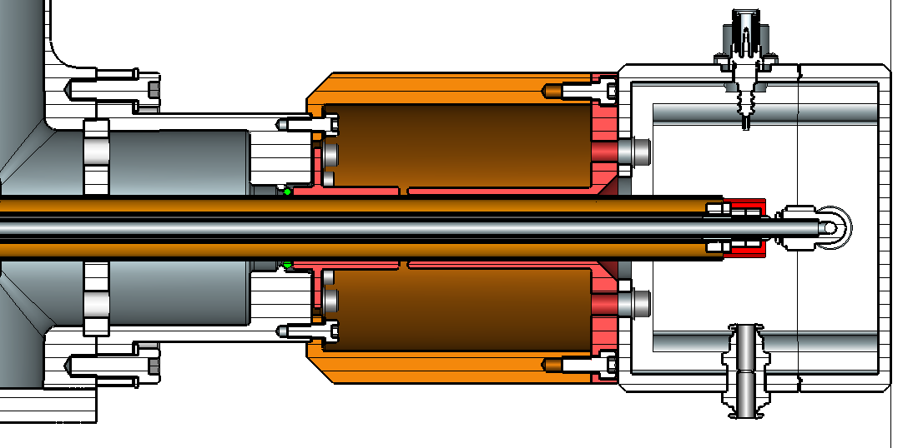
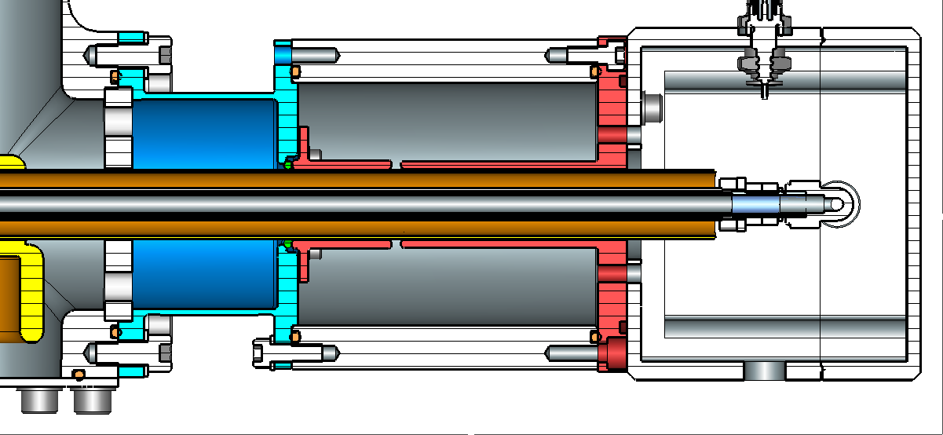
Connection between Tee and instrumental box was changed to make assembling simpler.

Slide 21
Reducing the stresses.

Slide 22
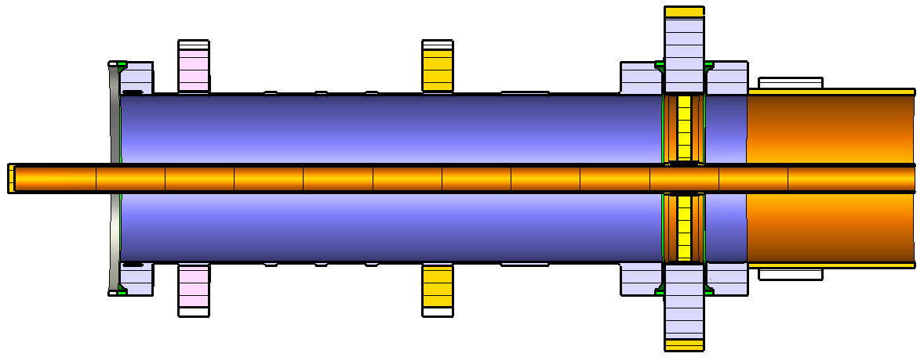
Main cause of stresses is difference of thermal expansions of ceramics and metal environment. Stresses depends on RF window configuration (materials, geometry) and cooling.
As reference was chosen present window of 325 MHz coupler.
Boundary conditions:
15K
90K
2K
Air, 293K,
h = 6W/(K*m2)
Air
Convection coefficient inside antenna: h = 26.83 + 56.54*A_rate (g/s)
A_rate (g/s) | 1 | 2 | 3
h (W/(K*m2)) | 83.4 | 139.9 | 196.5

Slide 23
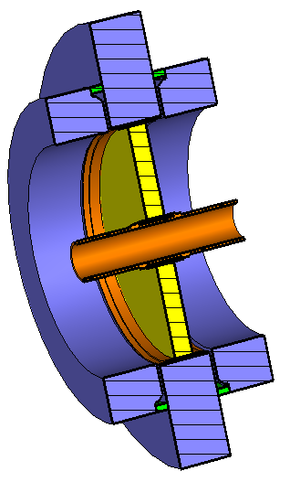
Analyzed configurations
Current version, VC

Slide 24
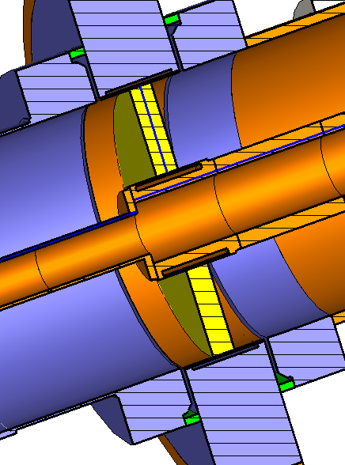
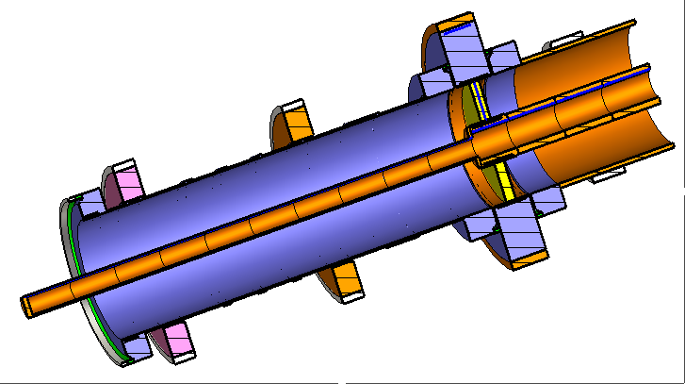
Version 1, V1
Lengths and of copper sleeves are increased.
Diameter of inner conductor at brazing point is increased.

Slide 25
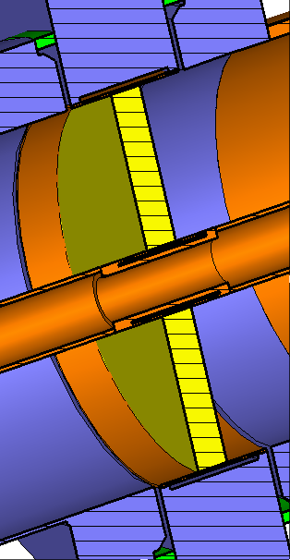
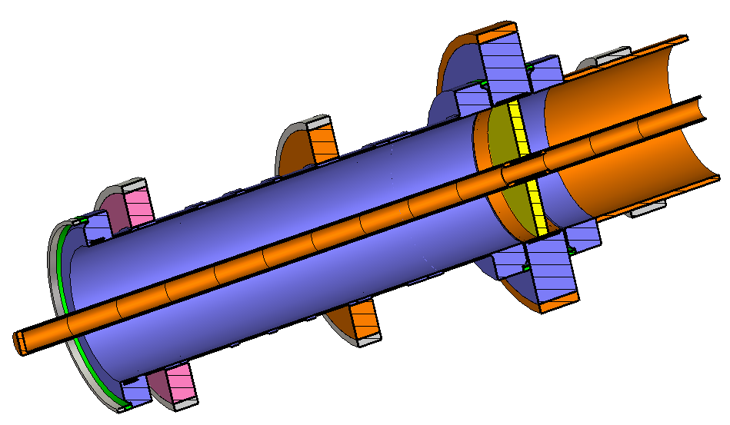
Version 2, V2.
Only lengths of copper sleeves are increased.

Slide 26
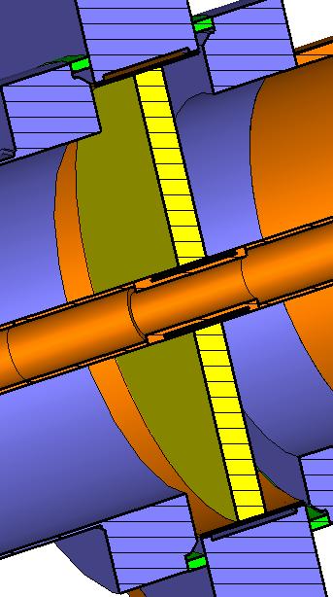
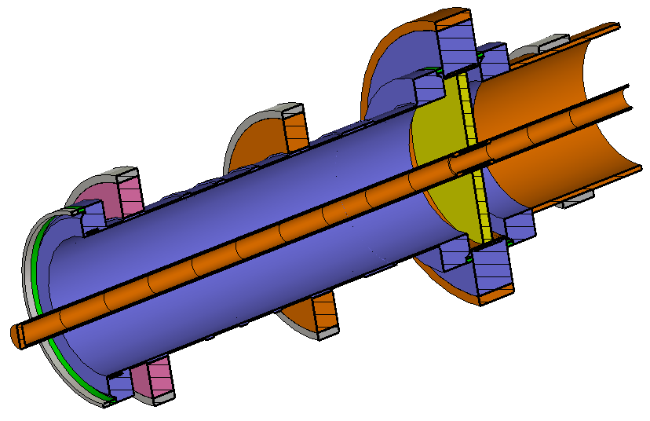
Version 3, V3
Lengths and of copper sleeves are increased.
Diameter of ceramic increased (from 76mm to 90mm)

Slide 27
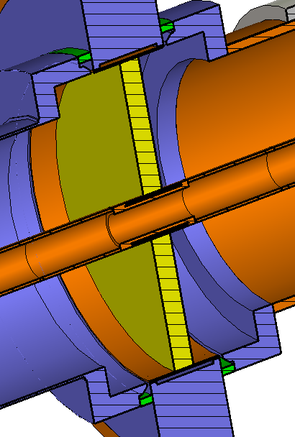
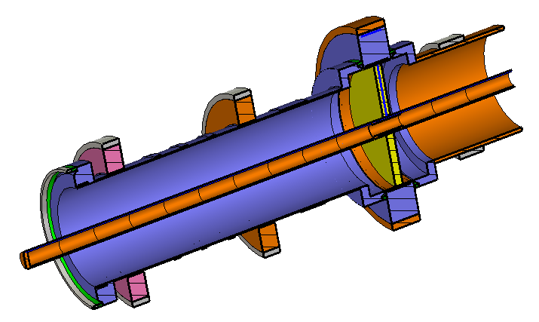
Version 4, V4
Lengths and of copper sleeves are increased.
Diameter of ceramic increased (from 76mm to 90mm)
Diameters of flanges around ceramics are increased

Slide 28
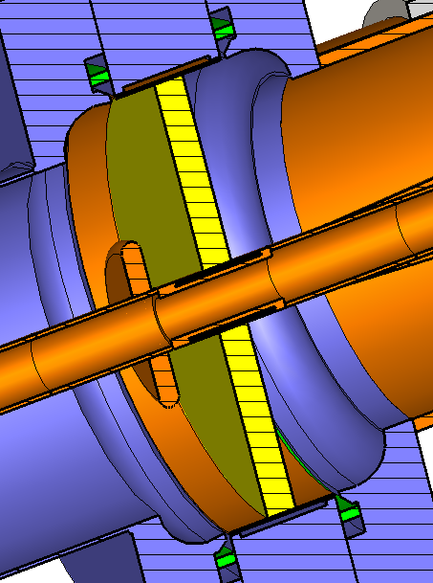
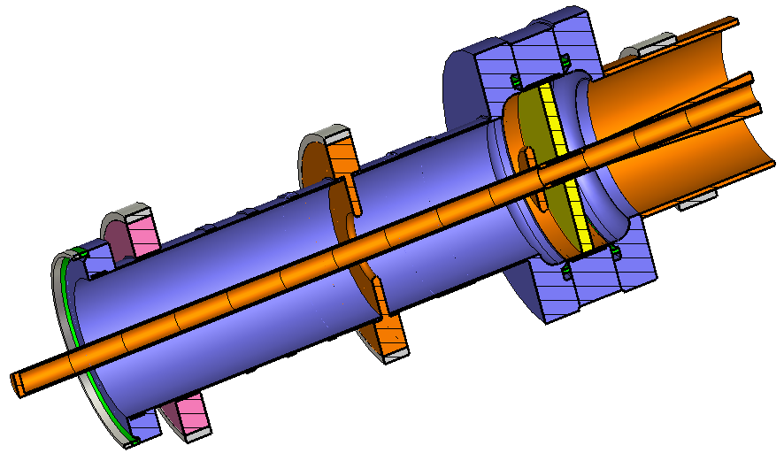
Final version, V5
Lengths and of copper sleeves are increased.
Diameter of ceramic increased (from 76mm to 90mm)
Diameters of flanges around ceramics are increased
Iris and antenna copper disk are added.

Slide 29
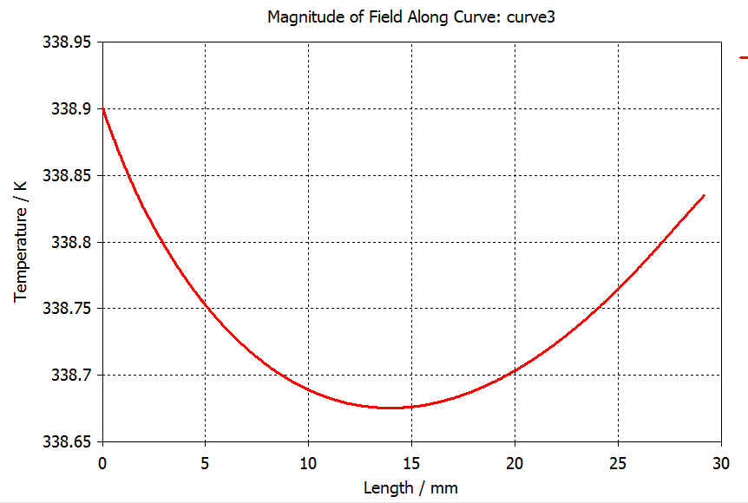
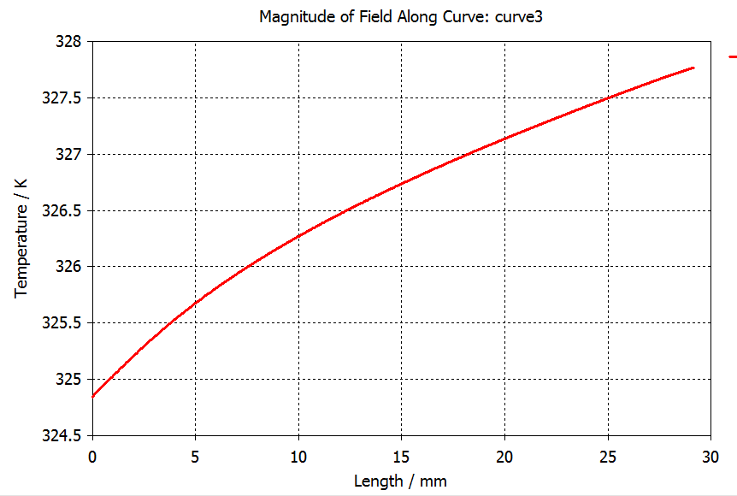
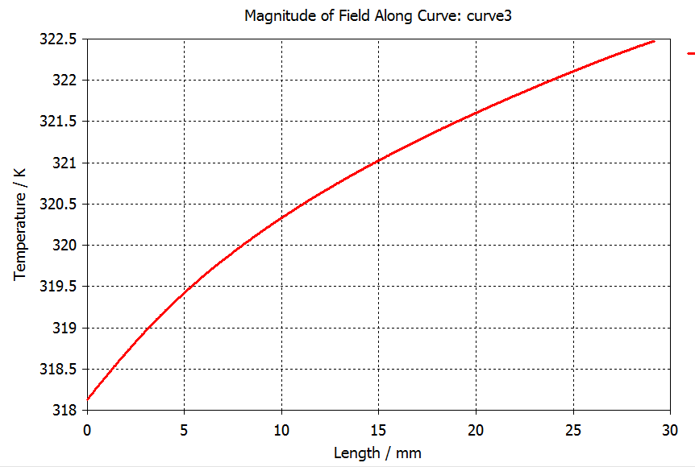
For simulation and comparison was chosen power 30 kW, full reflection, phase 270 dgr – the worst phase for ceramic temperature and stresses.
Examples of temperature distribution along ceramics for current design:
30 kW, SW, 270 dgr, 1g/s
30 kW, SW, 270 dgr, 2g/s
30 kW, SW, 270 dgr, 3g/s

Slide 30
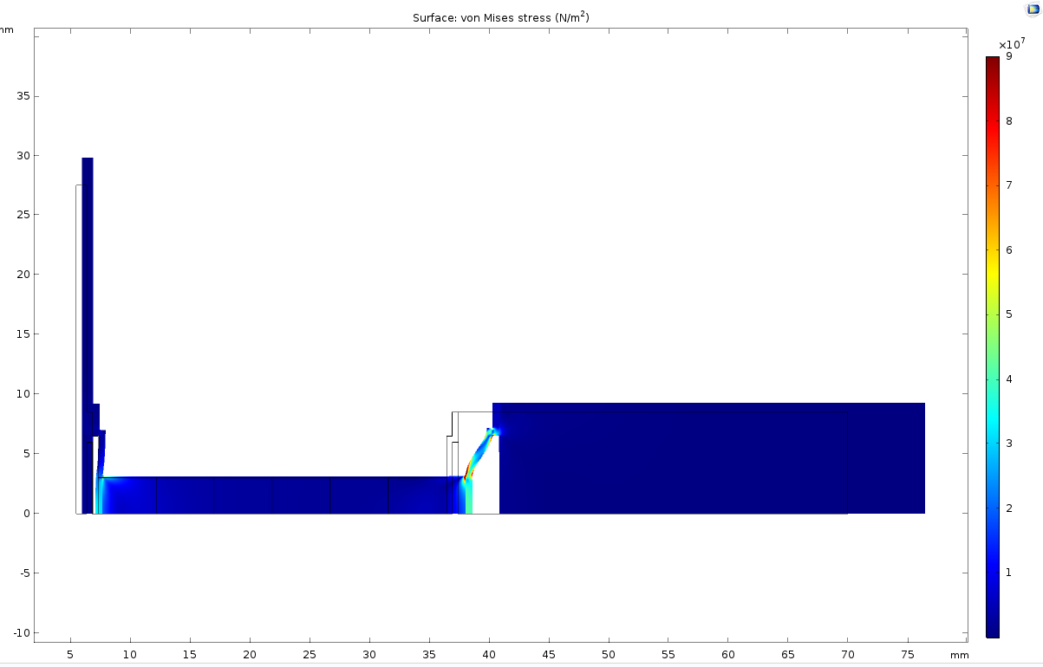
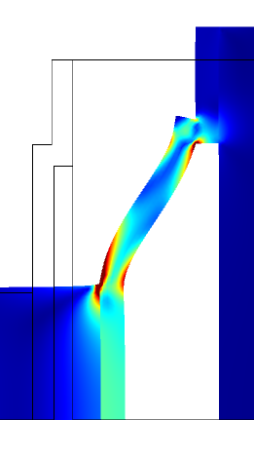
Stress analyses
(I. Gonin)
Current version (VC)
30 kW, SW, 270degr. 3 g/s
Input parameters:
Temperature distribution along ceramics.
Mechanical boundaries: free.
Thermal boundaries:
dQ/dt=0.

Slide 31
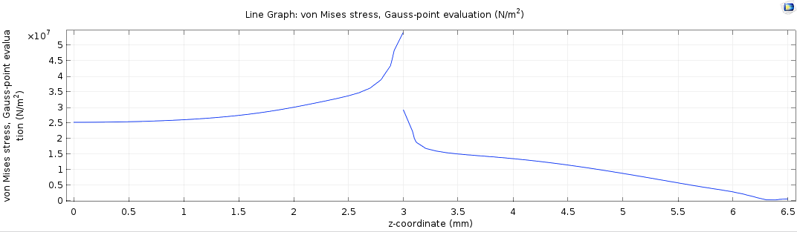
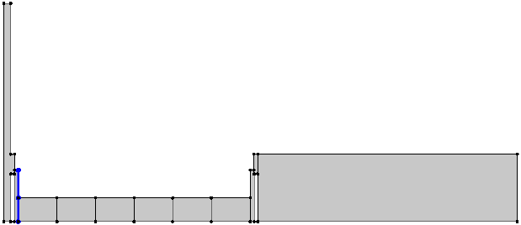


30 kW, SW, 270degr. 3 g/s
Stresses at inner conductor.
Current version (VC)
Stresses at outer conductor.

Slide 32


Stresses reduced ~ V3/VC ~ 40/50 = 0.8

Slide 33


Stresses reduced ~ v3/vC ~ 75/185 = 0.4 (or 100/285 ~ 0.35)
New window can be ~ 2.5 times more powerful.

Slide 34



VC, current design
V3
dT ~ 19.6 C
dT ~ 322.5 -293 = 29.5 C
V5, Final
V4
dT ~ 18.3 C
dT ~ 17.7 C

Slide 35

To compare different configurations (copper sleeves, window size, flanges..) the cooling of antenna was kept the same.
But really we improved the cooling by change the size of cooling pipe.
Final result is even better:
dT ~ 15.6 C
Conclusion:
stresses in new design is 2.5 times less then in current design.

Slide 36


Multipactor.
The suppressing of multipactor in regular coaxial part of coupler was investigated in previse design and proved experimentally. 3.5 kV bias suppresses a multipactor in regular coaxial part for operating range of power.
We need to check a multipactor in new parts only: window region and iris region.

Slide 37

Secondary emission of ceramics:

Slide 38




20 kW, TW, bias = 0 kV

Slide 39




100 kW, TW, bias = -3.5 kV

Slide 40




100 kW, TW, bias = +3.5 kV

Slide 41




20 kW, TW, bias = 0 kV

Slide 42




100 kW, TW, bias = 0 kV

Slide 43



100 kW, TW, bias = +3.5 kV

Slide 44
Conclusion:
Bias 3.5 kV suppresses a multipactor in all parts coupler up to 100 kW, TW at least.

Slide 45



Passband
Passband of coaxial part of coupler is wide enough:
S21:
S11:

Slide 46





Passband of T-junction:

Slide 47




Passband of full configuration:
S21:
S11:
S21:

Slide 48
Conclusion:
Passband of coaxial part of coupler is wide enough.
Passband is determined by T-junction. -3 dB passband is ~ 180 ~ 525 MHz.
We cannot eliminate the T-junction. We need it to apply air cooling and HV bias.
It is difficult to make the passband of T-junction larger.

Slide 49
Final conclusion:
Diameter of ceramic window is increased, shapes of copper sleeves of ceramic window are changed. As results the mechanical stresses are reduced scientifically. It will make new couplers more powerful and/or reliable.
Ceramics window is protected against charged particles in new design.
Thermal radiation to 2K is reduced due to 70K iris. Thermal property of new coupler has to be better.
Air cooling of antennas is improved. It will be more effective and reduce probability of mechanical oscillation caused by air flow.
Configuration of 5K and 50K thermal intercept are changed for more effective thermal joints with thermal straps.
Overall sizes of vacuum part of new coupler are the same as sizes of previse version. Coupler can be used for
SSR1 cavity and SSR1 cryomodule.
Total length and weight of new coupler are reduced.

