Slide 1
High Power RF Distribution for PIP2IT SRF
Dave Peterson
AD/Eng/RF
30 May 2019
In partnership with:
India/DAE - BARC

Slide 2
Outline
Part 1 - Overview & Functions
  Functional Requirements
  HWR Schematic
  SSR1 Schematic
  Overall Design
Part 2 – Interfaces
  Amplifiers
  RF Distribution and Cooling

Slide 3
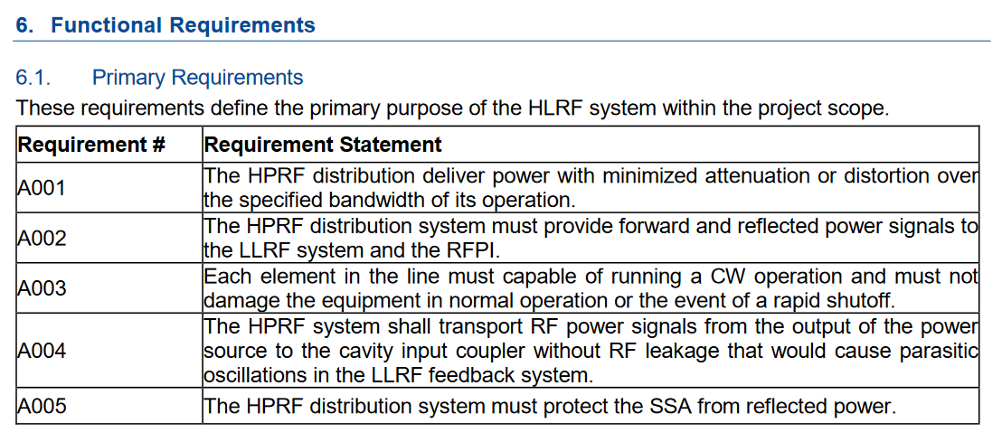
Functional Requirements
ED0010272

Slide 4
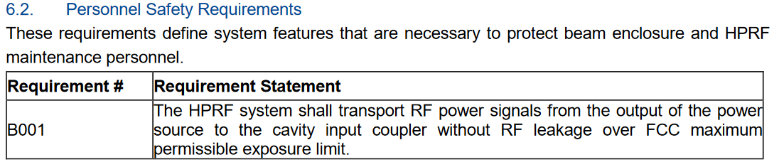
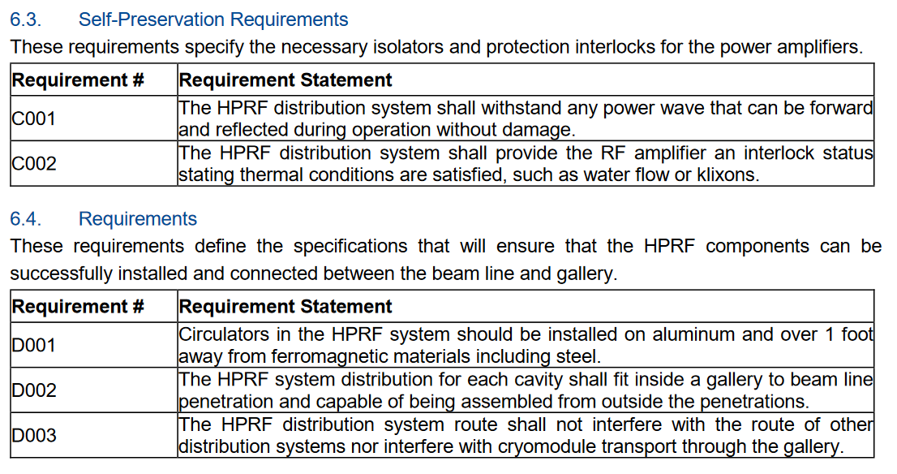
Functional Requirements

Slide 5
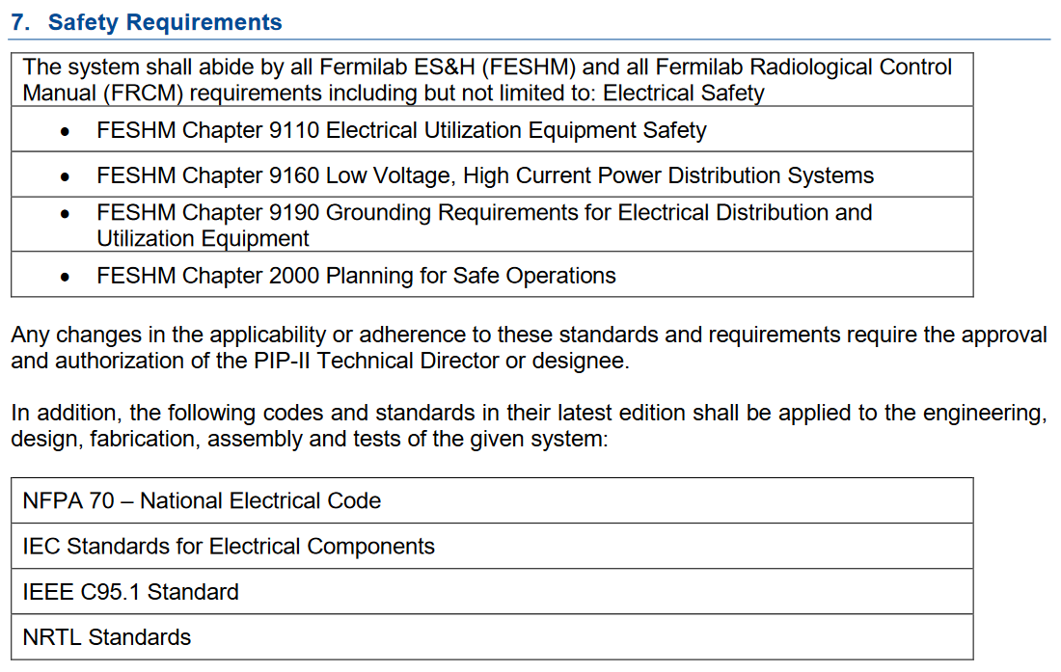
Functional Requirements

Slide 6
CMTF Layout
494021_CMTF_24JAN2019.pdf

Slide 7
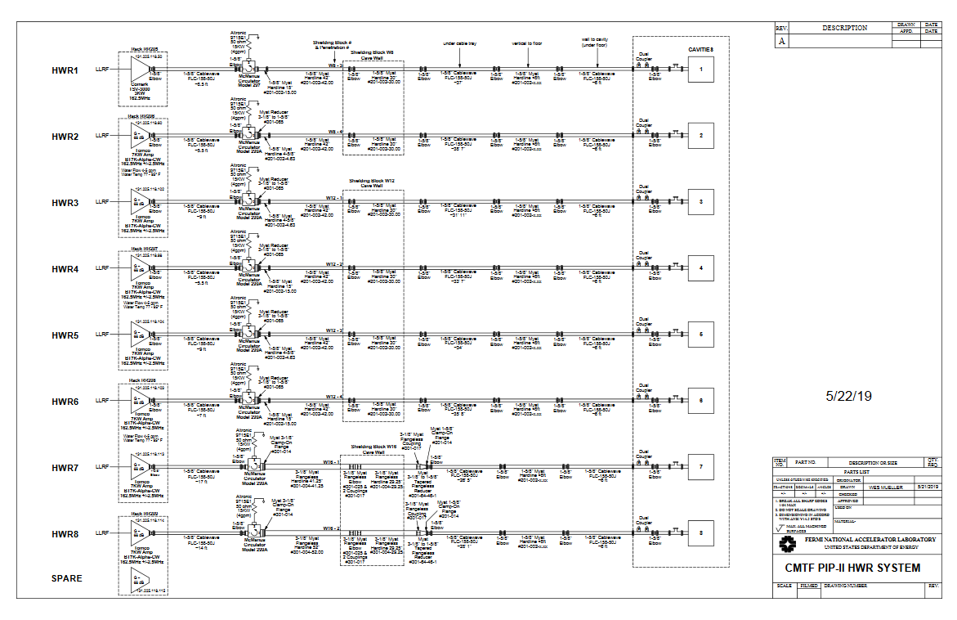
HWR Schematic

Slide 8
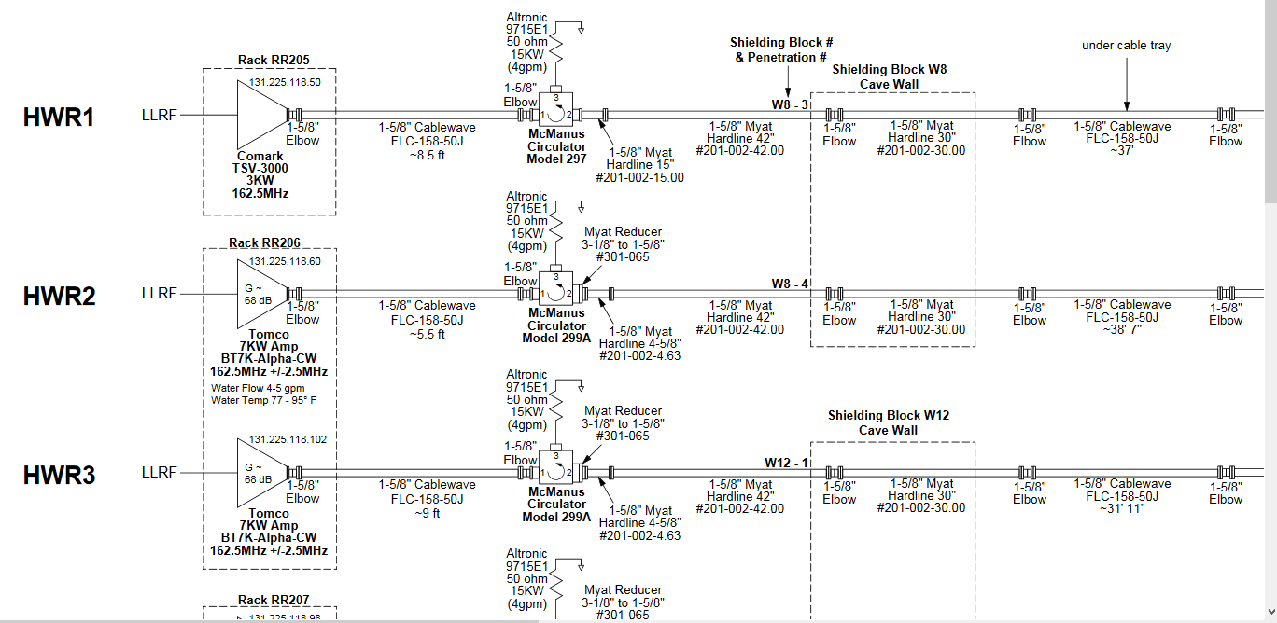
HWR Schematic

Slide 9
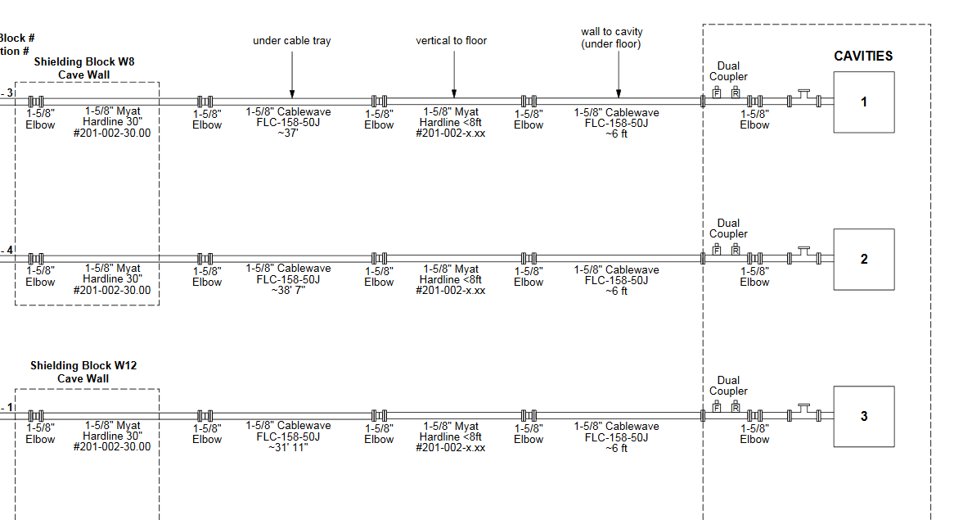
HWR Schematic

Slide 10
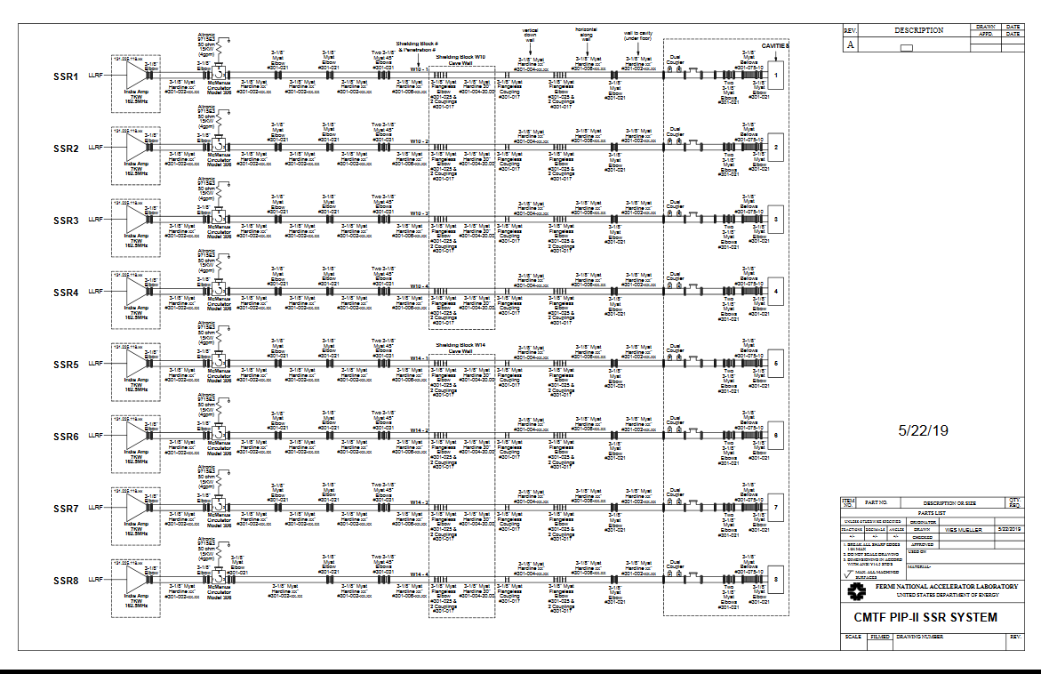
SSR1 Schematic

Slide 11
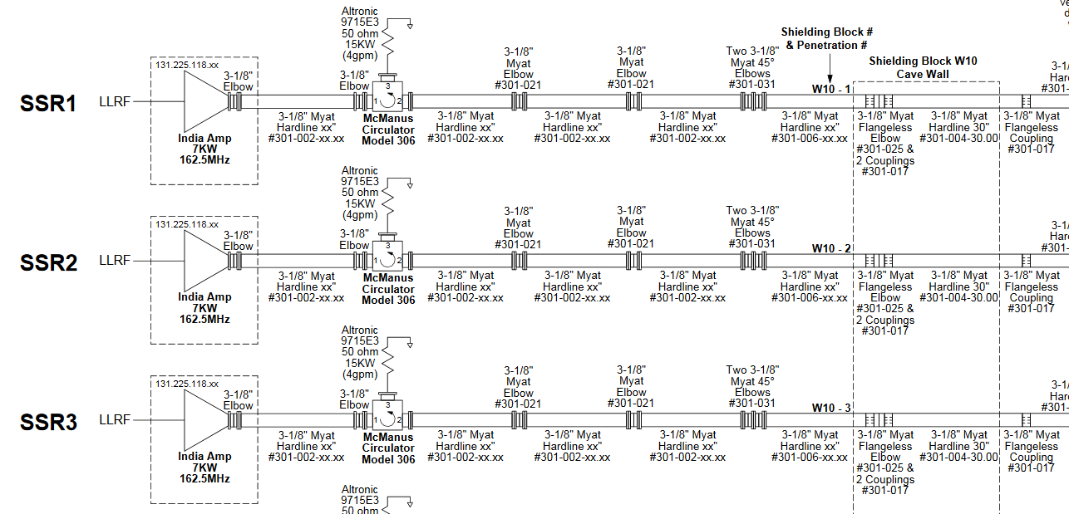
SSR1 Schematic

Slide 12
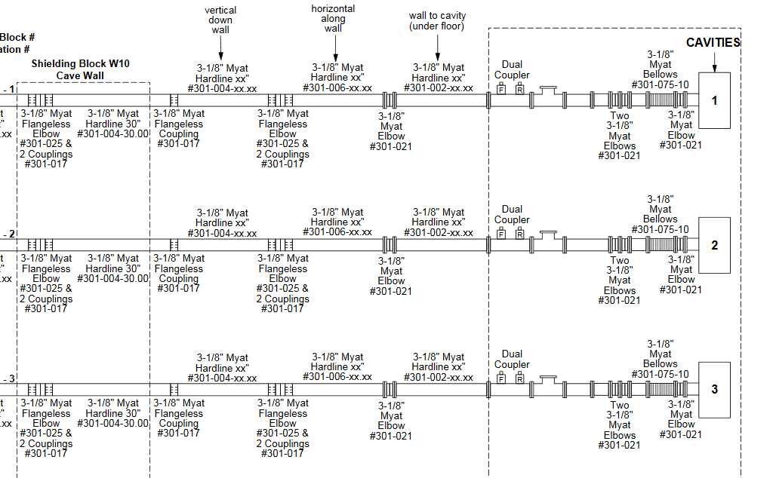
SSR1 Schematic

Slide 13
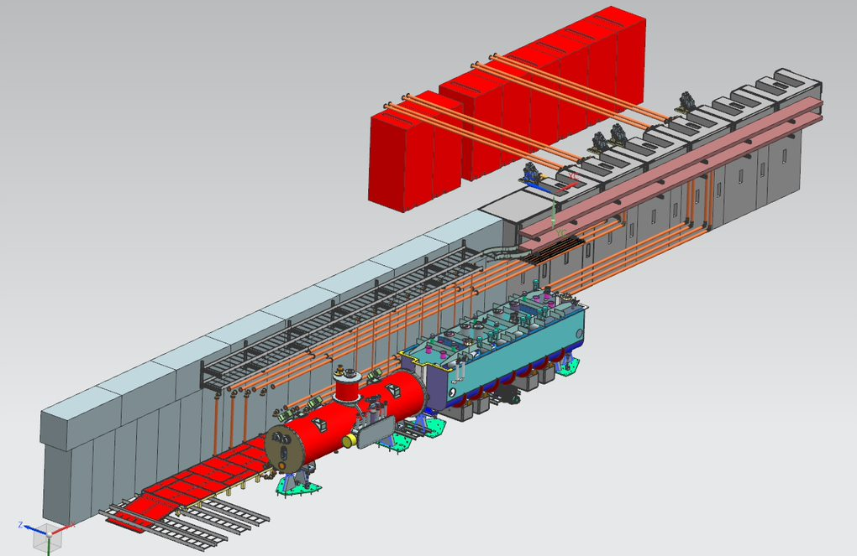
Overall View

Slide 14
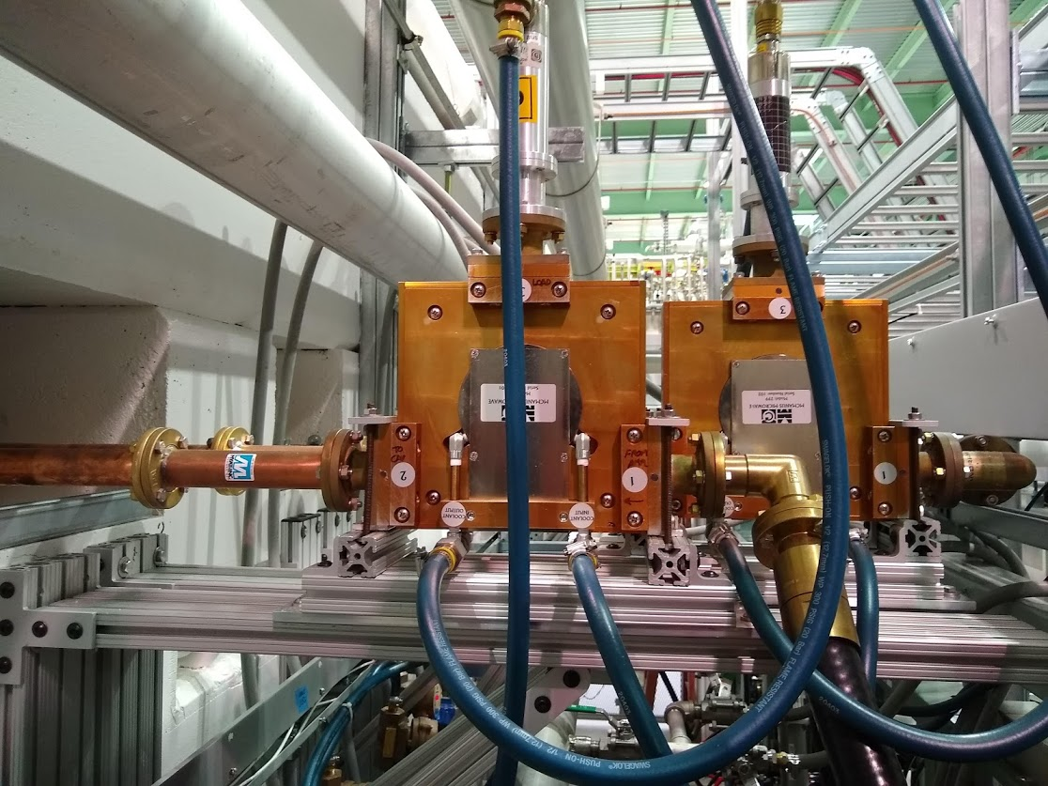
Example of Circulator Connections

Slide 15
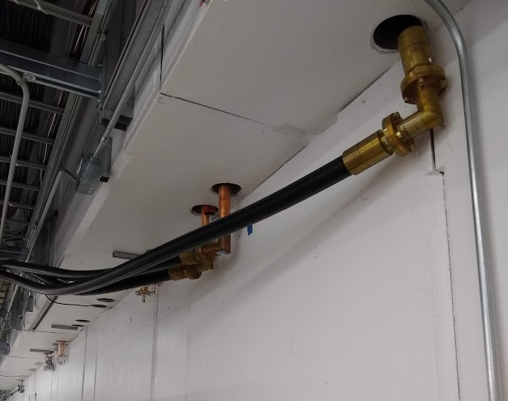
Example of RF connections

Slide 16
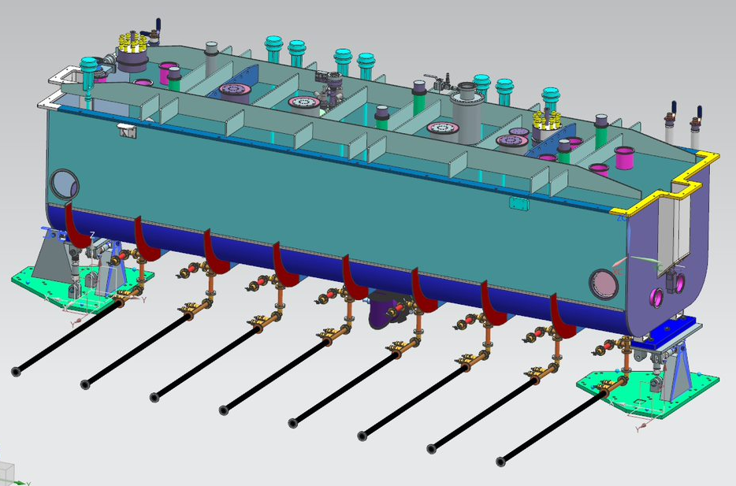
HWR Connections

Slide 17
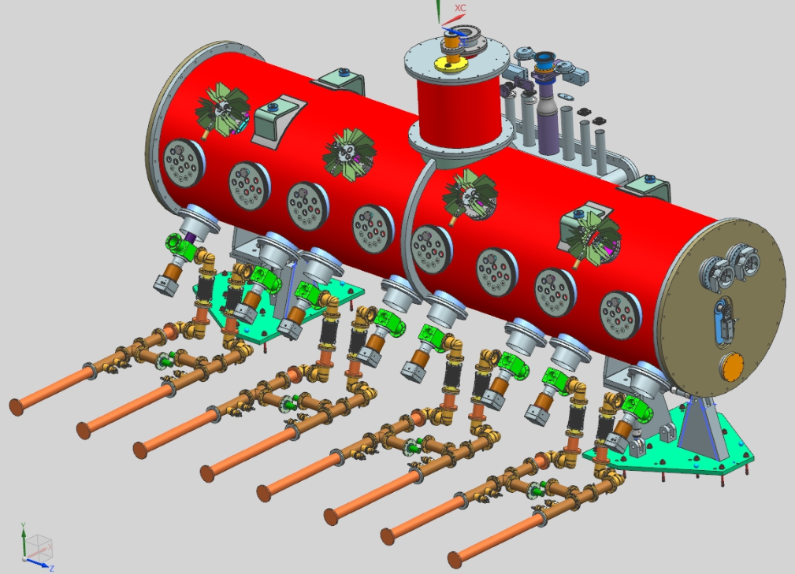
SSR1 Connections

Slide 18
End of Part 1

Slide 19
Part 2
Interfaces

Slide 20
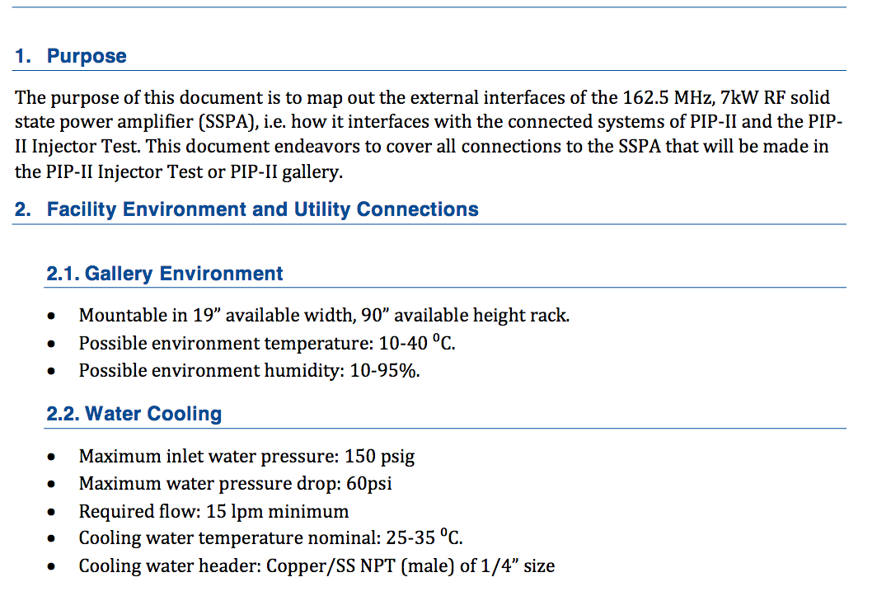
HWR 7 kW Amplifier Interface

Slide 21
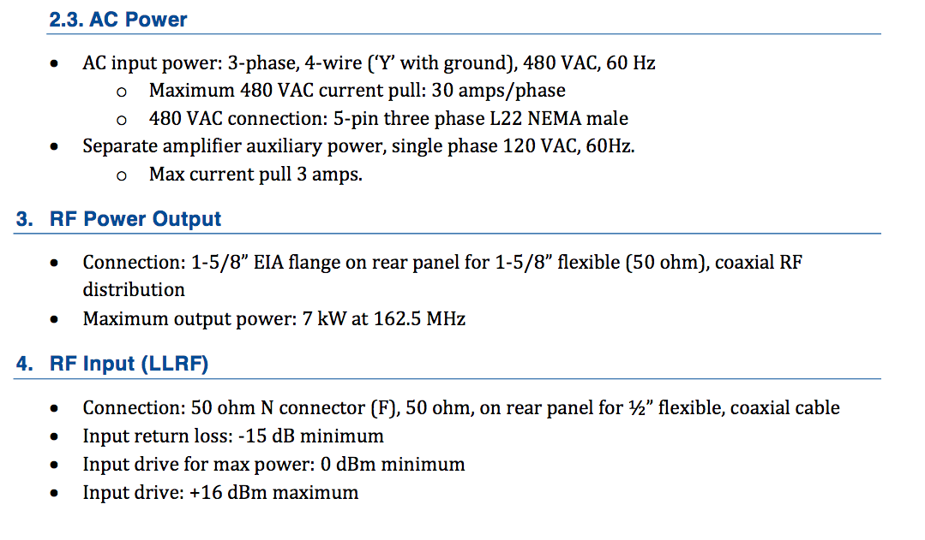
HWR 7 kW Amplifier Interface – cont'd

Slide 22
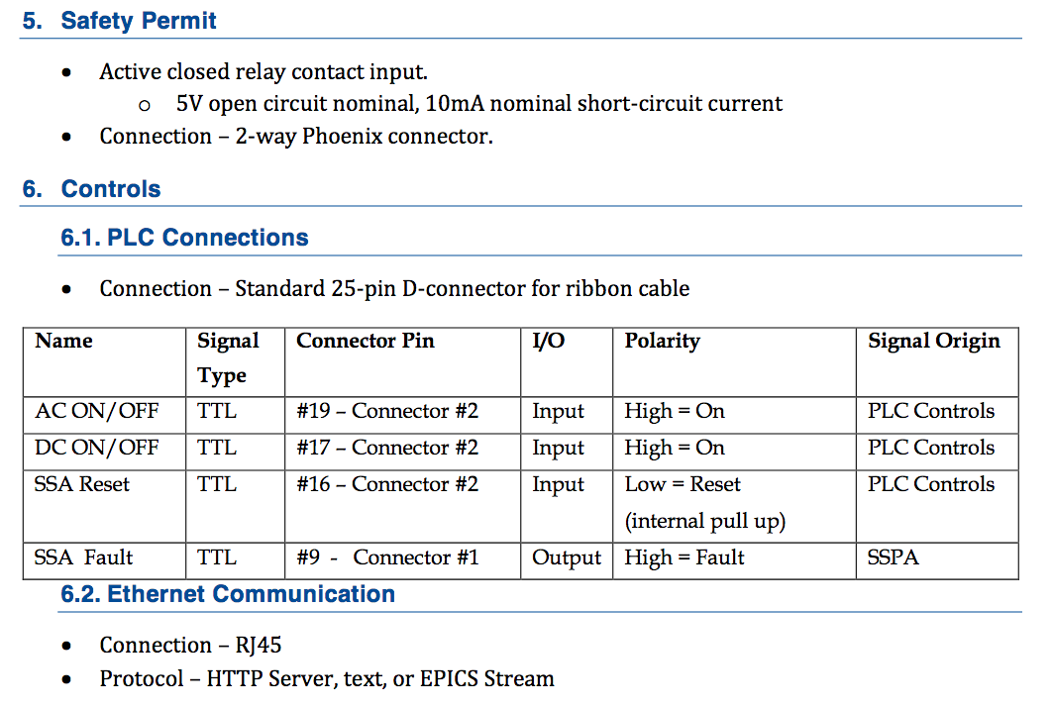
HWR 7 kW Amplifier Interface – cont'd

Slide 23
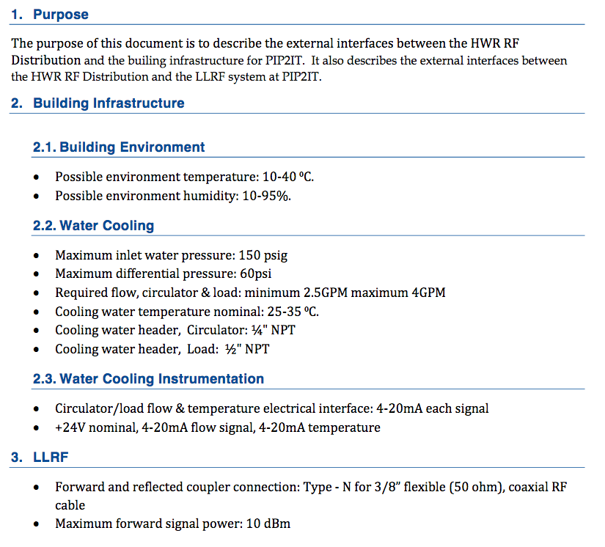
HWR RF LLRF and Cooling Interface

Slide 24
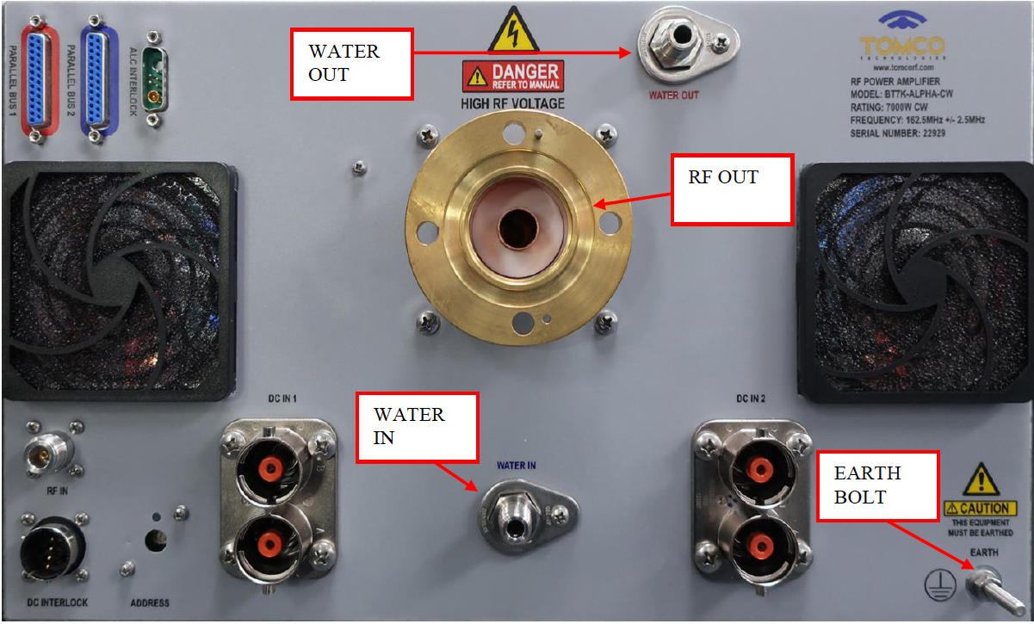
HWR 7 kW Amplifier RF Unit Connections

Slide 25
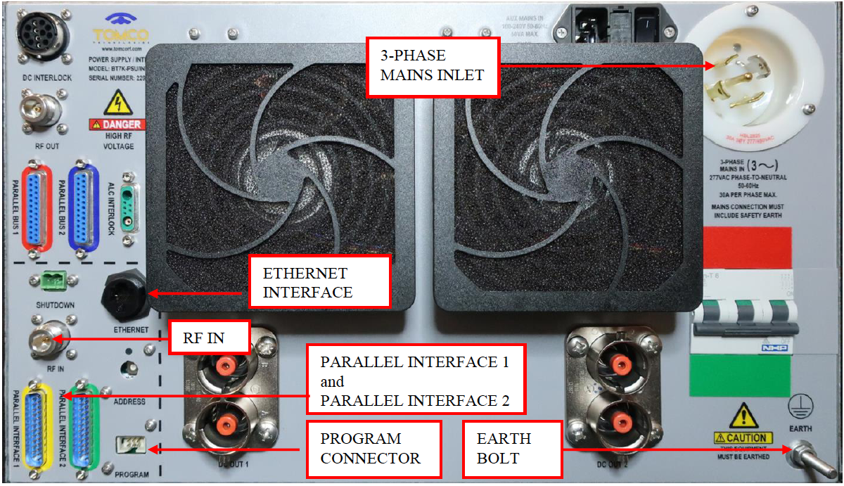
HWR 7 kW Amplifier Power Unit Connections

Slide 26
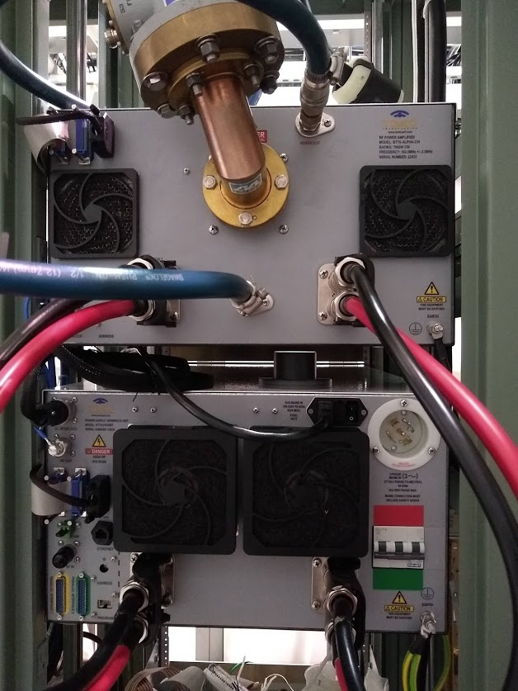
HWR 7 kW Amplifier Connections

Slide 27
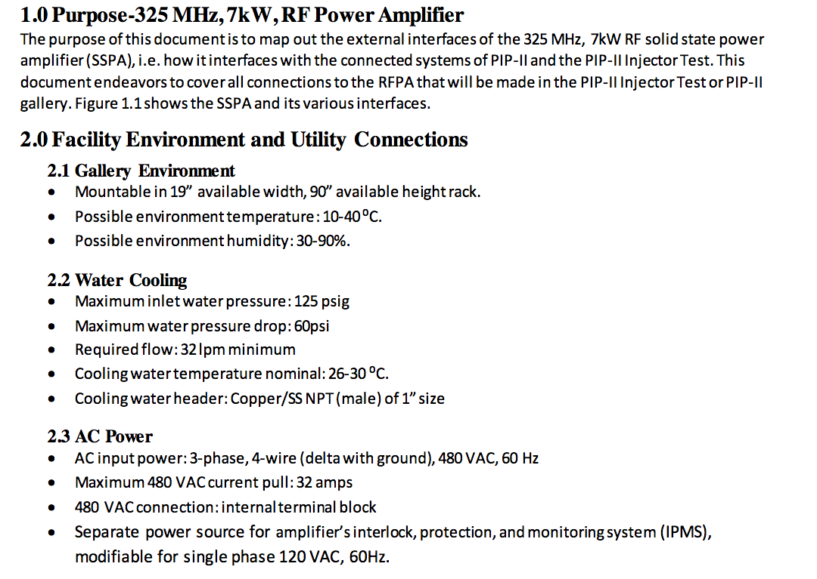
SSR1 7 kW Amplifier Interface

Slide 28
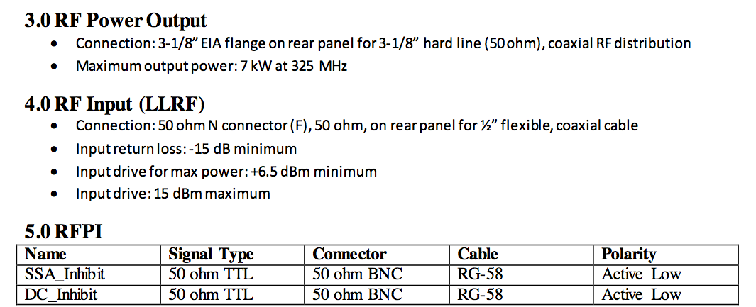
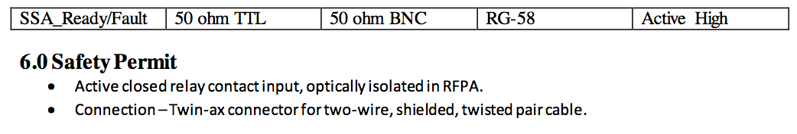
SSR1 7 kW Amplifier Interface – cont'd

Slide 29
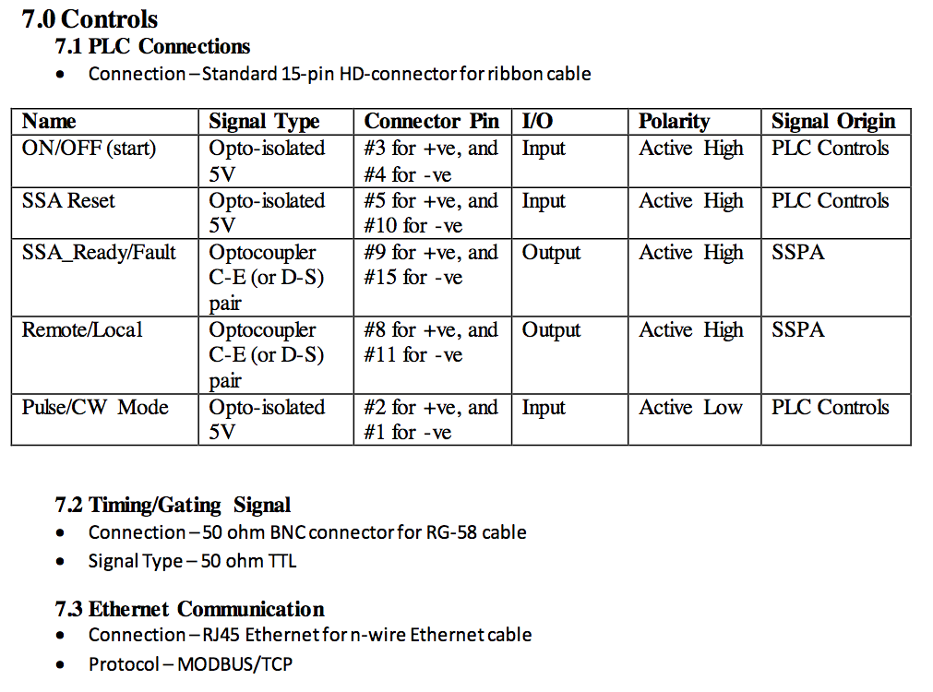
SSR1 7 kW Amplifier Interface – cont'd

Slide 30
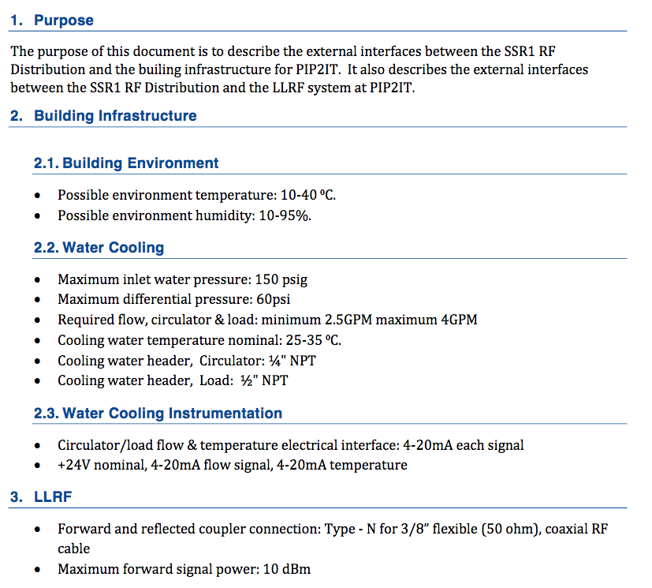
SSR1 RF LLRF and Cooling Interface

Slide 31
Acknowledgements
Those who provided valuable assistance behind the scenes:
Ahmed Syed
Wes Mueller
Pat Sheahan
James Burnham
Steve Wesseln

Slide 32
Thank You!
Questions?

Slide 33
Documents
08:20 - 08:50 II. Overview and Functions 30'
Speaker: David Peterson (Fermilab)
Primary references:
01-- HPRF Distribution Functional Requirements Specification ED0010272
20-- Circuit Schematic of HWR ED0010283
21-- Circuit Schematic of SSR1
23-- Overall Design F10109884
Secondary references:
02-- HWR HPRF Distribution Technical Requirement Specification ED0010279
03-- SSR1 HPRF Distribution Technical Requirement Specification ED0010280
04-- HWR RF 7kW Circulator Specifications ED0010274
05-- SSR1 RF 7kW Circulator Specifications ED0010275

Slide 34
D2
08:50 - 09:30 III. Calculations and Techinical Specifications 40'
Speaker: Mr. James Steimel (Fermilab)
Primary references:
22-- Engineering Calculations and Engineering Notes ED0010277
01-- HPRF Distribution Functional Requirements Specification ED0010272
02-- HWR HPRF Distribution Technical Requirement Specification ED0010279
03-- SSR1 HPRF Distribution Technical Requirement Specification ED0010280
04-- HWR RF 7kW Circulator Specifications ED0010274
05-- SSR1 RF 7kW Circulator Specifications ED0010275

Slide 35
D3
09:30 - 10:05 IV. Interfaces 35'
Speaker: David Peterson (Fermilab)
Primary references:
12-- Interface Specification Document HWR RF Distribution - HWR RF Power Amplifier ED0010281
13-- Interface Specification Document HWR RF Distribution - SSR1 RF Power Amplifier ED0006356
14-- ISD for PIP2IT HWR RF Distribution LLRF and Cooling Systems ED0010273
15-- ISD for PIP2IT SSR1 RF Distribution LLRF and Cooling System ED0010276
Secondary references:
10-- Technical Specification for interface HWR ED0002529
11-- Fermilab Interface Control Document for SSR1 ED0004129

