Slide 1
Surface Muon Production Using the Fermilab Linac
J. Johnstone and C. Johnstone
30 April 2019

Slide 2
Ultra-low Energy Muon Beams – Muon Spin Resonance Facilities
Muon Spin Resonance (µSR) involves embedding polarized, positively charged muons in a sample material which allows the properties of the material to be measured and characterized at the microscopic atomic-structure level.
  The muons produced must be of sufficiently low energy that they stop within a few millimeters of material.
Intense muon beams are currently produced first through bombardment of a low-Z production target with protons.
  The pions produced in nuclear reactions then decay “at rest” near the surface of the production target into low energy muons with polarization as high as 100%
    a π⁺ at rest decays into a 4.120 MeV, or 29.792 MeV/c, µ⁺ and a neutrino.
4 MeV polarized muons are collected and transported via a low-energy beamline to the experiment.
  Lower energies are produced depending on the depth

Slide 3
Current µSR Facilities
At present, there are four operating accelerator µSR facilities in the world:
  TRIUMF hosts the only North American center.
  ISIS accelerator at Rutherford Accelerator Lab, UK
  PSI, Switzerland
  J-PARC, Japan
Facilities are optimized for production of neutron beams for neutron scattering (spallation) experiments.
Muon production runs parasitically with severe limits on the reduction in the primary proton intensity available for the neutron program (4%).
  TRIUMF is the exception but its primary role is to service a wider nuclear community.
The TRIUMF muon facility and operation would most resemble a future muon facility at Fermilab

Slide 4
Surface Muon Production
Specifications for a μSR production target entail
  High yield of pions decaying to muons within the target,
  Simultaneously maximize the rate of collected surface muons –
    - Only muons formed close to the target surface escape
    - These are positive; low-energy negative muons are captured by the target nuclei.
  Minimize production of unwanted particles – electrons and positrons, neutrons, scattered protons, and gamma rays
    This is highly dependent on choice of target material – light elements
  Low-Z materials are also used for all μSR targets to minimize contribution of multiple scattering to the outgoing primary proton beam – this remains a requirement.
A high stopping density of low-energy pions in the target has achieved an intense secondary beam of surface muons of 10⁻⁸-10⁻⁹ μ+/p at 4 MeV;
lower energies will have reduced collection and intensity

Slide 5
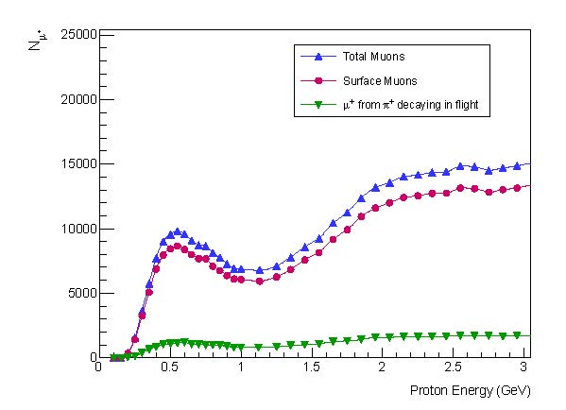
Surface Muon Production
Simulations of muon yields as a function of incident proton energy from threshold to 3 GeV were studied for pions produced at 30 MeV/c or less for 10⁹ POT using Geant4 and the ISIS graphite target.
These results are general
The relative yield at 400 and 800 MeV is ~80% of the peak yield observed at TRIUMF.
TRIUMF
ISIS
Fermi
Variation of µ⁺ yield with incident proton energy [10] for muons with momenta ≤30 MeV/c; i.e. surface muons.

Slide 6
This is to be compared with the total pion production which strongly increases with energy
Total single pion production cross section dependence on proton energy [12].

Slide 7
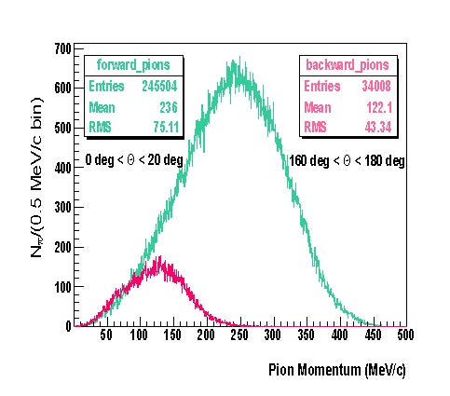
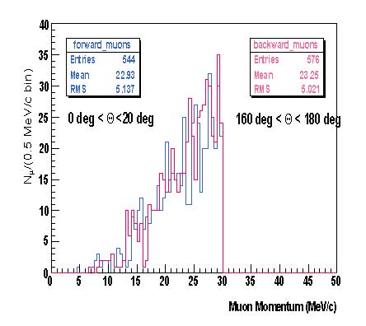
Optimizing collection of surface muons
Pion production is forward/backward angle asymmetric, surface muon production is isotropic
  suggesting that collection of backward muons is preferable for transporting a clean µ⁺ beam.
Pion momentum distribution for 500 MeV protons incident on graphite (left) and corresponding µ⁺ distribution (right) inside forward (green and blue) and backward (red and purple) within 20º [10].

Slide 8
Secondary beamline considerations
Isotropic production is very powerful in that it allows the prospect of multiple secondary muon lines viewing the same production target at different angles
  at PSI 7 beamlines access two production targets.
  ISIS has two 90° beamlines on opposite sides of the target.
  The forward pion asymmetry implies that a forward angle viewing within 20° would likely intercept tails of the primary proton beam even for a 4% graphite target
  A balance must be achieved between multiple beamlines and multiple scattering, the latter a function of target length and atomic number.
    For the ISIS 45°, 7mm graphite target, a beamline could not be implemented near the defining 20° (θ_{rms} is only 2.23 mr).

Slide 9
Target Design
Surface muon yield is highly sensitive to the geometric details of target design and relative orientation to collection.
A surface phenomenon necessarily involves maximizing surface area, minimizing secondary pion absorption, and, importantly, promoting the diffusion of ultra-low energy muons to the surface without significant energy loss.
Optimizing the production target for surface muon production emphasizes increasing surface area to volume;
  producing more muons near the surface implies thin targets which also reduces secondary pion absorption and energy loss in transit.
Increasing the target angle away from the normal is a highly effective way to increase the number of nuclear interaction lengths without consequentially impacting the surface to volume ratio and muon mean path to the surface.

Slide 10
Target slice geometry
In an ISIS study, to maximize surface, the graphite target was split into slices maintaining the nominal proton transmission efficiency of 96%. Target angle was also studied. The predicted yield is effectively doubled.
Number of surface muons collected at the ISIS entrance window to beamline with distance showing coupling of target design to muon beamline design
Variation of the number of surface muons with distance between target slices

Slide 11
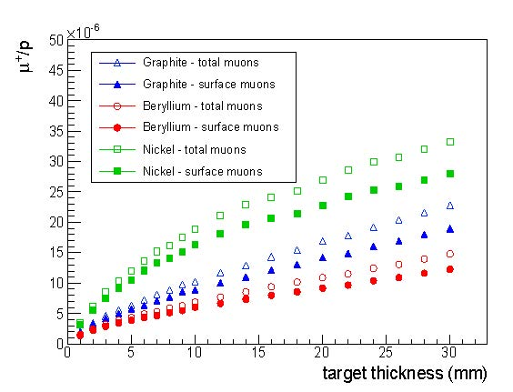
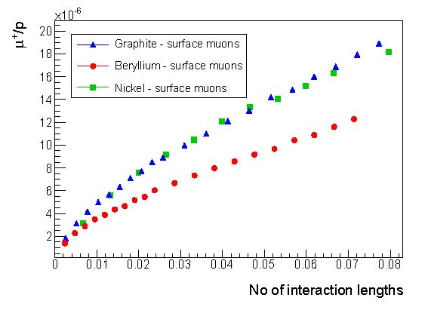
Target Material
A nickel target produces a substantially higher muon yield than graphite and beryllium due to decreased nuclear interaction length but the radiation length is also decreasing rapidly so the size of the downstream primary beam increases causing primary beam control issues.
Comparison of muon yield for 800 MeV protons on 3 different materials a function of target thickness
Comparison of muon yield for 800 MeV protons on 3 different materials as a function of interaction length

Slide 12
The 400 MeV Fermilab Linac
The 400-MeV Fermilab Linac operates at 15 Hz;
Currently the klystrons operate at 30 microsec pulse length but are capable of 80 microsec.
Parameter | Value | Unit
Kinetic Energy | 401.5 | MeV
Energy Spread | 1 | MeV
RF Structure | 201.24 | MHz
Bunch Length | 0.05 | ns
Max Pulse Length | 80 | µs
Max Particles Per Bunch (28 mA) | 0.88x10⁹
Max Particles Per Pulse | 1.4x10¹³
Peak Current | 28 | mA
Avg Current | 34 | µA
Max Beam Power | 13.4 | kW
Beam Emittance (99%) | 8 | mm-mrad

Slide 13
Beam Structure at other facilities
ISIS uses a 70 nsec pulse, 2.5x10¹³ p/pulse, @40 Hz on a 4% IL target for MuSR (1 out of every 5 pulses is sent to a different target station),
TRIUMF is a CW beam with a 23 MHz RF structure (PSI is 51 MHz); bunches are too closely spaced for MuSR experimental timing; however it uses up to a 24% IL Be target
The PSI cyclotron operates at 590 MeV with a proton current of 2200 μA [7], thus potentially delivering a maximum of 4x10²³ POT per year on two graphite production targets. A 1 Hz graphite target wheel with radiative cooling is used .

Slide 14
Replicating ISIS operation and conclusion
To replicate ISIS operation using the Fermilab Linac, a 70 nsec batch of RF bunches separated by 4.4 μsec of no beam is formed by stripping the H⁻ in the low 750- keV region where the current laser notcher
  For an 80 µsec Linac pulse (max klystron pulse length), 18 70 nsec batches of 15 RF bunches containing 0.88x10⁹ protons per RF bunch (28 mA) are formed separated by 4.4 microseconds yielding 2.4x10¹¹ p/pulse
  At 15 Hz, this corresponds to 3.6x10¹² p/sec, or 8.9x10¹¹ effective p/sec for a 25% IL target.
  To achieve an effective 7.2x10¹⁶ POT requires 22.5 hours of full Linac 15 Hz operation at an 80 msec pulse length for an exact duplication of ISIS conditions which are not optimized for MuSR
  If the larger admittance of the TRIUMF beamline is used instead of the multipurpose ISIS muon line transmission, only 2.25 hours is required. A 2-slice target would reduce this time further to 1.125 hours
  If no extinction time is required, we could exceed ISIS by about a factor of 50

