Slide 1
Cryogenic Equipment Sizing and Locations
Mike Zuckerbrot, Kathrine Cipriano, Min Jeong Kim

Slide 2
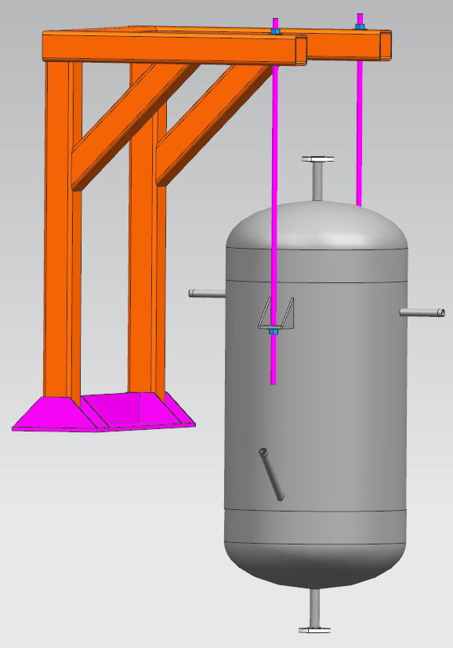
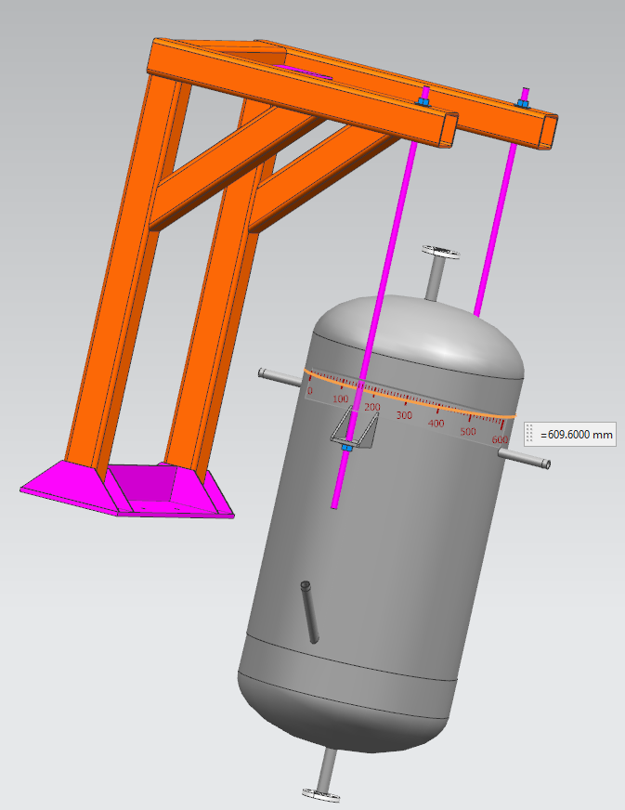
LN2 Phase Separator
Increase diameter to 48”, increase height by ~1 foot.
The height and diameter can be flexible, the total volume is what’s important.
The support structure in the model does not necessarily have to be duplicated if something else makes more sense.
This needs to be located at an elevation higher than the cryostat, more specifically it must be above the condenser.

Slide 3
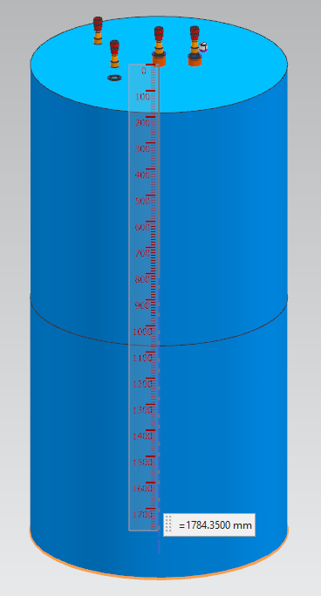
Condenser
Increase diameter to 48”, increase height by ~ 1 foot.
Again, dimensions can be flexible if volume is maintained.
There is also the option to use multiple smaller vessels.
Location needs to be above the cryostat, and under the phase separator

Slide 4
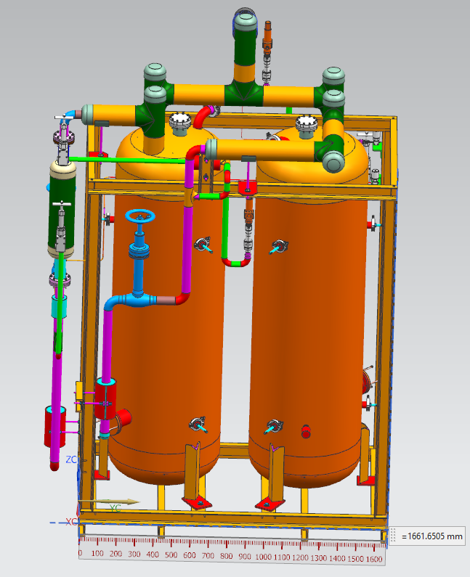
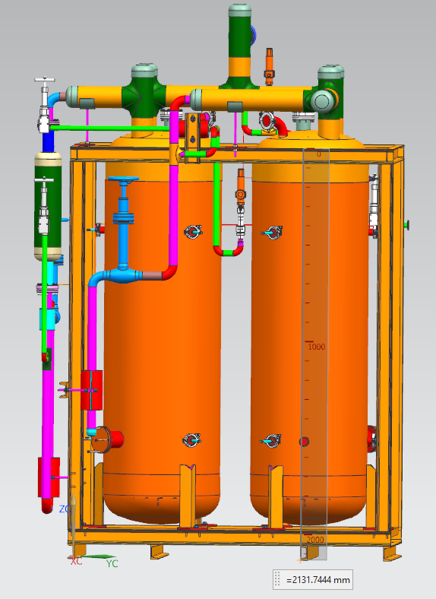
LAr Filter Skids
Can remain the same.
Location is not critical.
Two of these skids for redundancy.

Slide 5
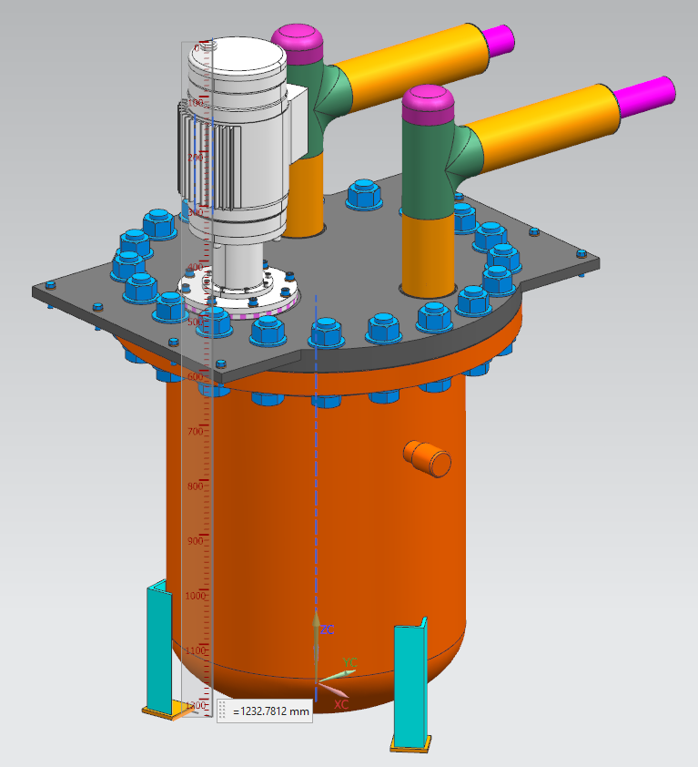
LAr Pumps
Can remain the same.
There should be two of these vessels, mounted on a skid (if there’s room), with 3 feet of room between the bottom of it and the floor so the jacket can be dropped.
Location should be as low as reasonably possible, at minimum half way down the cryostat but the lower it can be placed the better it will run.
¾ hp motors, 240V

