Slide 1
Bi-Weekly DUNE Near Detector
Engineering Integration Meeting
9/19/2019

Slide 2
Agenda
Bob Flight: Detector Transport System
Matthaeus Leitner: LAr Cryostat Steel/Aluminum
Matthaeus Leitner & Michael Zuckerbrot: Cavern ODH Calculation Plans
All: Discussion
Other Topics:
  Upcoming Collaboration Meeting
  Facility Requirements Document Update

Slide 3
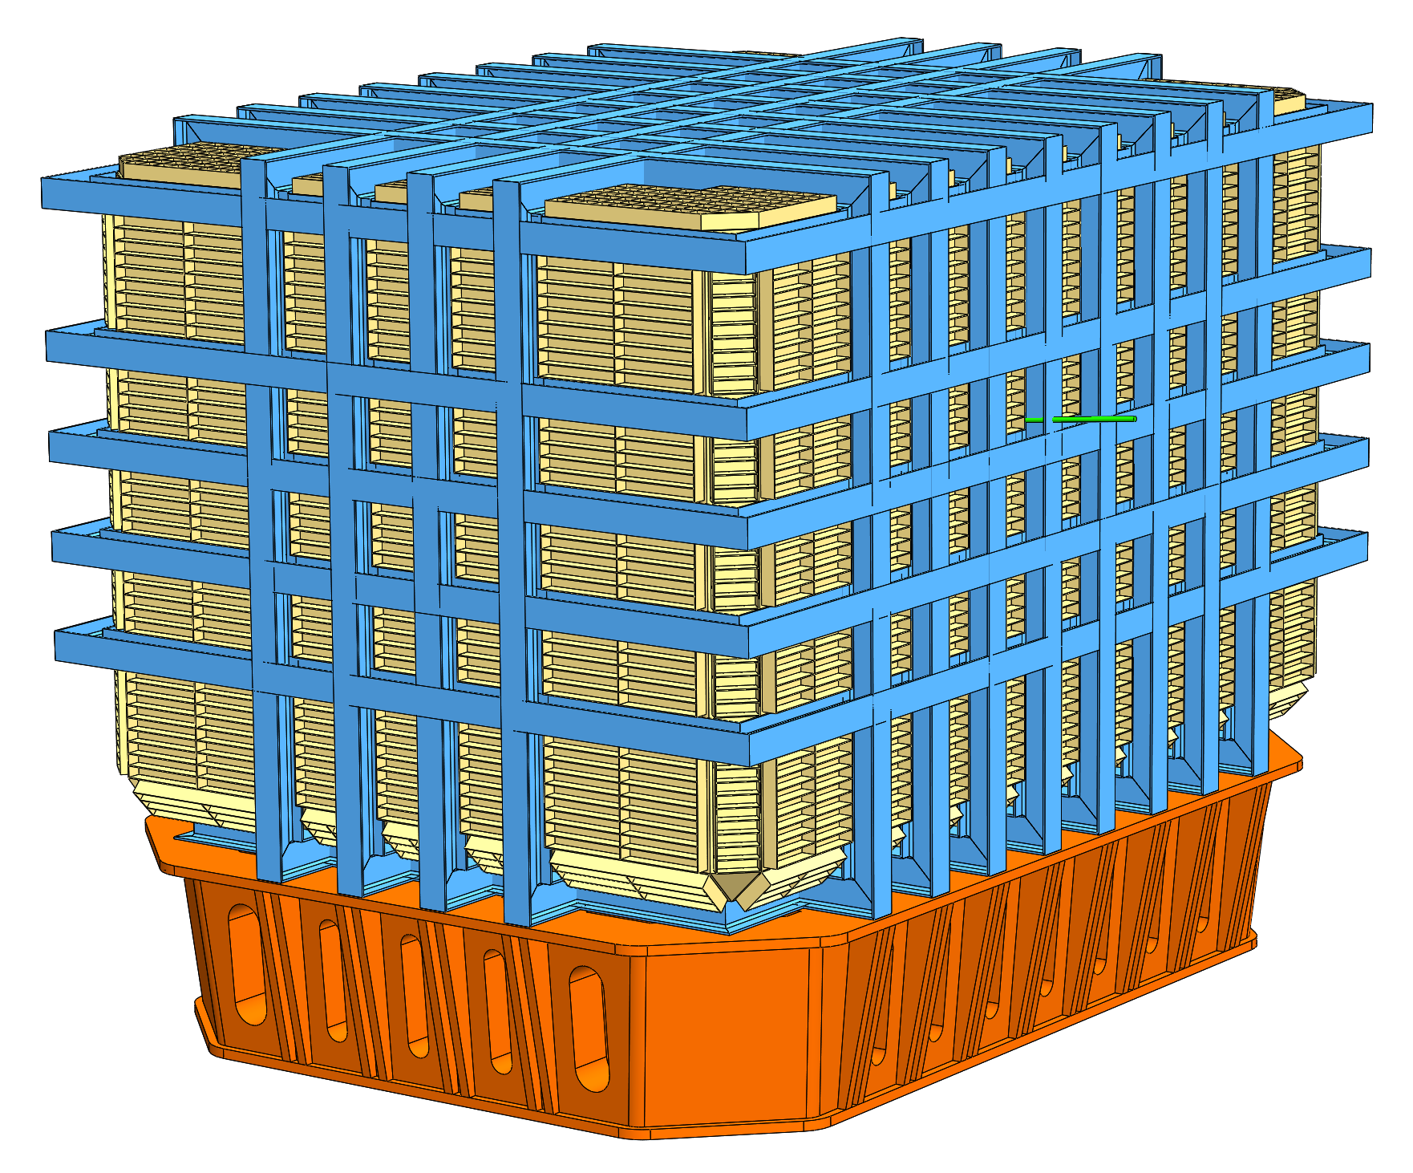
300 Ton LAr Detector Cryostat
Membrane Cryostat
Length = 11.34 m
Depth = 8.34 m
Height = 7.04 m
Room Temperature Beams
Auxiliary Stiffeners
Support Frame
based on latest SBND design

Slide 4
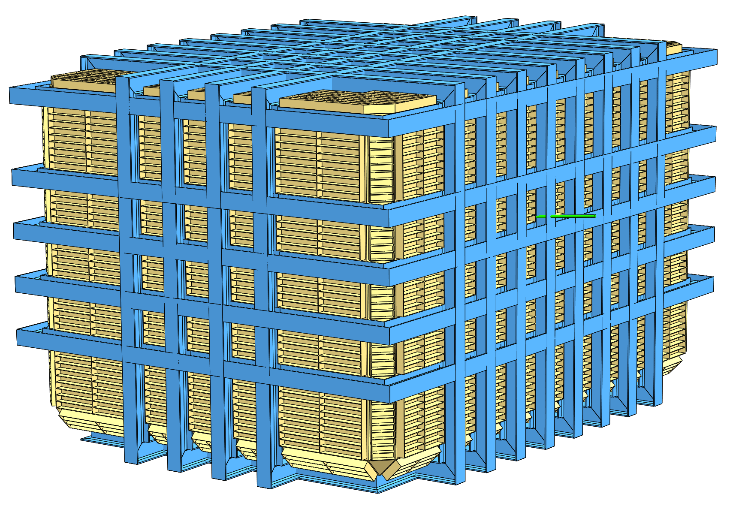
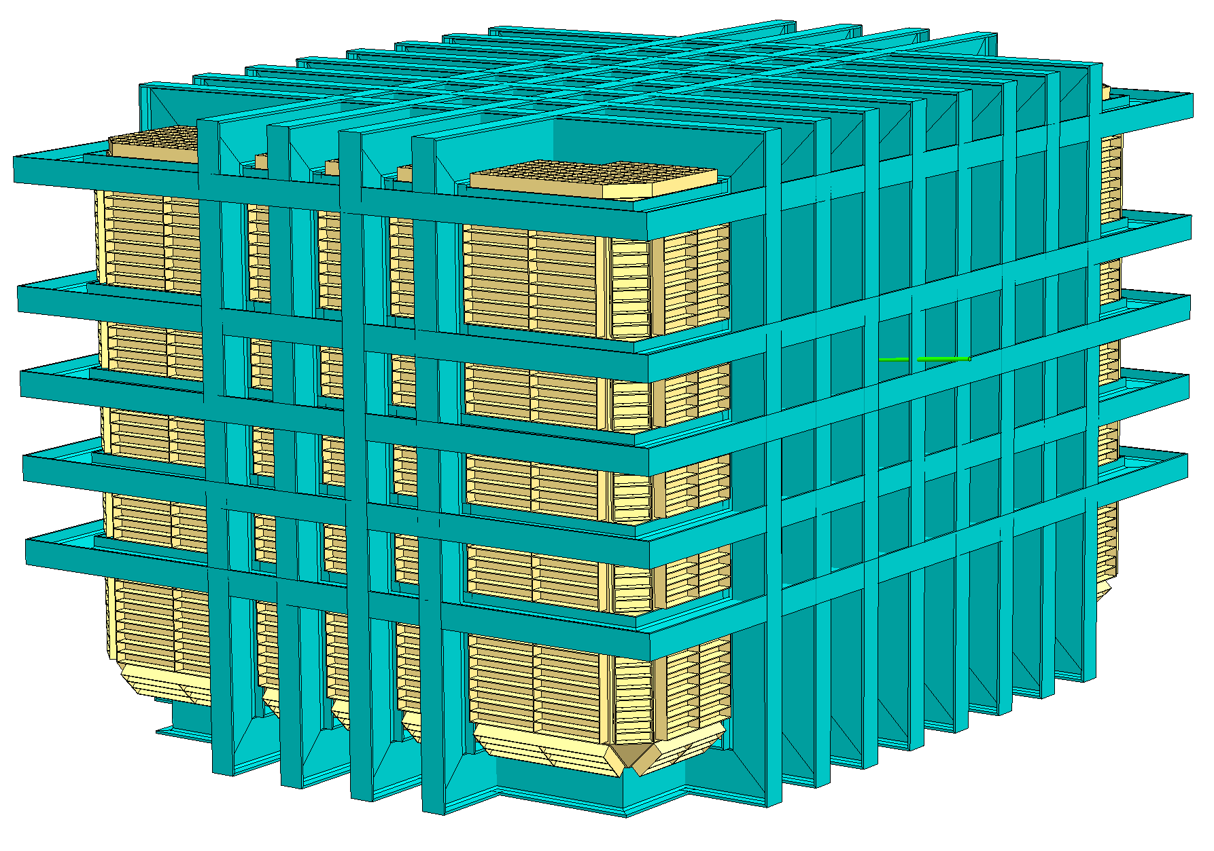
LAr Room Temperature Frame Could Be Engineered To Utilize Aluminum Beams: Fabrication More Challenging
Steel Beams
(Beam Structure Weight = 87 tonne)
Aluminum Beams
(Beam Structure Weight = 45 tonne)

Slide 5
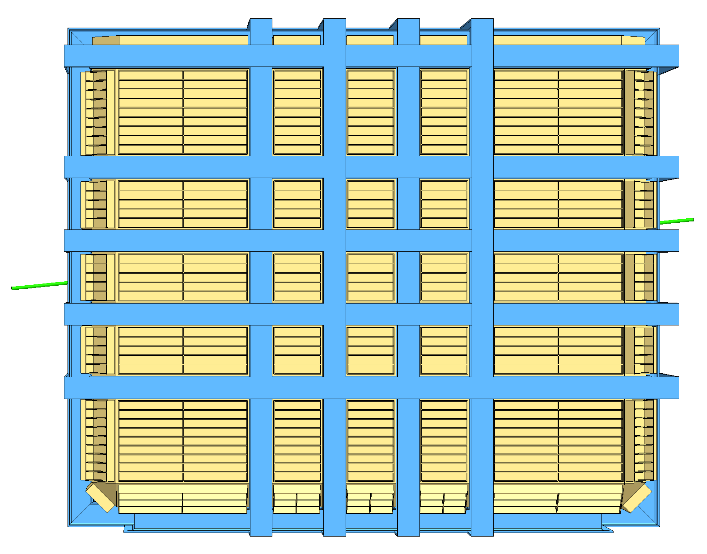
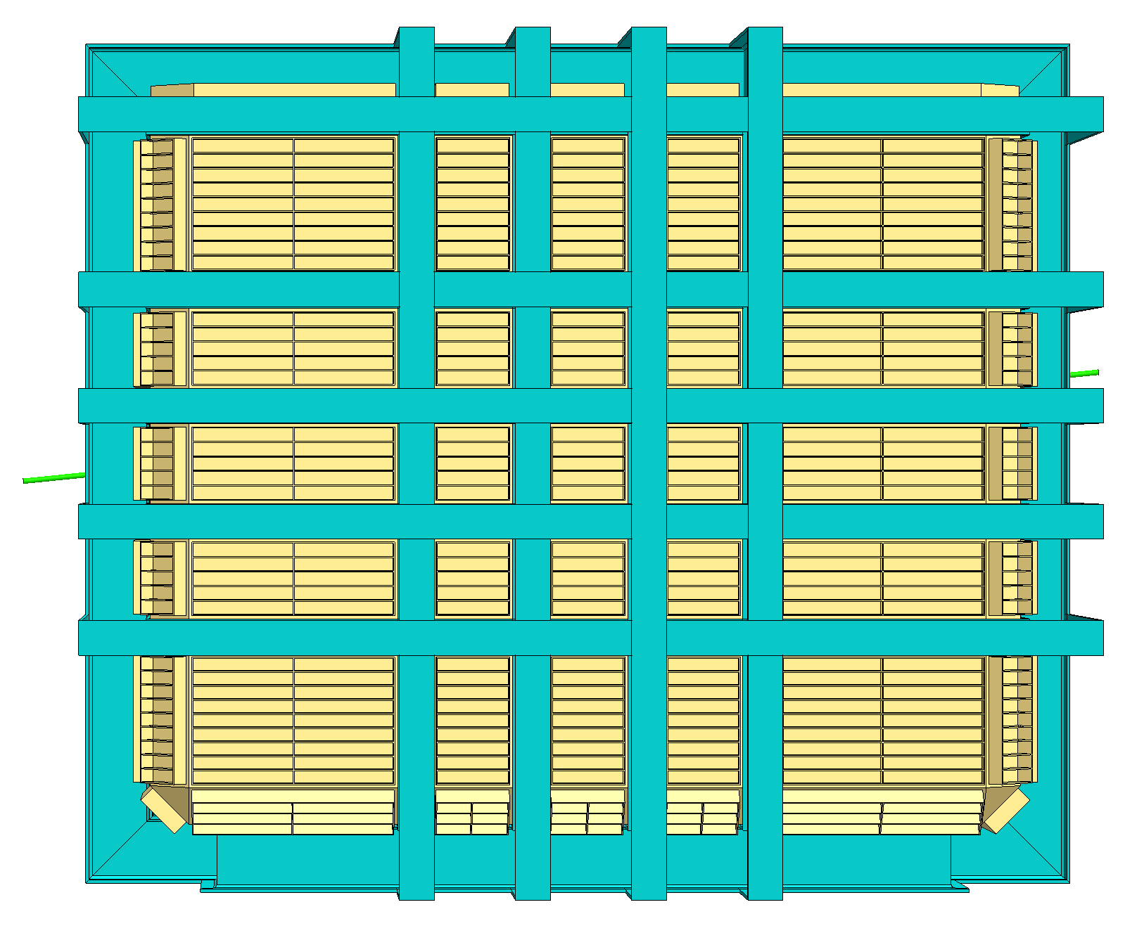
LAr Room Temperature Frame Could Be Engineered To Utilize Aluminum Beams: Cryostat Would Grow In Size
7.04 m
7.52 m
8.34 m
8.82 m
360 mm Depth Steel Beams
600 mm Depth Aluminum Beams

Slide 6
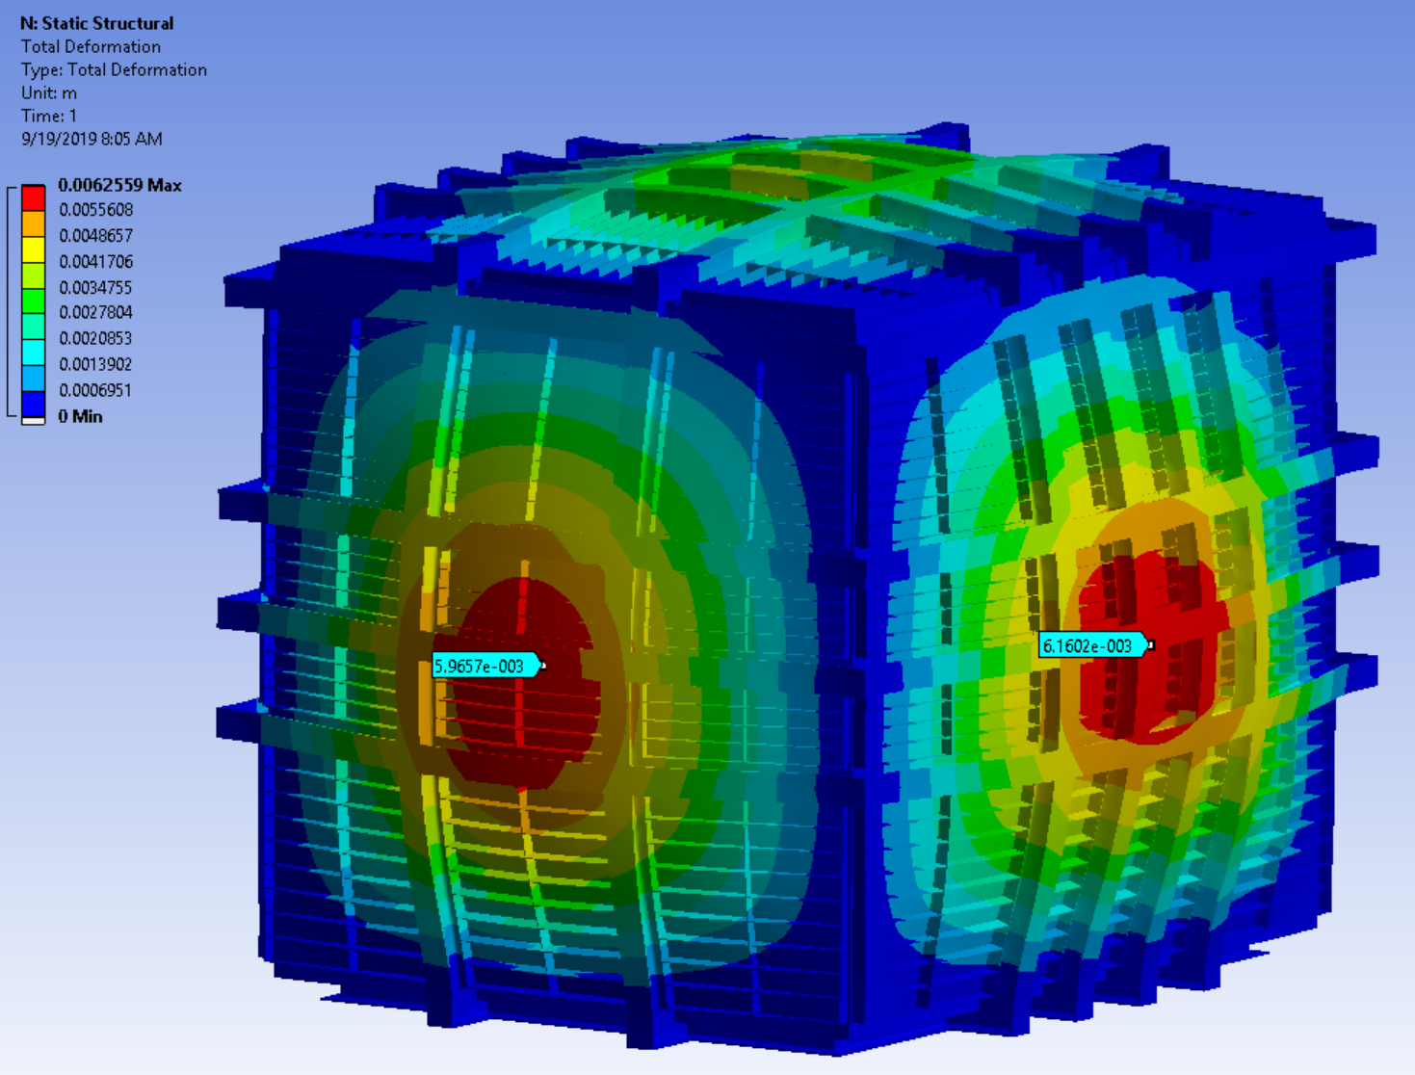
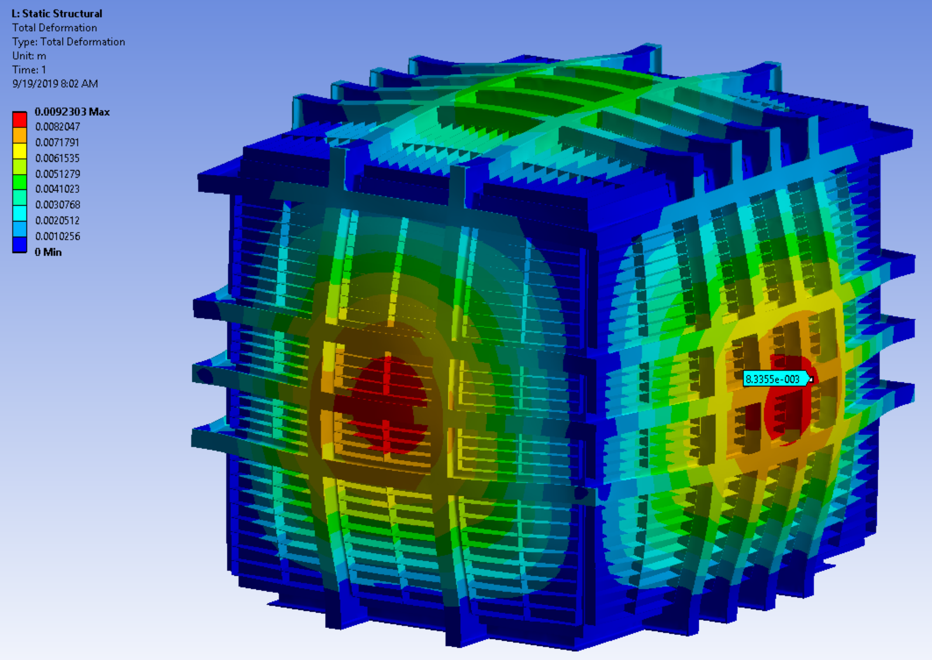
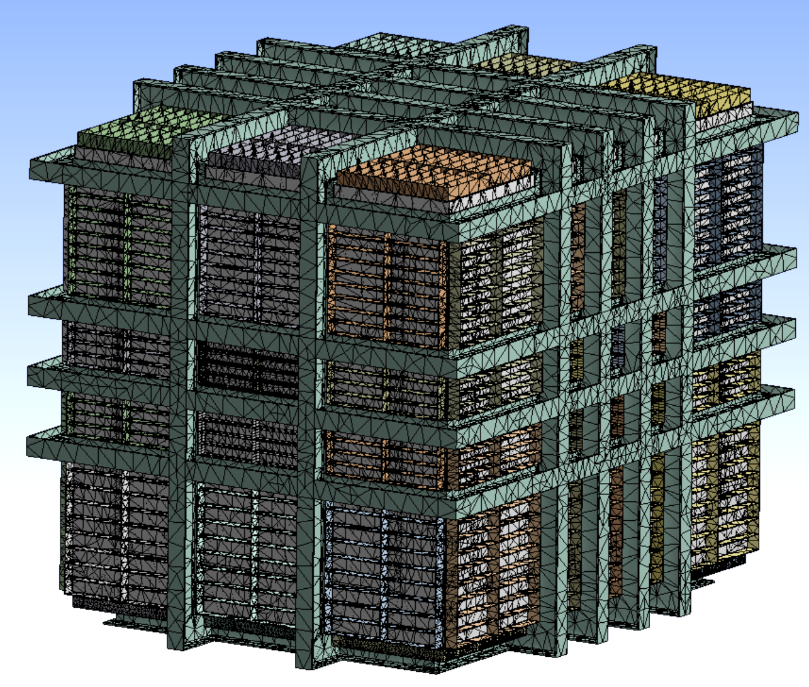
Sizing Is Based On A Quick FEA Scoping Study
Steel Beams
Aluminum Beams
Scoping studies did not include any details about beam corner joints
Performed simulations using shell and beam elements as well as solid elements (as shown in image to the left)
For quick scoping studies solid elements turned out to be more flexible without loosing too much accuracy
For detailed code calculations and accurate stress evaluations beam and shell models would be preferred

Slide 7
Conclusion
It is possible to engineer a room temperature (RT) aluminum cryostat structure. SBND maximum deflection is in 7 to 8 mm range (at relief pressure). Similar performance can likely be obtained with aluminum beams increased in depth by factor 1.7 (see aluminum design rules on next slide).
The RT membrane sheet would also have to be converted to an aluminum design and must be welded vacuum-tight.
Aluminum beams are not available in the required sizes and have to be custom-made. This will significantly increase costs in addition to the higher material cost.
Welded aluminum has significantly reduced strength and building codes provide data. Since the engineering design optimizes for minimum deflection the structure stresses using aluminum are less compared to steel.
Proposed cavern shaft diameter could permit the fabrication of side walls above ground with only final joints welded/bolted inside the cavern.
A fabrication study with the help of an aluminum structure fabricator would be required to determine feasibility and cost range.

Slide 8
General Aluminum Design Rules
Aluminum has about a third of the density of steel.
The elastic modulus of aluminum is only a third of the modulus of steel. Structure deflection depends linearly on the inverse of the elastic modulus at comparable stress.
If a steel section is to be replaced by aluminum and the stiffness is to be kept at the same level, a thickening of all parts by the factor 3 is not very efficient since the relation of the specific weight of the two materials is also approx. 3 to 1.
Theoretically, for the design of a structural beam all dimensions except for the width should be increased by the factor of 1.4 to arrive at a cross section with the second moment of inertia (scales with depth³) about three times as large and hence the same stiffness (between steel and aluminum). Such a design will result in 50% weight loss.
If we increase the second moment of inertia by a factor of three and increase the height only by the factor of 1.4 then the section modulus (moment of resistance) increases by 2.14 . Therefore, the stresses in a substitute aluminum section are less than half the steel stresses.

Slide 9
ODH Calculation Plans
ND cavern ODH calculations have not been performed, yet.
A preliminary design guidance could be based on the MicroBooNE ventilation system. MicroBooNE is a 90 ton LAr detector. The MicroBooNE pit footprint (floor area) is around eight times smaller than the ND cavern.
MicroBooNE Ventilation Parameters
  Duct Size: 3 ft diam.
  Louver Locations: top and bottom for LHe and LAr
  Ventilation Speed: 7,500 ft³/min with two fans for redundancy
Initial ODH scoping calculation will require
a few weeks of a cognizant engineer.
A full study can later be performed once the
designs are more matured.

