Slide 1
Bi-Weekly DUNE Near Detector
Engineering Integration Meeting
10/03/2019

Slide 2
Agenda
M. Leitner: DUNE ND Engineering Requirements Update And Next Steps
All: Discussion
Upcoming Meetings:
  DESY Near Detector Meeting October
  DOE IPR End October
  Installation Review January
  Collaboration Meeting CERN January
  DOE Baseline Review April/May

Slide 3
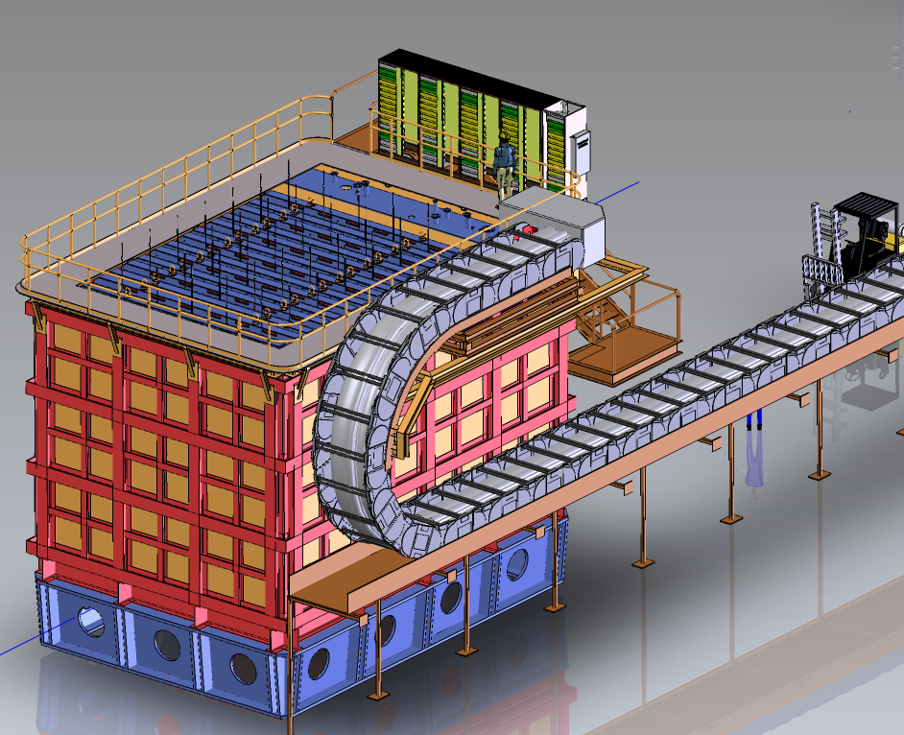
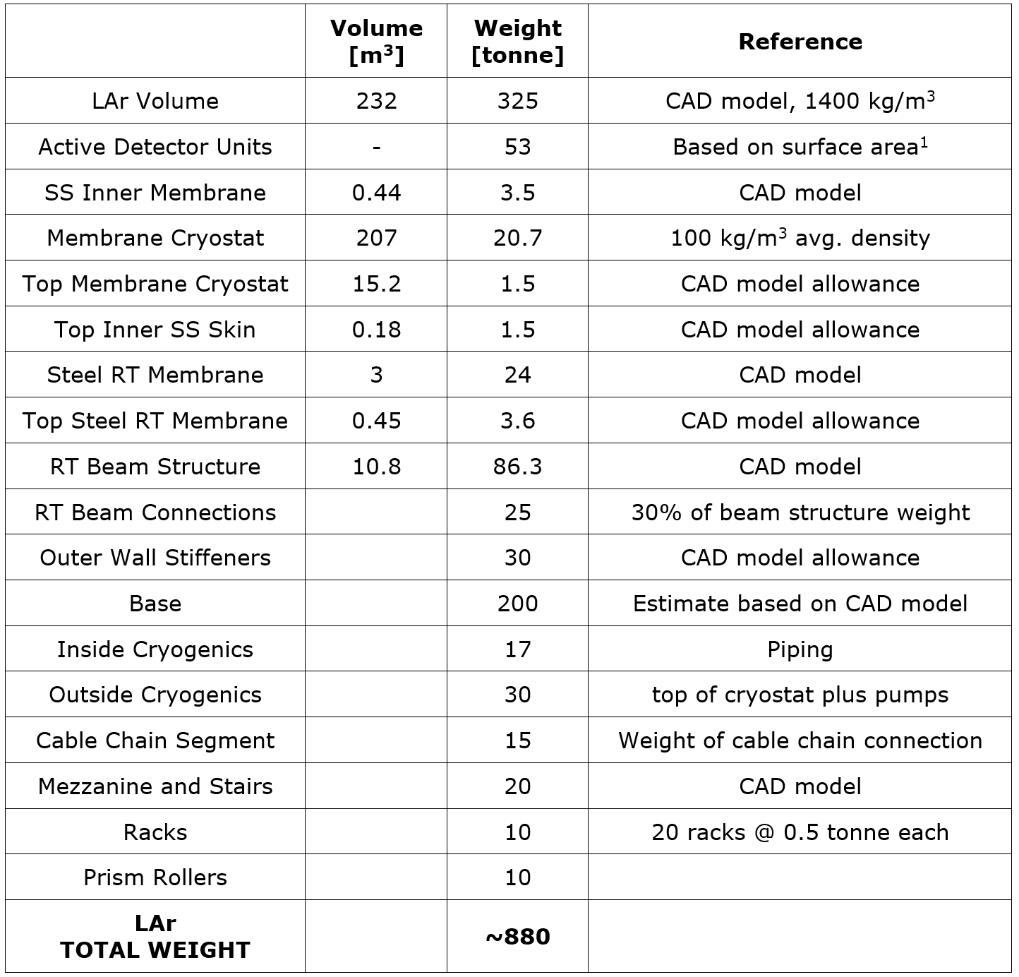
LAr Detector Main Structure Parameters
Width = 11.34 m
Depth = 8.34 m
Height = 7.04 m

Slide 4
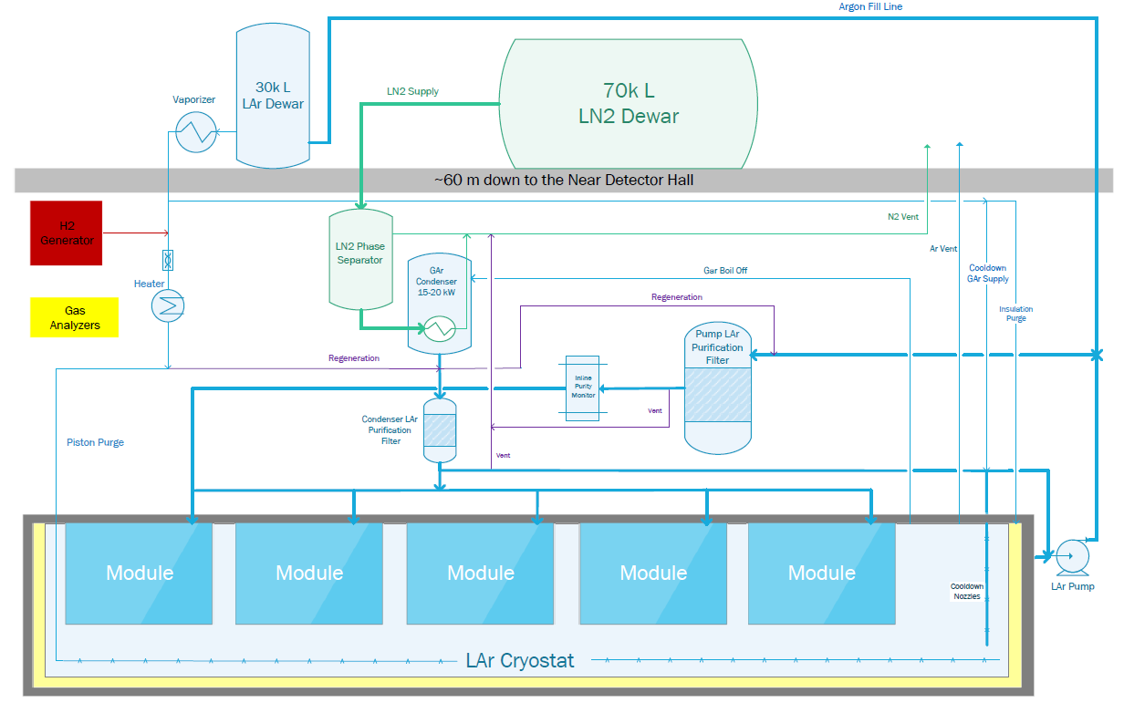
LAr Detector Simplified Flow Diagram:
Large Diameter Cryogenic Piping Needs To Move With Detector
Above Ground
3” pipe
6” jacket
6” pipe
12” jacket
24” pipe
3” pipe
6” jacket
2” pipe
Below Ground
Cryogenics Moves
With Detector
Graphic: Min Jeong Kim

Slide 5
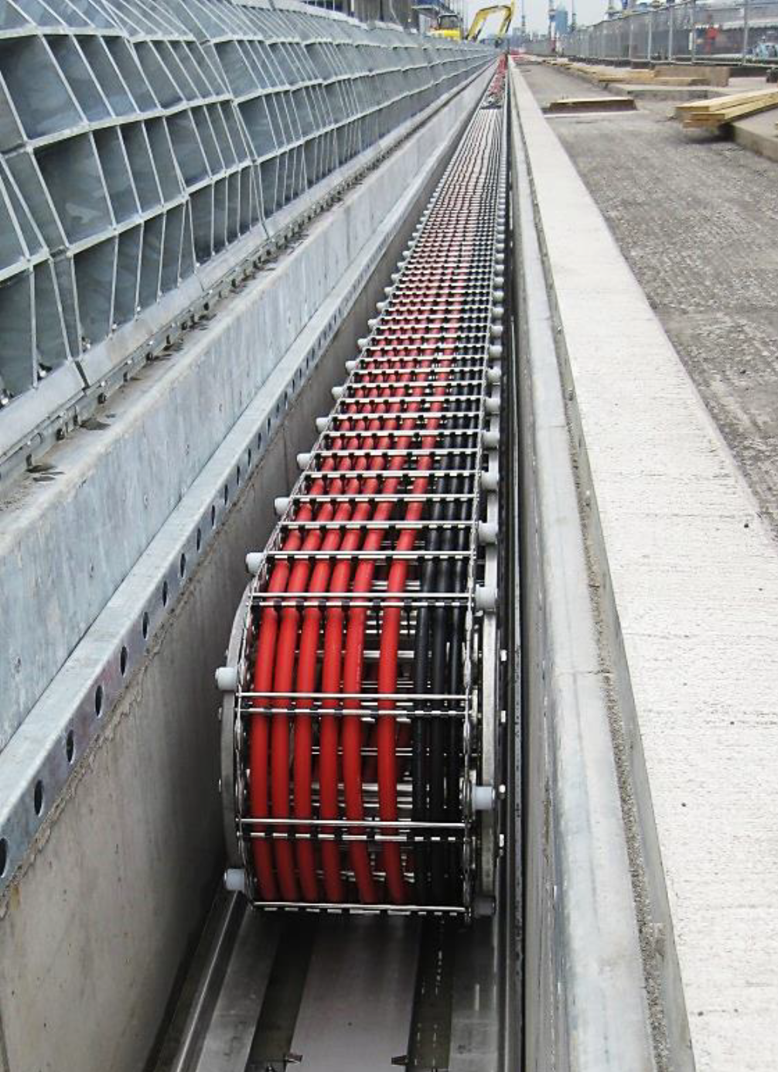
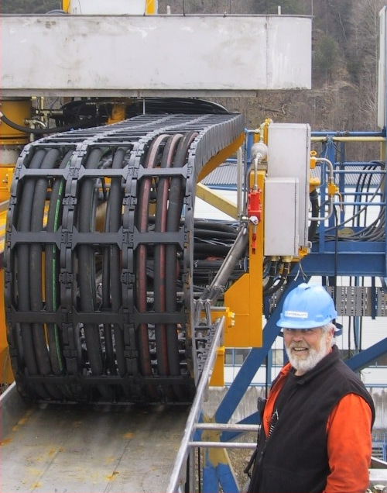
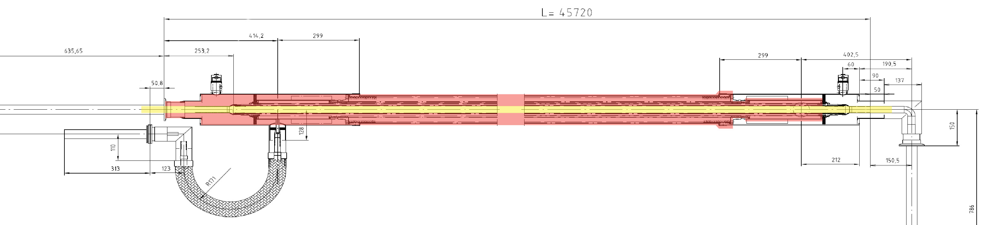
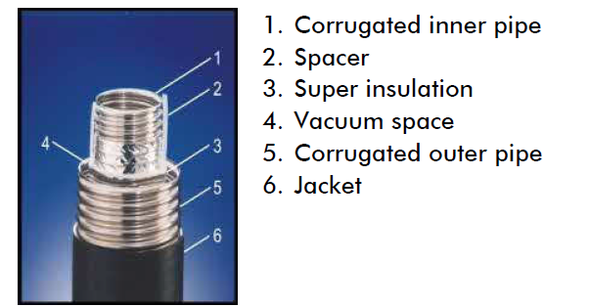
Cryogenic Line Guides Require Novel Design Solution
Metal Guide Option
Plastic Guide Option
Vacuum Jacketed Lines
Commercially Available
Guide Designs Needs To Resist “Coil-Up” Under Vacuum Load

Slide 6
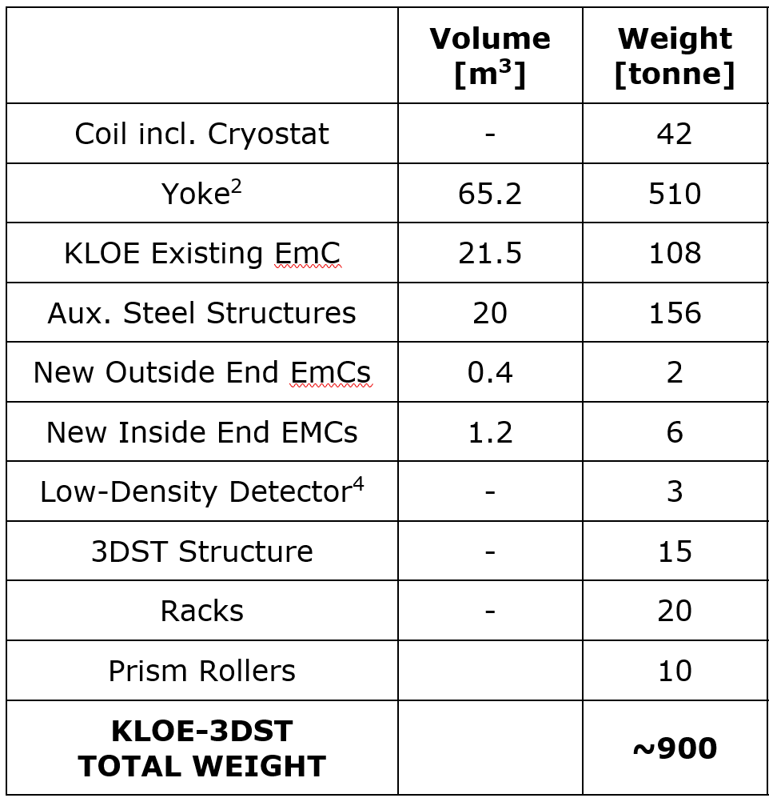
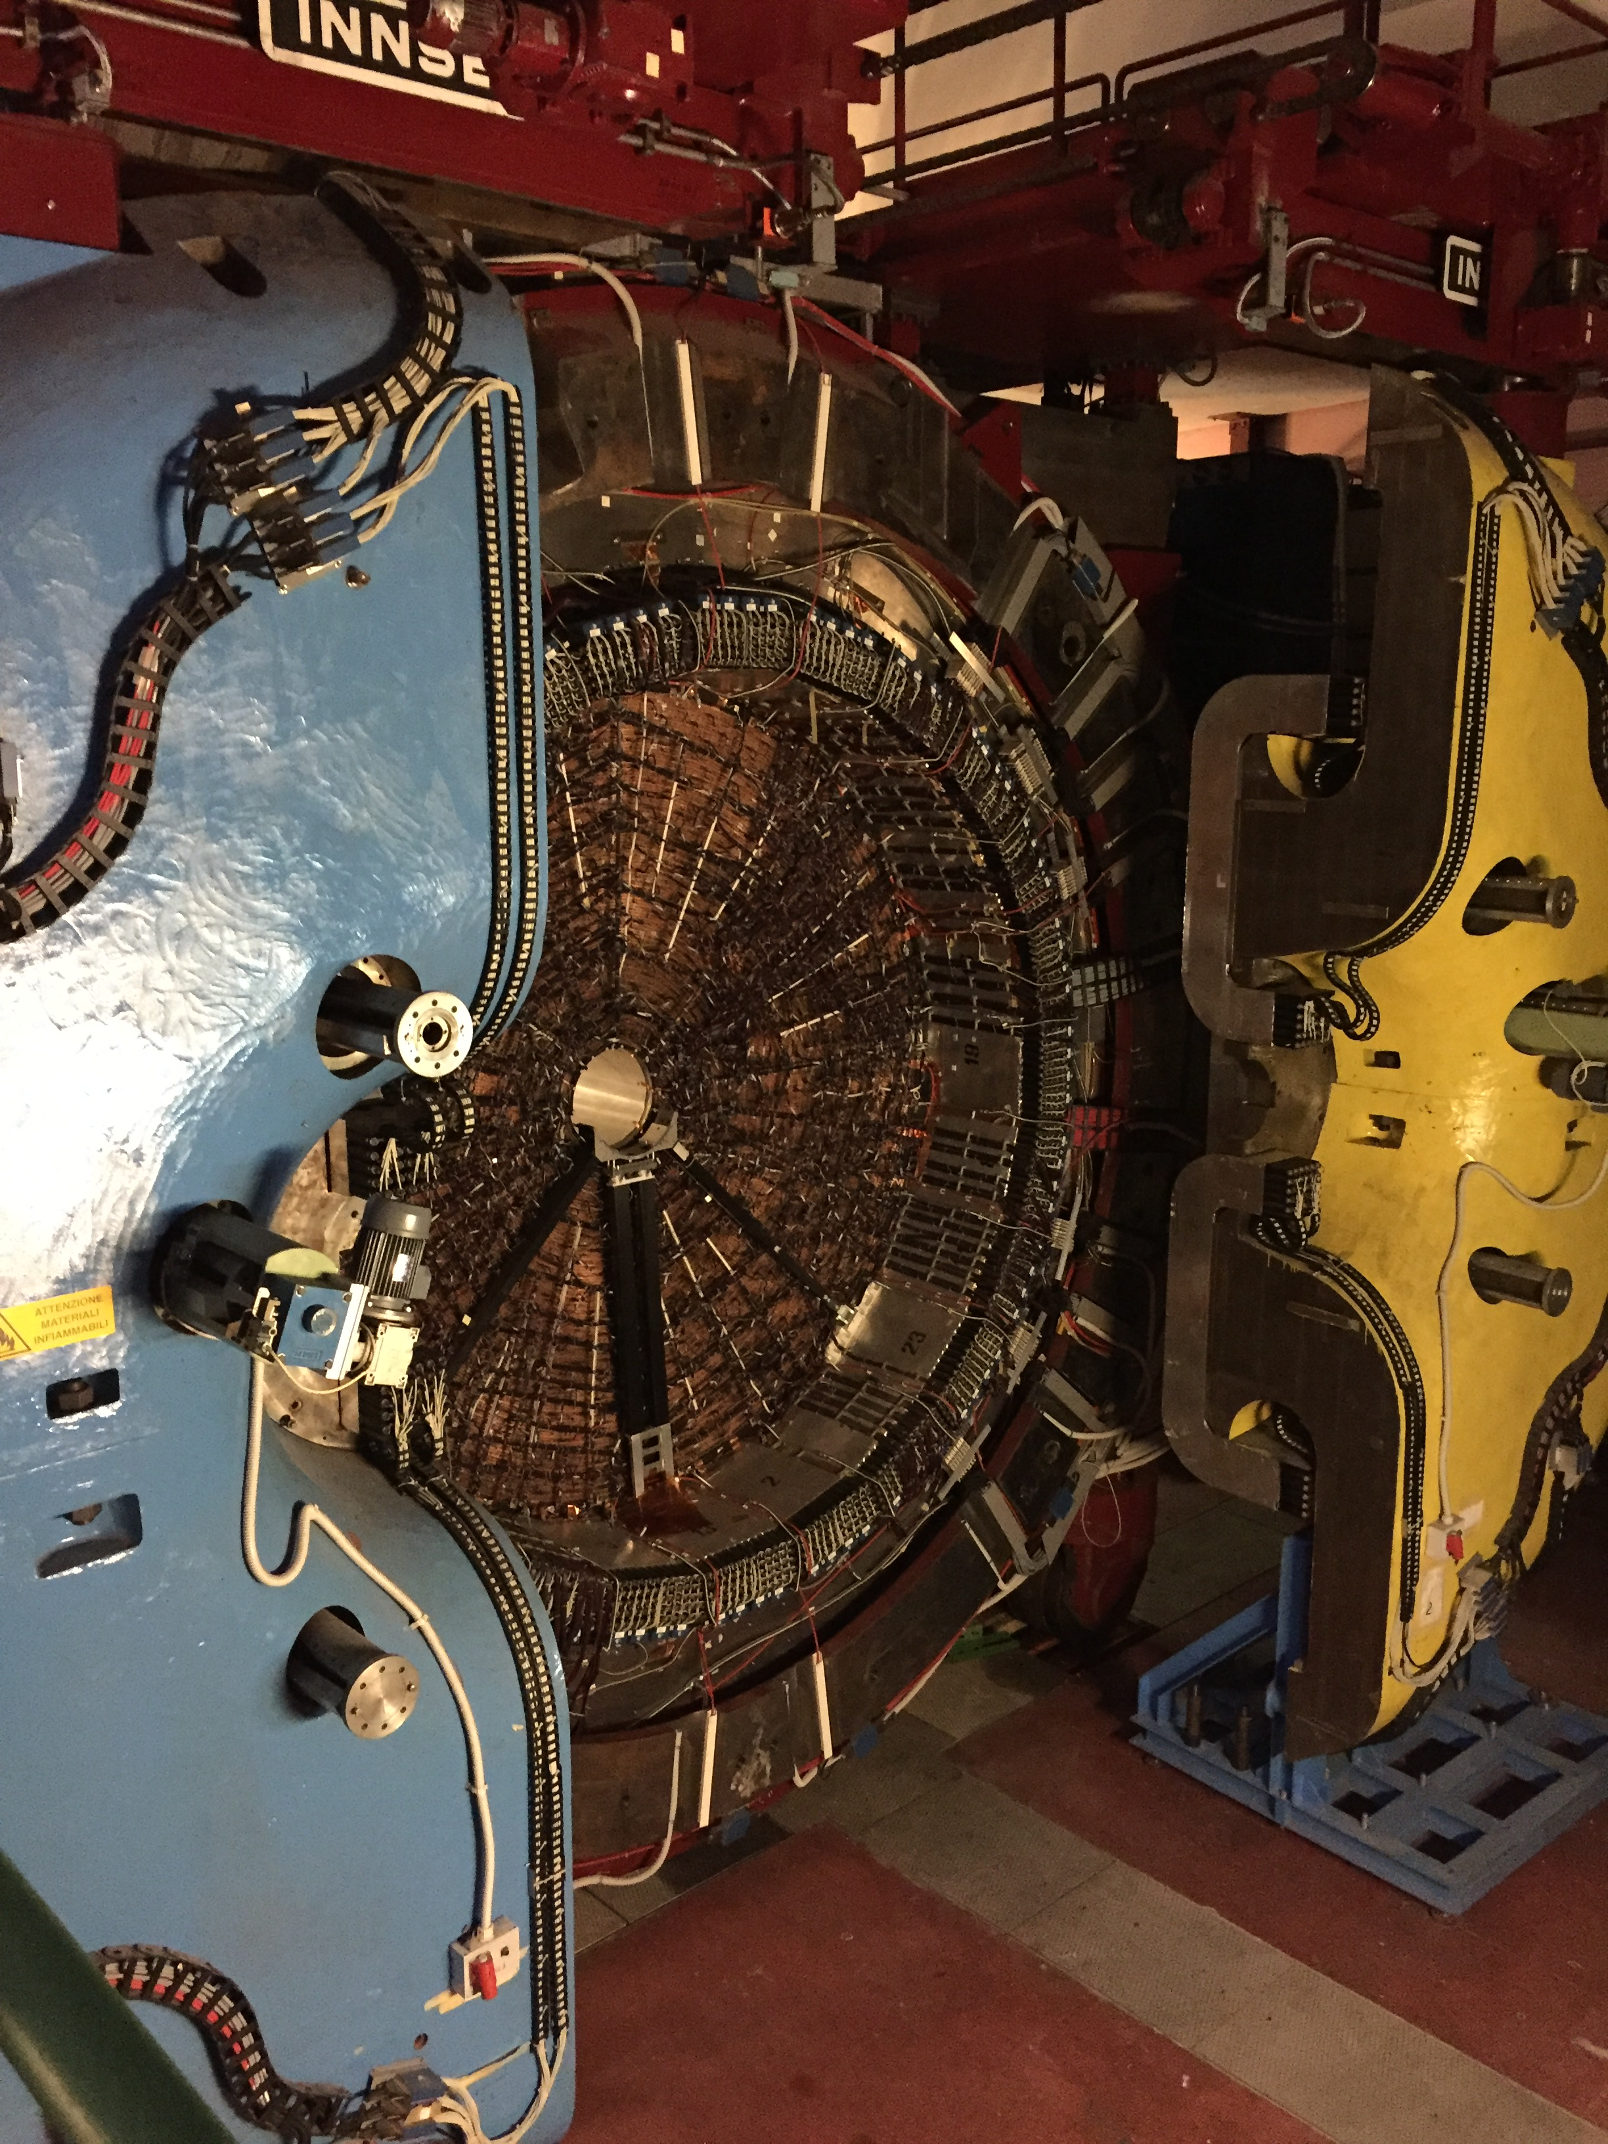
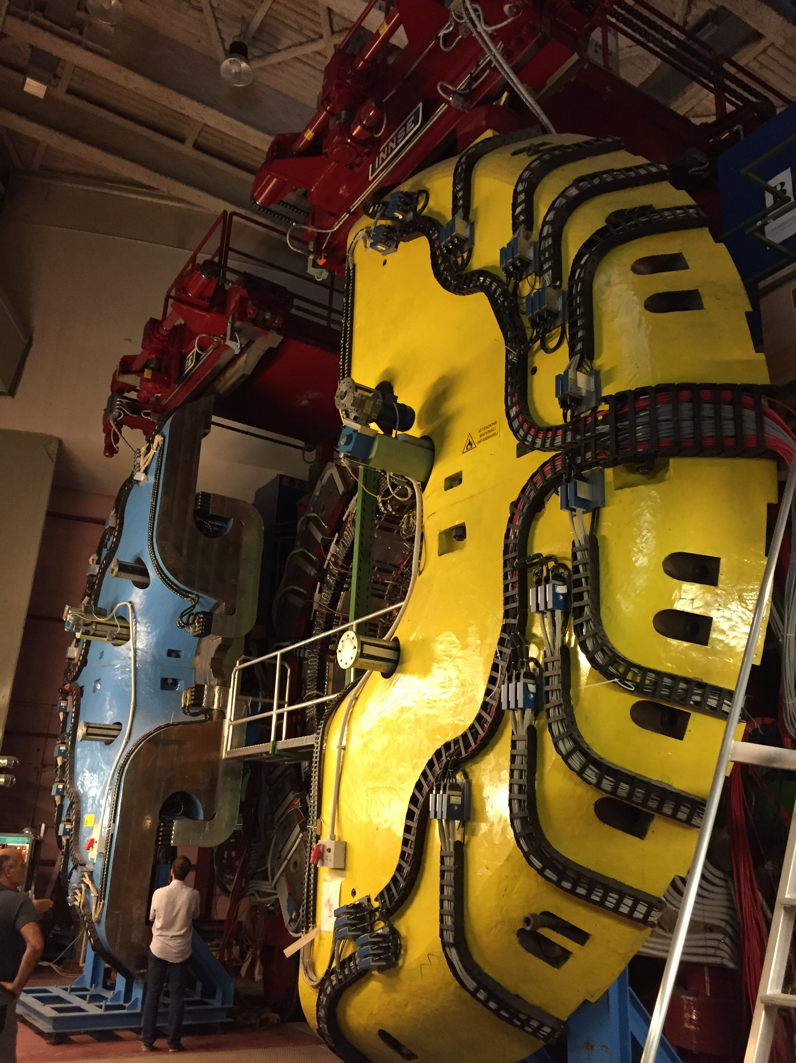
KLOE-3DST Detector Main Structure Parameters
Yoke:
Length = 6 m
Diameter = 7 m
Full Detector Size:
Length ≈ 10 m
Height ≈ 11 m
See Sergio Bertolucci Talk

Slide 7
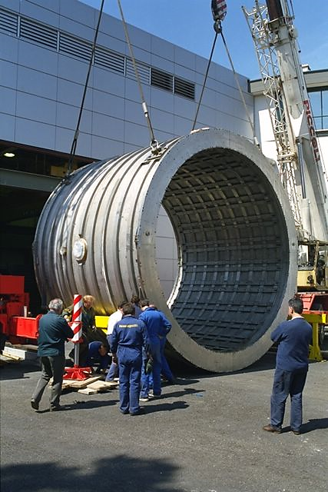
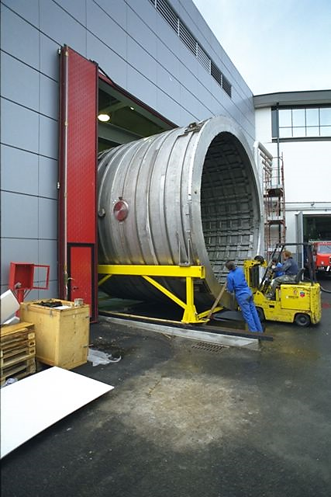
KLOE Magnet Incl. Cryostat Will Be The Heaviest Single Component To Be Lifted Into The DUNE ND Cavern
KLOE magnet: 42 tonne
Yoke: 510 tonne
(separable into individual units weighing less than 30 tonne)
See Sergio Bertolucci Talk

Slide 8
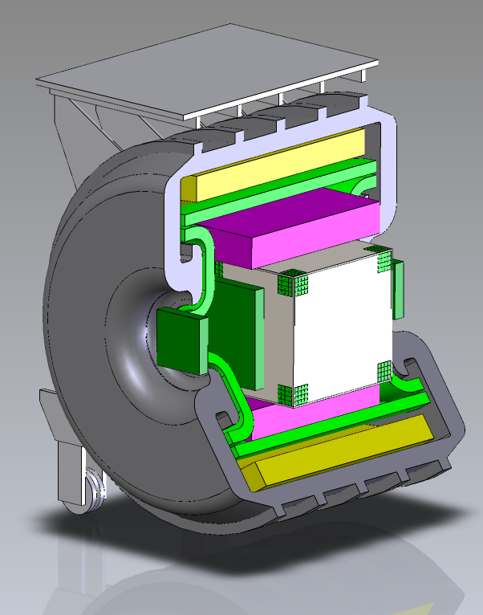
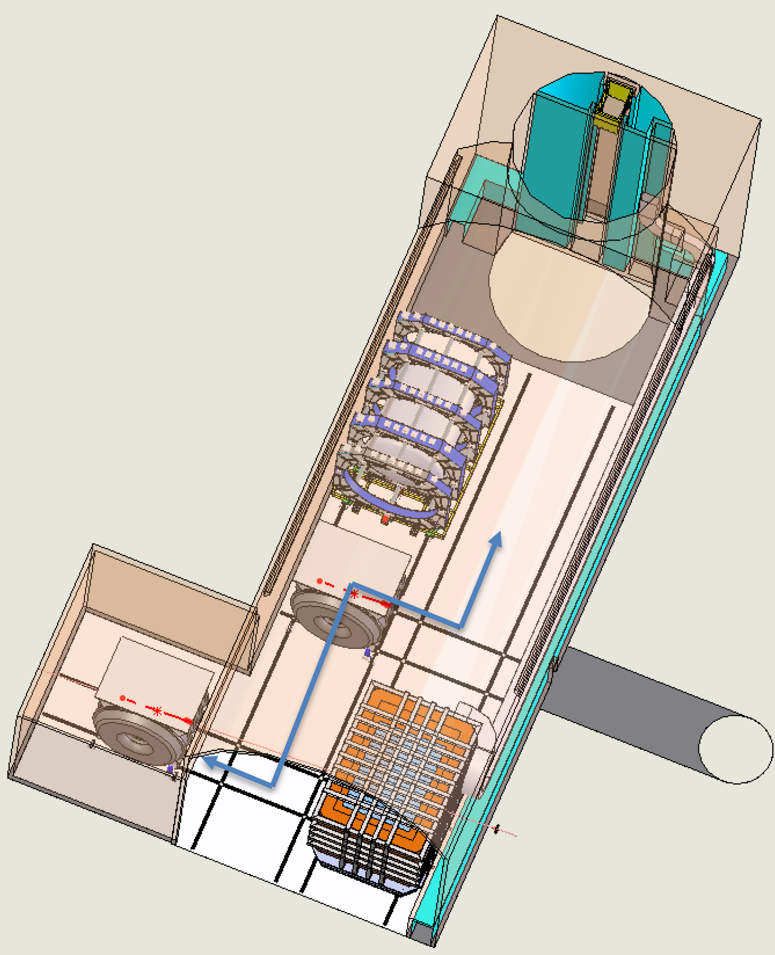
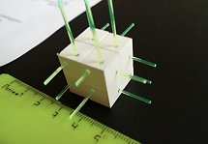
KLOE-3DST Detector Will Be Stationary And Can Be Assembled And Serviced Inside Cavern Below Ground
KLOE-3DST
Stationary Detector
Inside Alcove
Calorimeter
“Low Density Detector”
TPC or Straw Tubes
Floor Guides
To Assembly
And Servicing
Station
11 Million 3DST Cubes
Coil Cryostat
Yoke

Slide 9
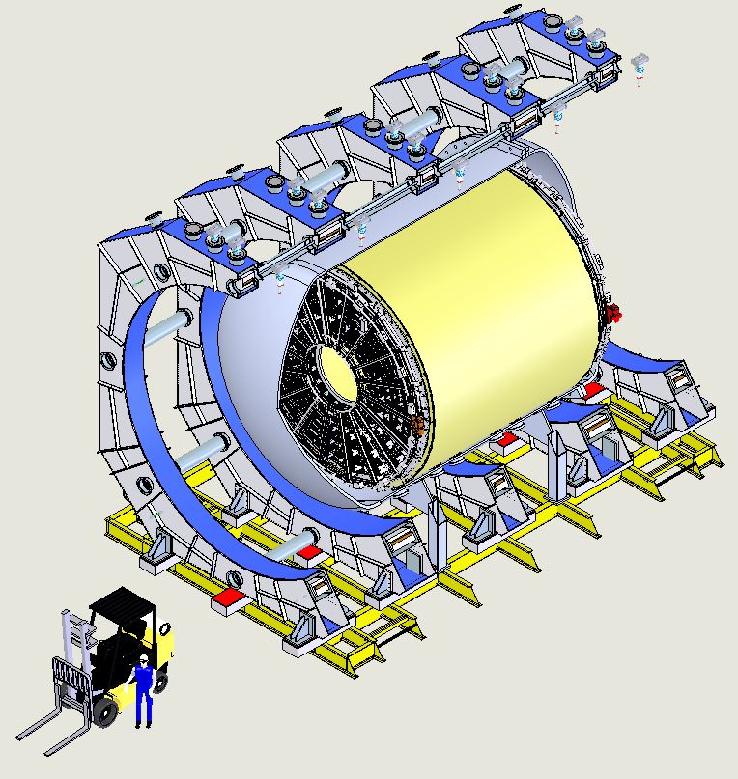
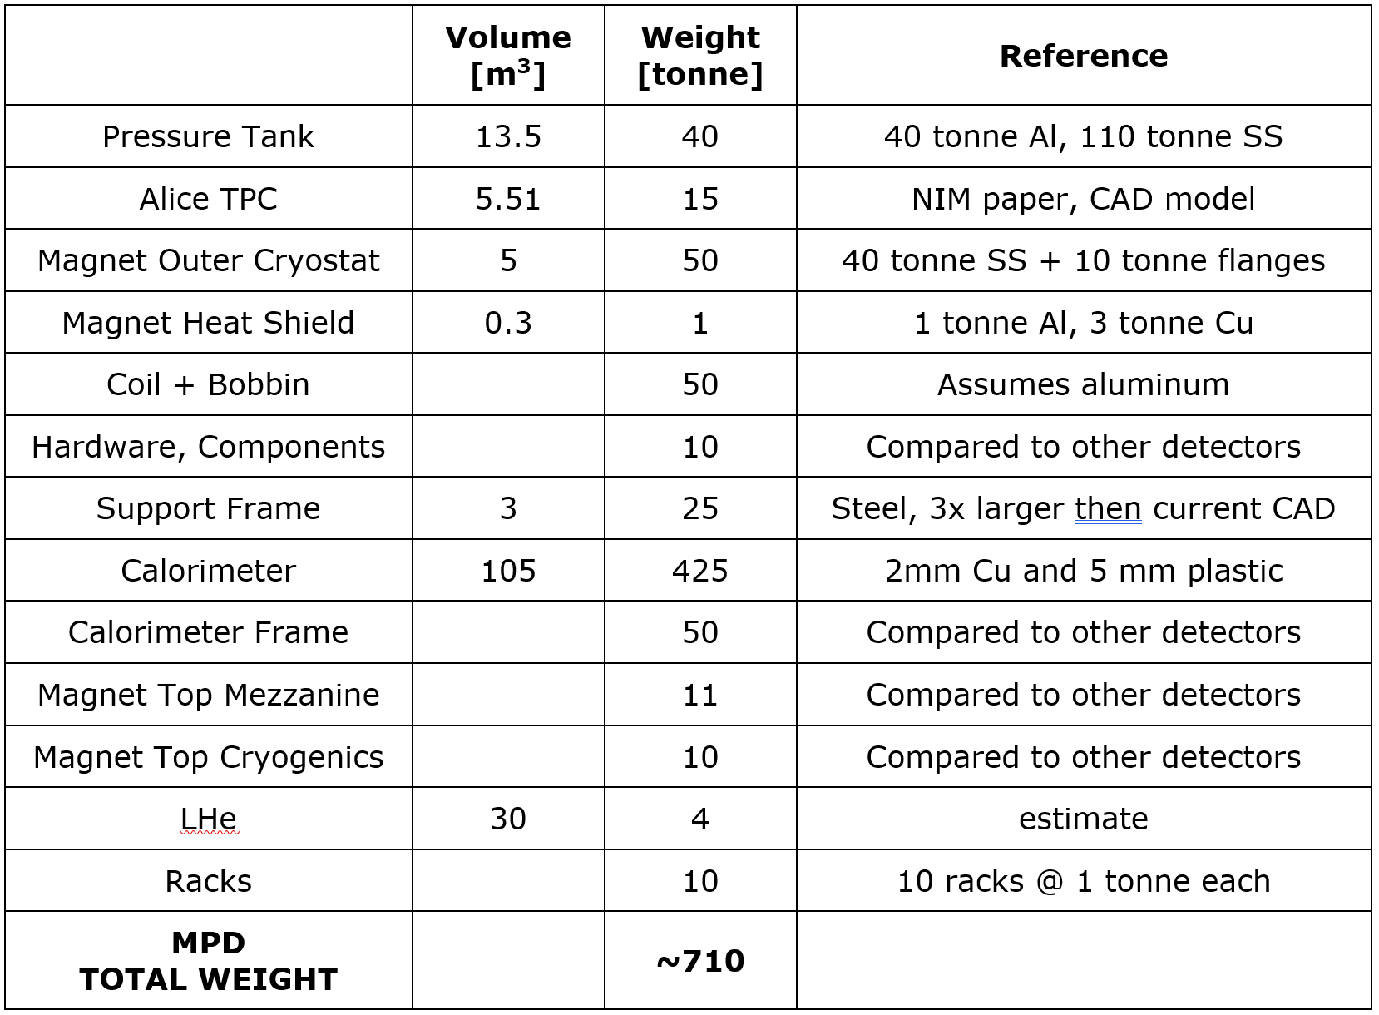
MPD Main Structure Parameters
Detector Size:
Length = 12.8 m
Height = ~10 m
Width = 8.5 m
See MPD Session

Slide 10
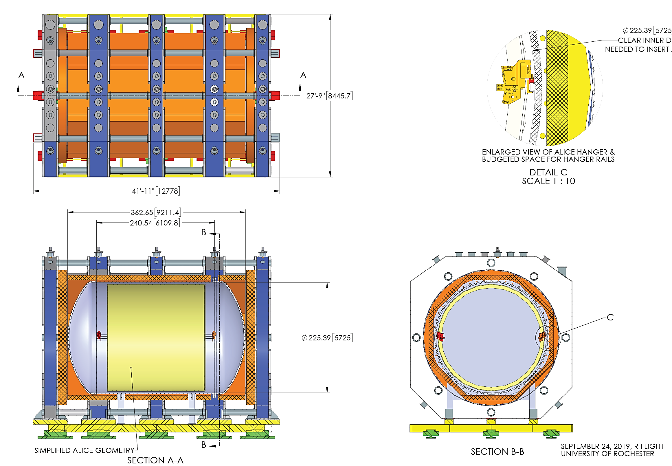
MPD Design Maturation: Achieved Fully Integrated Design
Coil and Cryostat Structure
Calorimeter
Pressure Vessel
Detector Size:
Length = 12.8 m
Height = ~10 m
Width = 8.5 m
TPC
See MPD Session

Slide 11
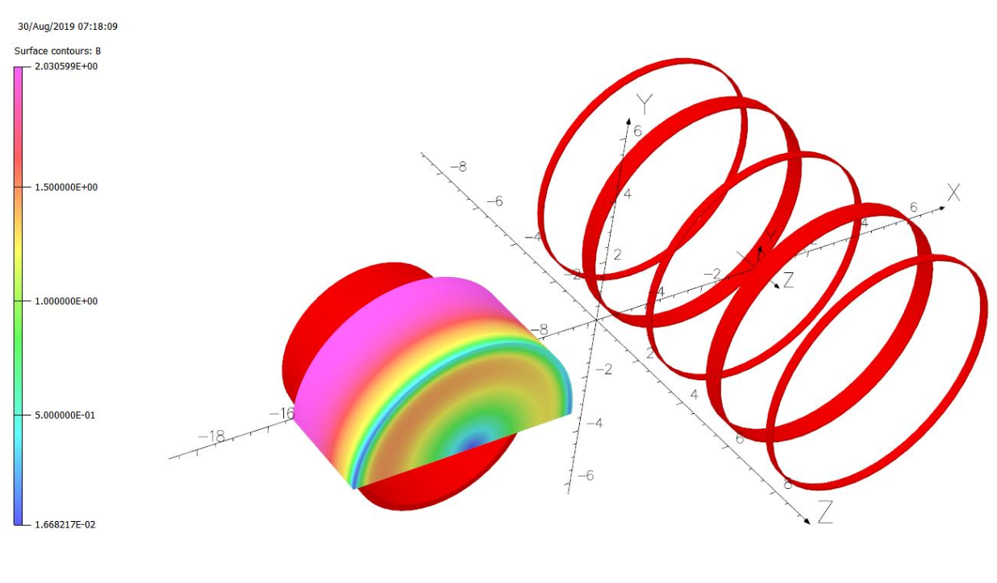
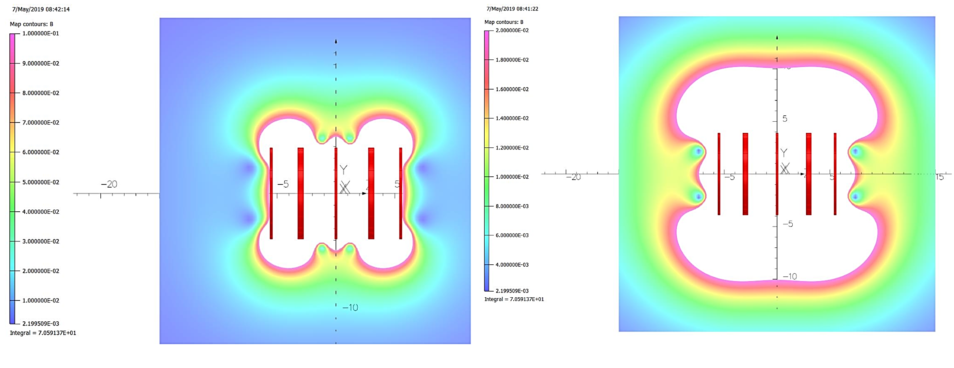
Open MPD Superconducting Coils Expose Adjacent Structures To Significant Magnetic Stray Field
1000 G Contour
200 G Contour
20 tonne-force between MPD and KLOE Plus Added Interaction Between Both Detector Coils
MPD field will require LAr cryostat room-temperature structure to be fabricated out of stainless steel or aluminum
More effort will be required to ensure magnetic interactions are fully understood
Simulations by Vladimir Kashikhin

Slide 12
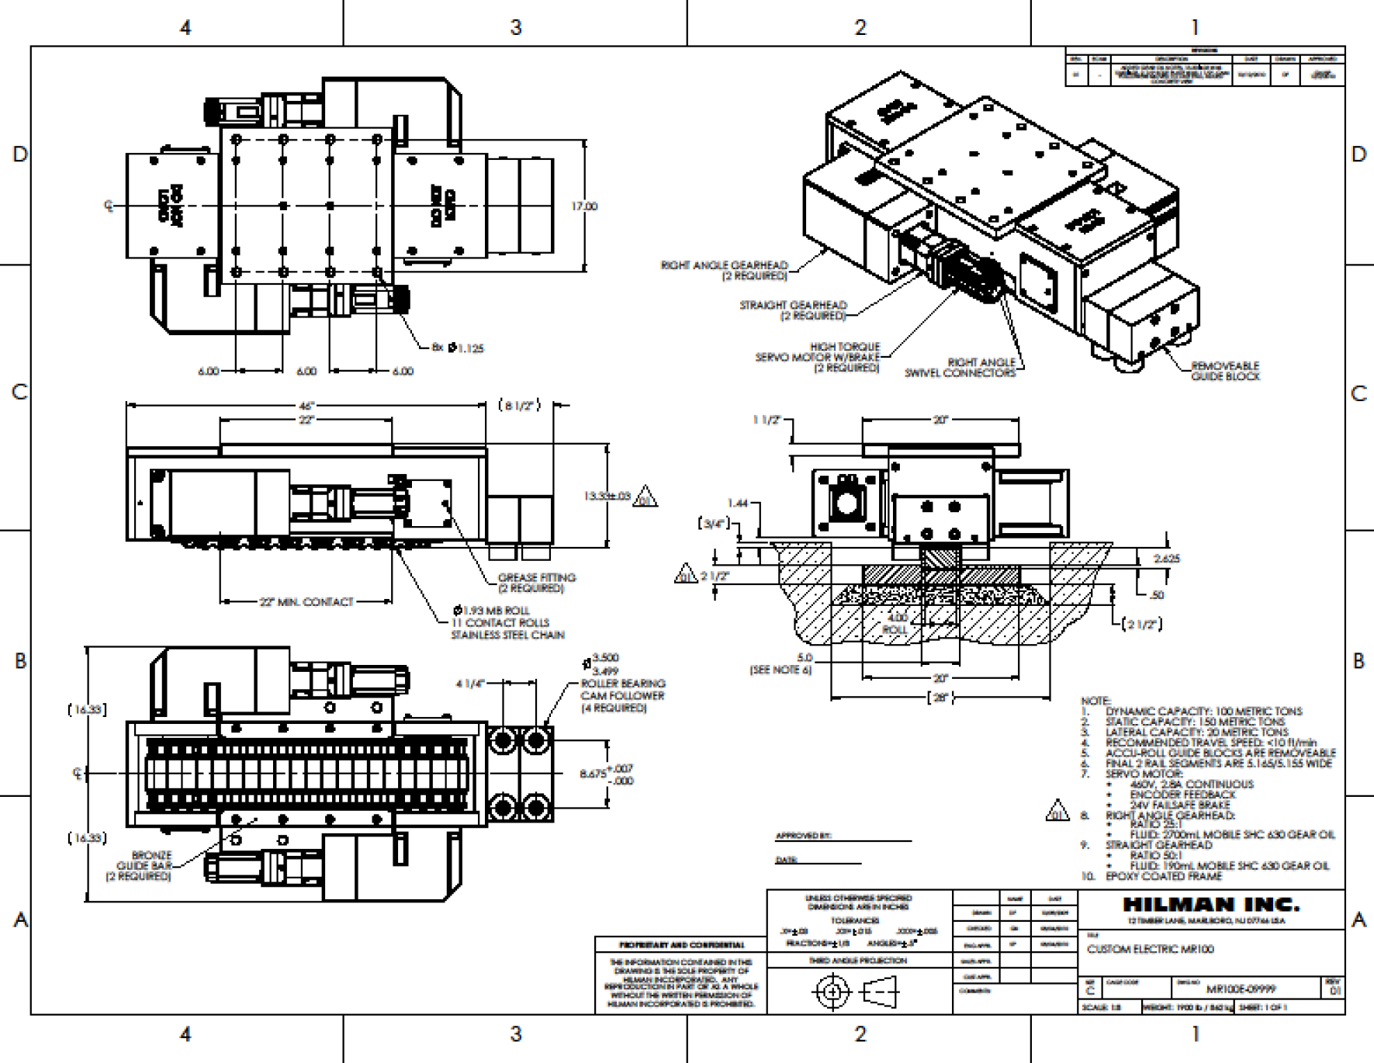
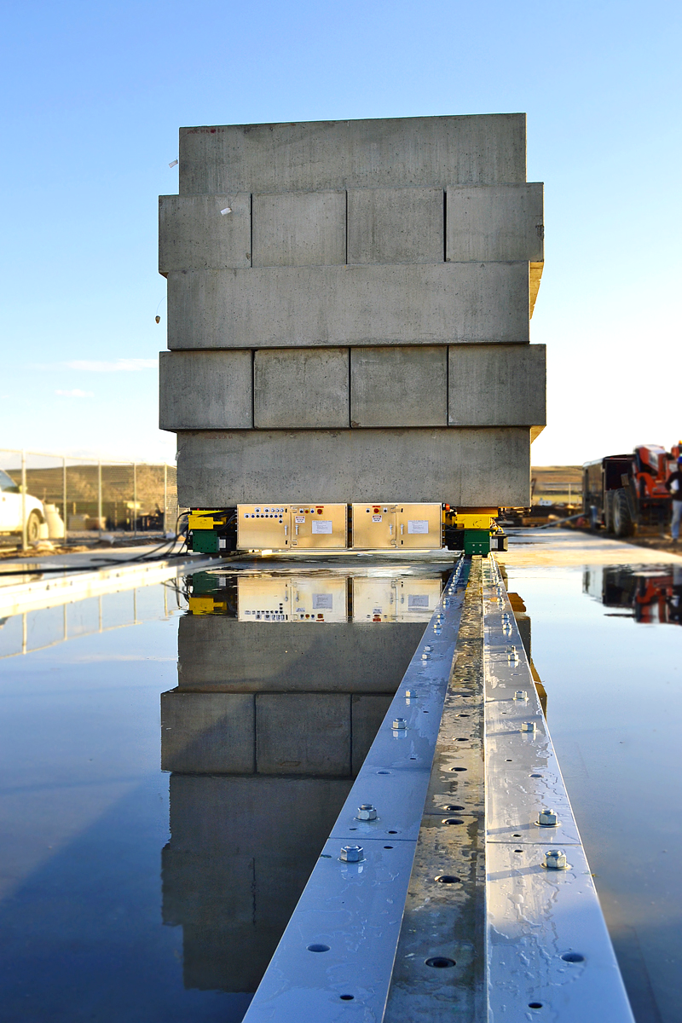
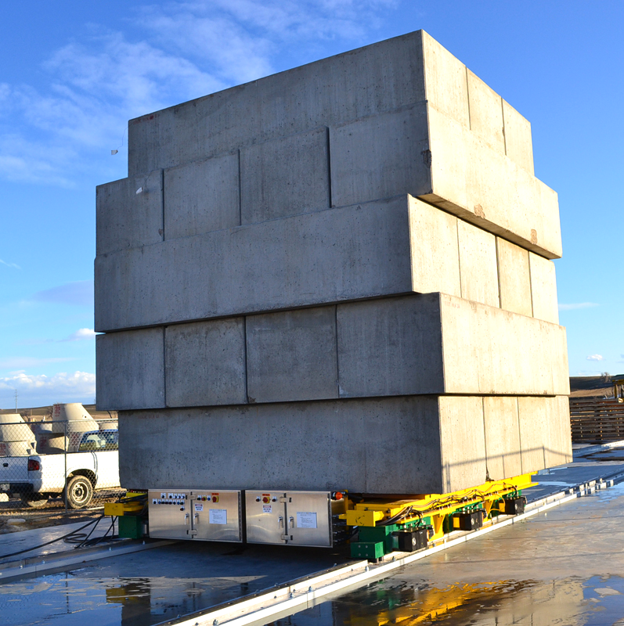
DUNE ND Prism Design Concept Utilizes Commercially Proven Roller Drives Which Distribute Detector Weights
Positive side capture required due to large magnetic forces
30.5 m movement range
9 stops, 2 weeks at each stop

Slide 13
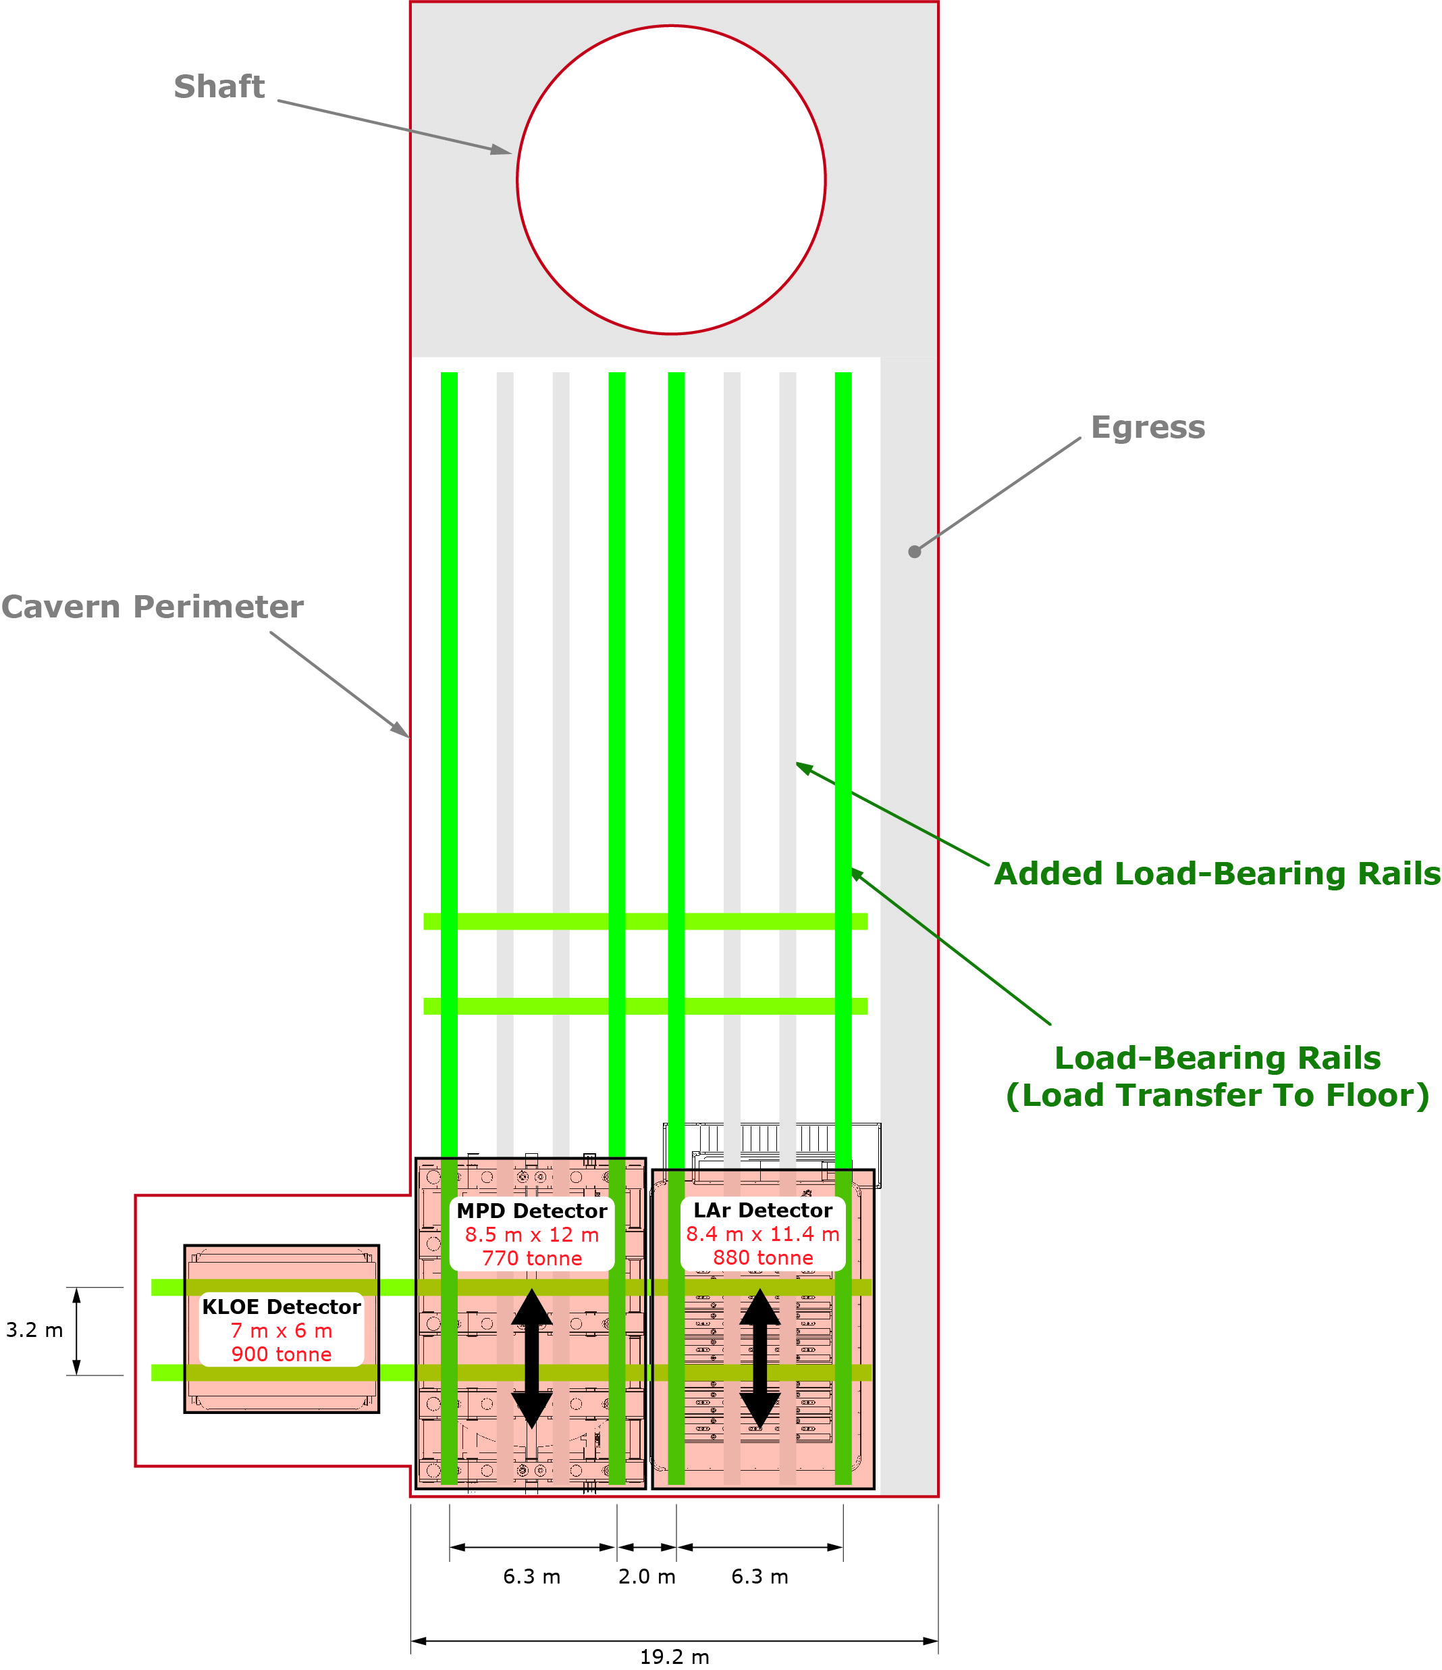
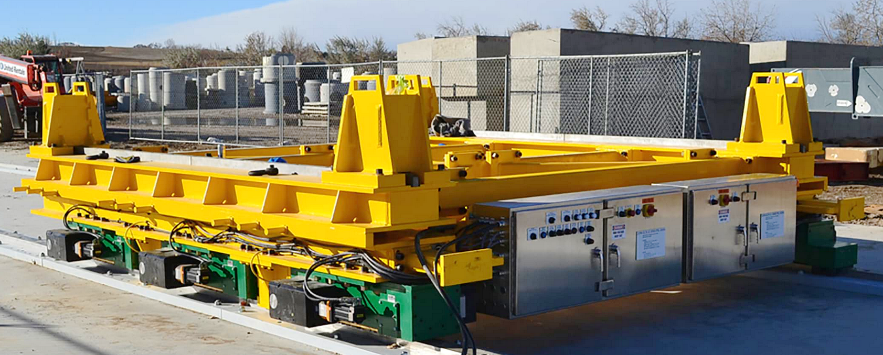
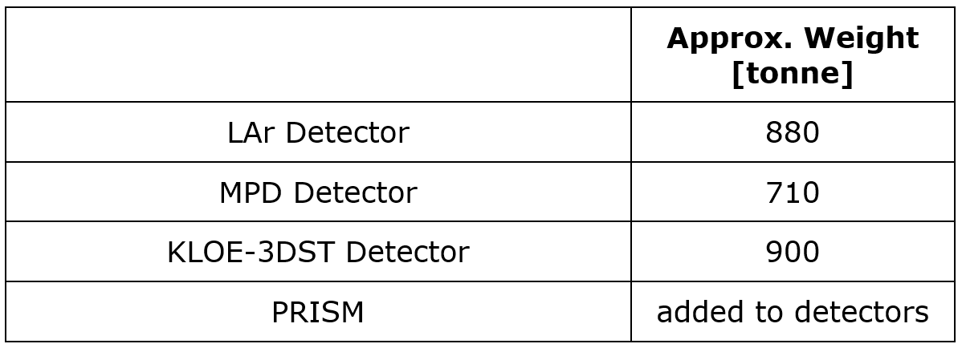
PRISM System Will Distribute
Significant Detector Weights
Magnet Forces Could Complicate Design
  Prevent tipping
  Prevent unanticipated movement
Control system can synchronize several rows of rollers to distribute weight
Guide rail design optimized together with cavern structural design
System Permits Smooth Movement

Slide 14
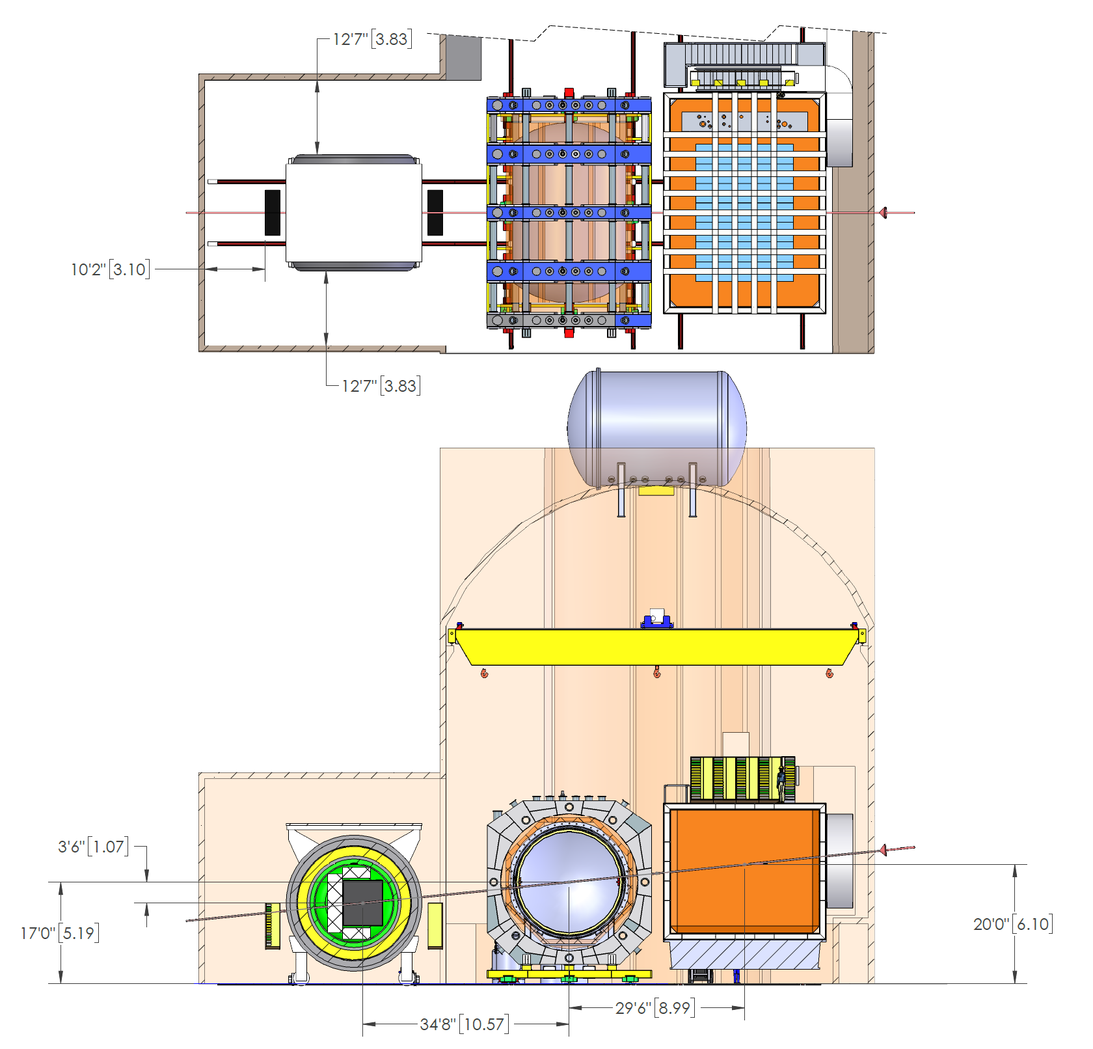
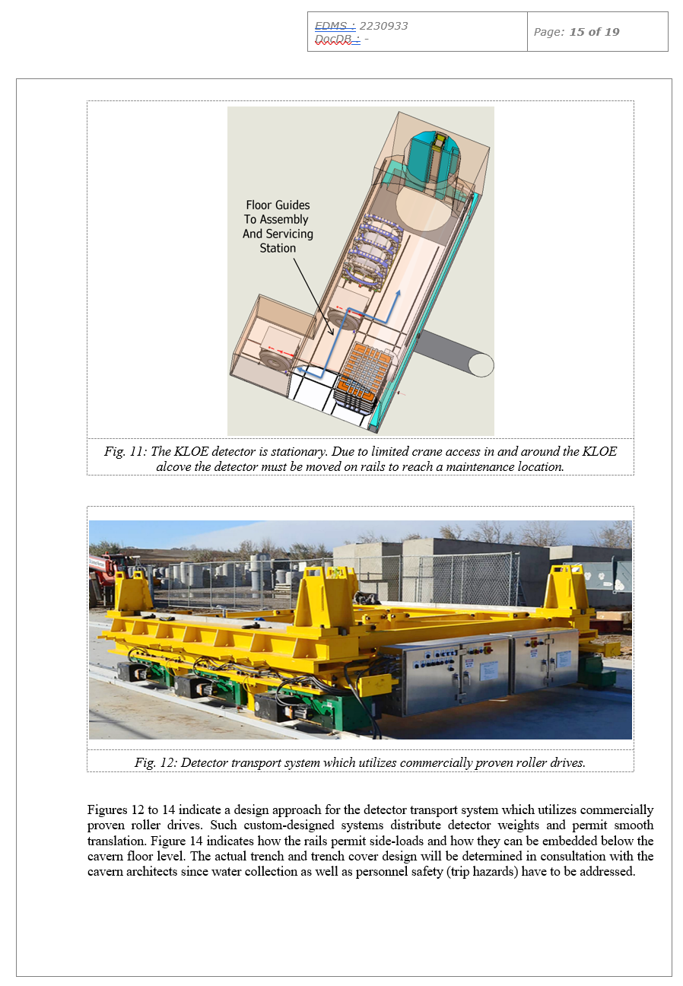
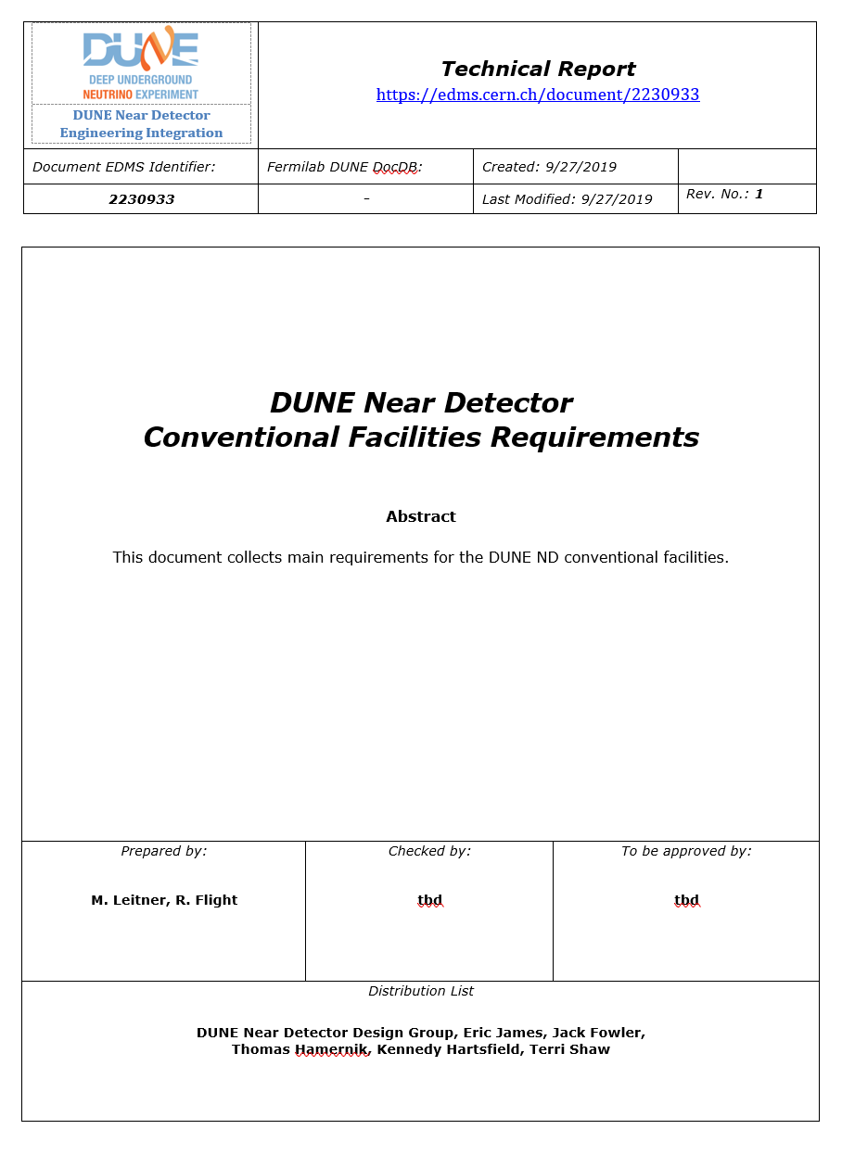
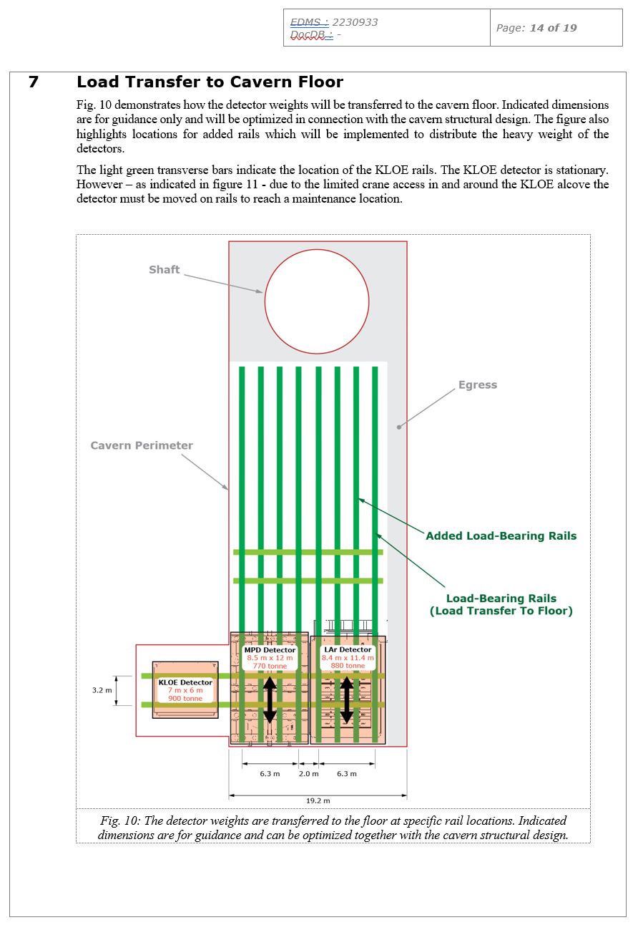
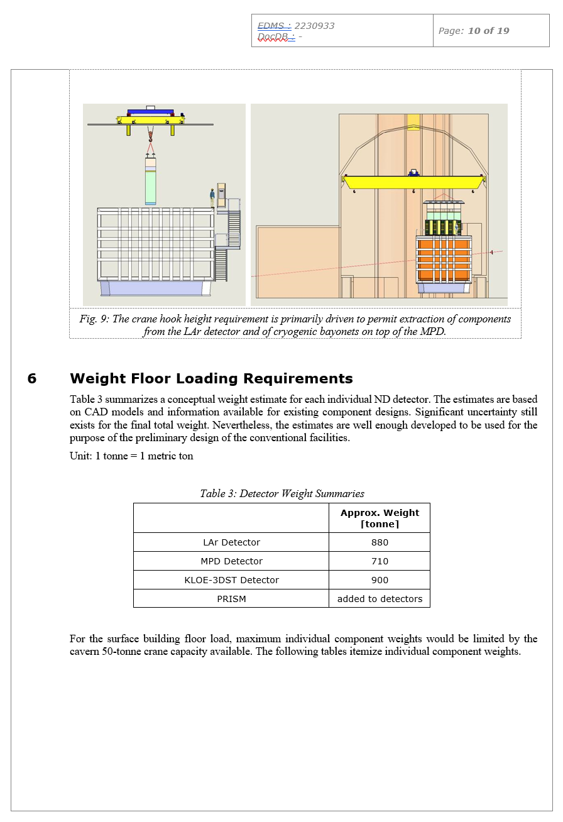
ND Requirements Document Collects Information About Facilities Interfaces
EDMS# 2222899
EDMS# 2230933

Slide 15
Next Steps
Climate Control Discussion
Electrical Engineering
  1-2 MW Maximum Power
  Power Spreadsheet
  Grounding Details
  Power Distribution and 1-Liner Drawing
  Controls Layout
  Cable Trays (Designer)
Surface Building Requirements
  Incorporating Info From Terry and Don
  Cable Trays and General Utilities For Experiments
Integration and Installation (I&I) Will Detail-Design PRISM System
  Movement System
  Cable Chain
  Prototypes

