Slide 1
Bi-Weekly DUNE Near Detector Engineering Integration Meeting
11/14/2019

Slide 2
Agenda
M. Leitner: Cavern and Surface Building Updates
Bob Flight / Matthaeus Leitner: Planned KLOE Site Visit
All: Discussion
Upcoming Meetings:
Installation Review January
Collaboration Meeting CERN January

Slide 3
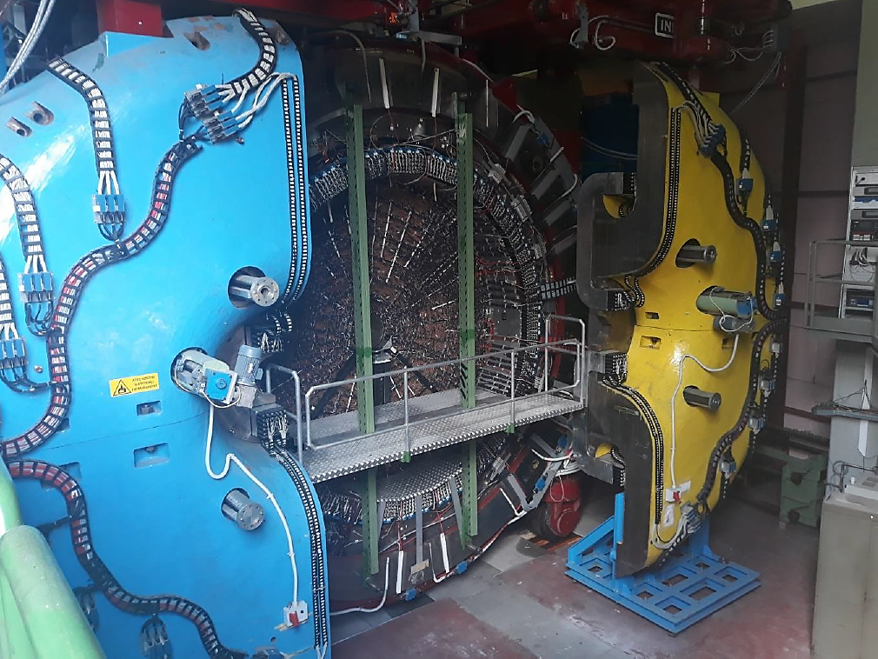
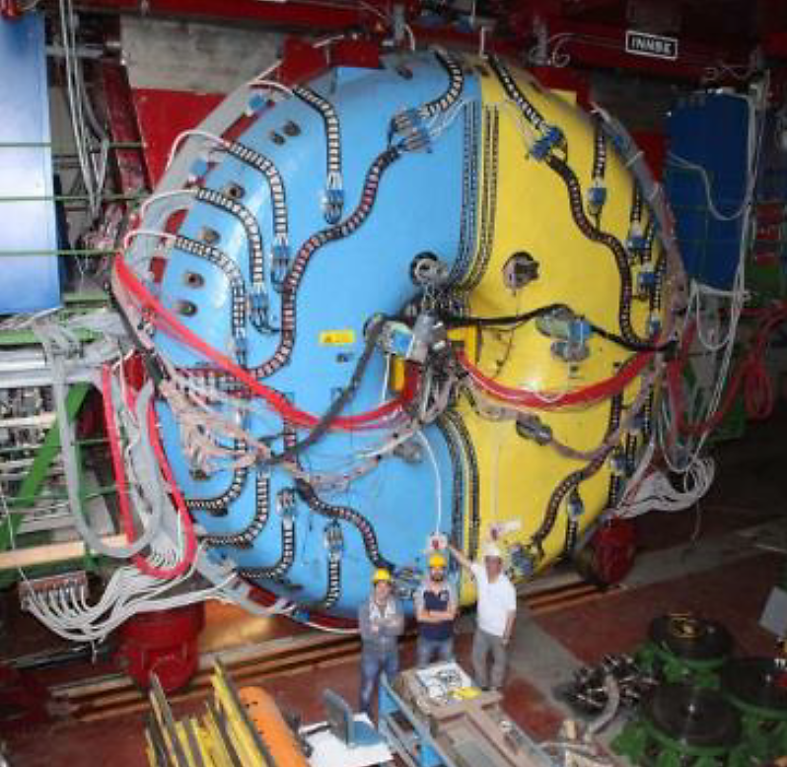
KLOE Detector Space Needs Increased Due To Auxiliary Equipment
Rack space needs drive alcove depth

Slide 4
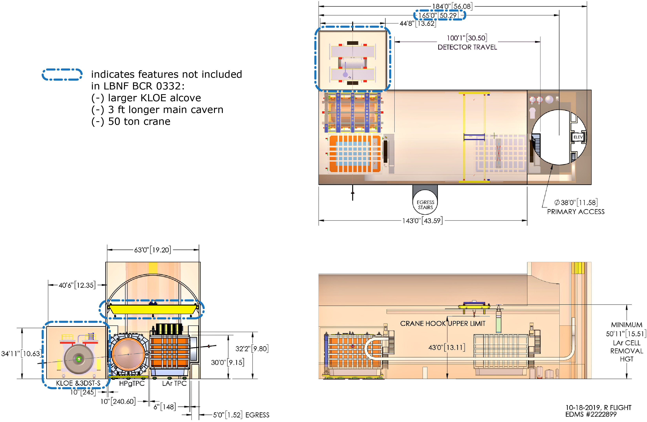
Total Excavation Volume Should Stay Constant: Large Cavern Volume May Need Reduction To Compensate For Added KLOE Alcove Volume

Slide 5
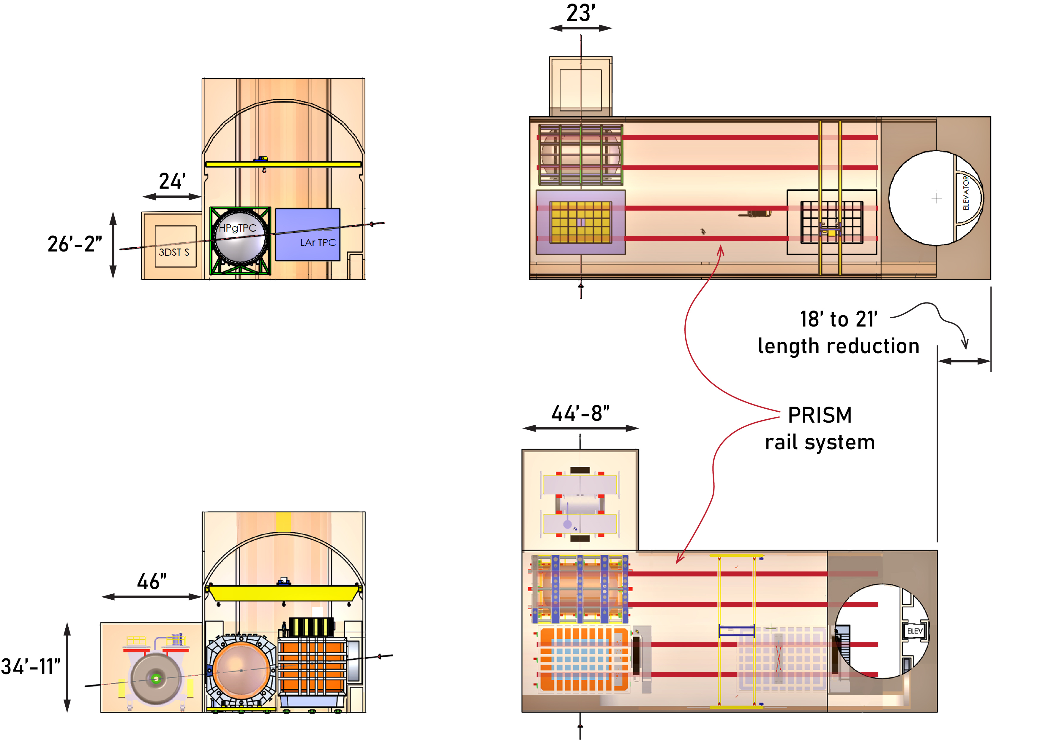
Cavern Layouts With Comparable Excavation Volume / Cost
BCR 0332 Cavern:
alcove volume = 14,444 cft
Larger KLOE Alcove Cavern Configuration:
alcove volume = 71,742 cft
alcove volume delta To BCR = 57,298 cft
3’ of added main cavern volume = 9,450 cft

Slide 6
Main Cavern Summary
Main cavern length can be shortened to compensate for increased volume/cost of KLOE alcove
Dependent on final KLOE alcove size main cavern may have to be shortened between 18 to 21 feet
No impact to PRISM length if rails are permitted to extend below shaft
Additional BCR impact: Currently 15 ton crane limit
Climate control:
 | Range
Temperature | 21° ± 5° Celsius
Humidity | self-regulated based on influx of conditioned air from the surface building

Slide 7
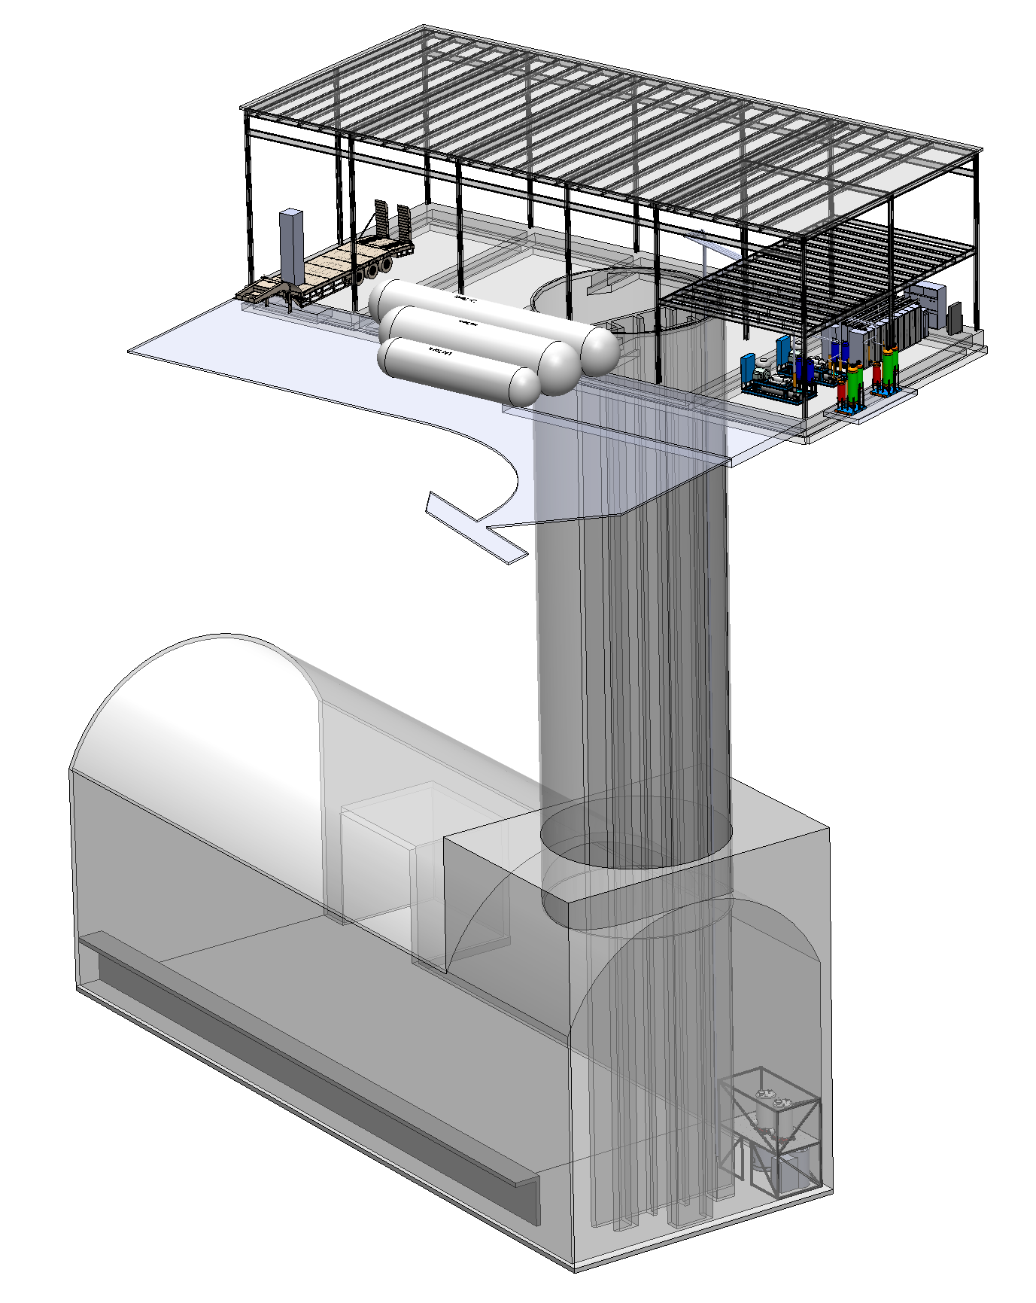
Current Effort Is Focused On Laying Out Surface Building And To Start Initial Detector Utility Routing
Surface Building
Truck Loading
DAQ Room
Cryogenic System
Storage Tanks
LHe Plant Compressors and Oil Purification
Shaft and
Utility Routing
Cavern
LHe Coldbox, Storage Dewar and Valve Box Location

Slide 8
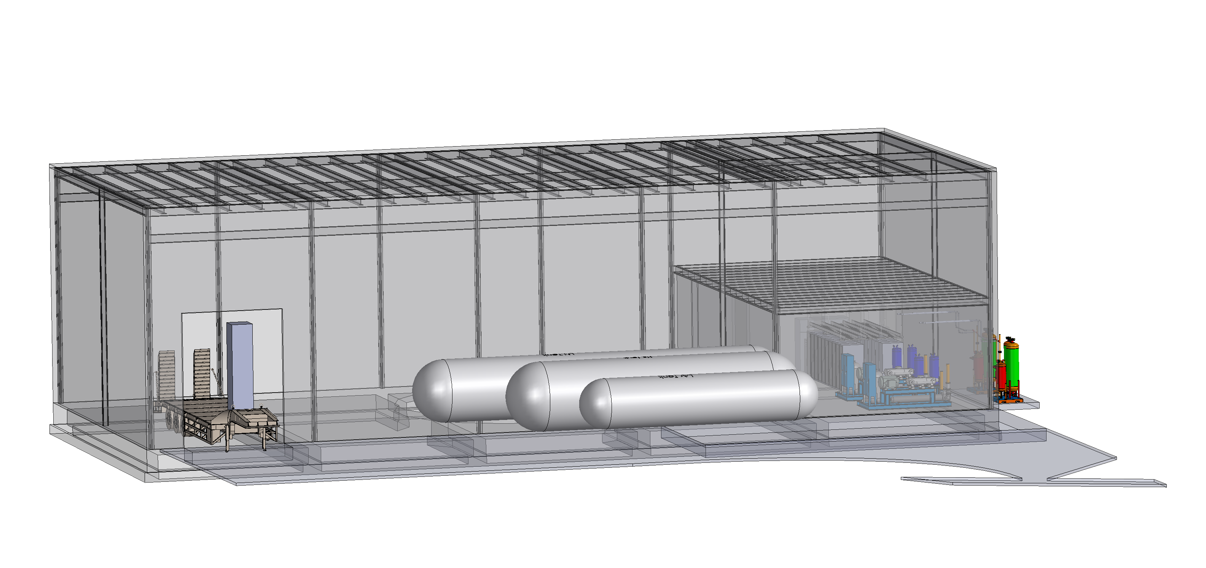
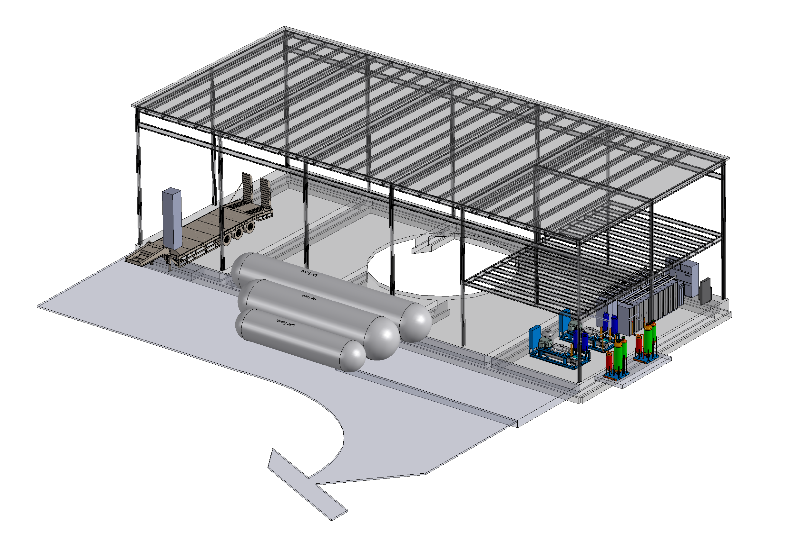
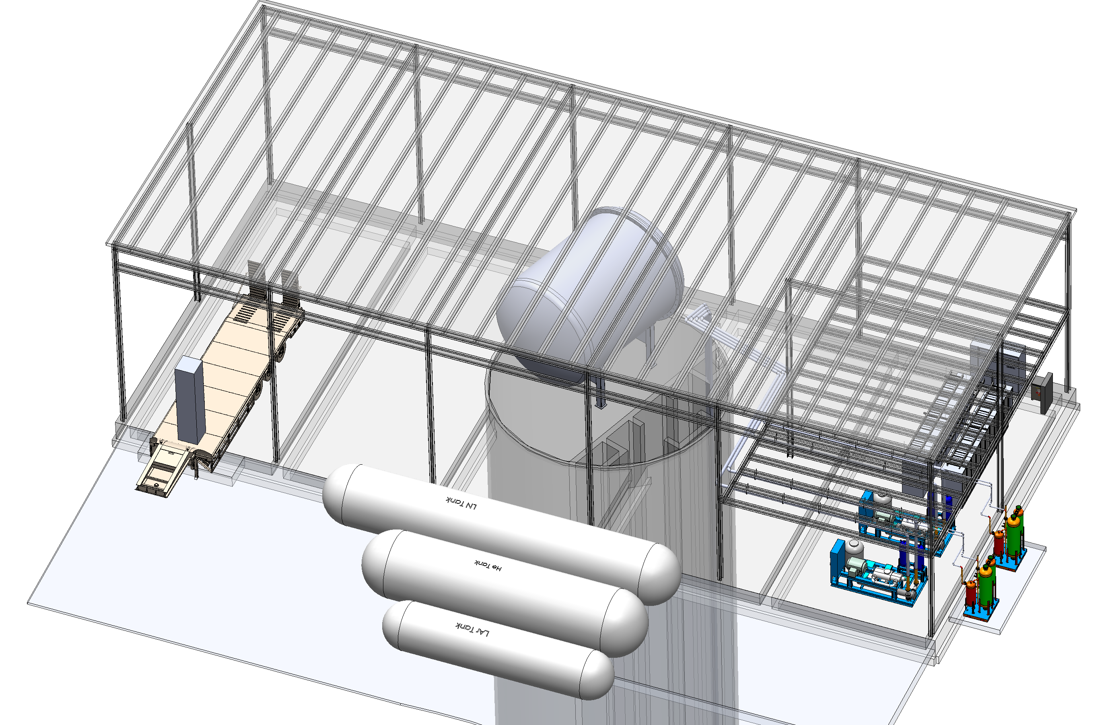
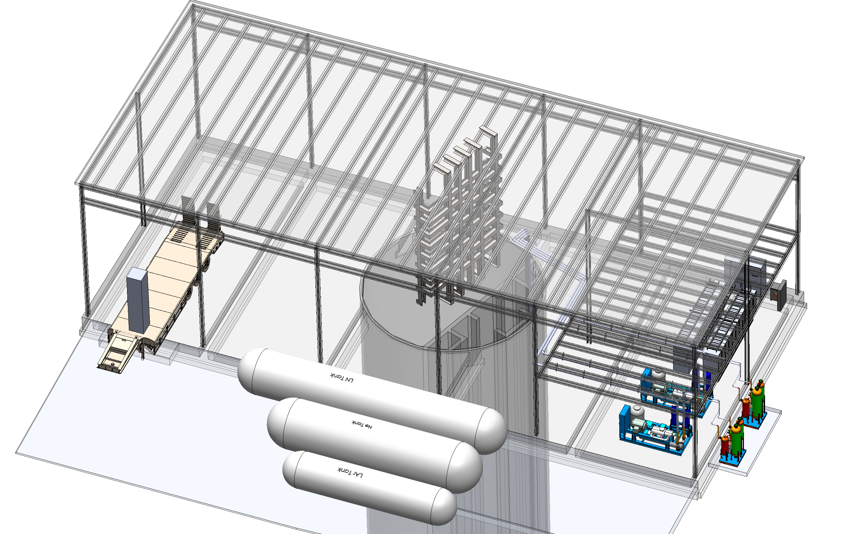
Surface Building Experimental Facilities
Surface Building Will Only Permit
Unloading of Smaller Detector Components
No Significant Assembly Space Provided
Space Reserved For
Building Utilities
Loading Dock Door Sizing
Horizontal Storage Tanks Reduce Neighborhood View Impact
MPD Shaft Rigging
LAr Cryostat Panel Shaft Rigging

