Slide 1
KLOE Site Visit Update
Matthaeus Leitner
12 Dec 2019

Slide 2
November 2019: Two DUNE Near Detector Engineers Visited INFN Frascati To Collect Cavern Design Requirements For KLOE Detector
Detector as-built physical sizes verified
Including supporting equipment on rack platforms
Including service space for open end yoke plates
Utility requirements verified
Electrical power
Cooling water
Exchanged cryogenics process flow diagrams, cryostat cool-down procedures, cryogenic connection interface details
Validated crane requirements
Discussed detector hydraulic lifting and movement procedures
Evaluated future storage/staging needs at FNAL
KLOE Engineering Information Required To Finalize LBNF Conventional Facility Design Has Been Successfully Transferred To DUNE

Slide 3
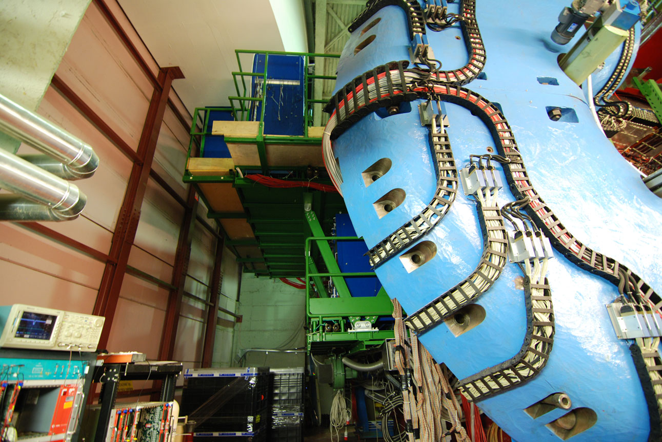
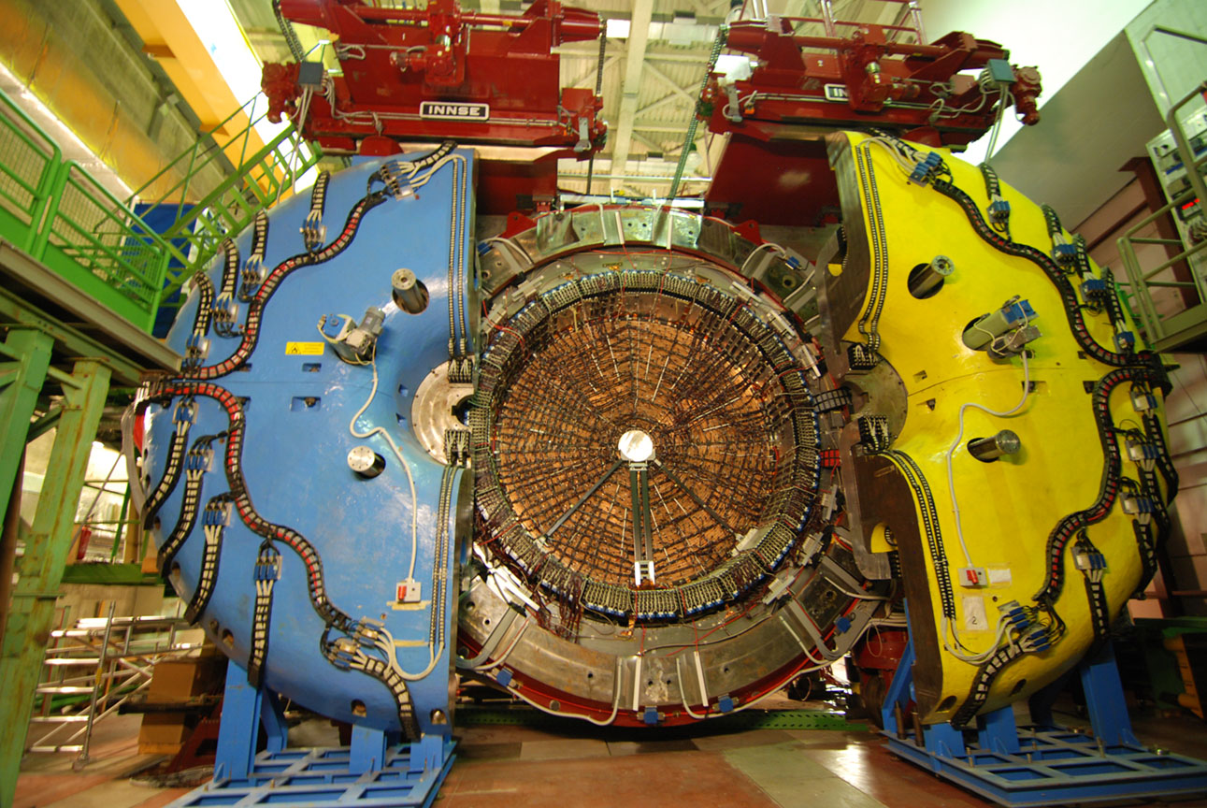
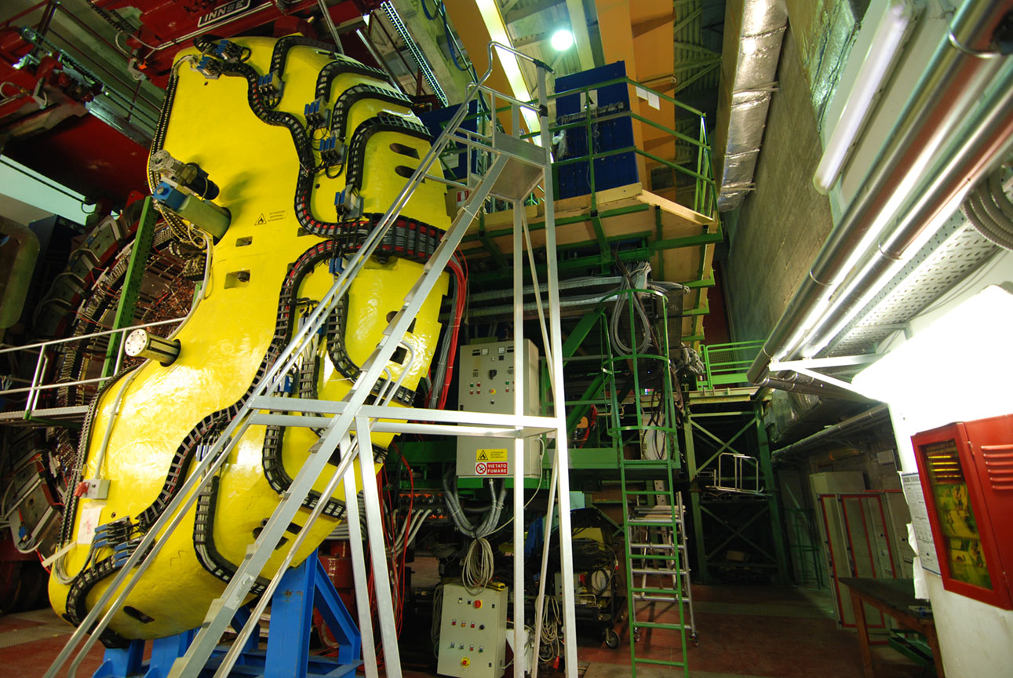
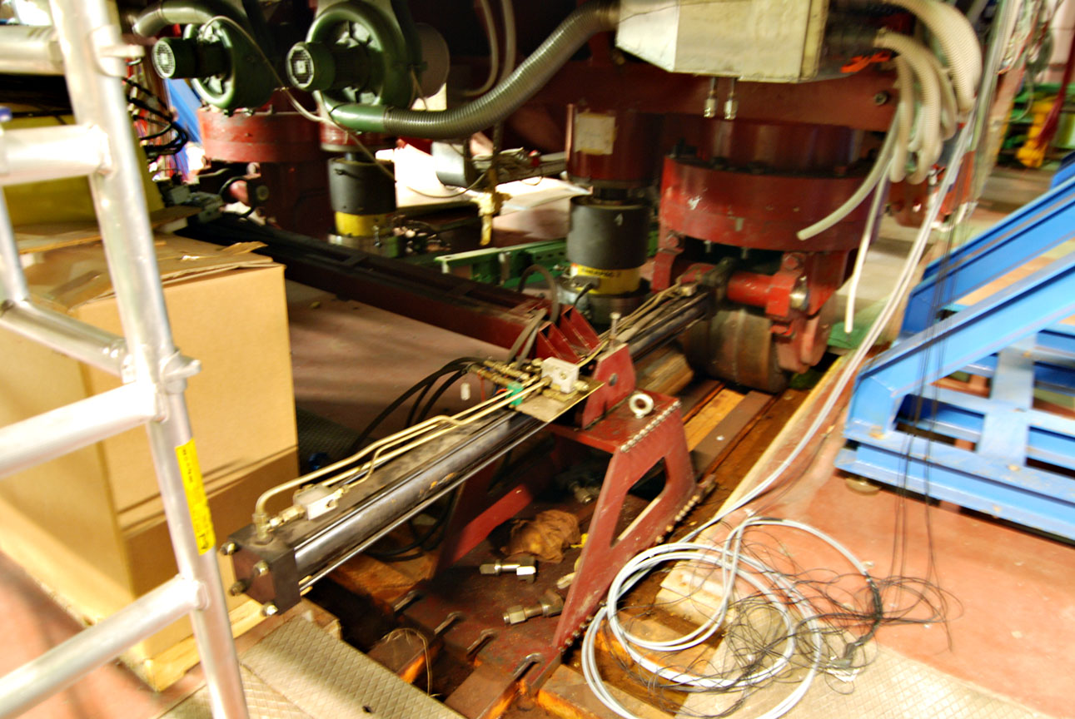
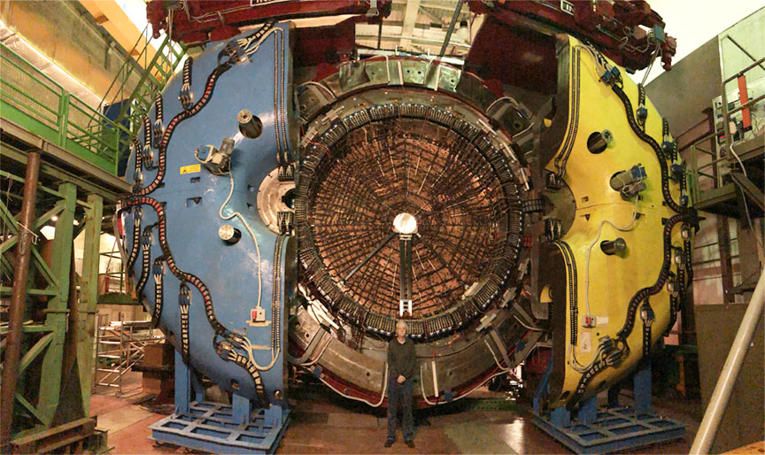
November 2019: Two DUNE Near Detector Engineers Visited INFN Frascati To Collect Cavern Design Requirements For KLOE Detector
Left Side Detector Utilities
Right Side Detector Utilities
Detector Movement System
Protrusions From Detector Have Been Recorded In Detail To Ensure Detector Will Fit Within Allocated Alcove Size
Topics Covered During Visit:
Cavern Interfaces
Electrical Interfaces
Cryogenic Interfaces
Handling Procedures
Detector Assembly
DUNE Engineer Bob Flight

Slide 4
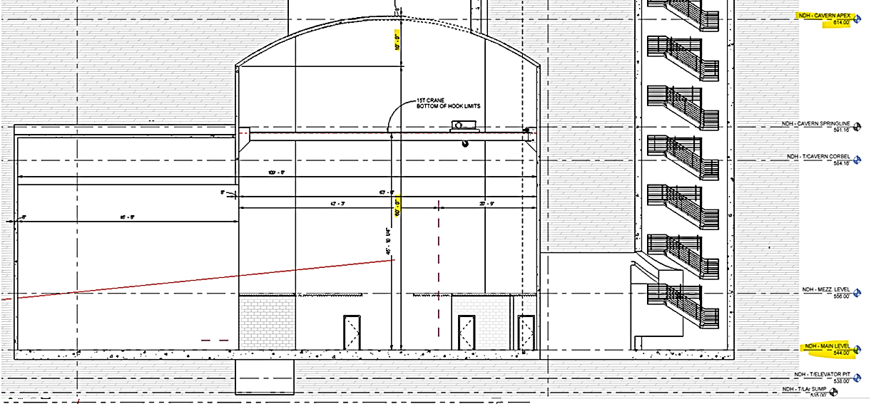
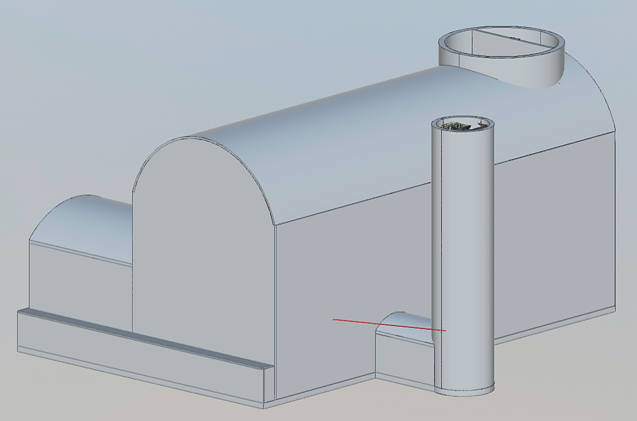
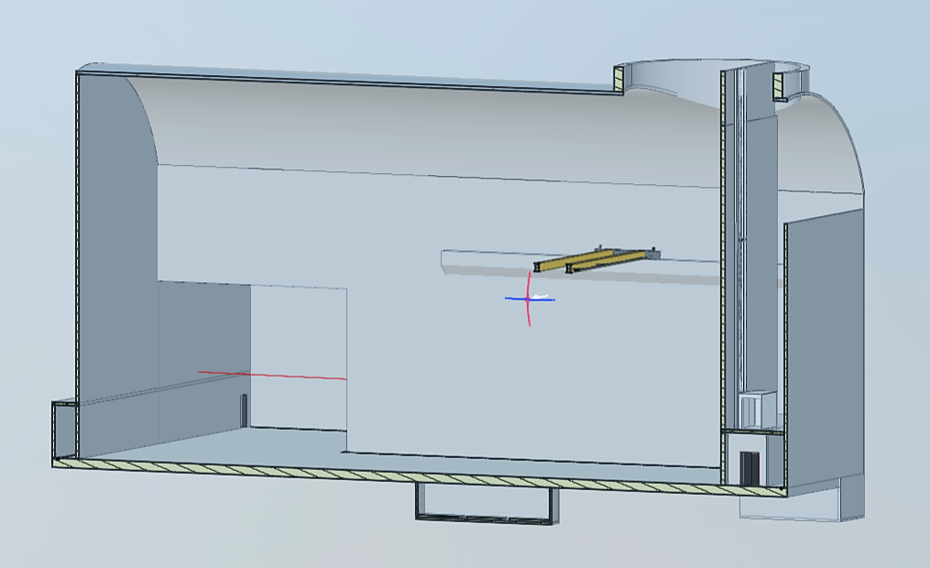
DUNE/LBNF Is Currently Completing The Preliminary Design Of The Near Detector Cavern: KLOE Space Needs Are Included
KLOE
Alcove
KLOE Detector Now Integrated Into LBNF Conventional Facility Design Alcove Size Requires One Last Final Update

Slide 5
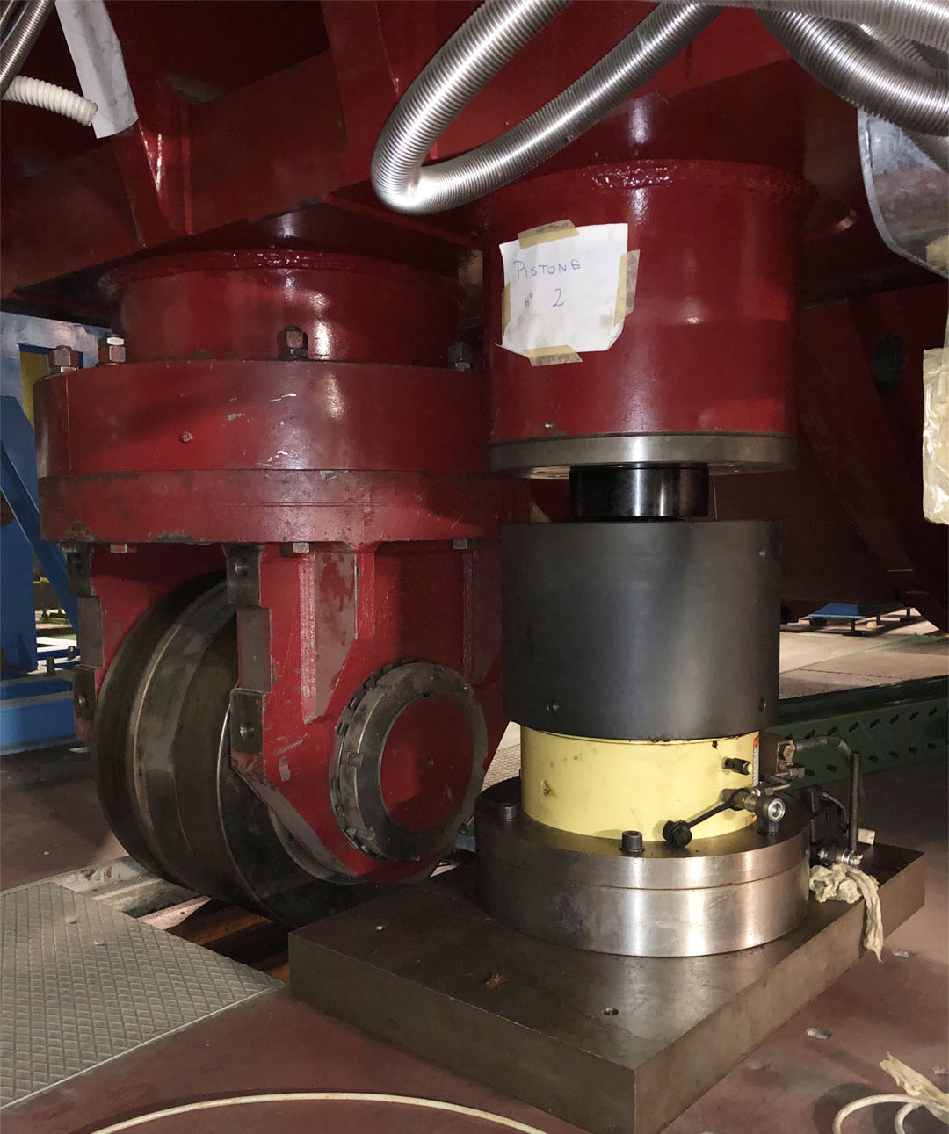
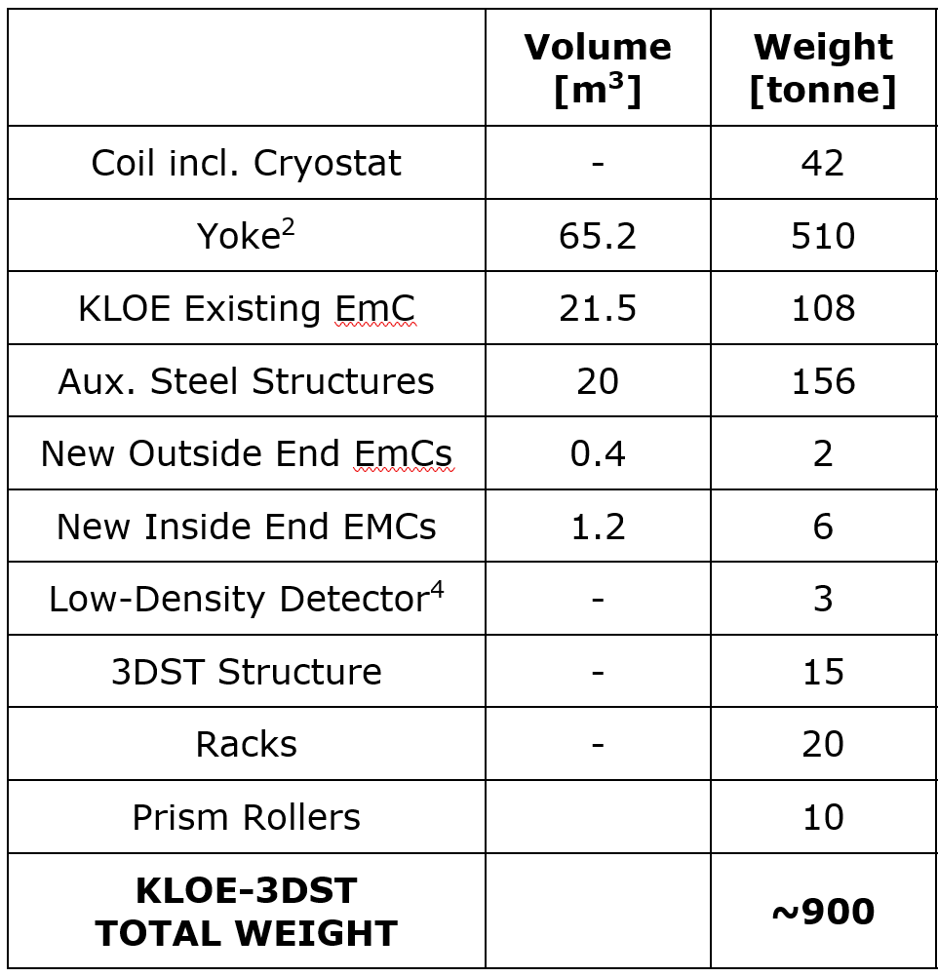
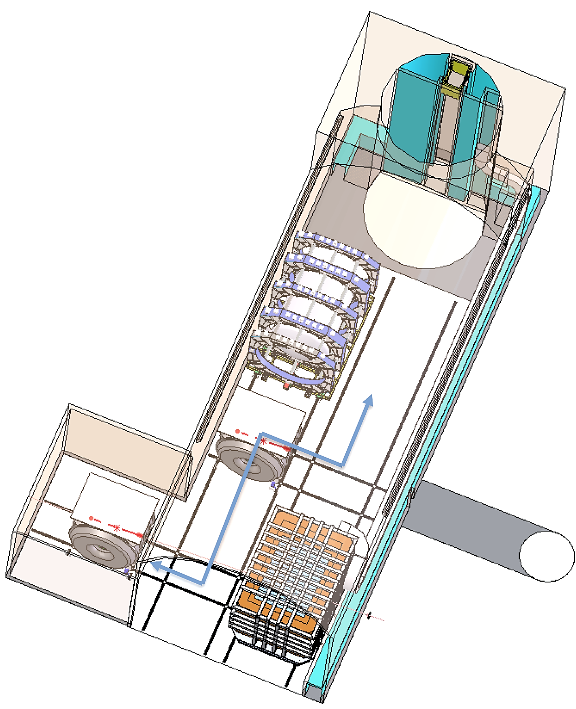
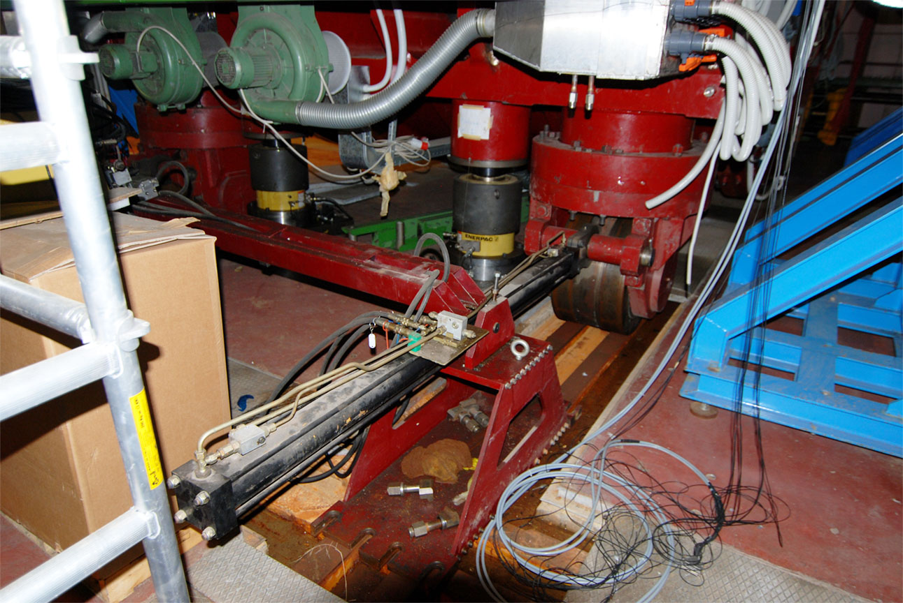
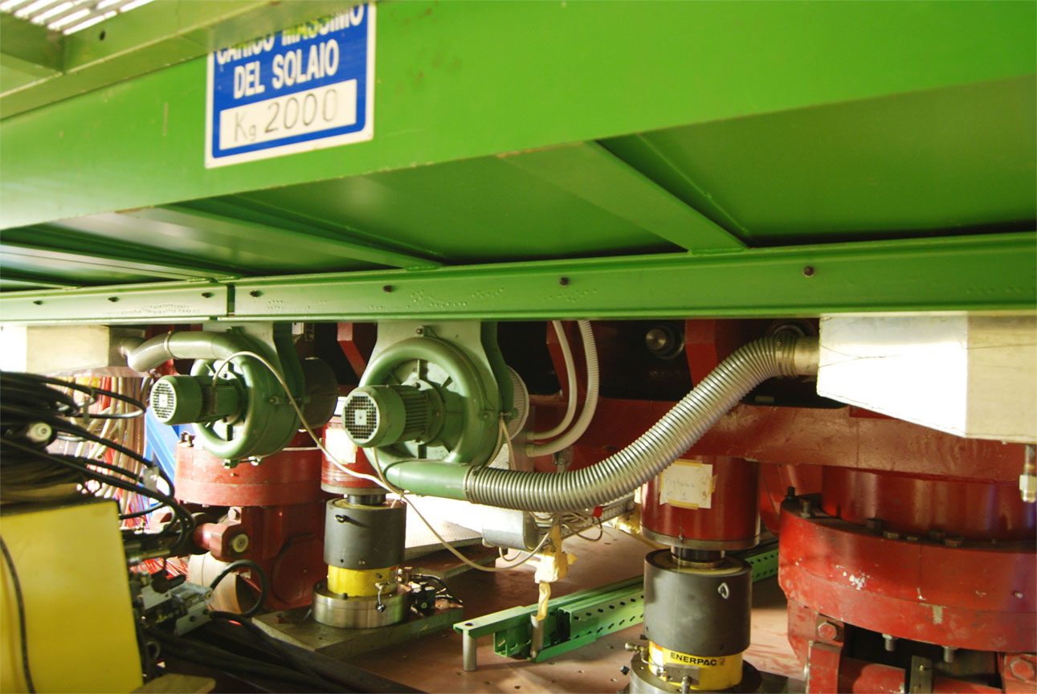
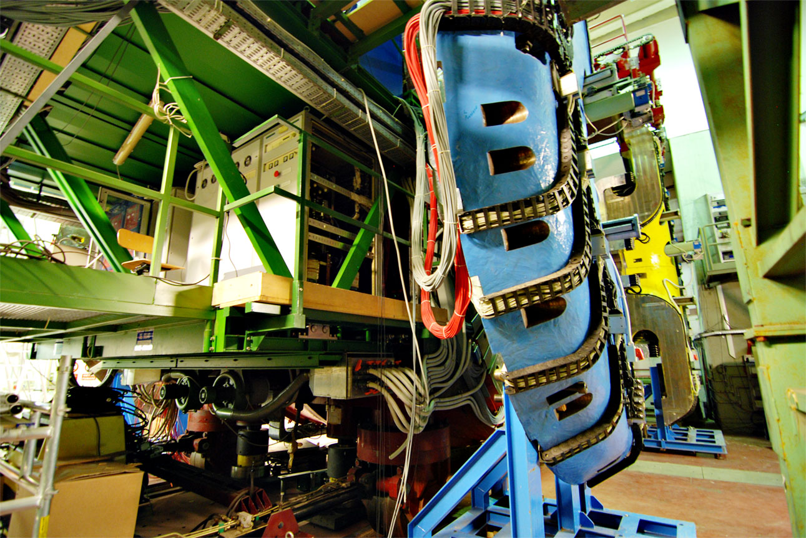
KLOE Detector Will Serve As Stationary Beam Monitor, But Movement During Installation And Servicing Must be Planned
Floor Guides To
Assembly And Servicing Station
KLOE Stationary Detector
Inside Alcove
Yoke:
Length = 6 m
Diameter = 7 m
Full Detector Size:
Length ≈ 10 m
Height ≈ 11 m

Slide 6
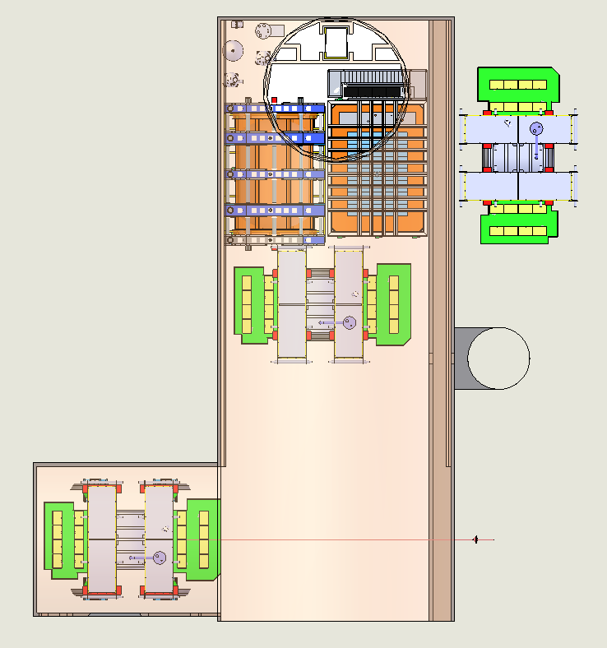
Size of KLOE Necessitates Careful Assembly And Installation Planning To Sequence With Assembly Of Other Detectors
Small Cavern
(“BCR Configuration”)
KLOE Detector Has To Be Assembled And Installed First Since Detector Size Prohibits Rearranging Once Fully Assembled
Final Alcove Size

Slide 7
Next Steps
Currently open issue: Develop solution for crane size
Cavern one-line electrical diagram completed, found solution for 50/60 Hz conversion
Cryoplant and distribution design has started

