Slide 1
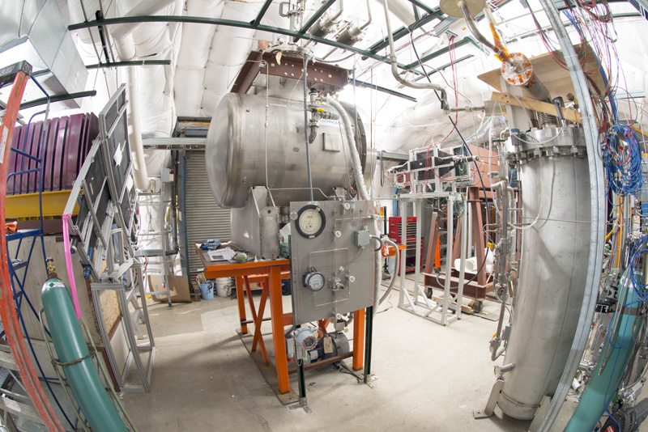
Re-factoring the LArSoft simulation
Hans Wenzel
7th May 2019

Slide 2
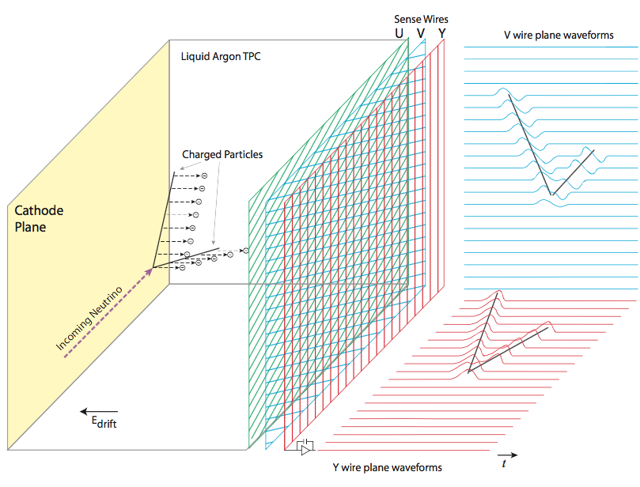
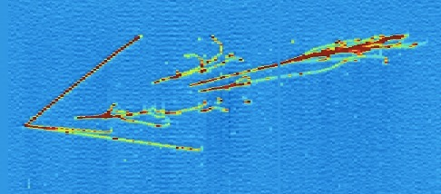
Light in liquid Argon (nobles) TPC’s
Light Production
Scintillation (competing with ionization depending on electric field)
24K VUV photons/MeV at 500V/cm
(MIP ~2 MeV/cm)
6ns/1.6μs (fast/slow)
Cherenkov radiation
Wavelength shifting
Light Arrival
Rayleigh scattering
Absorption
Obstructions, propagation,reflection etc.
PM
Light: provides trigger/t0 for non beam events. (e.g. SuperNovae)
can be used to improve calorimetric response → energy resolution important since neutrino energy unknown
spatial resolution limited by rayleigh scattering for VUV photons

Slide 3
Optical processes in Geant4
Production:
Cerenkov Process
Scintillation Process
Wave length shifting
(Transition Radiation)
Boundary Process:
Total internal reflection etc. at boundaries
between materials with different refraction
index.
Surface Process:
e.g. reflection on metallic surface needs
Surface properties.
Stepping:
Absorption
Rayleigh scattering
Mie Scattering

Slide 4
Optical physics in Geant 4
In Geant4, the optical physics has an exceptional position among the physics processes:
it adds:
special particles (optical photons).
The only particle that can be reflected or refracted at optical surfaces,
only particle created in optical processes like scintillation, Cherenkov radiation, and wavelength-shifting (WLS).
G4OpticalPhoton differs from the “usual” high-energy particle-physics photon (G4Gamma) in Geant4. (e.g. some wavelike properties (group velocity) but no coherencce/interference)
new properties for materials and optical surfaces. Optical properties need to be assigned to the materials whenever optical physics processes are to be considered in the simulation. Every material needs at least a refractive index spectrum (which corresponds to the dispersion relation) and an attenuation length spectrum, though the attenuation length is by default set to infinity if it is not defined. Special optical materials, i.e. scintillating and WLS materials, additionally require the specification of the emission spectra as well as of the rise and decay times. More properties can be assigned to optical surfaces between volumes, e.g. the reflectivity of the surface.
arXiv:1612.05162
Peculiarities in the Simulation of Optical Physics with Geant4

Slide 5
Optical processes on the CPU
Full simulation of optical photons is very CPU intensive → increases CPU time by a factor > 1000x (sec/evt)
https://github.com/hanswenzel/lArTest
LarSoft:
look up tables → memory requirements prohibitive as detector size and number of optical channels increase, needs full simulation to create the tables
Parameterized response → fast, but is it realistic?

Slide 6
Optical processes on the GPU’s (hybrid: CPU deals with everything non optical)
Opticks by Simon Blyth developped for the Daya Bay reactor neutrino experiment: A GPU Accelerated Optical Photon Simulation using NVIDIA OptiX
https://bitbucket.org/simoncblyth/opticks/
Based on the NVIDIA® OptiX™ Ray Tracing Engine
https://developer.nvidia.com/optix
Optical photons from scintillation and Cherenkov processes are allocated, generated and propagated entirely on the GPU, minimizing transfer overheads and allowing CPU memory usage to be restricted to optical photons that hit photomultiplier tubes or other photon detectors. Collecting hits into standard Geant4 hit collections then allows the rest of the simulation chain to proceed unmodified.
Optical physics processes of scattering, absorption, scintillator reemission and boundary processes are implemented in CUDA OptiX programs based on the Geant4 implementations. Wavelength dependent material and surface properties as well as inverse cumulative distribution functions for reemission are interleaved into GPU textures providing fast interpolated property lookup or wavelength generation.
→ basically as fast as Geant4 without tracing of optical photons

Slide 7
Short term Plan
Install Opticks and get the examples running.
Implement/profile simple liquid Argon TPC-→ orders of magnitude more optical photons produced in liquid Argon than in Cerenkov detector.
Study physics potential using optical photons. How can fast optical simulation be used to optimize detecor design
Find out how we can contribute to/optimize opticks

Slide 8
BACKUP

