Slide 1
Detector Grounding
T. Shaw
FNAL
20 AUG 2019

Slide 2
Detector Grounding
Are there compromises we can make on Infrastructure Grounding plan to reduce cost?

Slide 3
EDMS 2095975

Slide 6
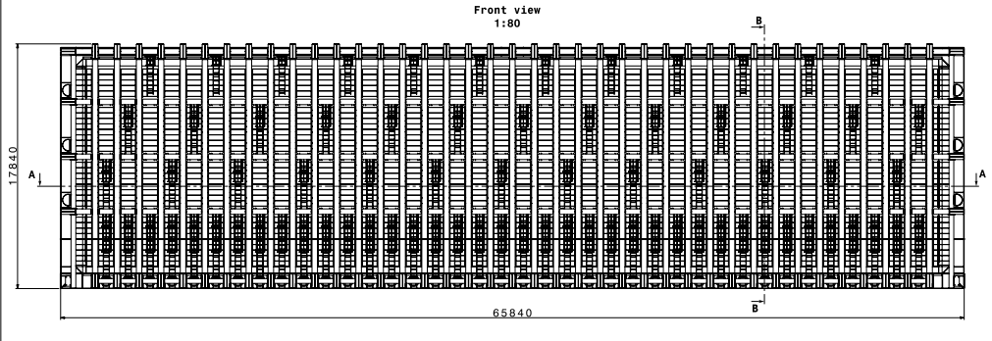
From Jack – distance between Cryostat wall and Cavern “Minimally it is supposed to be 430 mm”
Area of cryostat side wall 17.84 x 65.84 = 1176 sq. meters

Slide 7
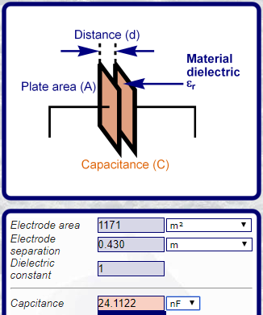
Calculate the capacitance between Cryostat and Building/Cavern Ground
Consider putting wire mesh on cavern wall parallel to cryostat instead of non-conductive shotcrete.
Assume parallel plate capacitor formed between cryostat and Cavern wall which contain wire mesh; not exactly the case but fringe effects help to approximate model; provides worst case number
C = 24 nF for one side of cryostat, Ctot = 48 nF both sides
Xc = 1/(2πfC)
@ 2MHz = 1.7 ohms
@500Khz = 6.65 ohms
For building noise not to couple onto detector, impedance back to building earth ground should be << ~1.7 ohms.
NOTE – Calculated Capacitance is likely much lower due to the fact wire mesh was approximated as plate. If calculated capacitance is 10% of above
@ 2MHz = 17 ohms
@500Khz = 66.5 ohms

Slide 8
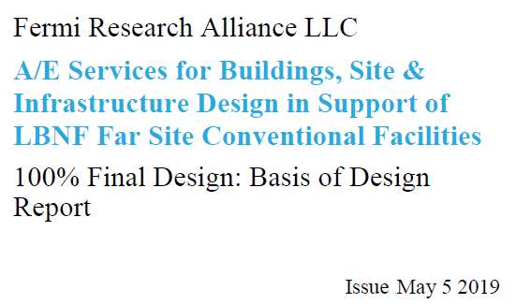
Building/Cavern Ground to remote Earth < 1 ohm
Conclusion: By design, any noise on the cavern walls shall have a very low impedance path to remote earth ground and will be less likely to couple onto the Cryostat and Detector ground. We can consider elimination of requirement for non-conductive shotcrete of walls parallel to the cryostat.

Slide 9
Cost savings if we allow wire mesh on cavern walls parallel to detector
Doug provided a quick estimate of potential cost savings if we allow a continuation of wire mesh on the cavern walls parallel to the cryostat.
From email communication 8/5/2019
Eliminate shotcrete from detector cavern walls, elev. 4850L to 4910L,
116,966 SF
Add WWF mesh on the detector cavern walls, elev. 4850L to 4910L,
108,405 SF

Slide 10
Cost savings if we allow wire mesh on cavern walls parallel to detector
Shotcrete $1,289.41/CY (Material cost of $927.16/CY and placement cost of $362.25/CY)
KAJV had a waste factor of 2.24 for shotcrete. That equates to 36.5 SF/CY,
or a unit price of $35.31/SF for shotcrete
WWF $17.66/SF (Material cost of $1.05/SF and install cost of $16.61/SF)
Based on these numbers, the change would be:
Deduct 116,966 SF x $35.31/SF = ($4,130,069)
Add 108,405 SF x $17.66/SF = $1,914,432
Total Credit ($2,215,637)
So about $1M savings per detector cavern if we eliminated shotcrete and added WWF on the walls from 4850 to 4910.

