Slide 1
HVS Planning for FD Integration/Installation
Bo Yu, Francesco Pietropaolo
21 August 2019

Slide 2
Outline
Parts Breakdown Structure, including the list of deliverables & tooling, items that require special handling
Personnel requirements during installation & integration
QA & testing plans
Expectations about services provided by detector installation team and facility services team

Slide 3
Foreword
After the HVS preliminary Design Review held in June and following the Committee recommendations, the HVS Consortium is now (for the last two months) focusing on the HVS design evolution aiming at:
Improving the HV stability
Simplify the construction and installation phases
Optimizing costs
Main changes are:
Decoupling of the Top Ground Planes from the Field Cage module
No Bottom GP (only local grounding on cryogenic instrumentation if required)
No Insulation elements exposed to the High field outside of the field cage
Bent profiles at End Wall edges to better define the E-Field
A full HVS design is quite advanced but still not final:
This presentation is based on the present status of the HVS design

Slide 4
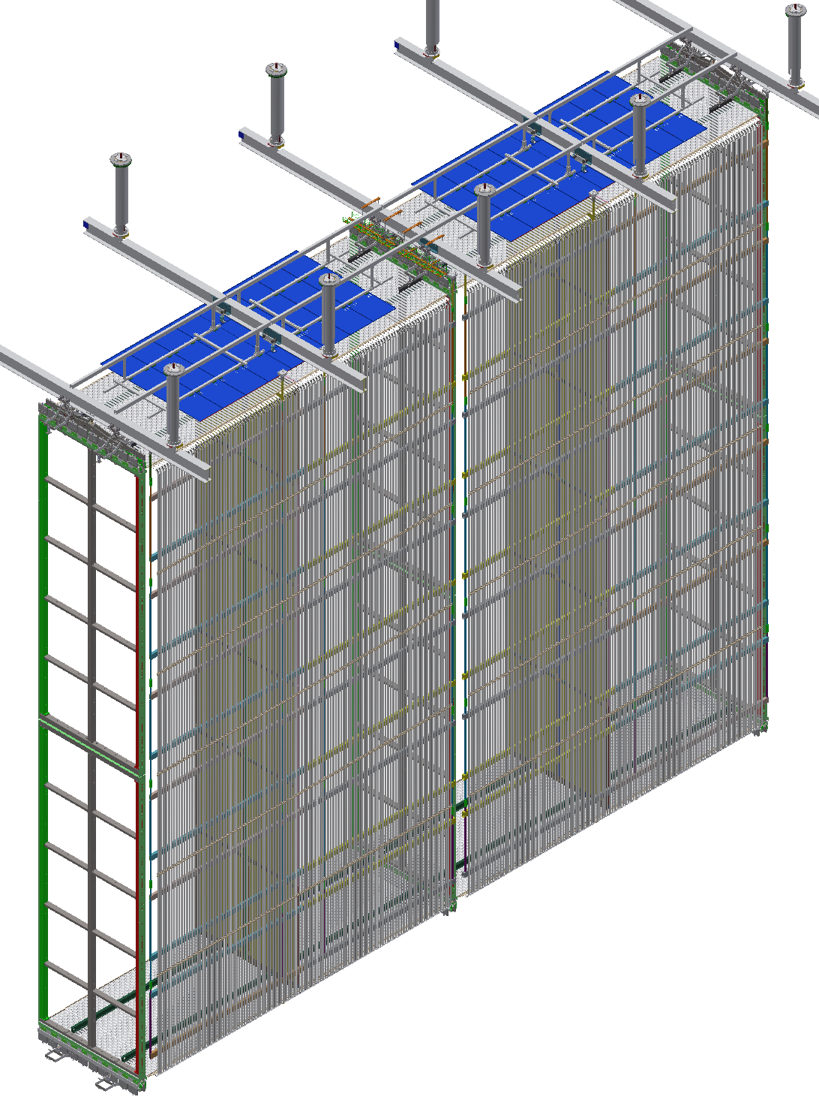
The new HVS design
2 End Wall FC’s each made of:
24 EW identical modules (2m x 3.5m), with top/bottom modules hosting bent aluminum profiles
25 ~ identical CPA/TBFC/GP rows, each made of:
2 CPA’s: 6 basic unit (1.15m x 4 m)
8 Top/Bottom FC module (3.5m x 2.3m)
4 Top Ground Planes (4 units each: 2.3m x 0.5m) hanged independently to the DSS beams
Assembly & Installation of FC modules:
Performed fully underground (NP02 experience on FC)
about 1 month for EW
1 week for each CPA/TBFC/GP slice: deploying of FC (and CP) can be performed during installation or at the end of installation (preferred)

Slide 5
HVS Integration/Installation Plan
CPAs are pre-assembled at factories in 1.2m x 4m panels and shipped to cleanroom in crates holding 6 panels each. It seems possible that these crates can fit in the Ross cage with some special handling. 2 crates are needed per week.
EWFC parts are shipped in crates through Ross cage to cleanroom. Modules are assembled at two stations in ~ 2 weeks at a rate of about 2 per shift. 6 modules are then linked into a column and raised to the DSS beam. Need to build 2 pairs of these columns in the rest of 2+ weeks. 4 large crates per endwall.
TBFC parts are shipped in crates through Ross cage to cleanroom. Modules are assembled at one or two stations in the cleanroom at a rate about 2 per station per shift. Completed modules are linked to the CPA. Need to assemble 4 top + 4 bottom per week. 3 large crates are needed every 2.5 weeks.
Parts for the upper ground planes and their DSS support structure are sent through Ross cage in crates. They are assembled in either the cleanroom or the cavern at a rate of about 2 person-hours per module.

Slide 6
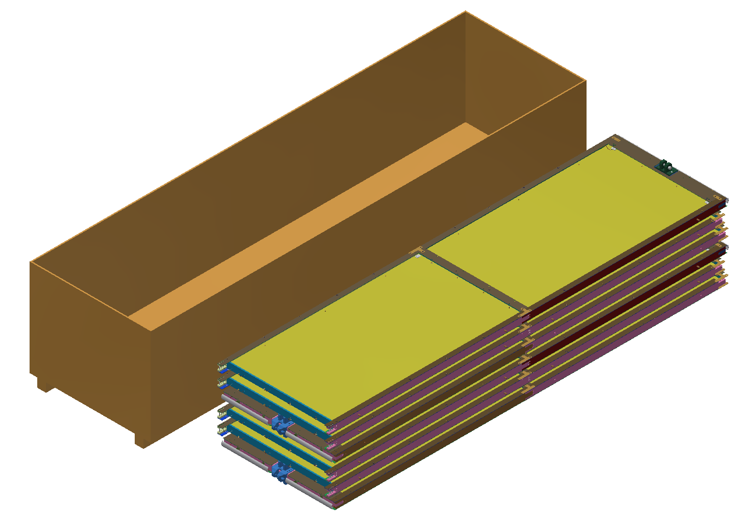
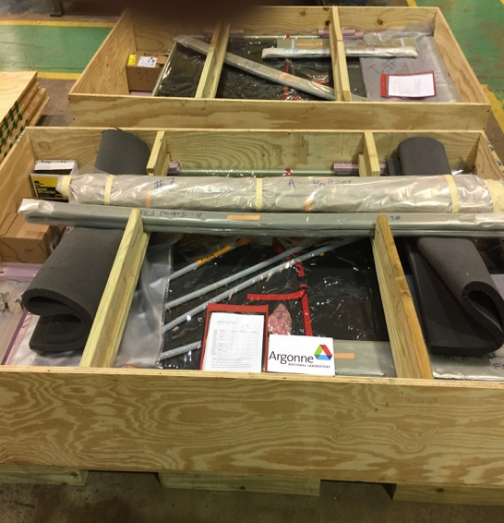
CPA
2 CPA Arrays:
→ 25 CPA Planes (50 CPA Planes)
→ 2 CPA Panels (100 CPA Panels)
→ 3 CPA Units (300 CPA Units)
→ 2 CPA modules (600 CPA RPs)
Production rate: 2 Panels/week/factory -> 2 factories ~ 6 months
Shipping Unit : 2 connected modules (1 CPA Unit)
Shipping crate : 6 CPA Units (2 CPA Panels -> 1 CPA Plane)
Shipping crate includes all fixtures and tooling needed to assemble the CPA Plane (as in ProtoDUNE)
Inclusion of diffuser (and Reflector foils???) at production site
50 Crates are required to ship 300 CPA Units
2 crate per week required underground during installation

Slide 7
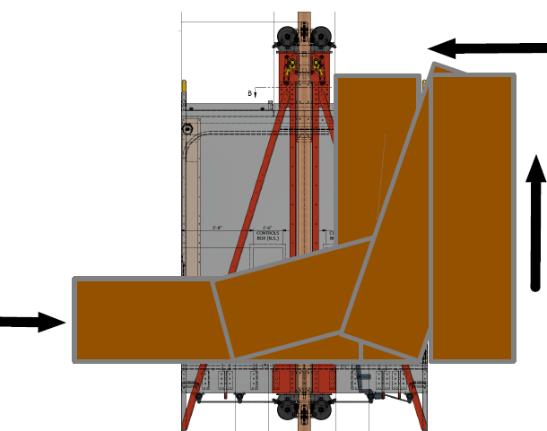
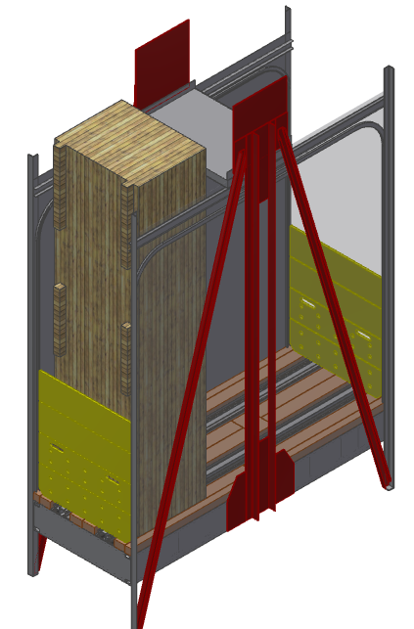
CPA Transport underground
The 6 panel shipping crate for the CPAs seems to fit in the Ross cage with the roof section removed. Ladia shared a loading concept for such a crate. His estimate is that the loading time is similar to a slung-load, but the cage travel is faster so it is still a time saver. In either cases, the crates will be designed to tolerate handling in various orientations.
Crate content | Size | Weight
6 CPA panels, installation hardware, jumper wires, PDS diffuser fibers | 4.5m x 1.4m x 1m | 700kg

Slide 8
EndWall FC Modules
24 EWFC Modules per assembly run (~1 month installation)
Items | Dimensions [cm] | Weight [kg] | Count with spares | Total Weight [kg]
Bent profiles | 200 x 5 x 15 | 0.5 | 480 | 240
Straight profiles | 200 x 5 x 1 | 0.5 | 960 | 480
FRP box beams | 355 x 10 x 5 | 7.5 | 48 | 360
Aluminum bars | 200 x 2.5 x 2.5 | 3.4 | 48 | 163
Slip nuts | 4 x 2 x 0.3 | 0.02 | 4320 | 90
PE caps | 6 x 2 x 3 | 0.02 | 2880 | 60
Hardware |  |  |  | 50

Slide 9
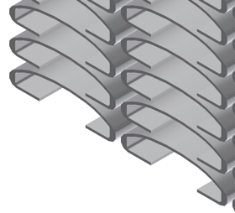
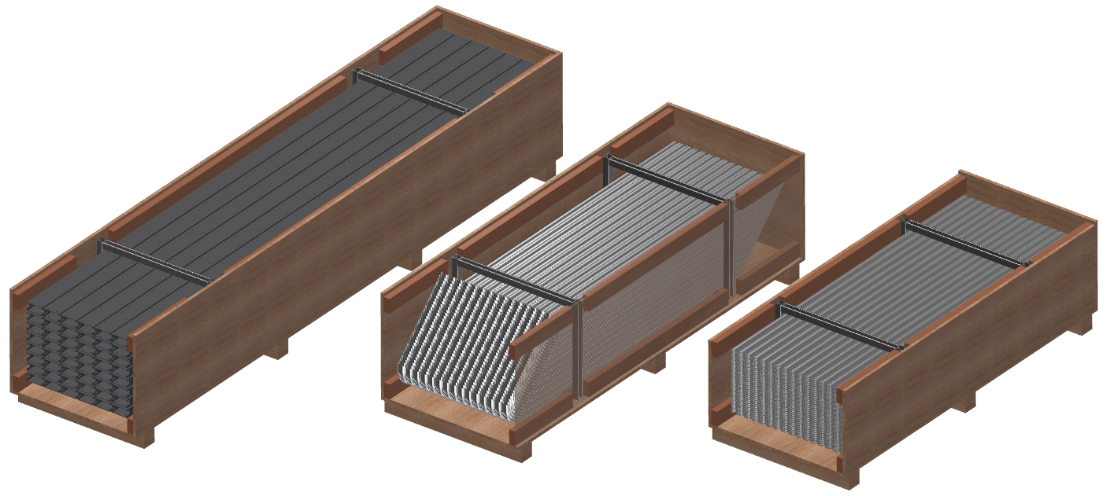
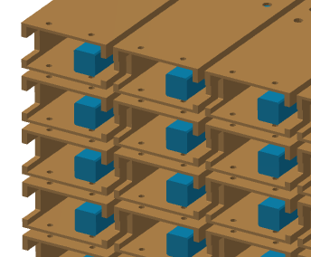
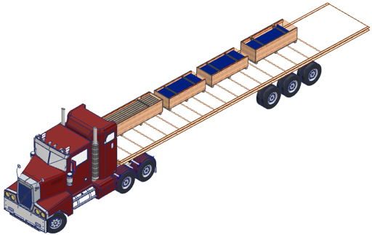
EW FC Parts Shipping
Option: pack aluminum bars & hardware inside box beams
Bent profiles 15 wide, 32 layers
Straight profiles
15 wide, 32 layers, 2 boxes
FRP beams 6 wide, 8 layers
Parts for one endwall
Box # | Dimensions [m] | Weight [kg] | Notes
1. Bent profiles | 2.5 x 0.9 x 0.8 | 350 | + PE caps & rivets
2. Straight profiles x 2 | 2.2 x 0.9 x 0.7 | 350
3. Box beams | 3.7 x 0.9 x 0.7 | 530
4. Aluminum bars | 2.3 x 0.4 x 0.3 | 350 | + slip nuts & hardware

Slide 10
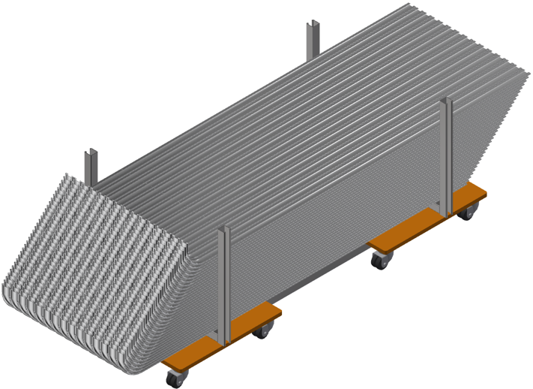
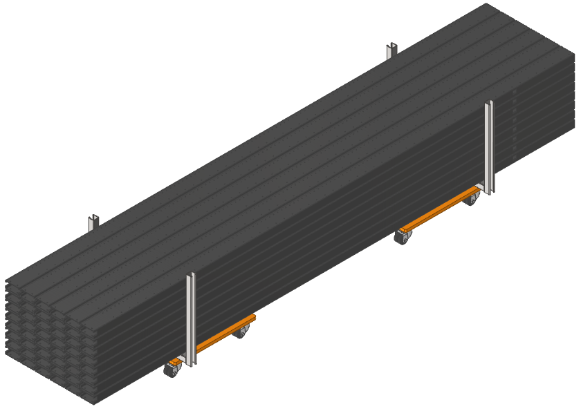
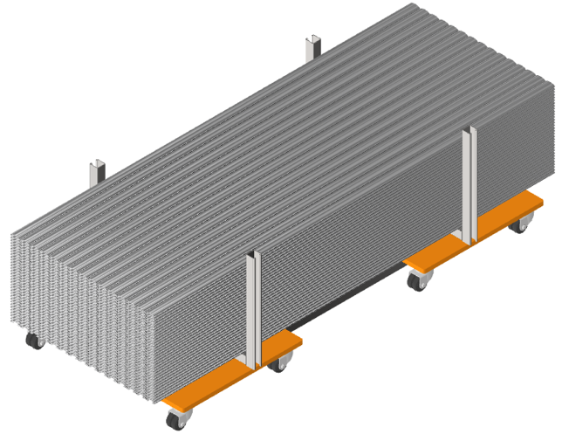
Inside Cleanroom
Assuming that the shipping crates are not allowed into the cleanroom, their contents can be transferred to a dollie in the SAS and rolled into the cleanroom.
or
First or last month of the HVS installation

Slide 11
Top/Bottom Field Cage Modules
20 TFC + 20 BFC modules per 5 weeks installation
Items | Dimensions [cm] | Weight [kg] | Count with spares | Total Weight [kg]
Top profiles | 230 x 5 x 1 | 0.56 | 1200 | 672
Top FRP I-beams | 355 x 10 x 5 | 7.4 | 40 | 300
Top slip nuts | 4 x 2 x 0.3 | 0.02 | 3600 | 72
Top FRP standoffs | 60 x 10 x 5 | 1.2 | 40 | 50
Bottom profiles | 230 x 5 x 1 | 0.56 | 1200 | 672
Bottom I-beams | 355 x 10 x 5 | 7.4 | 40 | 300
Bottom slip nuts | 4 x 2 x 0.3 | 0.02 | 3600 | 72
Bottom FRP standoffs | 60 x 10 x 5 | 1.2 | 40 | 50
PE caps | 6 x 2 x 3 | 0.02 | 4800 | 100
APA latches |  | 5? | 80 | 400?
Hardware |  |  |  | 120

Slide 12
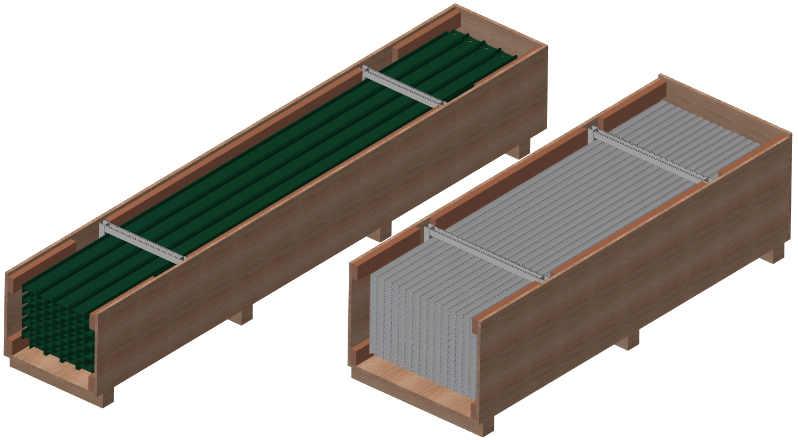
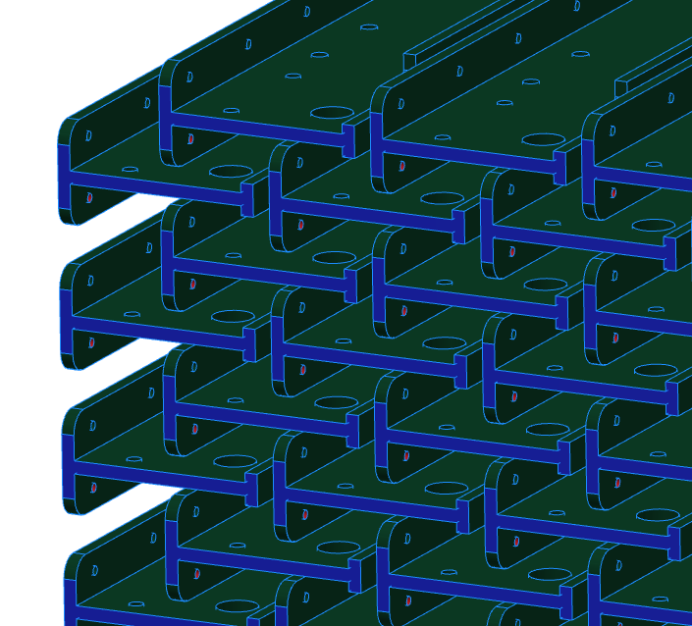
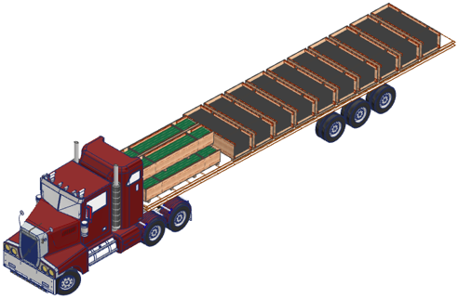
TBFC Parts Shipping
Profiles:
15 wide, 40 layers, 2 boxes
FRP I-beams 4 wide, 5 double layers
All top or bottom FC major parts
Box # | Dimensions [m] | Weight [kg] | Notes
1. Top profiles x 2 | 2.5 x 0.9 x 0.8 | 473
2. Top I-beams | 3.6 x 0.6 x 0.6 | 440 | + short riser I-beams
3. Bottom profiles x 2 | 2.5 x 0.9 x 0.8 | 473
4. Bottom I-beams | 3.6 x 0.6 x 0.6 | 440 | + short riser I-beams

Slide 13
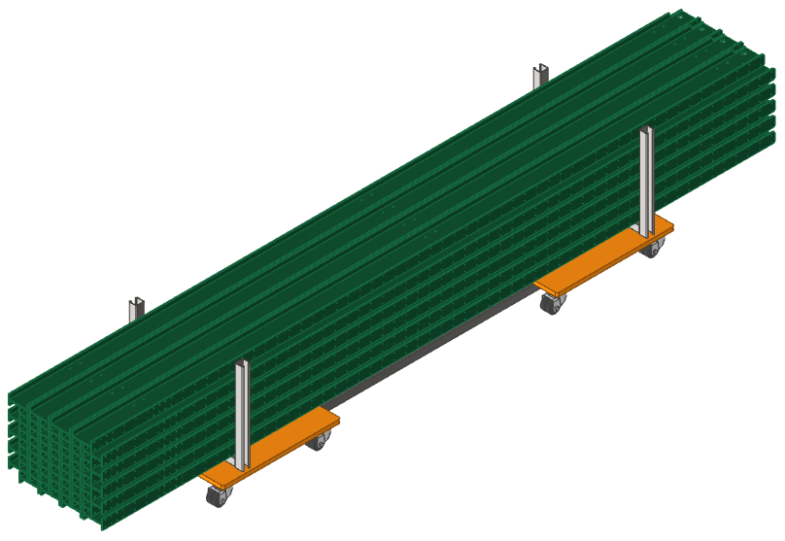
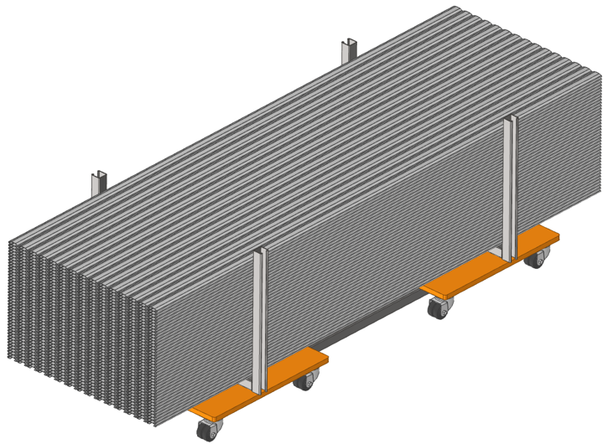
TBFC Inside Cleanroom
2.5 weeks’ supply
1.25 weeks’ supply
Alternative: move 4 beams from the crate in the cavern into the cleanroom every shift. Leave them on a shelf in the clean room to save floor space in the cleanroom. → This leads to the option of packing more beams in the shipping crate

Slide 14
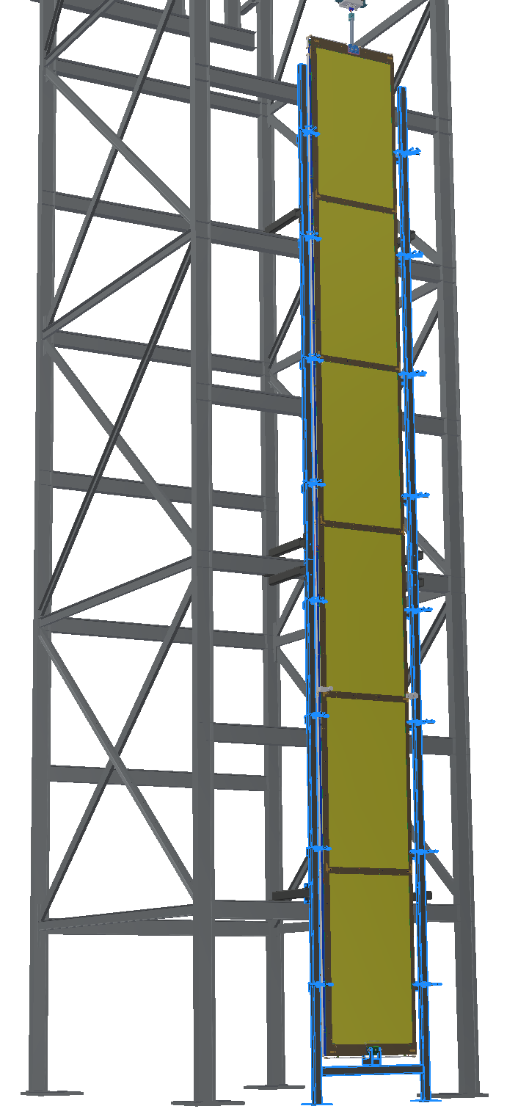
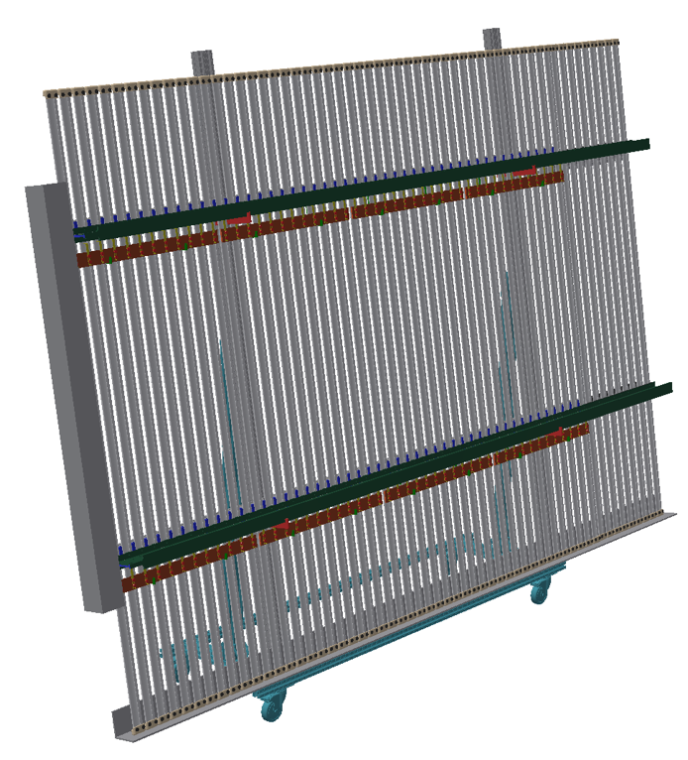
Main assembly tooling required
CPA assembly tower
FC assembly station
Can be the same for EW and TB (under study)
Possibly two station can be installed back-to-back

Slide 15
Parts Breakdown Structure, 1of 2
https://indico.fnal.gov/event/20775/session/3/contribution/23/material/0/0.xlsx
Package Type | Quantity | Contents | Dimensions | Weight | Origin
FD1.HV.CPA.Panels | 50 | 6 CPA panels, installation hardware, jumper wires, PDS diffuser fibers | 4.5m x 1.4m x 1m possible in Ross cage | 700kg | TBD
FD1.HV.CPA.Tower | 1 | Parts for CPA assembly frame | 6.2m x 1.7m x 0.7m | 900kg | TBD
FD1.HV.CPA.Tools | 1 | one tool chest with tools |  |  | TBD
FD1.HV.CPA.Hangers | 1 | 100 CPA hanger+trolley assemblies |  |  | TBD
FD1.HV.CPA.Cups | 1 | 6 HV cups |  |  | CERN
FD1.HV.TFC.Beams | 5 | 40 FRP long I-beams, 40 riser beams, installation hardware | 3.6m x 0.6m x 0.6m | 440kg | SBU
FD1.HV.TFC.Profiles | 10 | 600 TBFC profiles | 2.5m x 0.9mx 0.8m | 470kg | SBU
FD1.HV.BFC.Beams | 5 | 40 FRP long I-beams, 40 riser beams, installation hardware | 3.6m x 0.6m x 0.6m | 500kg | UTA
FD1.HV.BFC.Profiles | 10 | 600 TBFC profiles | 2.5m x 0.9mx 0.8m | 470kg | UTA
FD1.HV.TFC.Tools | 1 | one tool chest with tools
FD1.HV.TFC.Caps | 5 | 6000 UHMWPE caps, locking rivets |  | 150kg | BNL
FD1.HV.TFC.RDBs | 3 | 600 long RDBs, 80 short RDBs |  |  | LSU
FD1.HV.FC.Term | 1 | 240 FC termination boards and cables |  |  | BNL
FD1.HV.TFC.CIBs | 1 | 420 CPA interconnect boards |  |  | KSU
FD1.HV.TFC.Winches | 1 | 2 sets of TFP deployment winch bars, BFC deployment fixtures |  |  | SBU

Slide 16
Parts Breakdown Structure, 2 of 2
Package Type | Quantity | Contents | Dimensions | Weight | Origin
FD1.HV.TFC.Latches | 5 | 40 sets of top APA latches |  |  | SBU
FD1.HV.BFC.Latches | 5 | 40 sets of bottom APA latches |  |  | UTA
FD1.HV.TFC.Braces | 1 | 10 sets of FC temporary bracing, wheels and attachment plates |  |  | SBU
FD1.HV.GP.Panels | 5 | 90 ground plane tiles | 2.5m x 1.2m x 1m |  | W&M
FD1.HV.GP.Frames | 5 | 20 sets of top GP frame and beams |  |  | W&M
FD1.HV.GP.Shields | ?? | Bottom GP shield tiles |  |  | W&M
FD1.HV.GP.Pickoff | 1 | 110 GP pickoff boards and cables |  |  | KSU
FD1.HV.EFC.Beams | 2 | 48 sets of box beam, Al bars, hardware | 3.7m x 0.9m x0.7m | 530kg | LSU
FD1.HV.EFC.BentP | 2 | 480 bent profiles | 2.5m x 0.9m x 0.8m | 350kg | LSU
FD1.HV.EFC.StrtP | 4 | 480 straight profiles | 2.2m x 0.9m x 0.7m | 350kg | LSU
FD1.HV.EFC.Guides | 1 | Endwall to APA/CPA guiding plates |  |  | LSU
FD1.HV.EFC.Support | 1 | Endwall DSS support fixtures, lifting bars |  |  | LSU
FD1.HV.EFC.TransCart | 1 | Endwall module storage/transport cart |  |  | LSU
FD1.HV.EFC.AsmCart | 3 | FC module assembly cart kit |  |  | CERN x2, UTA
FD1.HV.HVC.FT | 2 | 2 HVFT |  |  | CERN
FD1.HV.HVC.Cables | 2 | 2 sets of HVPS cables |  |  | CERN
FD1.HV.HVC.Filters | 1 | 4 HV filters |  |  | CERN
FD1.HV.HVC.HVPS | 2 | one 300kV HVPS |  |  | CERN

Slide 17
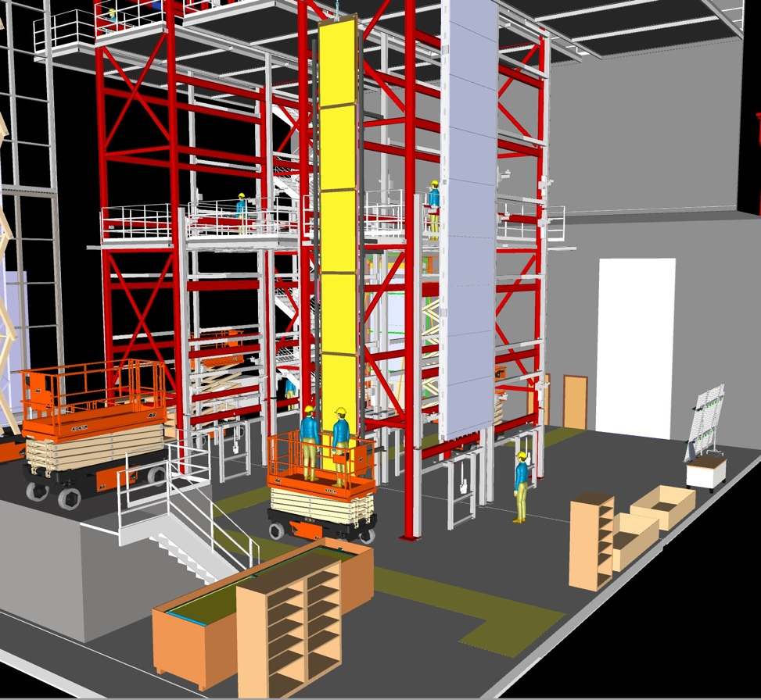
HVS installation: Assembly areas
The main storage for FC components will be outside in the main cavern and boxes will be moved via fork truck or motorized pallet jack
Boxes sized in the model match what is needed for profiles and FR4 beams and one tool cabinet and one work desk
CPA assembly tower allows to put together the CPA units to make a full panels and attach TBFC module
Details of assembly sequence under evaluation. Test in Ash River foreseen

Slide 18
HVS Integration/Installation Plan
We are developing a new CPA/TBFC installation sequence that should allow a more steady pace of FC module assembly, less storage need, faster final deployment:
Attach the bottom FC modules to the CPA similar to what we did in ProtoDUNE NP04
Move the CPA+T/B FC module super assembly into the cryostat, and connect to the HV bus. This step can be decoupled with the APA installation.
Some time before the installation of the 2nd endwall, start the deployment of the FC modules:
Row by row, deploy the top FC modules, remove the floor panels, clean the membrane, deploy the bottom FC modules in pairs using the top FC beams as lift points, check electrical connections. Repeat 25 times @ 1 row /day rate.
Install the 2nd endwall

Slide 19
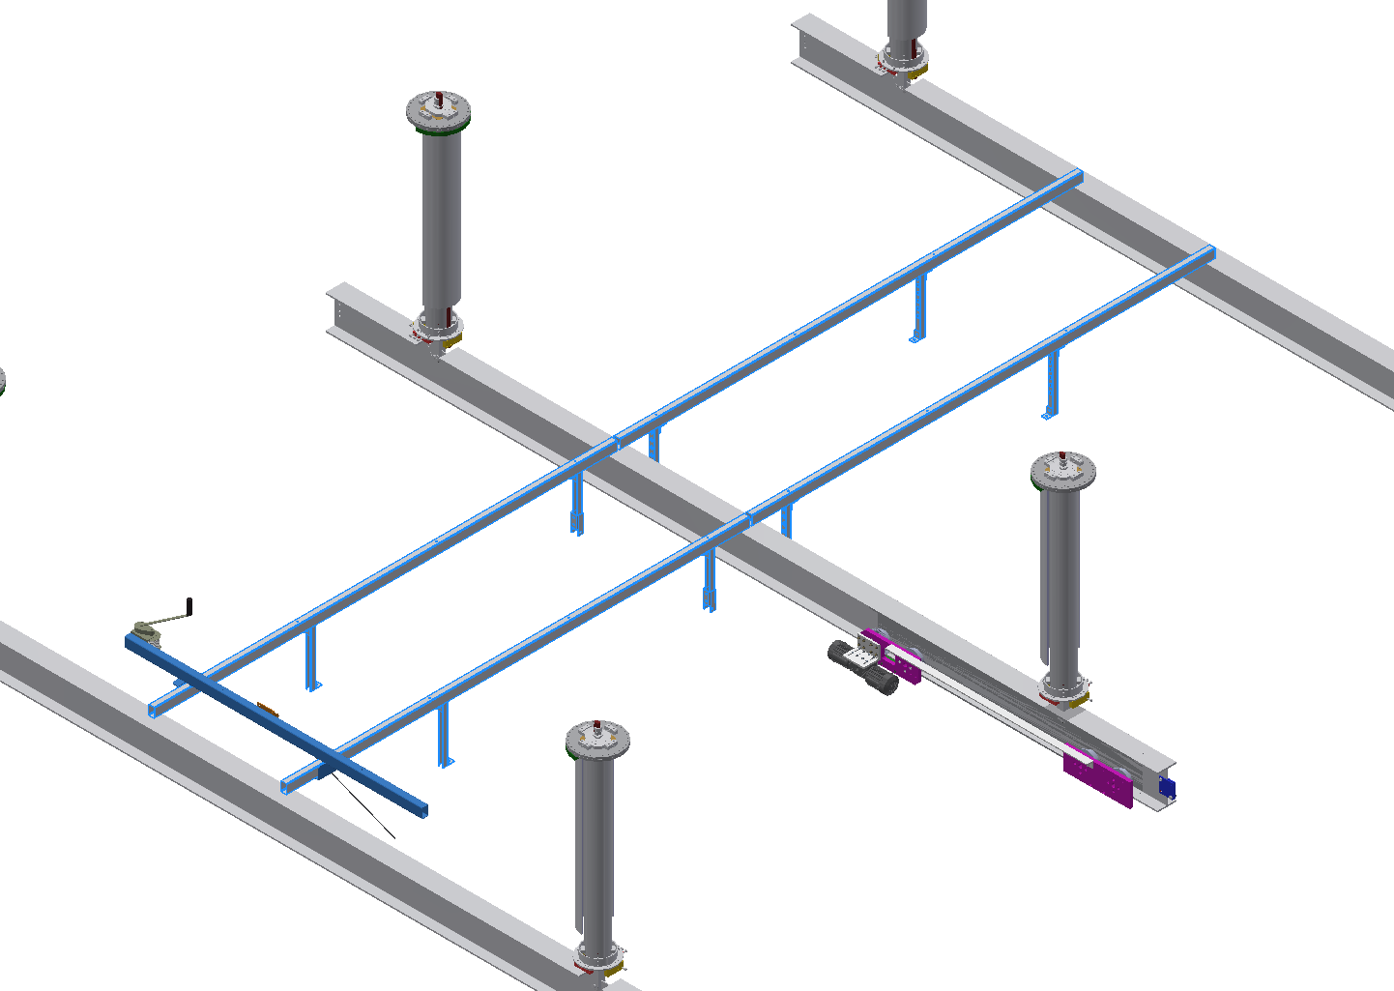
CPA-TBFC-GP Integration/Installation Steps
Install the ground plane support beams over the DSS beams.
At some rows, the support beams need to shift to avoid the CE feedthrough ports
Temporary upper FC deployment winch

Slide 20
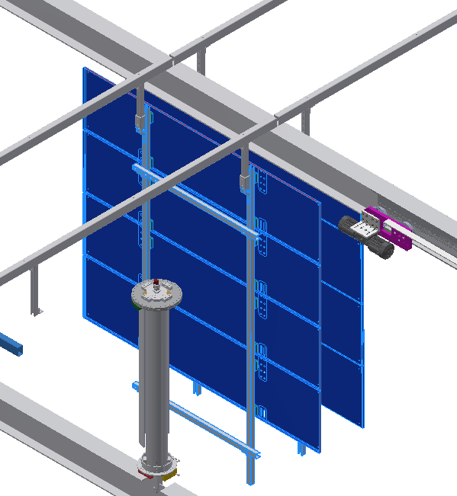
Raise the ground plane modules and attach to the support beams

Slide 21
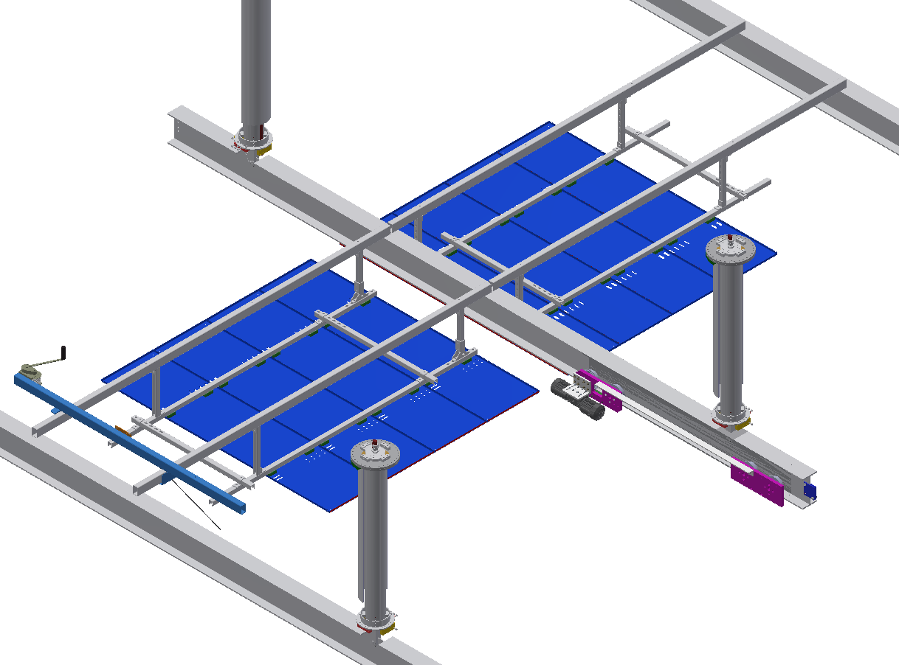
Rotate the ground plane modules and attach to the support beams.
Connect the GP monitoring wires.
This step needs to be done after the CE cables are routed through the feedthroughs.

Slide 22
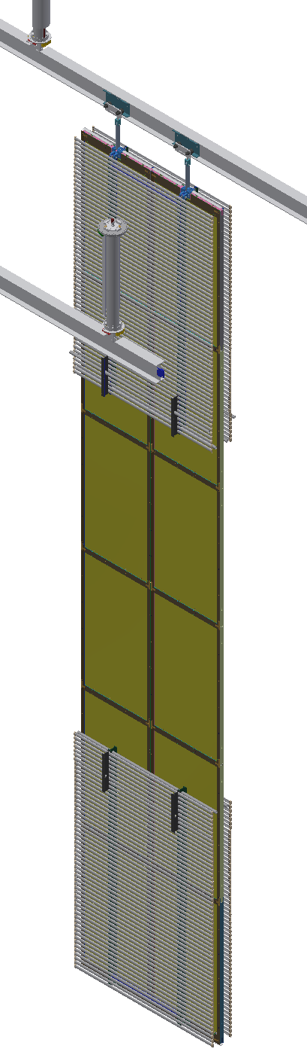
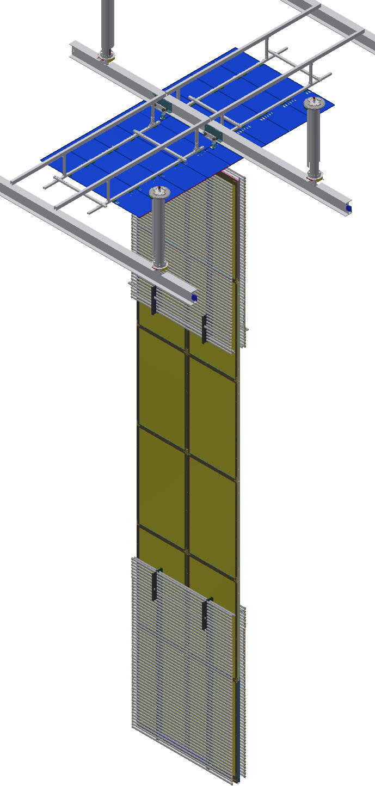
Fold the 2 top FC and 2 bottom FC modules with the two CPA columns in the clean room, push into the cryostat along the CPA DSS rail.
Once in position, install the small GP filler pieces above the CPA

Slide 23
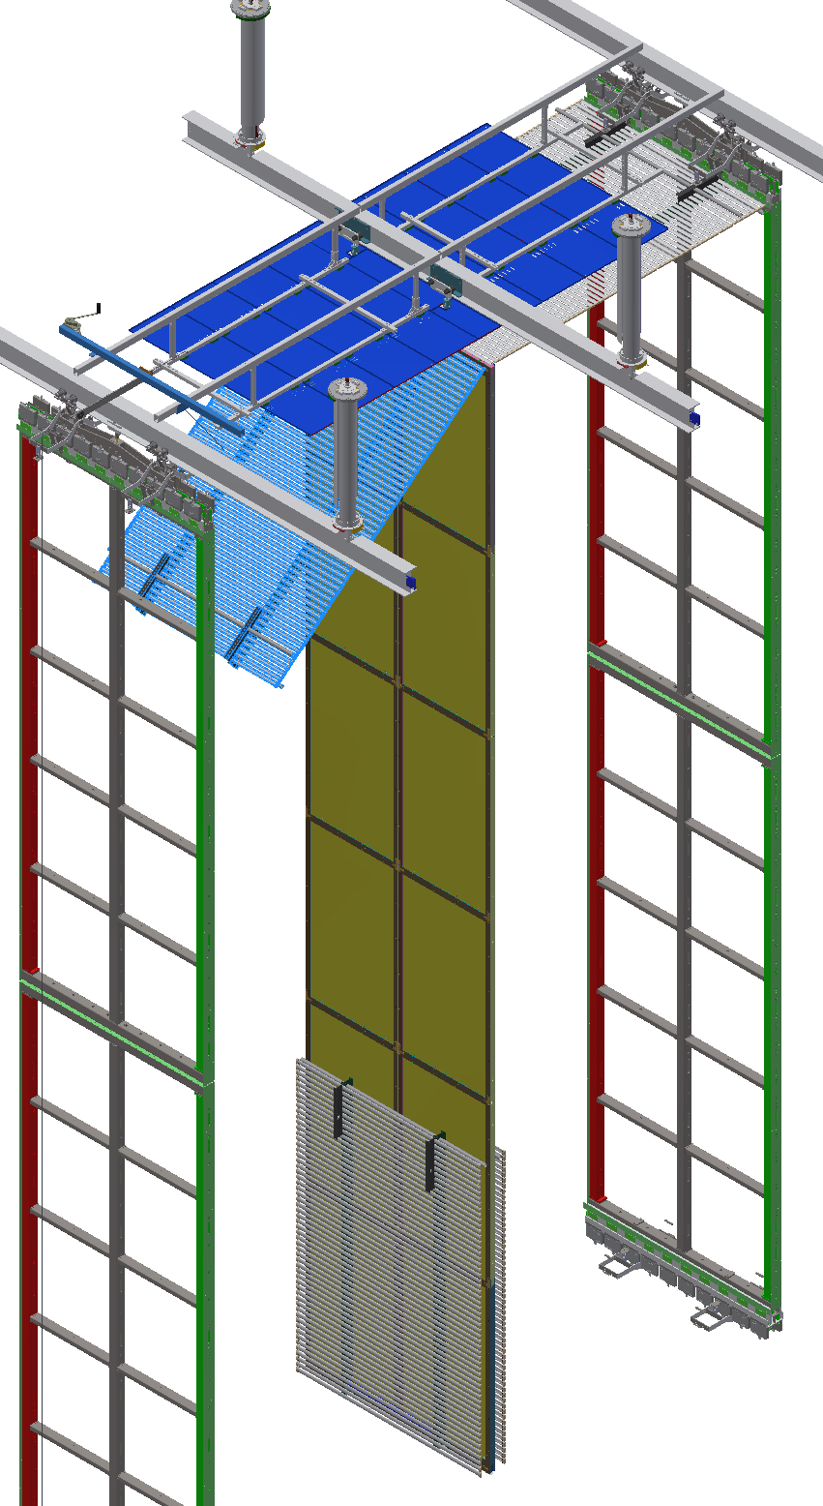
Deploy the top FC modules using winch bars on the GP support beams.
Connect top FC termination wires
This action (and the following ones) can be performed during the insertion of the row in the cryostat or when the full CPA/TBFC rows are inserted.
In the latter case insertion rate could decoupling from that of the APA

Slide 24
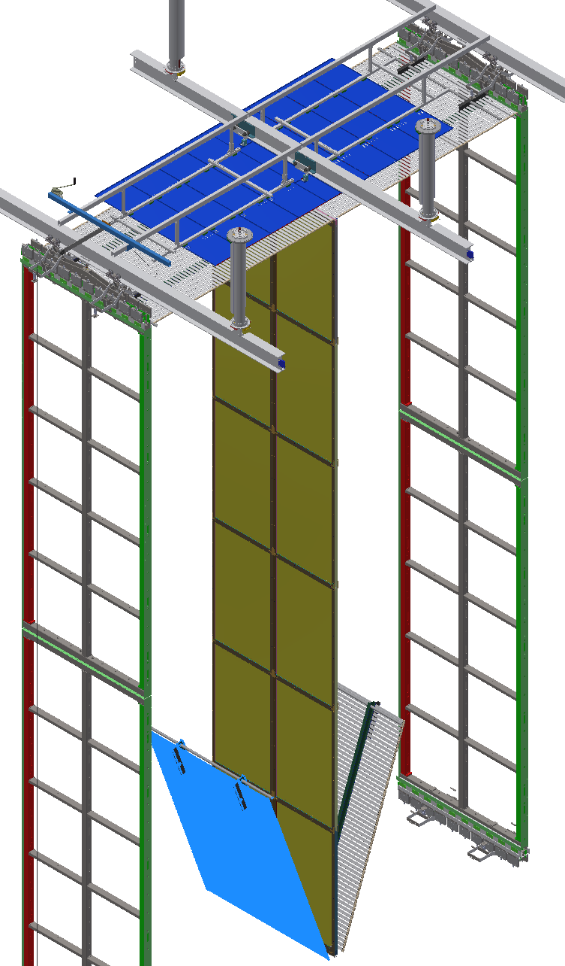
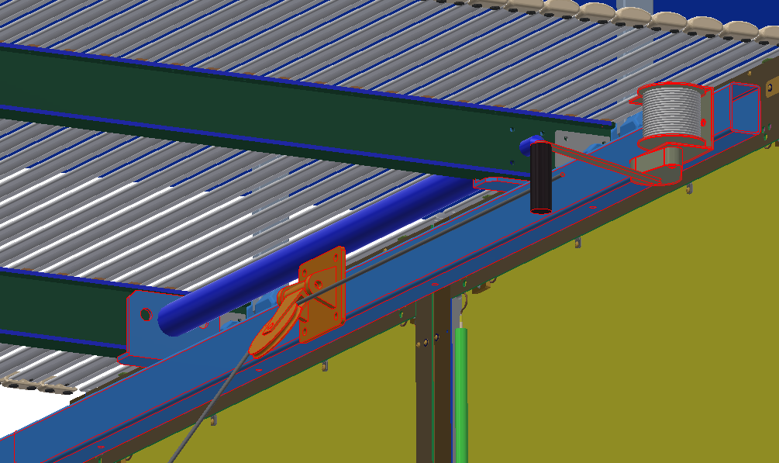
Deploy the 2 bottom FC modules, preferably symmetrically to minimize the lateral swing of the CPA.
The bottom FCs are lowered through a temporary winch bar attached to the CPA side of the top FC I-beams

Slide 25
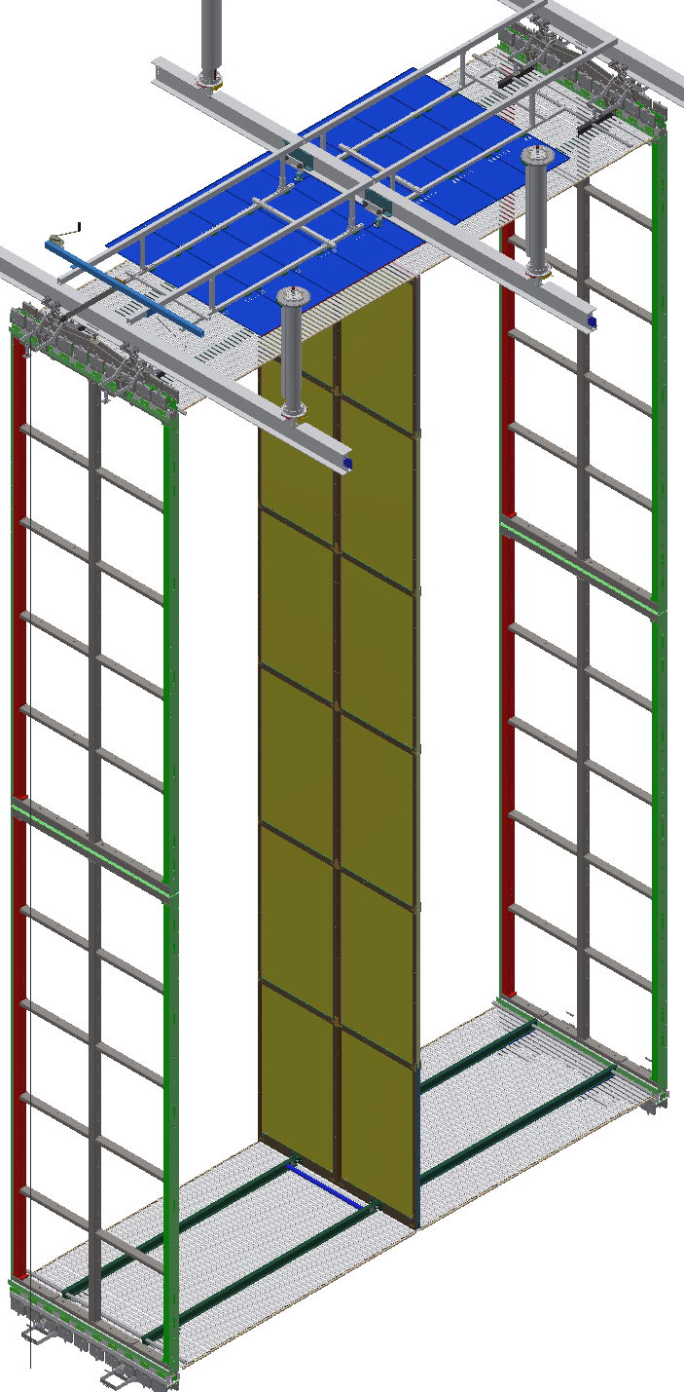
Connect bottom FC termination wires, final check all electrical connections.
Move on to next row.
The installation and deployment of the 2nd end-wall is more complex due to the limited accessibility inside the TPC for electrical and mechanical connections.
A conceptual deployment sequence is presently under study.

Slide 26
Underground Labor and Activities
Detailed schedule of assembly and installation is under definition assuming:
an HVS provided crew up to 6 workers + 1 physicist supervisor.
1 CPA workstation
2 FC assembly stations (allowing assembly of 1 or 2 modules) for both the TBFC and the EWFC
Schedule foresees 2 shifts/day and 4 days/week to complete a CPA/TBFC/GP slice:
Day#4 is dedicated to FC deploying electrical connection and QC: it can be moved at the end of installation in parallel with floor removal and cleaning (for a total of 3 to 4 weeks)
1 months per EW

Slide 27
Underground Labor and Activities
https://indico.fnal.gov/event/20775/session/3/contribution/23/material/0/1.xlsx
Day #1 Shift 1 (& 2)
Hours
FTE
Day #2 Shift 1
Open CPA Crates -- QC Receiving checklist | 0.5 | 2
CPA Panel #1-Remove bottom 4m CPA and rotate vertical -- secure to fixture on tower | 1 | 4
CPA Panel #1 (#2)-Remove middle 4m CPA and rotate vertical -- secure to bottom 4m and to fixture on tower | 1 | 4
CPA Panel #1 (#2)-Remove top 4m CPA and rotate vertical -- secure to bottom 4m and to fixture on tower | 1 | 4
Transfer to TCO beam #1 | 1 | 4
Remove CPA top lifting shackle assembly | 1 | 4
Final CPA Panel QC, Cleaning | 1 | 4
TFC #1:place profiles, 1st end caps | 0.5 | 2
mount beams, install screws | 1.5 | 2
install divider boards | 0.5 | 2
install 2nd end caps | 0.5 | 1
install riser block | 0.5 | 1
QC | 0.5 | 2
remove from fixture | 0.5 | 2
TFC #2:place profiles, 1st end caps | 0.5 | 2
mount beams, install screws | 1.5 | 2
install divider boards | 0.5 | 2
install 2nd end caps | 0.5 | 1
install riser block | 0.5 | 1
QC | 0.5 | 2
remove from fixture | 0.5 | 2
Assemble 4 top GP module | 4 | 2
Install 4 top GP module | 4 | 2
Pair Panels to make CPA Plane - Complete Plane Assembly QC checklist | 0.5 | 4
FC Crate opened -- FC Inspection | 0.5 | 4
Mount bottom FC1 | 1 | 4
Mount bottom FC2 | 1 | 4
Mount top FC1 | 1 | 4
Mount top FC2 | 1 | 4
CPA/FC HV Connections, Top and Bottom | 1 | 4
CPA/Top FC QC checklist | 0.5 | 4
CPA/Bottom FC QC Checklist | 0.5 | 4
Insert through TCO - QC checklist | 1 | 4
Day #2 Shift 2 and Day #3: repeat above operation for the next CPA/TBFC
Day #4 Shift 1 (& 2)
Deploy Top FC1 and FC2, HV Bus connection, install BFC deployment fixture | 2 | 4
CPA/Top FC QC Checklist | 0.5 | 4
Deploy Bottom FC1 and FC2 - HV Bus Connection, remove deployment fixtures | 2 | 4
CPA/Bottom FC QC checklist | 0.5 | 4
CPA/FC DSS Position checklist | 1 | 4
In our scheme where deploying is done after installation of the CPA/FC rows: day #4 are compacted at the end of the TPC installation (25 days).

Slide 28
QA testing plans, required services
QA Testing:
Visual inspection for integrity on material arriving in the crates:
Damage and scratches pf CPA resistive surface
Scratches, deformation of the FC aluminum profiles
Electrical checks of Voltage divider boards: resistor value, continuity.
Before mounting on the FC modules
After mounting
After assembly of FC’s on CPA and electrical connection
After deploying in the cryostat
1+1 High resistivity Multimeters to be provided by the consortium
Request to Detector Installation & Far Site teams:
No special requests: only riggers to move crates and assembled FC modules
Integration of a HVS expert into the installation/deploying team

