Slide 1
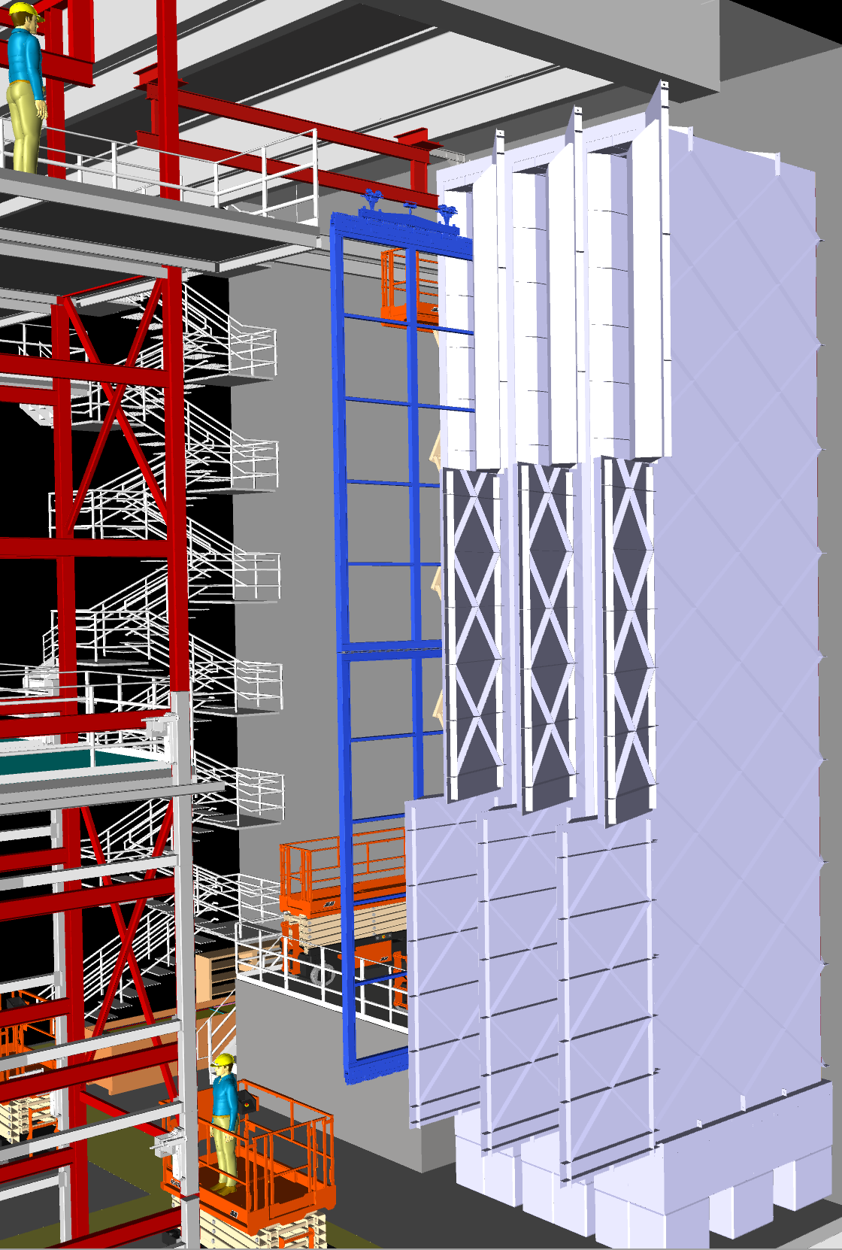
Cold Box Timing
August 19th, 2019

Slide 2
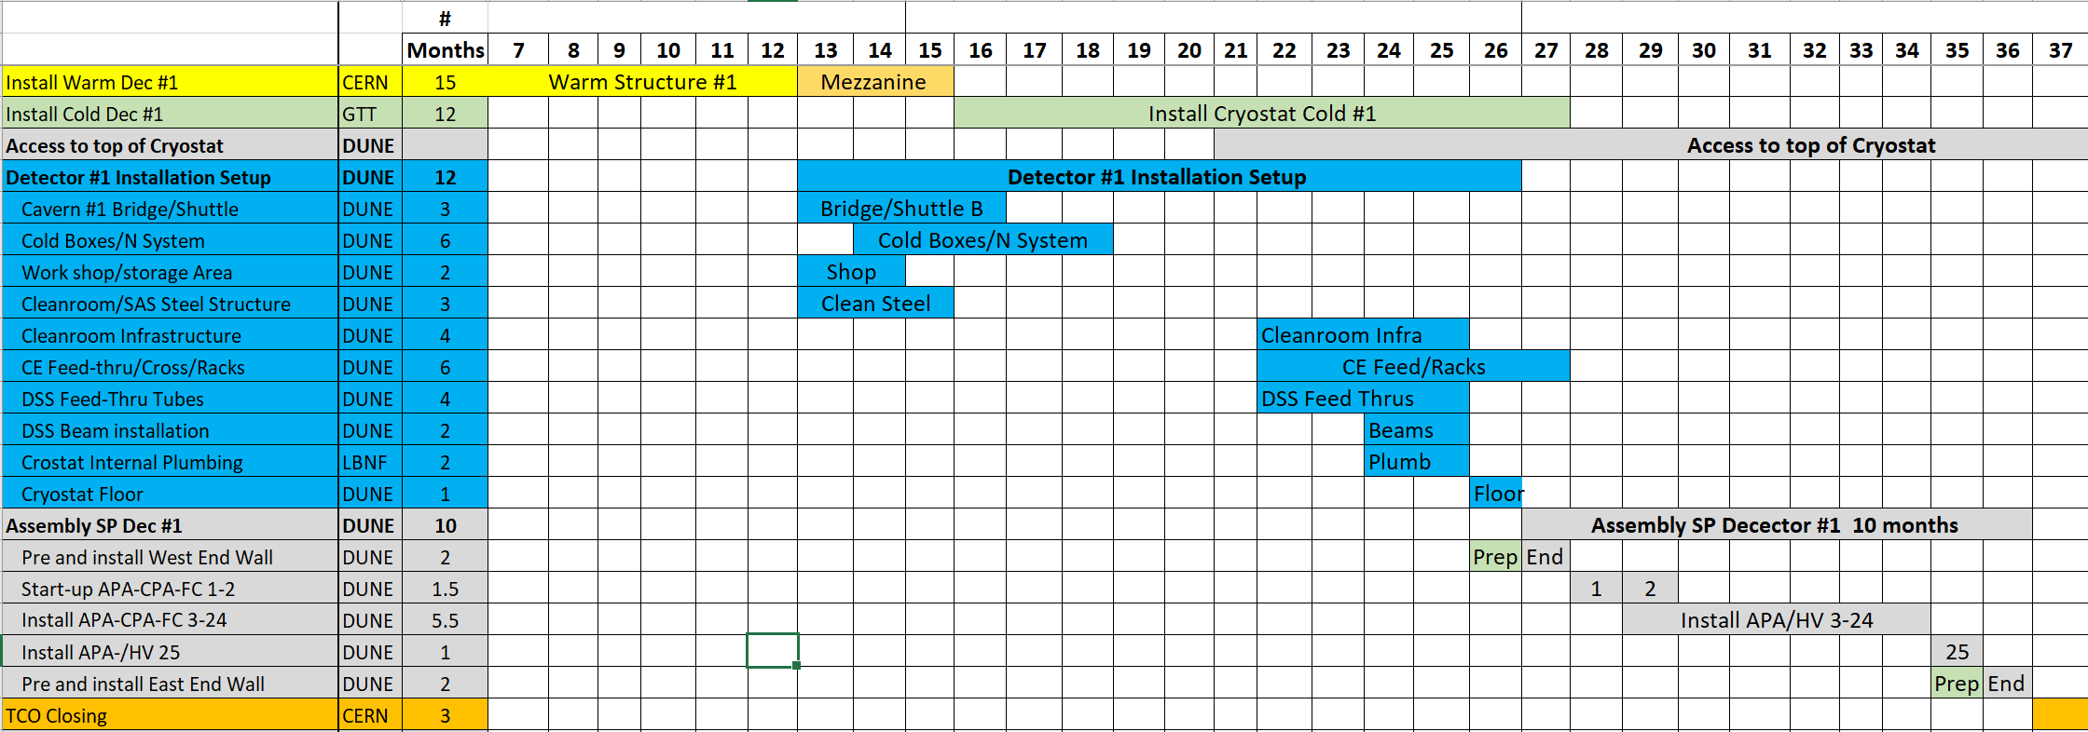
Schedule
The cold boxes including nitrogen system and DAQ readout need to be fully functional when we begin the SP detector installation approximately 27 months after AUP of the North Cavern
There is access for approximately a year for the cold boxes and 6 months for the nitrogen system and DAQ

Slide 3
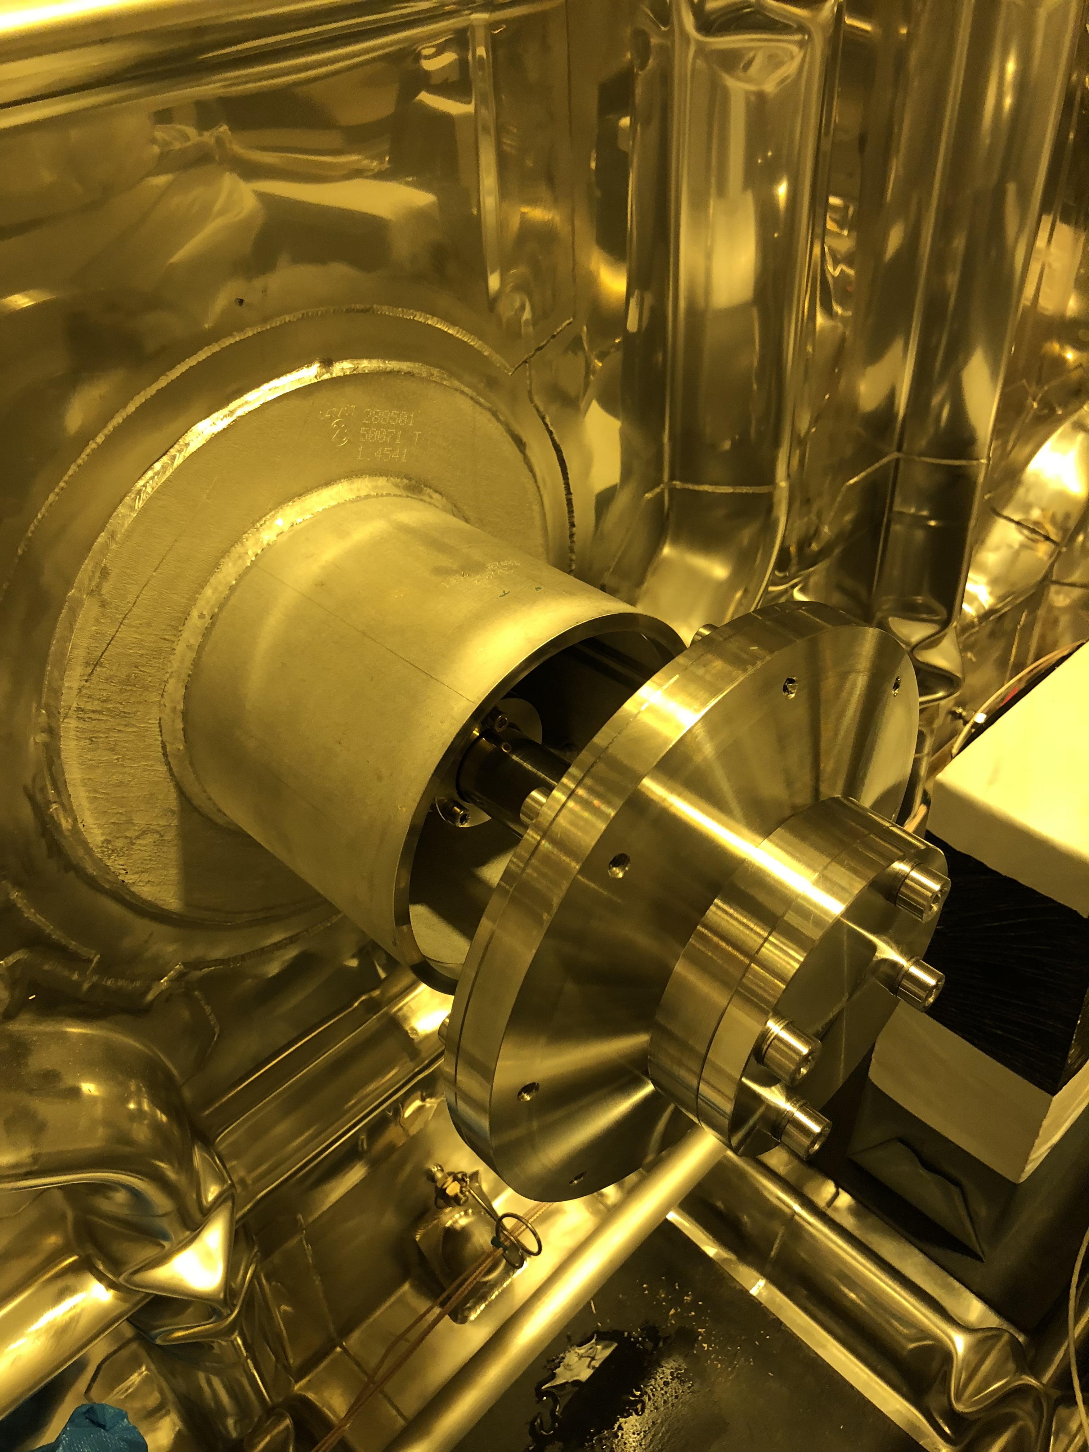
Schedule
Before the cold box can not go in place the protego valves need to be in place and tested.
The boxes will block access to this area.
They also need to be removed once the last set of APA doublets are in the cryostat so the pump installation can begin and moved to the South Cavern

Slide 4
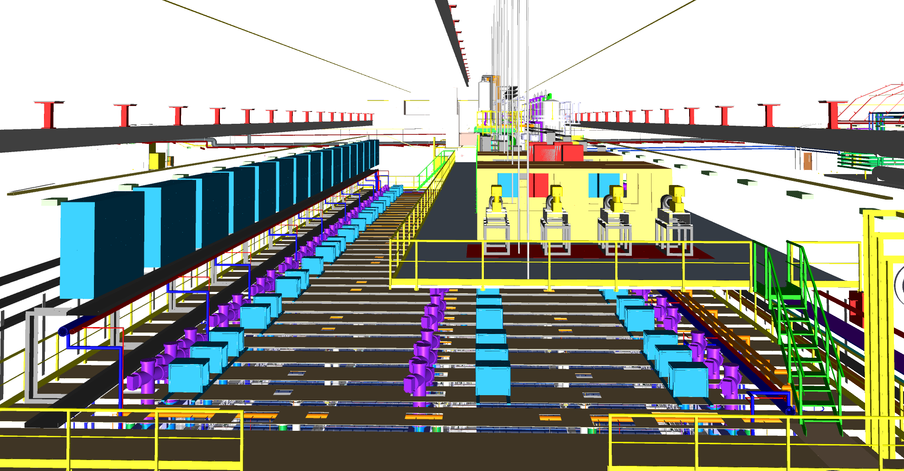
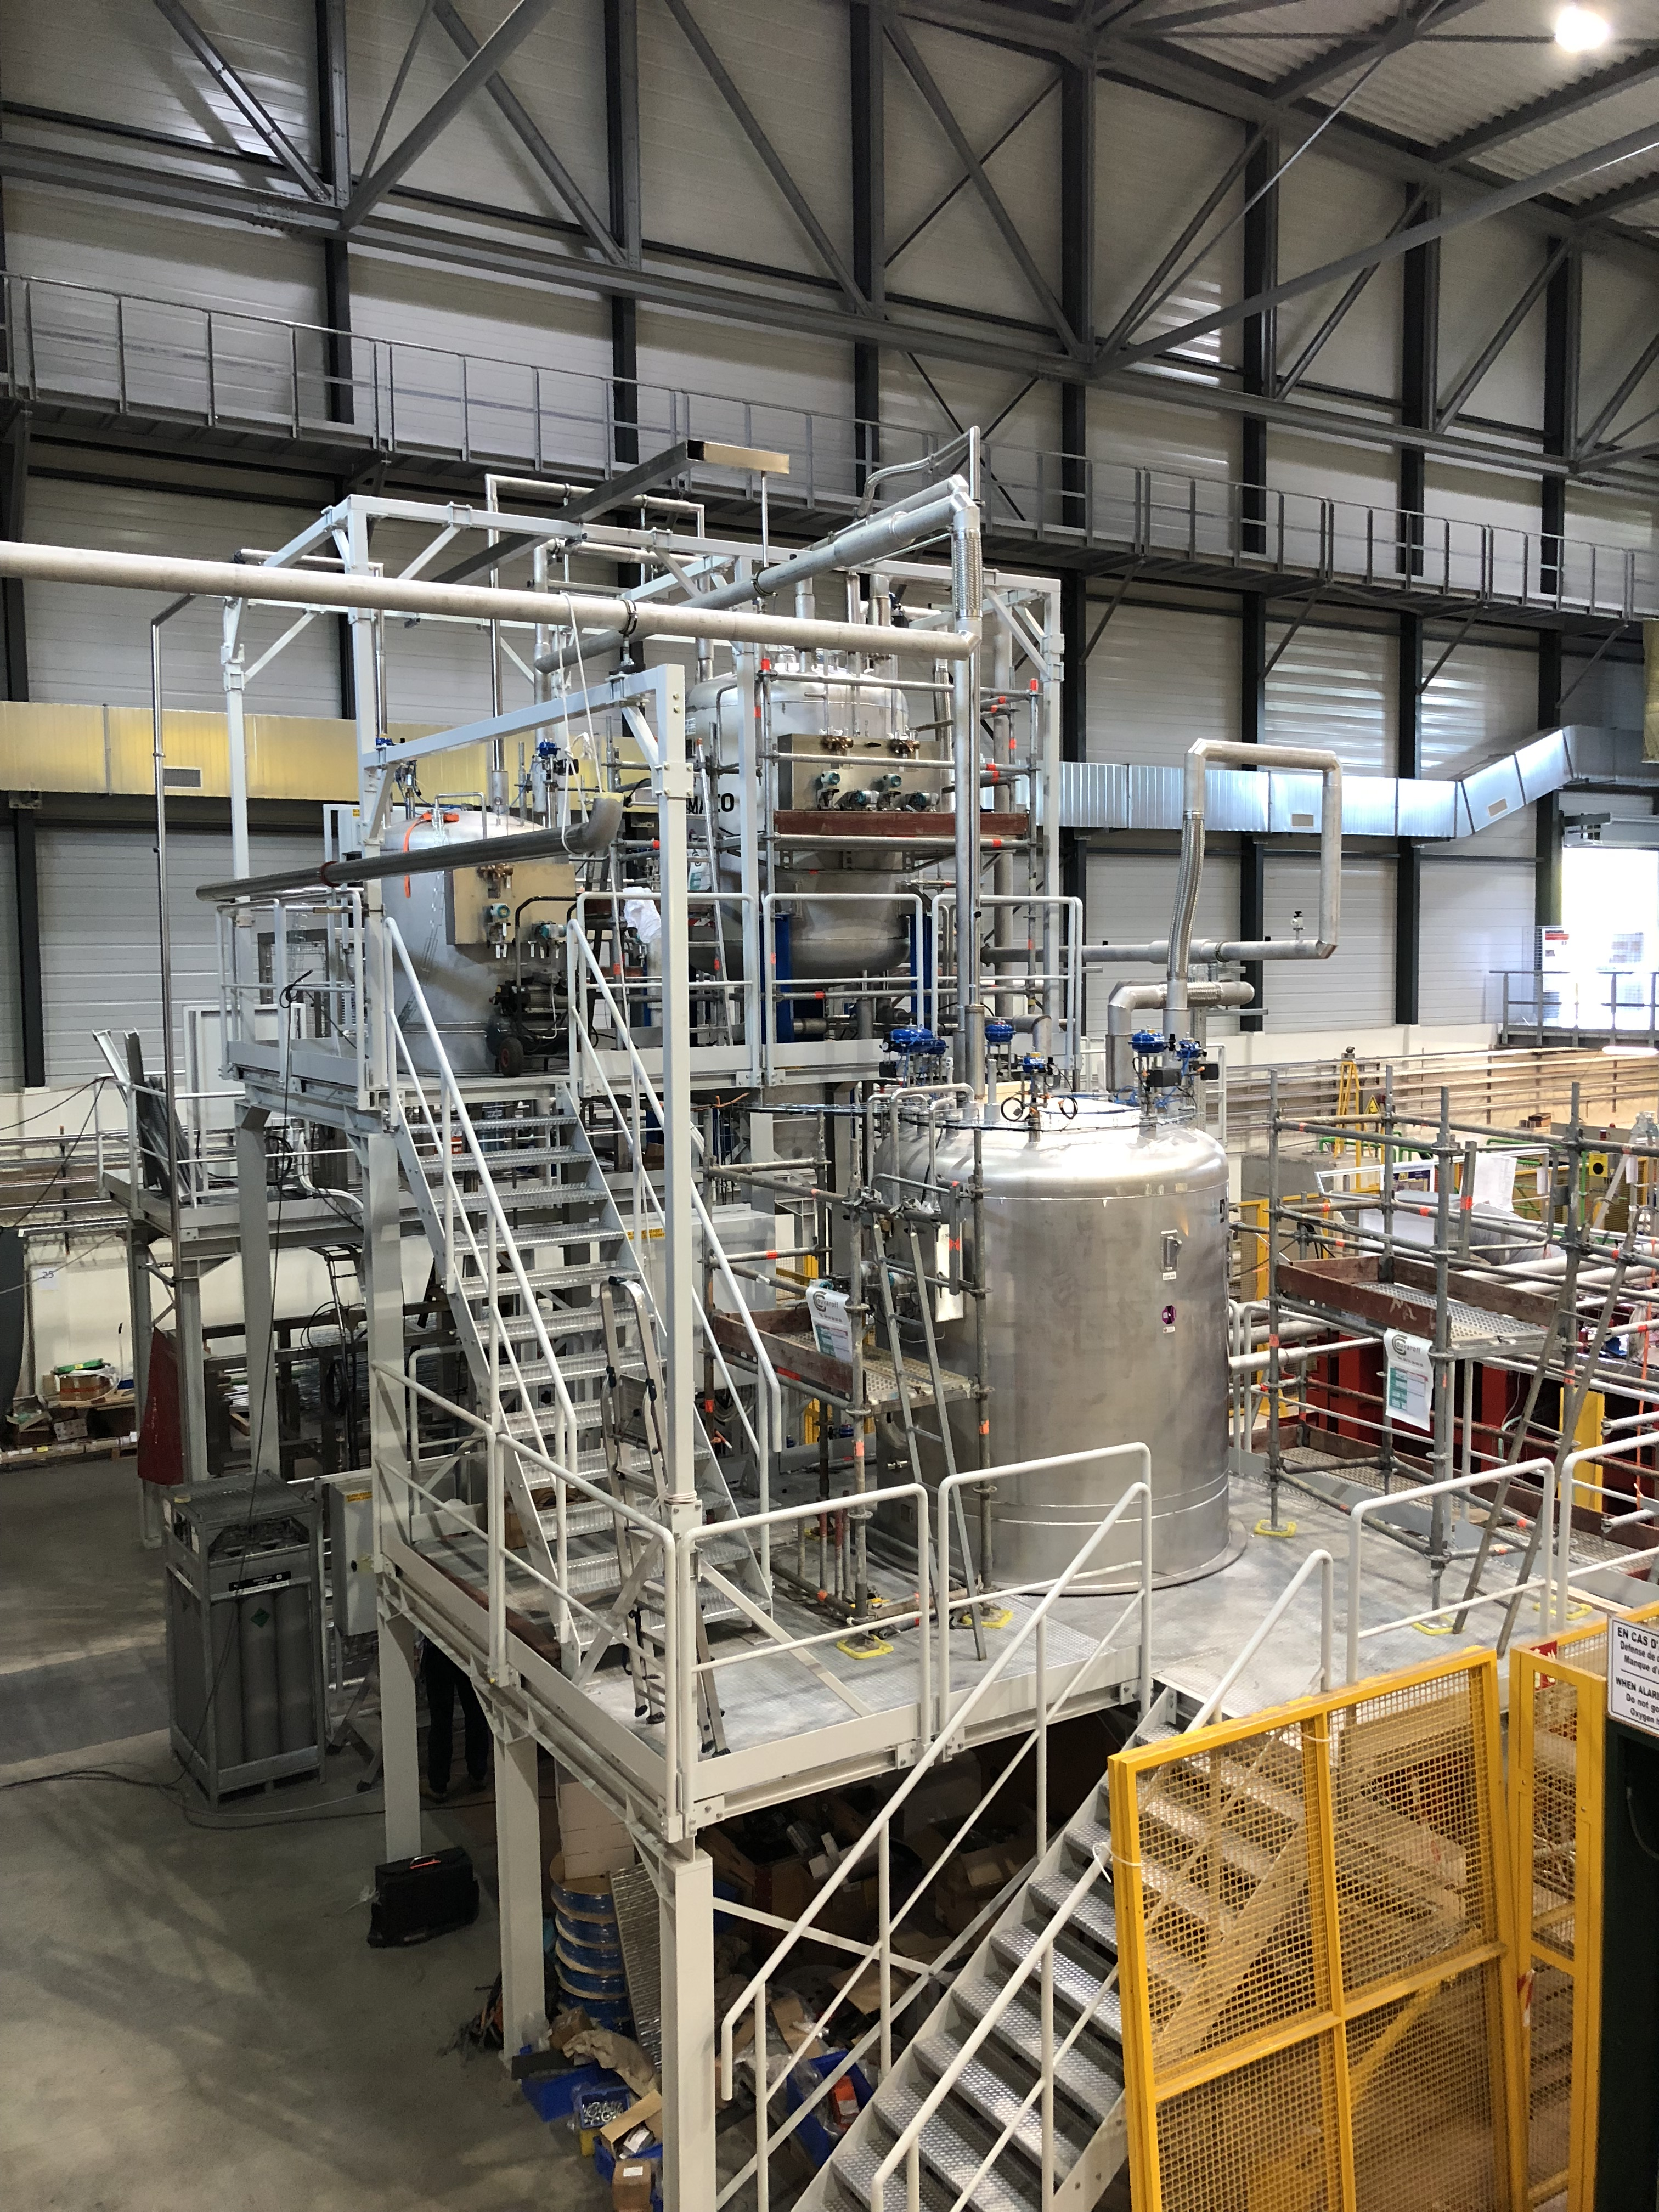
Schedule-Nitrogen and DAQ
The DAQ system for the cold boxes will be set up as part of the row 25 detector readout
The nitrogen system will live on the top of the cryostat mezzanine
Nitrogen will be supplied via large dewers approximately 4/day during operation
Cryogenic System for ProtoDUNE

Slide 5
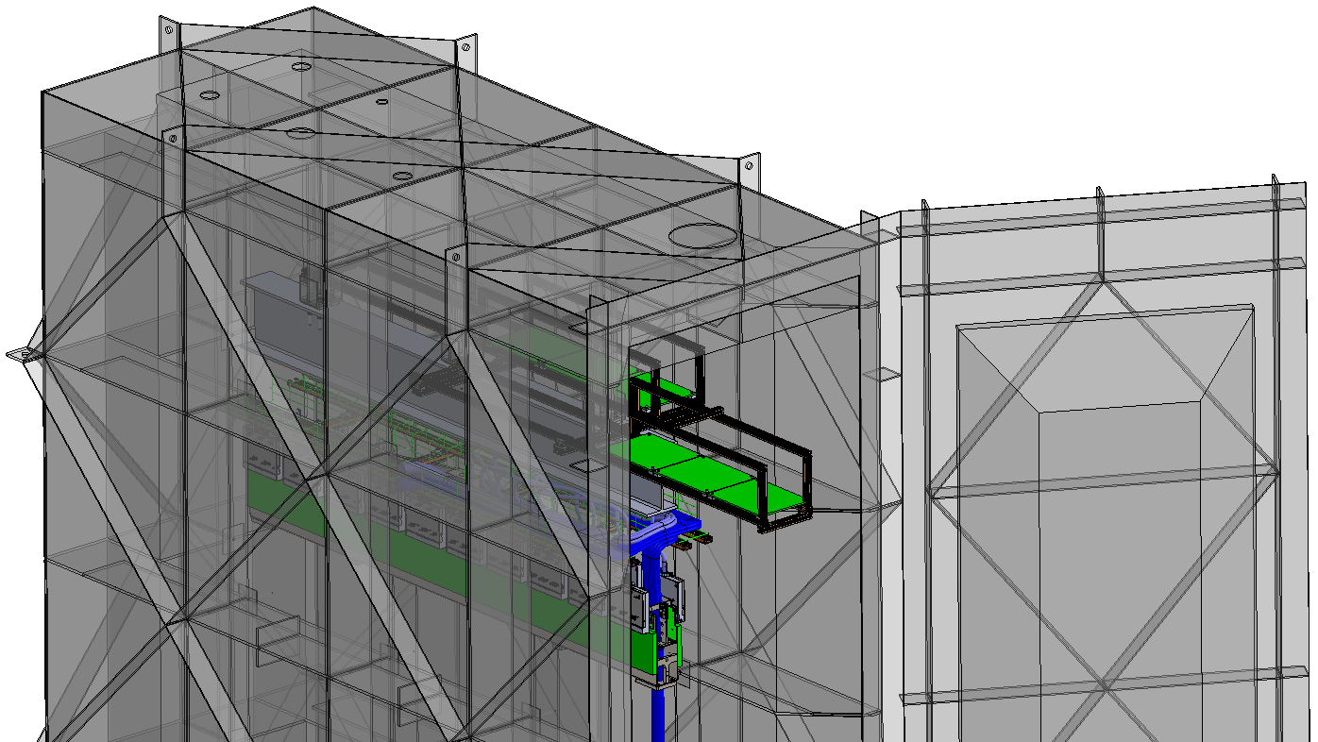
Box Design Requirements
DocDB – 10398 needs to be updated with new “features”
Design the box in sections so it can be moved underground and into the South Cavern
Doors need to allow for reasonable closure roughly every week
Size of box needs to include junction box (more pictures on the next slide)
Cold down and warm up rates?
????

Slide 6
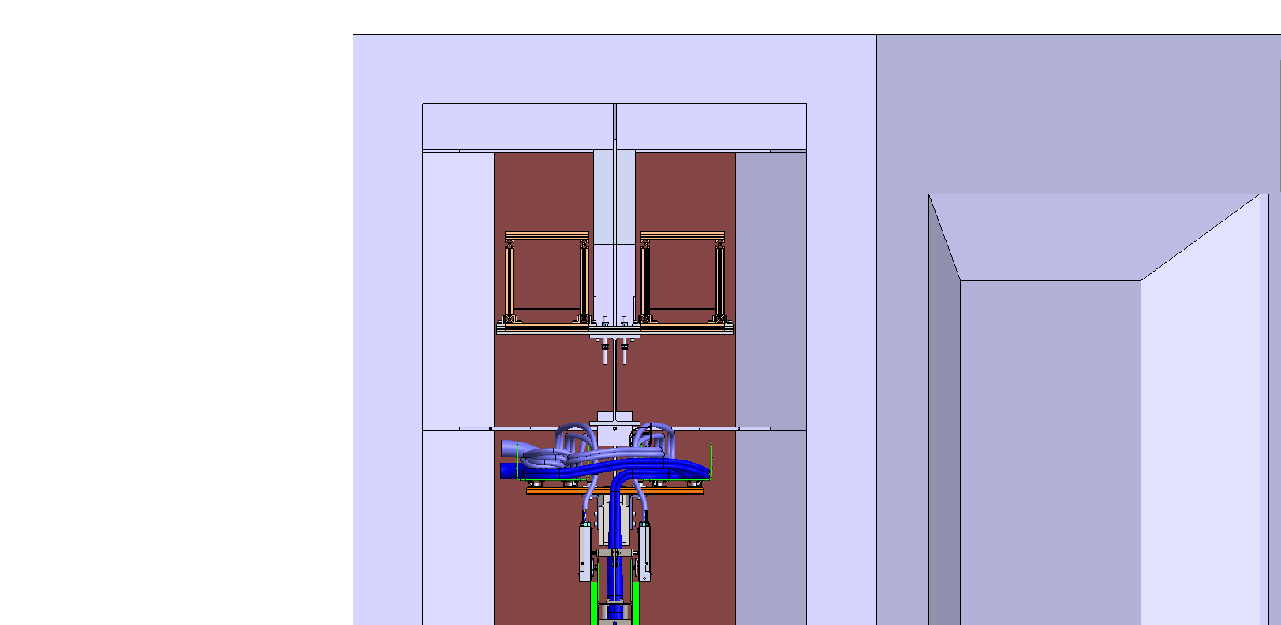
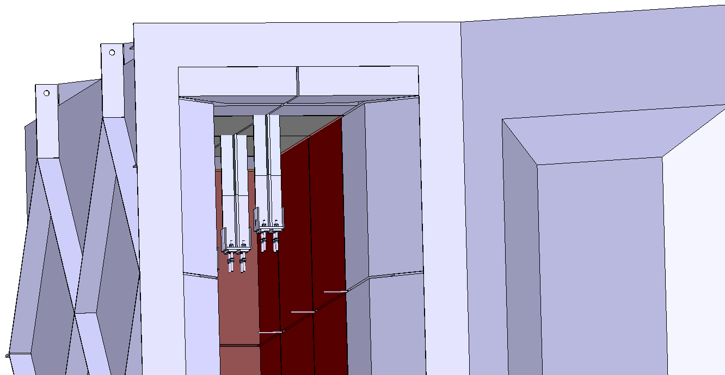
Current design of patch panel
This design requires the box opening to be higher than originally planned
The three posts where DSS W beam is mounted is extended by 300mm.
Drawings by Manhong

Slide 7
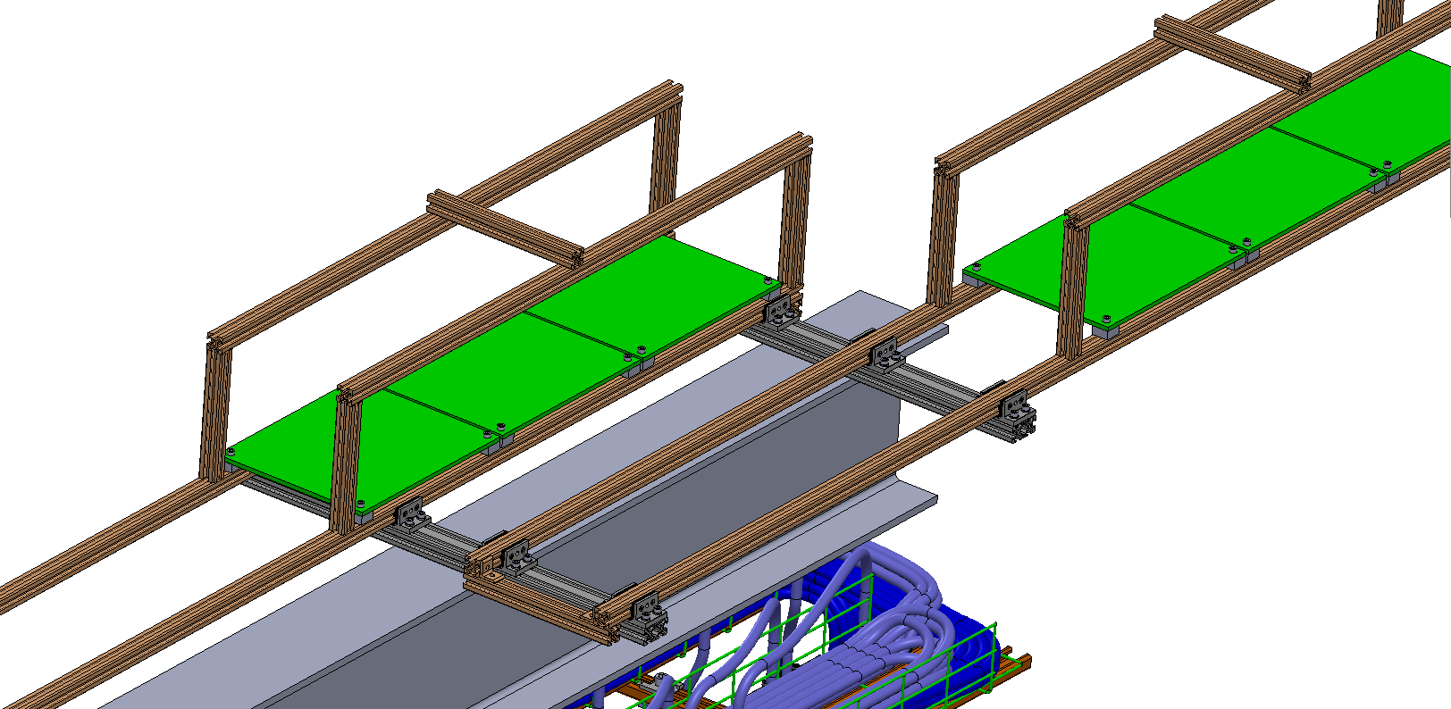
Patch Panels slide out for access
Patch panels in horizontal
Patch panel support frame slides out and in the cold box.
Linear bearings

Slide 8
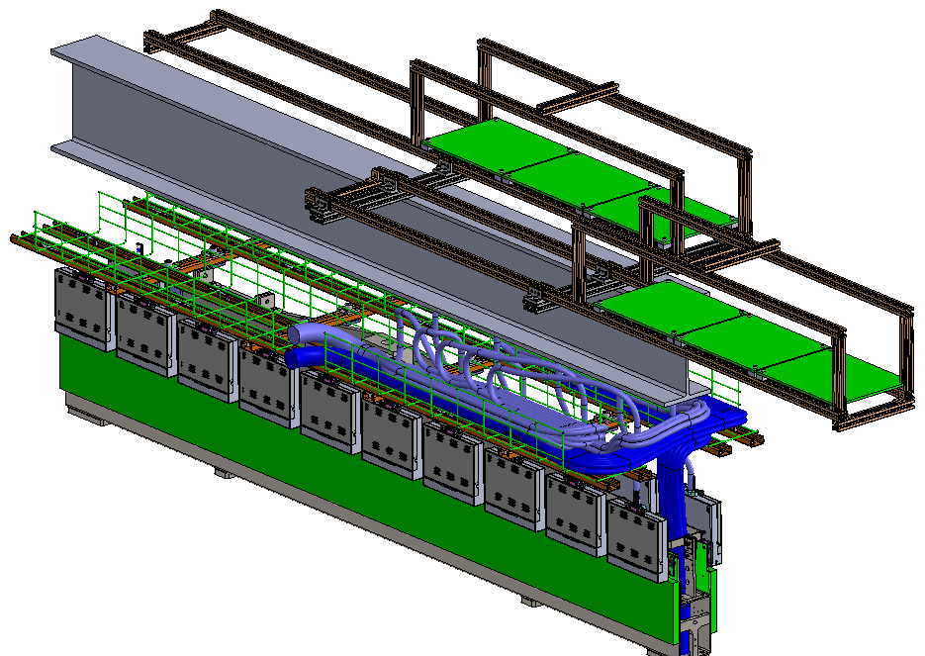
View inside the Cold Box
Cable bundle bend is cable tied on the frame.

Slide 9
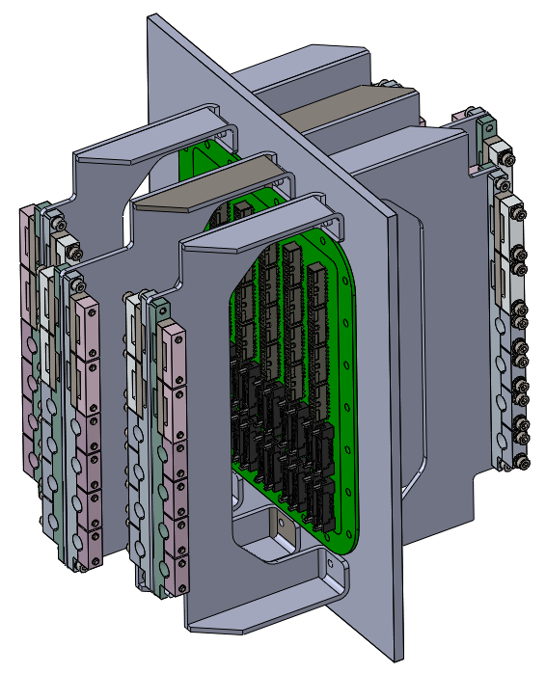
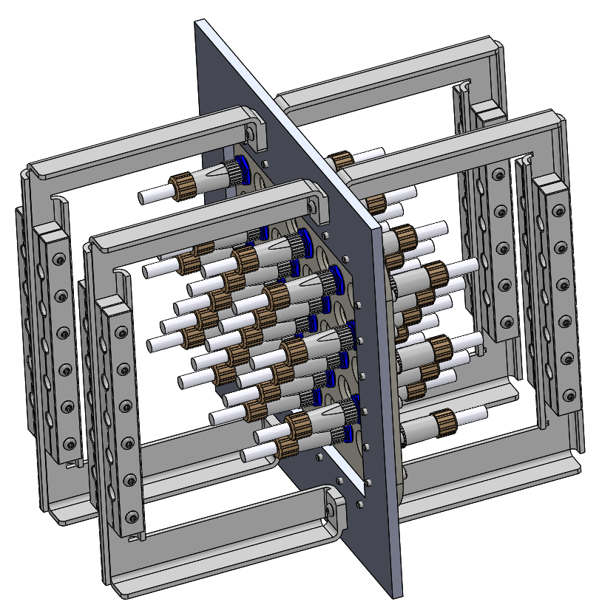
CE patch panel
PD patch panel

Slide 10
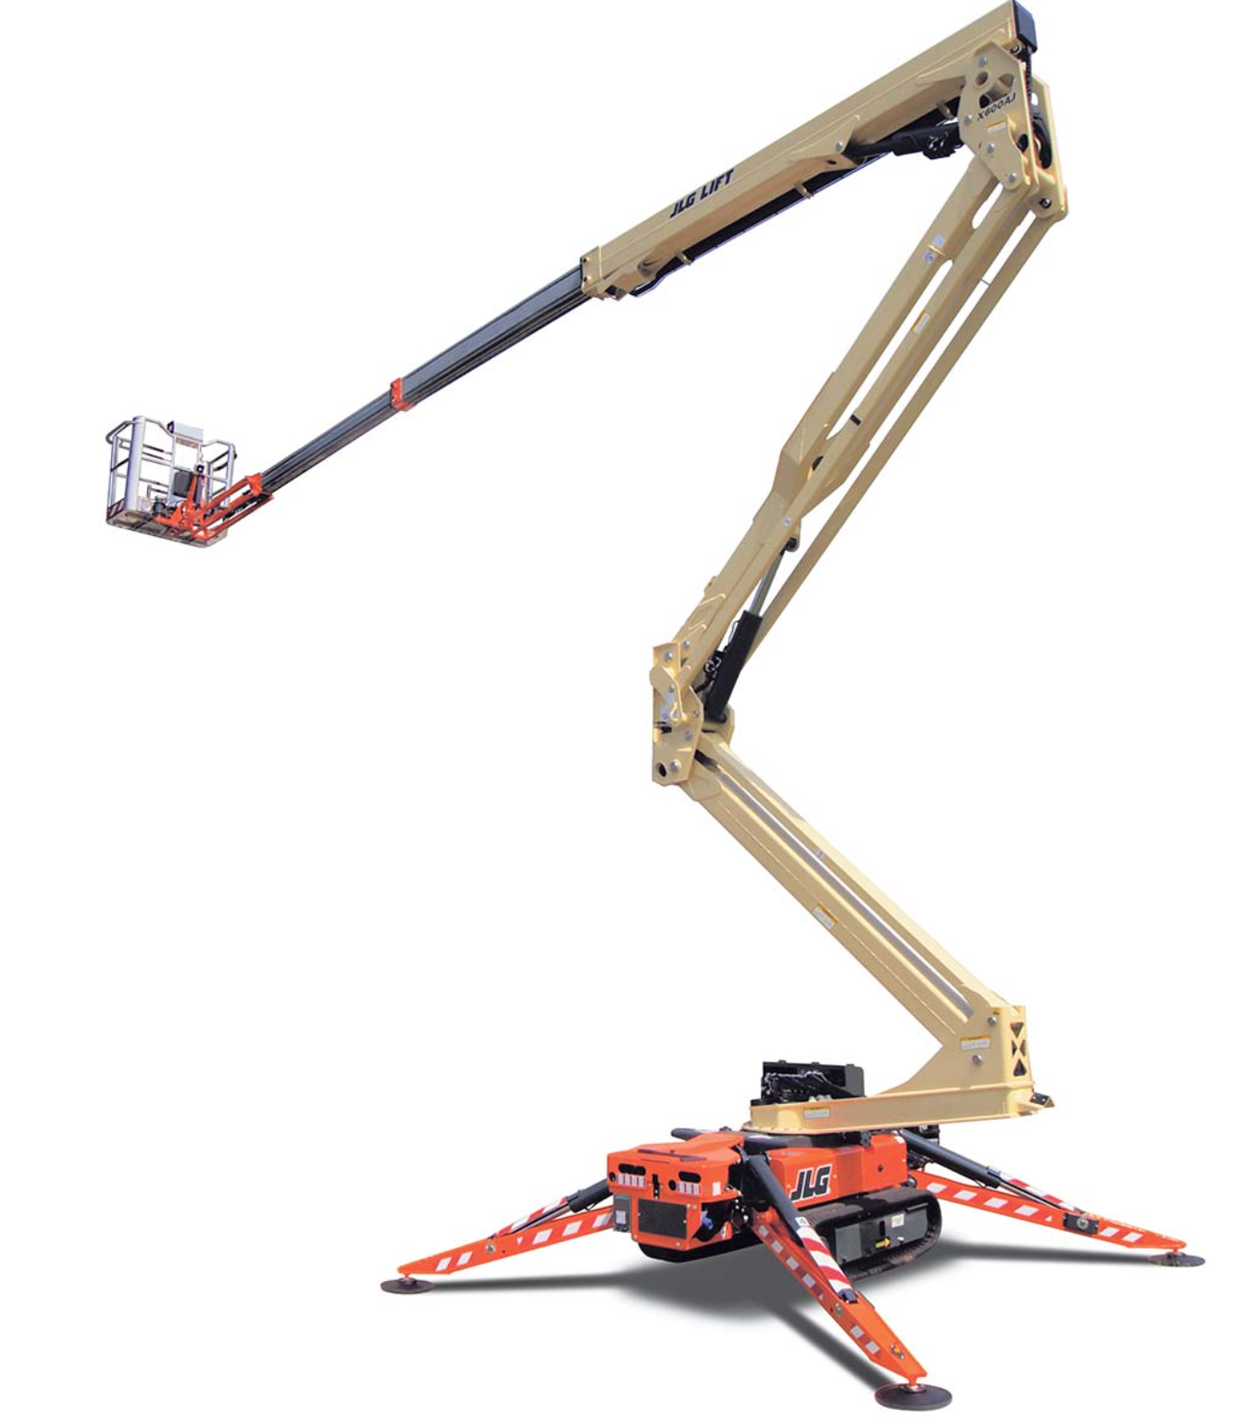
Access to Cold Boxes
None of the factor purchasable scissor lifts will reach besides the crawler boom lifts by JLG and Palazzani ($100-125k)
We looked at a platform that came off the cleanroom shuttle beam or the work platform but neither fit very well
Possibly a platform built into the box design?

