Slide 1
DUNE and LBNF FS post EXC Installation Planning
Marzio Nessi
SURF
19 August 2019

Slide 2
Our goal in the next 3 days:
Share with you our Far Site (FS) post CF organization plans
Discuss with some details the plans at the Far Site to arrive to the start of the detector installation
Cavern handover definition
BSI requirements
Cryostat installation
Cryogenics installation
Surface storage
Central organized manpower
Then we discuss the Detector installation scenario, including the requirements on the central SDSD and JPO teams. The requirements on the various consortia

Slide 3
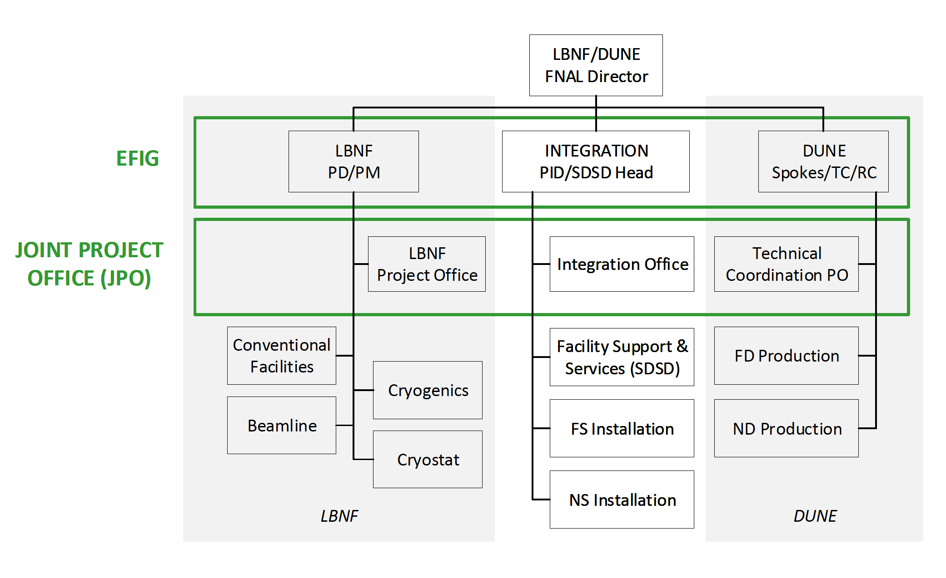
Work organization and actors

Slide 4
Work organization and actors
At some point in time (T0):
- EXCavation of the North (N) and CUC caverns will be over
- EXCavation of the South (S) cavern will continue for 4-5 months
We would like at this point to define a transition of responsibilities between the contractor in charge of the excavation and FNAL (handover)
A new phase will open, with several new and old actors sharing the same space at least in the N-cavern
At this moment, all activities will be controlled and steered by a new organization (JPO)

Slide 5
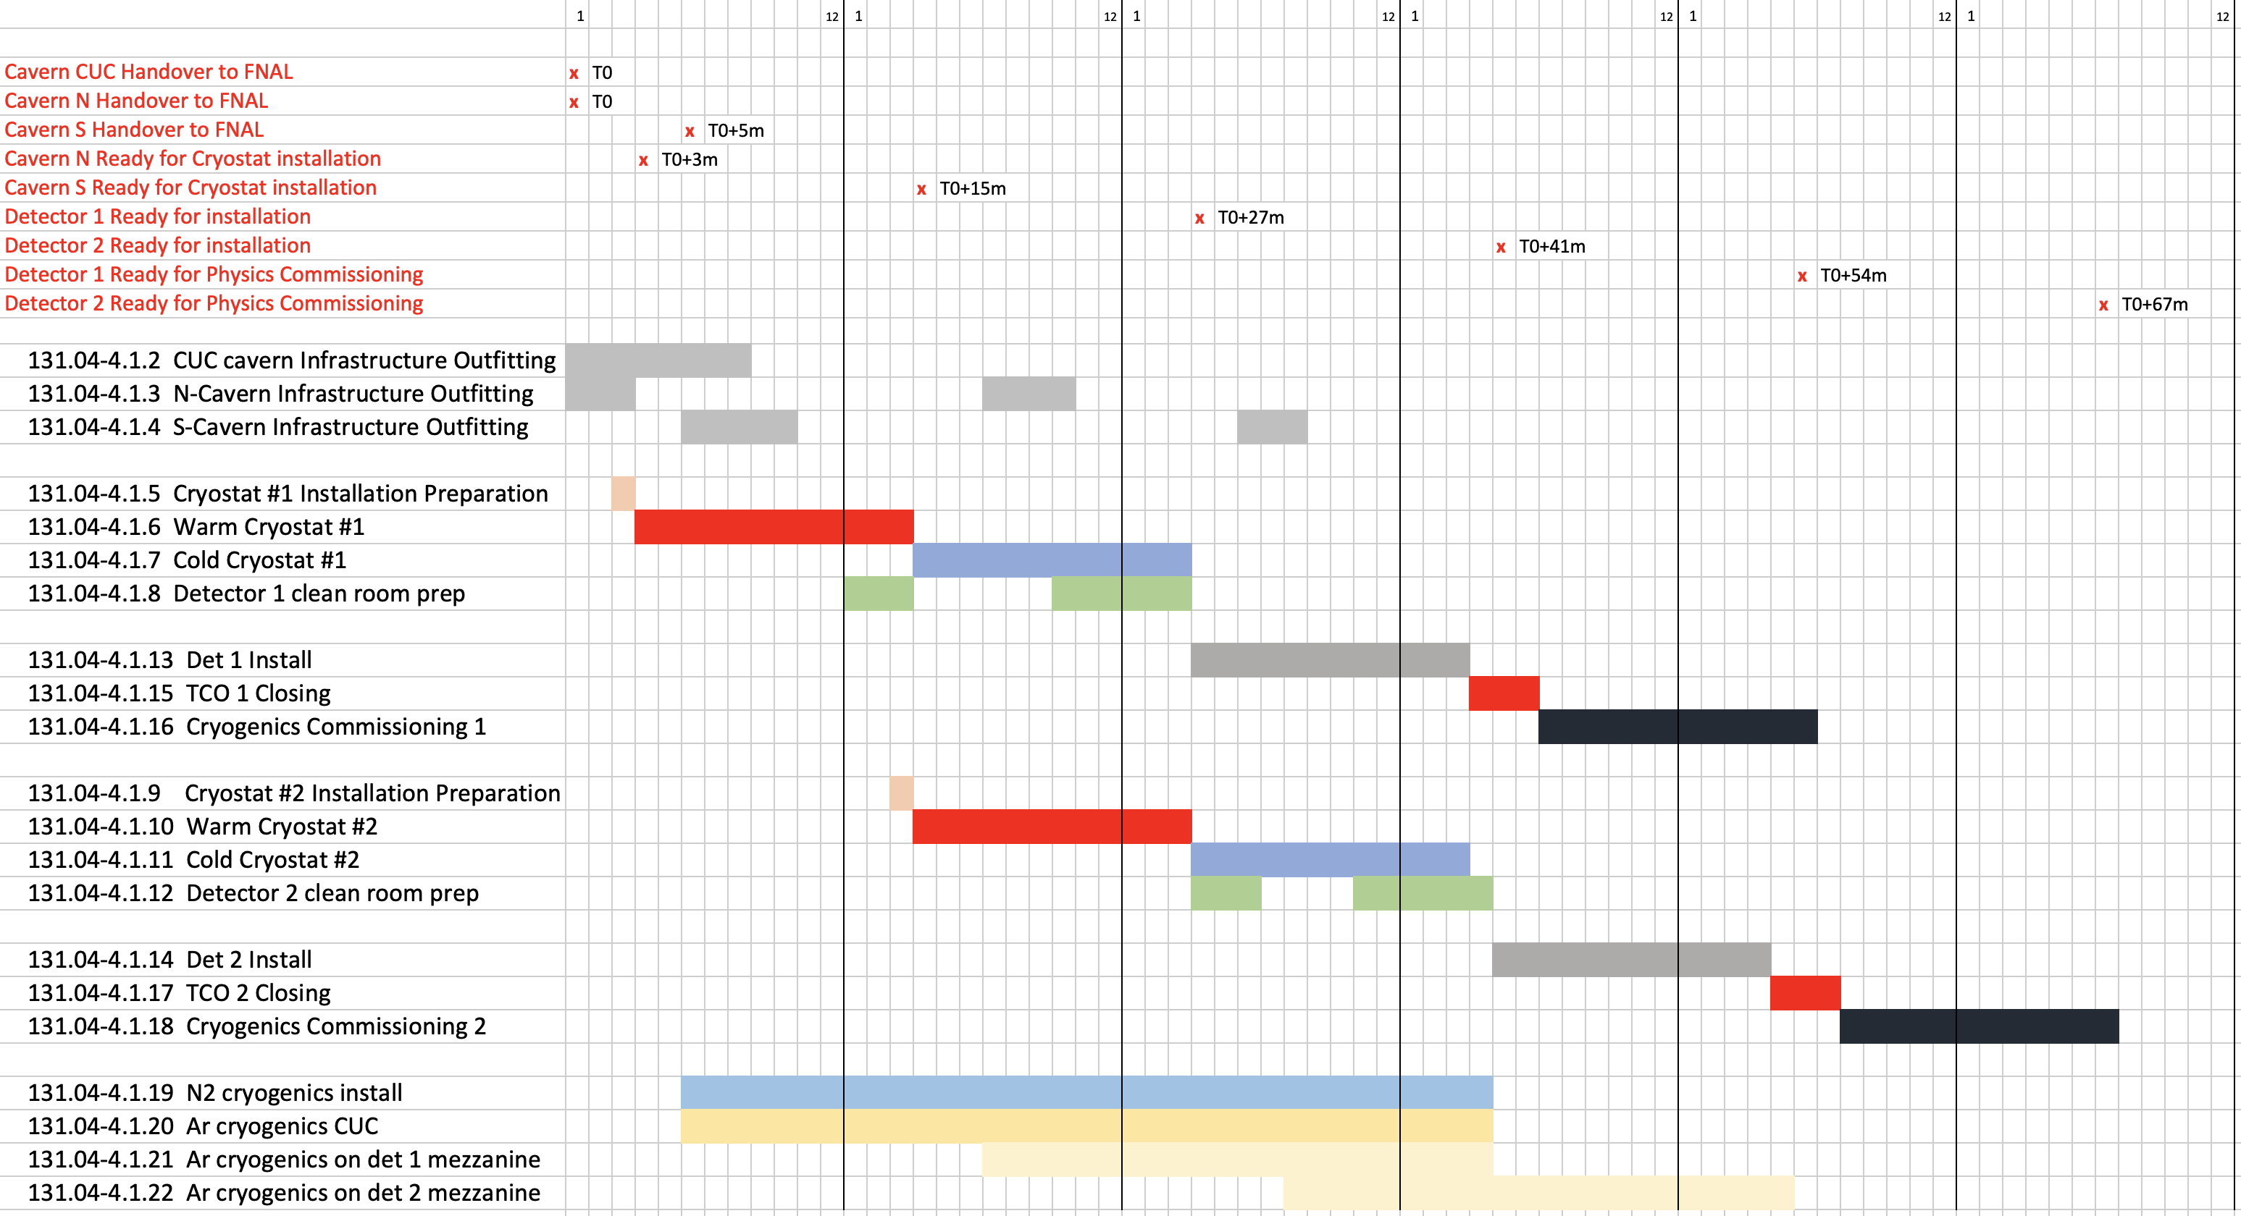
Highest level schedule protected by the EFIG (proposal in P6)

Slide 6
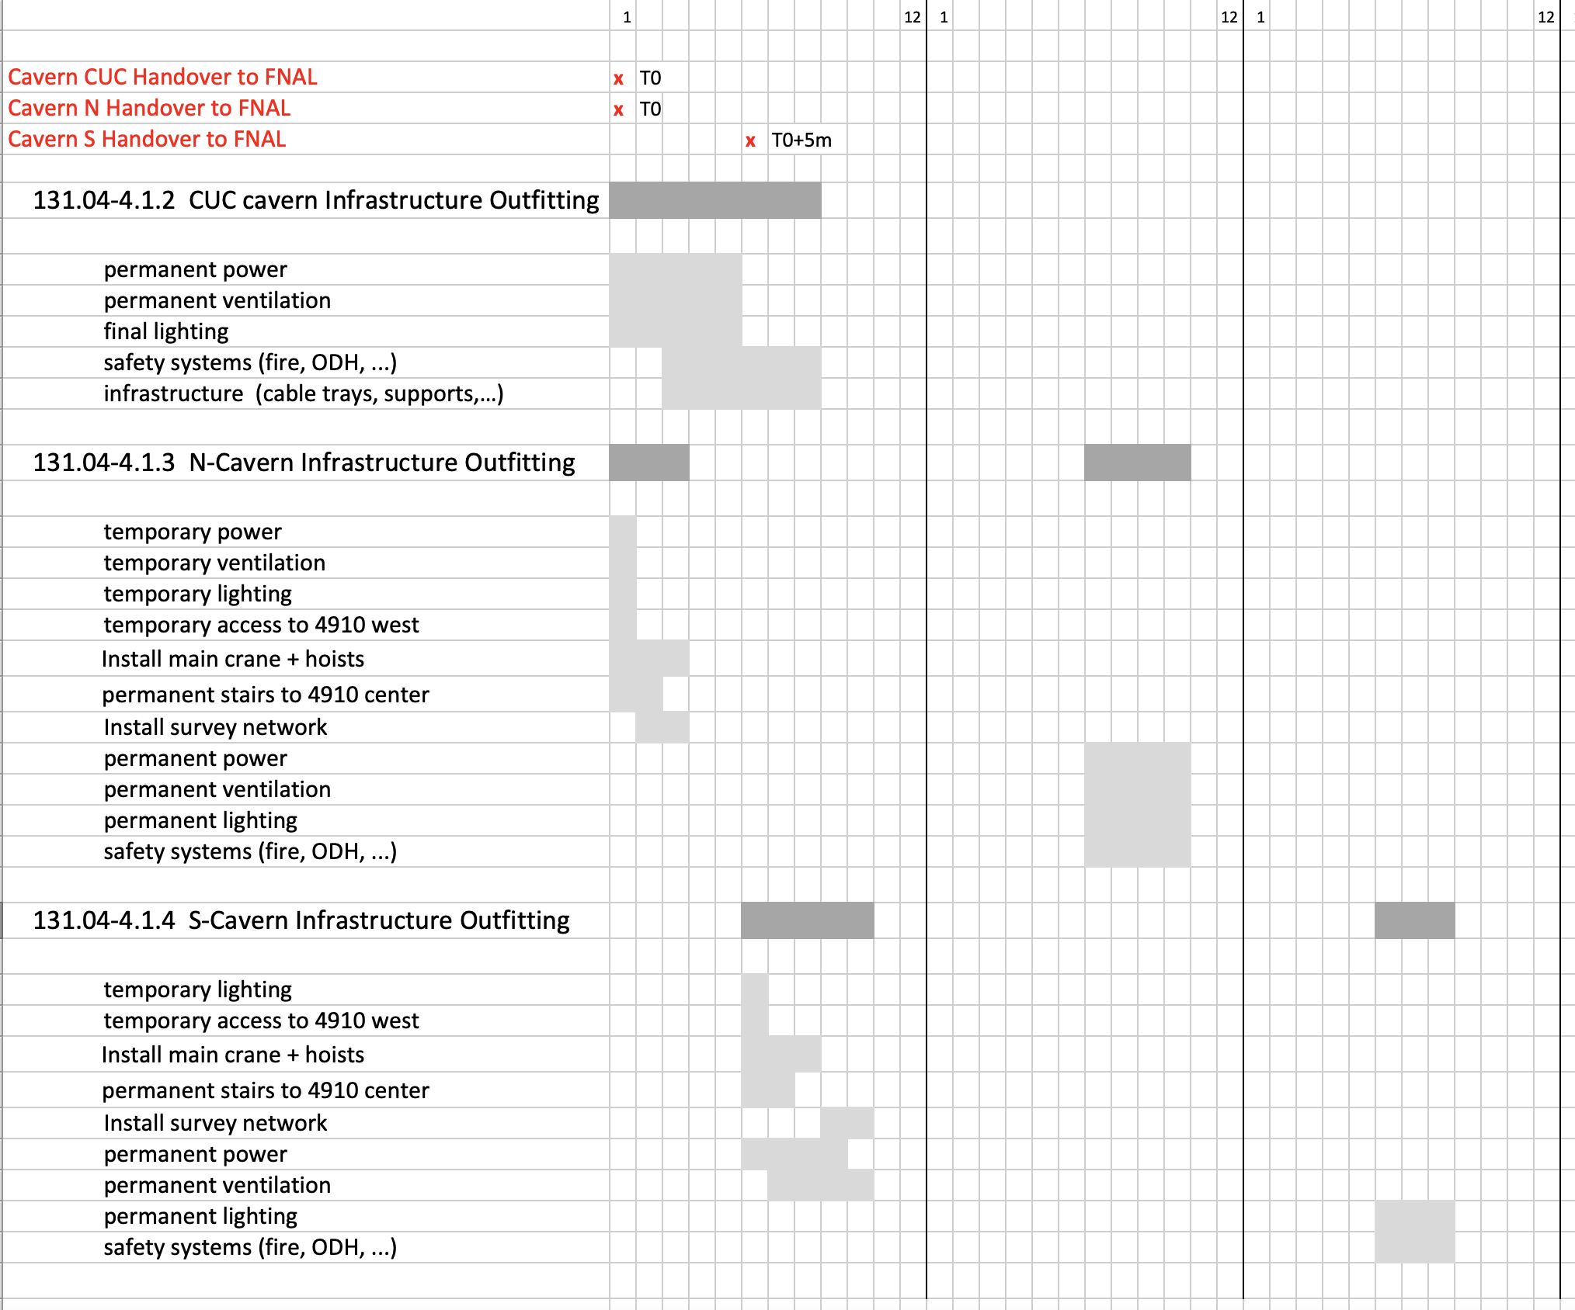
BSI activities proposal

Slide 7
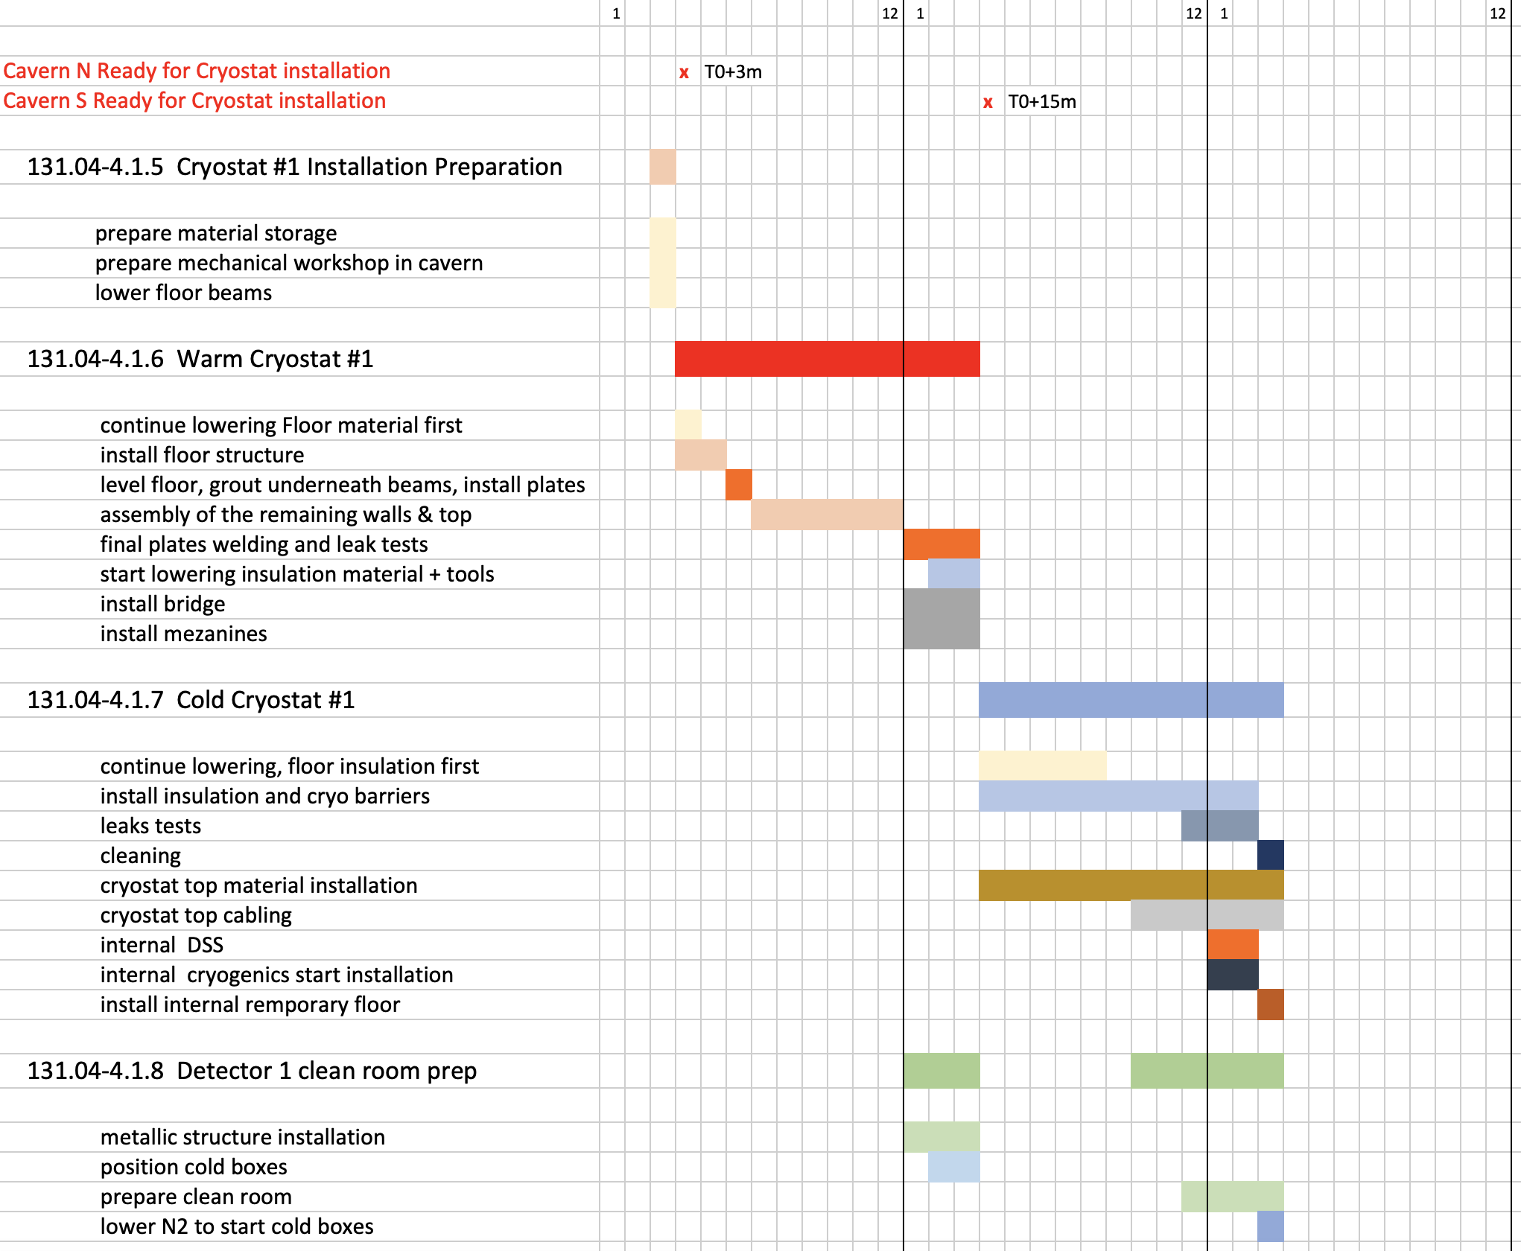
Cryostats activities (1/2)

Slide 8
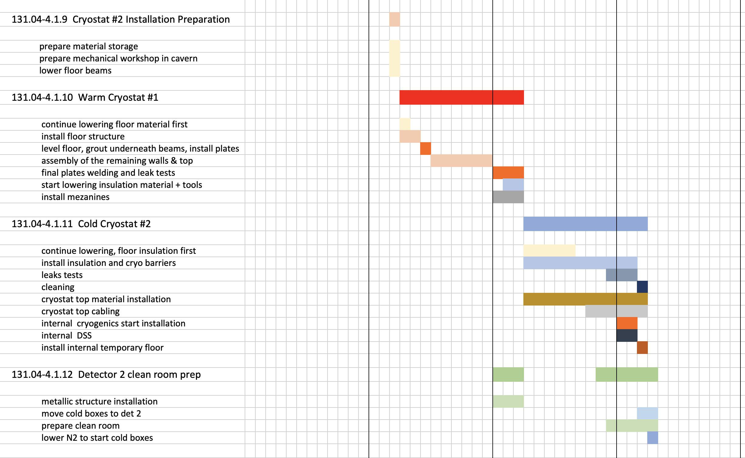
Cryostats activities (2/2)

Slide 9
Work organization and actors after handover

Slide 10
Work organization and actors after handover
Project overall coordination
work force

Slide 11
On the floor in situ
/ shift

Slide 12
On the floor in situ
Installation managers
1 person per shift for N cavern
1 person per shift for S cavern
- overview all activities ongoing
- plans all transport and rigging activities
- prepare next days plans
- run daily planning meetings underground
- report to the overall JPO coordination

Slide 13
On the floor in situ
20 general JPO technicians per cavern (N and S)
Covering many activities:
- Top of cryostat installation
- Technical support in the clean rooms
- Mechanical installation of the DSS, APA, CPA, Field cages inside the cryostat, ….
- Technical support to many activities in caverns and inside cryostats (cable trays, cabling, ….)

Slide 14
SDSD division manpower (today 4 FTEs)
Transport / Riggers
24/7 on call services
Experts
Surface Shaft transport/rigging
6 FTEs (2 shifts)
Surveyors
2 FTEs
Electricians
3 FTEs
Lower Shaft & Drift transport/rigging
6 FTEs (2 shifts)
Ventilation
& Network
3 FTEs
Welders (cryo) and cabling
3 FTEs
Caverns transport/rigging
8 FTEs (2 shifts)
Logistic services
Safety officers
3 FTEs
Logistics management
1 FTE
Surface storage/transport/rigging
2 FTEs
Contracted manpower
Labs manpower

Slide 15
What is now needed ?
A safety organization which prepares and overviews all safety files and installation procedures, before individual items are moved and installed underground
A PBS definition and marking of all items which will arrive to SD and will then be stored on surface or moved to the caverns
A DB system associated which links to each item ID his production, travel and safety history
A change request mechanism which allows or not changes to the baseline (schedule, layout, performance,..) once the baseline is defined

Slide 16
What is now needed ?
A baseline definition related to an internal review system
Final design reviews
Readiness reviews
Installation reviews
Production follow up reviews
An agreed budget line for all activities in the various domains (LBNF, JPO, DUNE, common funds ….) with a strict follow up mechanism. We need to start exploring manpower sources.
A formal agreement with LBNF/CF on the definition of the caverns handover and the change of responsibility
A formal protection of the top level schedules and milestones

Slide 17
Now lets go in steps to see where we are with the various activities preparation enjoy the next 3 days!

