Slide 1
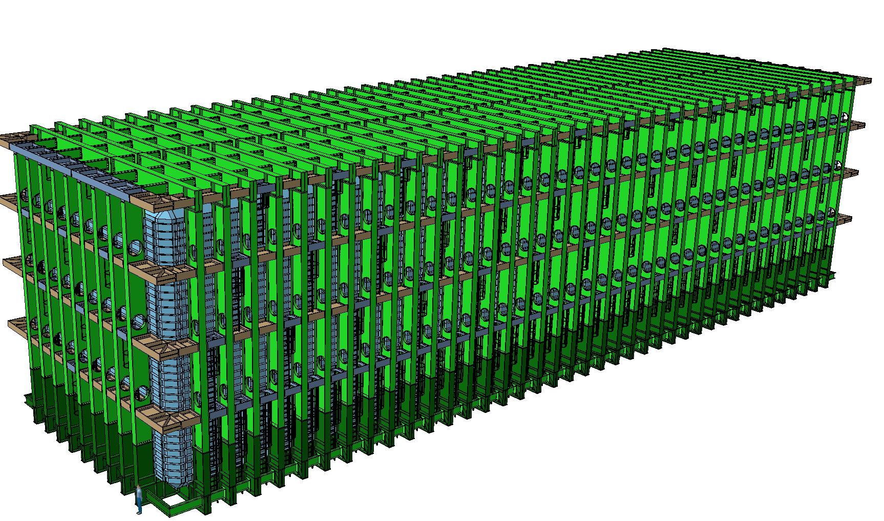


LBNF - Required infrastructure to start cryostat installation
and material movement
Dimitar MLADENOV & The entire CERN Team
FS Installation Workshop
SURF, 19-22 August 2019

Slide 2
LBNF – Required infrastructure to start cryostat installation
At T0 we would need:
Access (both sides)
If a permanent one is not available (the preferred option), then we need temporary one (stairs, scaffolding, Alimak, etc.)
Lights
If a permanent one is not available (the preferred option), then we need temporary one. In the cage?
Electrical Power
Single and three Phases, US as well as EU
Communication
  WiFi, GSM?,
Ventilation
Shall be operational
Compressed Air
Could be temporary
Working Safety Organization
  Training, approved PPE, requirements, access control, etc.
Full Organization on the Surface for lowering down the material
All the beams for the floor shall be ready for immediately availability
Underground Crane & Hoists
Shall be operational (including a professional rigging team, and full set of basic rigging accessories)
Fully operational survey team
General cleaning, by dedicated team will be performed on daily bases
Also to decide who provides some of the tools
  Load guiders for the shafts
  Carts for the beams
  Etc.

Slide 3
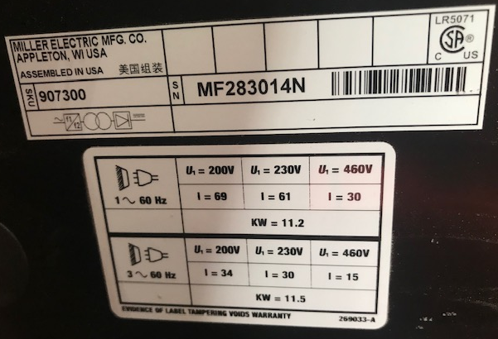
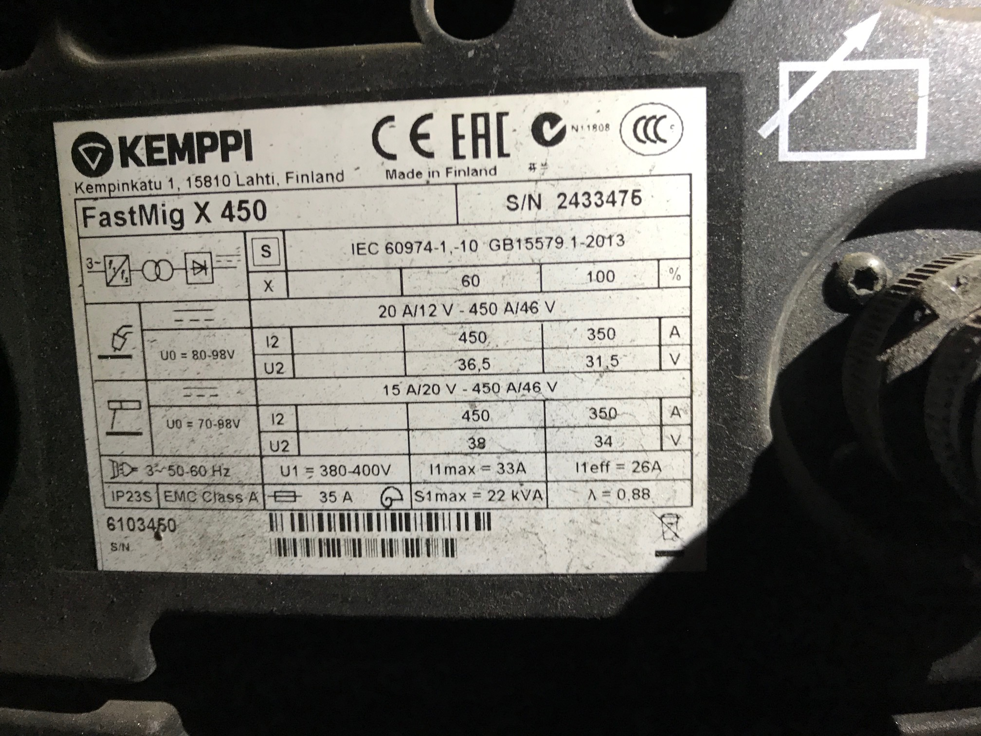
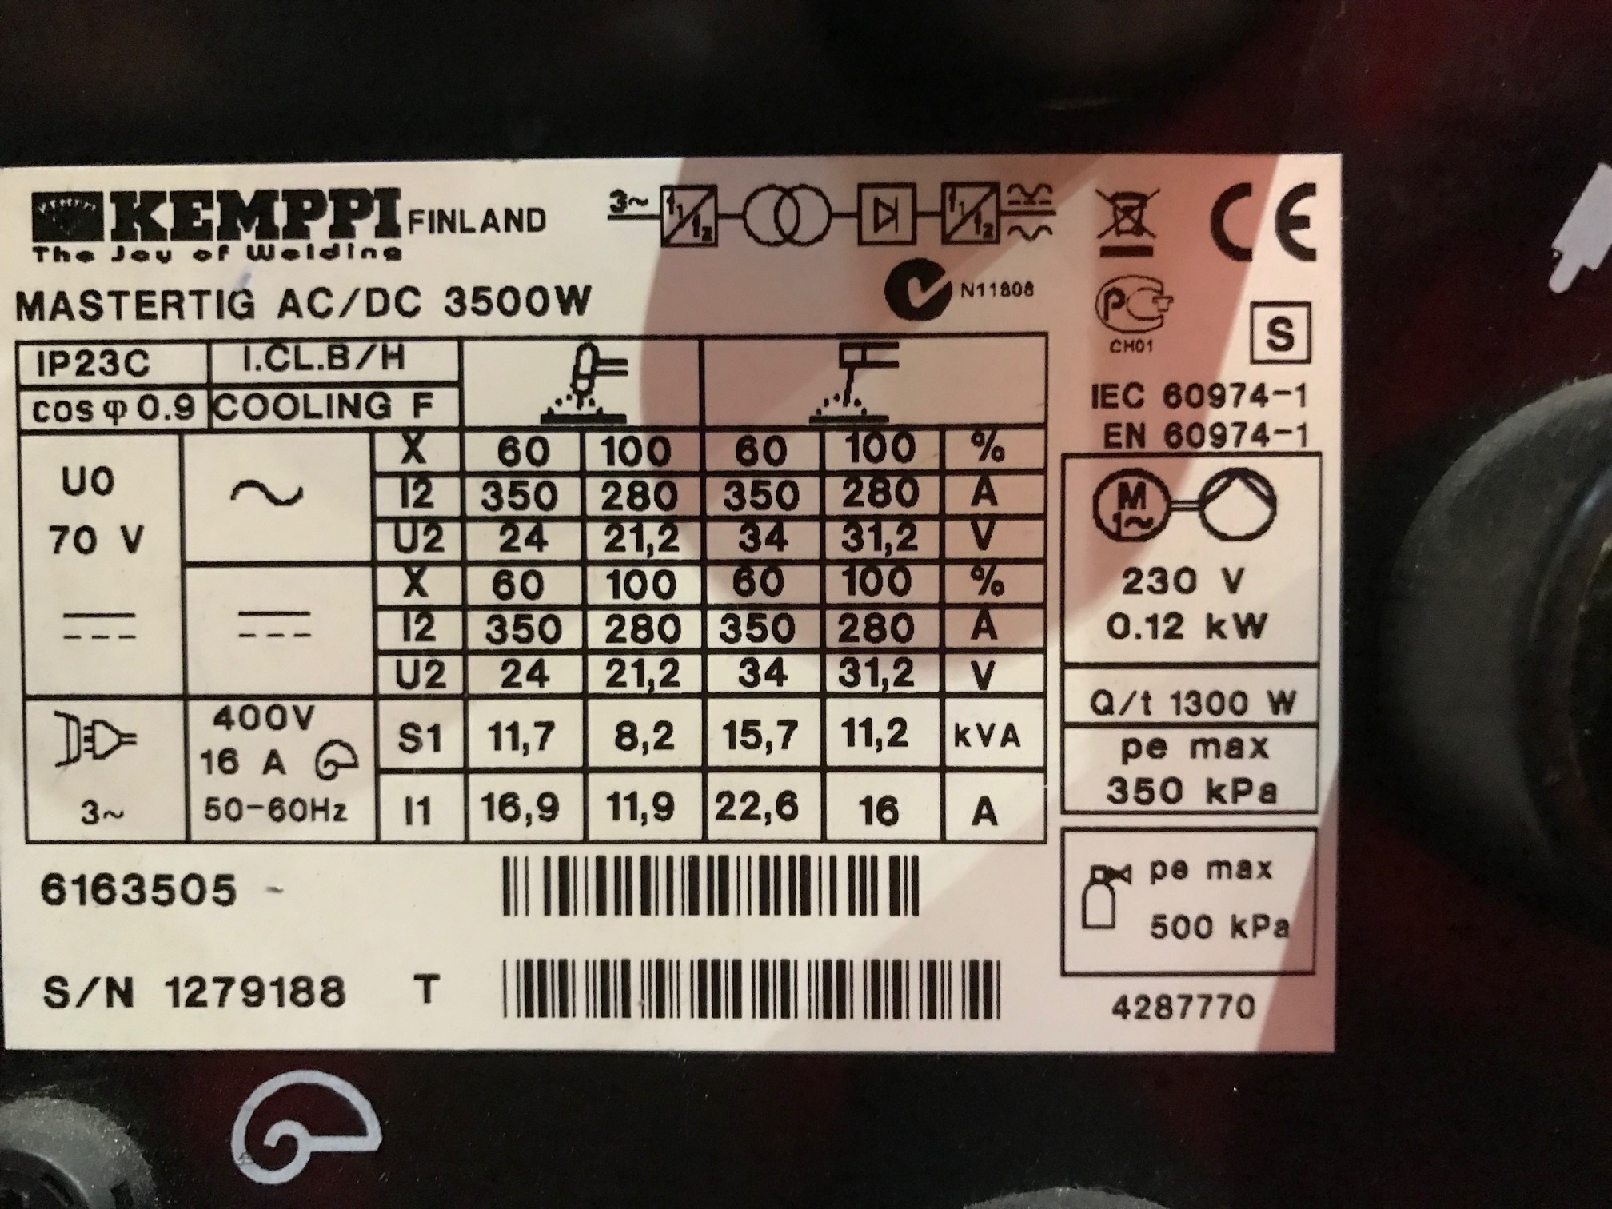
LBNF – Required infrastructure to start cryostat installation
and material movement
Main Electrical Power Requirements:
10 x Welding posts
  10 x 15A @ 460V
  Peak Power: 150A @ 460V (3 phase)
Ideally spread on two main electrical distribution boxes (north and south) in the middle of each cavern
US
EU
EU

Slide 4
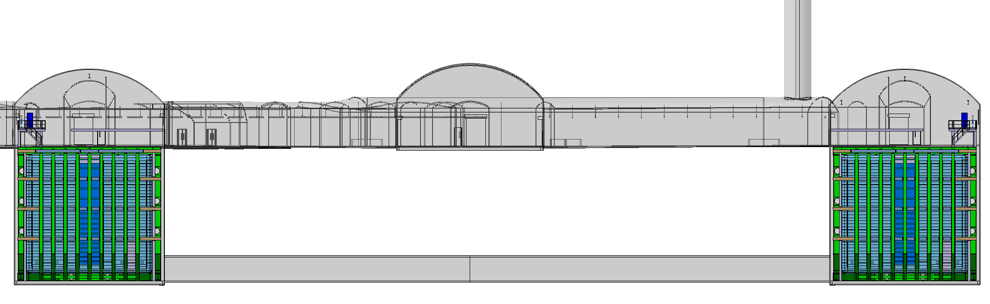
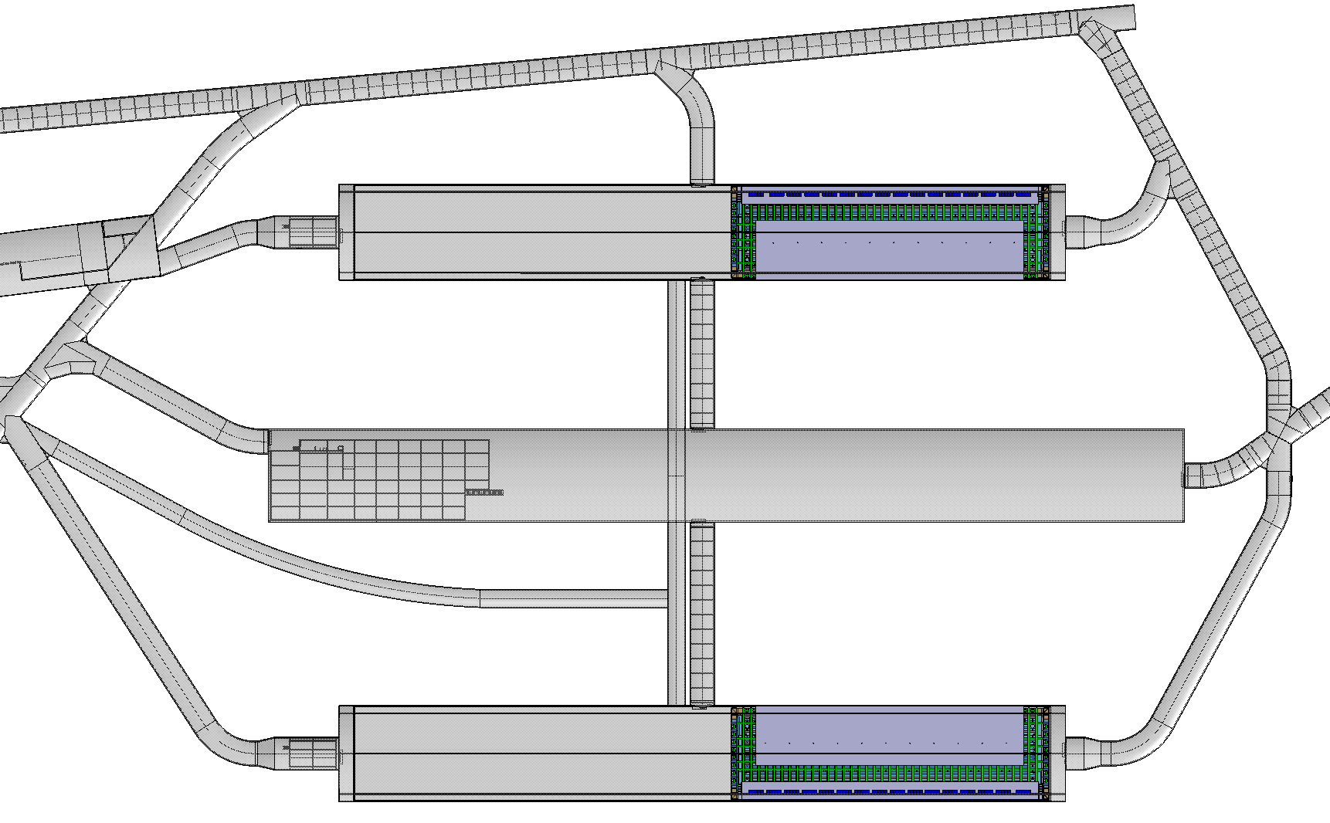
LBNF – Electric power requirements throughout the cryostat construction
Proposed locations
Electric Distribution Boxes (and Compressed Air)
Electric Distribution Boxes (and Compressed Air)

Slide 5
Thank you!

