Slide 1
Sequencing of handoff between FSCF EXC & BSI for Cryostat Installation
Jolie Macier
19 August 2019

Slide 2
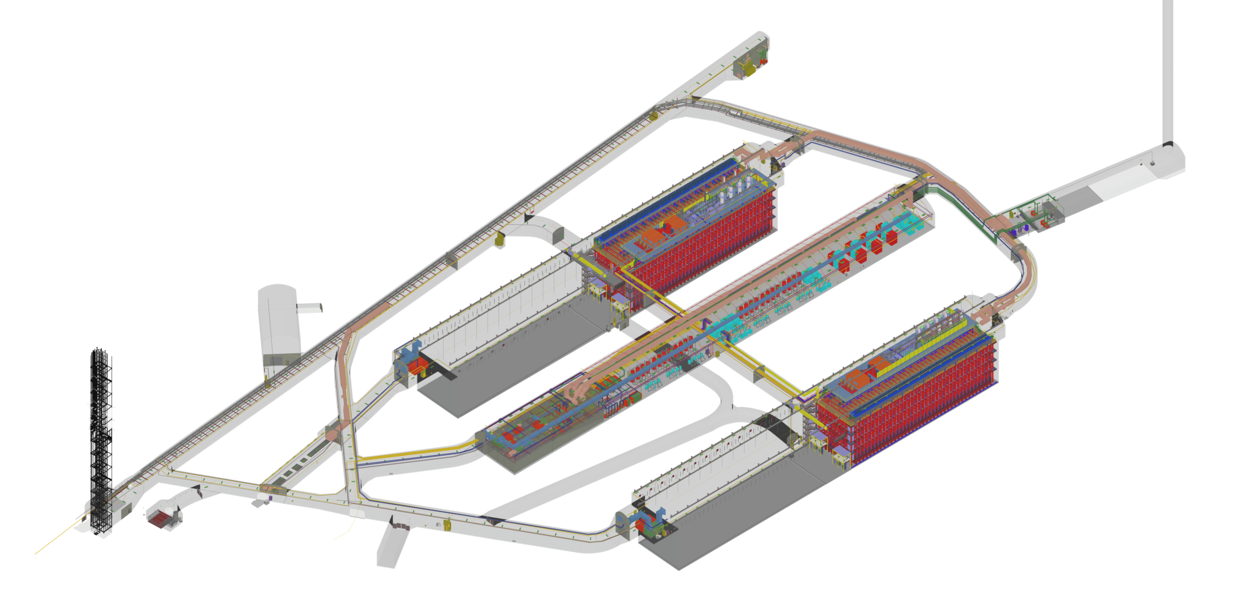
Outline
LBNF FSCF scope
Pre-excavation
Reliability work
Excavation
BSI
Handover to FS Integration team

Slide 3
FSCF Pre-Excavation
Focused on establishing the necessary systems to facilitate major underground excavation.
Includes 28 bid packages, some self-performed by Kiewit Alberici Joint Venture (KAJV), others sub-subcontracted by KAJV.
Ross Shaft & SURF Reliability Projects
Headframe Remediation & Modifications
Tramway Rehabilitation
Ore Pass Refurbishment
Rock Conveyor Supply & Install
New Substation and Site Electrical
Ross Shaft Utilities
Skip Loading System
Crusher Rehabilitation
Excavation

Slide 4
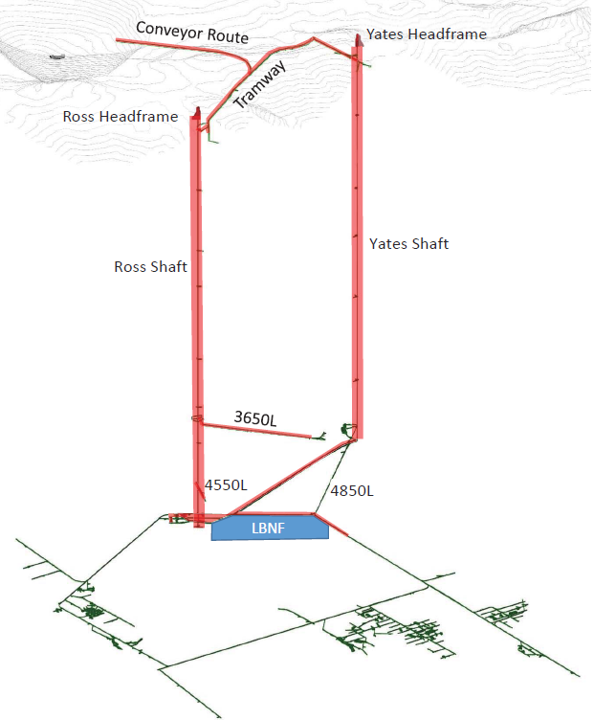
KAJV Self Performed Work
Tramway Rehabilitation
Surface Waste Rock Handling System
Ore Pass Rehabilitation & Reservoir
Ross shaft work at 5000L
Skip Loader & Spill Collection
Sub Anchors & Supports

Slide 5
Pre Excavation – Sub Subcontracted Packages
Site Preparation, Surface Civil, General
Fencing
Environmental Abatement – Monitoring
Environmental Abatement – Execution
Structural Steel
Mechanical - Fire Protection
Electrical Systems
Communication Systems
Crusher System Refurbishment
Hoists & Overhead Cranes
Quality Control Services
Noise and Vibration Monitoring
Survey Services
Pre-Mobilization Survey
Security Services
Temp Craft Sanitary Services
General Dumpster & Trash Services
Snow Removal
Work
Service

Slide 6
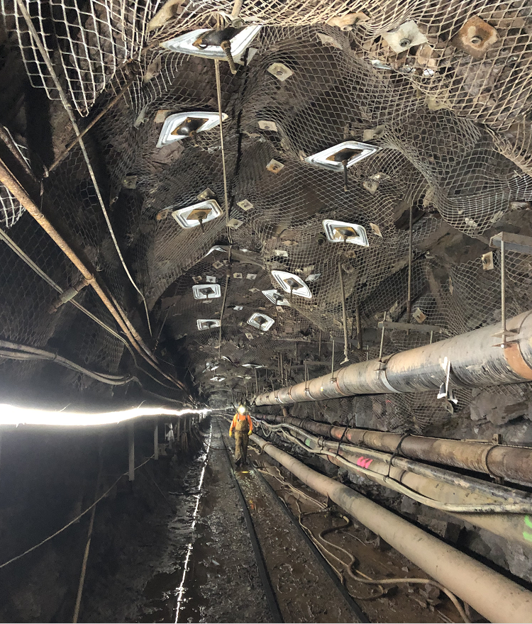
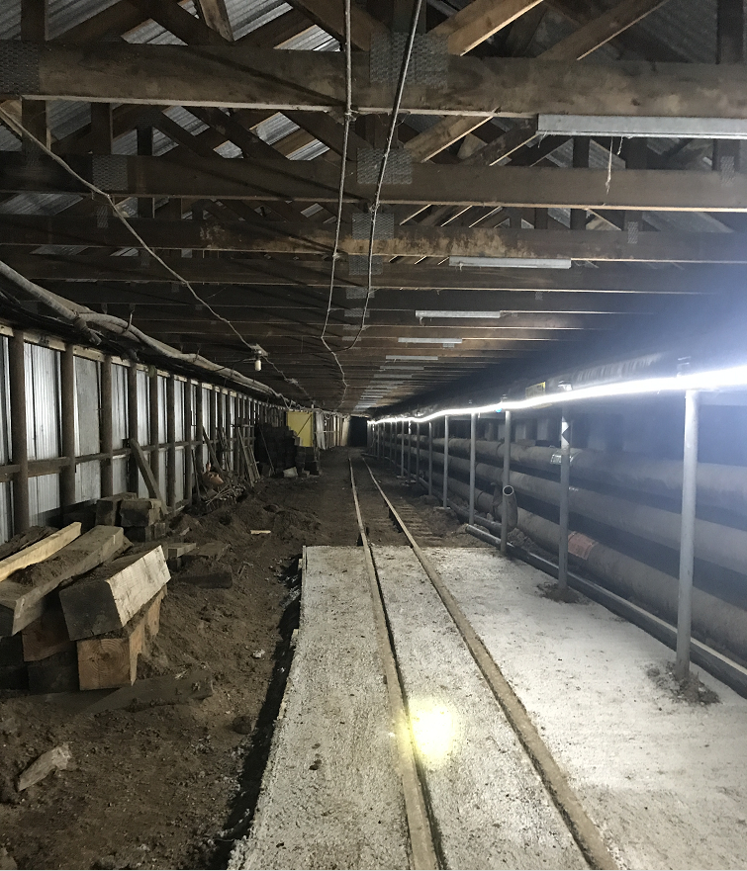
FSCF Pre-Excavation Construction
Tramway & Snowshed Progress (for proposed conveyor)

Slide 7
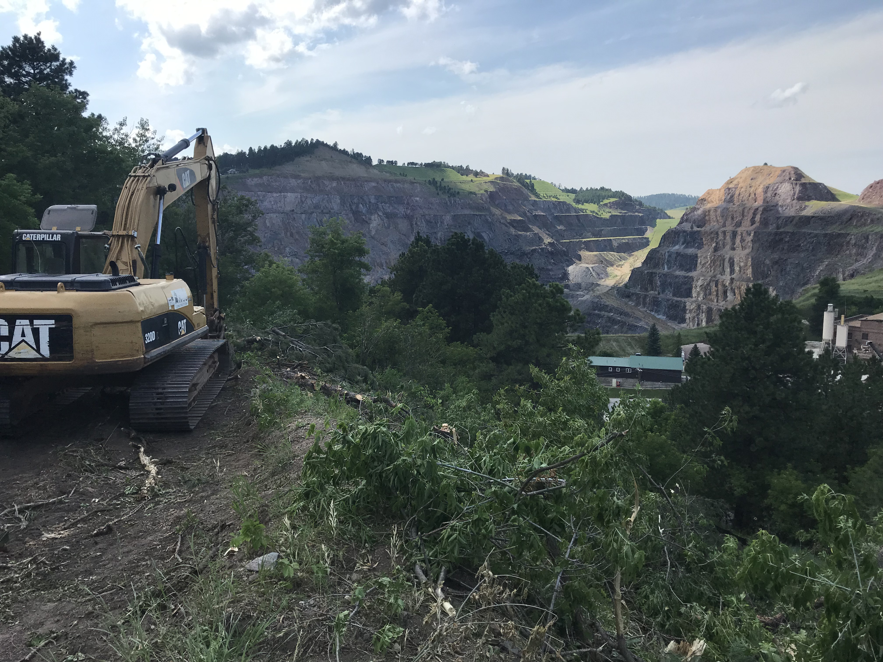
FSCF Pre-Excavation Construction
Site Clearing for Conveyor

Slide 8
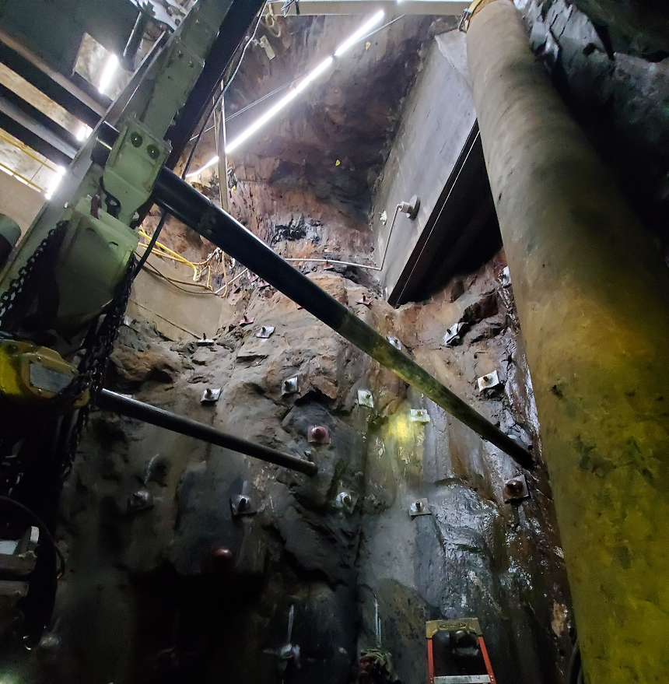
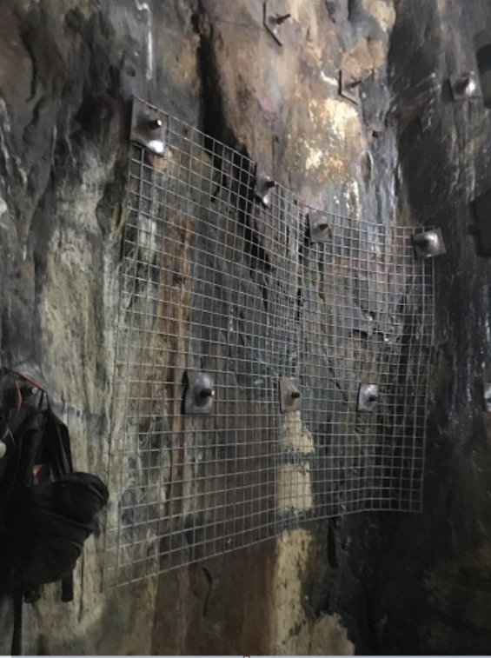
FSCF Pre-Excavation Construction
Ore Pass Progress (about 50' down, 45% Complete)

Slide 9
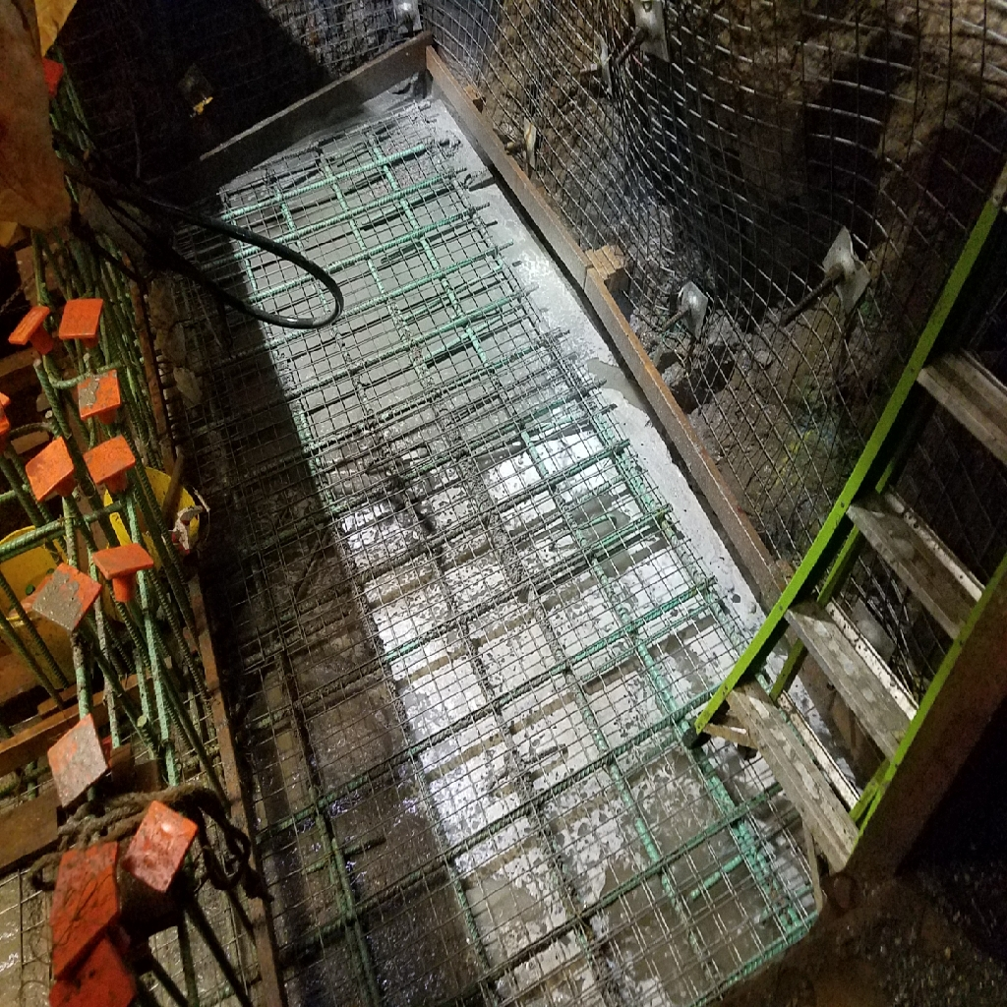
FSCF Pre-Excavation Construction
5000L Progress, reinforced sump slab

Slide 10
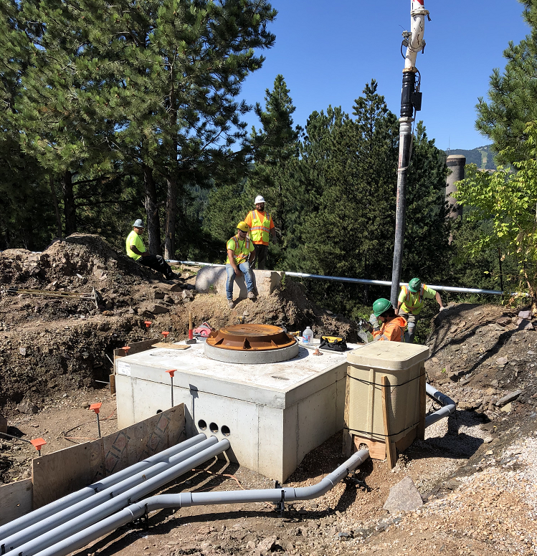
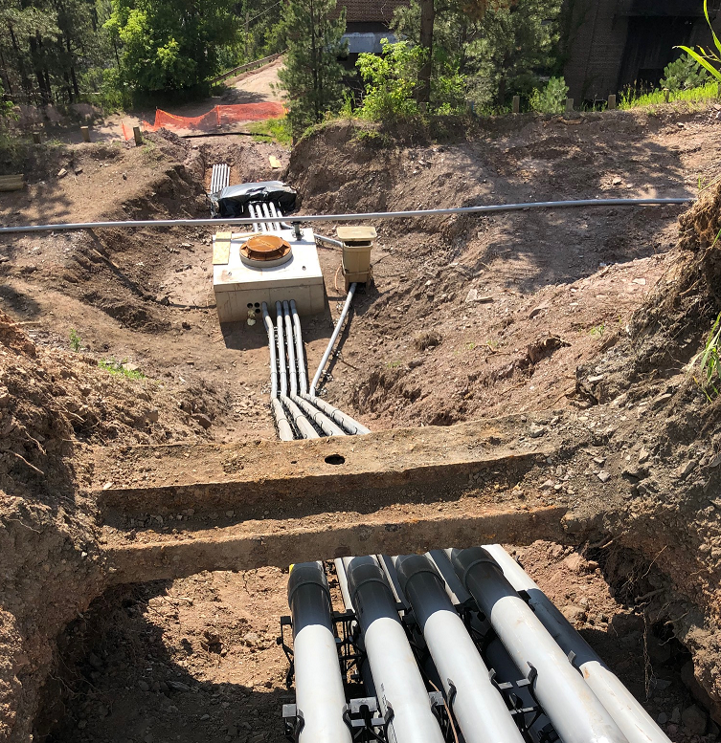
FSCF Pre-Excavation Construction
Electrical Infrastructure @ Surface

Slide 11
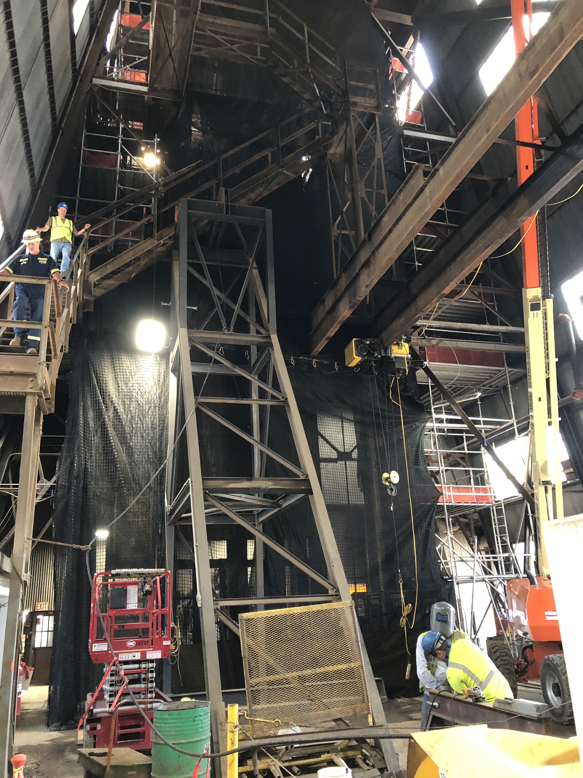
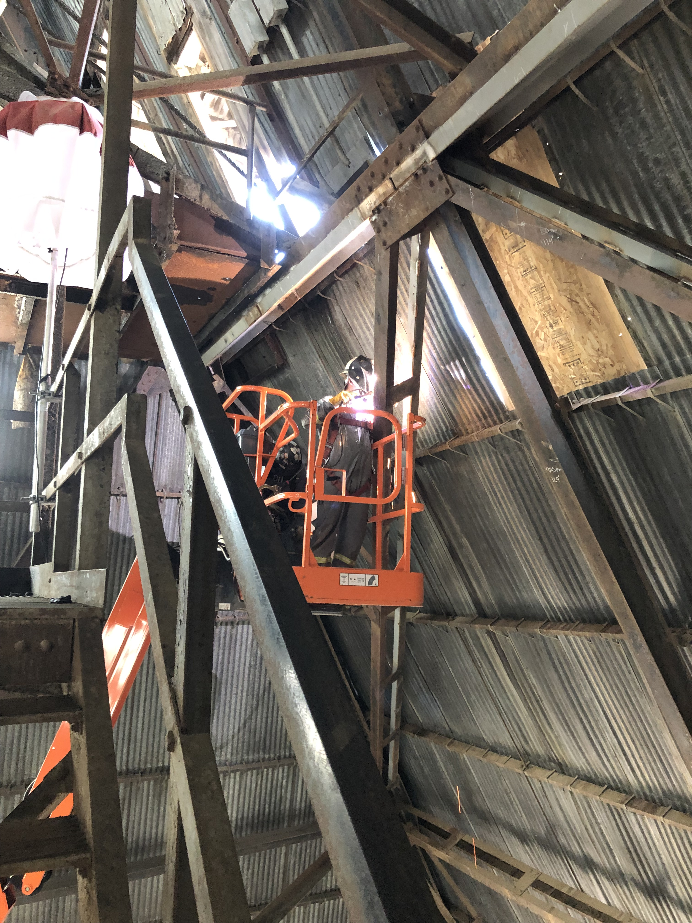
FSCF Pre-Excavation Construction
Ross Headframe Reinforcement

Slide 12
FSCF Pre-Excavation Construction Crushers

Slide 13
KAJV CPM, Update thru August 1, 2019

Slide 14
FSCF - Reliability Projects
Ross Shaft Rehabilitation
Ross Cage is 100% designed, to be delivered in October 2019
Ross Skips are fabricated, delivery in August 2019
Oro Hondo Fan VFD, demo completed, new VFD installed in August, to be completed and commissioned by October 2019
Ross Hoist Drives, Brakes, and Clutches, preliminary design to be completed in August
Refuge Chamber materials delivered in August, to be completed by September 2019
Ross Hoist Bearings and Bushings, Fusion Babbitting work on first set
Ross Hoist motor rebuild has been advertised, proposals due end of August

Slide 15
FSCF – Excavation
Status
Subcontracting for EXC underway
Pre-solicitation advertised in August
Site Visit on September 10, 2019
Bids due January 2020
Scope
As shown in 100% EXC drawings and specifications
Sequence
To be determined by successful bidder
Award criteria weighted by quickest schedule

Slide 16
Handoff to FS Integration
Minimum BSI requirements
North Cavern floor complete & crane rail installed
Temporary services:
Lighting
Ventilation
Power
First activities
Floor survey & leveling
Crane installation
Move steel for cryostat floor first
Shared occupancy for cryostat installation
Need fire protection provisions for cold membrane storage underground
Need final ventilation for cold membrane installation

Slide 17
Summary
FSCF work continues on all fronts: pre-excavation, reliability work, 1B->1A Early Works Packages
NOC 40: Blast Doors, 4700L Ventilation Fan, Borehole Grouting
NOC 50: 3650L Rehabilitation for Raise Bore Early Mobilization
NOC 51: 4850L Advance Drift to Spray Chamber
Subcontracting for EXC underway
FSCF goal to turn-over North Cavern first

