Slide 1
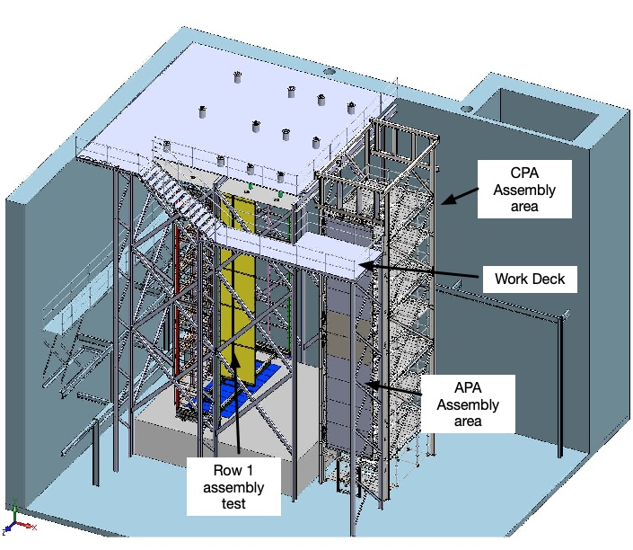
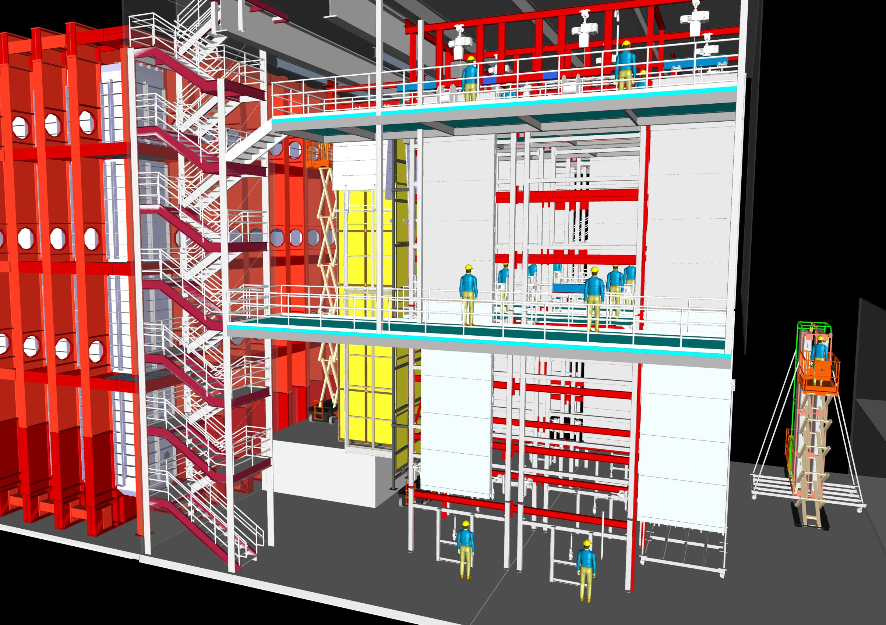
Status of DUNE Trial Assembly-Ash River
APA Assembly Tower and Cryostat DSS structure at AR
APA Assembly Tower and Cryostat DSS structure at DUNE

Slide 3
DUNE Installation Prototyping at AR
Draft AR Installation Prototyping requirements document on EDMS 2169069
After discussions the last week it appears best to combine phase 2 and 3 into one bid package to minimize design, fabrication and installation costs
Document also includes ProtoDUNE trial assembly work
FD-SP Installation Prototyping Goals
The goals for the DUNE SP-FD installation prototyping program are as follows:
Test each of the detector installation steps with full scale mechanical mockups based on the detector components final design.
  Verify the component interfaces are accurate and well understood and that the detector can be assembled.
  Verify the proposed installation tooling is adequate and re-design where needed.
  Propose design revisions to the detector components where needed.
Draft assembly procedure documents for all the installation work.
Archive a complete set of component documentation for the mockup tests.
Write full set of Hazard analyses for the installation process and identify points where risk mitigation would be beneficial to reduce the risks.
Test proposed access equipment (scaffold, scissor lifts, work platforms) and lifting fixtures.
Perform assembly time and motion studies including labor estimates which will be used to develop the schedule.
Train the installation crew prior to start of work underground.

Slide 4
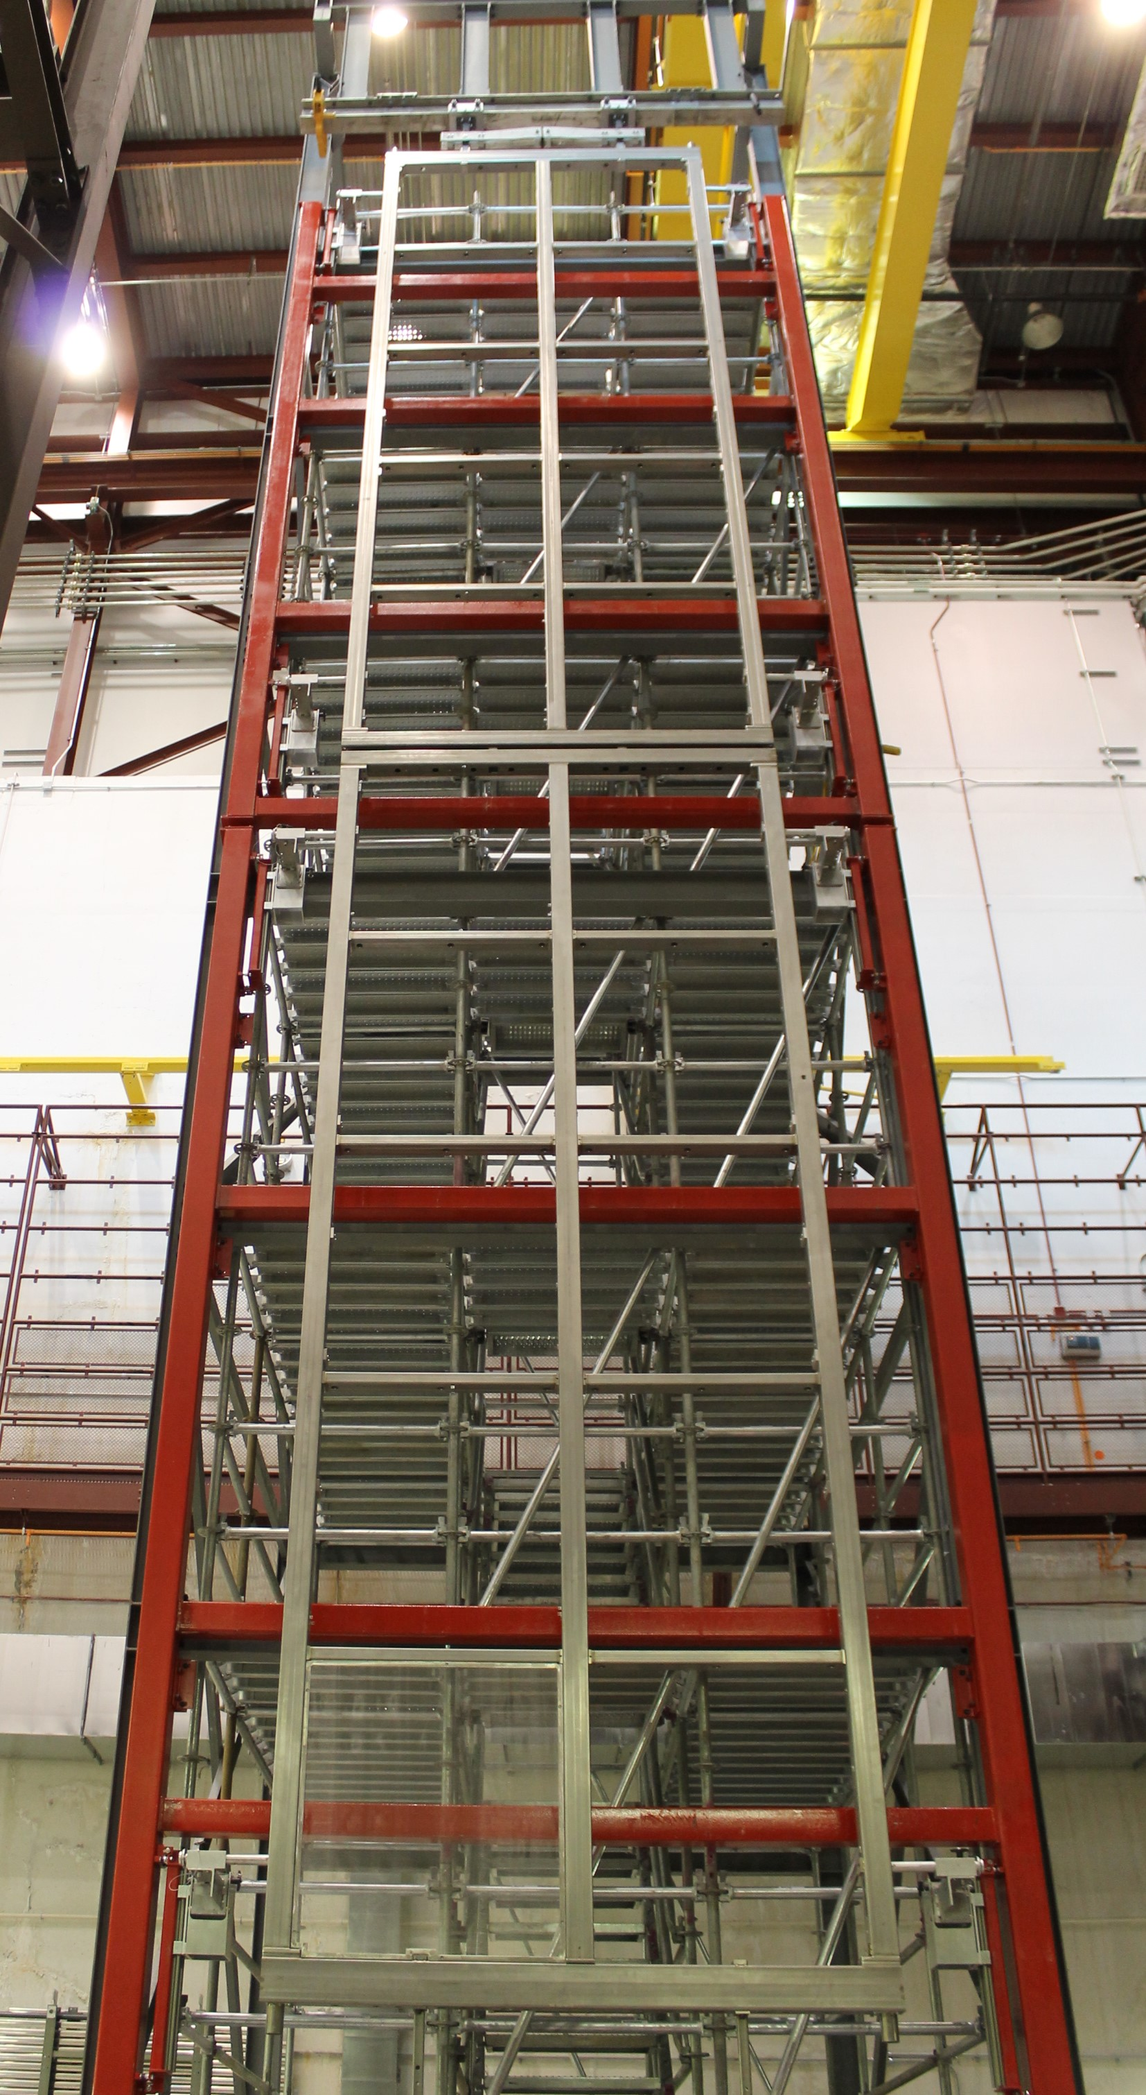
Phase 1
Completed APA First Doublet!
16 August, 2019
APA Assembly Tower is completed first APA doublet is hanging
Next 6 weeks
  Complete preliminary assembly of first doublet to confirm that everything functions as designed
  Update and post all documentation
  Make cable bundles for cable tests
Week of 30 Sept. APA doublet workshop at Ash River
  Demonstrate procedures to DUNE ES&H, UMD ES&H and QA teams, review documentation
  Receive Occupational Readiness Clearance

Slide 5
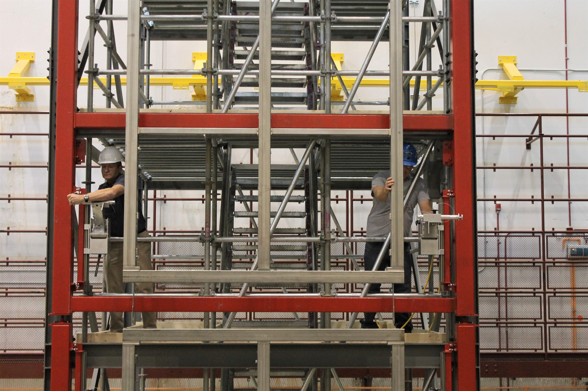
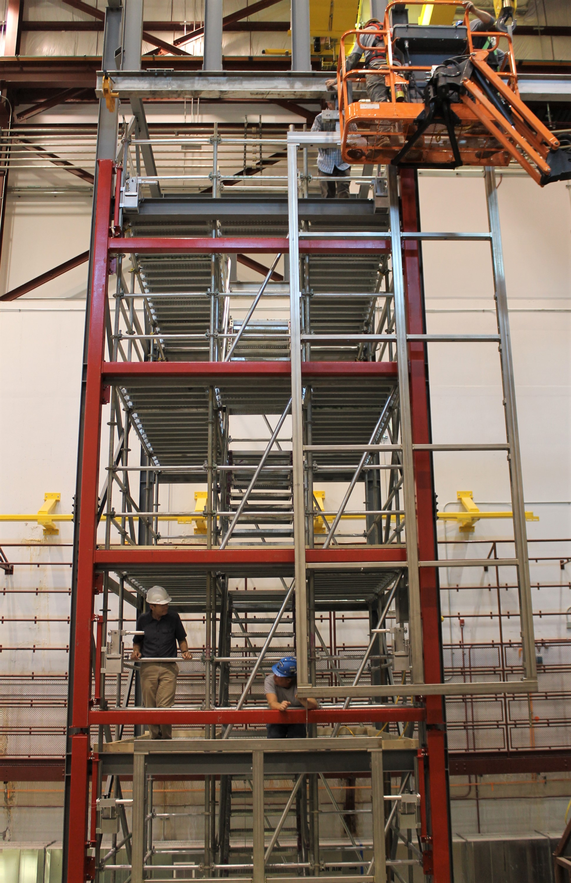
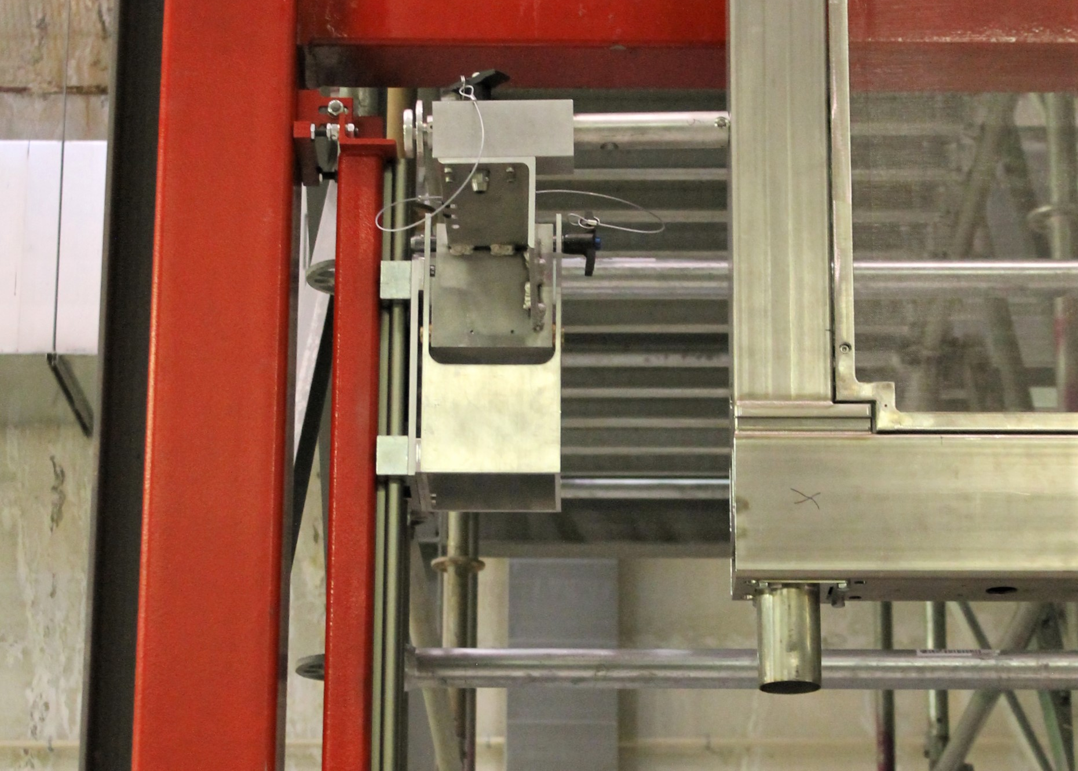
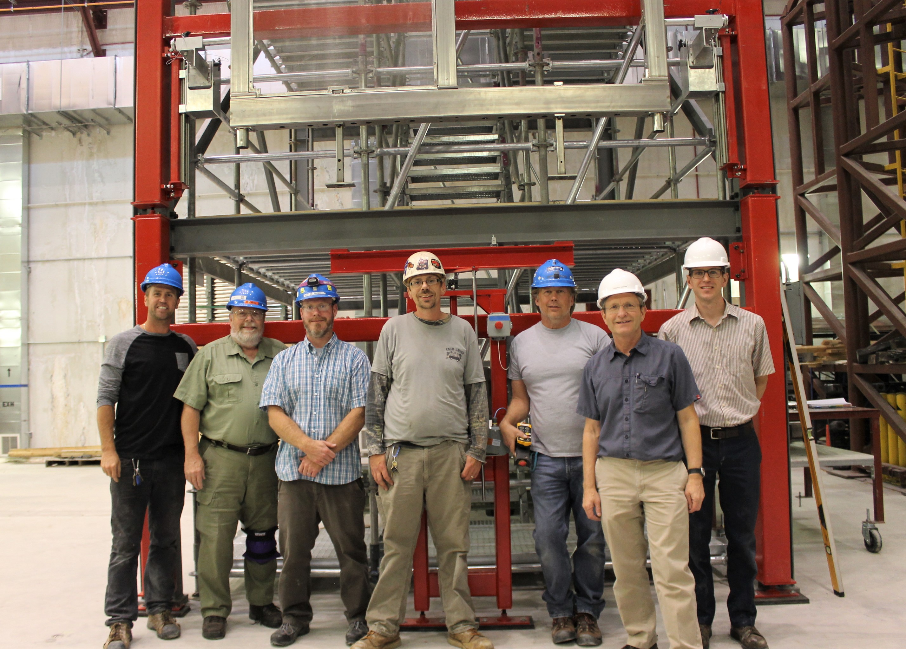
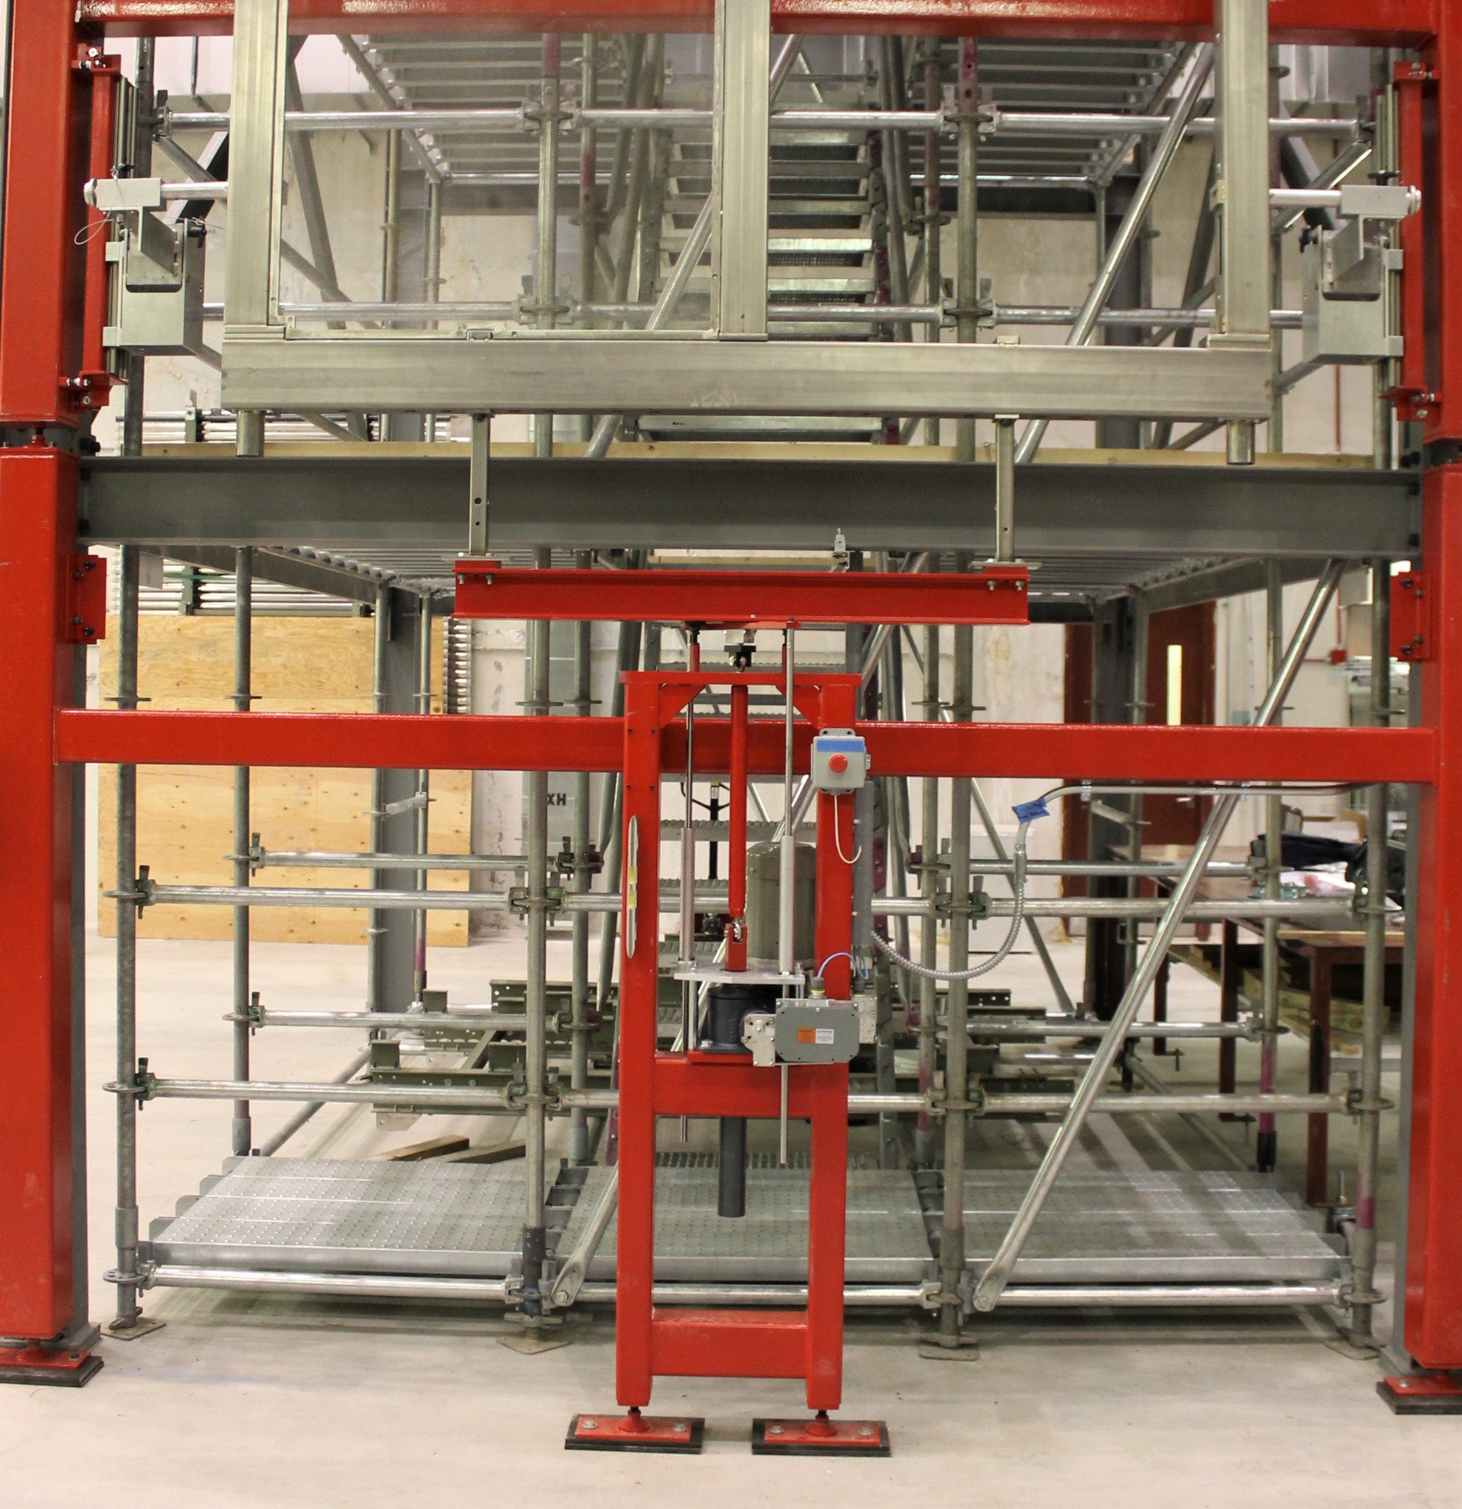
More pictures

Slide 6
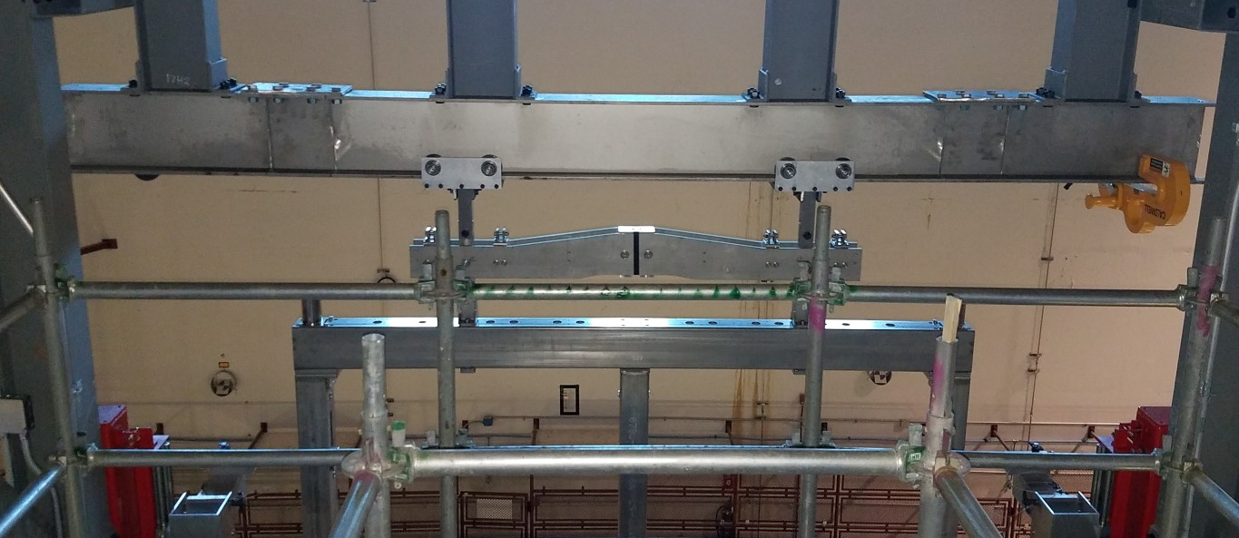
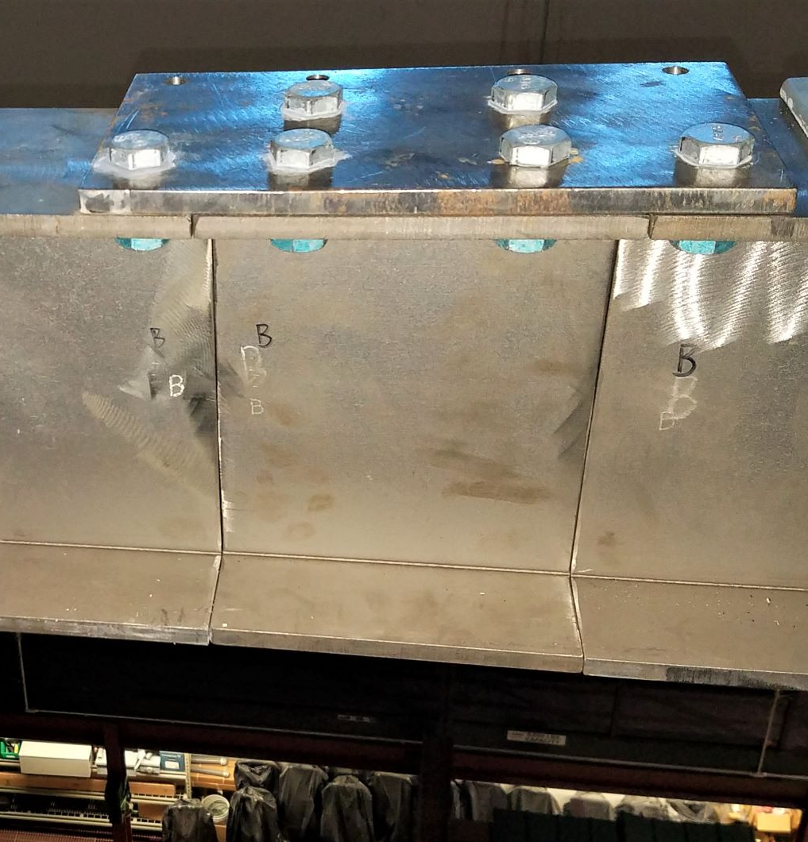
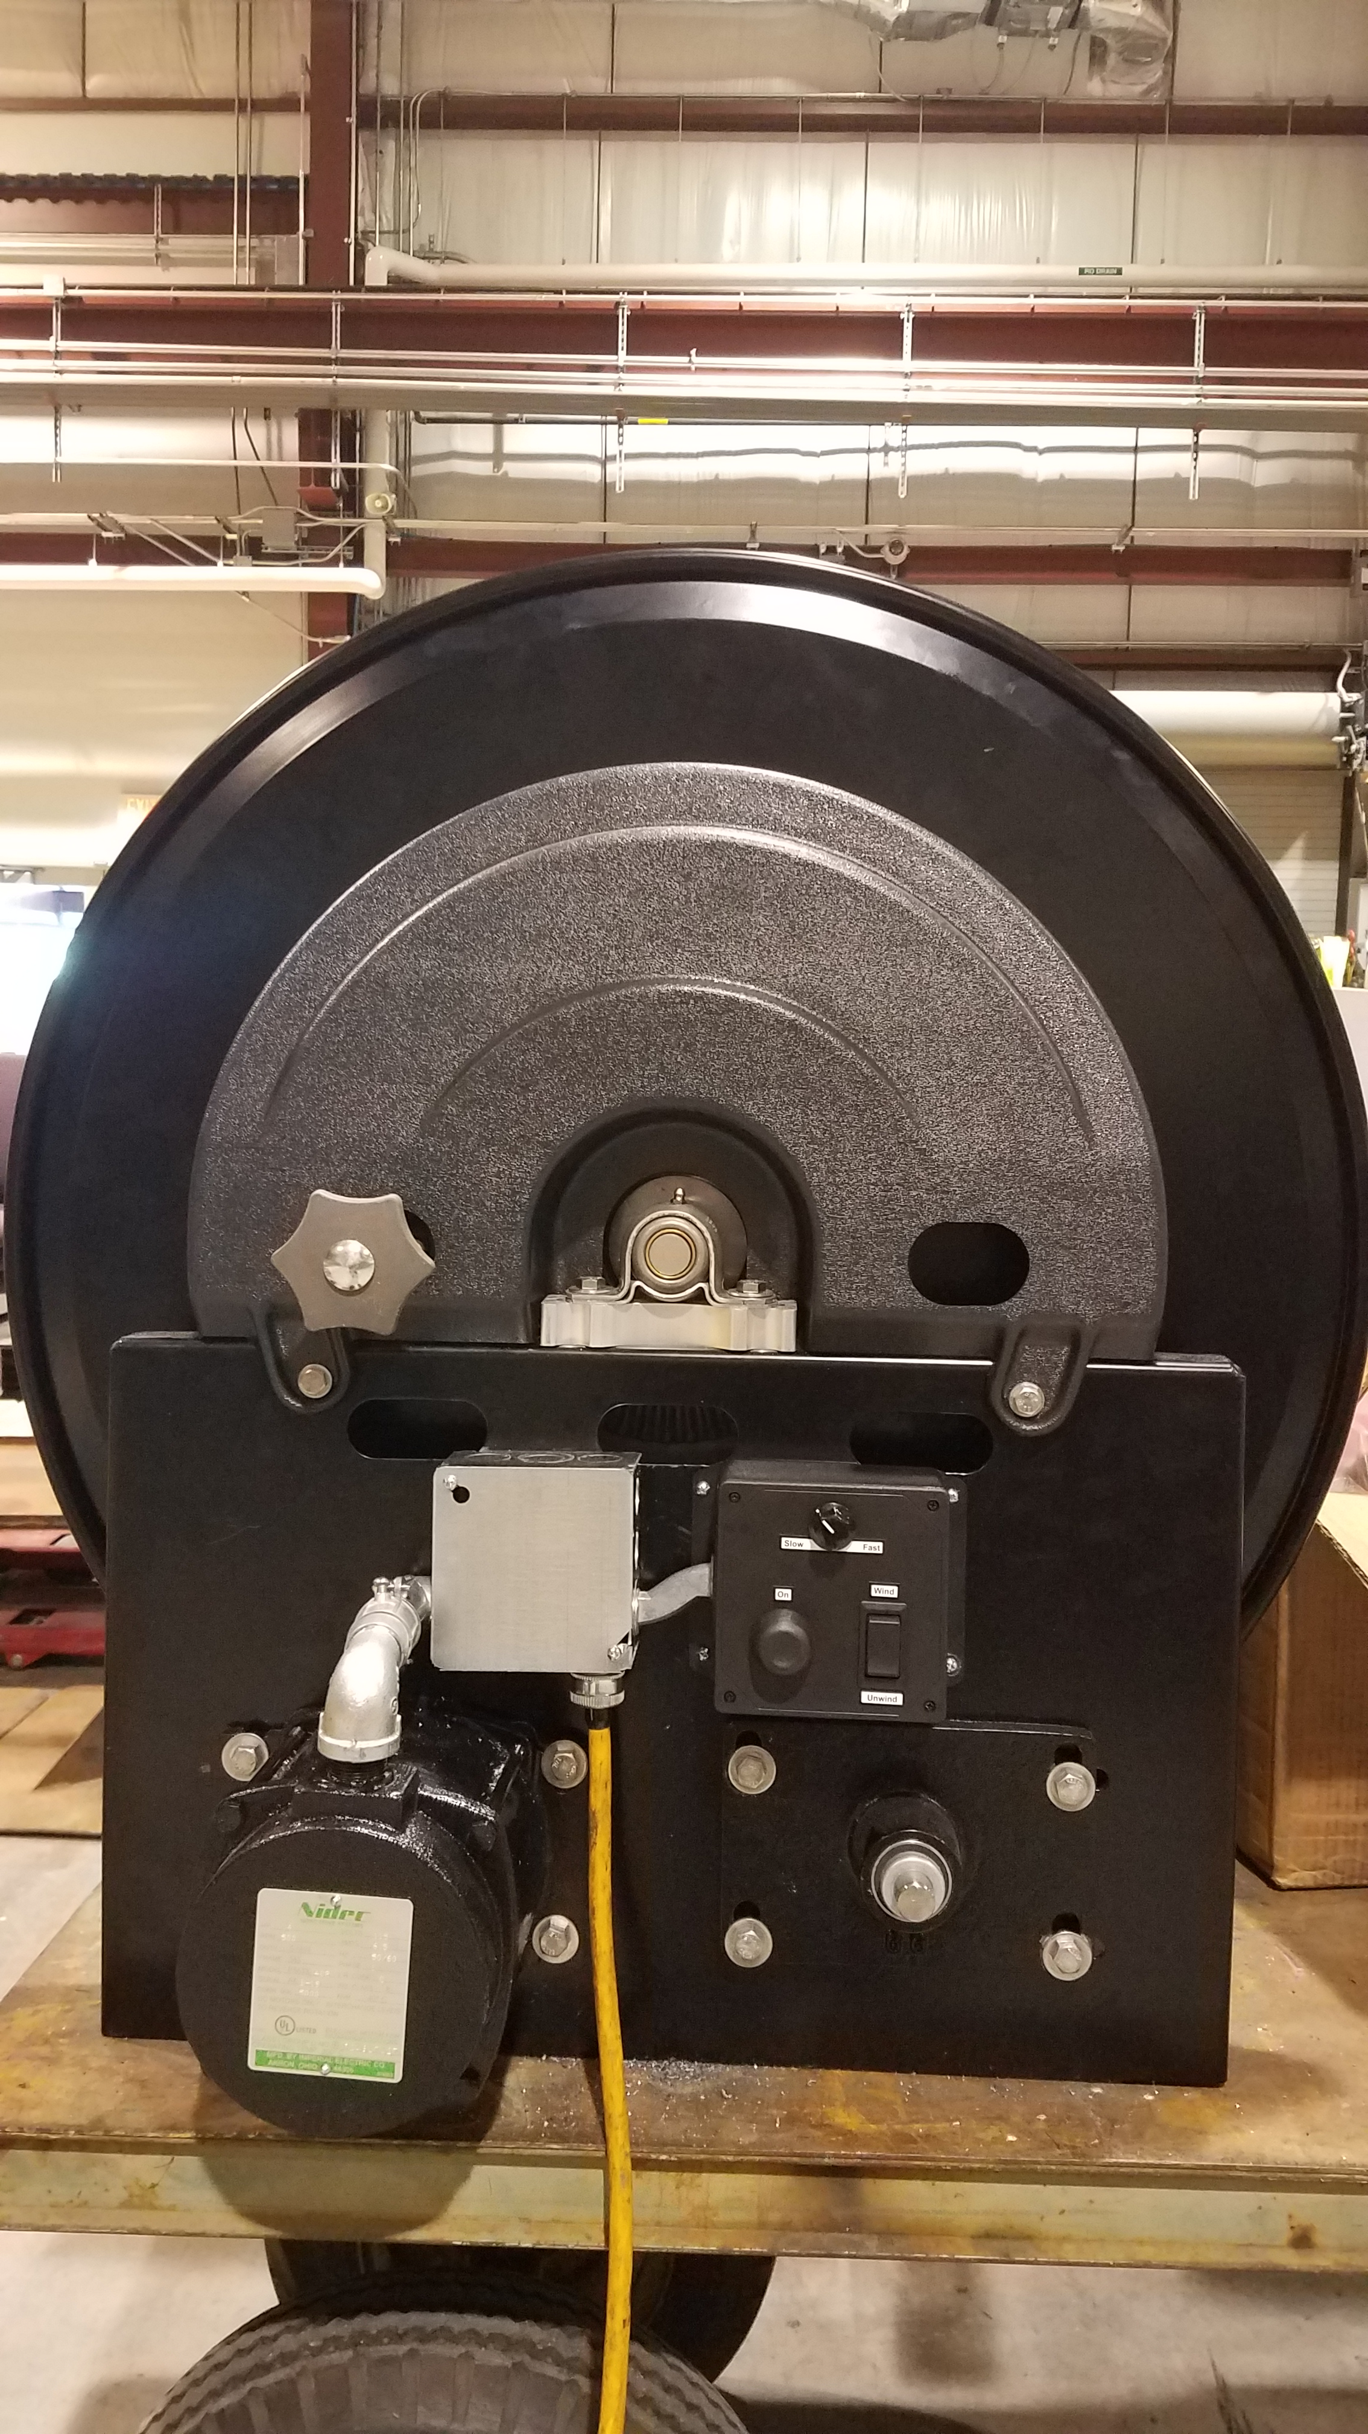
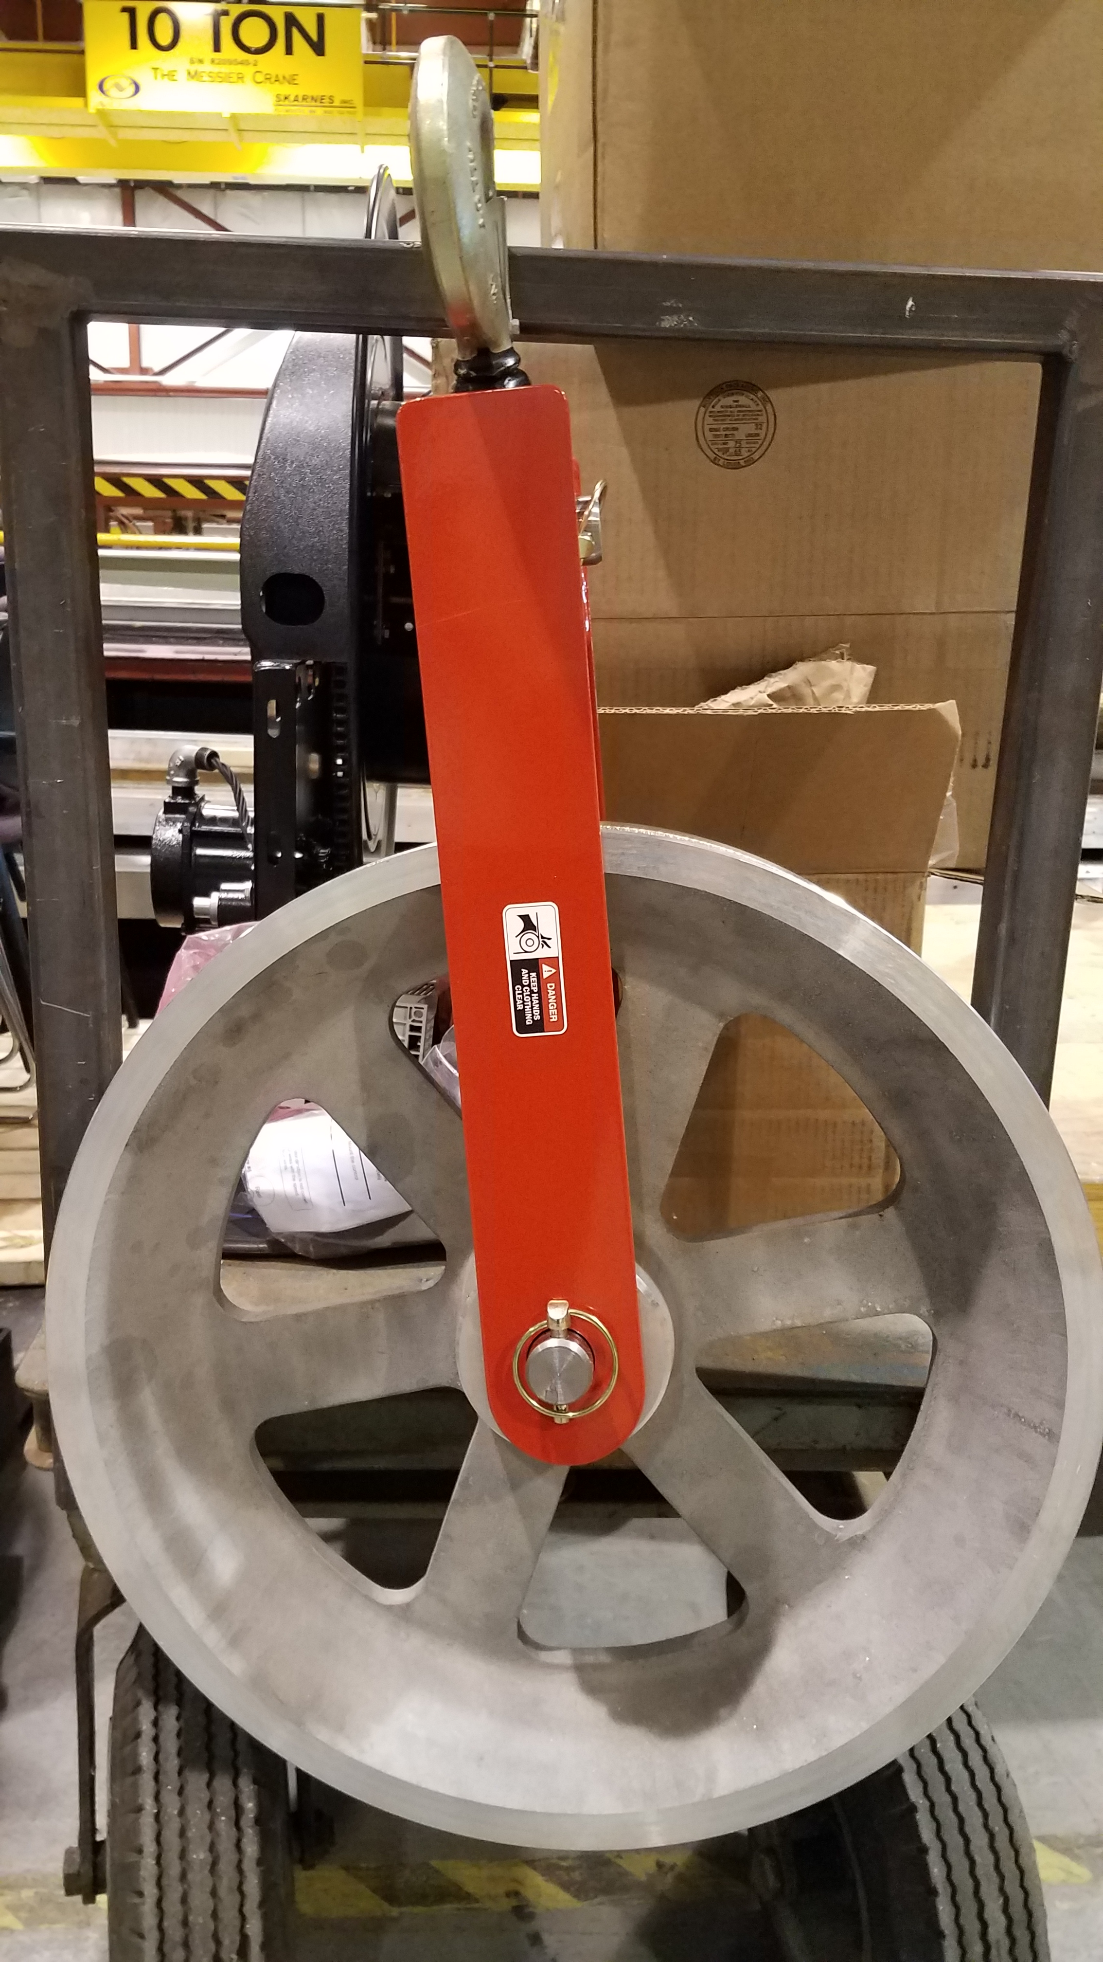
Phase 1
Continue refining procedures, take APAs apart, remove and replace several times
Begin Cable testing in slotted conduit
Install cable trays, begin cable management, test of mechanical cable spool
First time and motion studies and labor requirements
Test trolley movement
Modify lifting fixture documentation and beam to handle load of Doublet (load test to 5030 lbs)
Segmented beam to allow cable bundle installation
Segmented Beam section

Slide 7
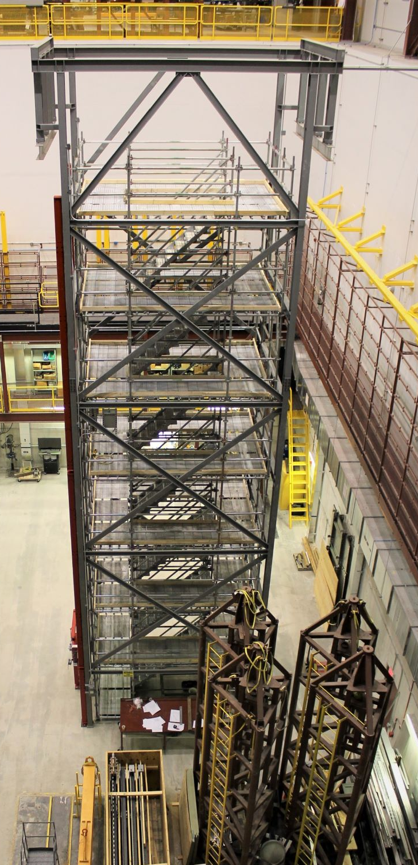
Phase 1-HV Status of CPA assembly frame
Moved current location on end of Tower to south side. This allows us to lift a completed CPA to the East side where the two can be joined together
Kyle has the load information to write a short engineering note about the load on the South side
Need to work with Vic to update drawings to mount to the new location-Distance from tower needs to be reduced and brackets align to different beams
Drawings need to be reviewed and I can put the CPA frame out for bids.
I am assuming that all clamping fixtures will be supplied by ANL

Slide 8
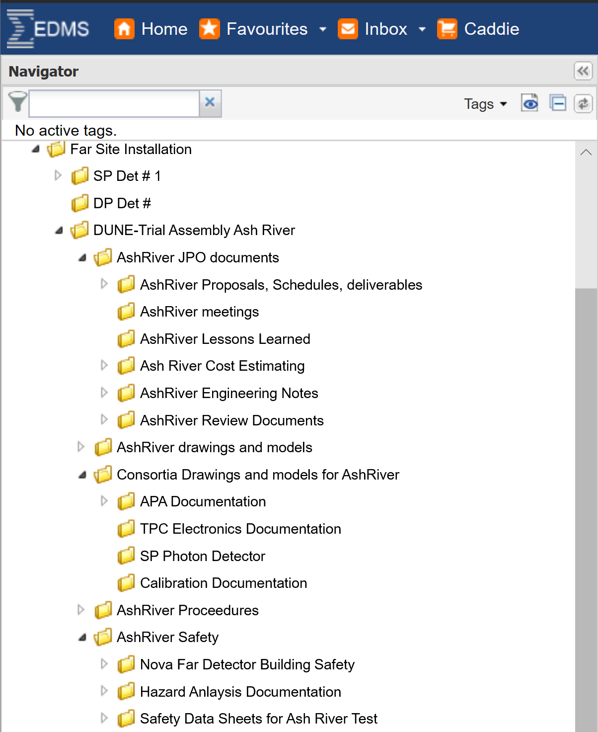
Ash River Documentation
After a series of useful meetings at Fermilab with TC and ES&H management we have agreed on the following for Ash River
Engineer reviews of all design, drawings and engineer notes will continue to be guided by the Lead Mechanical and Electrical Engineers for approval.
Procedures and Hazard Analyses will be reviewed by the University of Minnesota ES&H
Everything will be posted on EDMS
A formal header page will be approved for sign-offs and updated as any changes occur during the R&D process
It needs a little better organization but it is a good start

Slide 9
Documents-APA Assembly Tower

Slide 10
Documents-APA Pair Materials Handling

Slide 11
Phase 2
  Had initial meeting with Kevin Kalio from Barr Engineering to begin design/build documentation for next phase. This will be a several step process:
Develop criteria
  Location and elevation of DSS and shuttle beam. Lower DSS to eliminate the subfloor on the bottom and adjust top floor to top cryostat skin
  Define feed-thrus required- DSS, Manhole, HV, monitor ports, calibration
  Define loads on DSS and grated floor
  Goal is to have bid package reviewed and out on the street by the late Nov/Dec
  Fabrication/Installation completed March/April

Slide 12
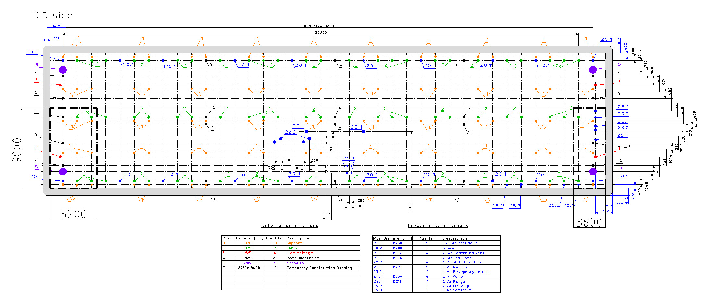
Single Phase Detector 1 mock cryostat at Ash River
  SW cryostat corner merged with SE cryostat corner (bold dashed lines), full height
  Penetrations to include for Ash River tests: support, cable, high voltage, instrumentation inside of bold dashed lines
    Are there others?

Slide 14
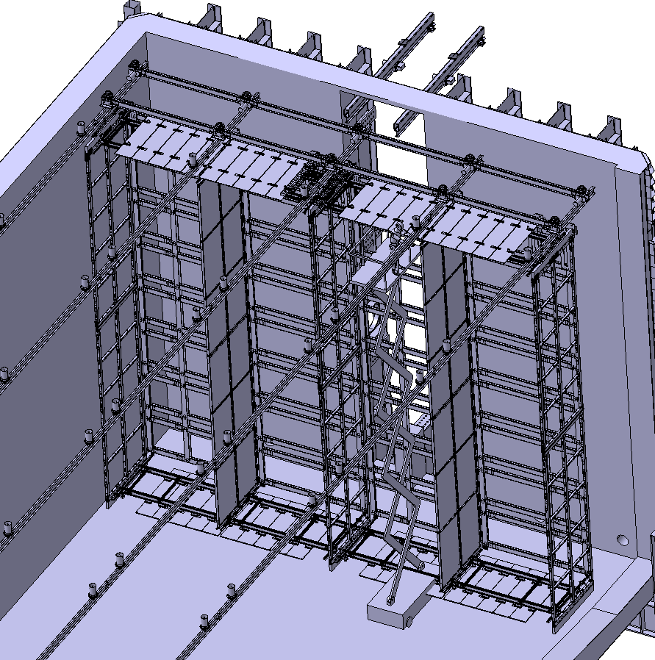
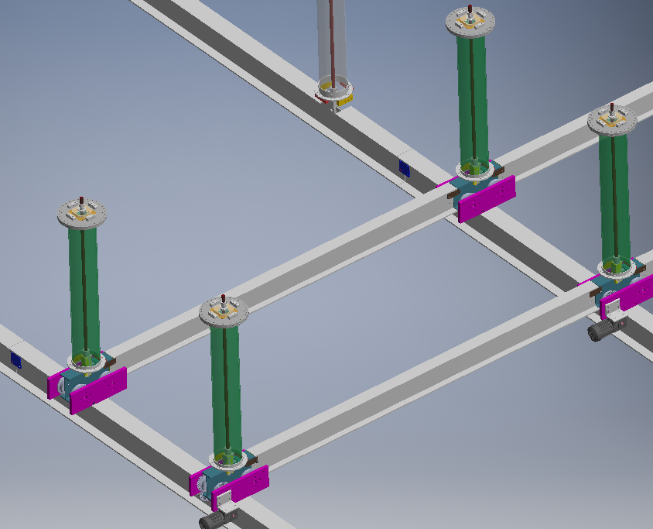
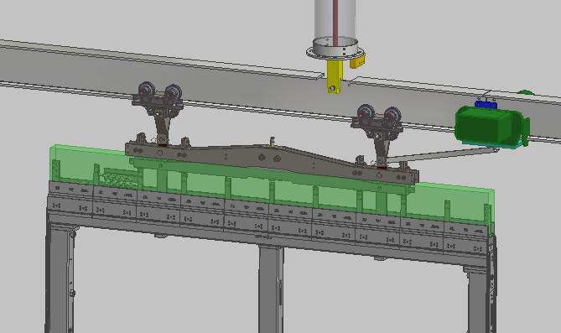
Phase 2 DSS Shuttle
Build DSS shuttle and DSS beams
  Test how it is powered for movement
  Test beam connections and access to them
  Do we want to test DSS installation procedures?
Test how APA pair and CPA components move
1
2
DSS Shuttle Beams
DSS Feed-thru

Slide 15
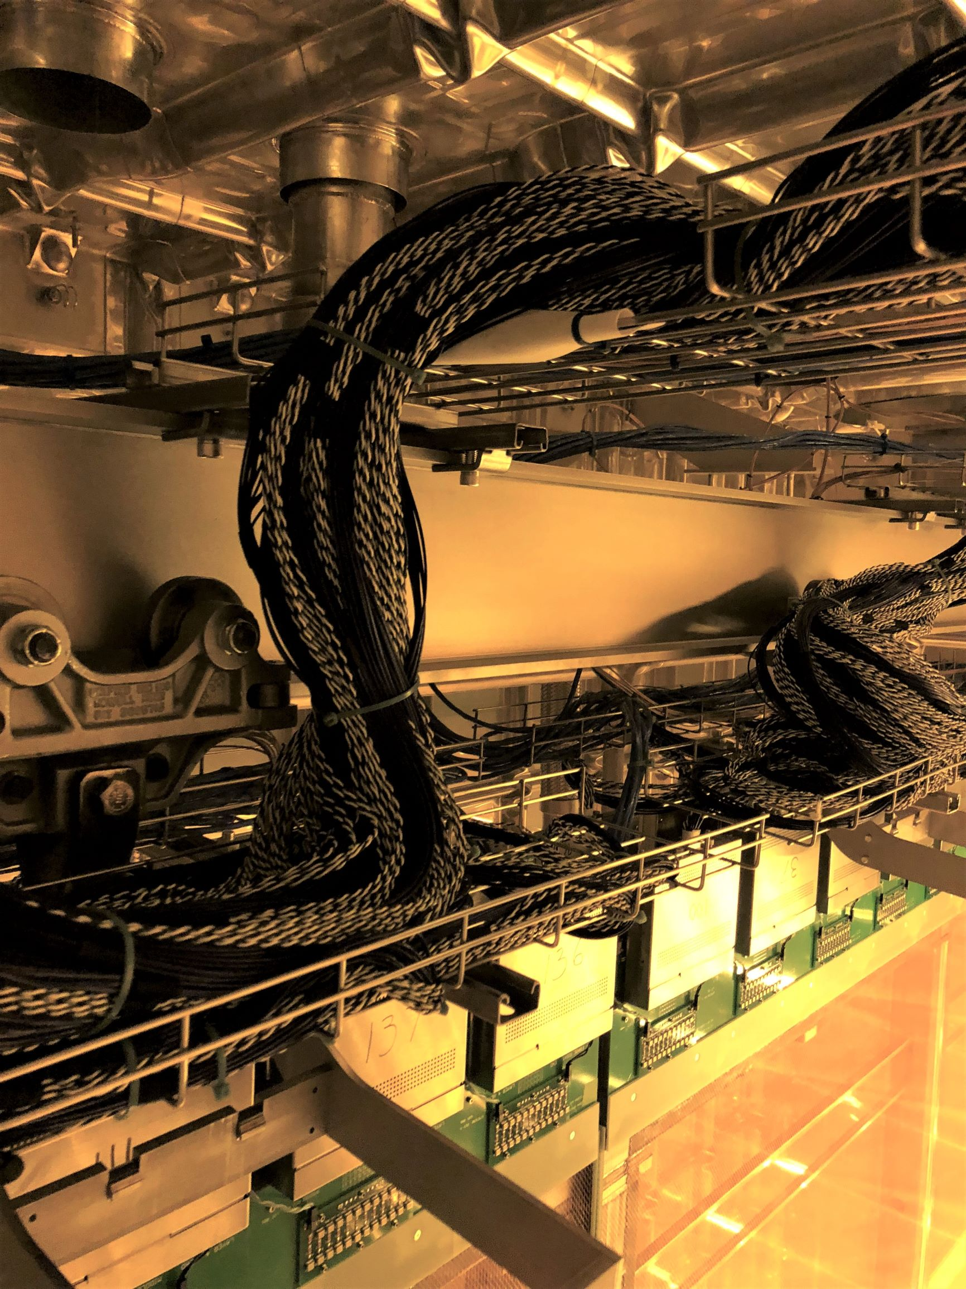
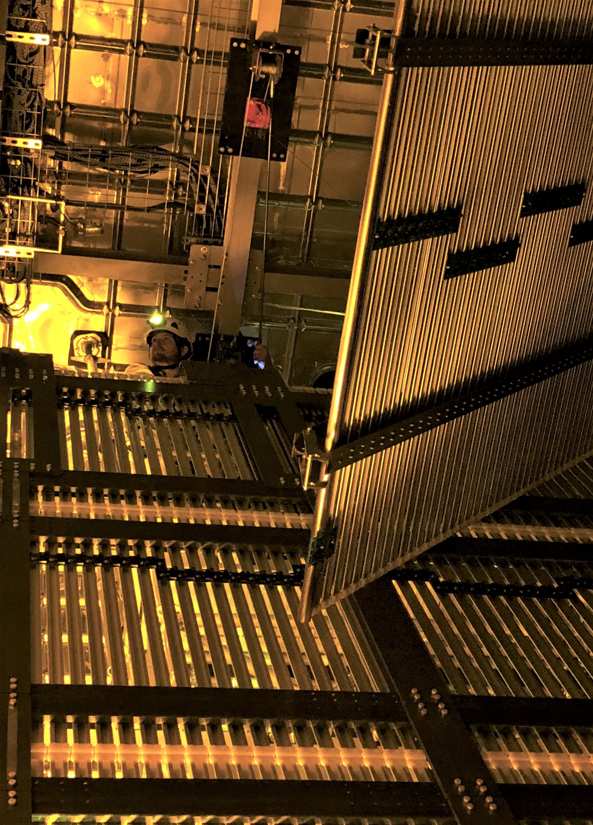
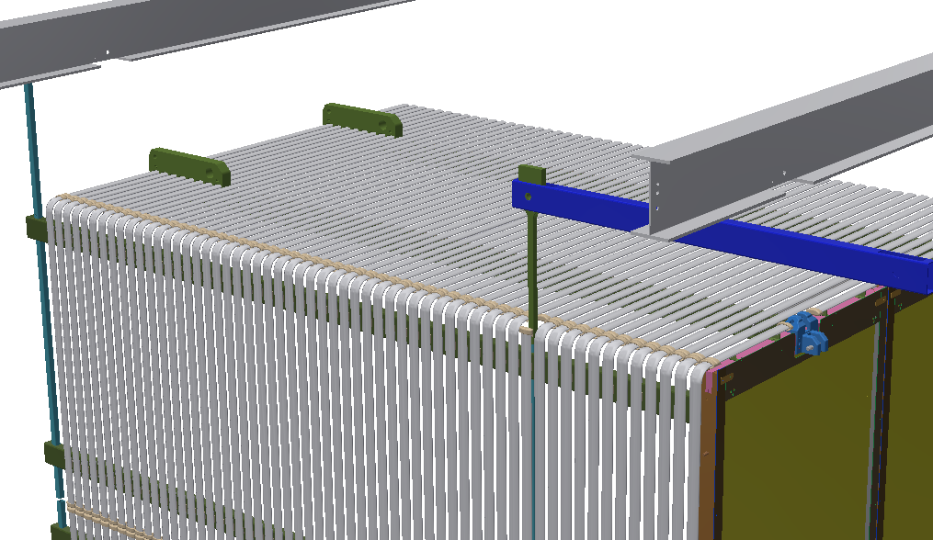
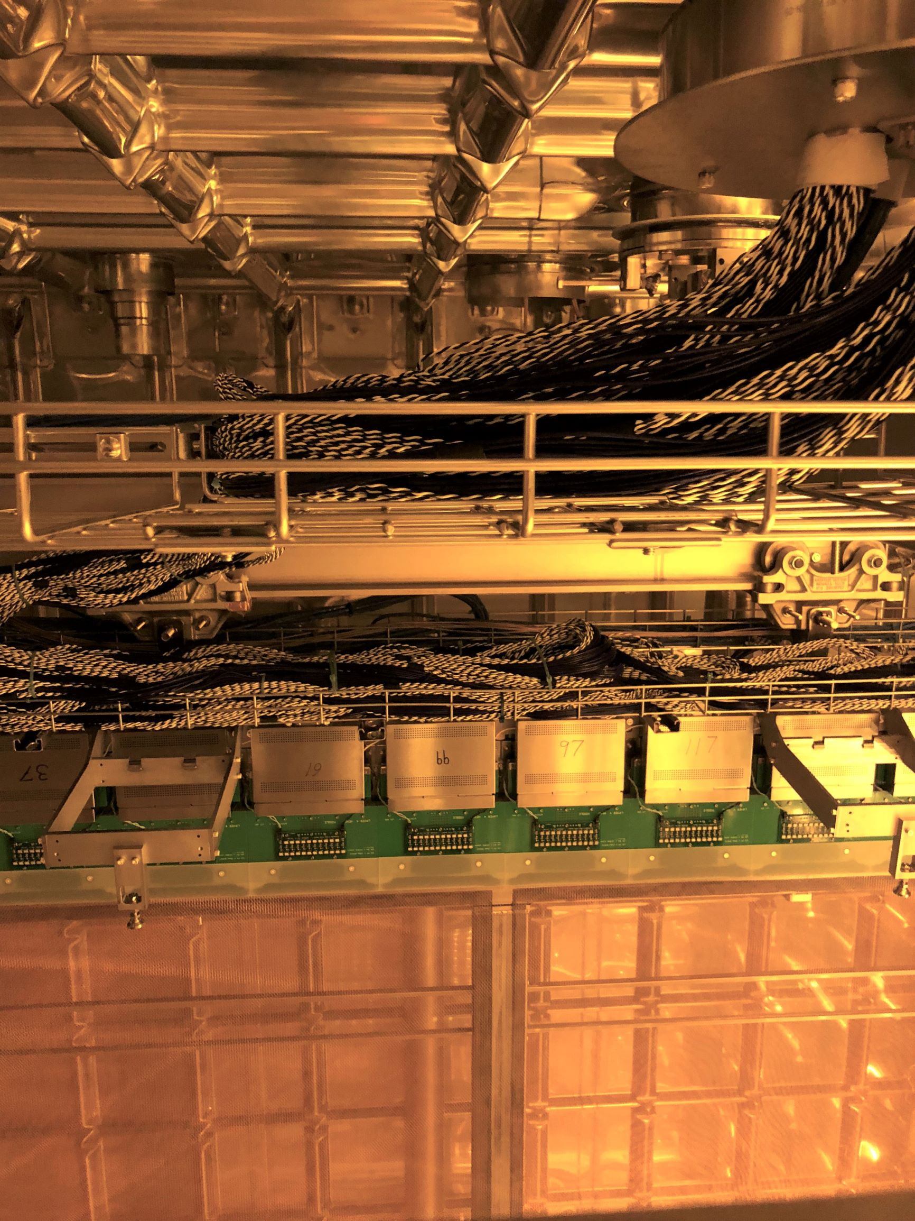
Phase 2 TPC Component Deployment
End Walls, Field cages, ground plane designs have all changed PLUS it is now 12m high making access more difficult
We need to understand how they interact with the APA
1
2
New HV Design
Row 1
Row 25

Slide 16
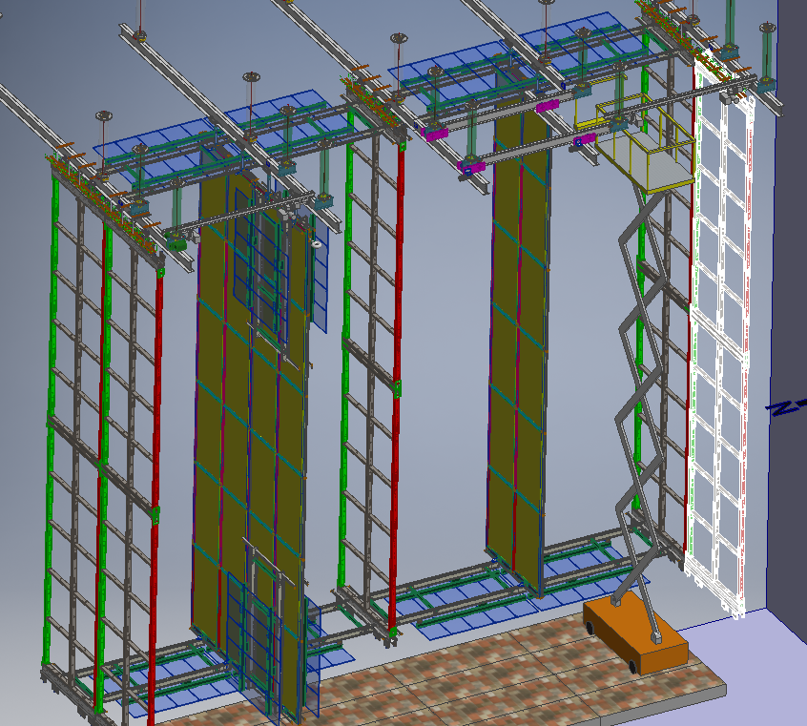
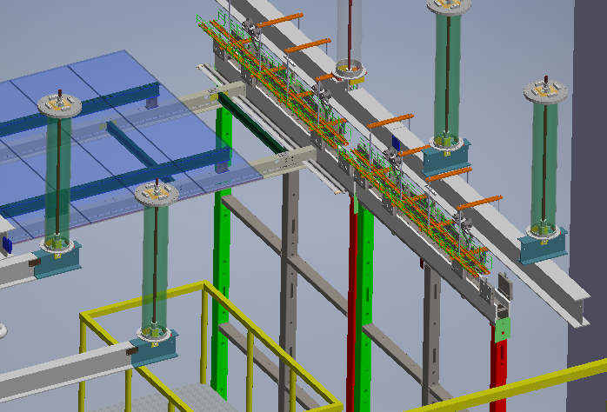
Phase 2 Closing the TCO
Placing the 25th row of TPC components and removing the runway beams while leaving enough room for closing the TCO (Temporary Construction Opening) will be difficult and needs to be tested
Shuttle Beam is then Permanently Mounted
Runway Beams are Removed

Slide 17
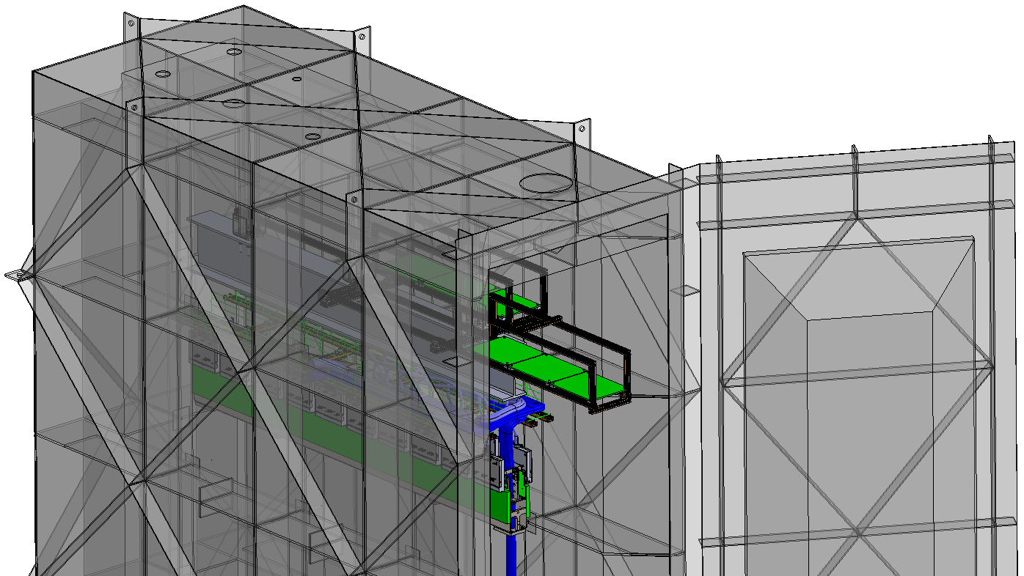
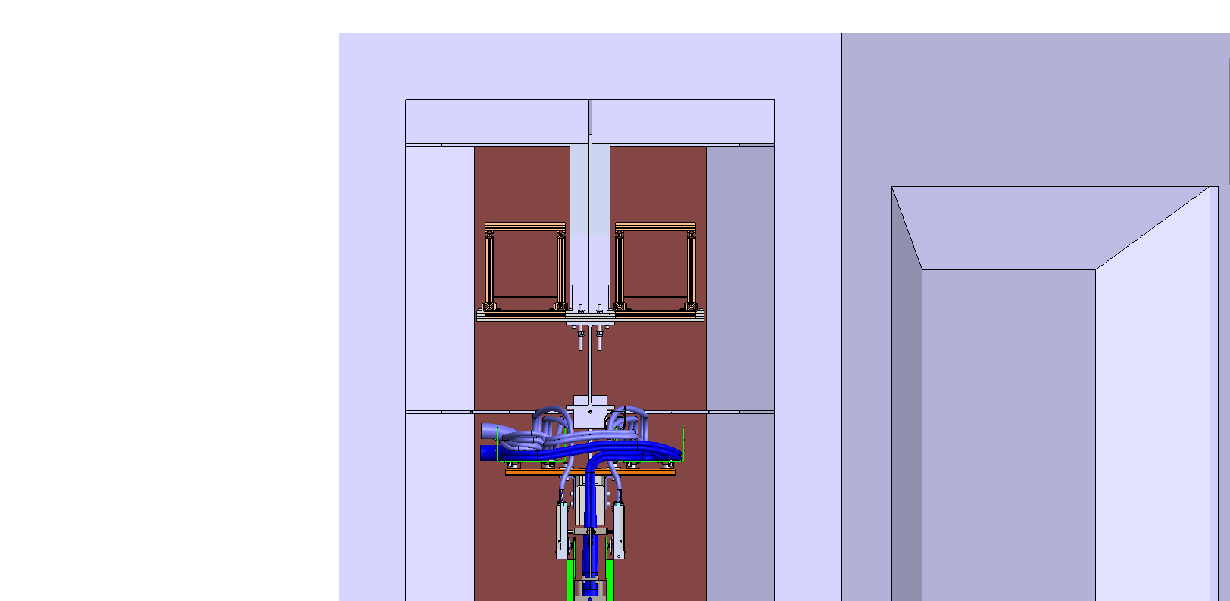
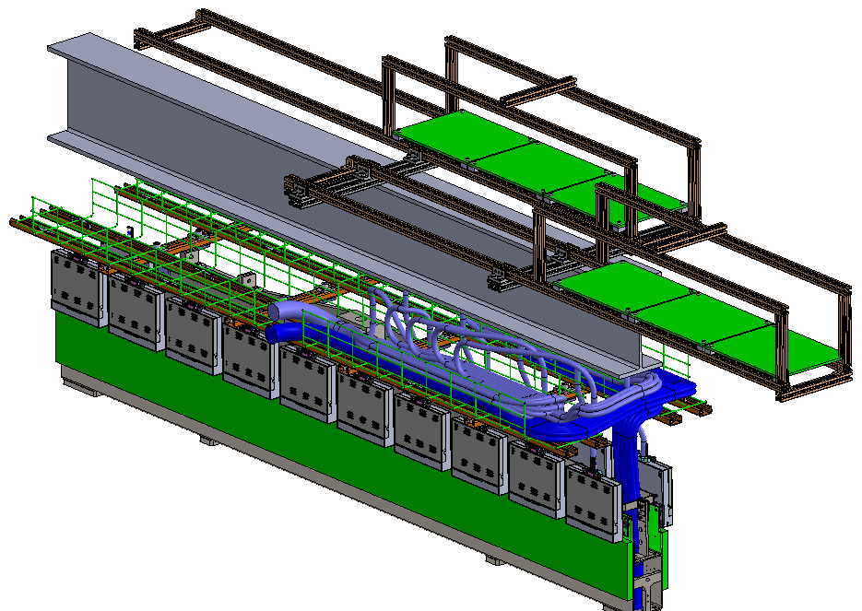
Phase 2 Access Issues
View of the top corner of the TPC
Lot’s of questions to answer:
Can we physically we access the cables on the back side of the APA?
Can we remove the APA trolley (not shown) ?
How to we get access to the cold boxes?

Slide 18
ProtoDUNE 2 Trial Assembly Schedule
Parts of the HV components made for ProtoDUNE 2 trial assembly will be used for DUNE trial assembly. Need to confirm that new design works early enough for fabrication of new design to be tested at CERN. Plan is to send some students to Ash River that will be at CERN during installation

Slide 19
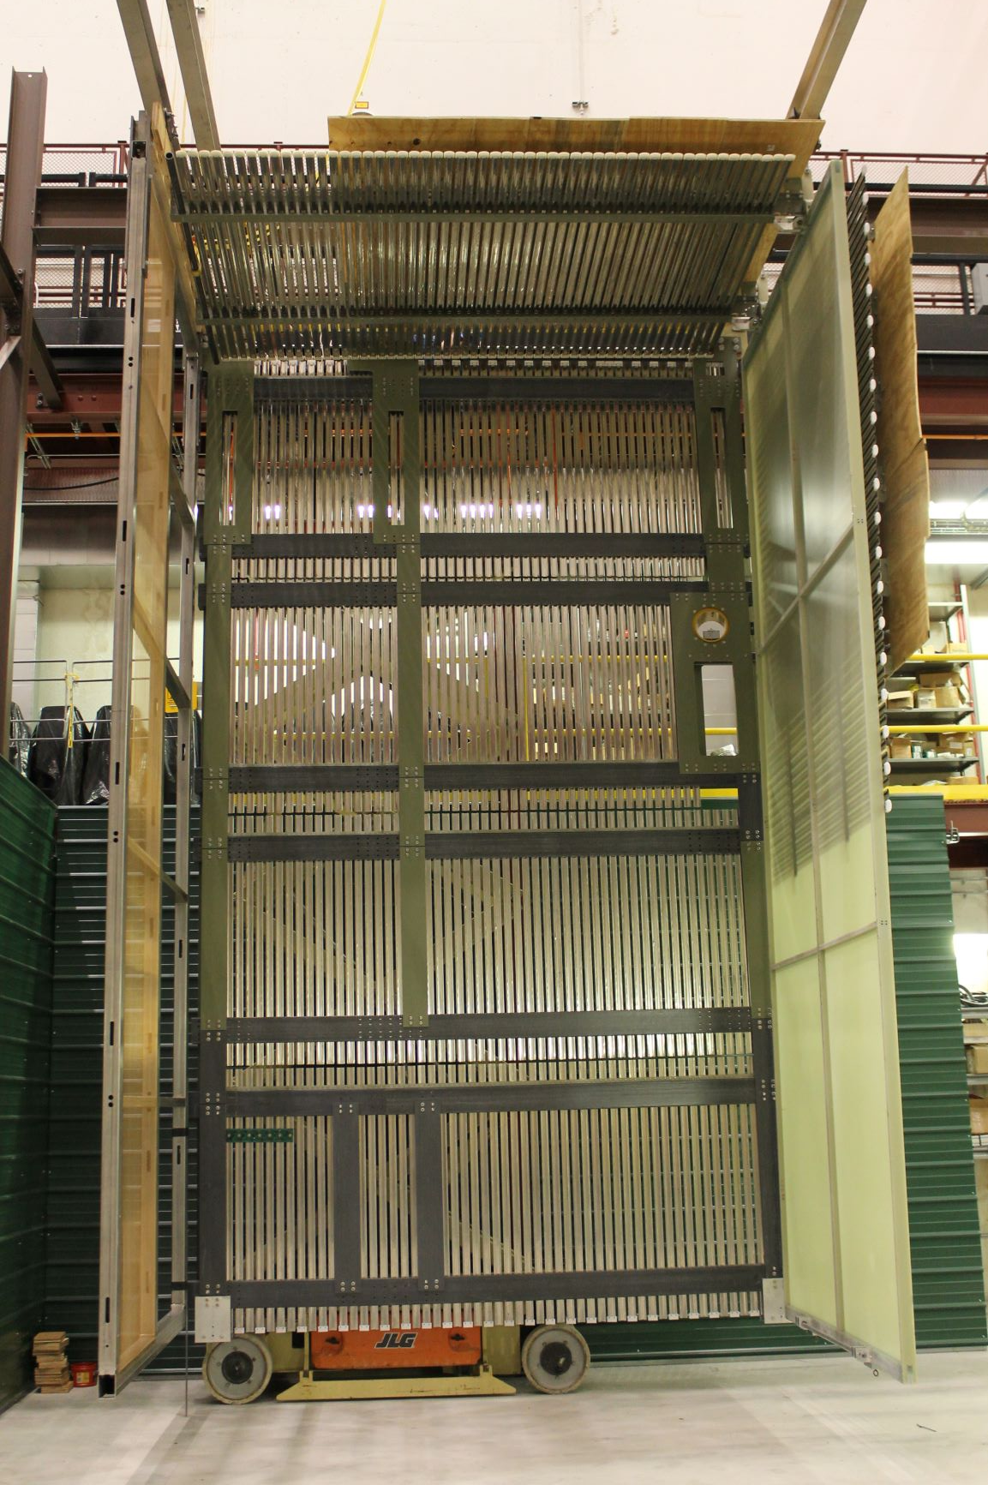
ProtoDUNE 2 Trial Assembly
In 2021 ProtoDUNE 2 will be constructed at CERN. Before this we need to develop a new deployment plan.
We still have the ProtoDUNE test frame to use for these tests
Equipment needed for Phase-2 | Responsible Group
Modified deployment system | Installation
Mockup of the DSS | Installation
End Wall and Field Cages | HV
The deliverables from the ProtoDUNE 2 Trial Assembly test are:
Validation of the HV installation procedures.
Validation of the TPC deployment
Document and test all new lifting fixtures
Final time and motion studies and updated schedule for the installation.
Draft procedures for decommissioning ProtoDUNE in the cryostat at CERN
Draft procedures for new installation procedures/documents required

