Slide 1
Critical Items needed for Installation
J Stewart
August 20 2019
Installation Workshop SURF

Slide 2
Critical Decisions
We need to decide if the slots in conduit in the APA side tubes will be adequate to allow PD installation and still enable CE cable installation.
Definitive decision after September test with Marco.
When are the FC deployed?
This revises the schedule. It may add time to the schedule.
Where are the DAQ computers?
A baseline scope for the CISC and CAL systems needs determined so concrete planning of the installation can be done.
The systems have many interfaces to the different components and the installation equipment.
At present no elements from these consortia are in the 3D model.

Slide 3
Underground labor needs
The underground occupancy is at the limit for parts of the installation period.
This could cause schedule delays and make the weekly planning very difficult.
We need to understand if it is possible to reduce the number of people planned underground.
This requires stepping through each activity in more detail and understanding if the time and labor estimates are real. Right now we have looked at 4hr time blocks. By going to finer resolution we may find fewer people are possible. Time and motion studies are needed to really understand the time and labor needs.

Slide 4
FC and end wall design revision
Revised design of the FC is needed before the details of the FC installation and the interfaces to the other detector components can be clarified.
Where do the ground planes go and when? If these are pre-installed then we need to modify the schedule.
Are there thermometers installed on the ground planes? When are the cables installed? How do these cables interfere with any other equipment on top.
What tooling will be used?
The HV installation plan and QC should be required for the next design review.
Procedures and QC should be part of the documentation.
Installation needs to work on organizing the place on EDMS to store the installation related documents.

Slide 5
Detector installation inside the cryostat
All the installation images we have are now very old. It is critical that we start revising the model and start work on detailing the installation process. This will be necessary for all future reviews.
This makes it critical that the consortia technical leads ensure that the 3D models for there equipment (including fixtures and tooling) are in EDMS and are current and complete.
These models will be used to assemble both the detector and create the installation process flow images.
What is not available soon will not be shown at the October DOE review as part of the installation.

Slide 6
DAQ/CE installation and other work on cryostat roof
Similar to the work inside the cleanroom we need to step the installation of the DAQ equipment and define the sequence of activities and the needed labor.
I propose doing this at one of the Wednesday morning meetings.
The same is true for the CE installation of the crosses and the WEC.

Slide 7
Ash River Phase II
The present plan is to have the next revision of the Ash River infrastructure in place this winter. This will allow performing test installation of the detector components next year. Experience has shown that this is critical. The test installation will find the flaws in both our designs and in our installation planning. It is needed to get a more refined plan for time and labor.
The engineering design of the Ash River phase II setup needs to make progress now.
Bill is preparing to contract structural engineering.
Comments to the AR plan need to be made now.
DSS rails and trollies for the AR test are also needed on the same time scale. The planned delivery is Christmas.

Slide 8
Part Breakdown structure
It is impossible to do professional quality control unless you know which part you are testing. It is also impossible to plan deliveries unless you know what is being made. Without a clear part breakdown structure you cannot know that responsibility for each part is assigned.
A large amount of test data is collected for each detector component which is now not readily accessible. This is not acceptable going forward.
The part breakdown structure must be created to define exactly what we are building.
This should be in place for ProtoDUNE-SP run II if this is intended to be a real module-0 test of the detector.
Not having a good archive of the test data would be silly – personal opinion.

Slide 9
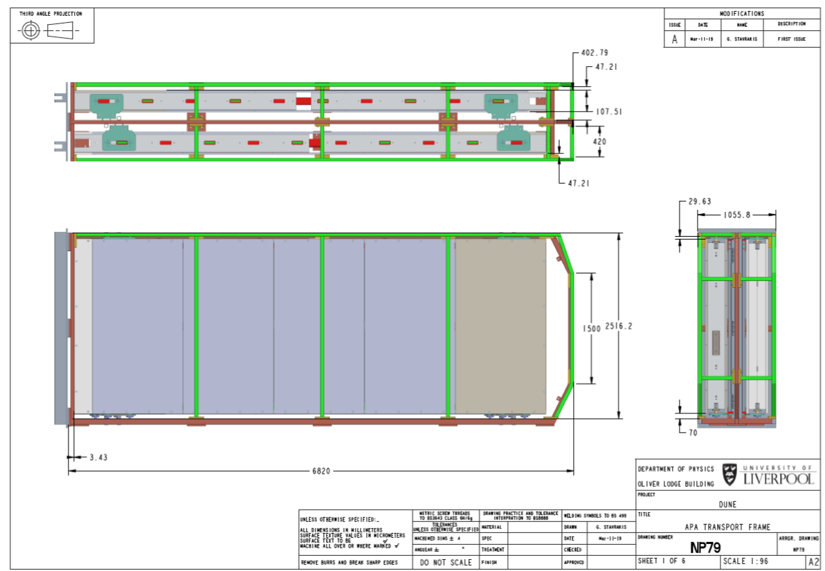
APA transport frame
A lot of work has gone into defining the requirements for the transport frame.
https://edms.cern.ch/document/2165518/1
The Zimmer cart needs to be designed. Is this JPO scope or APA scope? Where are the interfaces? Who will work on this?
When we moved equipment around the cleanroom we could not get everything in if the scissor lifts for the PD were fixed. We need to look into mounting the tooling on the frame.
When will the engineering analysis for the frame be ready for review?
What are the outer covers and how are they removed?
When will a frame be at Ash River?

Slide 10
APA transport cart
The design of the cart used to move the APA around in the cleanroom has significant impact on the cleanroom. The present design is 4m wide which restricts motion around the APA significantly.
Can the cart be made narrower?
Are braces needed on both sides?
When can the cart be in AR with a turning unit for testing?

Slide 11
CISC and CAL
Need to understand the installation process in detail if this is to be shown at any review next year. Working through the details (process and interfaces) could easily take 6 months.
A realistic plan for what is possible/desired for the reviews should be made after the scope decisions are officially approved.
Engineering effort is needed here if new elements are to be added to the model.

Slide 12
Electrical design for the Cleanroom and cryostat
The cost will be a major part of the DOE review in October. An estimate for the electrical cost for the cleanroom and cryostat is required for this. In order to estimate the cost the quantity and location of the power needs to be laid out.
The next steps are to define the loads and circuits, place the power outlets, and start the estimating process.
The location of the outlets will be shown at the weekly meetings in the next few weeks .

Slide 13
Fire suppression concept for cleanroom
Like the electrical the fire suppression also needs designed.
Bill and I have been to busy to make progress here.

Slide 14
Ventilation
A simple ventilation system for the cleanroom and cryostat has been conceptually laid out.
Has no cooling or humidity control, but does meet the minimum airflow for ISO-8 per ISO-14644.
No modeling of the airflow has been performed to verify there are not stagnant areas.
Should be engineered by a HVAC engineer.

Slide 15
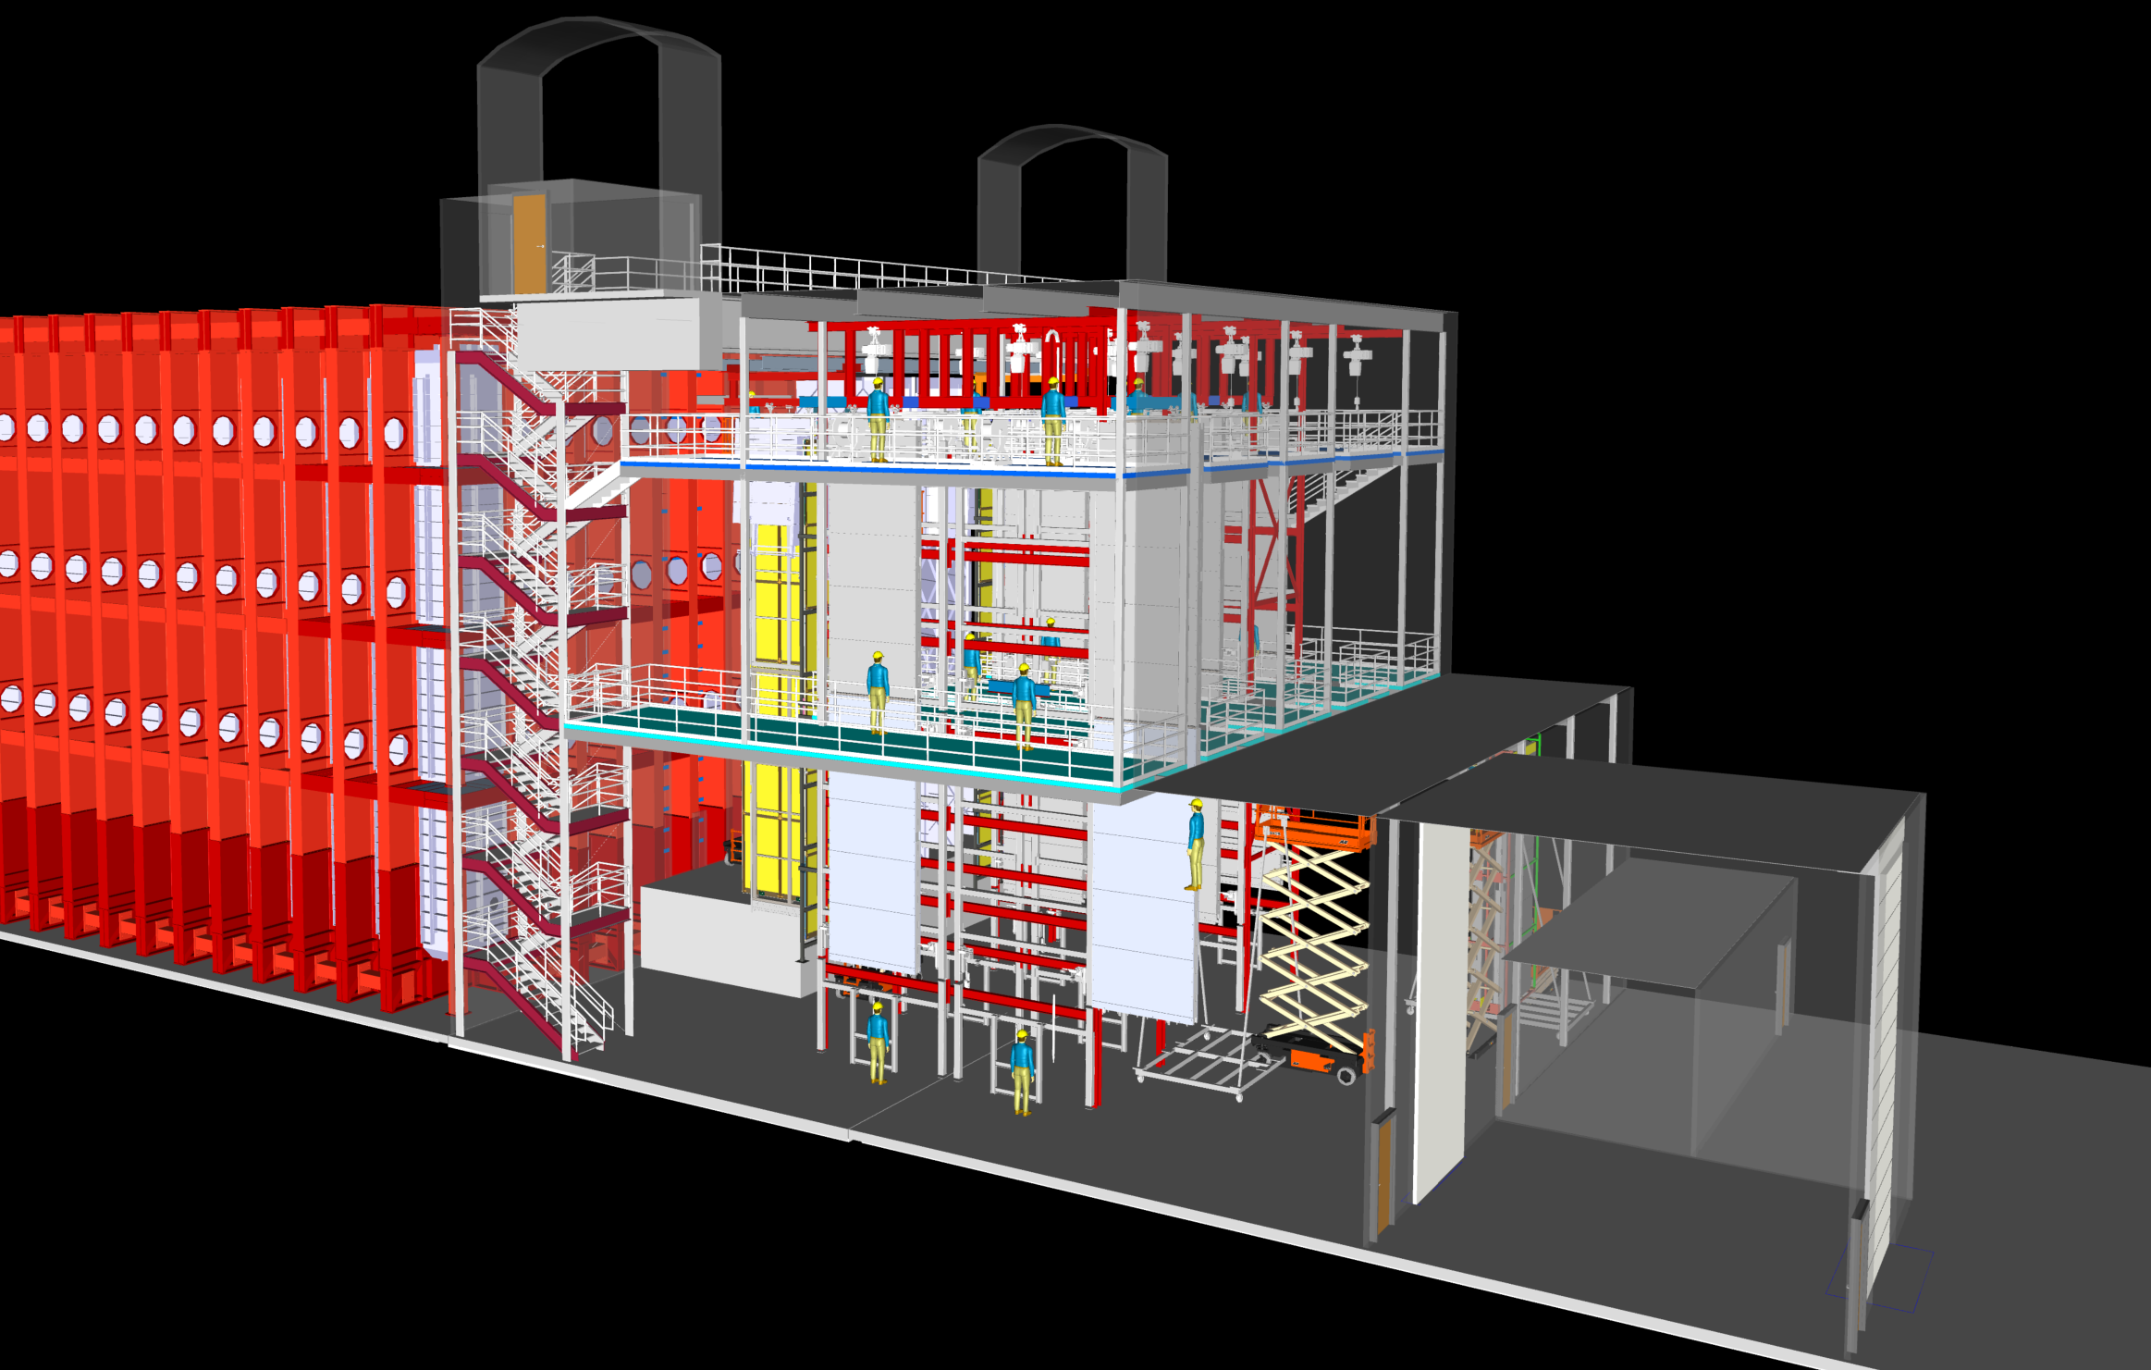
Egress plan for cleanroom
Presently we are seeing roughly 20 people on the top level of the cleanroom. These people are working on moving APA, Installing electronics boxes, cabling the APA and testing the final system. This is enough to require a stairway for secondary egress. Fitting this into the system is challenging.
We are presently looking into engineering options.
The mid-level probably has an average occupancy around 1 and a peak around 5. We are investigating ships ladders for this (possibly the cryostat).

Slide 16
APA cover panels
The cover panel and corner bracket design for ProtoDUNE was very labor intensive to remove. It required handling a lot of loose hardware (that got dropped), had loose fuzz which went everywhere, and was heavy. This needs improved for DUNE.
Need a new design that allows the panels to be removed while on the towers in a safe and clean manner is needed. The present time estimate has many hours planed just for panel removal.

Slide 17
Installation QA plan is needed
In preparation for the DOE reviews the installation QC plan needs developed.
This requires first having the installation plan and then developing the QC for each piece of equipment.
The first step is to develop the installation plan and procedures.
Do we need this at the DOE review next year?

Slide 18
Discussion

Slide 19
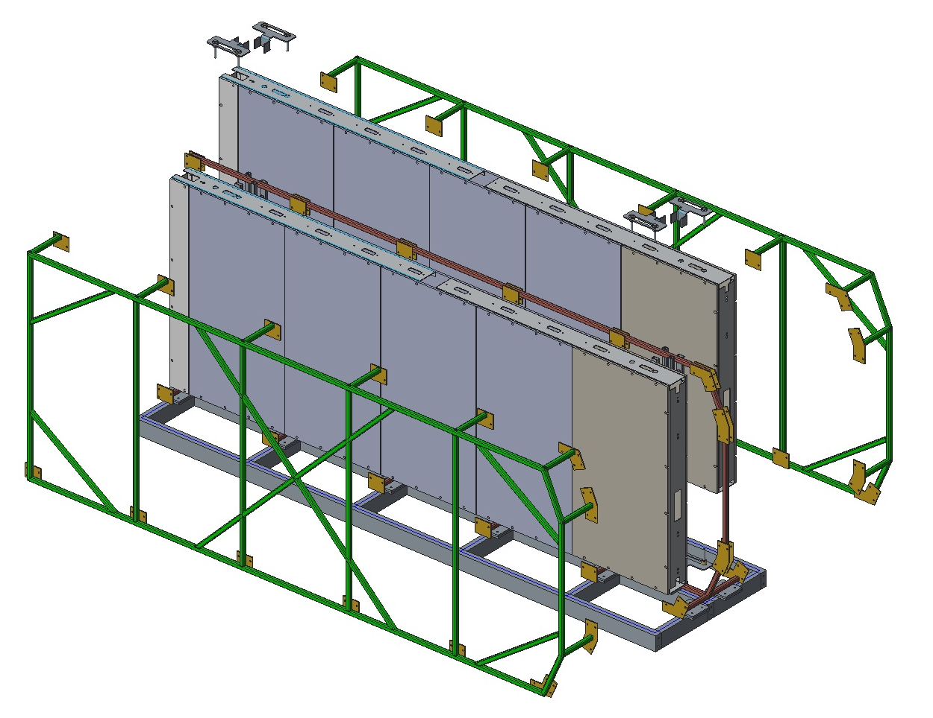
APA transport frame

