Slide 1
APAs
PBS, testing plans, personnel
Alberto Marchionni
21 August 2019

Slide 2
Outline
APA production timeline
APA transport frame
Storage and testing at SDWF
APA Installation: tooling, testing plan and personnel
PBS
Action items

Slide 3
APA Production
Production of APAs
  6 winders in US (2 Uchicago, 2 Yale, 2 PSL)
  4 winders in UK
APA Production/year
Production Site | 2020 | 2021 | 2022 | 2023
Daresbury | 6 | 24 | 24 | 24
Yale |  | 2 | 9 | 13
Chicago |  | 2 | 9 | 13
PSL |  | 6 | 10 | 12
TOT | 6 | 34 | 52 | 62
  End of APA Production - detector module #1 September 2023
  End of APA Production - detector module #2 April 2026

Slide 4
APA transport frame

Slide 5
APA transport frame requirements document
https://edms.cern.ch/document/2165518/1

Slide 6
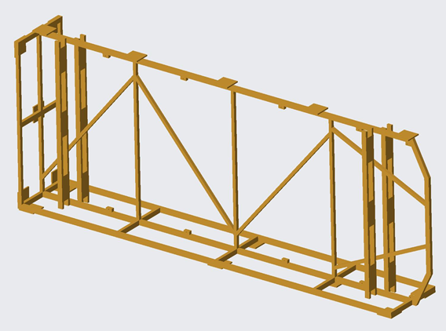
APA transport frame components
Main steel frame
Removable aluminum side frames
Removable panels
It contains one top and one bottom APA
Design needs to be finalized
FEA analysis started

Slide 7
APA frame transportation down the shaft
To be tested at SURF in the second half of 2020

Slide 8
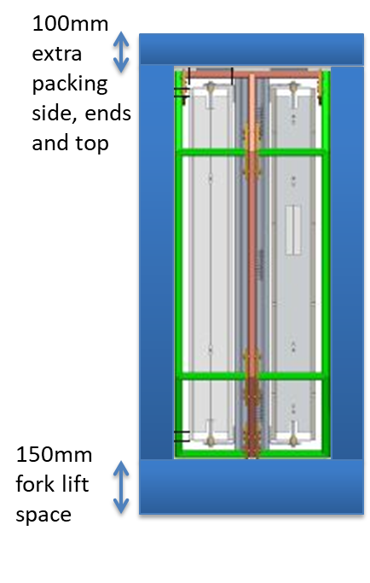
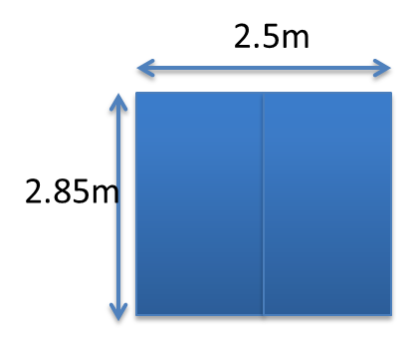
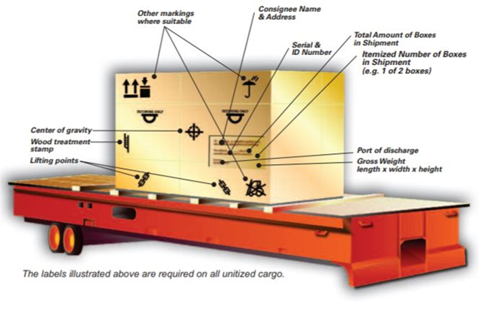
APA transport frame packaging
The transport frame will need the following additional protection for transportation from UK (and US?):
  Hermetically sealed in plastic
  Wooden box built around the frame
This makes the overall dimensions
  7.1m long
  2.85m high
  1.250m wide
Transport 2 pairs of APAs on a MAFI trailer in the ship hold
Shipping crate

Slide 9
Storage at SDWF
Upon arrival the crates will be visually inspected for damage and any logging devices checked for excessive accelerations by APA consortia designated personnel
Long-term storage in appropriately controlled conditions (only modest temperature/pressure swings to avoid condensation within the wrapped APAs). In some cases they will be stored for two or three years or longer.
A 50% relative humidity at 20C (68F) the temperature would have to drop to about 8C (46F) before the humidity would hit the condensation point.
If 50% relative humidity turns out to be unrealistic or expensive due to the type of warehouse, other combinations can be found (depending on what can be done within the warehouse).

Slide 10
Testing at SDWF
If possible, test wire tension with the electrical wire tension method, otherwise apply low voltage to wire plane bias to test for shorts (broken wires).
The tests need access to the APA head boards.
This involves removing a portion (all?) of the shipping crate, cutting the hermetic wrap, and removing a protective panel to expose the head boards.
The APAs are tested inside the transport frames, the protective covers replaced, and the APAs are then resealed.
This inspection will require a basic clean room class 100,000 large enough for a UK crate and work space around the crate to remove sides and access head boards
Provide a crew of 4 APA people every two shipments of APA crates (8 APAs)

Slide 11
APA Installation: tooling, testing plan and personnel

Slide 12
3 assembly lines + 1 spare
J. Freitag

Slide 13
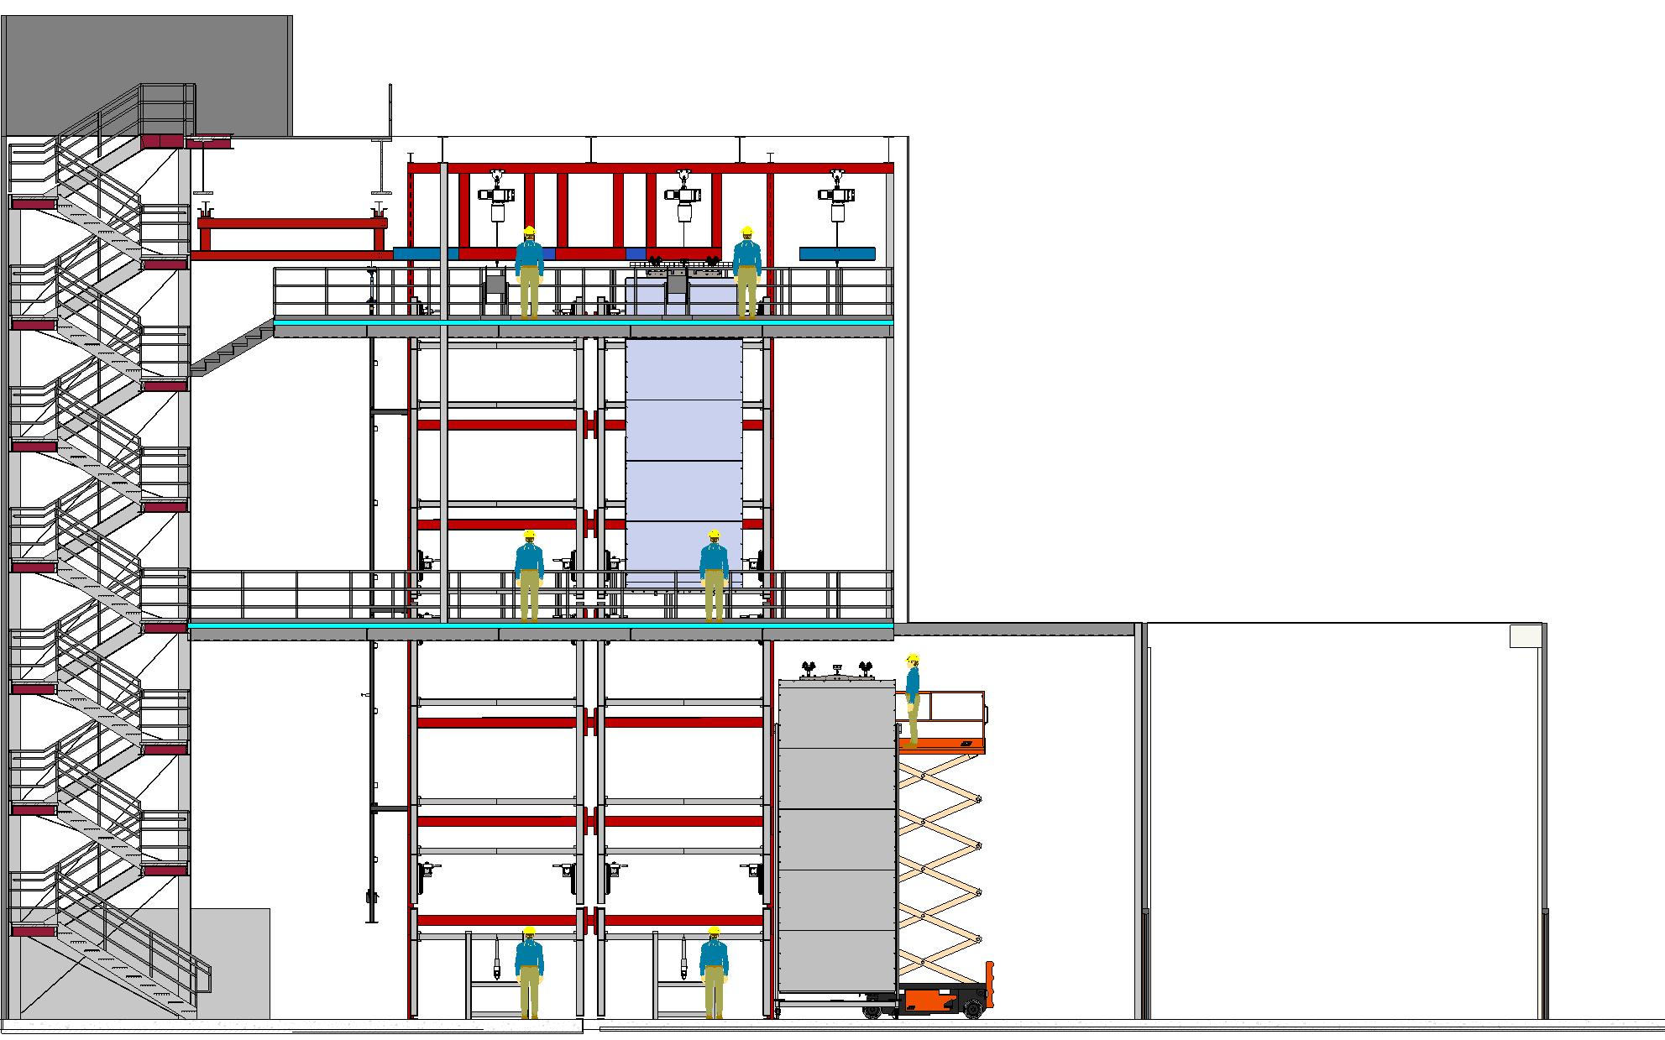
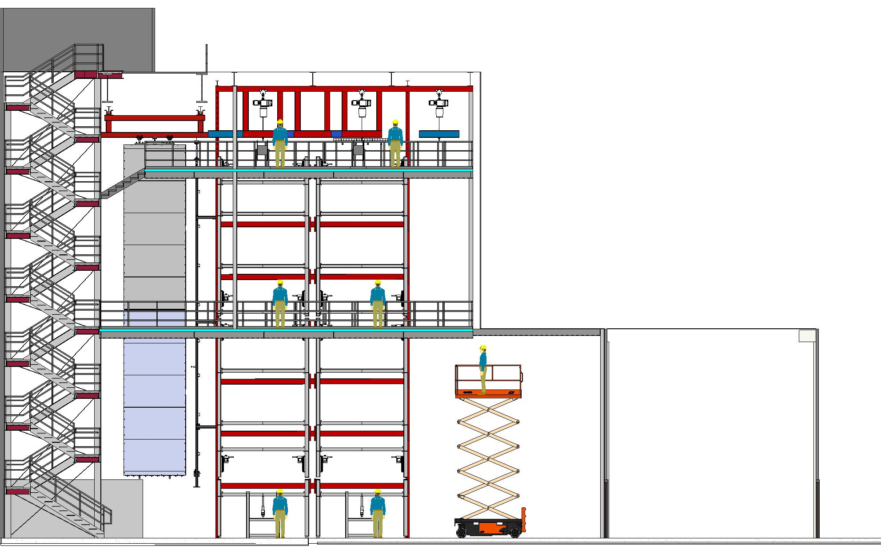
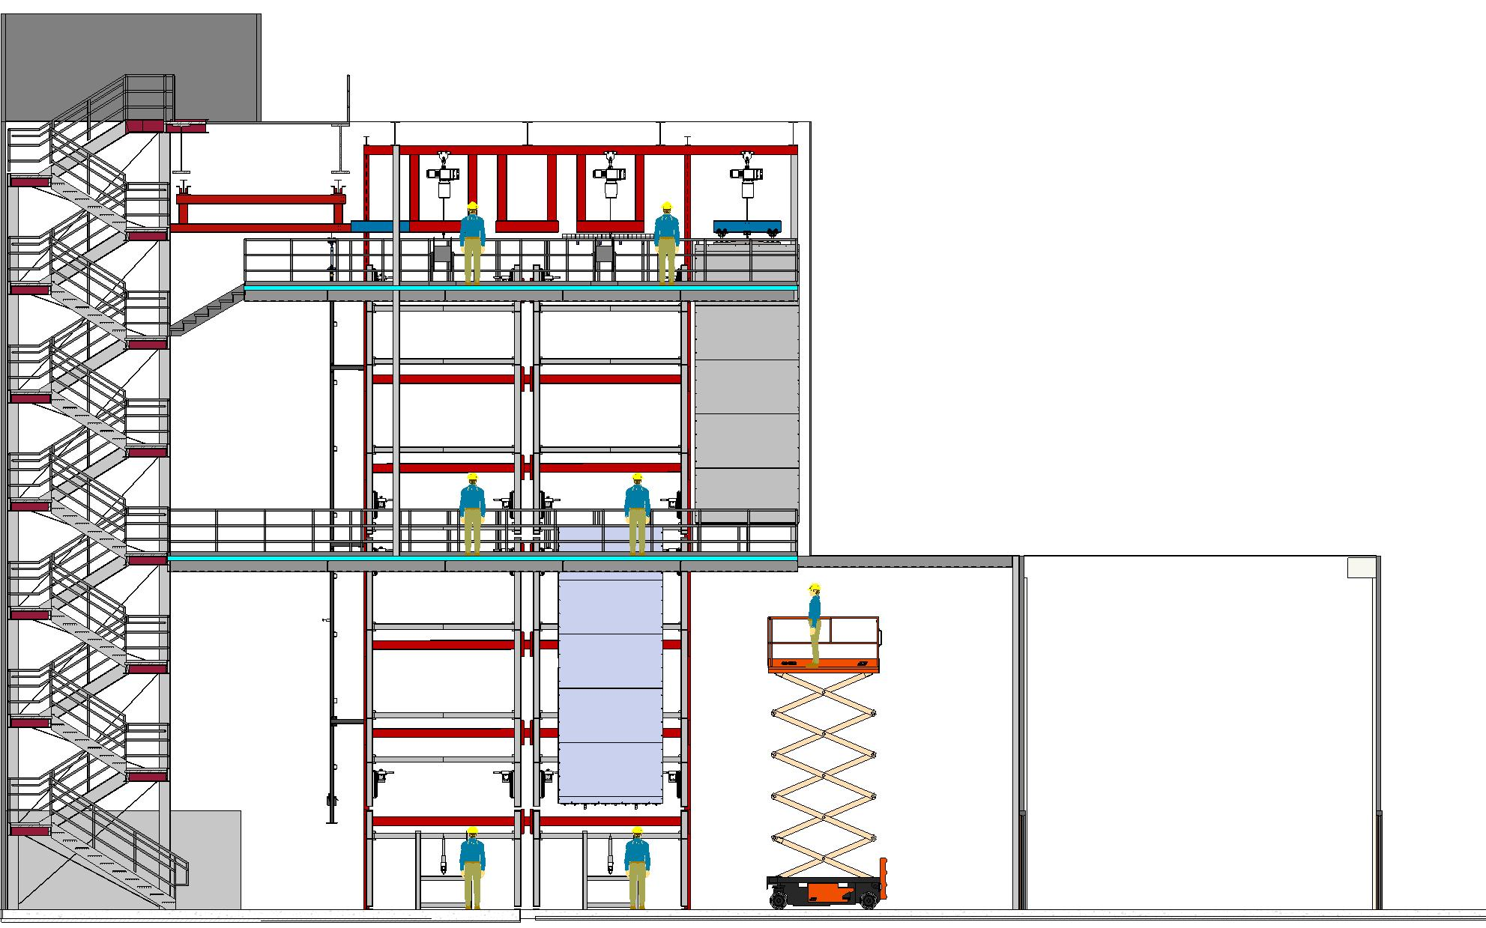
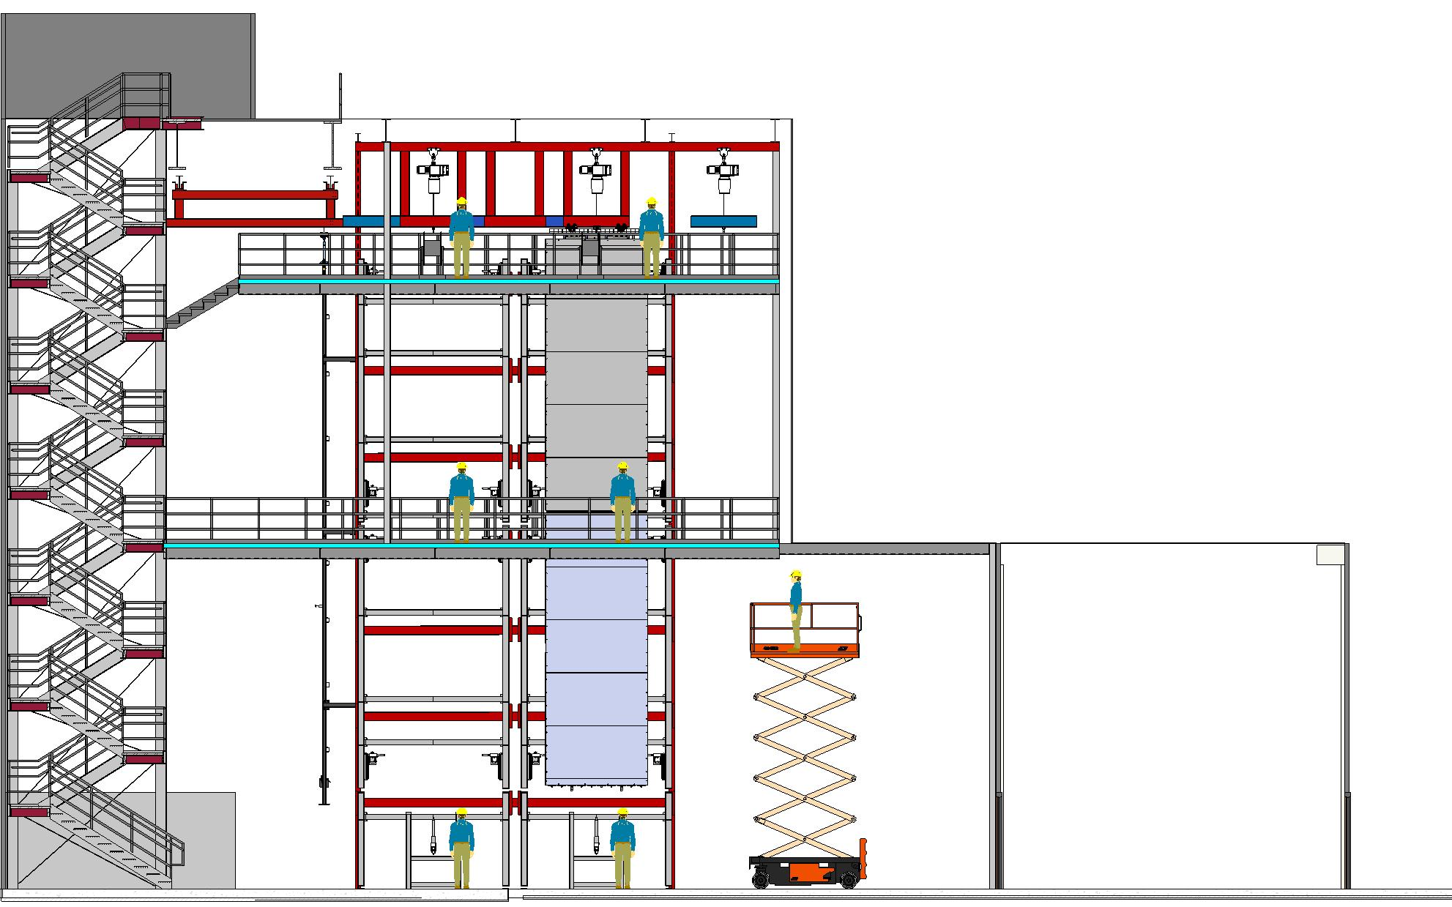

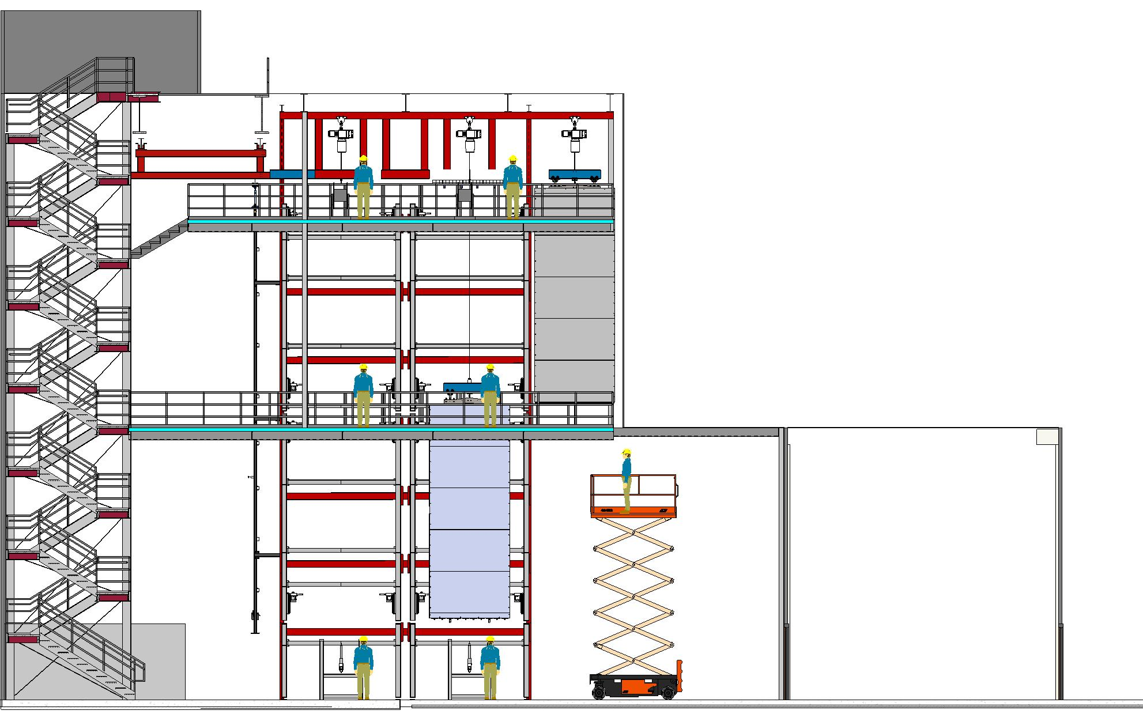
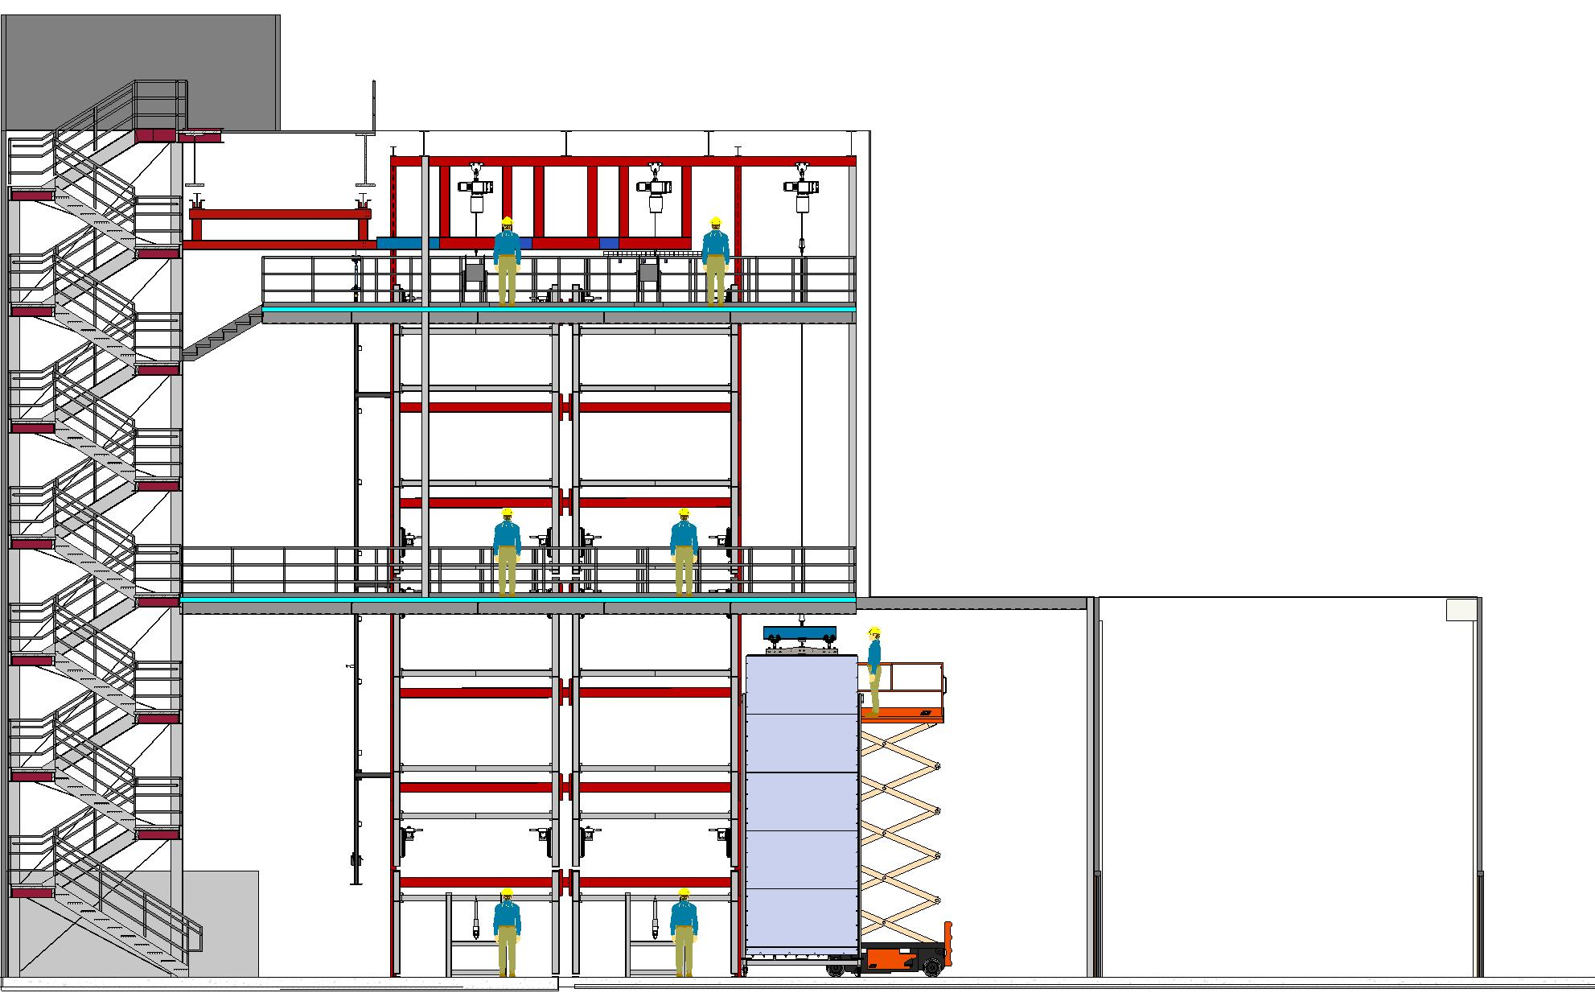
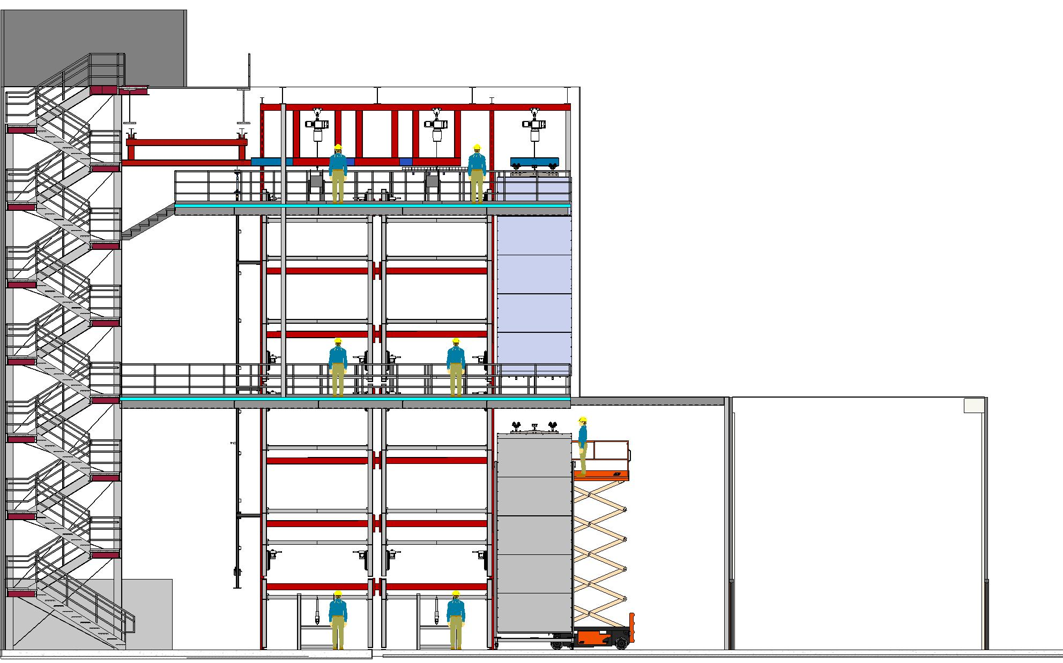

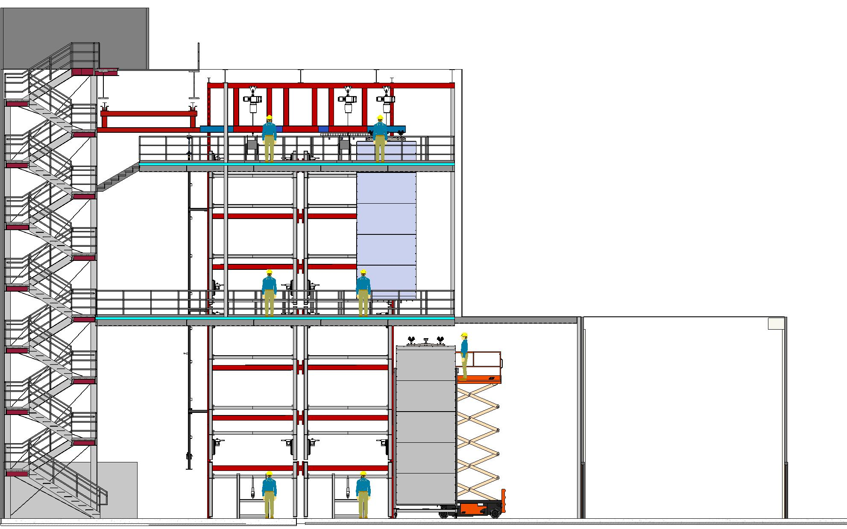


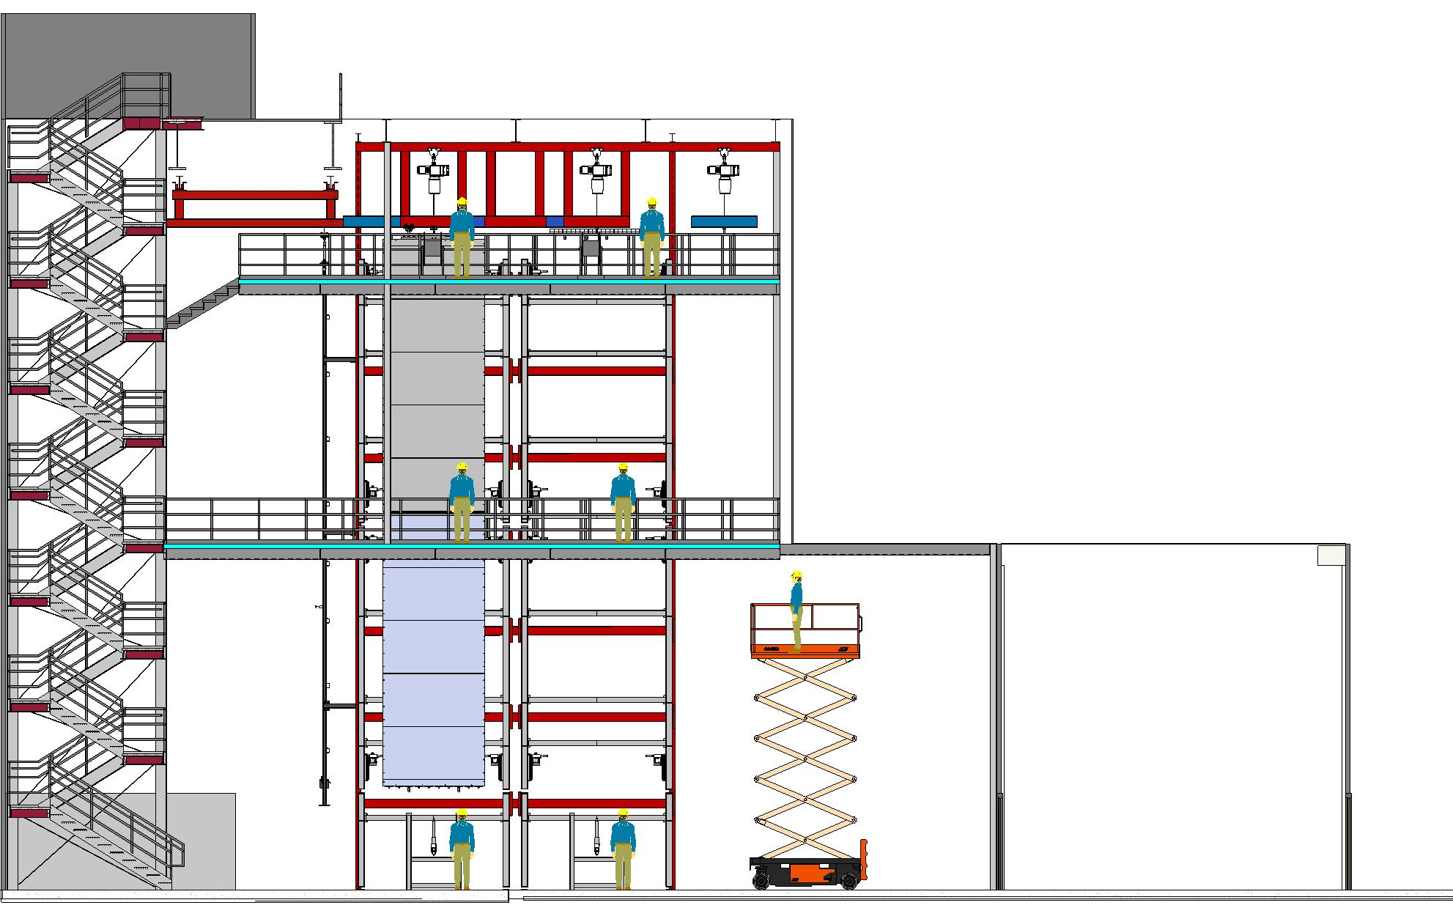
APA integration up to cold box
Up to 6 APAs (12m) at the same time
M. Nessi

Slide 14
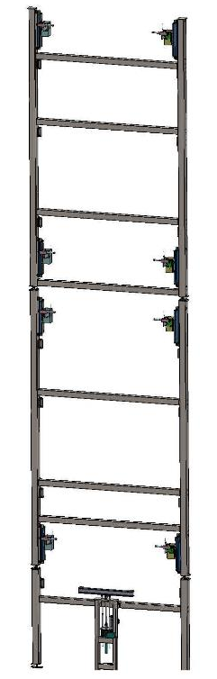
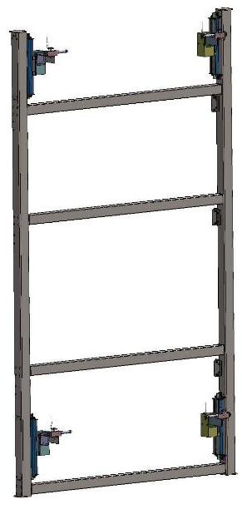
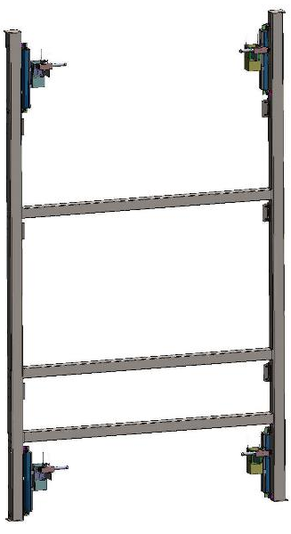
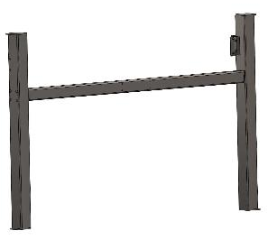
APA Assembly Fixture –Ladder Frame
Top
Frame
Middle Frame
Bottom Frame

Slide 15
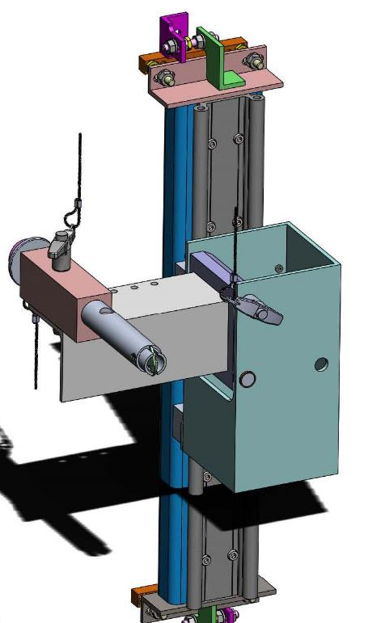
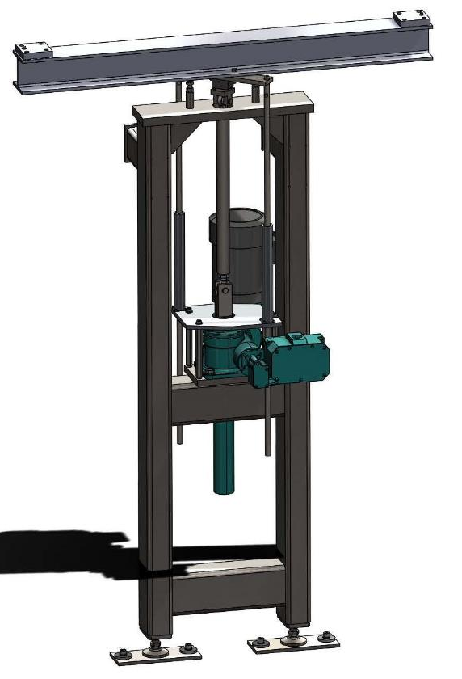
Stabilizer and actuator stand
Bottom APA standoffs are connected here
Stabilizer
Actuator stand

Slide 16
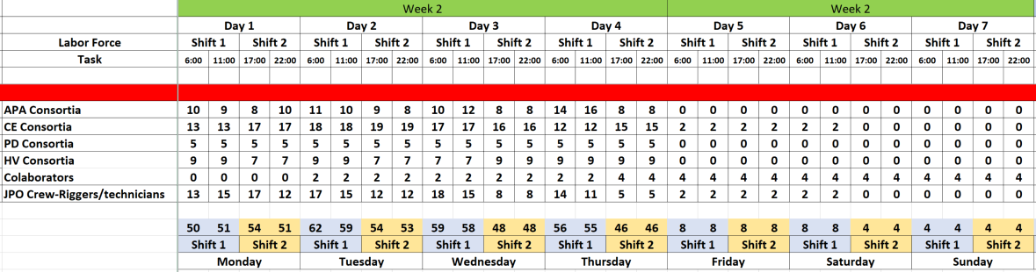
APA personnel during installation
Goals are to make it so each station to be roughly the same length of integration time leveling the manpower levels
Average of 11 people/shift from APA Consortium,
of which 3 technicians/shift
B. Miller, May 2019

Slide 17
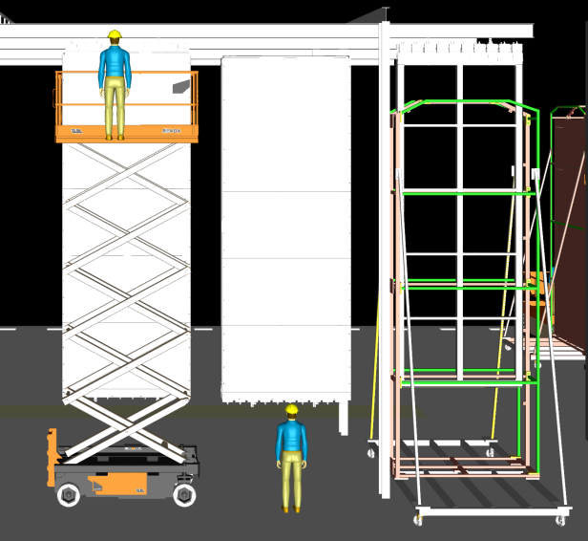
Electronic Wire Tension Measurements
Top and bottom APAs are lifted out of APA shipping box and placed on lower rail. APA protection panels are NOT removed
The Electronic Wire tension boards are installed on the head boards. Measure 8 wires at a time simultaneously
There is access on both sides of the APA via scissor lift and work platform.

Slide 18
Photogrammetry/Survey
Remove the protection panels (on the tower? To be tested at Ash River)
Photogrammetry and Survey, just before APA doublet is inserted in the cold box. This task has not been clearly defined yet. How to access APAs?

Slide 19
PBS
Assumptions
High level description of deliveries
  Shipments to the Warehouse
  Deliveries through the shaft
  Deliveries to the cleanroom
  Deliveries to the cryostat
  Returns from underground
Dan Wenman

Slide 20
Assumptions
All items are shipped to the Warehouse for shaft schedule planning
Parts of factory APA assembly
CE TEE
CABLE CONDUIT ASSEMBLY
Supplied to warehouse and underground by CE
CE BRACKET
CE TO CR ADAPTER BOARD ASSEMBLY
Supplied to warehouse and underground by HV
Field Cage Terminations PCB
I&I supplied rigging tools
Zimmerman cart (?)
I&I supplied test equipment
Survey Equipment

Slide 22
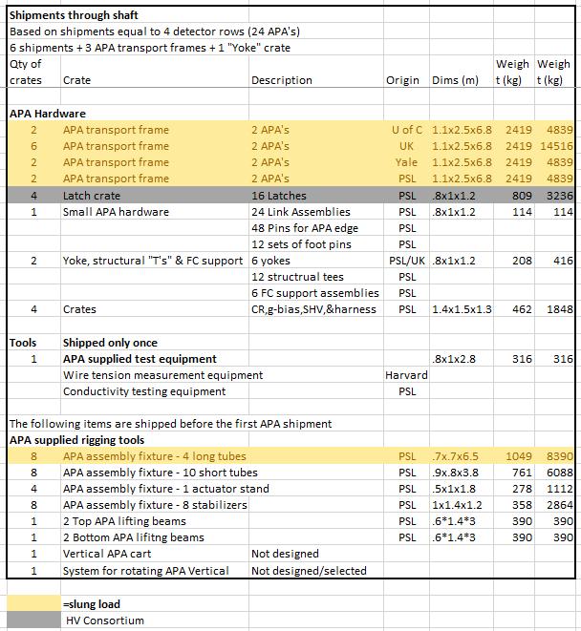

Slide 23
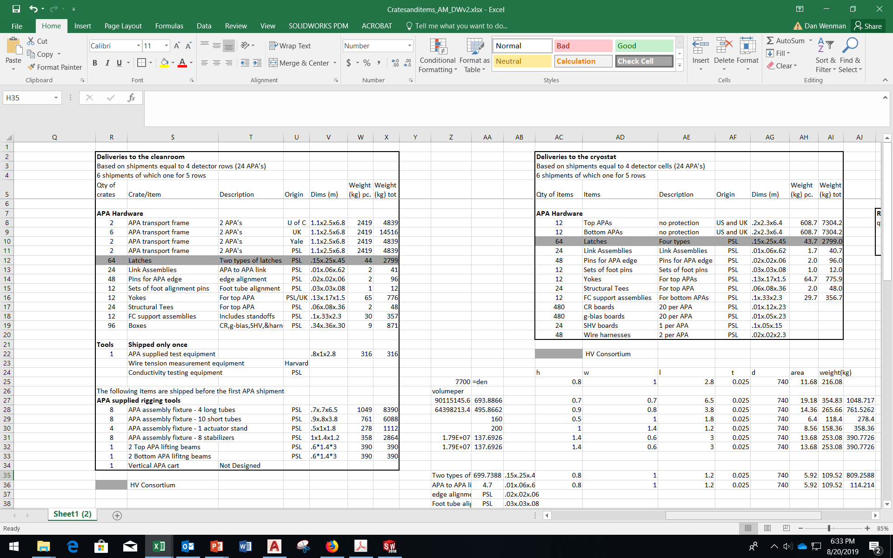

Slide 24
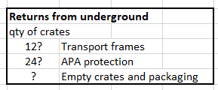

Slide 25
Action items
Design & FEA analysis of the APA transport frame and engineering review by November 2019
  Need help from I&I on procedure & hardware design for lowering APA transport frame down the shaft
  A prototype transport frame will be built in US and shipped to Ash River (~February 2020) and then to SURF (second half of 2020)
Decision on slotted/non-slotted conduit by October 2019
Decision on the wire tension measurement method by March 2020
Plan for photogrammetry/survey by end of 2019

