Slide 1


Crane, Hoists & Handling equipment
FS Installation Workshop
Jean-Louis GRENARD - CERN
SURF 19 – 21rst August 2019

Slide 2
Summary
Monorails of the main cavern
  Interfaces
Crane in the main cavern
  Specification
  Installation in the cavern
Power lines
Commissioning
Use of the handling equipment over the construction of the cryostat
General handling equipment
Maintenance – Periodic inspection
Standards

Slide 3
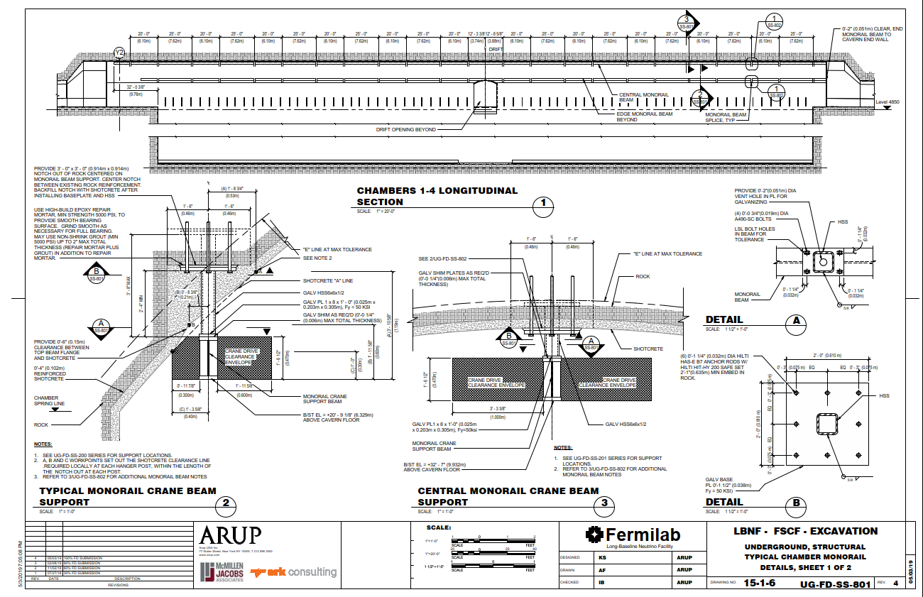
Monorails in the main cavern

Slide 4
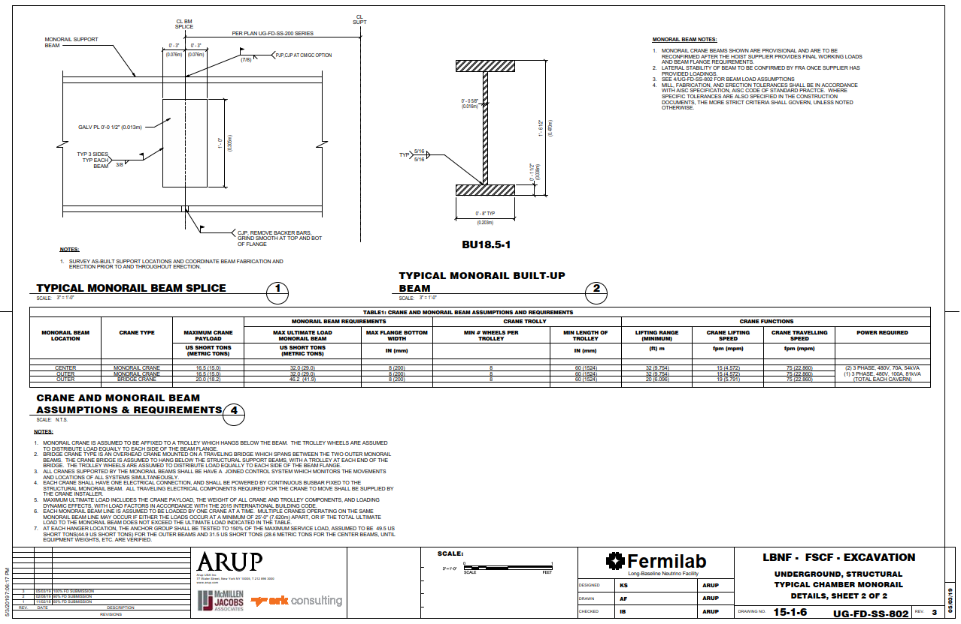
Monorails in the main cavern

Slide 5
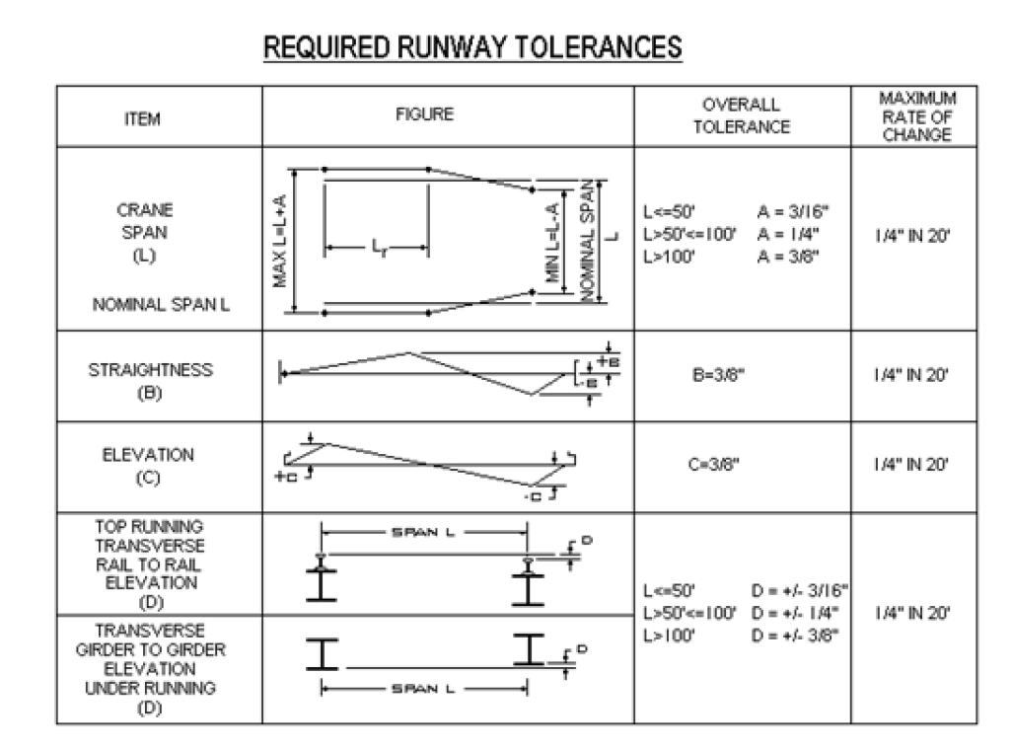
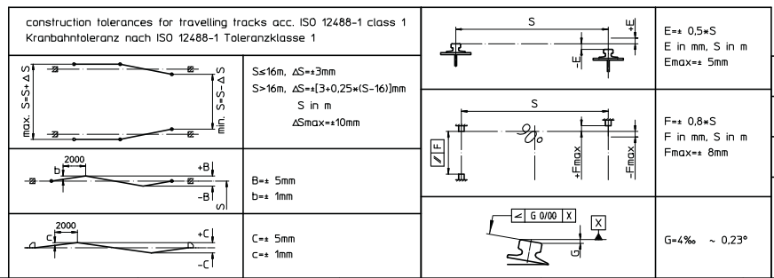
Monorails in the main cavern
Tolerance of installation of the 2 externals rails (used by the overhead traveling crane) : CMMA* specification #70
*CMMA: Crane Manufacturer Association of America

Slide 6
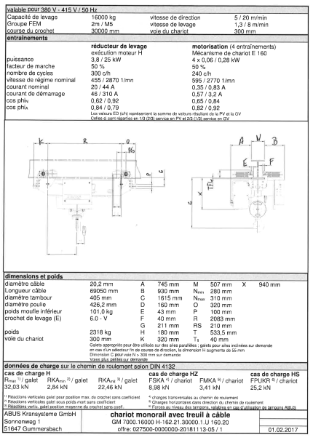
Hoists in the main cavern

Slide 7
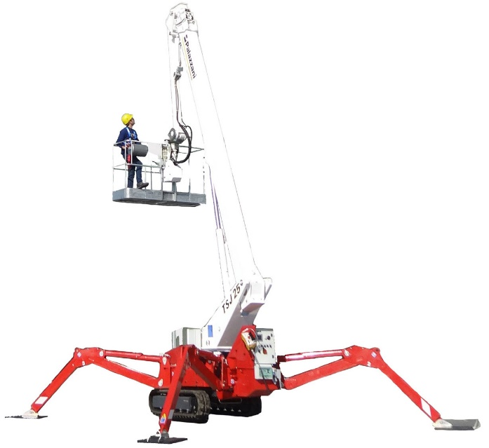
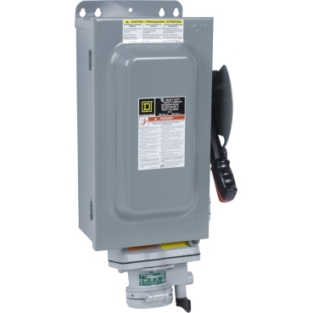
Hoists in the main cavern - Installation
General assumptions
- The unloading of the truck(s) in the surface ‘’building’’ and the handling of the equipment from the surface building to the cavern will be covered by a rigging team part of the SURF facility
- In the cavern one cheery picker (Palazzani kind of) will be provided by the facility to reach the top of the cavern from the lower level and a small scissor lift to access the crane, hoist from the extremity of the cavern
- In the cavern, drifts typical basic handling equipment (pallet truck, small forklift) will be available
- If Specific PPE (ODH, oxygen mask….) for the access in the underground are required they will be provided by the facility
- I have not assumed specific external training with a cost for the contractors (else than typical training given by the facility at the charge of the facility)
- The electric power supply of the cranes and hoists will be delivered by the facility up to the loading deck (one extremity of the cavern) -> Location to be discussed

Slide 8
Crane in the main cavern - Specification
Main
 | Building | SURF
 | Installation type | Cavern
 | Project type | New crane with new feeding line
 | Use | Service crane for cavern
 | Design temperature [°C] | 0 / + 50
 | Type | Single girder suspended crane
 | Working load limit [ton] | 12.5
 | Span S [mm] | 19700
 | Main hoist range of lift [mm] | 22000
 | Lifting speed [m/min] | 0.2 - 10 variable speed range with frequency converter
 | Cross travel speed [m/min] | 0.6 - 12 variable speed range with frequency converter
 | Long travel speed [m/min] | 0.7 - 15 variable speed range with frequency converter
 | Total installed power [kW] (not to be exceeded) | 35 to be confirmed by the contractor
 | Main hook left approach [mm] | 700
 | Main hook right approach [mm] | 700
 | Longitudinal distance from axis of main hook to end buffer [mm] | 1500
 | Height of rail above floor [mm] | 21500
 | Clearance under girder from ground level [mm] | 21500
 | Clearance under main hook from ground level [mm] | 21500
 | Crane height from top of rail [mm] | 1250
Rails
 | Type and size of rail | IPE /IPN to be defined
 | End-stops | to be supplied
 | Max static vertical reaction per wheel [KN] | 29
 | Max static horizontal transverse reaction per end cariage [KN] | 23
 | Max static horizontal longitudinal reaction per rail [KN] | 17
Bridge structure
 | Number of girders | 1
 | The supply shall include proper means to avoid derailment of the crane in case of seismic event | applicable
 | Number of motorized wheels per end-carriage | 1
Long-travel mechanisms
 | New mechanism shall be supplied (see "Gen. Requirements" section 3.5.2) | applicable
 | Number of motorized wheels | 2
 | Number of motors | 2

Slide 9
Crane in the main cavern - Specification
Catwalks and access to crane
 | Number of catwalks on bridge | 1
 | Access to the crane | to be defined
Trolley structure
 | The contractor shall supply a new trolley structure | applicable
 | Proper means to avoid derailment of the trolley in case of seismic event or sudden release of the load shall be provided | applicable
 | Number of motorized wheels | 2
 | Lamp maintenance platform | applicable
Hoist
 | Number of ropes coming out of the drum | 2
 | Bad winding of rope | detected and the lifting movement stopped
 | Acceptable acceleration/deceleration with nominal load | ±0,5 g
 | Hook type | Single (DIN 15401)
 | Hook size / material | 12 / material to be communicated by contractor
Feeding line and cubicles
 | Crane feeding line | contractor shall supply and install a new line including its steel supports
 | Building-mounted main switch | supplied by contractor
 | Fixed electrical installation from switch to crane feeding line | supplied by contractor
 | Crane feeding line | sliding contacts,
 | Position of main switch | to be defined
 | Lenght of feeding line [m] | 150
 | Trolley feeding line | cable festoon
 | Cubicles position | on the crane girder
Controls - safety
 | Control system performance level | C
 | Main operator control | remote control
 | Emergency control | remote control
 | Remote control storage cubicle | applicable
 | Load measurement and display | applicable
 | Time counter | applicable
 | Safety zones | applicable; it shall be possible to define an adjustable rectangular area (in long and cross travel direction) where crane can access only if the hook is above a certain height; controlled with limit switches

Slide 10
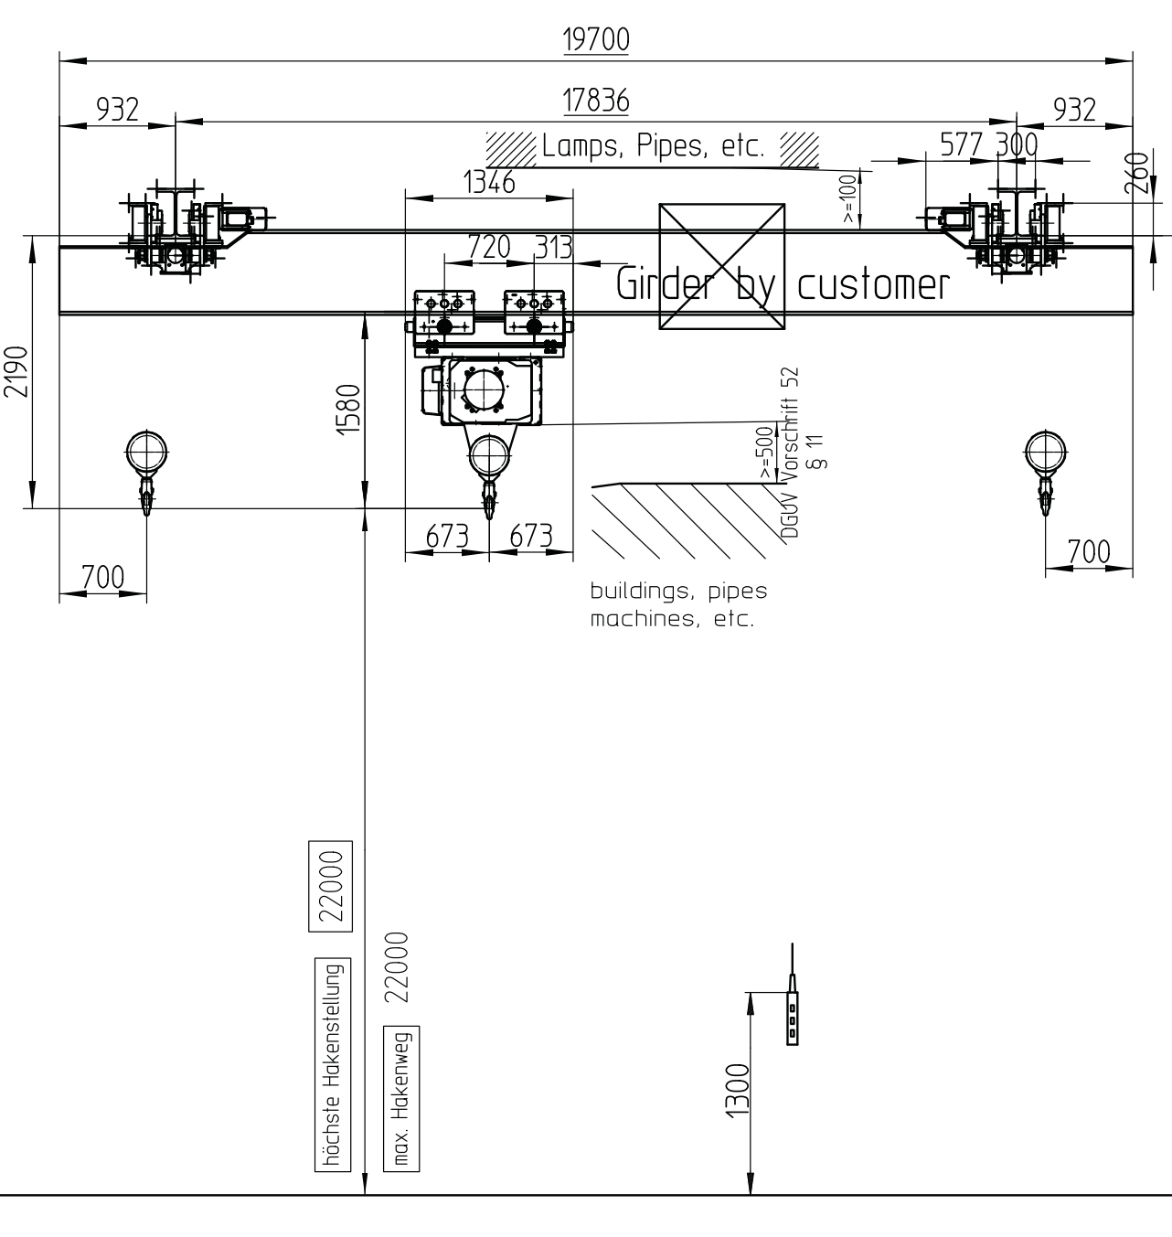
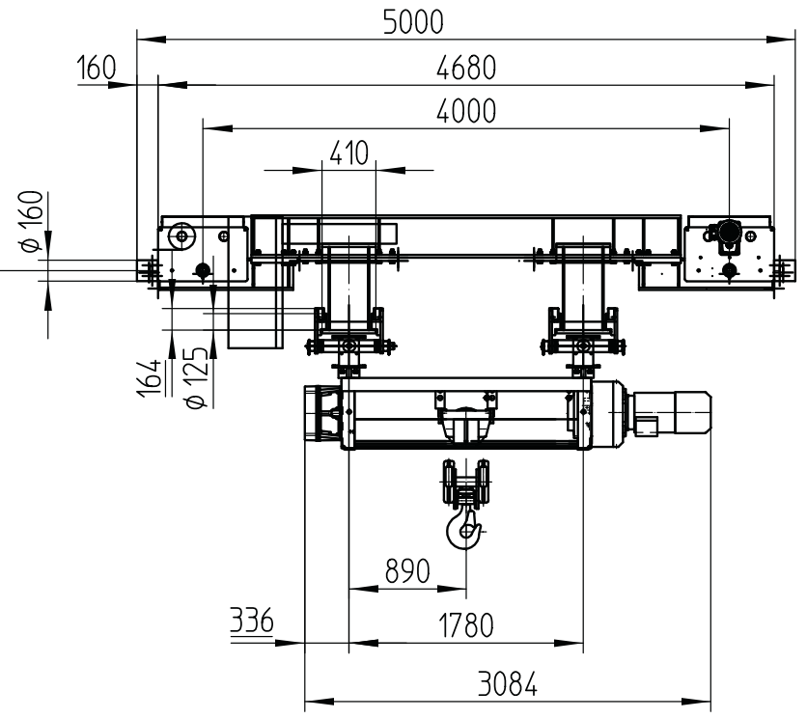
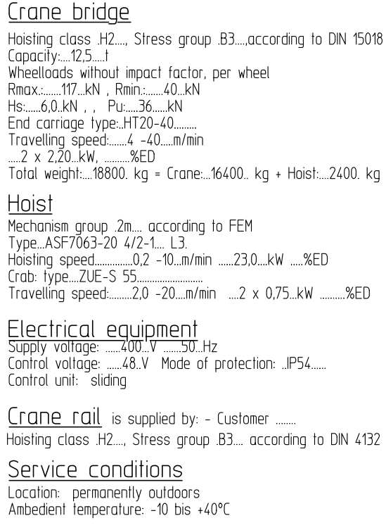
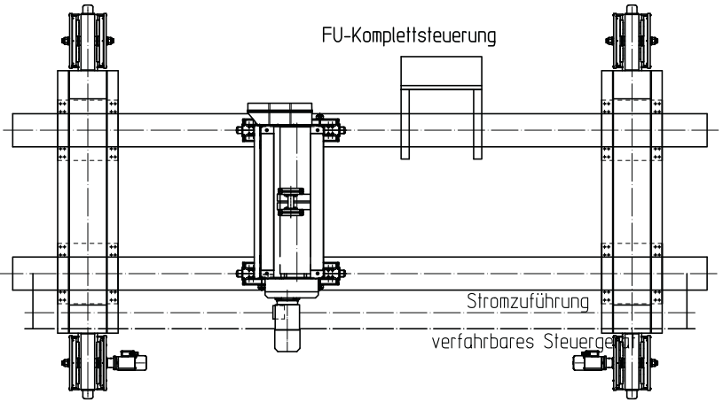
Crane in the main cavern - Specification

Slide 11
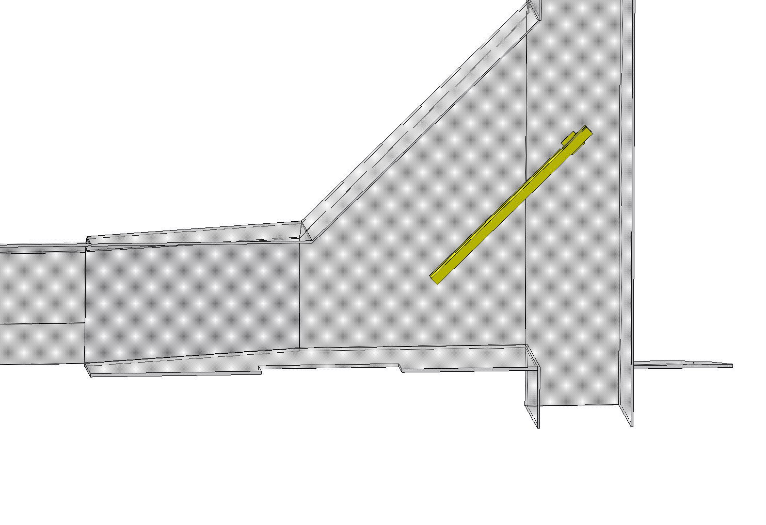
Crane in the main cavern - Installation
Lowering of ½ girder in the bottom of the shaft
Weight ½ girder (3.25 metric tons /7165 lbs.)

Slide 12
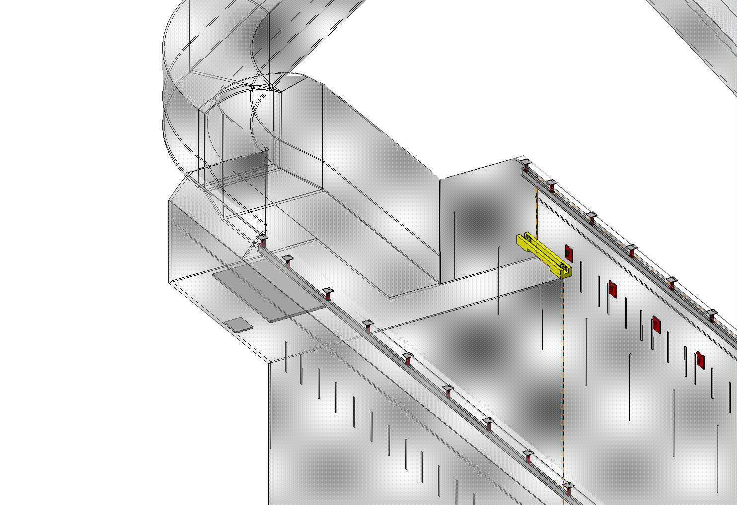
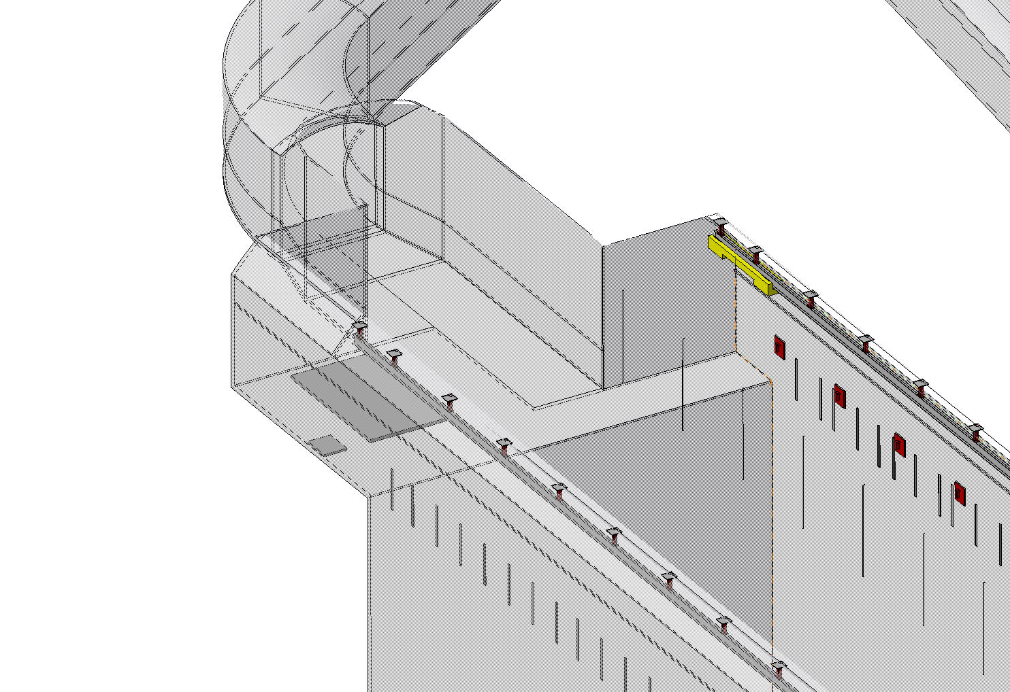
Crane in the main cavern - Installation
Assembly of the 2 bogies from the platform
Weight of one bogie 3t / 6724 lbs.

Slide 13
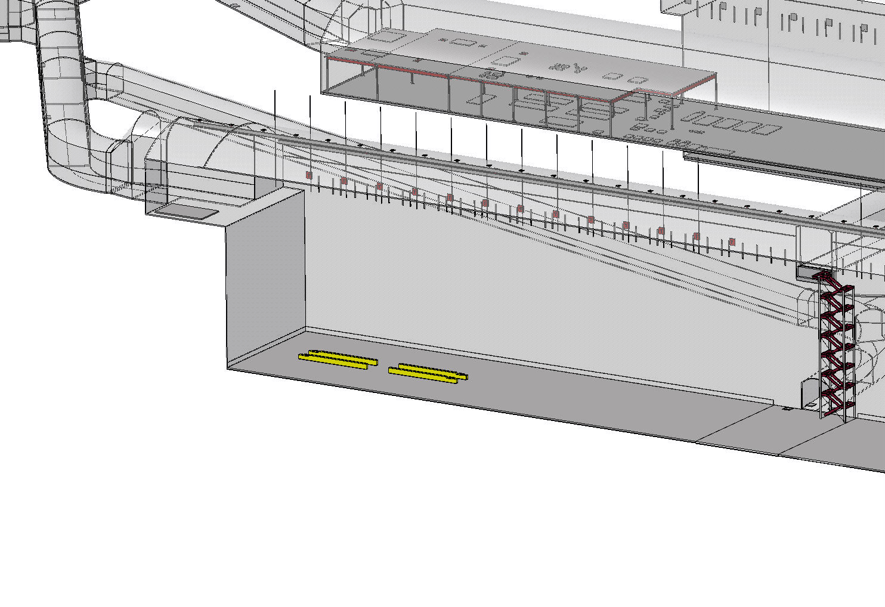
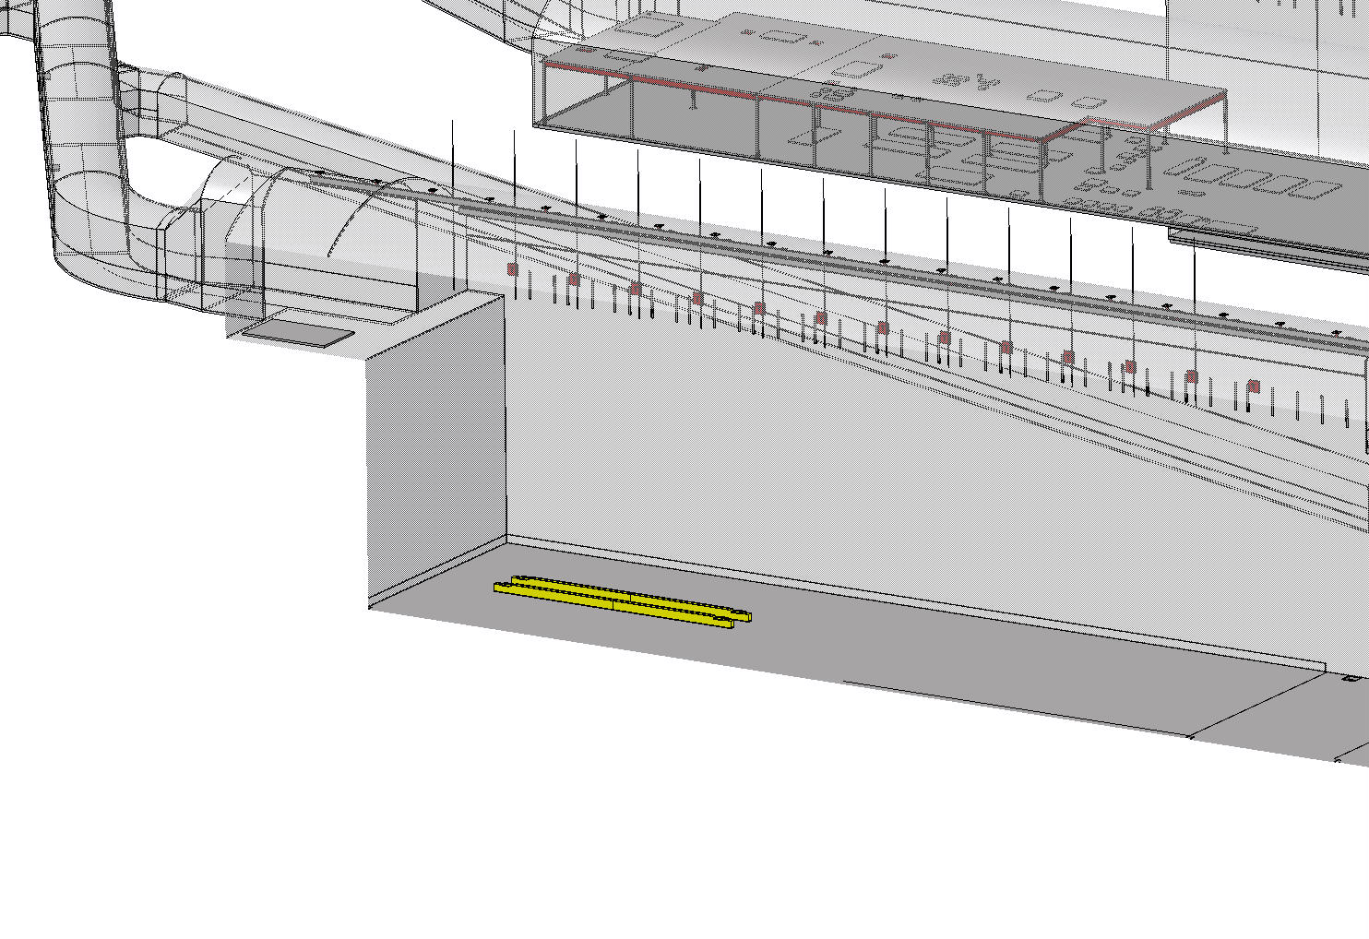
Crane in the main cavern - Installation
Assembly of the 2 girders in the cavern
Weight one girder (6.5 metric tons / 14330 lbs.)

Slide 14
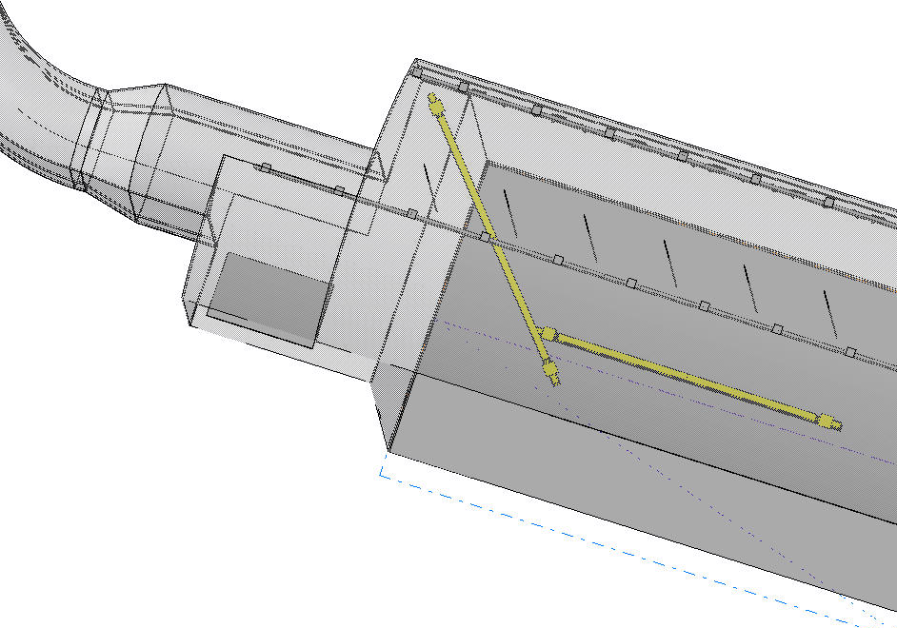
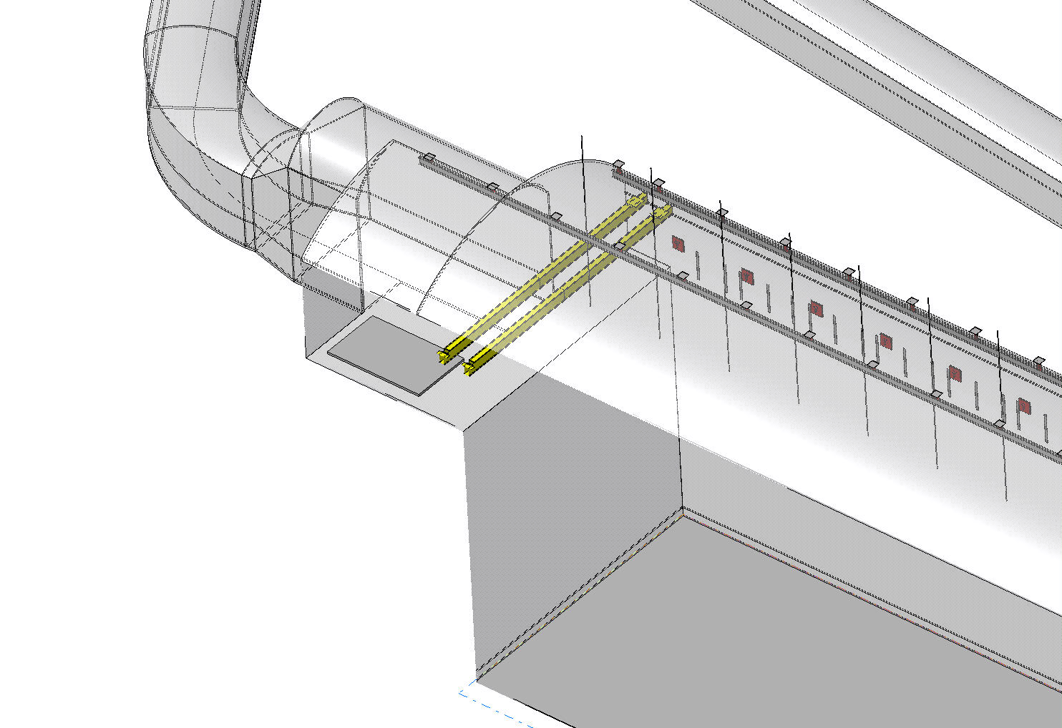
Crane in the main cavern - Installation
Installation of 2nd girder
Installation of 1rst girder (diagonal of the girder 19710mm)
Lifting with 1 central hoist

Slide 15
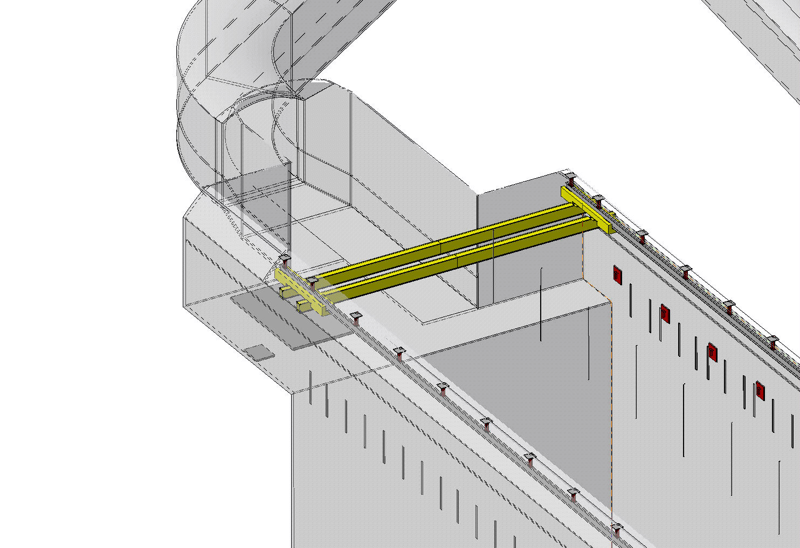
Crane in the main cavern - Installation
Installation of the winch of the crane
Weight of the winch 2.4t / 5291 lbs.

Slide 16
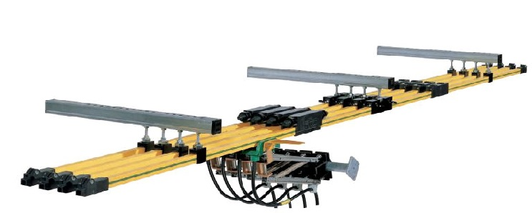
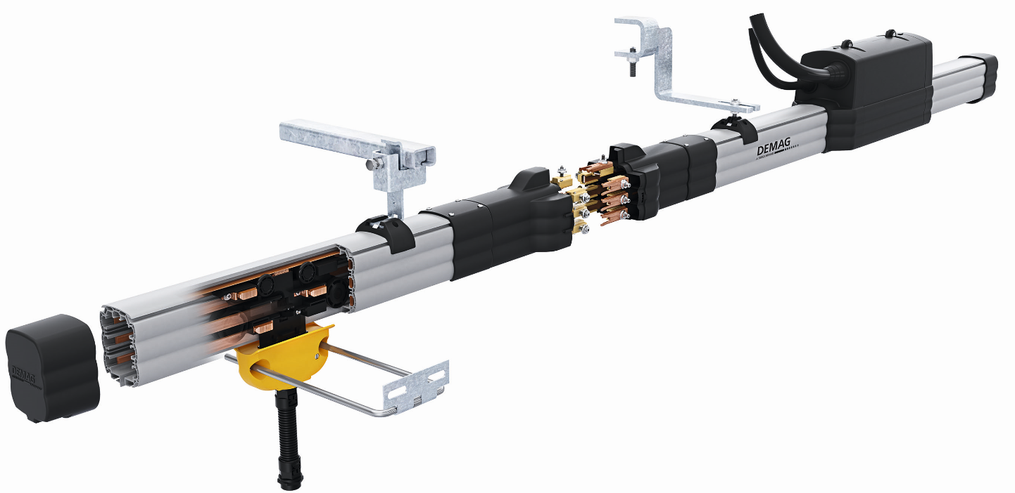
Power lines
Will be clamped to the monorails one support every ~2m (75 supports/monorail)
One will be common between 2 hoists and the overhead crane
Sliding rail with 4 conductors (3 Phases + Ground)
Exact size type of power line will be defined in the specification
What are the requirement in term of fire? UL94-V sufficient? Should it be halogen free?

Slide 17
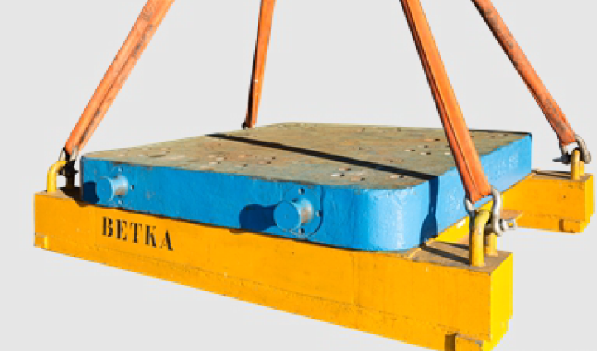
Commissioning
Load test of the crane and hoists-> what to do? 125% of the nominal load?
Crane: 12.5t -> 15.6t / 34392 lbs.
Hoist: 15t -> 18.75t / 41336 lbs.
For 1rst test load for testing should be part of the contract
Load test of the monorails anchor prior to the crane and hoist installation?

Slide 18
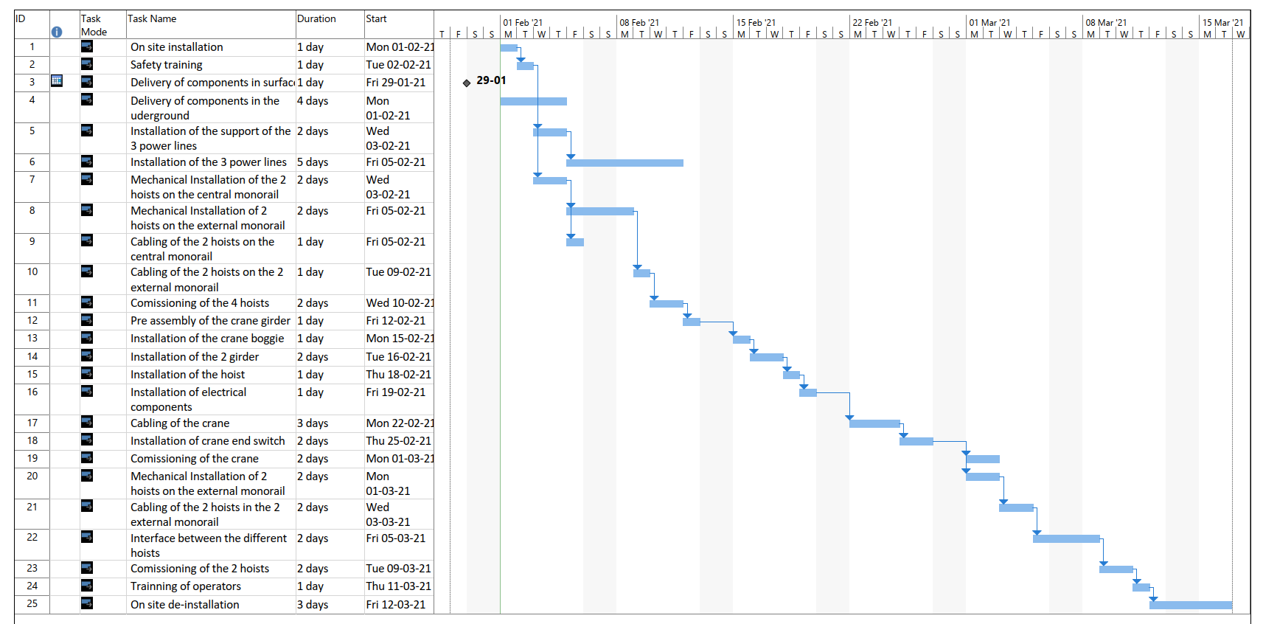
Planning of installation

Slide 19
Specification
One contract for all the 6 hoist and the crane / cavern
including design, procurement, installation, commissioning, preventive maintenance, corrective maintenance

Slide 20
Use of the handling equipment over the construction of the cryostat
Temporary modification of crane, hoist end stop might be required during installation phase
On call maintenance service should be organized (having a local team from a company with full access and training to underground)

Slide 21
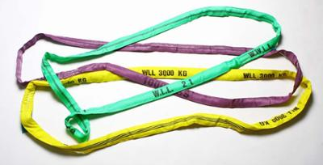
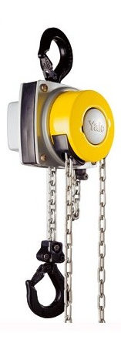
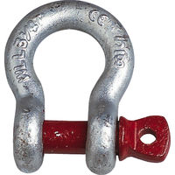
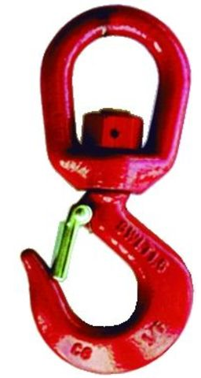
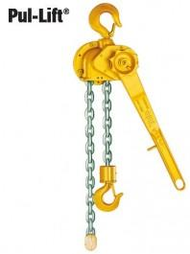
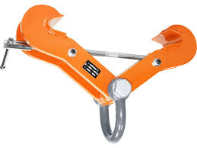
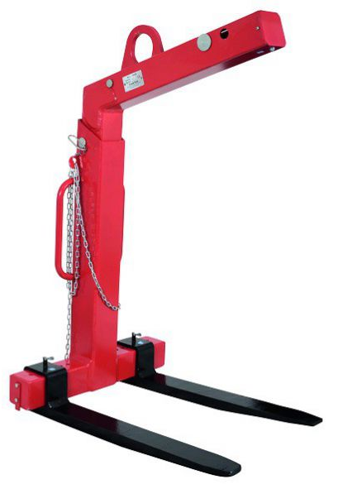
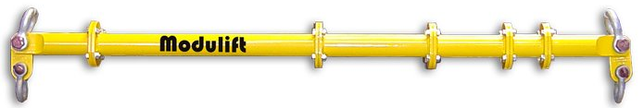
General handling equipment
A wide range of standard lifting accessories will be required:
  Lifting slings (different length, capacity)
  Lifting shackles
  Lifting hooks
  Lifting clamps
  Manual hoists
  Lifting fork for pallets
  Modular lifting beam

Slide 22
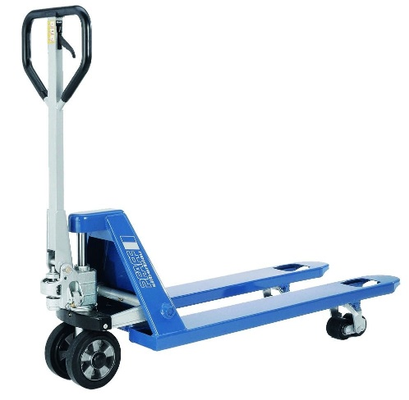
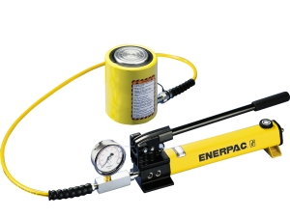
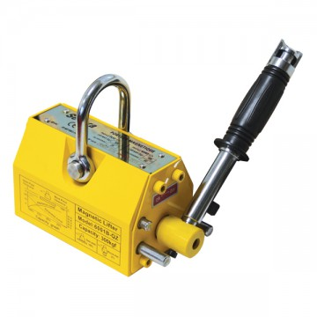
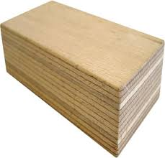
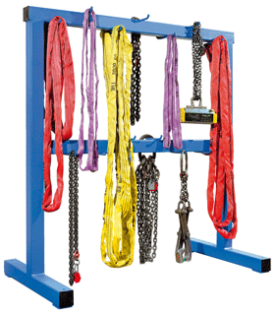
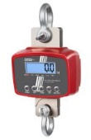
General handling equipment
  Magnetic lifting spreader
  Weighting device
  Pallet truck
  Hydraulic jack
  Hard wood
  …
Slings, shackles, hooks…. need to have a correct storage

Slide 23
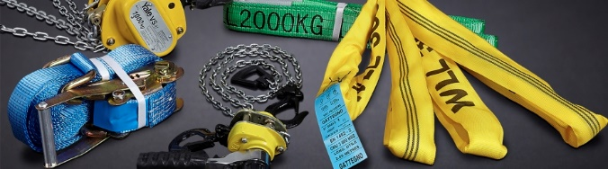
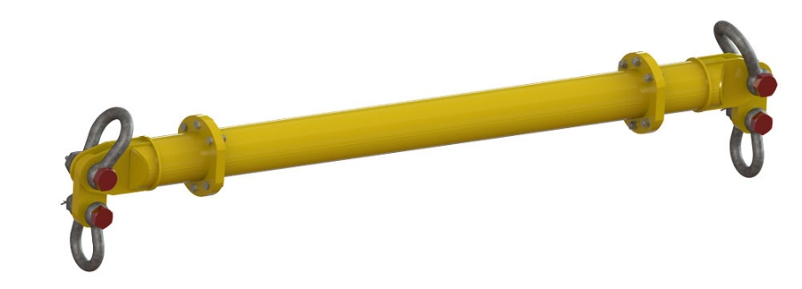
Maintenance – Periodic inspection
One preventive maintenance of crane and hoist need to foreseen at least every 6 month (this will depend on average use)
One periodic inspection is mandatory every year (including load test at nominal load)
A periodic inspection should although include all lifting accessories (slings, shackles, hooks, lifting beams, manual hoists…)

Slide 24
Standards
OSHA Occupational Safety and Health Administration
Part 1926.554 - Overhead Hoists
Part 1910.179 – Overhead and Gantry Cranes
CMAA Crane Manufacturer’s Association of America
Specifications for Top Running Bridge & Gantry Type Multiple Girder Electric Overhead Traveling Cranes - No. 70 (2004)
Specifications for Top Running and Under Running Single Girder Electric Overhead Cranes Utilizing Under Running Trolley Hoist - No. 74 (2004)
ANSI / ASME American National Standards Institute / American Society of Mechanical Engineers
ANSI / ASME HST-4 - 1999 Performance Standard For Overhead Electric Wire Rope Hoists
ANSI / ASME B30.16 – 2003 Overhead Hoists (Underhung)
ANSI / ASME B30.2 - 2001 Overhead and Gantry Cranes (Top Running Bridge, Single Or Multiple Girder, Top Running Trolley Hoist)
ANSI / ASME B30.11 – 2004 Monorails and Underhung Cranes
ANSI / ASME B30.17 – 2003 Overhead and Gantry Cranes (Top Running Bridge, Single Girder, Underhung Hoist)
NEMA National Electric Manufacturer’s Association
NEC National Electric Code – 1999
Article 100, Article 240-1, Article 430-31, Article 430-51, Article 610-1, Article 610-31
DOE rules?

Slide 25
Questions?

