Slide 1
Magnet Fabrication Travelers, Non-Conformities and Resolution
Katherine Ray – LBNL (QA)
Mike Solis – LBNL (Procurement Technical Contact)
May 22, 2019 – MQXFA03 Structure and Loading Review

Slide 2
Overview
State of the Magnet Fabrication Travelers
Non-Conformances on MQXFA03
Change Tracking Process
Shell Receiving process

Slide 3
Magnet Fabrication Travelers Overview
# | Title | Revision | ID
1 | Yoke Pre-Stack WI | B | SU-1008-8072
2 | Yoke Half Stack WI | B | SU-1009-7829
3 | Shell Instrumentation WI | B | SU-1009-3745
4 | Shell-Yoke Assy WI | A | SU-1008-2169
5 | Loadpad Pre-Stack WI | B | SU-1008-8075
6 | Dressed Coil WI | B | SU-1008-8073
7 | Pad-Collar Assy WI | Not released | SU-1010-1610
8 | Coil Pack Subassy WI | A | SU-1008-8074
9 | Magnet Electrical QA at LBNL | B | SU-1010-1903
10 | Magnetic Measurements | Not released | SU-1010-2018
11 | Magnet Fiducial Structure WI | A | SU-1008-8070
12 | Axial Rods Instrumented WI | B | SU-1008-8069
13 | Axial End Load Structure WI | B | SU-1008-8068
14 | Splice Box WI | A | SU-1008-8067

Slide 4
Magnet Fabrication Travelers Overview
# | Title | Revision | ID
1 | Yoke Pre-Stack WI | B | SU-1008-8072
2 | Yoke Half Stack WI | B | SU-1009-7829
3 | Shell Instrumentation WI | B | SU-1009-3745
4 | Shell-Yoke Assy WI | A | SU-1008-2169
5 | Loadpad Pre-Stack WI | B | SU-1008-8075
6 | Dressed Coil WI | B | SU-1008-8073
7 | Pad-Collar Assy WI | Not released | SU-1010-1610
8 | Coil Pack Subassy WI | A | SU-1008-8074
9 | Magnet Electrical QA at LBNL | B | SU-1010-1903
10 | Magnetic Measurements | Not released | SU-1010-2018
11 | Magnet Fiducial Structure WI | A | SU-1008-8070
12 | Axial Rods Instrumented WI | B | SU-1008-8069
13 | Axial End Load Structure WI | B | SU-1008-8068
14 | Splice Box WI | A | SU-1008-8067
The majority of the 14 travelers that describe the magnet fabrication process have been released.
However, revisions based on Lessons Learned have been and will continue to be made.

Slide 5
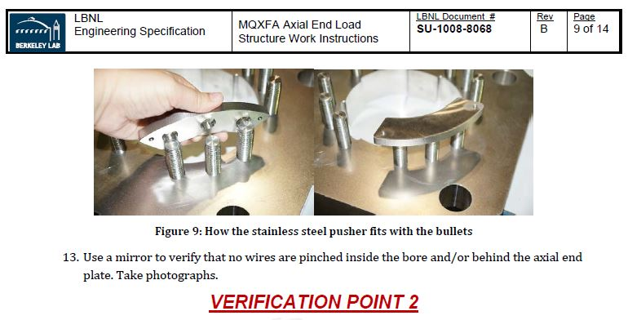
Magnet Fabrication Traveler Changes Made to Address Pinched Wire in MQXFAP1b
Added verification point

Slide 6
Change Records
We are tracking Non-Conformances, Deviations and Engineering Changes in one spreadsheet
These are currently communicated to Fermilab on a monthly basis

Slide 7
MQXFA03 Change Records
Thus far we have only minor non-conformances, which we are tracking
Pion mounting, non-certified washers, minor out of tolerances on parts

Slide 8
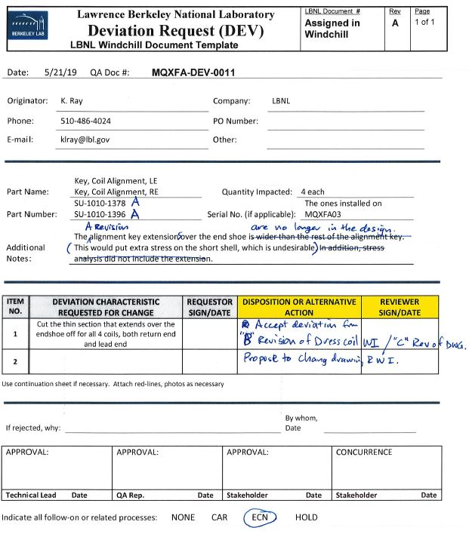
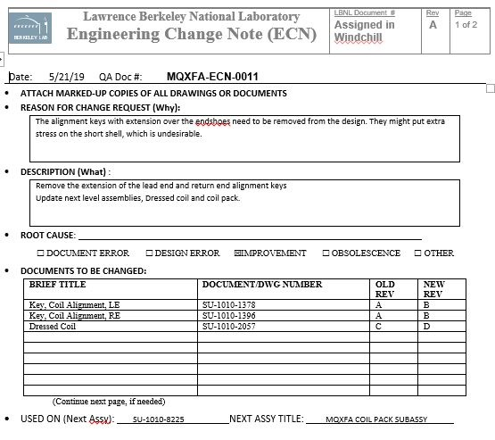
Example Change Records Process: Coil Alignment Keys
MQXFA03 alignment keys were made full-length as well
MQXFAP2 coil alignment keys were full length
Project subsequently decided not to have full-length alignment keys. Request to deviate from the released drawings for MQXFA03 documented.
Engineering Change Note used to request drawing changes and work instruction changes for future magnets

Slide 9
Overview
State of the Magnet Fabrication Travelers
Non-Conformances on MQXFA03
Change Tracking Process
Shell Receiving process

Slide 10
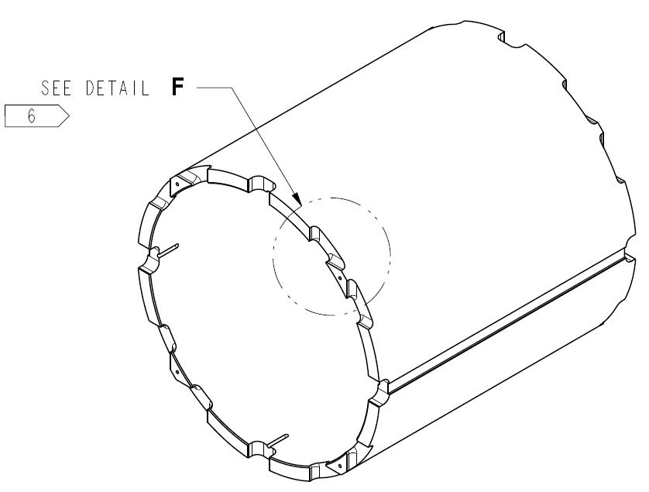
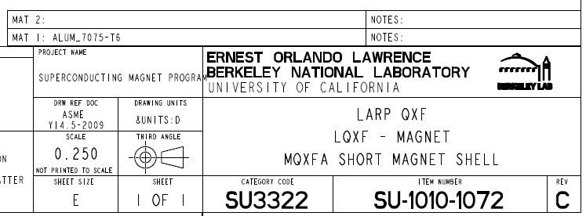
MQXFA03 Shells Built to Drawing Revision C
Added larger radii to cutouts
Shell Material updated to Aluminum 7075-T6, from T652

Slide 11
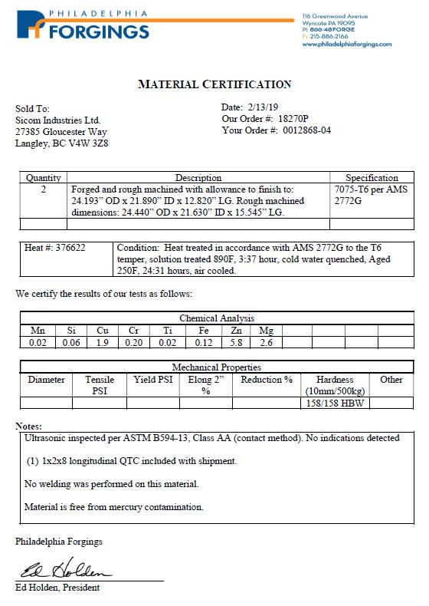
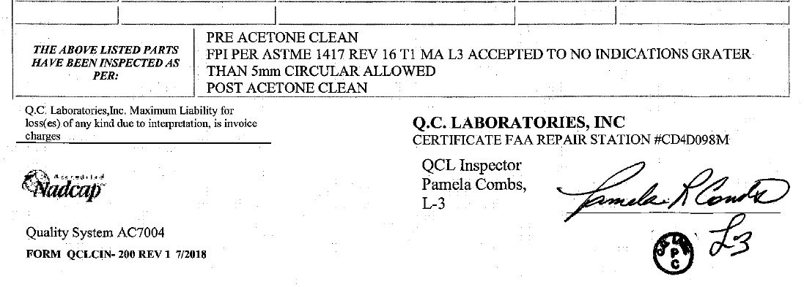
Shell Material Certifications and Inspections
Aluminum 7075-T6
Fluourescent (Dye) Penetrant Inspection (FPI) now required
Ultrasonic inspection

Slide 12
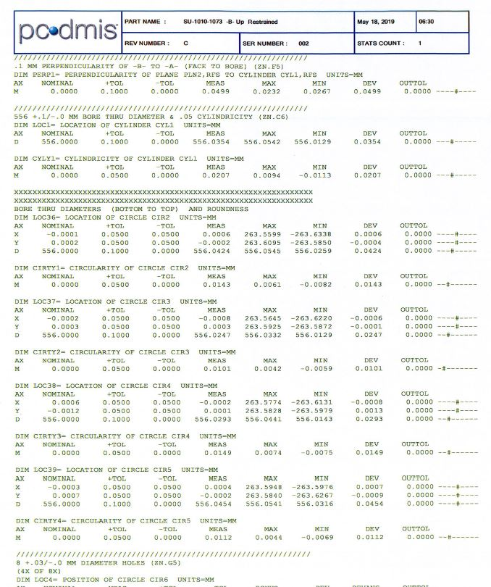
Shell Dimensional Inspections at the Vendors
Vendors measure inner and outer diameter in 5 locations
Other vendor’s report in restrained position looks good
Tolerances are for restrained condition. Above measurements made in unconstrained condition.
Measurements averaged when evaluating.

Slide 13
Shell Dimensional Inspections at LBNL
Shells started arriving at LBNL this week
They will be sent to our CMM facility to verify the vendors’ data

Slide 14
Summary
The procedures and drawings are mostly released
We are tracking changes from lessons learned
Drawing & procedure updates
Documented with various change records
Reporting monthly to L2
Shell QC recommendations have been implemented
Certs and inspection data are retained for records
No critical deviations noted to date

