Slide 1
MQXFA03 Preload Proposal
--- with measured pole key gaps
H. Pan, D. Cheng
LBNL

Slide 2
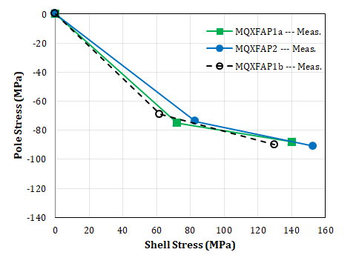
Preload Achieved in MQXFAP1 & 2
Average stress: (MPa)
 |  | MQXFAP1a (Meas.) | MQXFAP2 (Meas.) | MQXFAP1b (Meas.)
RT | Coil | -75 | -74 | -69 (RE)
 | Shell | 72 | 83 | 62 (Shell 6)
CD | Coil | -88 (FEA) | -91 | -90
 | Shell | 140 | 153 | 130
Actual Interference (μm) |  |  |  | 510
MQXFAP1b was preloaded to the same coil stress as MQXFAP1a according to the average measured pole key gaps of 2.9 mil / side.
The actual shims thickness for MQXFAP1b is about 510 µm.
Since the preload targets for MQXFAP1b meets the MQXFA Structural Design Criteria, the preload target baseline of MQXFA03 is set to follow the same principal as implemented on MQXFAP1b.
Same coil R.T. stress as MQXFAP1a;
Leave as much pole key gap as possible.
Same axial preload target.

Slide 3
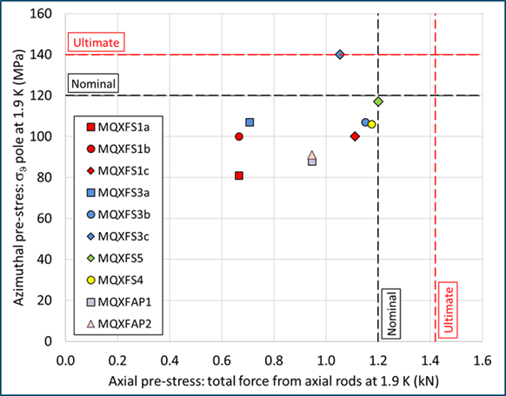
Preload Achieved in MQXF magnets
MQXFAP1b Meas.

Slide 4
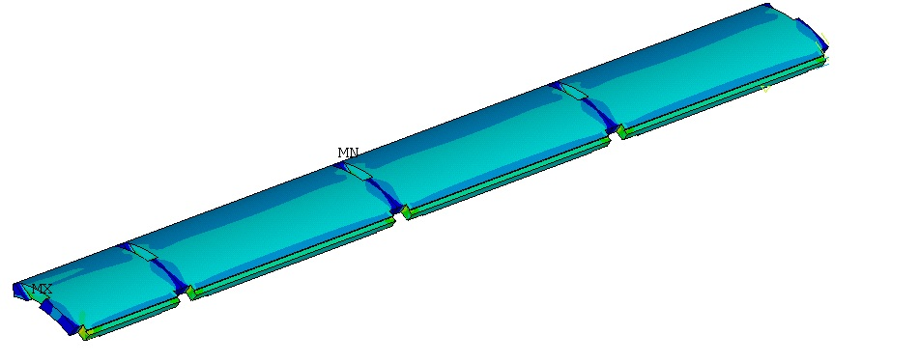
Preload on MQXFAP1b
 | Value
Interference (µm) | 510
Polekey gap (µm/side) | 75
Polekey interception F_{pole}/F_{shell} (1.9K) | 9%
Coil stress remains same as MQXFAP1a
 | 1.9 K | 16.47 kA | 17.89 kA | 19 kA
Shell Average Von Mises Stress (MPa) | 120 | 130 | 134 | 140
Shell Peak Stress (MPa) | 502 | 506 | 506 | 505

Slide 5
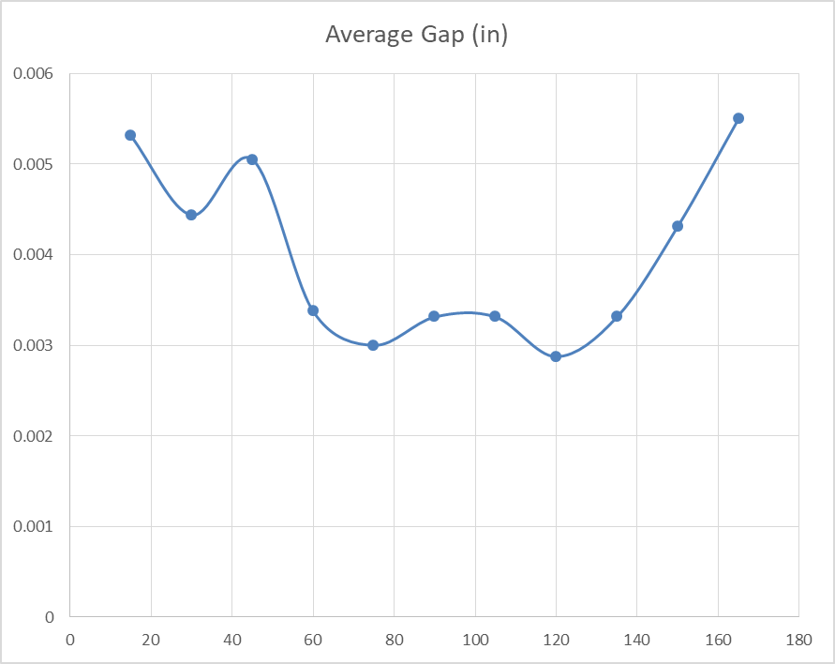
Pole Key Gap Measurements of MQXFA03
The measured average (of all quadrants) pole key gap of MQXFA03 coil-pack along the magnet length;
The two bounding cases of pole key gaps were performed in the target calculations.
~average pole gap: 5.5 mil
~average pole gaps of 3 mil

Slide 6
Preload on MQXFA03 --- 3 mil PK Gap
This case is same as MQXFAP1b
 | Value
Interference (µm) | 510
Polekey gap (µm/side) | 75
Polekey interception F_{pole}/F_{shell} (1.9K) | 9%
Coil stress remains same as MQXFAP1a;
Shell stress has a reduction of 20 MPa compared to MQXFAP1a
 | 1.9 K | 16.47 kA | 17.89 kA | 19 kA
Shell Average Von Mises Stress (MPa) | 120 | 130 | 134 | 140
Shell Peak Stress (MPa) | 502 | 506 | 506 | 505

Slide 7
Preload on MQXFA03 --- 5.5 mil PK Gap
This is very close to the NO-PK case
 | Value
Interference (µm) | 470
Polekey gap (µm/side) | 140
Polekey interception F_{pole}/F_{shell} (1.9K) | 1%
Coil stress remains same as MQXFAP1a.;
Shell stress has a reduction of 28 MPa compared to MQXFAP1a
 | 1.9 K | 16.47 kA | 17.89 kA | 19 kA
Shell Average Von Mises Stress (MPa) | 116 | 121 | 125 | 129
Shell Peak Stress (MPa) | 488 | 481 | 481 | 480

Slide 8
MQXFA03 Preload Summary
As discussed in the review (https://indico.fnal.gov/event/19361/), MQXFAP1b preload aligns with same R.T. coil stress of MQXFAP1a. This is also applied for the MQXFA03 preload operations.
Because the measured pole key gap varies from 3 mil to 5.5 mil, the interferences to align with the MQXFAP1a coil stress are 510 μm (3 mil) and 470 μm (5.5 mil) .
MQXFAP1b Meas.
MQXFA03 --- 5.5mil PK gap
MQXFA03 --- 3mil PK gap
MQXFA03
MQXFA03 --- No PK

Slide 9
Axial Preload Calculation
As the axial preload does not dominantly impact the magnet performance, the MQXFA03 would retain the same axial load as MQXFAP1 magnets:
MQXFA03 Proposal | Room Temperature | 1.9 K | Nominal Current
Preload | 580 µε | 1200 µε
Axial Force (MN) | 0.36 | 0.85 | 0.9
Ratio to the e.m. force at nominal current | 30% | 70.8% | 75%
Total axial e.m. force is 1.2 MN at nominal current.

Slide 10
Preload Proposal
MQXFA03 will have the same coil stress as MQXFAP1a and 1b according to the average measured pole key gap.
To achieve the proposed coil stress at R.T., the resultant interference for azimuthal preload of MQXFA03 ranges from 470 ~ 510 µm(the latest gap measurements will confirm the final target).
 |  | MQXFAP1a (Meas.) | MQXFAP1b (Meas.) | MQXFA03 (FEA)
RT | Coil | -75 | -69 (RE) | -76
 | Shell | 72 | 62 (Shell 6) | 51~59
CD | Coil | -88 (FEA) | -90 | -90 ~ -102
 | Shell | 140 | 130 | 115 ~125
Actual Interference (μm) |  |  |  | 470~510
MQXFA03 --- 5.5mil PK gap
MQXFA03 --- 3mil PK gap
Baseline axial preload strain at RT is still 580 με / rod.
Full bridge HBM strain gauges are installed on rods RE.
MQXFA03 --- No PK

