Slide 1
Loading Sequence for MQXFA03 (Proposed)
Soren Prestemon – LBNL (L3/CAM)
Dan Cheng– LBNL (Deputy L3/CAM)
Heng Pan
May 22, 2019

Slide 2
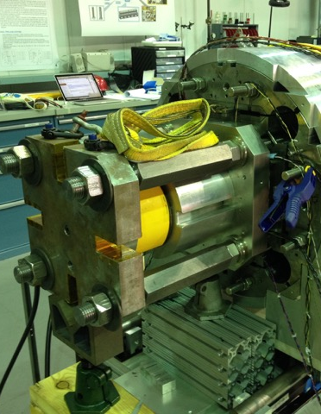
Loading considerations
Azimuthal (radial) preload is applied via a bladder-and-key approach
Target strain values for Aluminum shells and coil poles are determined in advance
Strain gauges on shells and coil poles are monitored during loading
Keys are shimmed to lock in the load
Axial preload is achieved via a hydraulic loading rig
Target strain values for the rods are determined in advance
Strain gauges on rods are monitored during loading
Once target strain achieved, nuts lock the preload in place

Slide 3
Order of operations
The order of these operations has evolved through LARP and into HL-LHC AUP
In the TQ era, partial radial preload was followed by partial axial, then full radial and then full axial
In the HQ era and into HL-LHC AUP (through MQXFAP2), the full radial preload was performed, then the axial rods installed and full axial preload applied
Note that CERN has used the following process (similar to TQ):
Snug the rods; 50% radial loading, 50% axial loading, then 100% radial, 100% axial
In the absence of friction, the order will not affect the end state
With friction, there is the potential for difference in end state stress distribution
Influences primarily the coil ends

Slide 4
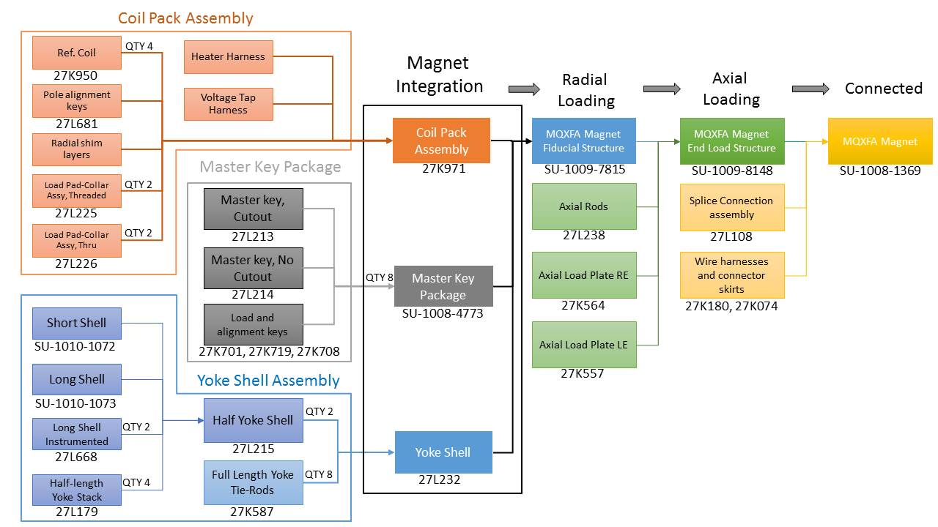
Proposed order of operation for MQXFA03
MQXFAP1b test results hint at issue with coil end preload
We intend to perform the following loading sequence with MQXFA03:
Install and snug the axial rods
Perform azimuthal (radial) preload to 50% of target value
Perform axial load to 50% of target value
Perform azimuthal (radial) preload to 100% of target value
Perform axial load to 100% of target value
The magnet assembly plan will be modified accordingly
Implies updates to travelers and drawings
Will be captured in the updated FDR

