Slide 1
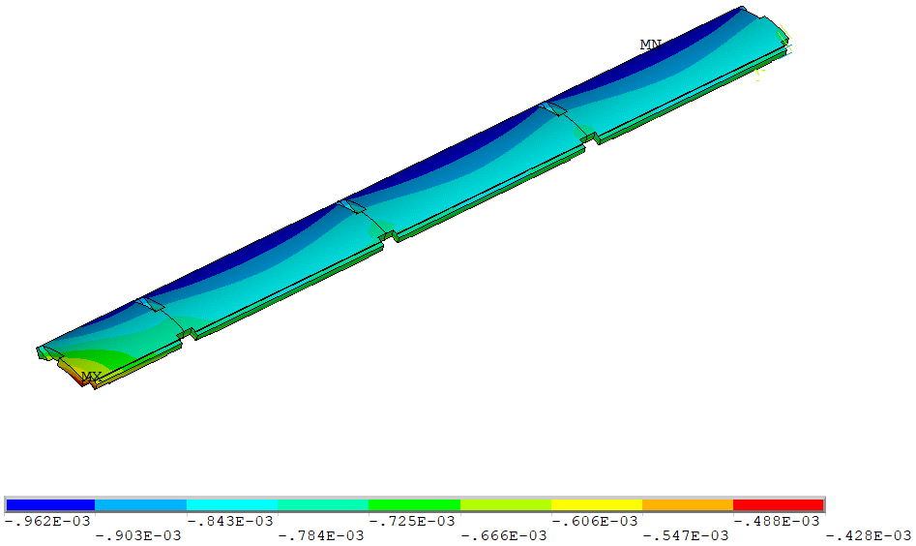
Fracture Analysis for the Weld Strip Groove
The end shell is the most stressed one compared with other shells
End shell bends more than the middle shells
①
②
④
③
Radial deformation after cool-down in cylindrical coordinate (meter)
The following locations are checked in FAD in order to verify the high stress area is local (the fillet radius of the weld strip grooves on all shells is 0.5 mm).
Middle of the center shell ①;
End of the center shell ②;
Middle of the end shell ③;
End of the end shell ④.

Slide 2
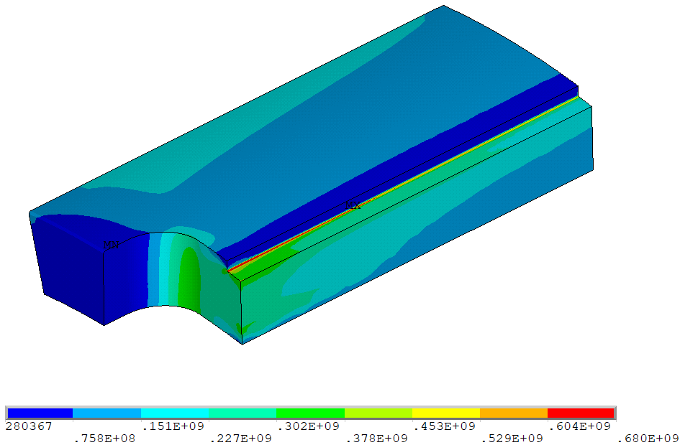
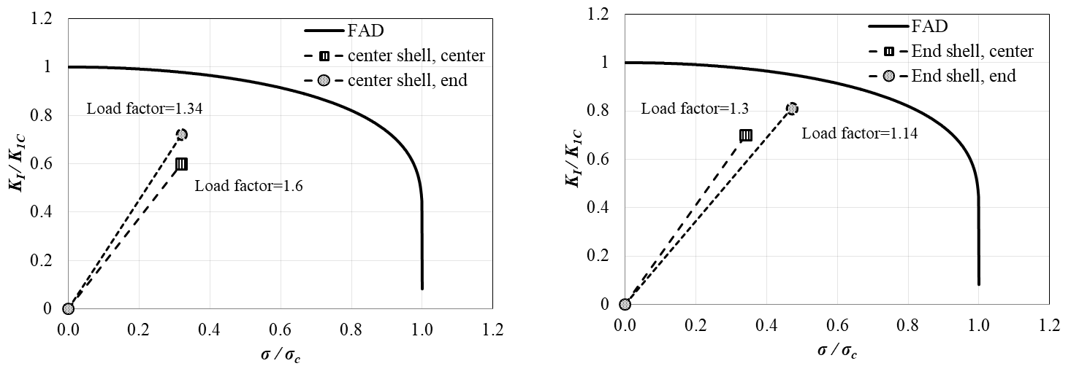
FAD of Different Shell Locations of MQXFAP1b
The stress in the center shells and in the middle of the end shell are comfortably above the defined load factor of 1.2.
The end of the end shell is the most stressed area in the entire shell assembly, and is marginal with respect to the Design Criteria.
Localized larger fillets (> 2 mm) are proposed (next slide)
Plastic zone:
30 mm long
Path
Pa
2 mm crack size,
K_{IC}=$\text{24 }\text{MPa}\text{ ∙}\sqrt{\text{m}} in C−R directon$
2 mm crack size,
K_{IC}=$\text{24 }\text{MPa}\text{ ∙}\sqrt{\text{m}} in C−R directon$
②
③
④
①
Less than 1.2 for the current 0.5 mm radius

Slide 3
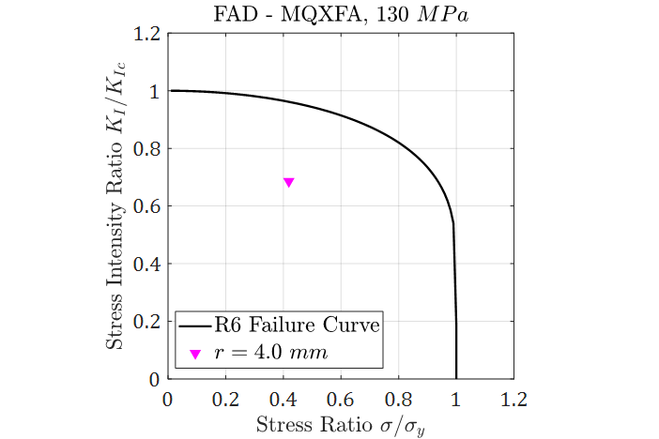
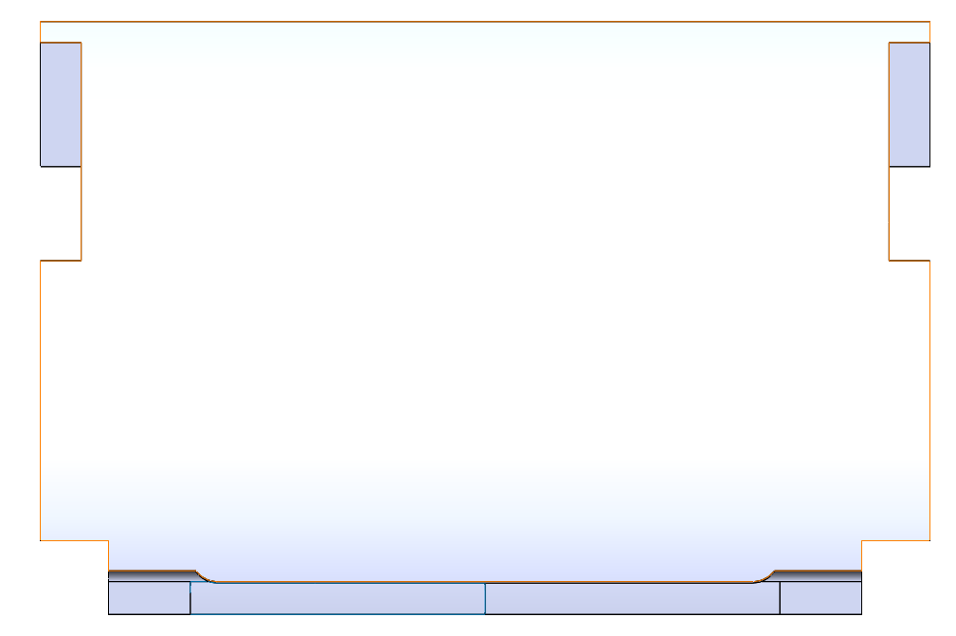
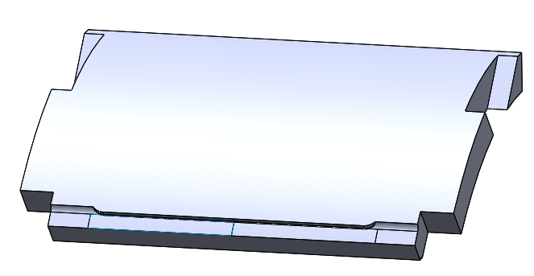
FAD with Different Fillet Sizes in the End Shell
For 2mm crack with K1c=24:
Load factor = 1.34
Proposed modifications on MQXFA03 end shells :
4 mm fillets on the extremities of the end shell groove;
0.5 mm on the rest middle groove.
Modifications can be performed at LBNL without impacting schedule
For future end shells these would be incorporated by vendor

