Slide 1
Summary statements on lessons-learned
Soren Prestemon, Lawrence Berkeley National Laboratory
LBNL Coordinator & L3 Control Account Manager for Structures
LHC AUP Project
LBNL – March 22, 2019

Slide 2
Outline
Lessons learned:
  Understanding of MQXFAP2 shell fracture
  Communicating and handling non-conformance
  Enhanced QC for flaw detection
  Implications of integration features
  Designing within Criteria
Status of shell design moving forward
  Satisfy design criteria
  Meet integration feature requirements

Slide 3
We have a general understanding of the issues leading to the MQXFAP2 shell failure
Very tight radii on a short end shell:
  Led to enhanced stress concentrations
  Analysis predicts plastic region
    strains can exceed the tensile limit of the material and introduce cracks
    Propagation of the cracks is then possible under some stress scenarios
Fairly high stress level on (all) shells
  Decision to apply collar key interception played a role
Additional elements that may have enhanced the return end shell stress:
  Pole key was extended – first time in AUP:
    Results in “stiffer” ends
    Had been successfully used by CERN
      (reduces stresses on coil ends)
  RE shell is first to see cold He gas – possible enhanced stress during cooldown
    High-conductivity and low heat capacity of Al as compared to yokes, masters, pads, and coils
  Tolerances may have resulted in higher stress on end-shell
    Typical band of shell stresses measure ~ 25-30MPa; end shells typically not monitored

Slide 4
Value and limits of the FEA analysis and the Failure Assessment Diagram
The analysis effort provides…
  An understanding of the critical roles (sensitivities) of parameters
    E.g. corner radii, membrane stress, yield and tensile stress, K_{1c}
  A means of qualitatively understanding the failure mechanism
  A means of comparing different cases in terms of margin
The analysis effort does not…
  Provide a clean line for a fail/no-fail design
  Need design margin and avoid plastic regime
The FAD assumes a flaw and evaluates the design against failure
  Not meant to evaluate designs outside of LEFM

Slide 5
Communicating and handling non-conformance is critical for the project
The shell cutout radii were flagged by the manufacturer as non-conforming, and accepted
  Non-conforming parts must be rejected or quarantined for further review by L3 and L2
  Project is providing explicit guidance moving forward
Requires regular communication with vendor in order to minimize cost and schedule impact
  If possible we need to avoid just-in-time procurements, where non-conformance leads directly to schedule delay

Slide 6
Flaw detection is a critical element to avoid fracture of the Al shells
Based on feedback from experts, we have enhanced our flaw QC:
  Tightened ultrasonic inspection of the forgings from A to AA
  Added post-machining dye penetrant inspection to catch any surface flaws
From each forging we now capture a material drop from which mechanical property samples can be made
  Intend to evaluate 10+ K_{1c} samples (C-L orientation) to build statistics

Slide 7
Implications of features added for “downstream” integration need to be properly understood
The cutouts were added during the design phase to address cryostat integration needs
  Al shells were initially designed purely to prestress coils via circumferential tension (hoop stress)
  We did not fully recognize the implications of the addition of the cutouts
This is mainly a lessons-learned for future projects
Design Criteria help by providing a ”formalism” to evaluate the impact of design changes

Slide 8
Design Criteria support the project design on multiple fronts
Guide the analysis process
Enable the project to leverage the material properties within a safe envelop
Provide a systematic “formalism” that instills rigor to the design process
Facilitates design reviews and the evaluation of potential impact of design changes

Slide 9
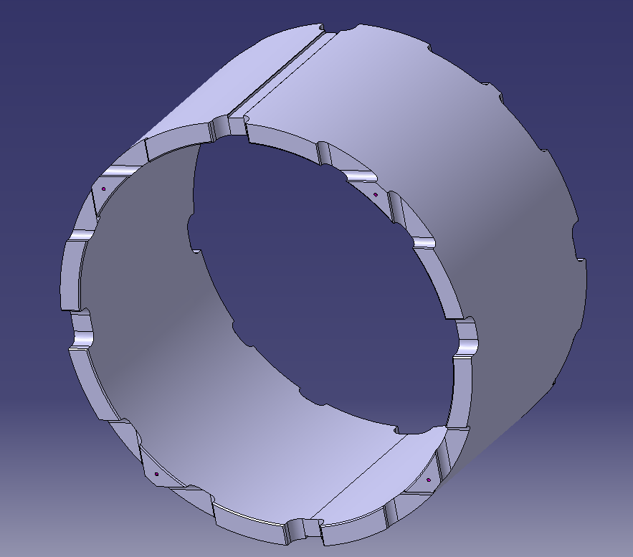
Recap: modifications of shells address the Design Criteria requirements for brittle materials
10 mm radius on the triangular slots
15 mm radius on the square slots
Class AA ultrasonic flaw detection on forgings
Post-machining dye-penetrant testing

Slide 10
Cold measurements provide critical data for assessment against design criteria
  The cold measurements of Al-7075-T6 give confidence that ample margin exists moving forward
    Need to evaluate 10-20 samples to build reliable statistics
    Measured data to-date indicates:
      some anisotropy in fracture toughness properties
      Fairly good reproducibility of properties
      General agreement of “typical” material behavior with inverse correlation of yield strength and fracture toughness
  “Drops” from each forging are now captured to enable further material property testing as deemed necessary by the project

Slide 11
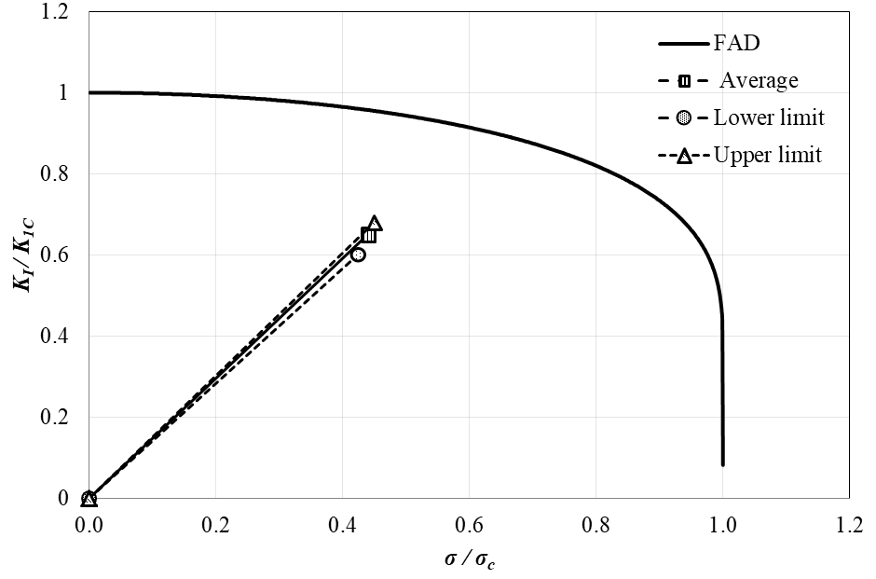
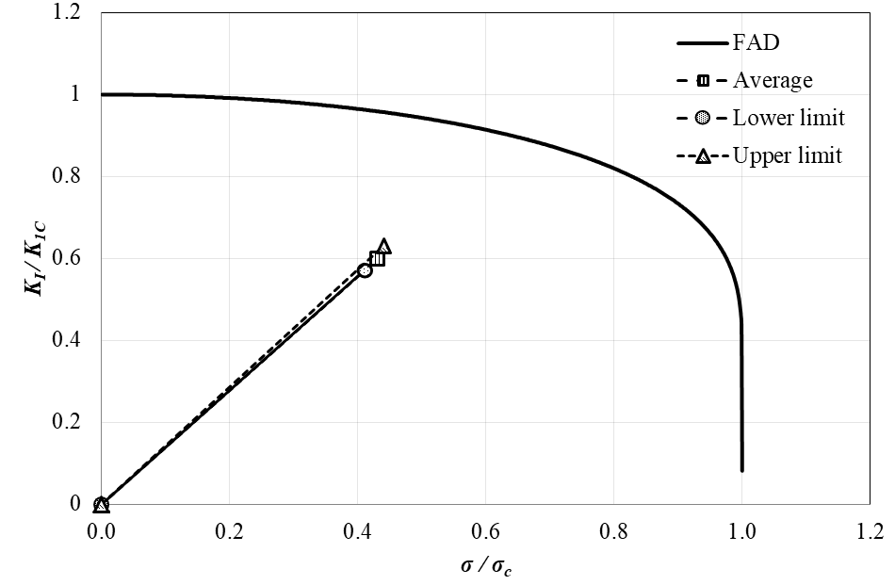
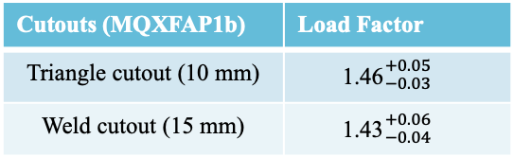
The final Al shell design meets the Design Criteria
The large radii meet two critical needs:
  They allow the cutouts to satisfy their purpose
  They result in stress concentrations well within linear elastic behavior and well within the FAD
    the design criteria require load factor >1.2
Cutouts (MQXFAP1b) | Load Factor
Triangle cutout (10 mm) | 1.46${}_{−0.03}^{+0.05}{}$
Weld cutout (15 mm) | 1.43${}_{−0.04}^{+0.06}{}$
Load factor with average shell stress 120MPa ±11MPa
15 mm weld block cutout
10 mm triangle cutout

Slide 12
The cutouts maintain their function

Slide 13
Conclusions
We have developed an understanding of the primary sources at the heart of the MQXFAP2 fractured shell
We have developed a thorough set of Design Criteria that enable us to design within a safe envelop for both brittle and tough materials
We now have a design that meets the Design Criteria while satisfying the technical requirements

