Slide 1
ES at UChicago
MWT2
Ilija Vukotic
University of Chicago, September 30th, 2019

Slide 2
Background
There are 7+ ES deployments at UC.
Managed by different people, different use cases, cluster scales.
More than year ago we had a UC ES users get together to exchange experiences.
None of them pays for support.
I am physicist on ATLAS experiment.
At UC we run MWT2 Tier2 computing center (22k + cores, 12PB+ storage,.. )
We provide Monitoring, Analytics and ML platforms for ADC (ATLAS distributed computing).
ES we manage is a part of that infrastructure.

Slide 3
Analytics Infrastructure
Data sources:
Oracle (panda, jedi, rucio)
MySQL (BOINC)
AMQ (FTS)
RMQ (PerfSonar)
Pilot (benchmarks)
User codes (xAOD usage)
Frontiers (full logs)
HC jobs (cost matrix)
SLATE
XCache
CERN
DB - Oracle, Hadoop, Ingress, Elastic
Processing - Sqoop, pig, Spark, SWAN, Kubernetes cluster
UC
Elasticsearch
K8s cluster, ML platform
CERN
UC
CERN
UC
CERN
UC
UC
UC
CERN
UC
UC
UC
UC
‹#›
UC

Slide 4
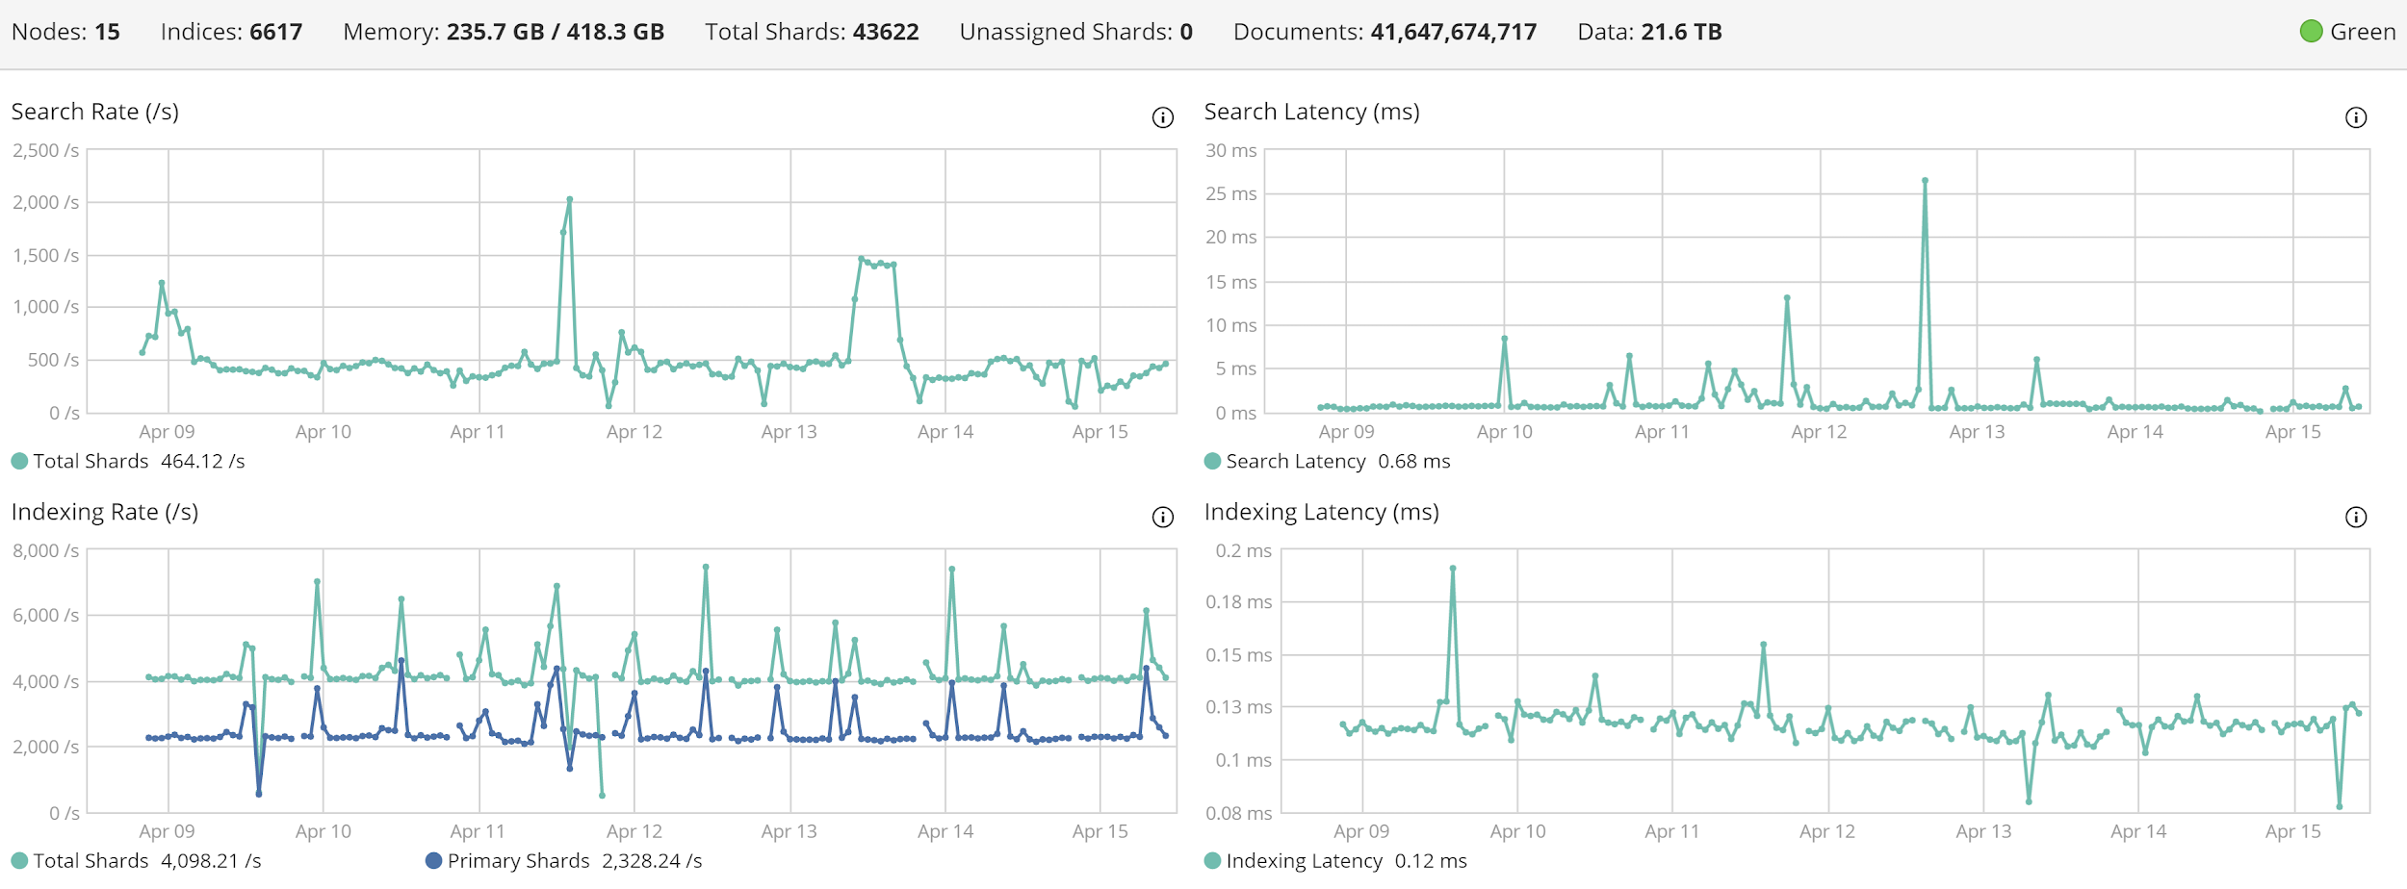
UC ELK infrastructure
10 data nodes
3 master nodes (also running kibana, ingress and client instances)
Total 45TB of storage.
NFS4.1 backup

Slide 5
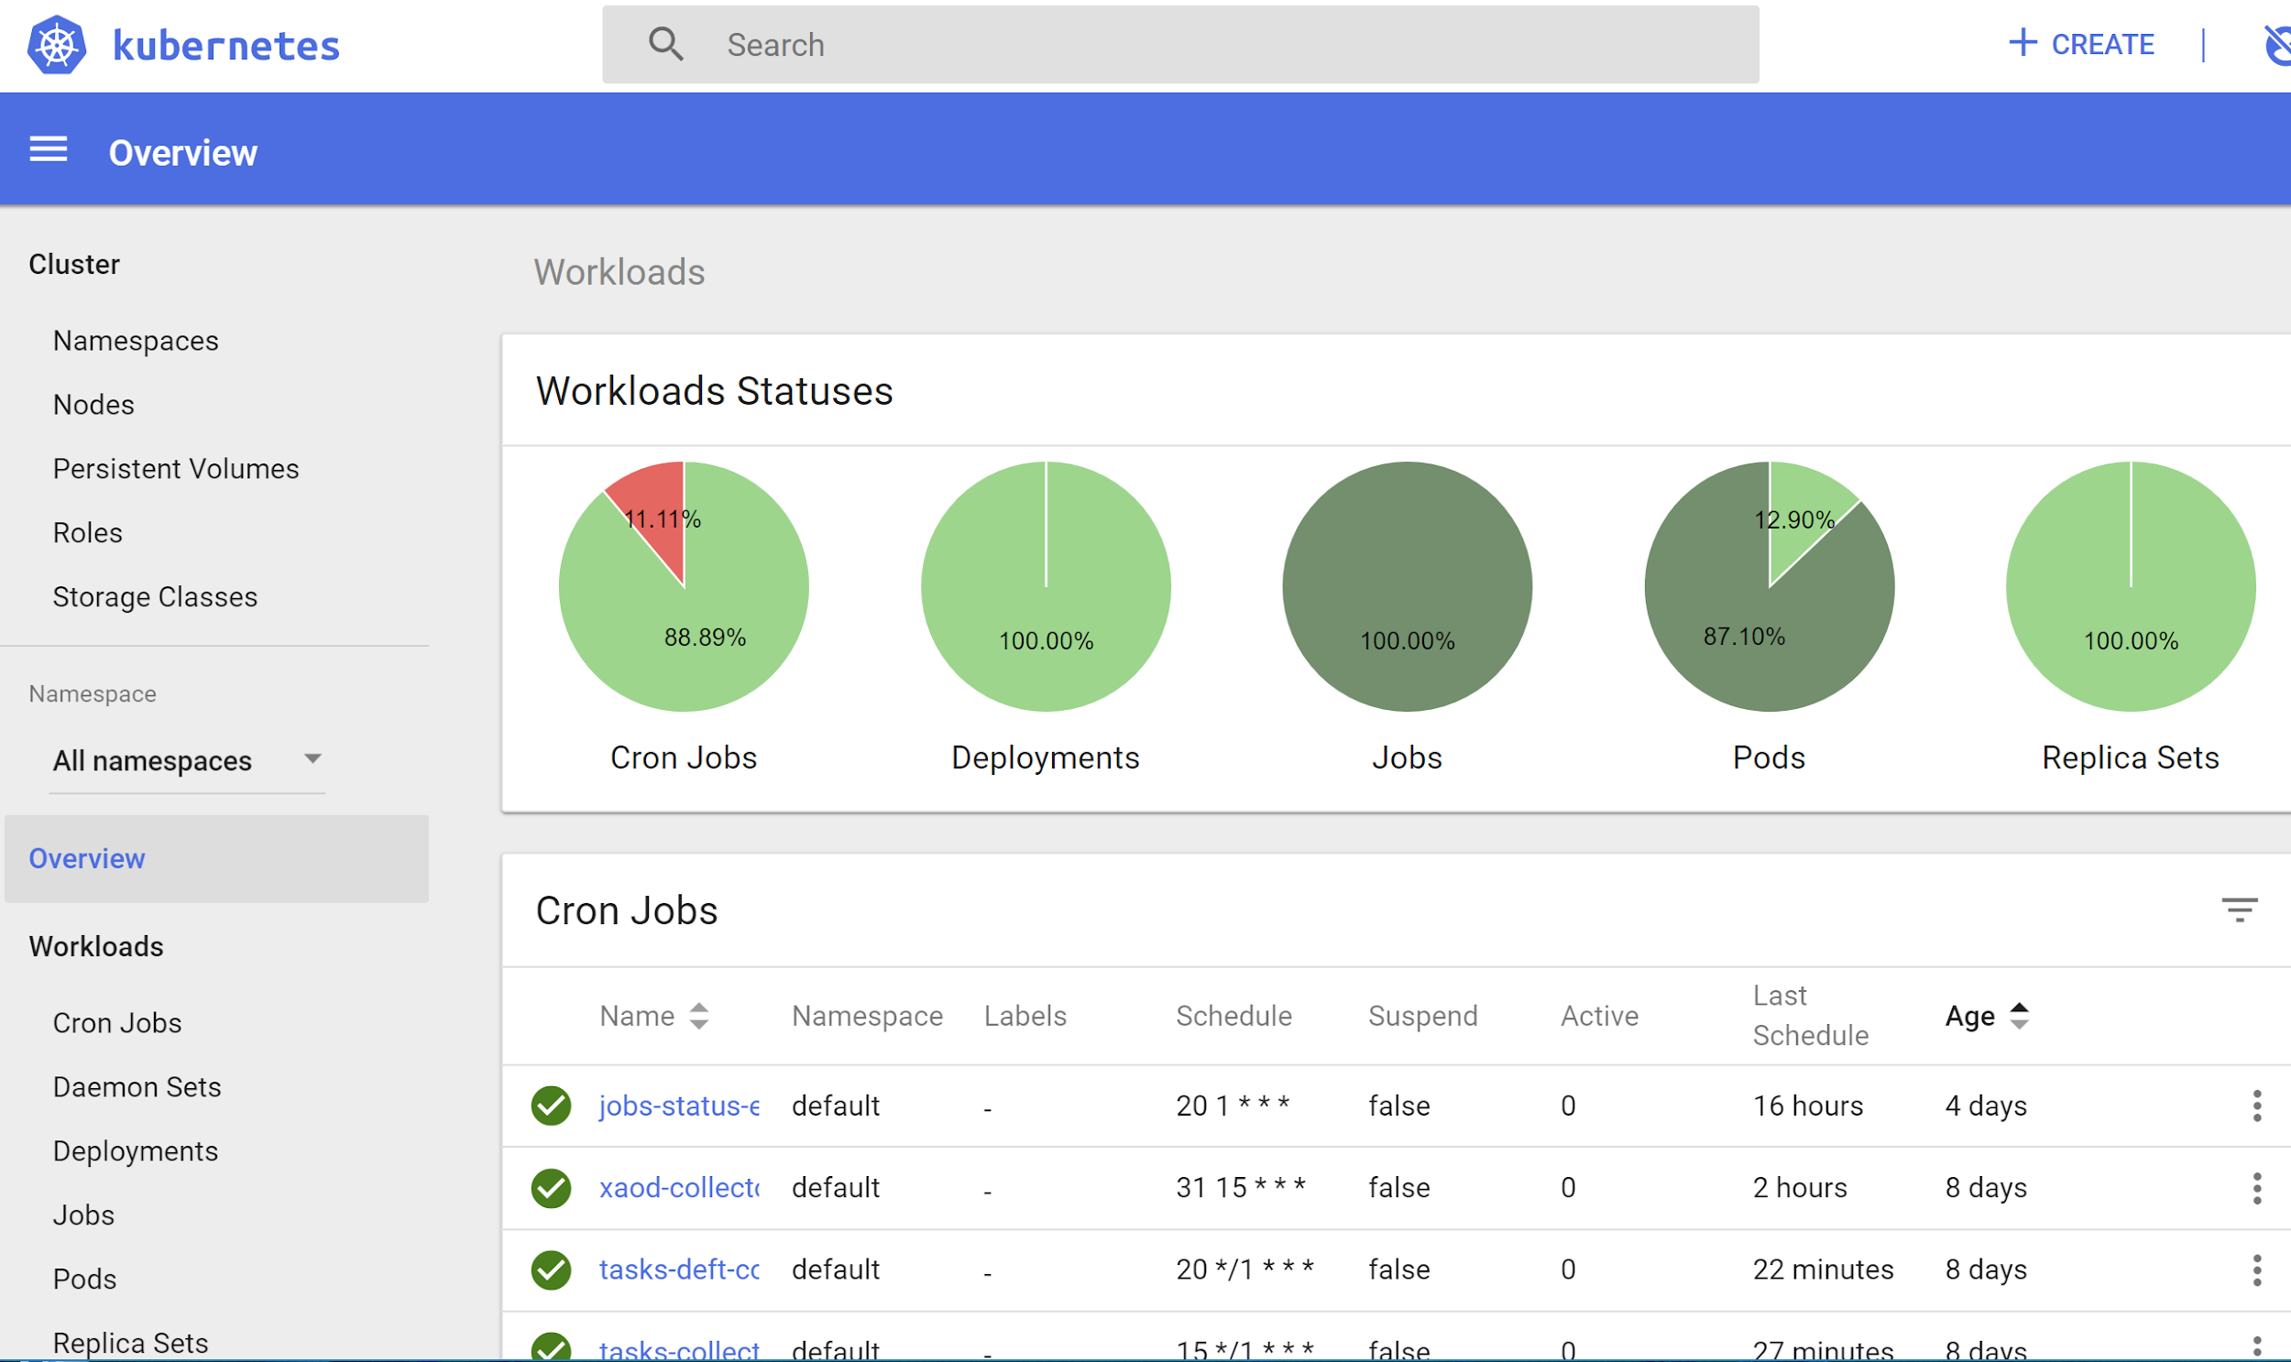
Data collection infrastructure - CERN
All services dockerized
All running in a single kubernetes cluster at CERN. Very stable.

Slide 6
Data collection infrastructure - UChicago
All services dockerized. All running at UChicago kubernetes cluster.
Running:
logstash collectors
rollup jobs (DDM)
Alarm & Alert service
REST interfaces (benchmarking, cost matrix, xcache backend)

Slide 7
Users
Most users just use kibana only.
Now around 120 users. No group accounts.
Split in 20+ spaces.
Most users have read only roles, special users and roles for services doing indexing, access for web frontends, etc.
Access to 9200 firewalled except for our ML platform and few ATLAS sites.

Slide 8
Update to ES 7.3
Why?
We were running ES 6.8 stack as we had a lot of indices that could not be upgraded to ES 7.0+
The longer we wait, harder it gets.
Indexes data in 25% less space.
Steps
Preparation
ES - reindex all the data produced with version less than 6.2 - more than 2200 indices.
Update cluster settings
ES update
Kibana update
Logstash update
Indexing codes updates

Slide 9
Update to ES 7.3 - Preparation
ES provides a nice tool that reports “all” the issues that should be solved before attempting upgrade.
We went by that list and verified all of them were solved.
Took ~10 days to reindex old indices.
Some indices still had multiple types in the same index so had to be completely restructured.
Some were deleted as no longer needed
Few hundreds indices were too small and were reindexed into monthly indices to reduce overheads.

Slide 10
Update to ES 7.3 - ES
Took half day and everything looked fine.
3 days later cluster became unstable. A random data node would disconnect from cluster and would not be able to reconnect (flapping).
A lot of efforts from UC admins looking for the reasons and a solution:
Created new backups
Removed write access from some roles.
Firewalled cluster
Disabled kibana
Reduced number of replicas
Closed all very large indices
Stopped ingress and client nodes
…
A lot of complications as nodes started corrupting metadata. Several open-heart surgeries with hex editor on nodes metadata. Backup was incredibly important.
Finally added 1 more data node and one dedicated node for kibana/ingress. That made it stable.

Slide 11
Update to ES 7.3 - Kibana & Logstash
Kibana stores all the index-patterns, searches, visualizations, dashboards in its own index.
Upgrade needs to change format for most of them.
A lot of new limitations and issues cropped up:
User defined variables with spaces and special characters not allowed any more, old ones could only be deleted.
Variables defined in “Express” language not allowed. All of them have to be rewritten in “Painless”.
Painless changed too. Now one have a different way to check if a variable is present in the document.
Some old searches and visualizations could not be re-mapped to new kibana document format. These were lost. Visualizations relying on lost searches or using user defined varibles that don’t exist anymore also don’t work.

Slide 12
Update to ES 7.3 - Kibana & Logstash
Some dashboards took months to make. We have to fix them.
We have both old index backed up and also all Kibana objects exported as JSON.
There are over 30000 objects people saved, large part of them still works and some part is not needed any more.
We will fix first ones that people need right away:
Recreate user defined variables that are needed.
Recreate searches needed
Manually edit visualizations json documents to point to the recreated objects
Reimport them

Slide 13
Update to ES 7.3 - Client side updates
This update breaks some clients codes:
Some clients were still trying to send multiple doc types.
Some clients were sending docs with implicit boolean conversion.
Client API changed so one can’t just upgrade client and expect code will work.
Responses to requests from even old clients changed so that code needs updates. eg. to get number of hits in the search instead of doing: response.hits.hits.total one has to do: response.hits.hits.total.value.

Slide 14
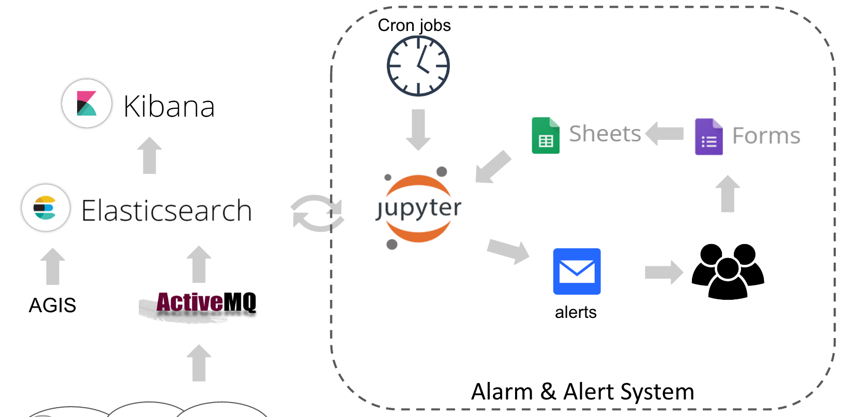
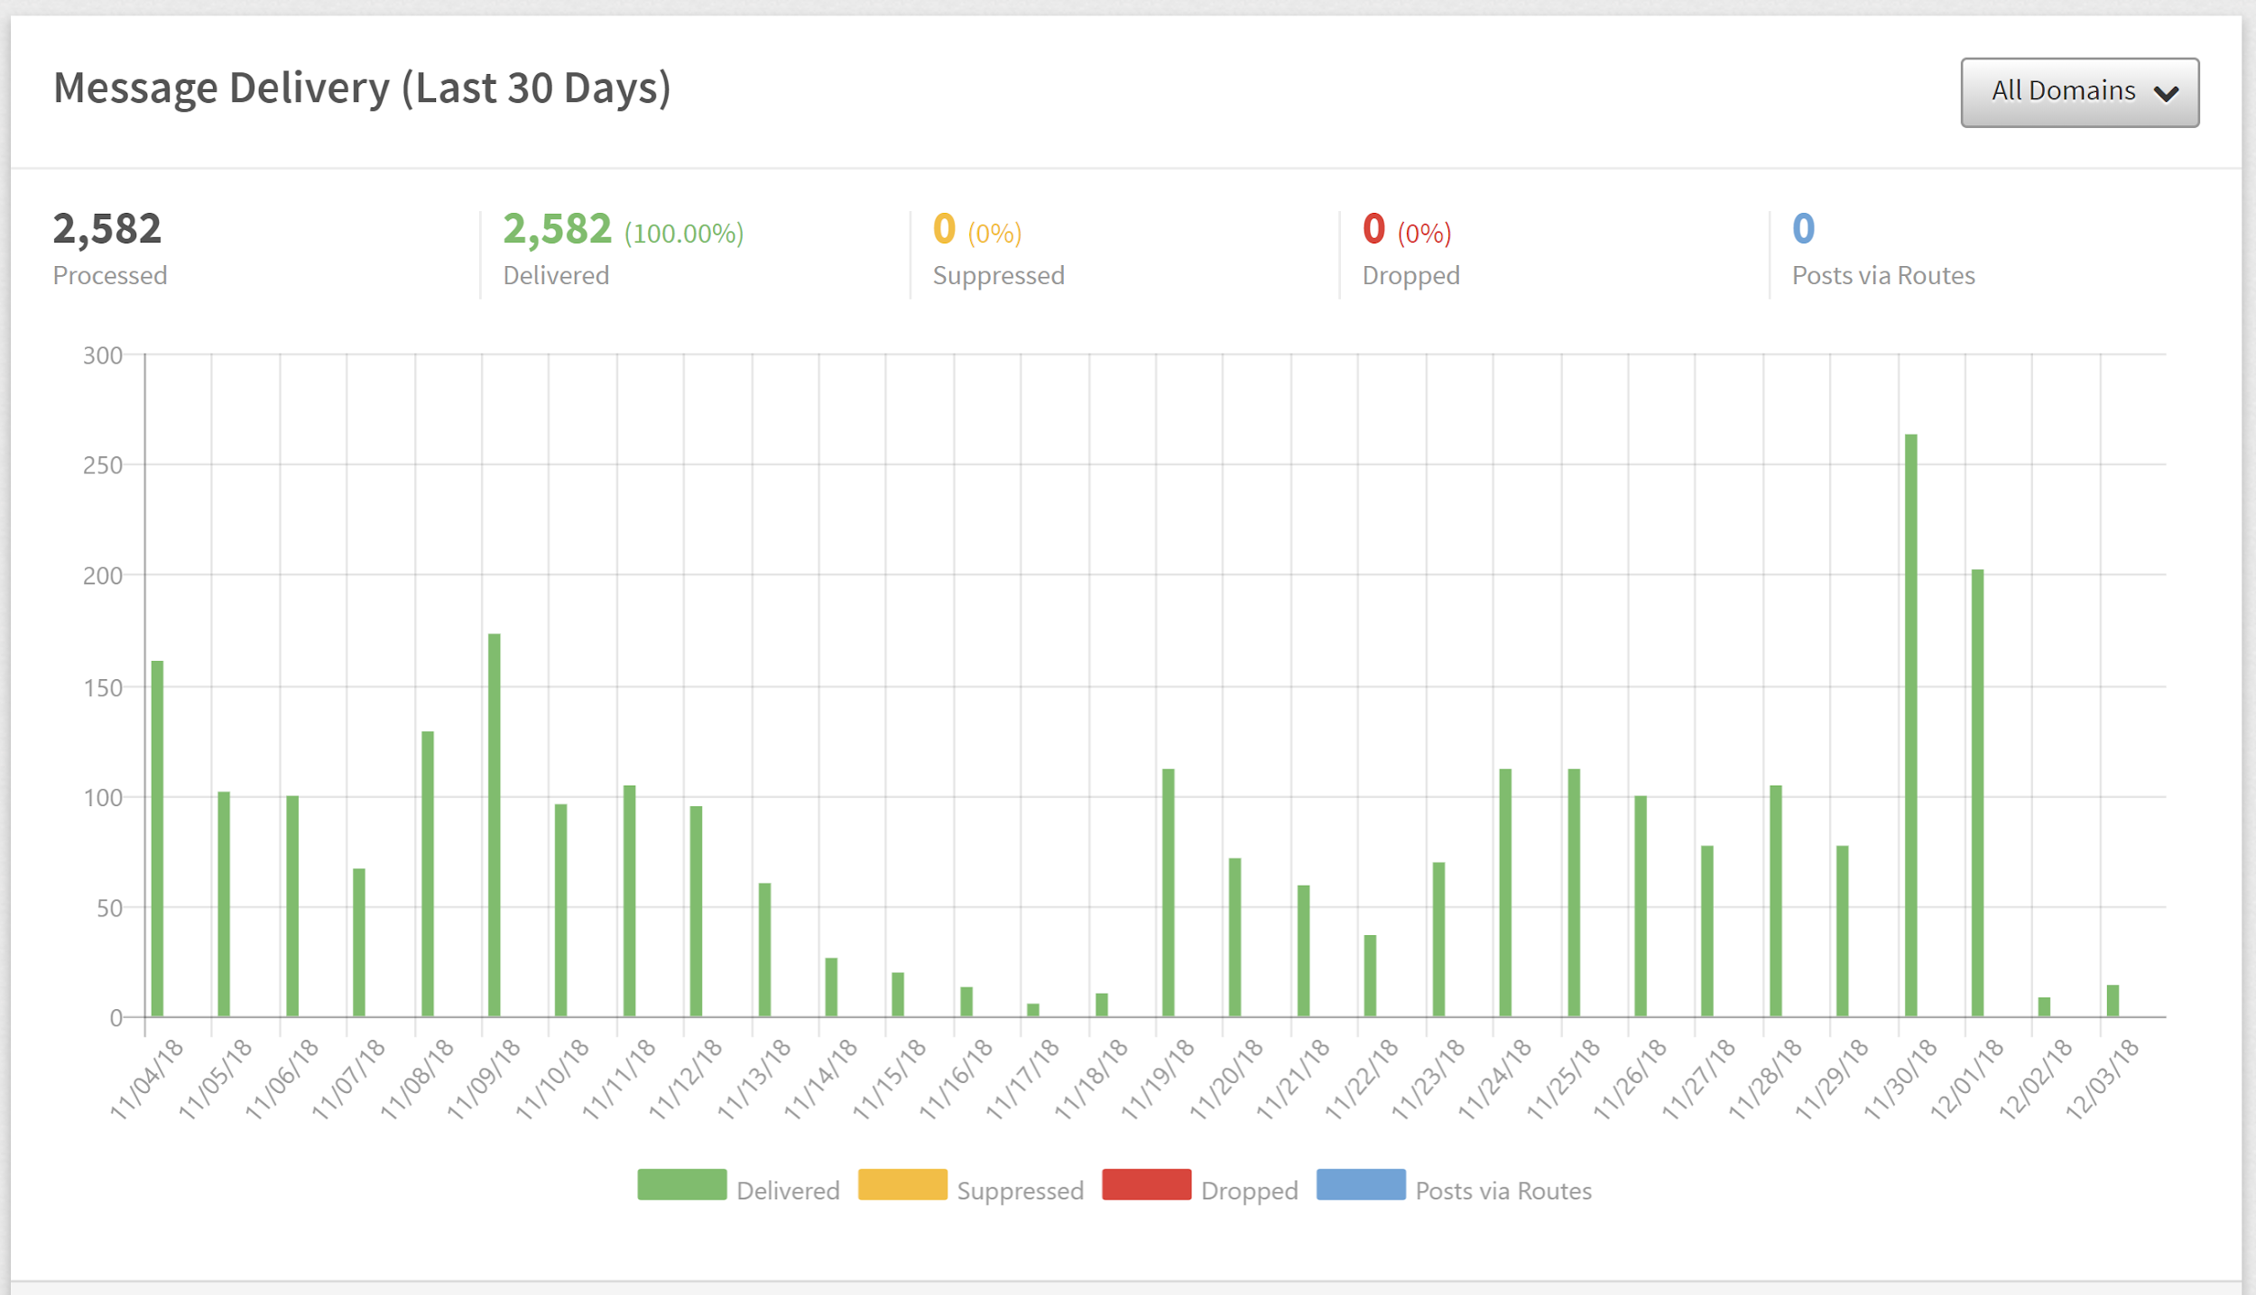
Alarm &
Alert service
Part of our platform
Moved mailing to MailGun
A number of reports in place
Some alerts:
ES, Kibana state
Indexing rates per source
Complex analysis alerts
“Advanced” users

Slide 15
UC ML platform
https://www.atlas-ml.org/
Nodejs, express/pug site running on k8s. Has full control of k8s deployments.
Easy to customize/deploy elsewhere
ML workshops (eg. CODAS)
Teaching computational physics courses (eg. Phys 250)
Uses Globus authentication.
Authorization by the instance owner.
Limits resources per instance.
Extensible. Current services:
Private/Private JupyterLab
SparkJobs
Caffe ML service
Current hardware:
5 CPU only nodes
1 node with 8x 1080Ti
1 node with 2xTesla k20c
only node scratch space, can directly access ES, ATLAS data through xroot
To add:
NVidia Jetson Nano inference dev board.

Slide 16
Hardware upgrade
Thanks to SAND project funds we will add new hardware to our analytics platform.
4 new ES data nodes. R640 Xeon Gold 5215 (10/20 cores) 7TB SSD 2x10Gbps NIC. About 32k$.
Two ML nodes first 8 x 2080Ti GPU, second 4 x V100 (25-32k$ each)

