Slide 1
Progress of RF beam detector R&D
Katsuya Yonehara
TSD Topical Meeting
05/16/2019

Slide 2
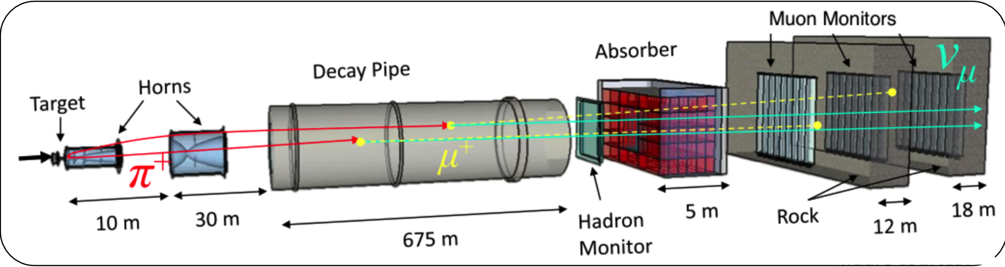
Beam Monitor in Neutrino Beam Line
NuMI Target system
Use multi-pixel ion chamber as beam monitor
Primary function of Hadron Monitor
  Monitor beam centroid and deterioration of target
  Evaluate systematic of beam parameter
Present Hadron Monitor shows low gain due to radiation damage
  Only use for aligning beam element (baffle, target and horns)
  Need rad-hard Hadron Monitor

Slide 3
Present hadron monitor signal
Log10[x]
Example of vertical beam scan
I₀ = 3.05
I = 13.79
μ = 5.673
σ = 0.85
I₀ = 4.27
I = 11.77
μ = 2.618
σ = 0.778
I₀ = 2.11
I = 2.07
μ = -8.095
σ = 1.190
Beam view
Blueish color pixel is low gain
Central pixel still useful to align
beam elements
Found:
Baffle = -1.211 mm
Target = 2.618 - 3.7 = -1.082 mm

Slide 4
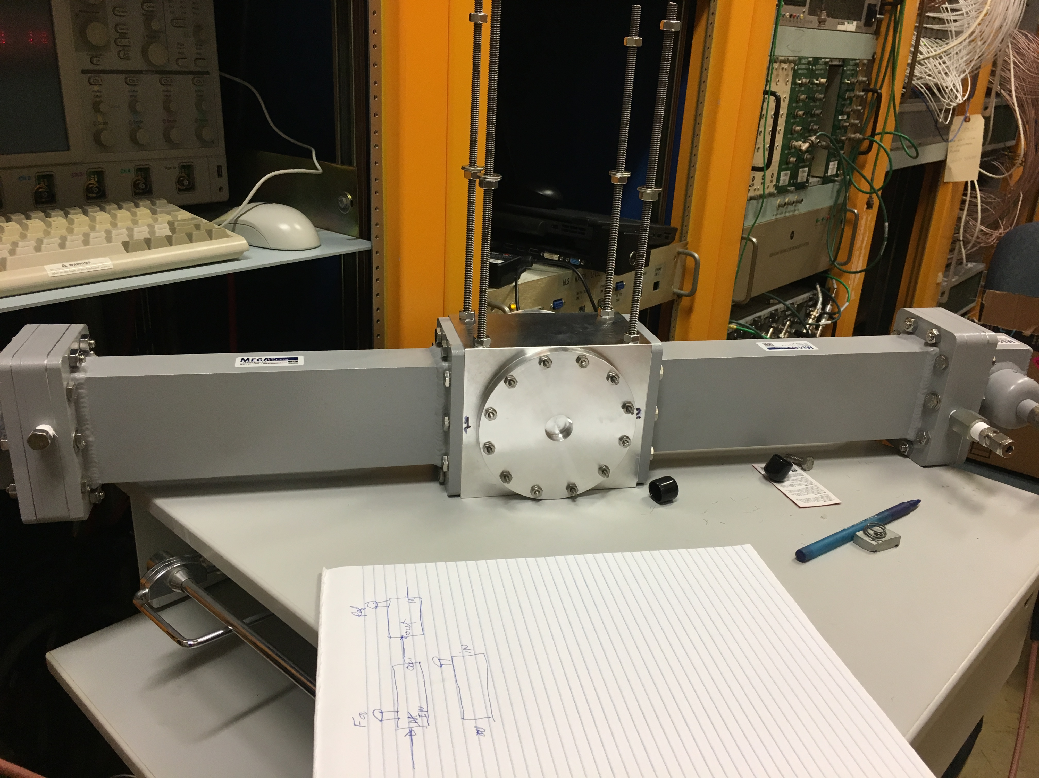
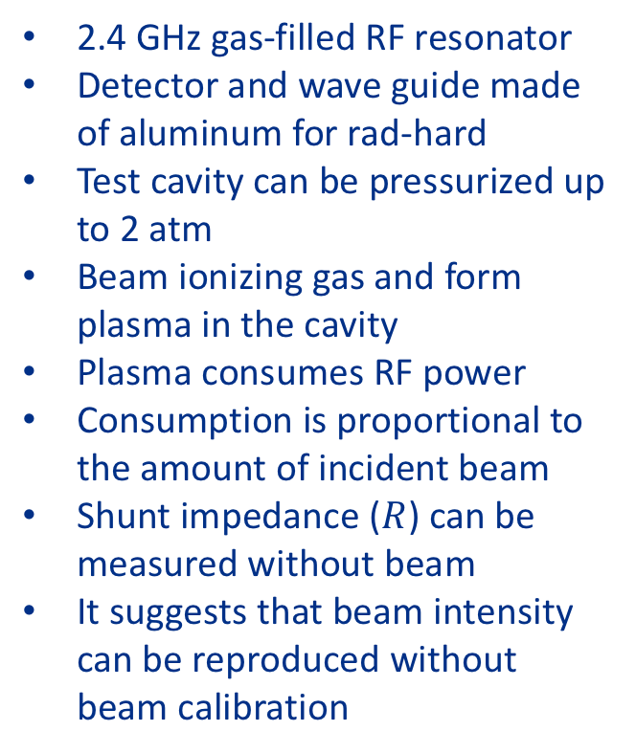
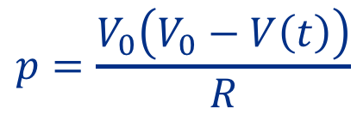
Rad-hard RF detector (test cavity)
2.4 GHz gas-filled RF resonator
Detector and wave guide made of aluminum for rad-hard
Test cavity can be pressurized up to 2 atm
Beam ionizing gas and form plasma in the cavity
Plasma consumes RF power
Consumption is proportional to the amount of incident beam
Shunt impedance ($R$) can be measured without beam
It suggests that beam intensity can be reproduced without beam calibration
RF power consumption
at equilibrium condition
$$p=\frac{V_{0}\left(V_{0}−V\left(t\right)\right)}{R}$$

Slide 5
Circuit diagram
White
Blue
NWA
20 dB
1 W
10 dB
5 W
Orange
N-type to SMA
SMA to N-type
Red
Filter
Green
port2
port1
1.6 dB
Real-time
RF power meter
2.45 GHz
resonator
Unique structure of two sets of attenuator and RF amp to make a linear gain and the first RF amp has a narrow band pass to remove RF noise

Slide 6
Linearity of gain of RF amp
ν = 2.385 GHz
2.390 GHz
2.379 GHz

Slide 7



Q factor measurement
RF signal calibration
  Q factor measured by decay time
  Q factor measured by spectrum
  Accuracy in both measurements is within ~10 %
Pickup
Forward
Reflected
$$Q=\frac{ν_{0}}{∆ν}=239$$
$$τ=1.65∙{10}^{−8}$$
$$Q=2πν_{0}τ=247$$

Slide 8
Beam loaded RF signal
Beam intensity = 1.3e13
Detector filled with ambient air
Beam is turned on
Five peaks during the beam on shows
the gap of MI beam batches

Slide 9
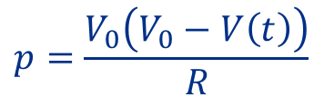
Linearity test
$$p=\frac{V_{0}\left(V_{0}−V\left(t\right)\right)}{R}$$
1-atm N2, V0 = 120 V
2-atm dry air, V0 = 120 V
1-atm He, V0 = 120 V
2-atm N2, V0 = 60 V

Slide 10
Discussion of analysis
Took average of whole equilibrium voltage for first analysis
  Nice linearity vs beam intensity!
  Fraction is typically 10 %
RF detector is very sensitive to the beam intensity
  But beam intensity is changed in one batch
    Confirmed with MI group
  Beam position is also changed bunch by bunch
    SWIC data recorded
    Will calibrate RF signal with beam position and profile
RF detector is also sensitive to resonant condition
Find optimum E/p
Gas dependence
  N2 & dry air
Intensity varied
+2 MHz off
-2 MHz off

Slide 11
Concept of Prototype RF Detector
Design high-Q cavity
  In the cavity the gradient is 6.57 V/cm, in the Iris coupling hole is 3.2 V/cm, in the rest of the WG is 1.0 V/cm (see next slide)
  Possible power consumption on the WG is ~1/36 lower than the cavity, but the volume of WG is much bigger than the cavity
    Iris is fine since it is localized (take a part of the sense area)
  What is Q to reduce the gradient on WG to below 10 % of the cavity gradient?
N2 and dry air
< 100 V RF potential looks good
  Need to be higher than the beam noise

Slide 12
Next step
Keep carrying out beam test at MI-40
Improve DAQ (with Lee Teng Student)
  Triggered by the MI beam
  Take Q measurement every spill
  Write a script for automatic data acquisition
Study influence of wave guide on the RF signal
  Move the RF detector to directly hit beam on the wave guide
  This can be a noise of the RF signal for neutrino application
  After summer shutdown

Slide 13
Study influence of ionization in waveguide
Cell body
Waveguide
+
+
+
+
(+) Possible beam position to test the off-axis beam effect

