Slide 1
TSD Update
Robert Zwaska
TSD Topical Meeting
16 May 2019

Slide 2
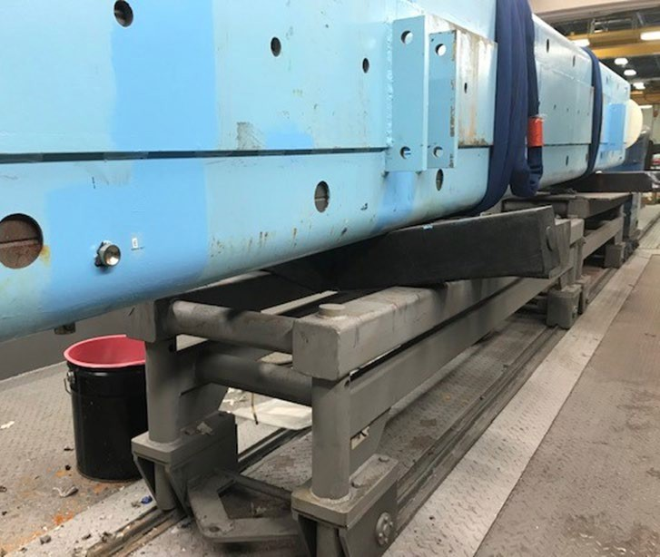
Cribbing Failure
Black plastic cribbing used as a structural member spanning a space.
Recommendations to monitor and check condition of cribbing coming soon from the Mechanical Safety Subcommittee (MSS)

Slide 3
Performance Reviews
The 2019 Performance Review cycle begins in less than a month
June 3rd – July 5th
  Self-evaluations open in FermiWorks
  Workday Demos and goals assistance by HR Partner
Mid-July
  Job change info must be completed in FermiWorks by July 19th
  Manager evaluation due by July 26th
  Goal setting discussions begin for 2020
August 9th
  Performance reviews submitted for final approval
September 24th – November 1st, 2019
  Performance reviews are finalized and ready to be viewed by employees and managers for discussion
Look in Fermiworks inbox and approve outstanding goals by the end of May 2019
– Unapproved goals may be dropped from the system at the end of the review cycle—very frustrating for employees who took the time to enter goals.

Slide 4
AD Budget Info
AD communicated a substantial overrun on Accel operations of ~$7M in SWF at Feb budget brief to DOE
Requested ~$10M supplemental from DOE
  Have been told they will send $2.45M - then $2.3M
Division actions
  Not supplying as much project labor as requested
    Work with PIP-II, LBNF, Mu2e
– And get them the labor they need
  Continue to squeeze M&S
  Modified run plan – beam off for 9 days / on for 5

Slide 5
AD Budget Info
Run plan is not a certain success for either saving enough money or working well to deliver beam
  Expect ~ $1M savings from reduced electrical usage
  Hoping for > $1M from increased vacation usage and stepping up project work
  This, and the money we expect from DOE gets us into the range of overrunning the budget by “less”
Less effort on ops means less ops work gets done
  Want impact statements
    Keep track of what work you are deferring so we can total it up at the end and use it
    Send all these to me (and to division heads if significant)

Slide 6
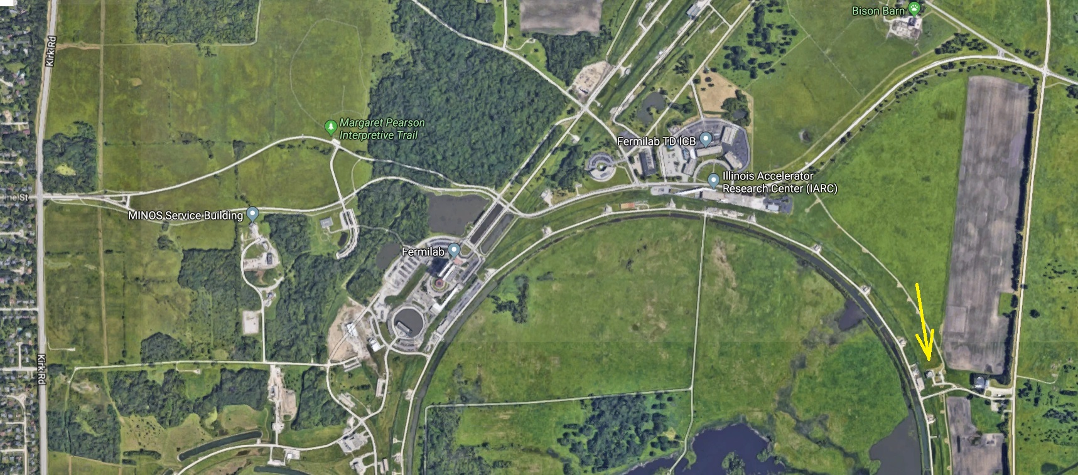
CZero Open House
Friday, May 24, 2019 10:00 AM – 12:00 PM
For those who have not been there before, please see attached map. Keith Anderson, Cervando Castro, Cory Crowley, Mike Campbell, and Jon Hunt (FESS) will be there to give tours. This will be your best chance to come see this recently completed facility before we start filling it up with hot storage components. We hope to see everyone there!

Slide 7
TSD Picnic
Our Working Committee has put together a picnic. Please everyone attend (who can)
https://web.fnal.gov/project/TargetSystems/TSD_social/SitePages/Home.aspx

