Slide 1

Advanced Material Studies for High Intensity Proton Production Targets and Windows
RaDIATE Collaboration
Patrick Hurh (FNAL), on behalf of the full scientific team and Taku Ishida (KEK)
T. Ishida*, S. Makimura, M. Hagiwara, N. Kawamura, E. Wakai, M. Teshigawara, S. Meigo (J-PARC: KEK & JAEA)
P. Hurh*, K. Ammigan, K. Yonehara (FNAL); D. Senor, A. Casella (PNNL); N. Simos, D. Kim (BNL)
*Lead Principal Investigators

Slide 2
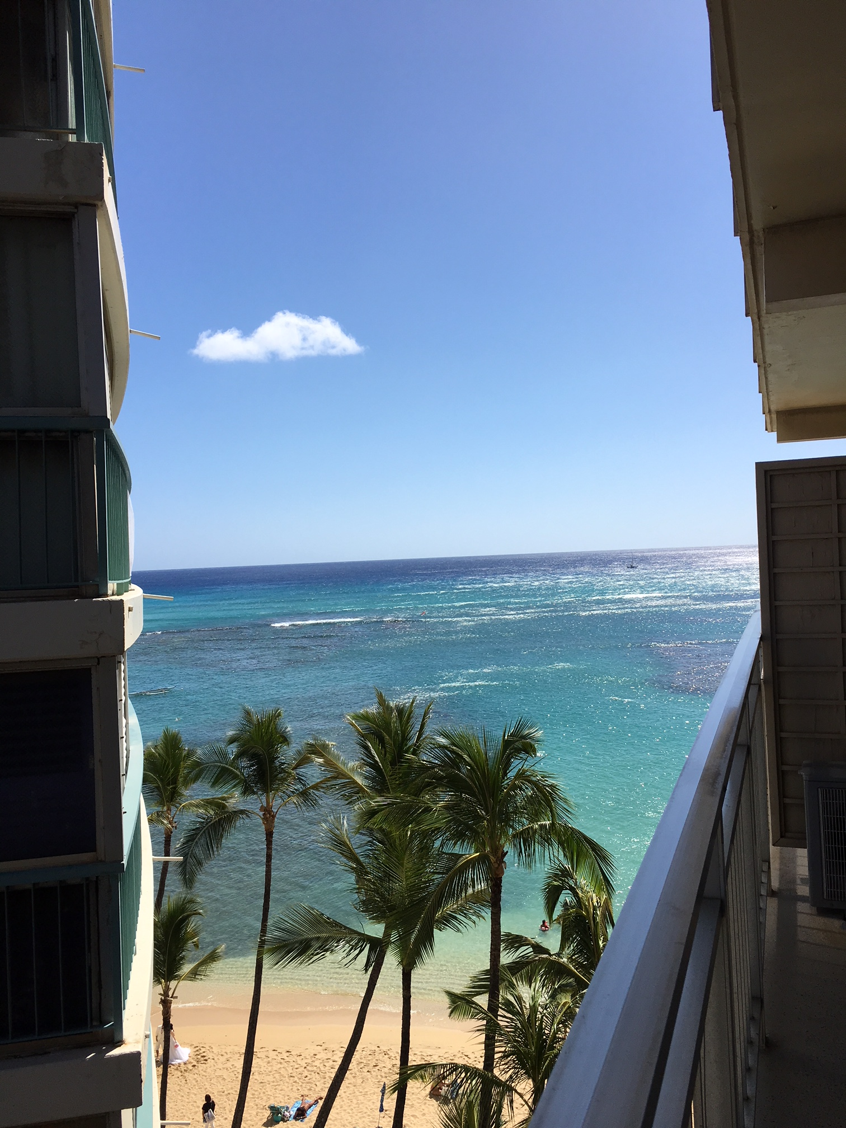

Slide 3
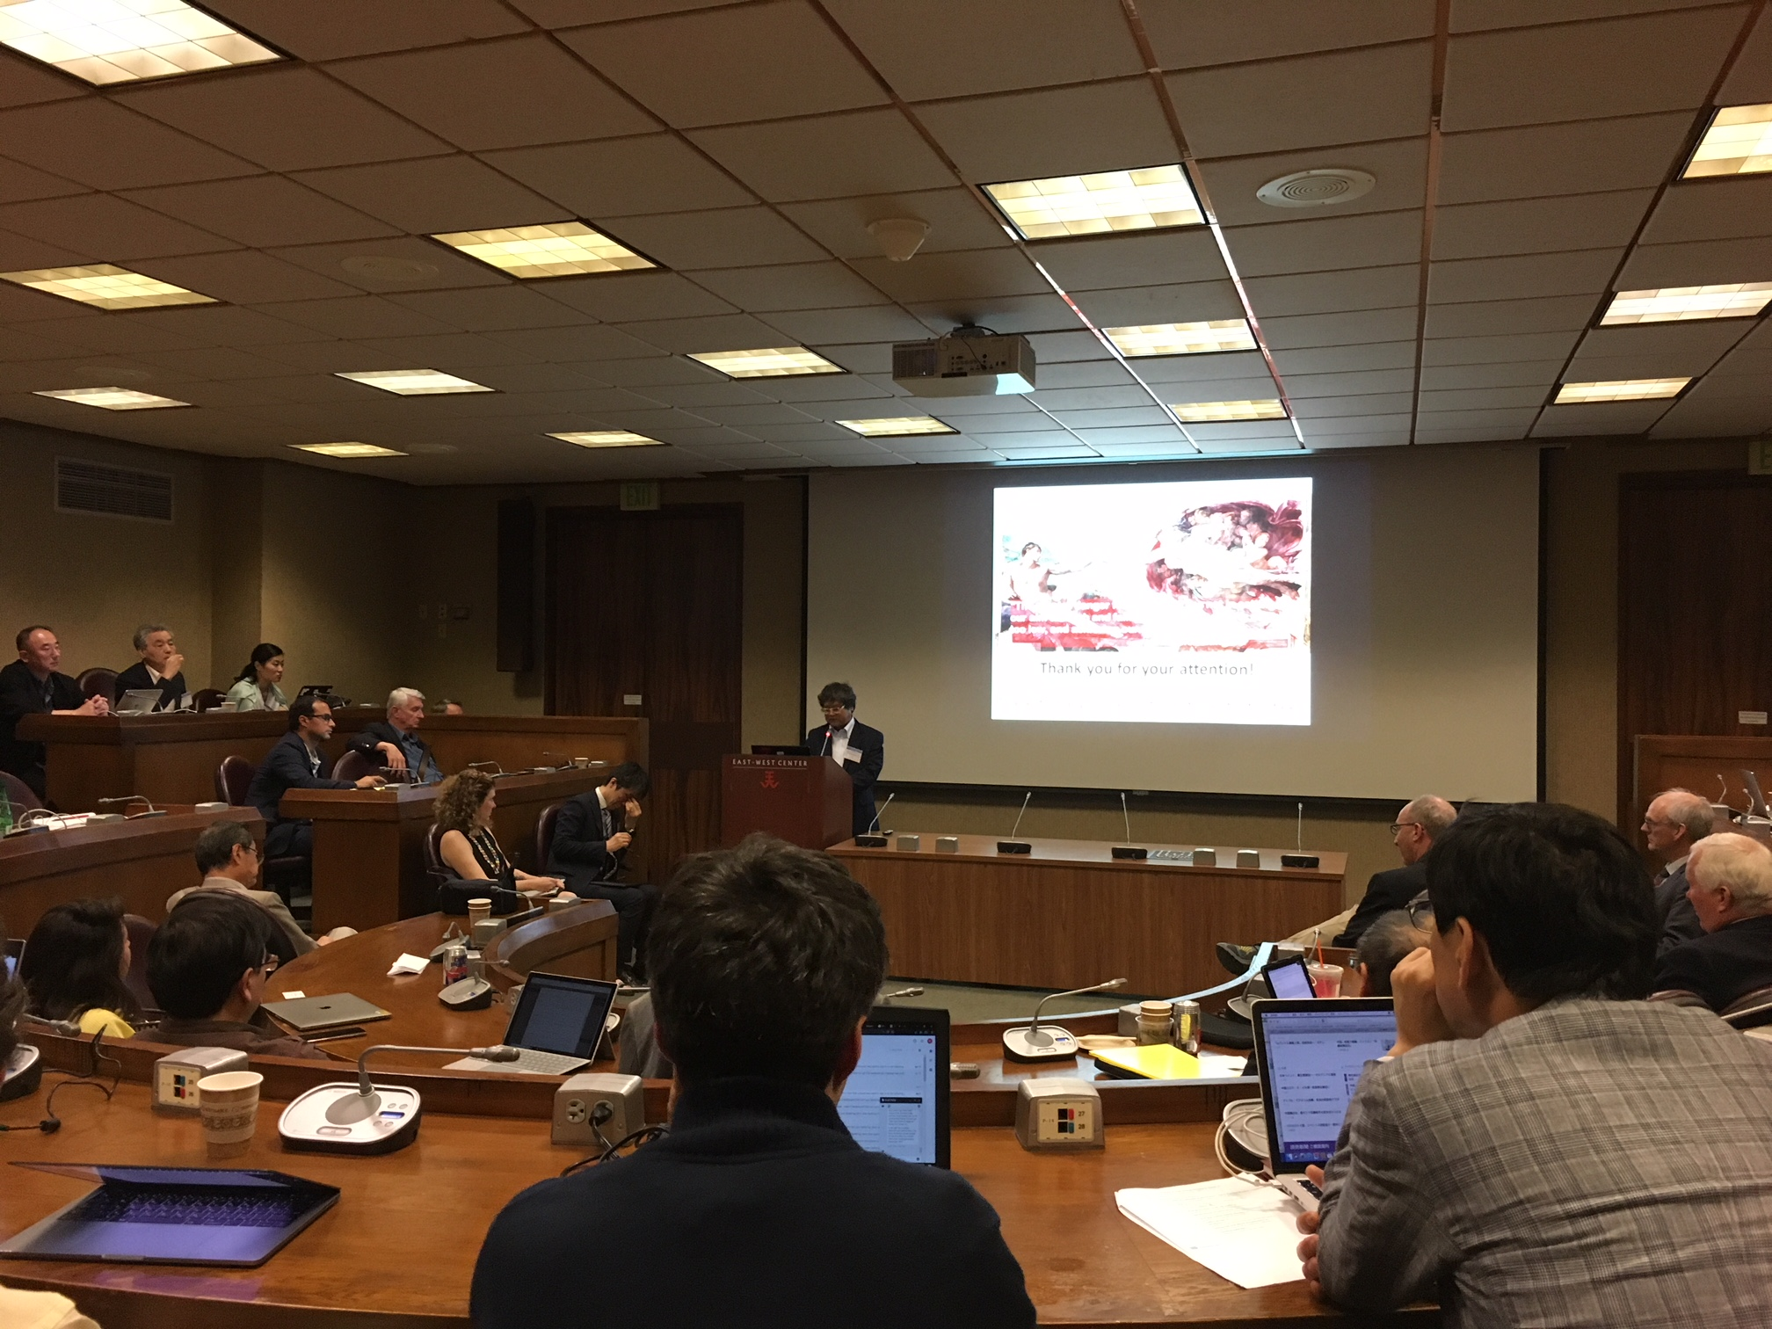

Slide 4
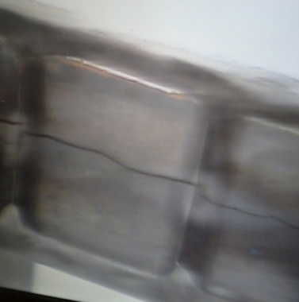
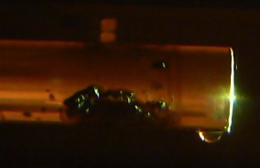
Past Experience is our Motivation
In the recent past, major accelerator facilities have been limited in beam power by target and window survivability
  To upgrade the accelerator facilities to much higher beam powers (1.2 - 4 MW) R&D of robust high power targets and beam windows is essential
Imperative to research radiation damage effects to enable :
  Accurate component lifetime prediction
  Design of robust multi-MW targetry components, and
  Development of new materials to extend lifetimes

Slide 5
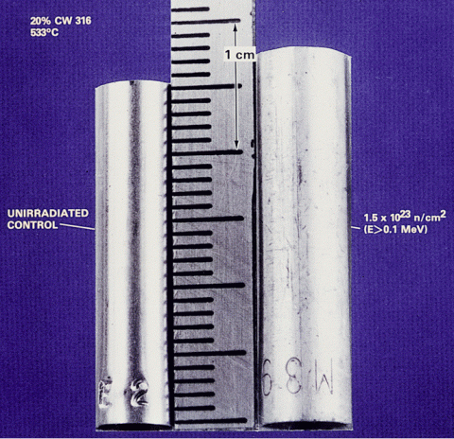
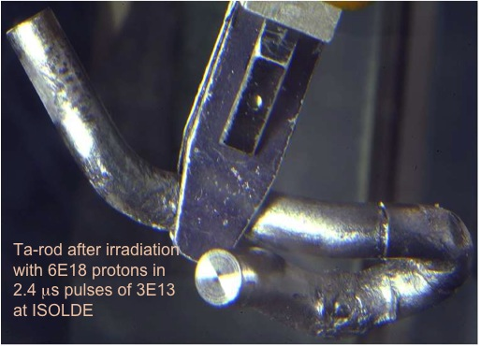
Radiation Damage and Thermal Shock:
The Primary Challenges to Targetry Materials
Radiation Damage - Displacements in crystal lattice
(expressed as Displacements Per Atom, DPA)
  Hardening and Embrittlement
  Creep and Swelling
  Fracture toughness reduction
  Thermal/electrical conductivity reduction
  Coefficient of thermal expansion
  Modulus of Elasticity
  Fatigue Strength
  Transmutation products
    H, He gas production can cause void formation and embrittlement
    (expressed as atomic parts per million per DPA, appm/DPA)
D.L. Porter and F. A. Garner, J. Nuclear Materials, 159, p. 114 (1988)
Thermal Shock - Sudden energy deposition from beam pulses
Fast expansion of material surrounded by cooler material creates a sudden local area of compressive stress
Stress waves (not shock waves) move through the target
Plastic deformation, cracking, and fatigue can occur
Ta-rod after irradiation with 6E18 protons in 2.4 μs pulses of 3E13 at ISOLDE (photo courtesy of J. Lettry)

Slide 6





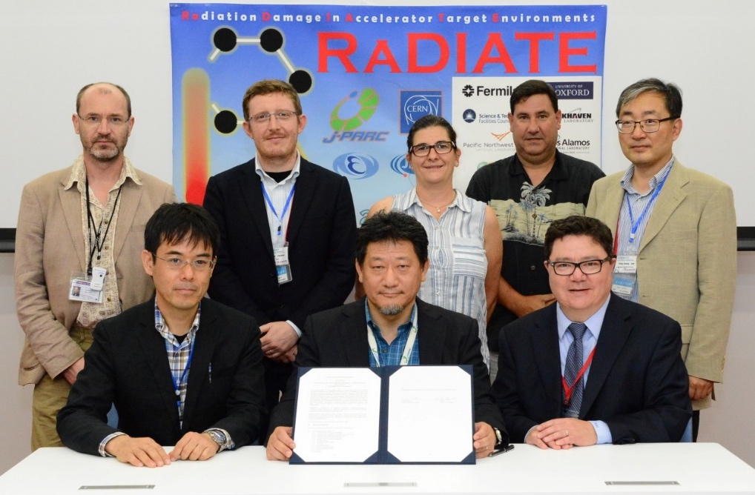
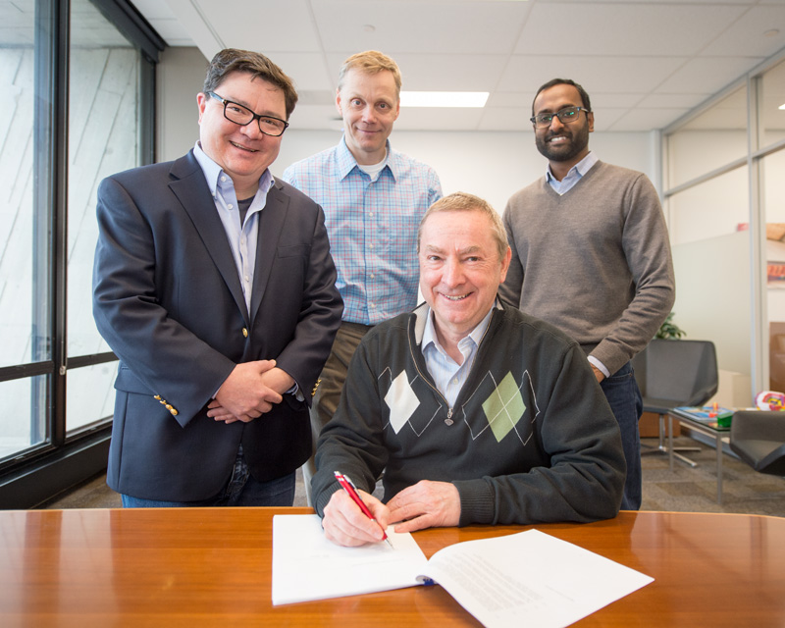
R a D I A T E Collaboration
Radiation Damage In Accelerator Target Environments
To generate new and useful materials data for application within the accelerator and fission/fusion communities;
To recruit and develop new scientific and engineering experts who can cross the boundaries between these communities;
To initiate and coordinate a continuing synergy between research in these communities, benefitting both proton accelerator applications in science and industry and carbon-free energy technologies
In 2017, MoU revision has counted J-PARC (KEK+JAEA) & CERN as official participants
http://radiate.fnal.gov
CERN
PNNL
STFC
FRIB
ESS
J-PARC
FNAL
@J-PARC, Sep.20, 2017
@FNAL, Dec.11, 2017

Slide 7
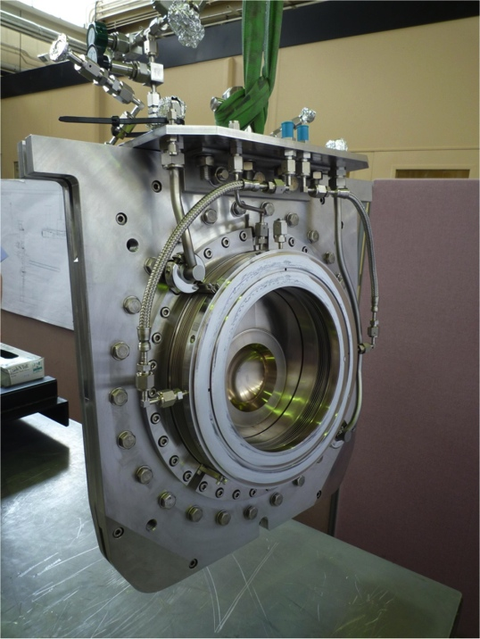
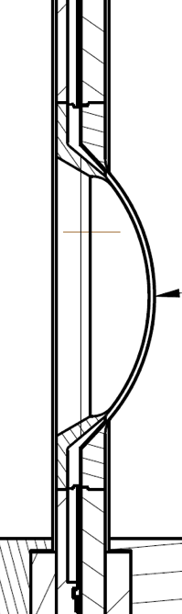
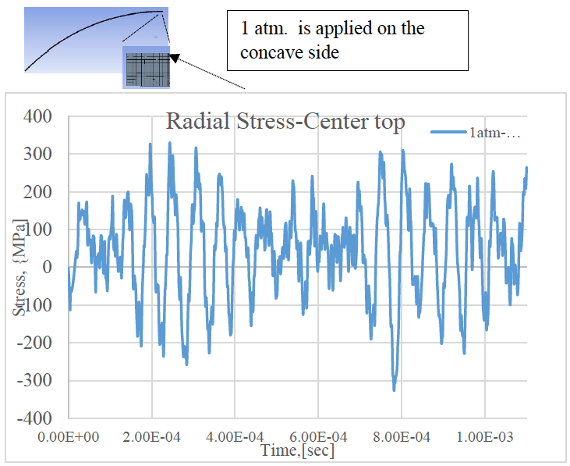
Of Specific Concern:
Titanium Beam Windows at the J-PARC Neutrino Facility
Beam Power | PPP | Rep. cycle | POT / 100 days
420kW (achieved) | 2.2 x 10¹⁴ | 2.48 sec | 0.8 x 10²¹
750kW (proposed) | 2.0 x 10¹⁴ | 1.3 sec | 1.3 x 10²¹
750kW (original plan) | 3.3 x 10¹⁴ | 2.1 sec | 1.3 x 10²¹
1.3 MW (proposed) | 3.2 x 10¹⁴ | 1.16 sec | 2.4 x 10²¹
designed
~8M pulses/yr
~1 DPA/ops-year (MARS)
Periodic thermal stress wave caused by the intense proton beam energy deposition
750kW operation will cause radiation damage of ~1DPA/ops-year, whereas significant irradiation hardening and loss of ductility has been reported with 0.3DPA (no higher DPA data exists)
No known data exists on high cycle fatigue (>10³ cycles) of irradiated titanium alloys

Slide 8

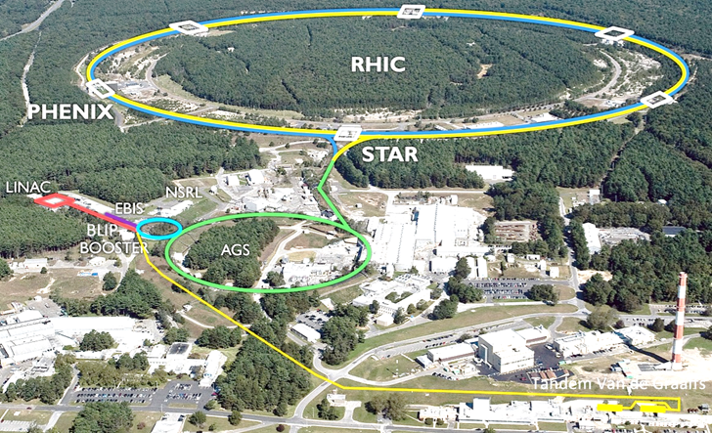
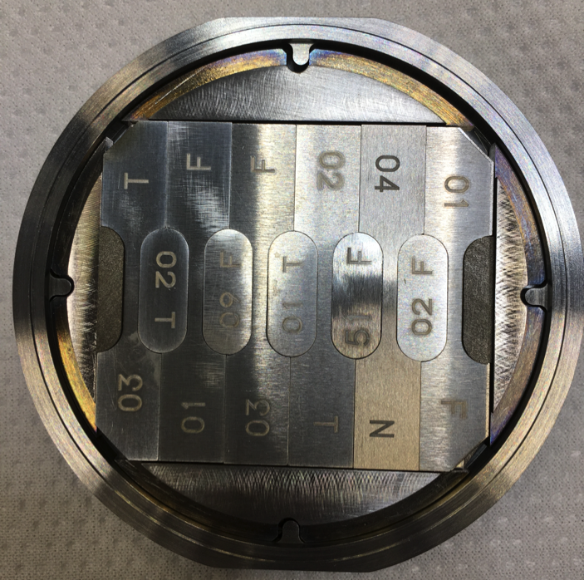





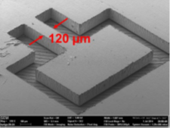
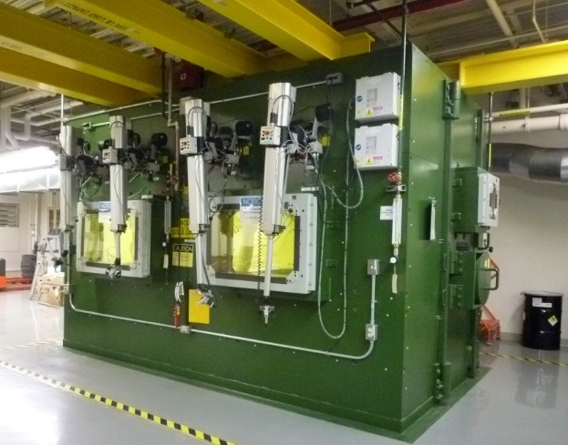

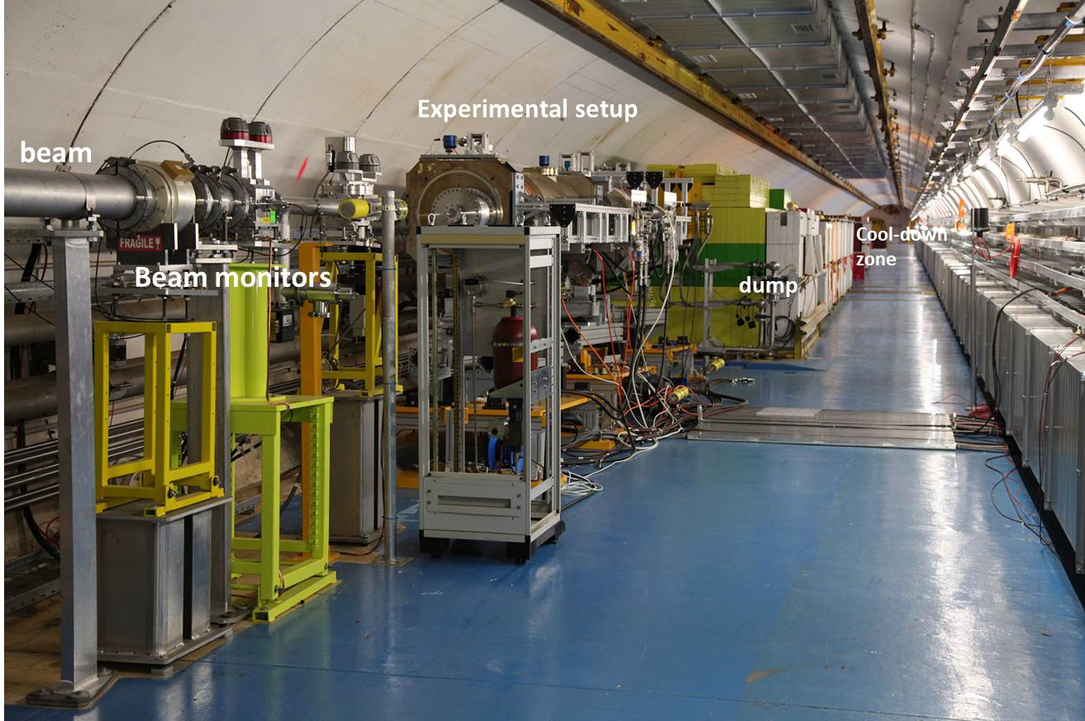
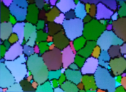
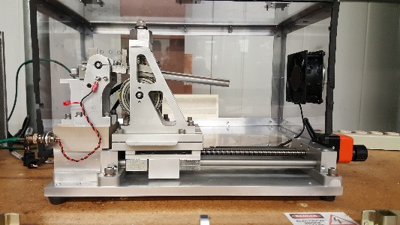


RaDIATE Program Work Flow
Specimen Preparation
High Power
Proton Beam
Irradiation
Brookhaven
Linac
Isotope
Producer
PIE- Mesoscale-Fatigue
In-beam Thermal Shock
Unloading / PIE
PIE–Fatigue

Slide 9
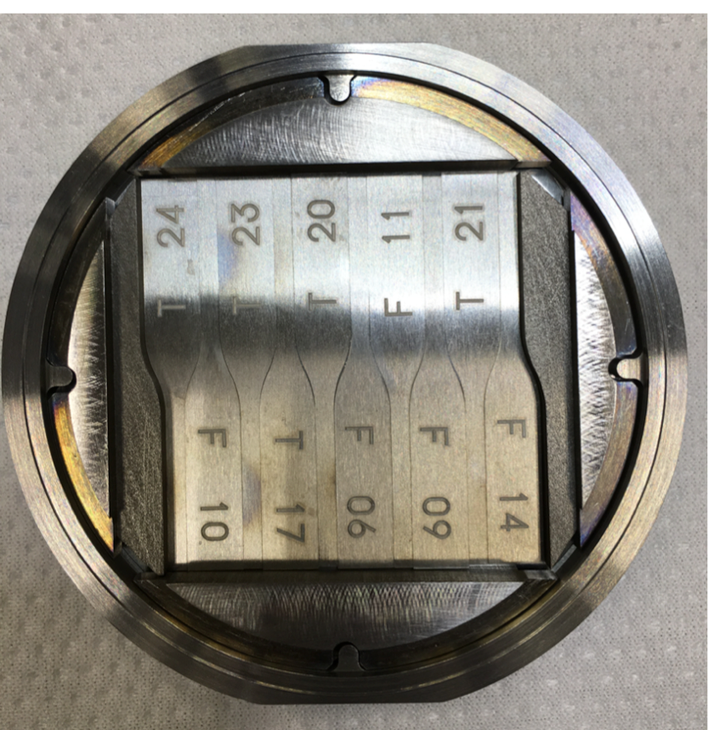
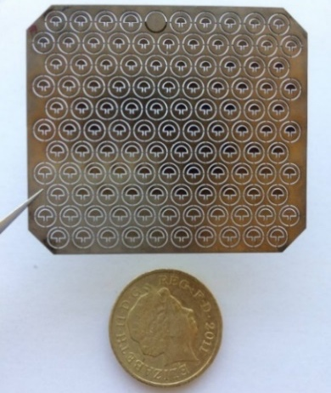
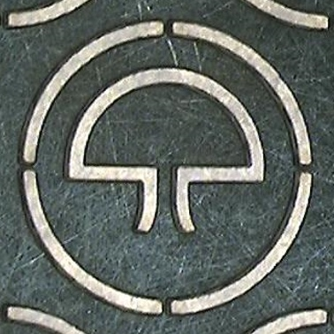
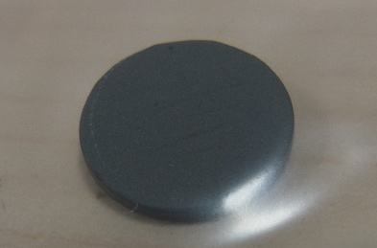
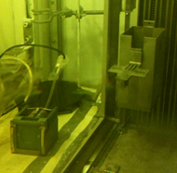
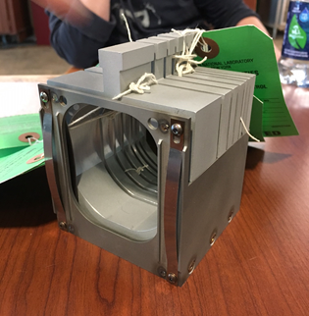
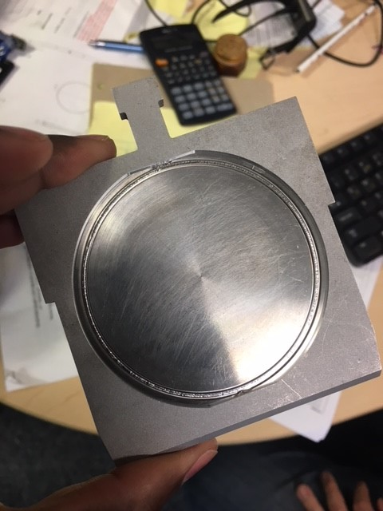
RaDIATE Irradiation run at BNL-BLIP Facility
Tensile, Micro
Bend - Fatigue
3.4mm
SiC coated graphite
48mm
10 mm
Meso-scale fatigue foil
  The J-PARC capsules include
  Ti alloy Gr. 1, 2, 5, 23 and Ti 15-3
  Tensile, micro-structural, fatigue, & meso-scale fatigue specimens
  SiC coated graphite specimens
70mm
Proton Beam

Slide 10
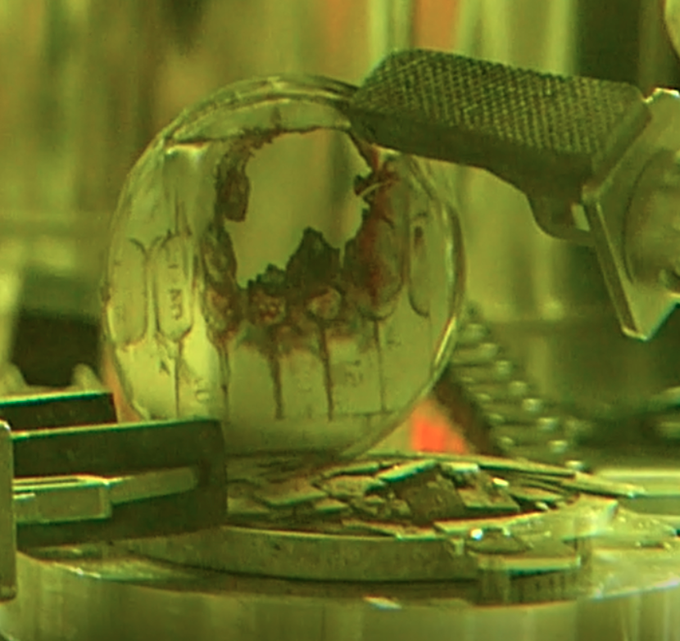
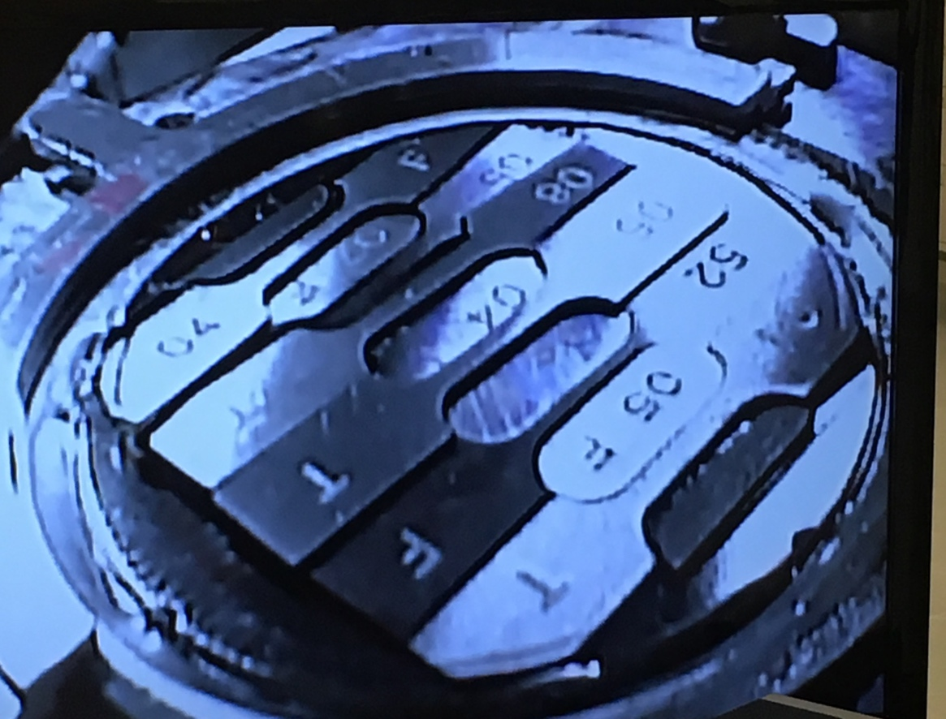
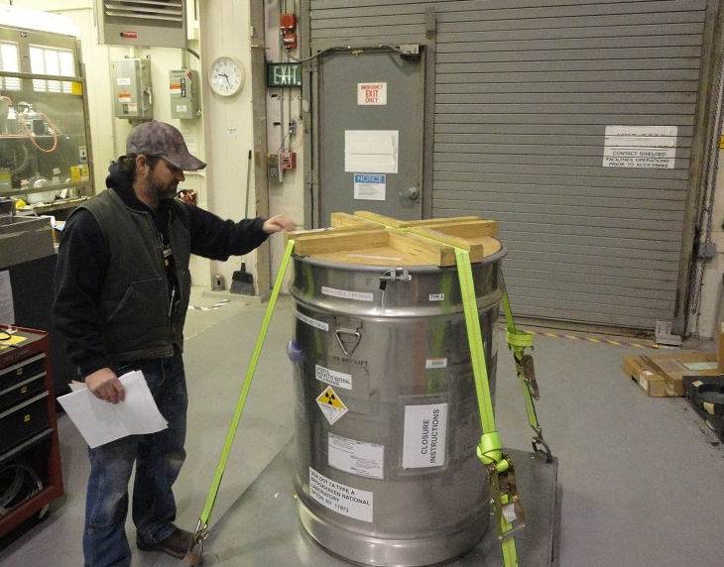
RaDIATE Irradiation Run Completed in March 2018
Total of 4.6 x 10²¹ protons on target
Peak DPA on Ti specimens (0.3 DPA previous maximum)
  DS Ti-1 capsule: 0.25 DPA
  DS Ti-2 capsule: 0.95 DPA
  US Ti capsule: 1.53 DPA
Post Irradiation Examination Activities Underway (PIE)
  DS Ti-1 capsule shipped to PNNL and opened
    Tensile samples tested
    Advanced microscopy
    Bend-fatigue specimens shipping to FNAL next month
    Meso-scale fatigue specimens shipping to CCFE during summer
  DS Ti-2 capsule shipping to PNNL during summer
  SiC Coated Graphite specimens examined at PNNL
  Irradiated Ti and SiC coated graphite specimens sent to CERN for in-beam thermal shock test at HiRadMat facility
Capsule breached during third phase of irradiation. Forensic Examination underway.

Slide 11
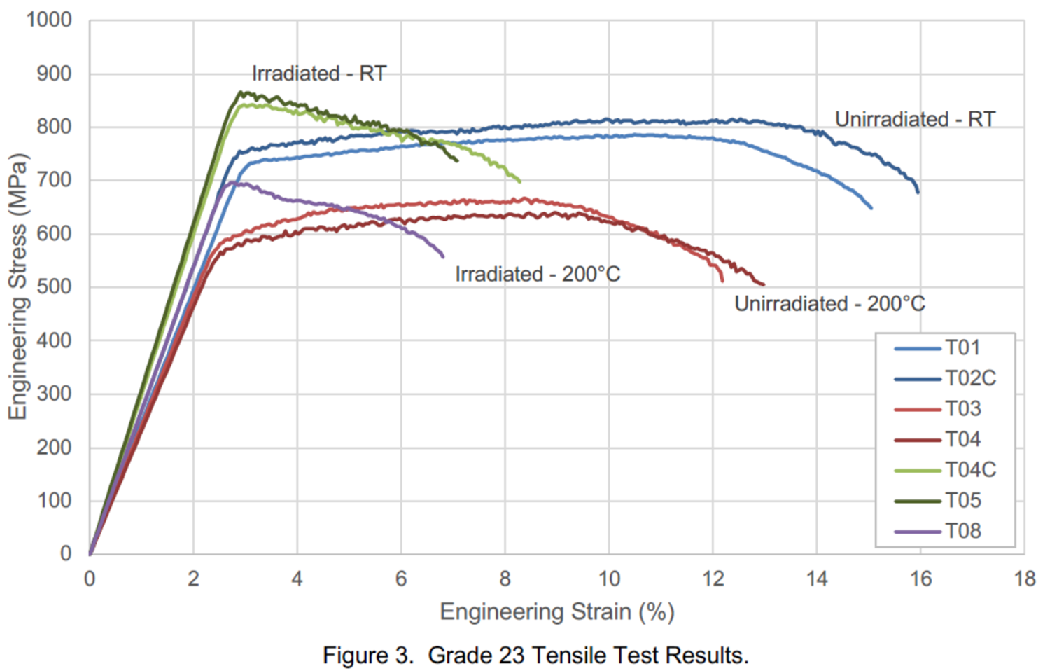
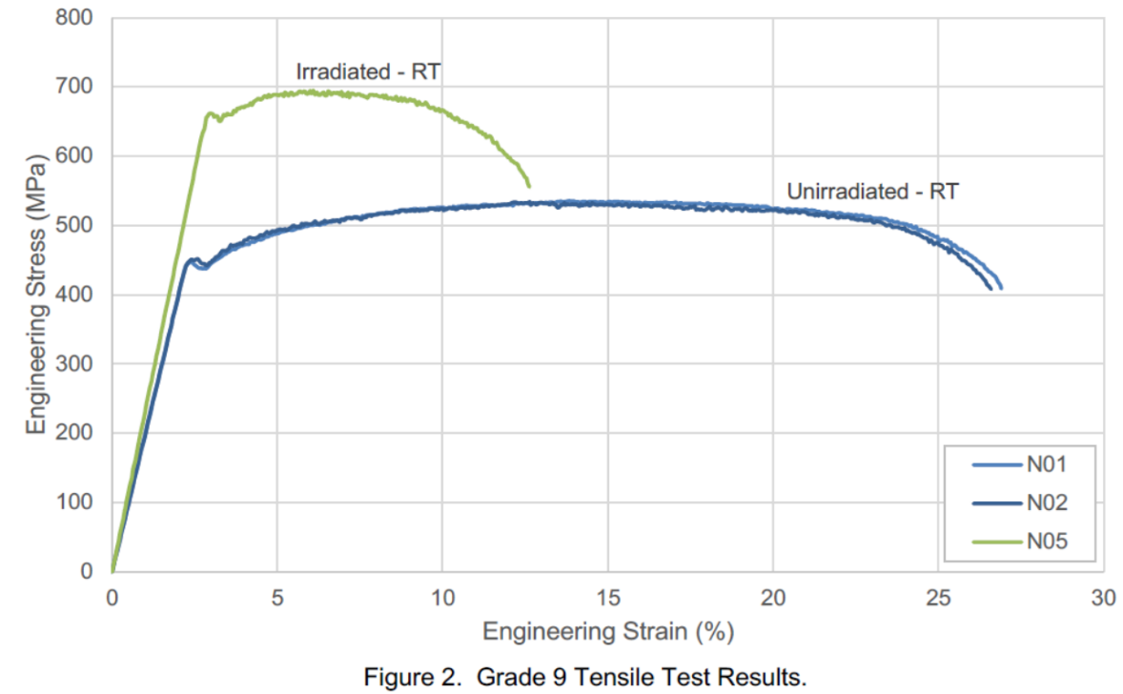
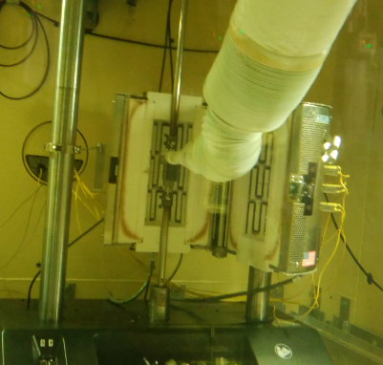
DS Ti-1 (0.25 DPA)Tensile Results
Ti-6Al-4V large loss of ductility
  Uniform elongation after irradiation(~0.1%)
  Grade 23 (Extra Low Insterstitial) under consideration for next T2K beam window did not show any advantage over grade 5
Ti-3Al-2.5V smaller loss of ductility
  Uniform elongation (3%) after irradiation
  Near-α phase alloy seems more radiation tolerant (but lower non-irradiated strength)
ASTM Grade-9
Ti-3Al-2.5V
ASTM Grade-23
Ti-6Al-4V
ASTM Grade-9
Ti-3Al-2.5V
D.Senor, RaDIATE2018

Slide 12
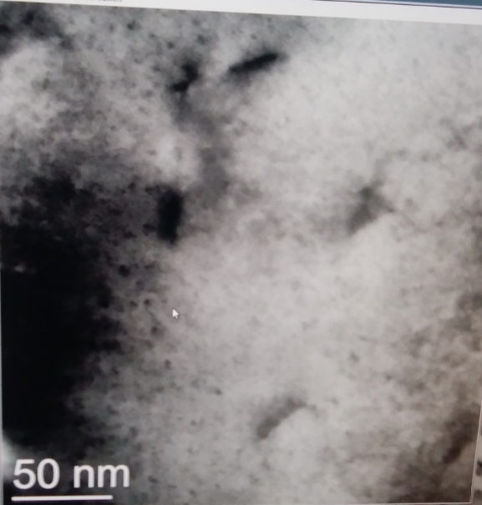
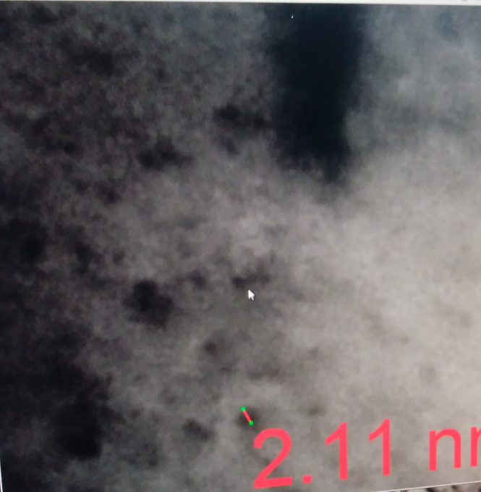
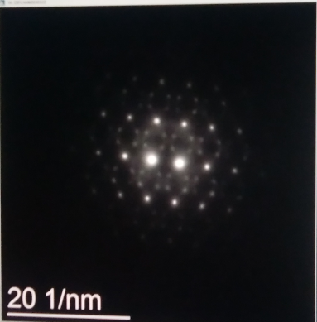
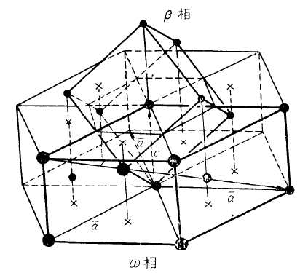
DS Ti-1 (0.25 DPA) Microscopy (TEM) Results
Grade 23 α-phase defect clusters
  High density small defect clusters with ~2nm in size are identified
  Only seen in α grains
  Likely dislocation loops
  Could contribute to embrittlement
Grade 23 β-phase show ω-phase
  Diffraction patterns match ω-phase
  ω-phase is a meta-stable transition phase that can form during aging and/or quenching
  ω-phase content is associated with hardening and loss in ductility
  Not seen in non-irradiated material
Other microscopy studies performed include AFM, SEM & EBSD
Zhao et al (Mat. Trans 2012), showing ω-phase reflections superimposed over β-Ti [110] zone axis

Slide 13
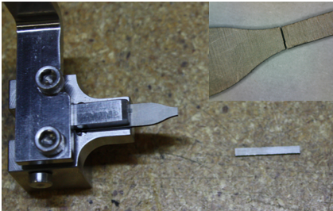
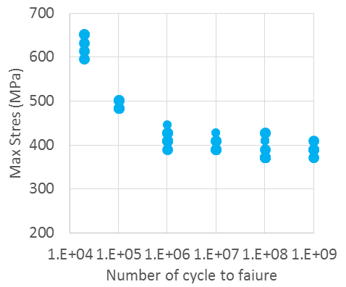

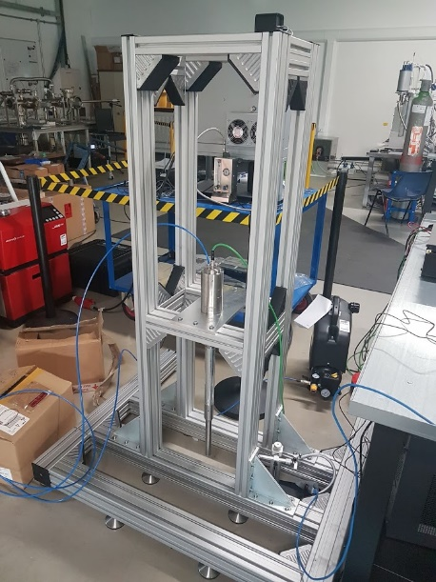
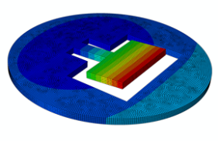
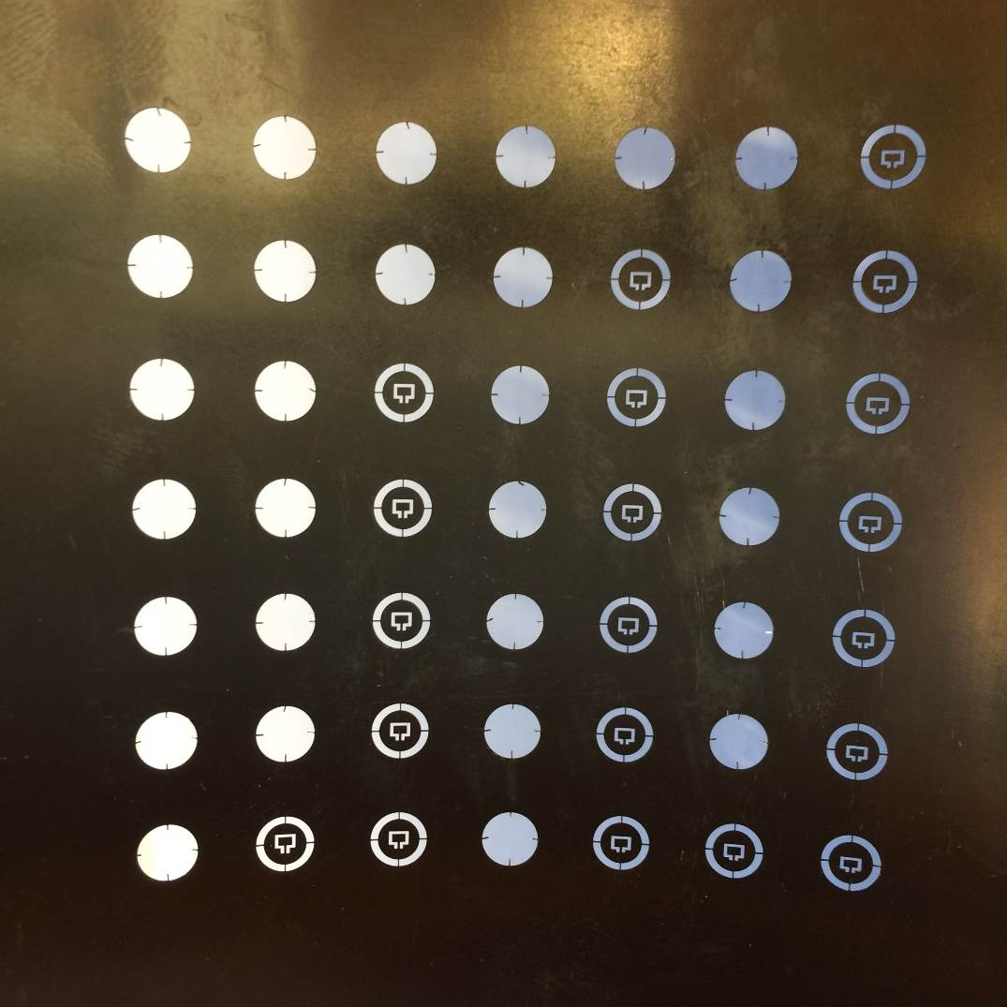
2 Methods of fatigue testing of irradiated Ti alloys
Macro-scale Fatigue Testing
Mesoscale Ultrasonic Fatigue Testing
700
600
Wilkinson, Gong
Max Stress (MPa)
500
400
300
20 kHz = 10⁸cycles in 1.5 h
200
Triangles: Batch 1
Squares: Batch 2
Circles：Batch 3
Red: Broken
Green: Unbroken
＋：Literature
10⁴
10⁵
10⁶
10⁷
10⁸
10⁹
# of cycle to failure
+
+
Average 6.3E+06 cycles to failure (stress max = 819 MPa and R = 0.23)
To start testing at CCFE soon
3 mm

Slide 14
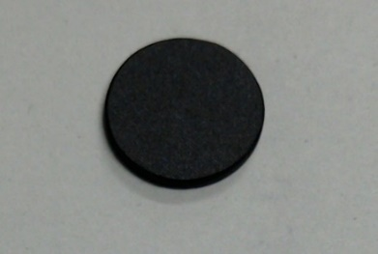
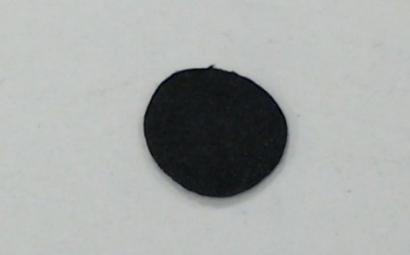
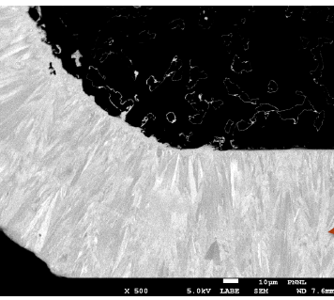
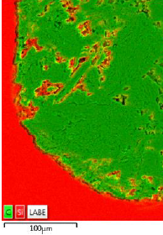
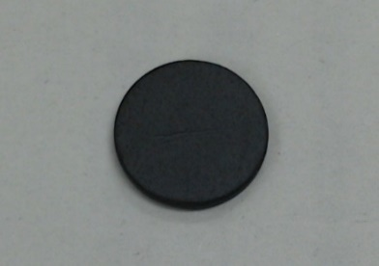
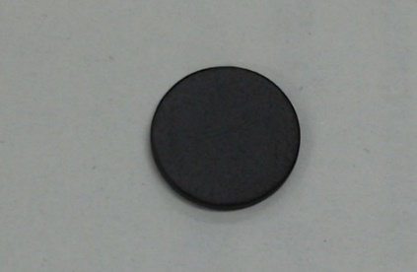
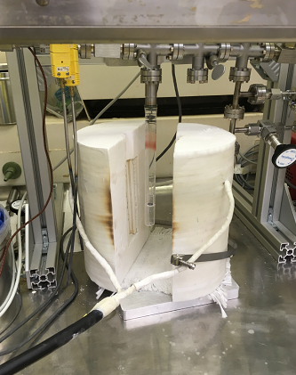
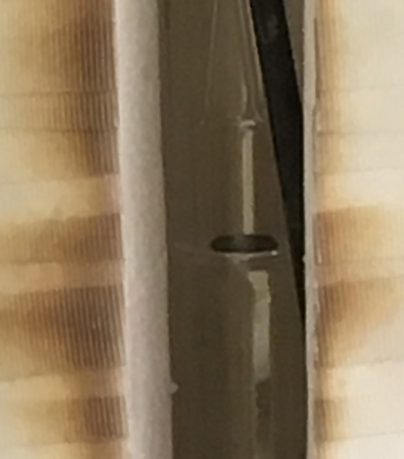
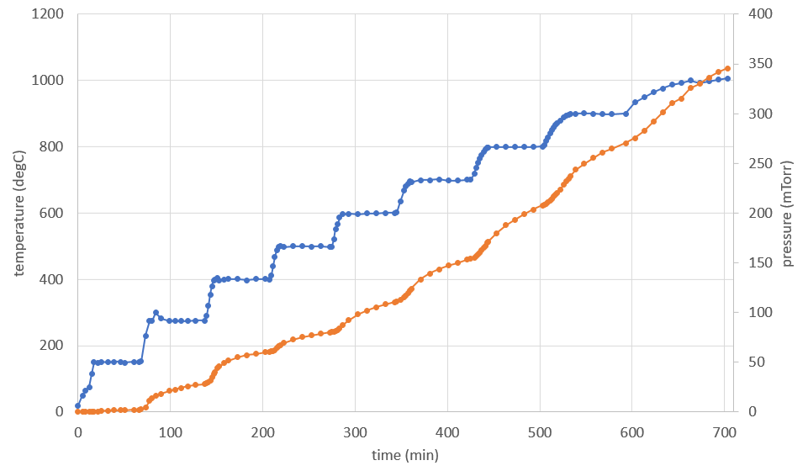
SiC Coated Graphite (Poster Session)
Good performance to prevent graphite oxidization (non-irradiated specimen)
IG-430U
@800ºC
Air 200cc/min.
20 min : - 43%
Si
SiC-coated graphite (IG-610U)
Si migrates into the graphite up to 100 to 200um
Intact coating
grain perpendicular to graphite surface
60 min : (none)
Thermal Desorption Spectroscopy (TDS) has been carried out on a BLIP irradiated specimen to study reduction of radioactive gas emission (HT, HTO) with SiC-coating
Temperature
RT→ 1,000ºC
Pressure
26mSv/h at 1in

Slide 15
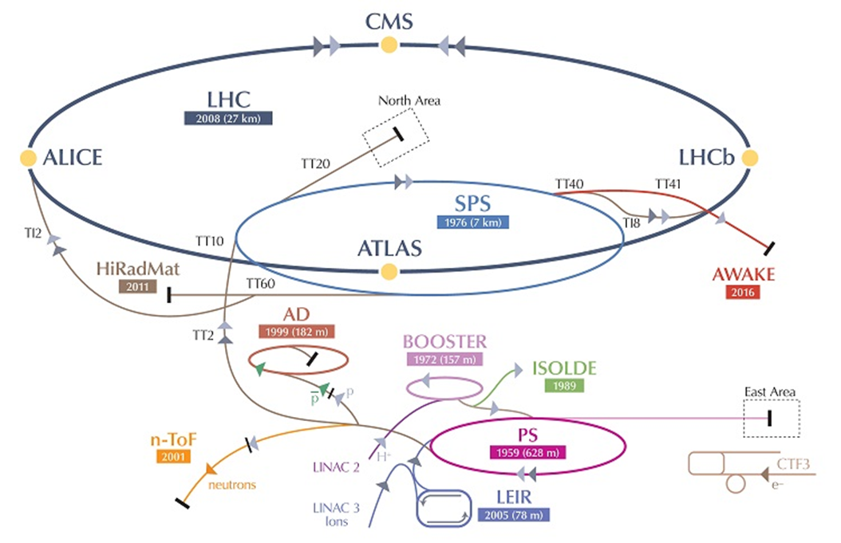



World First: Response of Irradiated Materials to Thermal Shock Induced By High Intensity Proton Beam
HRMT43-BeGrid2 :Expose irradiated & non-irradiated specimens to high intensity beam pulses to compare thermal shock response
  Irradiated specimens included Beryllium, Graphite, Silicon, Titanium, SiC-coated Graphite, Glassy Carbon specimens from BLIP
  First unique test with radiation damaged materials with actual high-intensity proton beam-loading condition
Beam Parameters
Beam energy | 440 GeV
Max. bunch intensity | 1.2 x 10¹¹
No. of bunches | 1 – 288
Max. pulse intensity | 3.5 x 10¹³ ppp
Max. pulse length | 7.2 µs
Gaussian beam size | 1σ: 0.1 – 2 mm
Iridium rod in HRMT27 exploded
with single shot 1.27x10¹² ppp
15

Slide 16











HRMT-43 Experiment Set-up
Glassy carbon windows (US/DS)
POCO ZXF-5Q graphite slug
Borosilicate glass viewport
Gafchromic foil fitted in US window flange
Radioactive Specimens
Irradiated at BLIP
Hermetically-sealed in air to fully contain specimens and avoid contamination release
Irradiated specimens were shipped from BNL to PNNL
  Assembled specimens in holders and inner containment boxes
Irradiated boxes were shipped from PNNL to CERN for final assembly to vertical base plate
With remote handling features (captive nuts in cover boxes) for 3 boxes that contained irradiated specimens

Slide 17





Successful Beam Exposure at CERN
BOX-3
Ti-6Al-4V Gr5
Ti-3Al-2.5V Gr9
SiC-coated Graphite IG-630U
3 boxes with irradiated-specimens
assembled at PNNL hot-cell
K.Ammigan, RaDIATE2018
October 1 – 2, 2018 4:00am
BeGrid2 Exposure has been completed !
PIE to begin in July 2019
Sep.26(Wed)
@HiRadMat

Slide 18



Exciting work in 2019/2020
Complete PIE on specimens from BLIP irradiation and subsequent HiRadMat in-beam thermal shock test
  New, interesting Ti alloys irradiated up to 0.95 DPA at BLIP
  Grade 5 & 23 Ti alloys and SiC-coated graphite from HiRadMat
Perform high-cycle fatigue testing on Ti alloys from BLIP irradiation
  Macro-scale bend testing at Fermilab begins this summer
  Meso-scale high frequency testing at CCFE begins this summer
Perform ion-beam irradiation on Ti alloys at HIT (High Fluence Irradation Facility at Tokai) and MIBL (Michigan Ion Beam Laboratory)
  Ion beam irradiation offers capability to study microstructure evolution up to 10 DPA in a short amount of time and without activation of specimens
Specimen Holder
Beam Profile Monitor
25mm

Slide 19


US-Japan Program: A Significant Part of the Global High Power Targetry (HPT) R&D Program
The impact of the US-Japan Target Materials project is much broader than just the Ti alloy and SiC graphite studies described here.
Via the RaDIATE collaboration, it has contributed to establishing the methods, technology and procedures for evaluating and developing candidate materials for the future.
The HPT R&D Roadmap, currently under development, draws upon these experiences to plot the path to a desired Targetry R&D Capability Platform
!!
Multi-MW
Targets Ahead

Slide 20

HPT R&D Roadmap
Destination: HPT R&D Capability Platform
Established Methods and Technologies to support Multi-MW Target Facilities of the future
Multiple Lanes: Materials and Technology
e.g. Ion beam irradiations and micro-mechanics
e.g. Ab initio and molecular dynamics modeling
e.g. AI empowered robotic remote handling
Milestones:
When critical capabilities are expected
to be available
Off-ramps:
Readiness to inform design & operation
of anticipated target facilities

Slide 21



Targetry Materials Science and Technology Lab Initiative Building the infrastructure to support the HPT materials R&D program
Vision: Establish the material science of targets as a core competency at Fermilab
Objectives:
Materials science lab capable of activated specimens
  Thermal & mechanical testing
  Advanced microscopy, including micro-mechanics
  Autopsies and activated specimen preparation
Robotics lab to innovate remote handling methods
Thermal test stand for high heat-flux cooling concepts
Alternative thermal shock & irradiation development lab
Outcomes:
Accelerate and broaden R&D scope to meet material demands and schedule of future HPT facilities
Develop targetry materials science & engineering experts of the future via University collaboration
Synergy of research applications across the DOE complex (HEP, NP, Fusion, NE) and global partners

Slide 22
Summary
Great progress has been made in the study of Ti alloys for critical beam window applications
  BLIP and HiRadMat irradiations completed
  Preliminary PIE results already impacting material choices for T2K beamline upgrade and LBNF neutrino beamline components
Exciting work ahead in 2019/2020
  Extensive PIE work on new Ti alloys and SiC coated graphite irradiated at BLIP and HiRadMat
  Ion irradiation of Ti alloys at HIT/MIBL
US-Japan program has played a significant role in the broader HPT R&D program and fostered many beneficial collaborative activities and sincere friendships that go beyond the individual projects
There has been great effort through the RaDIATE collaboration on other target materials (graphite, beryllium…) as well. Promoting this program will make multiplying benefits to the high-power target community worldwide.

Slide 23


Slide 24

Back up slides follow

Slide 25




Specimen capsules from first BLIP irradiation phase received at PNNL
Lab. locates at the famous Hanford site
Radiochemical Processing Laboratory (RPL)

Slide 26



PNNL Begins PIE work
  First irradiation phase Ti-alloy and SiC graphite specimens extracted from capsules successfully
  PNNL currently testing tensile grips with SS specimens
  Testing of irradiated Ti specimens should start ~ May 1
  Second irradiation phase Ti specimens expected to ship to PNNL in June, 2018 after cooling
  Irradiated Ti specimens expected to ship to CERN for HiRadMat experiment in July, 2018
  Irradiated SiC-coated graphite specimens expected to be examined in August, 2018

Slide 27

Thermal Shock (stress waves)
Ta-rod after irradiation with 6E18 protons in 2.4 μs pulses of 3E13 at ISOLDE (photo courtesy of J. Lettry)
Simulation of stress wave propagation in Li lens (pbar source, Fermilab)
Fast expansion of material surrounded by cooler material creates a sudden local area of compressive stress
Stress waves (not shock waves) move through the target
Plastic deformation, cracking, and fatigue can occur
Notes:
Ta-rod after irradiation with 6E18 protons in
2.4 μs pulses of 3E13 at ISOLDE

Slide 28
Stress wave example: T2K window
Preliminary
Material response dependent upon:
  Specific heat (temperature jump)
  Coefficient of thermal expansion (induced strain)
  Modulus of elasticity (associated stress)
  Flow stress behavior (plastic deformation)
  Strength limits (yield, fatigue, fracture toughness)
S. Bidhar, FNAL
For more on the T2K window, see Ref. [1] at end of slides
Heavy dependence upon material properties, but:
Material properties dependent upon Radiation Damage…
Notes:
I will NOT speak to every material property as I did in the practice talk. I will gloss over and make the main point at the bottom of the slide

Slide 29

Radiation Damage
Displacements in crystal lattice
(expressed as Displacements Per Atom, DPA)
  Embrittlement
  Creep
  Swelling
  Transmutation products
    H, He gas production can cause void formation and embrittlement
    (expressed as atomic parts per million per DPA, appm/DPA)
  Fracture toughness reduction
  Thermal/electrical conductivity reduction
  Coefficient of thermal expansion
  Modulus of Elasticity
  Fatigue response
Dependent upon material condition and irradiation conditions (e.g. temp, dose rate)
0 DPA
3.2 DPA
14.9 DPA
23.3 DPA
S. A. Malloy, et al., Journal of Nuclear Material, 2005. (LANSCE irradiations)
For an in-depth treatment of radiation damage effects, see Ref. [2] at end of slides
Notes:
One notes that all the properties that are important for thermo-mechanical health of the target are affected by radiation damage. The dependence on irradiation temperature is due to annealing (or healing) the crystal structure is faster at higher temperatures.

Slide 30

Examples of radiation damage
D.L. Porter and F. A. Garner, J. Nuclear Materials, 159, p. 114 (1988)
Factor of 10 reduction in conductivity at 0.02 DPA
Void swelling in 316 Stainless steel tube (on right) exposed to reactor dose of 1.5E23 n/cm²
N. Maruyama and M. Harayama, “Neutron irradiation effect on … graphite materials,” Journal of Nuclear Materials, 195, 44-50 (1992)

Slide 31
Radiation Damage
p
100+ MeV
n
1-14 MeV
Irradiation Source | DPA rate (DPA/s) | He gas production (appm/DPA) | Irradiation Temp (˚C)
Mixed spectrum fission reactor | 3 x 10⁻⁷ | 1 x 10⁻¹ | 200-600
Fusion reactor | 1 x 10⁻⁶ | 1 x 10¹ | 400-1000
High energy proton beam | 6 x 10⁻³ | 1 x 10³ | 100-800
14.9 DPA
23.3 DPA
Effects from low energy neutron irradiations do not equal effects from high energy proton irradiations. Table compares typical irradiation parameters.
Cannot directly utilize data from nuclear materials studies!
Notes:
Add note that use of data from nuclear materials research is limited and should not be depended upon.

Slide 32







RaDIATE R&D Progress
New directions and techniques
  High frequency meso-scale fatigue testing (20 kHz, 100 um foil) (Wilkenson/Gong, Oxford)
Other planned work
  Graphite
    2016 Low E ion irradiation studies (Notre Dame?)
    2017 – Micro-mechanics (Liu @ Oxford?)
    2017? - NOvA TA-01 target autopsy/PIE (PNNL)
  Beryllium
    2016-17 – Recovery of NuMI NT-02 target window & PIE (Kuksenko @ Oxford?)
    2016-17 – Irradiation of Be fins in NOvA TA-02 target with PIE in 2018-19?
  Titanium 6Al-4V
    2018 - Macro-fatigue testing of BLIP specimens (BNL?)
    2018 - Meso-fatigue testing of BLIP specimens (20 kHz) (Oxford, Culham?)
  Micro-mechanics on graphite (Liu, Oxford)

