Slide 1
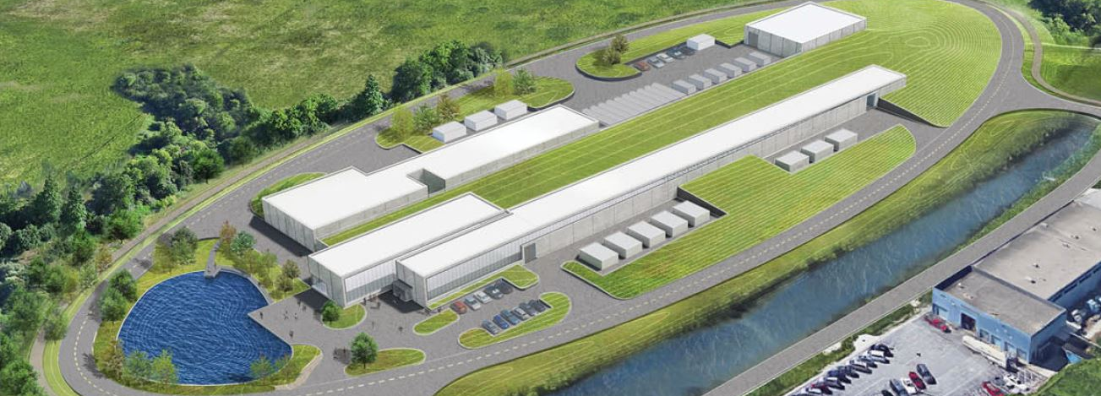
Introduction
Ioanis Kourbanis
PIP-II Booster ORBUMP Magnets PDR
30 May 2019

Slide 2
Outline
PIP II Scope
PIP II Requirements
Accelerator Upgrades Scope
Booster Upgrades Scope
Organization
Review Charge
Agenda

Slide 3
PIP II Scope
800 MeV H− linac
Warm Front End
SRF section
Linac-to-Booster transfer line
3-way beam split
Upgraded Booster
20 Hz, 800 MeV injection
New injection area
Upgraded Recycler & Main Injector
RF in both rings
Conventional facilities
Linac Tunnel includes 2 empty slots
Upgrade capability to 1GeV

Slide 4
PIP II Requirements (Existing Accelerators)
Project FRS requirements: Deliver ≥1.0 MW of proton beam power from Main Injector, over the energy range 60-120 GeV.
All Accelerator Upgrades required to meet the FRS requirements are part of 121.05 L2 WBS.
In addition WBS 121.05 WBS includes the Transfer Line from the Linac to the Booster the Beam Absorber Line and the Beam Dump.

Slide 5
121.05 L2 System Scope
WBS Dictionary Definition: pip2-docdb #599
Labor, materials, travel, and costs associated with the management, design, procurement, fabrication, and installation of and upgrades to the Booster, Recycler, and Main Injector to accommodate increased injection energy, increased intensity and higher repetition rates. Includes the design and installation of the beam line from the superconducting Linac to the Booster and the Beam absorber line and beam dump.

Slide 6
121.05.04 Booster - Scope
121.05.04.02 AccU – BSTR - 800MeV Injection System
New Girder for mounting injection components
ORBUMP magnets & power supply (4)
Injection waste beam absorber assembly
Stripping Foil Assembly
H & V Painting magnets & power supplies (8)
New “D” combined function magnets (2)
121.05.04.03 AccU - BSTR – 20Hz Upgrade
Resonant Capacitors
Accelerator Controls (local to GMPS)
Magnet girder Chokes
Booster Power Supplies & controls
Integration and testing

Slide 7
Organization
WBS 121.05
ACCELERATOR COMPLEX UPGRADES
I. Kourbanis
System Manager
WBS 121.05.01 Project Management
I. Kourbanis
WBS 121.05.02
Transfer Line/Beam absorber
M. Xiao
WBS 121.05.03
Beam Transfer Line Installation
D. Morris
121.05.04.02 800 MeV Injection System
121.05.04.02.01 Injection Girder Magnets
Magnetic calculations (V. Kashikhin)
Mechanical Design (J. Amann)
WBS 121.05.04
Booster
D. Johnson
WBS 121.05.05
MI/RR
J. Dey

Slide 8
Review Charge Questions
Are the requirements documented, clear, complete and appropriate?
Is the proposed design for the ORBUMP magnets likely to meet requirements? Explain any deficiencies or concerns.
Are there any features present (or absent) that threaten the intended function and performance of this design?
Have safety and environmental aspects been appropriately considered?
Have quality aspects been appropriately considered?

Slide 9
Review Agenda
Introduction: I. Kourbanis
Physics Requirements: D. Johnson.
Magnetic Design: V. Kashikhin
Mechanical Design: J. Amann
Closeout – Review Chair

Slide 10
END

