Slide 1
Mu2e Online Software (otsdaq) and firmware improvement
Wydglif Dorlus
Summer Project
10 / 2019 / 06

Slide 2
Mu2e DAQ
Data Acquisition
Filter, process and analyze data
Software and hardware used to monitor, select, and validate physics and calibration data for the experiment

Slide 3
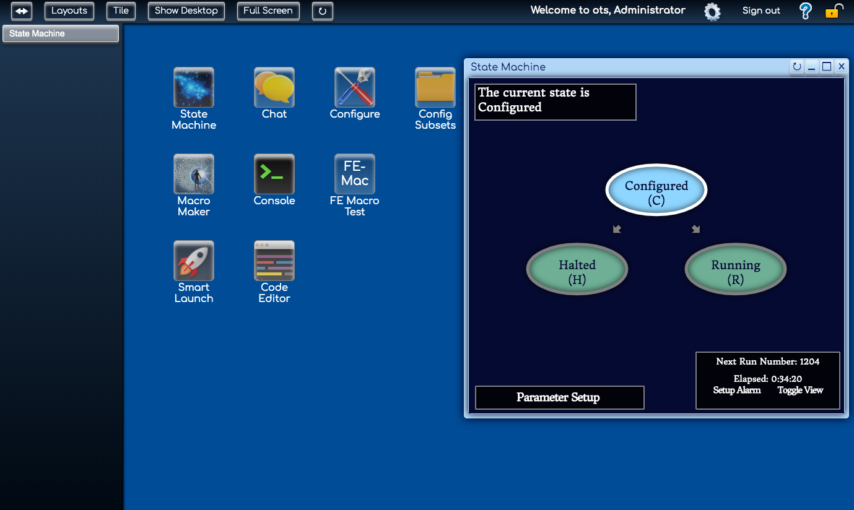
otsdaq
Off-the-shelf data acquisition
Web based desktop
Commercial hardware components
Uses artdaq
for filtering, analysis, event-building, event reconstruction, data transport
Online features for users
Customizable
Provides information about the status and health of the Mu2e detectors

Slide 4
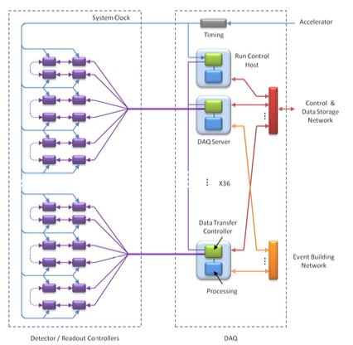
Data Exchange
Real time communication
Programming and testing of FPGA (field programmable gate arrays) boards using VHDL

Slide 5
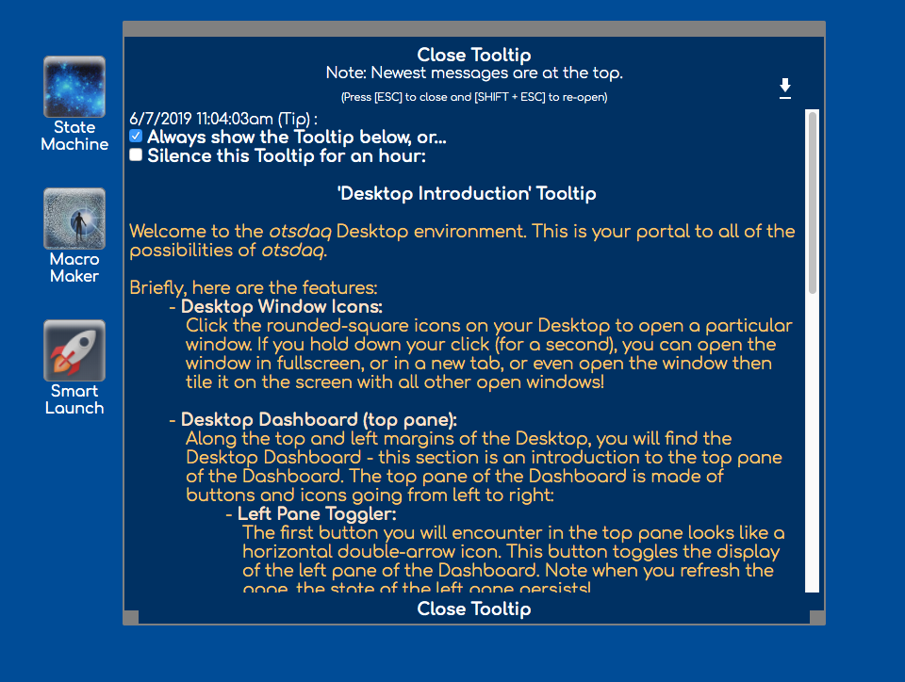
Web-Based Desktop
Improving user’s experience
User friendly
HTML, CSS, C++, Bash Scripting, Javascript

