Slide 1
The Wire Chambers: User friendly
By, Neomy O. Gutierrez
Advisors: Mandy Rominsky and Evan Niner
Location: The Fermilab Test Beam Facility
06/10/2019

Slide 2
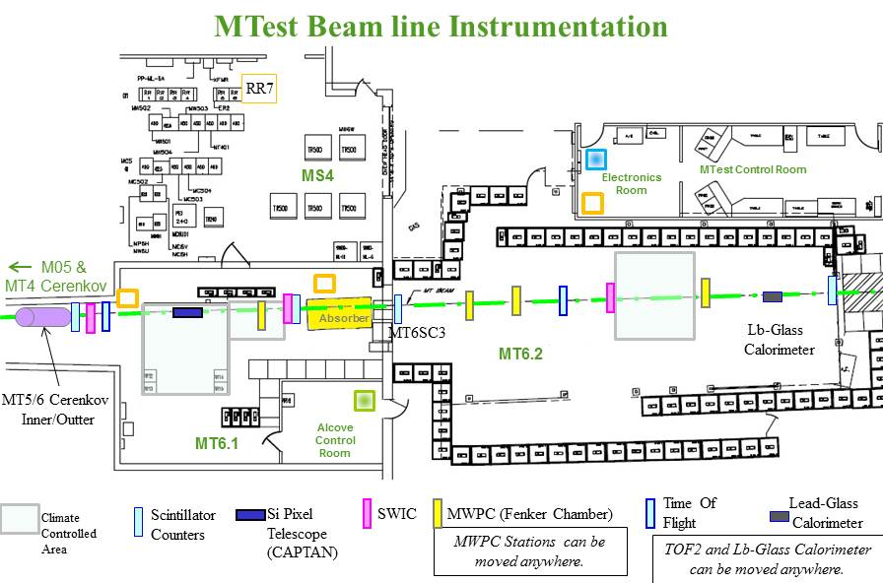
Beam and Users
James Harrington
The FTBF is one of the few that carries a beam that can handle high energy that is devoted to detector research and development
The FTBF has two beam lines, the MTest and MCenter to provide a variety particle types such as a proton beam and secondary particles called muons, pions, electrons, and kaons.

Slide 3
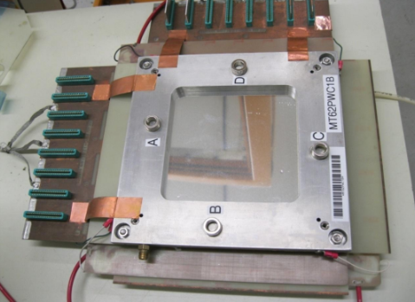
Wire Chambers
Structure/Description:
The Multi Wire Proportional Chambers (MWPC) is a small rectangular shape instrument that contains multiple wires inside these two planes.
These Wires are going through vertical and horizontal, creating a grid.
128 wires exact
The chambers (4) uses nonmetric amplifier-discriminator cards, where there are 8 cards installed in each plane.

Slide 4
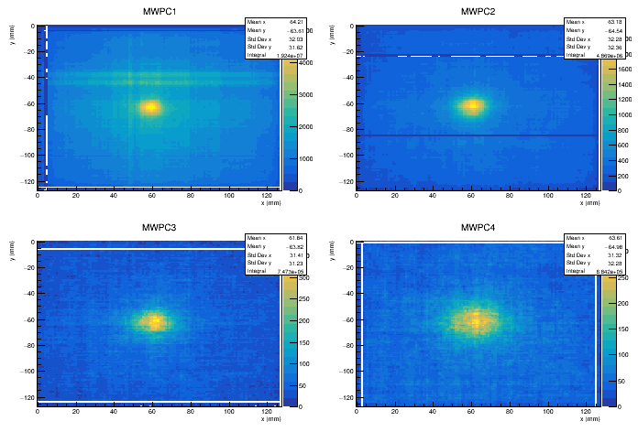
Continue…
Use:
It was designed to reduce the amount of matter in the path of the beam.
When it is passing through these chambers, the beam will hit these wires causing there to collect data of where and when the beam hit any of the wires.
This allows one able to adjust it.
Issues:
Due to the intense level of beam, these chambers sometimes have difficulties collecting data from being overused.
Therefore, they have to be internally fixed and then tested to put back in the beam.
Each chamber can only handle a certain level of voltage.

Slide 5
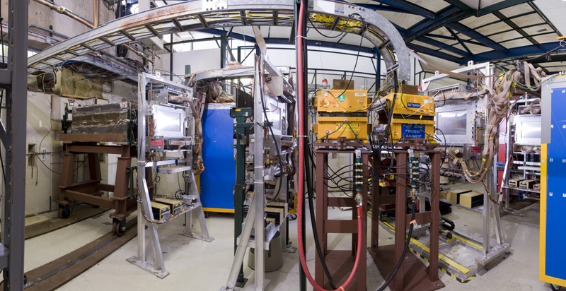
Project: User Friendly
Information:
Users are given multiple codes either from the facility or past users depending on their detector,
If there is a problem, the FTBF staff is able to help and install their detectors.
The purpose of these codes/programs is to adjust the beam in order to collect correct data.
Task:
Improve and organize the multiple codes/programs, so that is accessible and user friendly for future users in order to run their detector's to collect the data from the Wire Chambers
Able to improve and test these codes through the otsDAQ program.
Learn and Use Roots and C++

