Slide 1
Booster Beam Studies 2019 S.09: Tune Scans, Instensity Scans
J.Eldred, K.Seiya, V.Shiltsev
June 27 (whole day) and June 28 (PM), 2018

Slide 2
S.09: Dependencies of SC effects – Original Plan
Objective: systematic study of the evolution of transverse emittance growth and beam loss over the ramp; effects of the space-charge, tunes, Q’, octupoles, known magnet nonlinear errors// will use of RWM and IPM to carry out corresponding scans (~400)
PI’s (Fermilab and non-Fermilab): K.Seiya and V.Shiltsev
Participants: (J.Eldred), K.Seiya, V.Shiltsev, CERN, GSI
Est. duration: 2 shifts parasitic, 1 shift dedicated
Comments: all instruments have to be available (built and installed); small loss scans at the rate 2-10/min (0.1-1% effect on proton timeline), larger loss results in PA trips and 10-15 min recovery – will be minimized to about 10-15.

Slide 3
S.09: Dependencies of SC effects – Actual Plan
Thur. June 27 - 2D tune scans:
Q_x,Q_y scan: Low N_p 4T, low Q’ (-6)
Q_x,Q_y scan: Low N_p 4T, high Q’ (-20)
Q_x,Q_y scan: High N_p 14T, high Q’ (-20)
Q_x,Q_y scan: High N_p 14T, medium Q’ (-12)
Fri. June 28 – 2 D tune scans, 1D scans:
Q_x,Q_y scan: Medium N_p 9T, medium Q’ (-12)
Q_x,Q_y scan: Medium N_p 9T, high Q’ (-20)
N_p scan, standard optics: nominal Q’ *, -12, -20
* nominal operational Q_x,y = 6.78/6.88; Q’_x,y=-4/-16

Slide 4
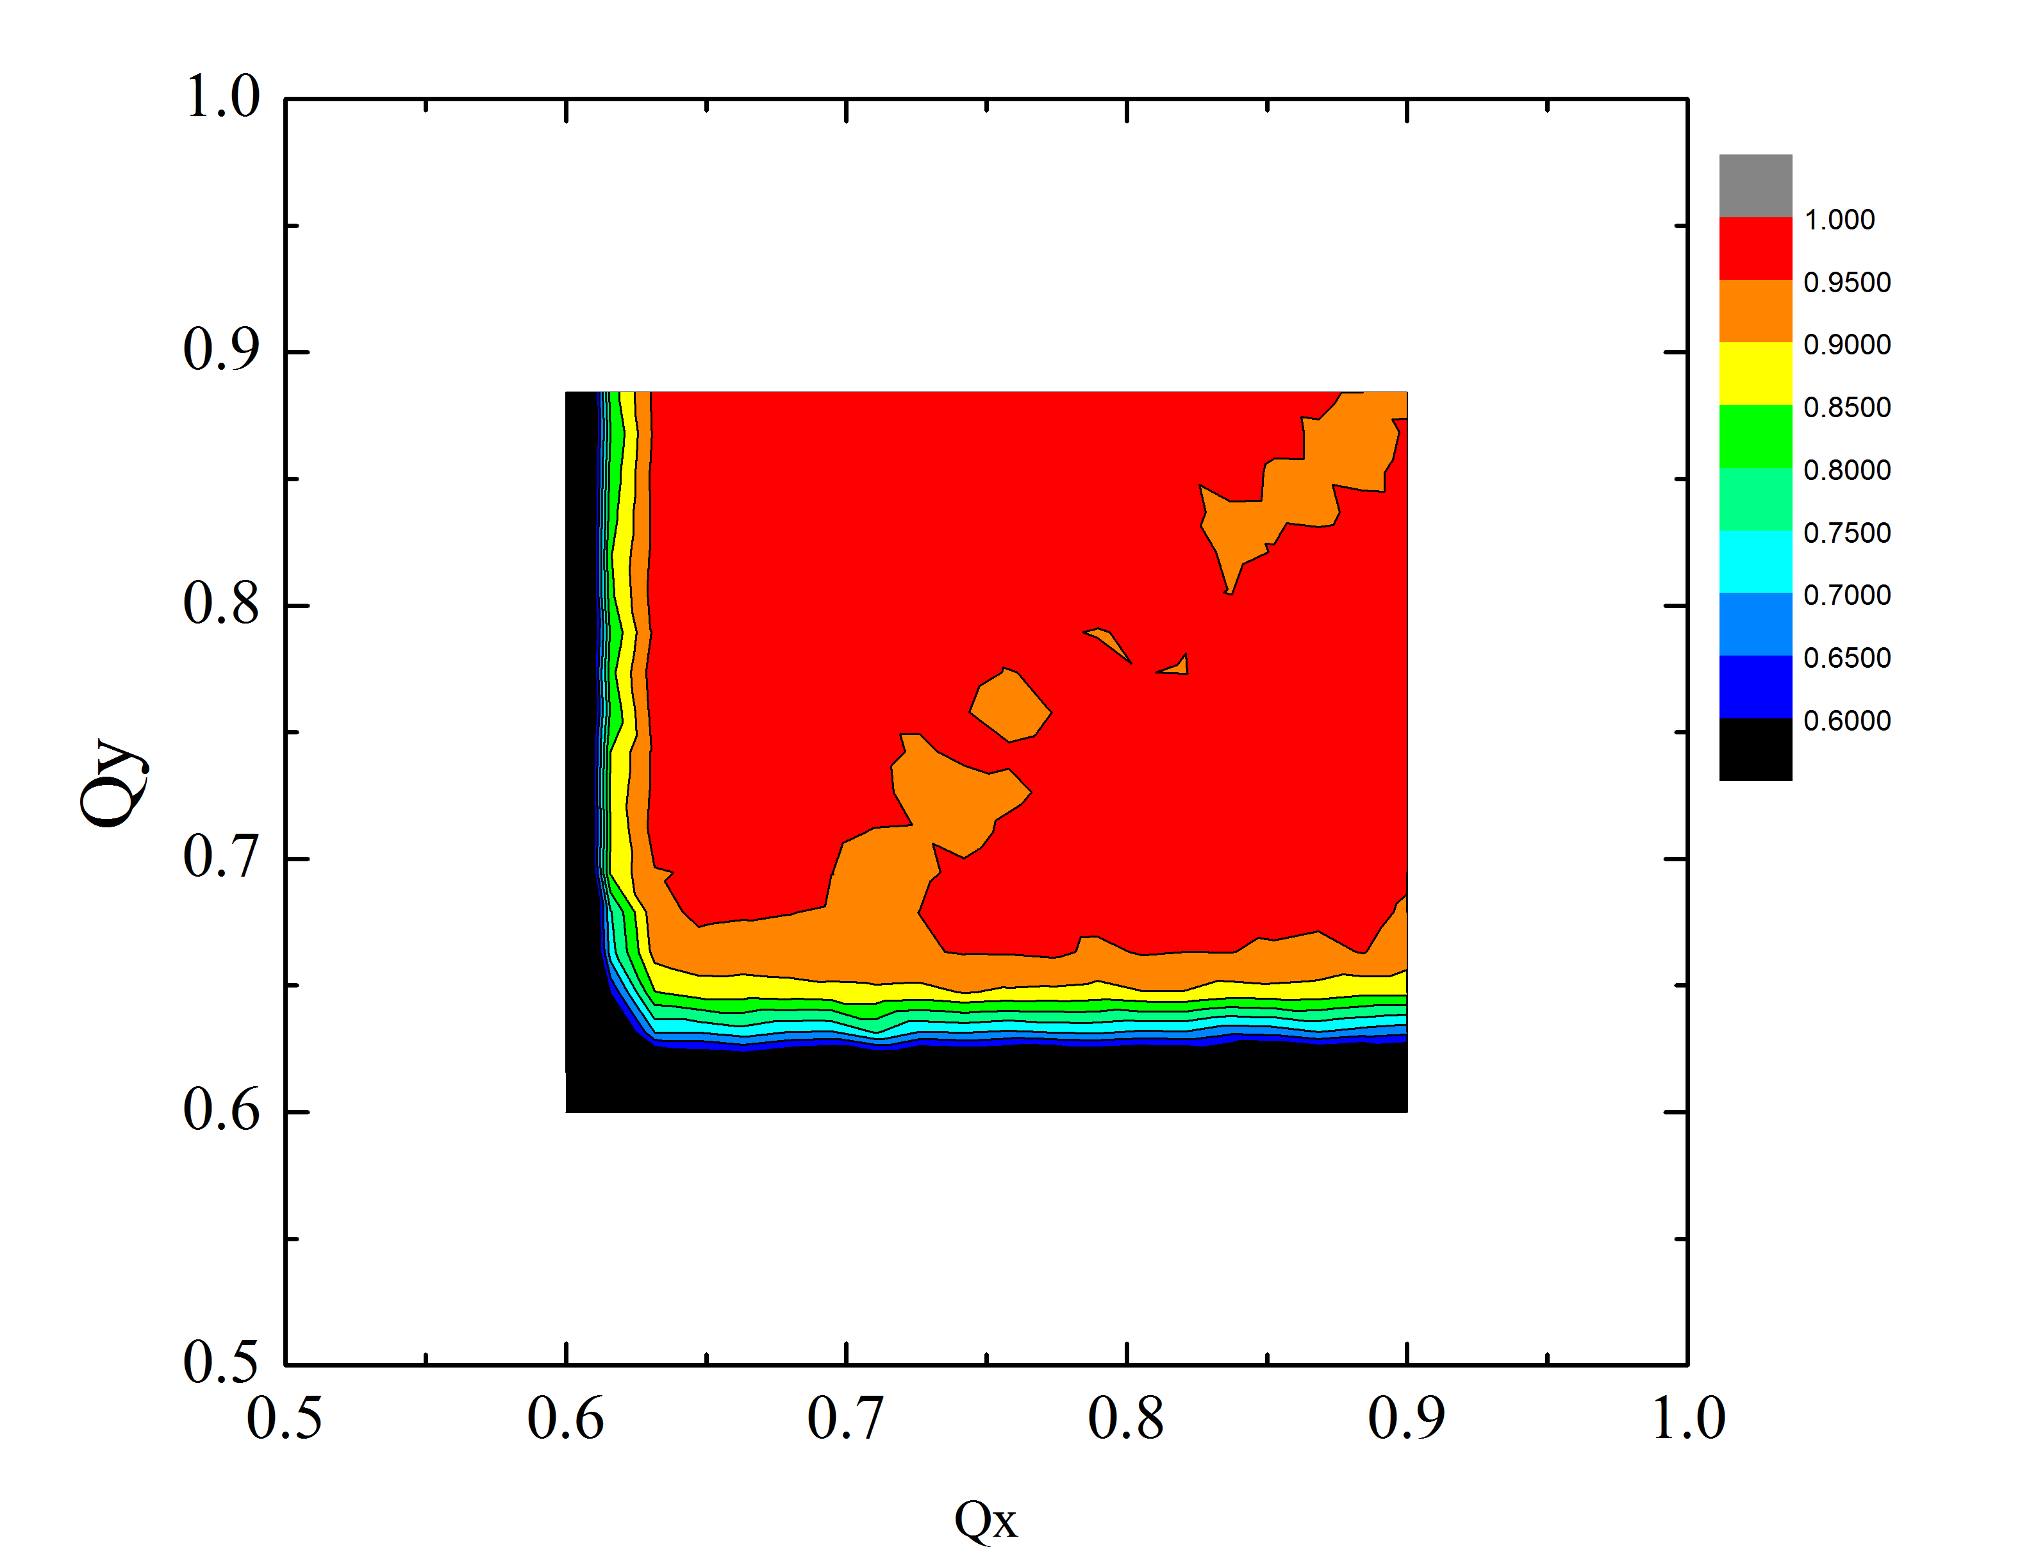
S.09: (Thur 06/27 data) Q’=-6 N_p=4 turns
Best transmission @1ms:
98.5% at Q_x,y=0.68/0.84
Best transmission
end of cycle: 96.5% at Q_x,y=0.82/0.81
Intensity transmission after 450 turns (“point A”, +1 ms)

Slide 5
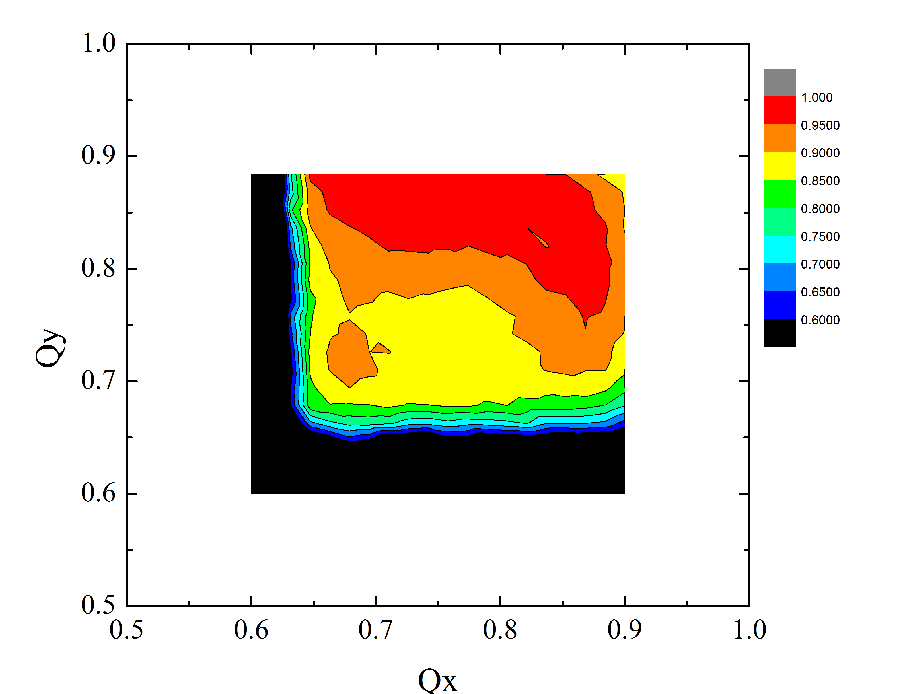
S.09: (Thur data) Q’=-20 N_p=4 turns
Best transmission @1ms:
98.8% at Q_x,y=0.69/0.88
Best transmission
end of cycle: 97.4% at Q_x,y=0.77/0.88
Intensity transmission after 450 turns (“point A”, +1 ms)

Slide 6
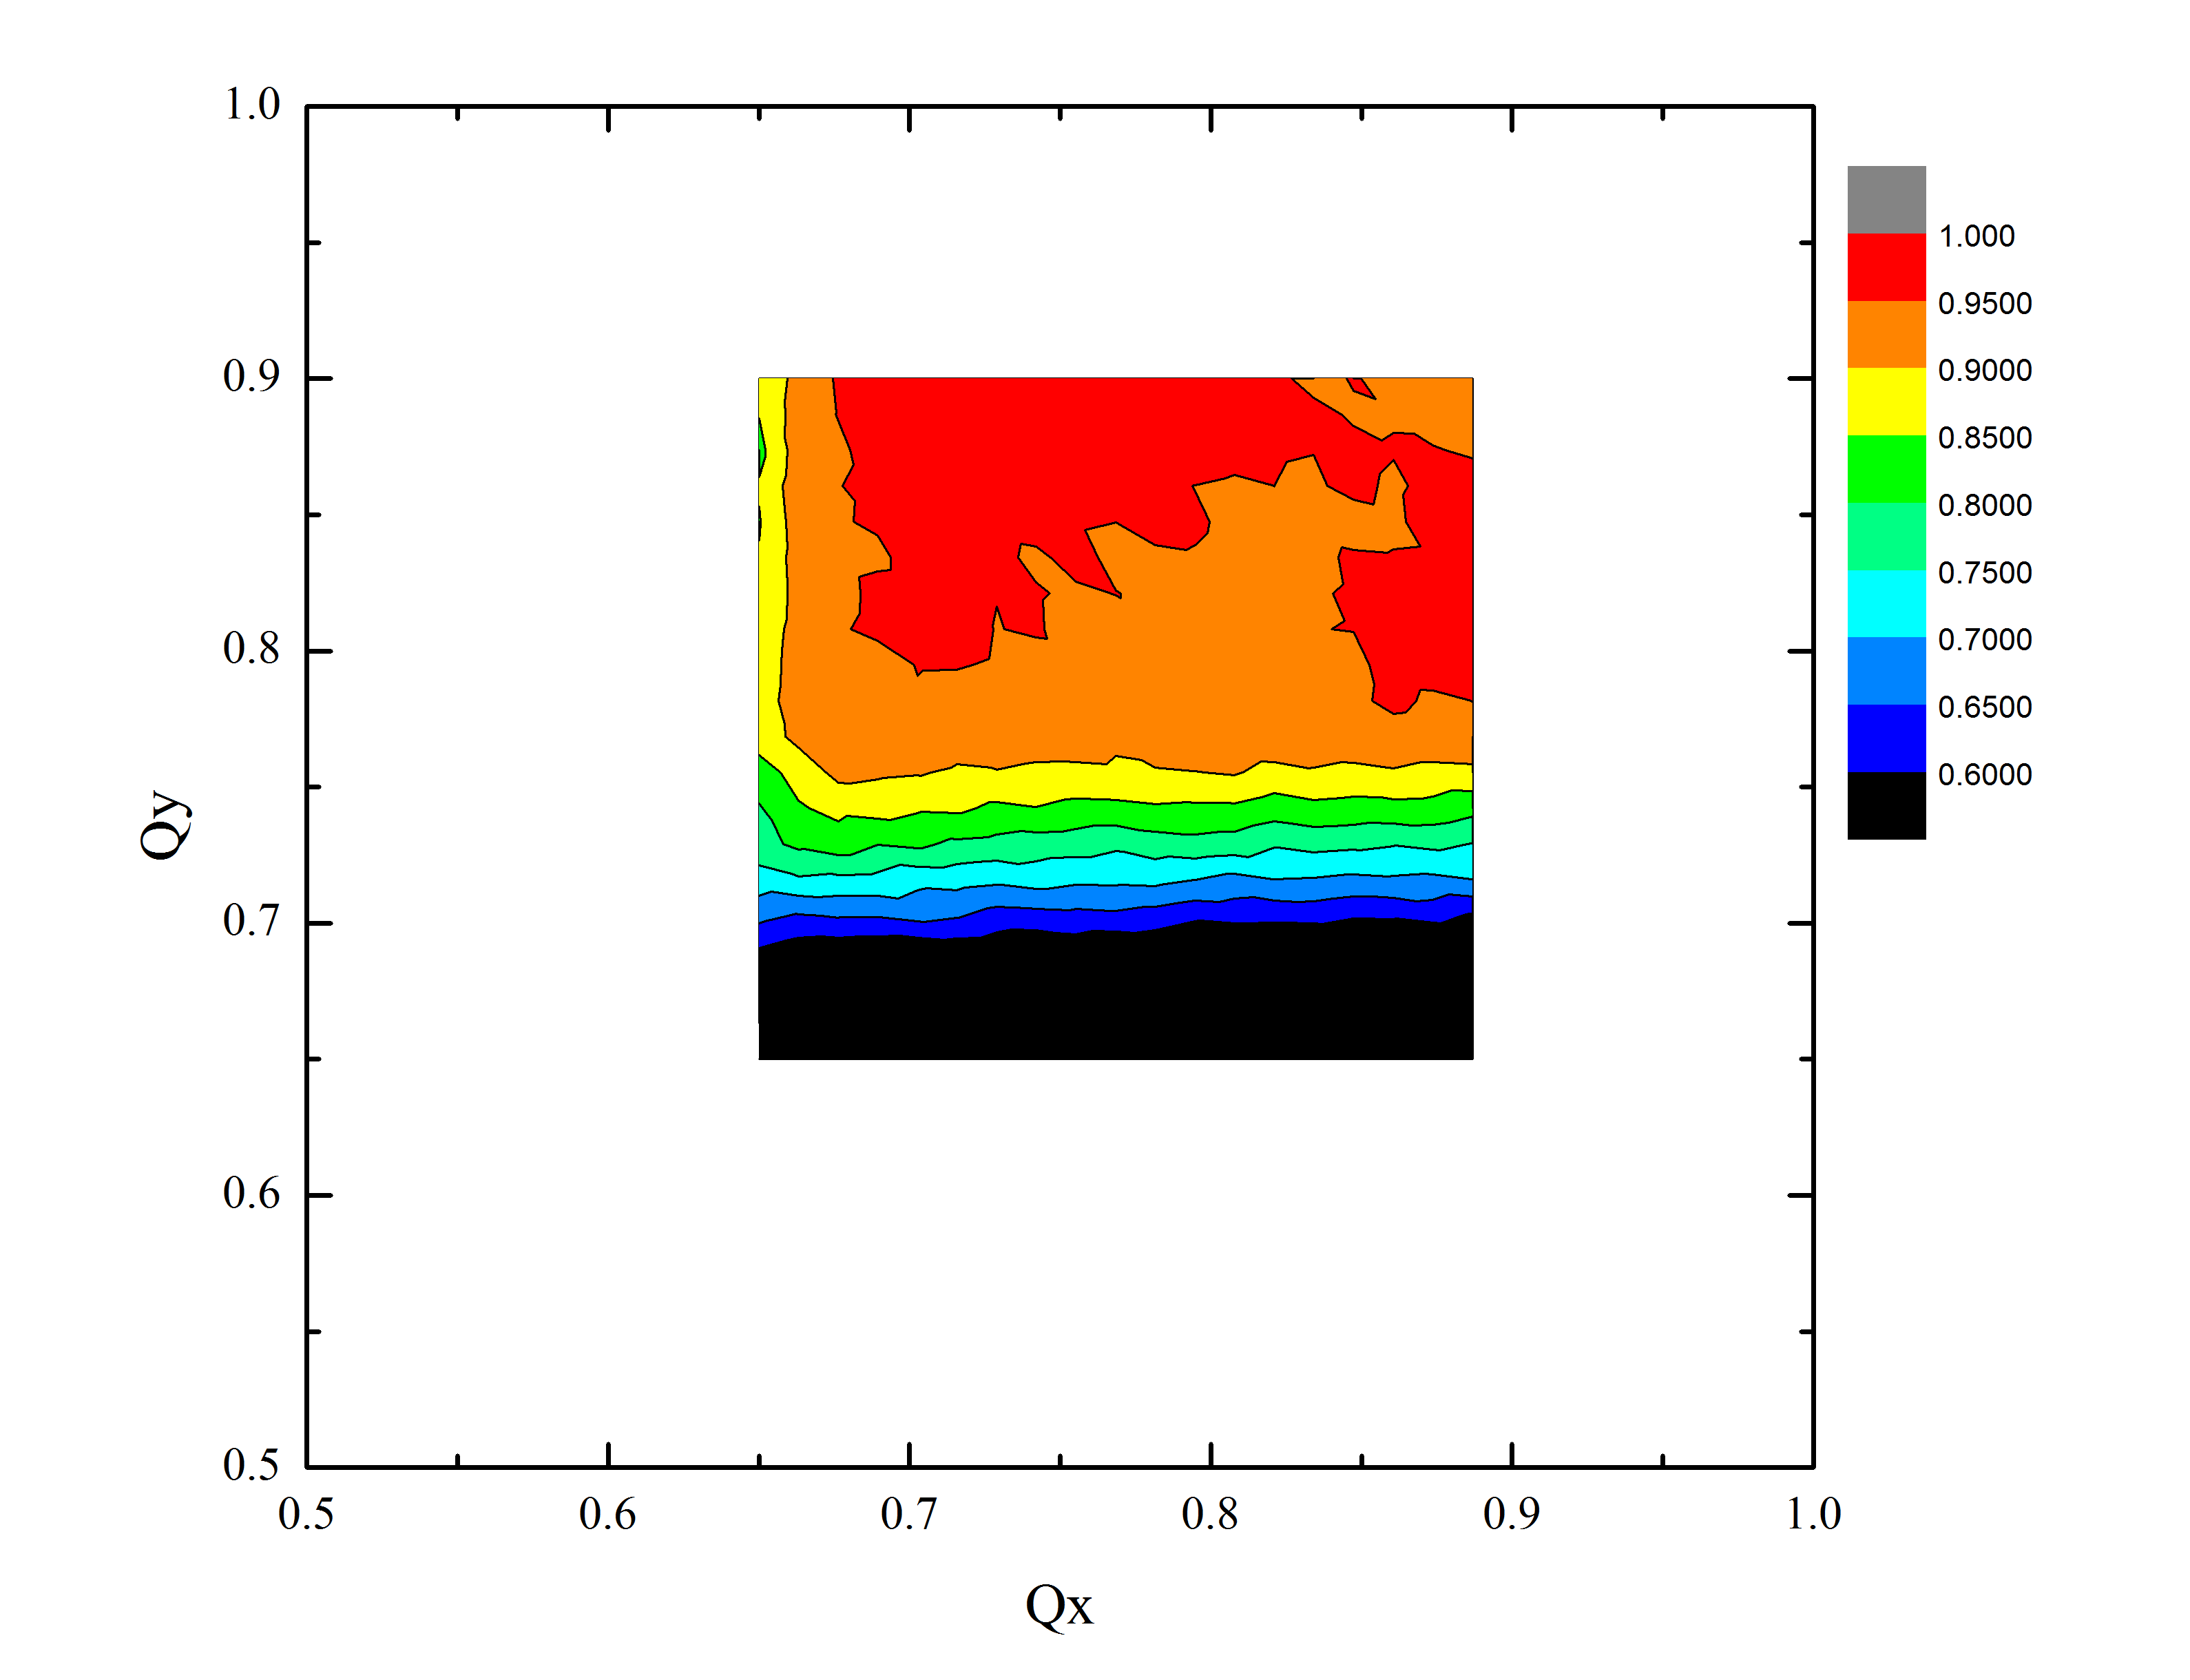
S.09: (Thur data) Q’=-12 N_p=14 turns
Best transmission @1ms:
97% at Q_x,y=0.74/0.87
Best transmission
end of cycle: 93% at
Q_x,y=0.8/0.9
Intensity transmission after 450 turns (“point A”, +1 ms)

Slide 7
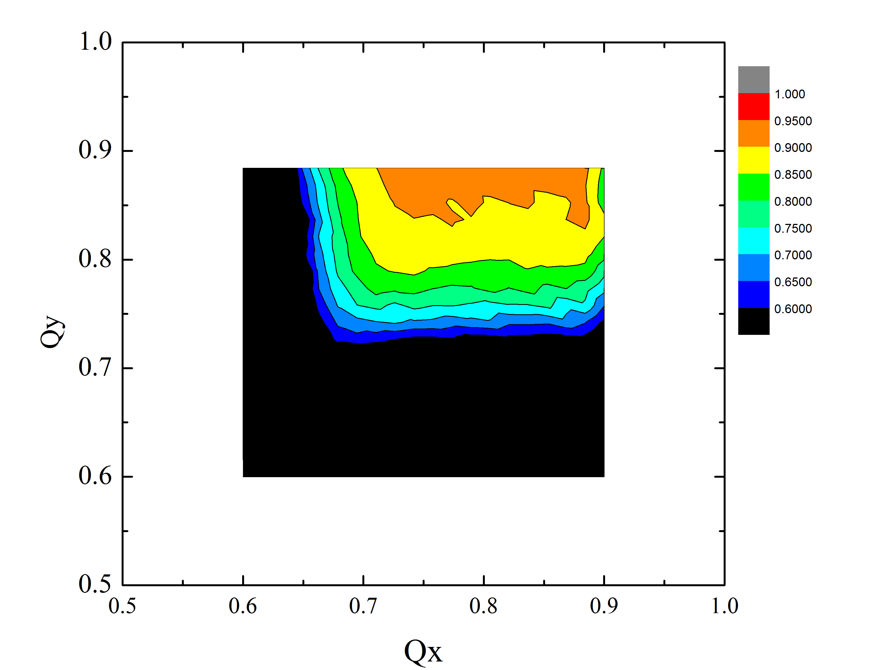
S.09: (Thur data) Q’=-20 N_p=14 turns
Best transmission @1ms:
93% at Q_x,y=0.77/0.88
Best transmission
end of cycle: 84% at
Q_x,y=0.77/0.88
Intensity transmission after 2000 turns (“point A”, +1 ms)

Slide 8
Approx. Scaling dN/N vs N and Q’
 | Q’=-4 | Q’=-12 | Q’=-20
N=4 turns | 1.5% (1ms) (3.5 % extr.) |  | 1.2% (1ms) (2.6 % extr.)
N=14 turns |  | 3.0% (1ms) (7.0 % extr.) | 7.0% (1ms) (16 % extr.)
i.e. for losses after 1 ms
$$\frac{dN}{N}\left[\%\right]=\left(1.5±0.5\right)+5.5{·(\frac{Q′}{20})}^{2±0.5}{·(\frac{N}{14 turns})}^{1.5±0.5}$$
Compare with the Tevatron at inj, ramp and squeeze (long-range beam-beam)

Slide 9
Also : is the footprint “shrinkage” = (dP/P)xQ’ ?
For N=4 turns:
Change of chromaticity dQ’=20-6=14 units
Reduction of the 90% transmission tune area dQ_x=0.02, dQ_y=0.05
Rms energy spread at inj ~0.0017
So, in the units of dQ’(dP/P) : dQ_x=0.8 and dQ_y=2.1
For N=14 turns:
Change of chromaticity dQ’=20-12=8 units
Reduction of the 90% transmission tune area dQ_x=0.05, dQ_y=0.1
Rms energy spread at inj ~0.0017
So, in the units of dQ’(dP/P) : dQ_x=3.7 and dQ_y=7.4
Why dQ_x << dQ_y? Why does Q’ footprint reduction scale with N_turns?
Three effects: dQ due to Q’, dQ due to SC for particles off center due to D_x(dP/P), dQ_SC tuneshift due to long oscillations along the bunch for particles with dP/P…

Slide 10
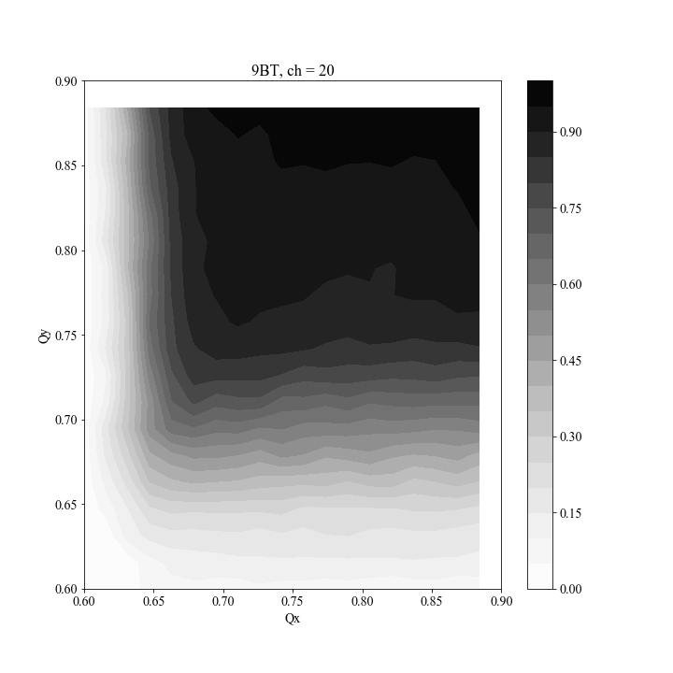
Kyiomi looked at 9BT CH=-20, IPM data from 0 to 512 turns (first 1msec)
1: I looked at first 512 turn IPM data.
2: The data is the beam size (sigma) which is averaged over 6 turns.
3: I fixed Qx=0.76 and scanned vertical tune and plotted BPM data in horizontal and vertical in slide2.
4: I fixed Qy=0.86 and scanned horizontal tune and plotted BPM data in slide3
5: Beam size was increased first 200 turns in Horizontal and vertical probably due to multiturn injection and adiabatic capture.
6: Intensity kept decreasing from 0 turn to 512 turn.
*I have not made this plot, but slide 4 show an example.
7: The slide4 shows the horizontal position moved more than 5 mm in 512 turns
*I have not made this plot
8: * I have to do same analysis with different chromaticity.
**Question**
If beam size is not increasing, why are we loosing beam for 1 msec?
Why is the horizontal position moving?

Slide 11
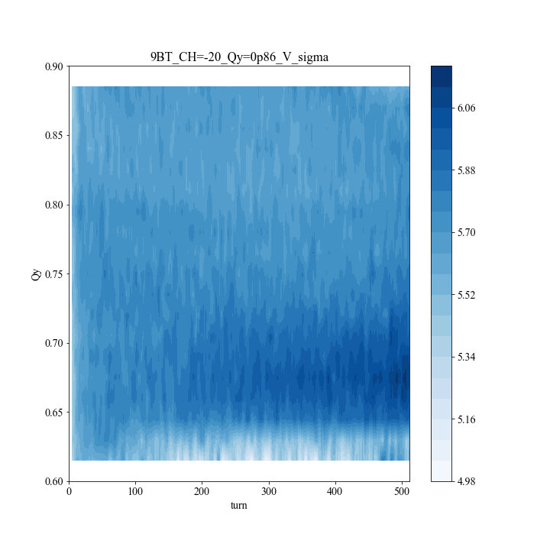
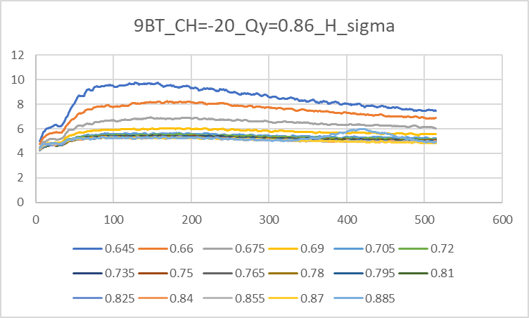
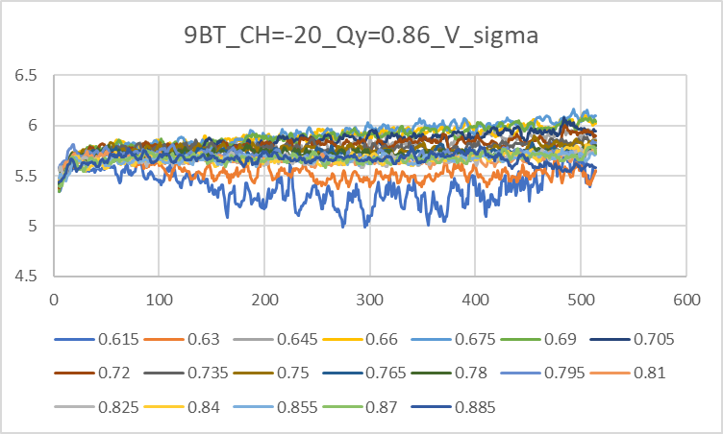

Slide 12
Intensity Scans: MW Emittances (8 GeV, extr. beam, 95%)
HEP tunes and Chromaticity (-4/-16)
Signs of scraping?

Slide 13
Intensity Scans: Losses and MW Emittances (rms)
HEP tunes and Chromaticity (-4/-16)
Scraping indeed…

Slide 14
Intensity Scans: Losses and Chromaticity
Things get much worse (~2-3) with higher Q’

Slide 15
Intensity Scans: Emittances and Chromaticity
Emittances get somewhat lager at higher Q’, but show “scraping”

Slide 16
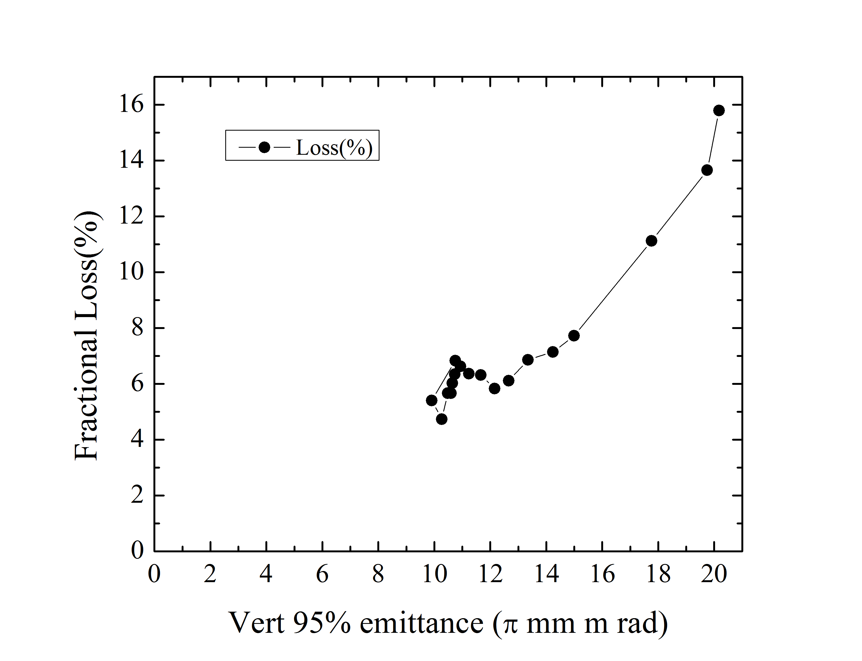
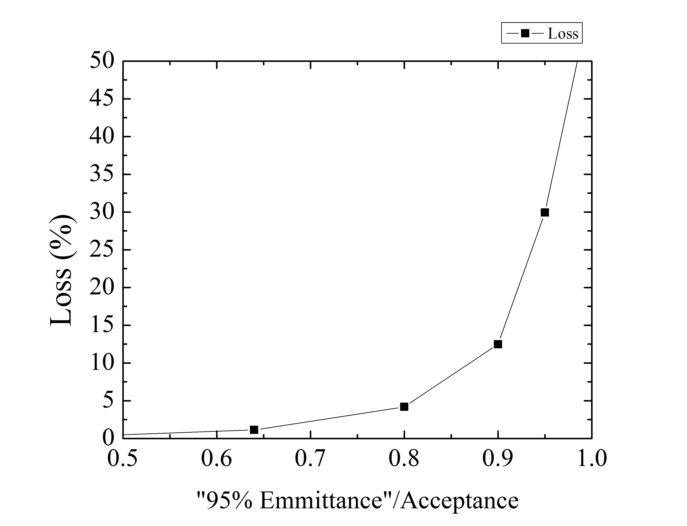
Acceptance
2 D Gauss
Booster Loss
Booster Acceptance is about 22+-2 pi (mm mrad , normalized)

Slide 17
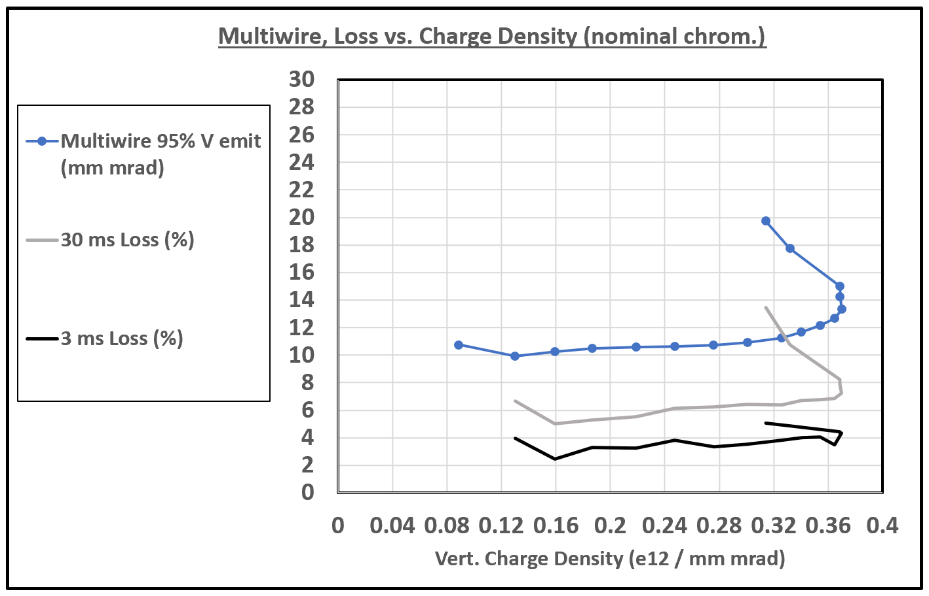
Nominal Chromaticity – Emit Loss vs Charge Density
Emittance blow-up
with aperture loss.
Emittance at
half-integer
resonance limit.
Slow emittance growth.

Slide 18
Important issues/notes : a) on chromaticity Q’ b) on the ionization profile monitor (IPM) c) on ultimate beam out of Booster “now and then”

Slide 19
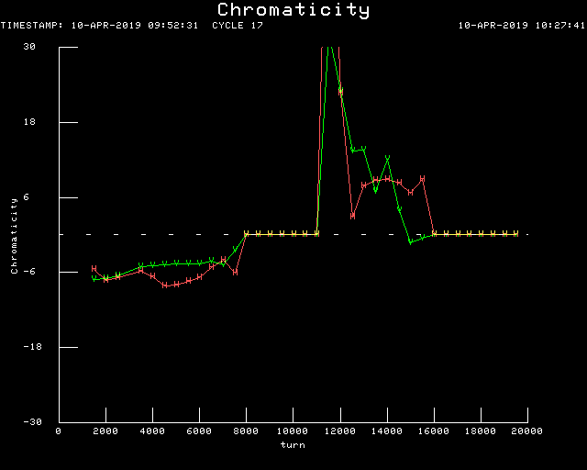
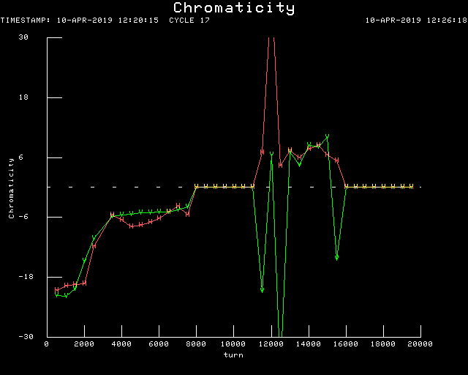
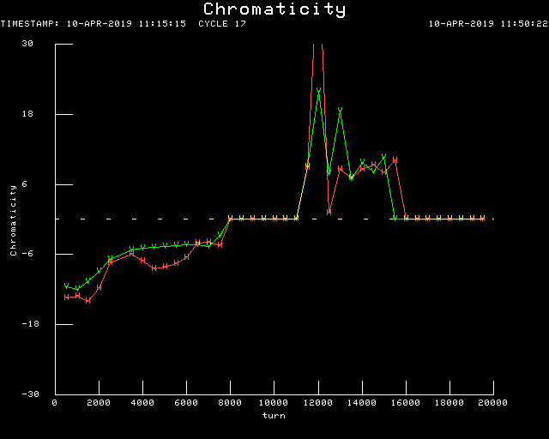
Measured Q’ (Jeff)
Q’=-6
Q’=-20
Operational HEP
Q’x/y=-16/-4
Q’=-12

Slide 20
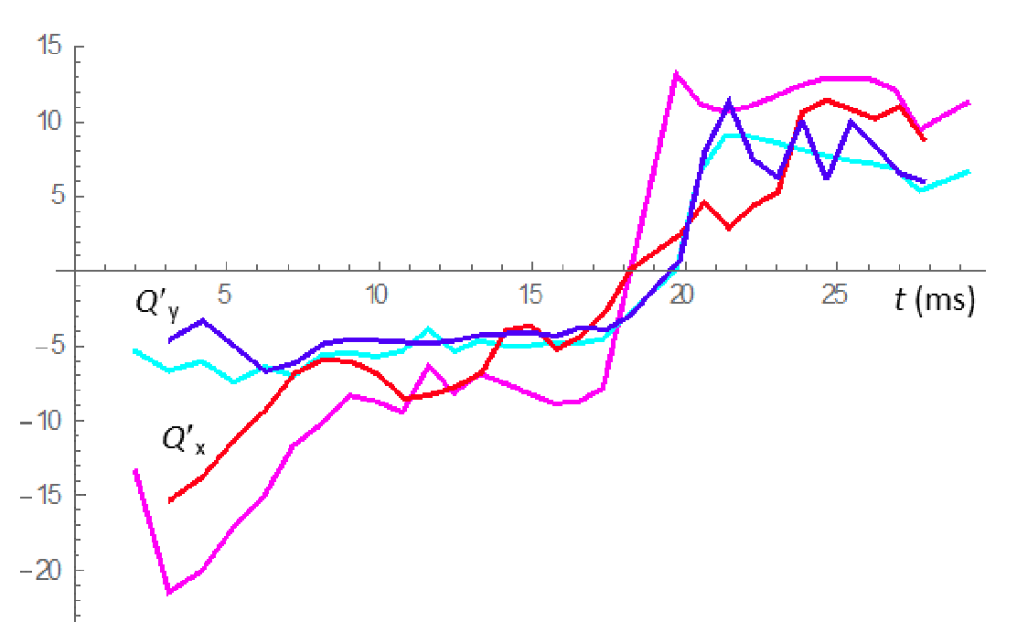
On the Booster chromaticity : model vs reality
From Yu.Alexahin
red and blue - measured,
magenta and cyan - model.

Slide 21
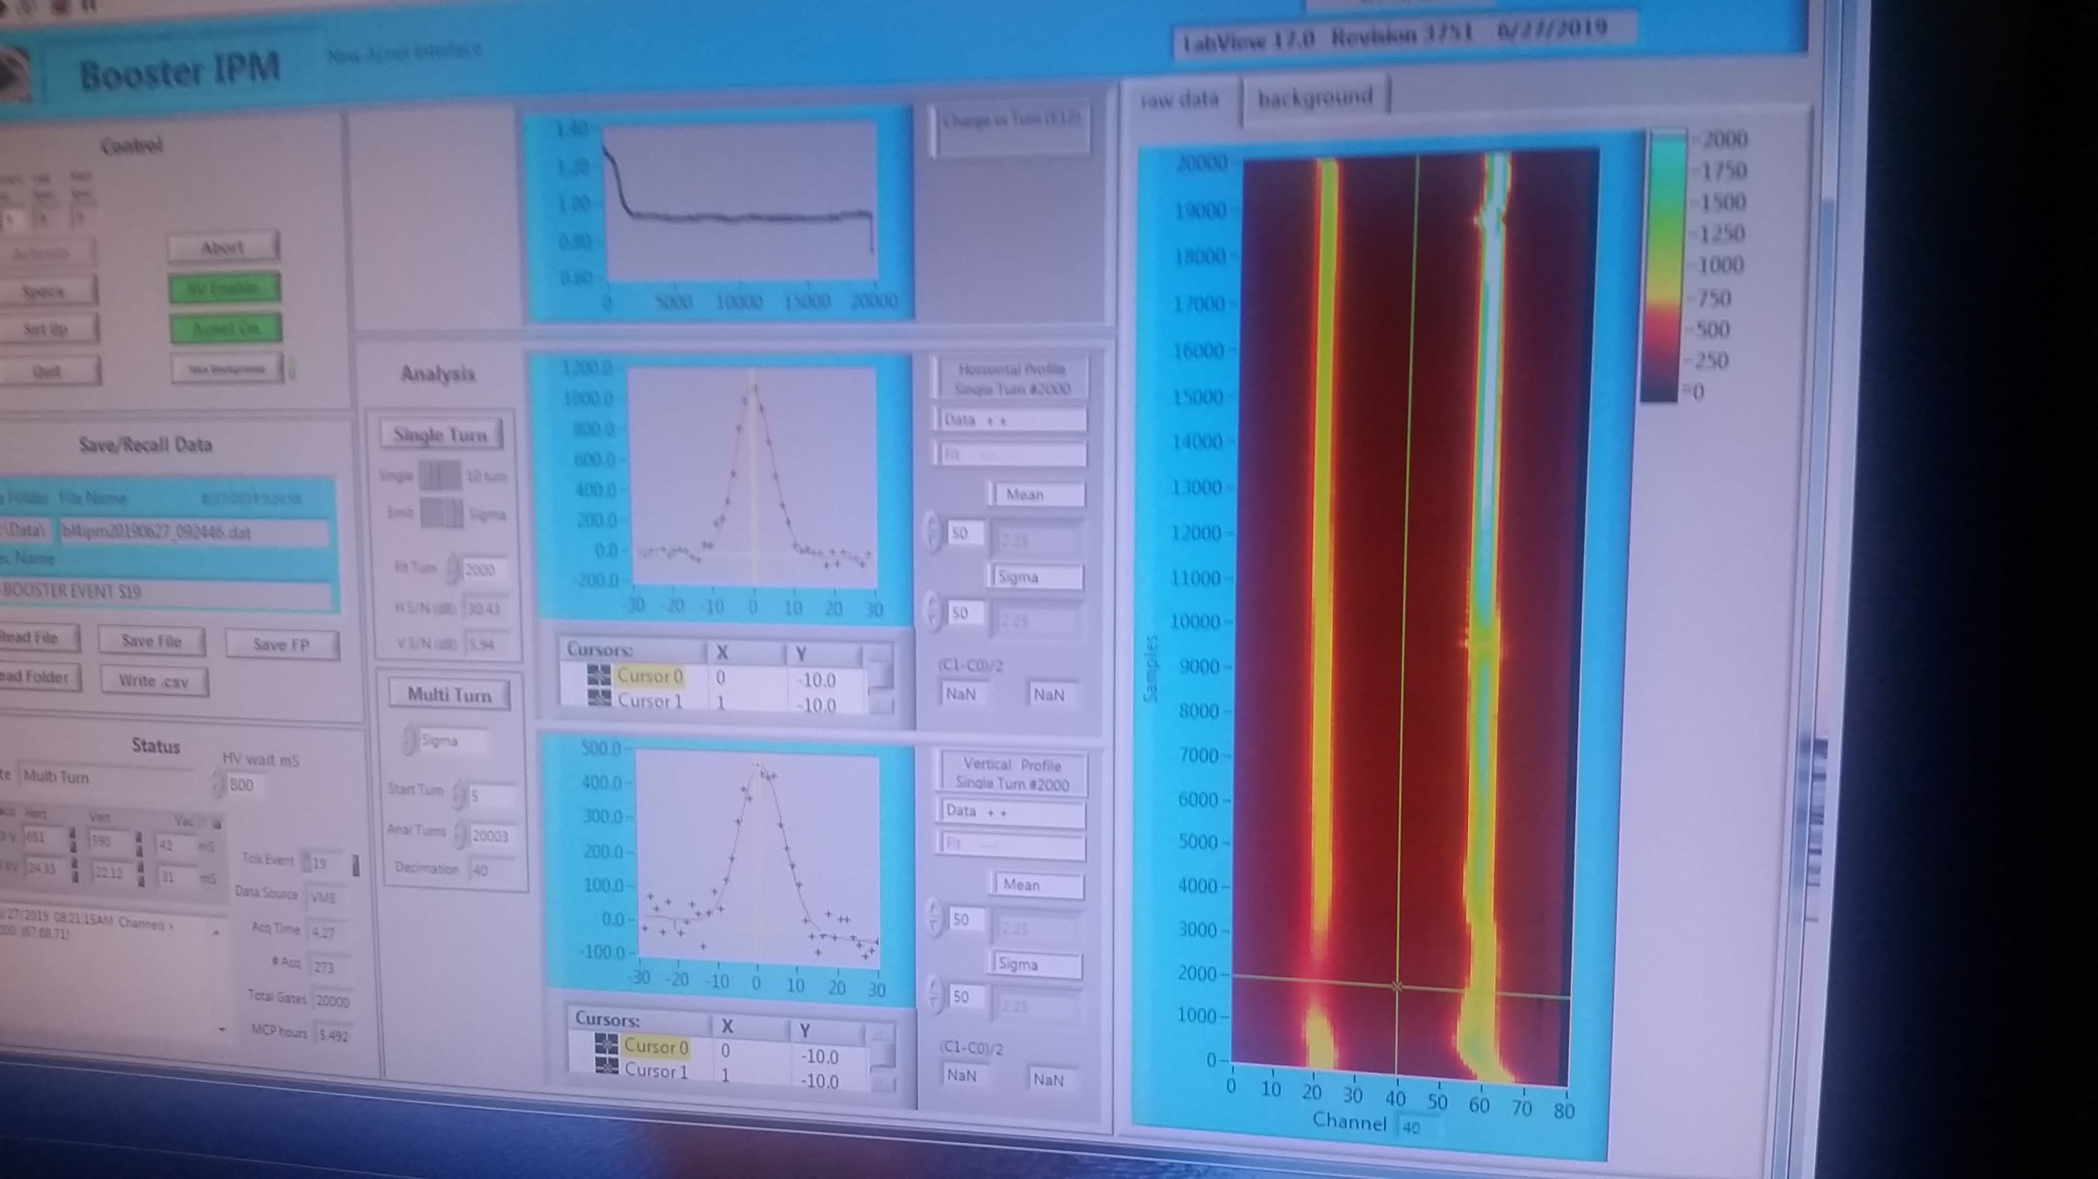
S.09: (Thur data) gap in IPM V data stream – very helpful!
• New IPMs are located ~ at the middle of Long 4: β_{x}~ 6m, β_{y}~ 20m beta_x=5.9571m, beta_y=20.106m, disp_x=1.805m
The data is collected at every turn but the LabView software
Average position and r.m.s. beam sizes are output
IPM voltages: Horizontal 650, Vertical 600
See around 2000th turn

Slide 22
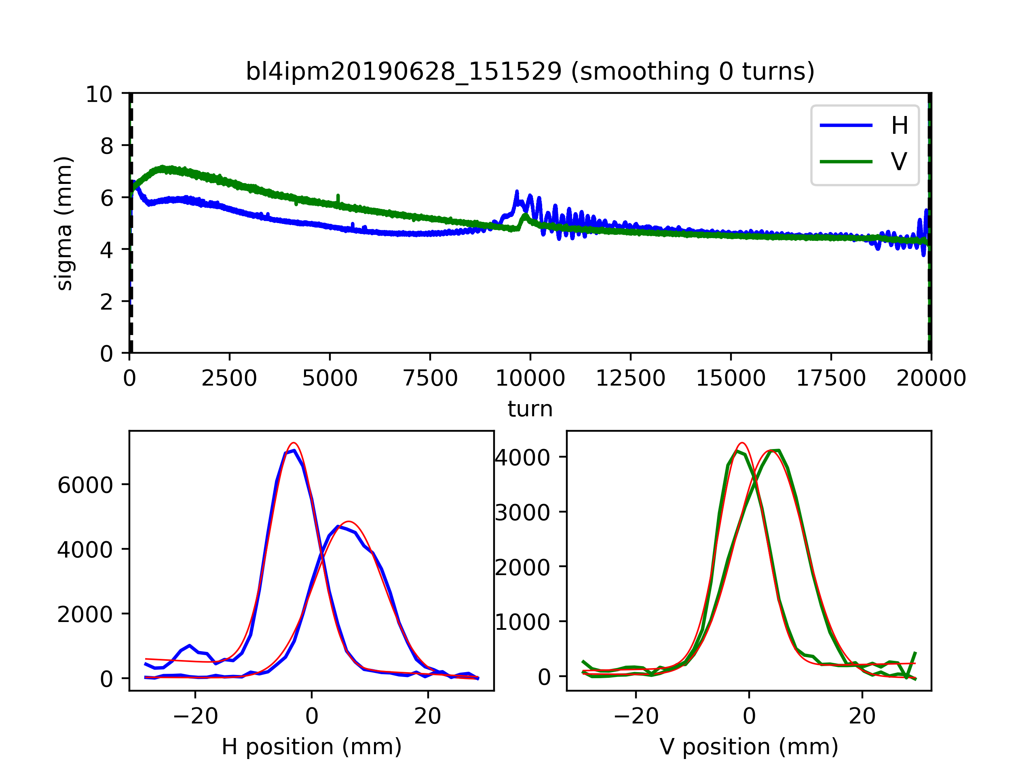
IPM
4 turn injection
20 turn injection

Slide 23
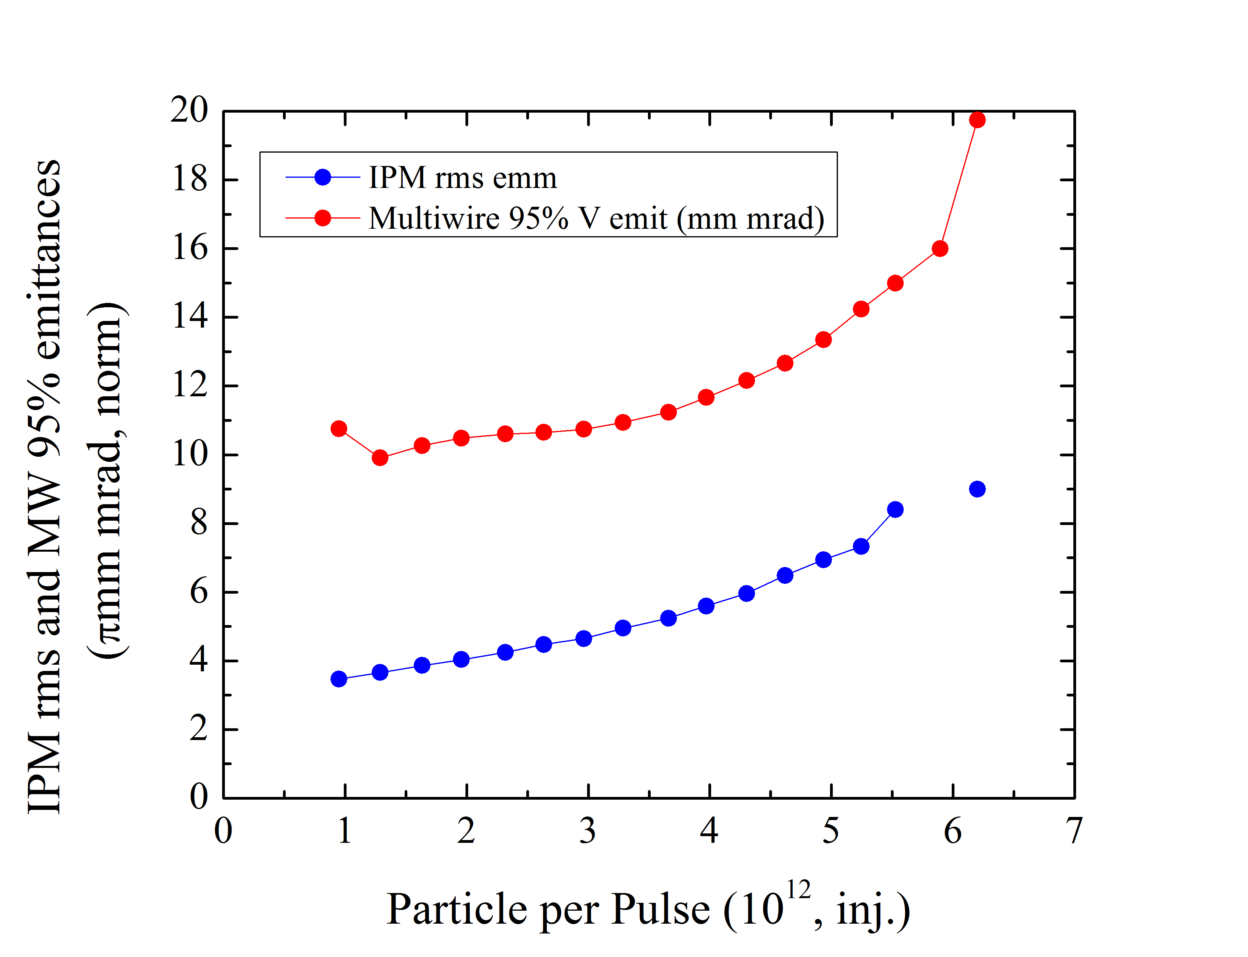
IPM and MW Emittances vs Intensity
Both show growth, but …(see next slide)

Slide 24
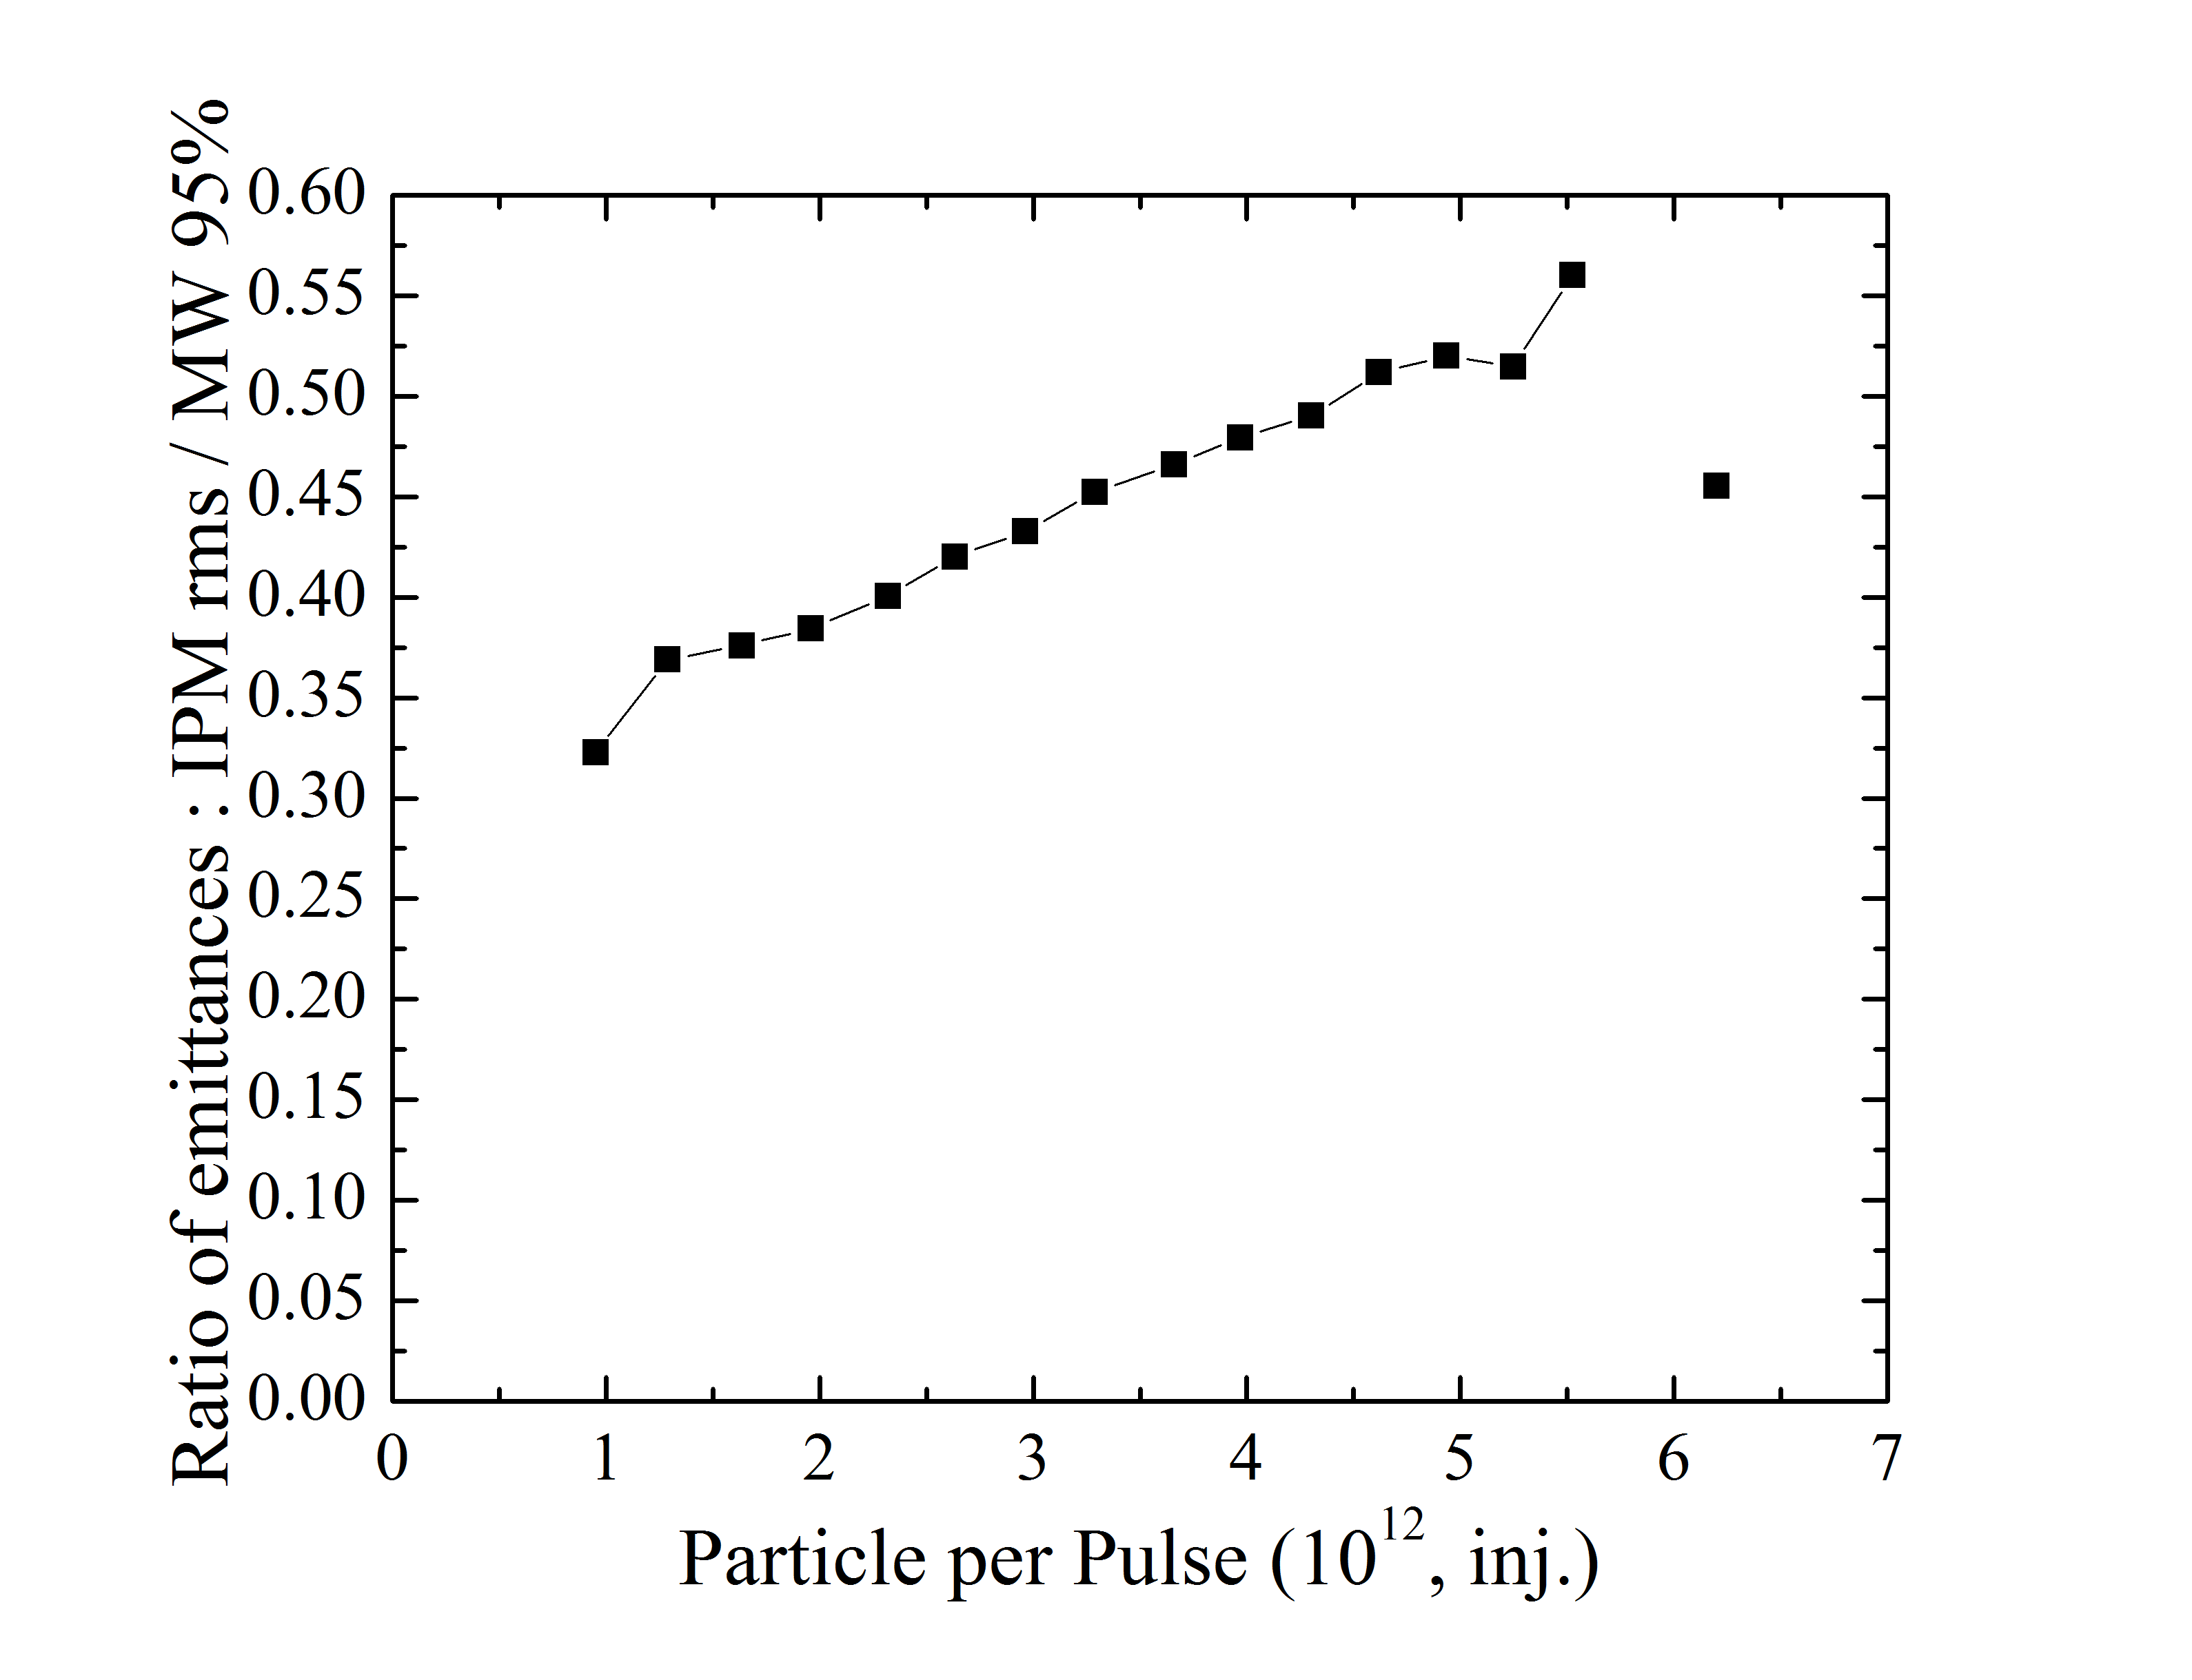
Ratio of IPM / MW Emittances : Three questions
R=0.3+0.3·(N/6.5) - ??
???
Expected: rms vs “95%”
1:6=0.166 .. Numerical factor of 2 ?

Slide 25
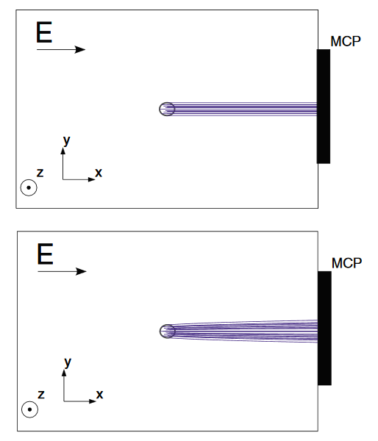
IPM vs MW (ionization profile monitor vs multiwire chamber)
While AGS IPM (PAC1987):

Slide 26
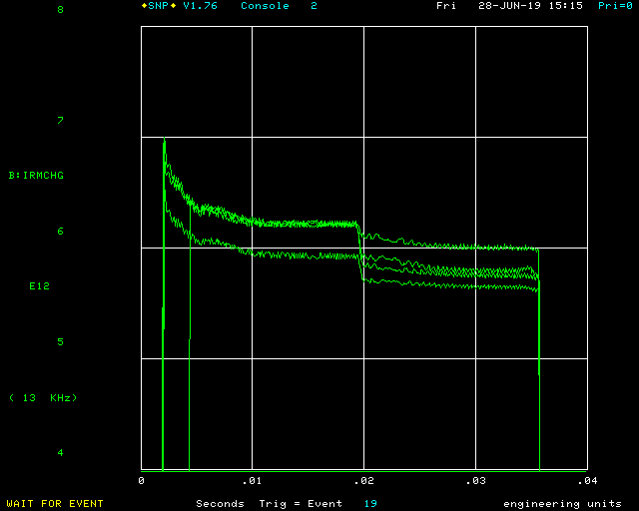
S.09: (Fri data) 6e12 ppp – Booster record?
(per Jeff)
“…I went through some Elog history and Datalogger data, and I think it is a record. I could not find any prior occasion in which the Booster successfully extracted above 6e12.”
Need in PIP-II era:
6.5e12; <3.6% loss
6e12/7e12= 86%
Transmission efficiency

Slide 27
(Tentative) Summary of S09 Study :
2 D tune scans show that :
Operational tunes are close to optimal at high Np
Losses in optimal tunes scale approx. as Np x Q’ ^2
Min loss @1 ms at low N_p ~1-2%, grows to 7% at 14 turns
1 D Intensity scans from 4 to 21 turns show that:
dN/N Losses grow with N
Q’ is a huge factor (x2-3 from ~12 to ~20) – for the total loss
Emittances grow too, by ~60% from 1 to 6 e12
Max extracted N_p is 6.0 e12 , with 14% loss (worst)
vs required 3.6% at 6.5e12 during PIP-II era (long way to go)
IPM is calibrated vs MW :
Great tool – fast! … though have some unresolved issues
Absolute values wrt MW (off by ~2)
Strong intensity dependence (~x2 from 0 to 6e12)

Slide 28
Back up slides

Slide 29
(Chandra to Kornilov) On the end of Capture parameters
dE_rms = dE_95 / 4 ~ 4.6MeV / 4 = 1.15MeV (@inj., maximum over the years)
dp/p_rms=(dE_rms/E)*(1/beta**2)=(1.15/1338.27)*(1/0.713**2) = 1.7E-3
V_rf ~0.7 MV (at the end of capture )
frequency_rf = 37.899 MHz
Bunch length BL(4sigma) ~17- 19 ns ( end of capture)
Emittance_longitudinal LE (95%) ~0.06-0.07 eVs (end of capture)
Emittance_xy_95: meas’d in 400 MeV transfer line is ~7pi-mm-mr; ~11 pi-mm-mr (at 1e12, IPM sizes 4.7/6.0) and ~13.5 pi-mm-mr (at 4.5e12) - measured at extraction (divide by 6 for rms)

Slide 30
Tunes vs currents (VS and Kyiomi)
Booster fractional tune vs IQS/IQL Amps: QX = IQS*0.0449 + IQL*.0096 + 0.77945 QY = -0.0277*IQS - 0.0078*IQL + 0.88

Slide 31
Extra Analysis by Kiyomi

Slide 32
Scan data
 | Ch = 6 | Ch = 12 | Ch = 20 | Ch = Op
2BT | TS | TS |  | TS
4BT | TS |  | TS
9BT |  | TS | TS
14BT |  | TS | TS

Slide 33
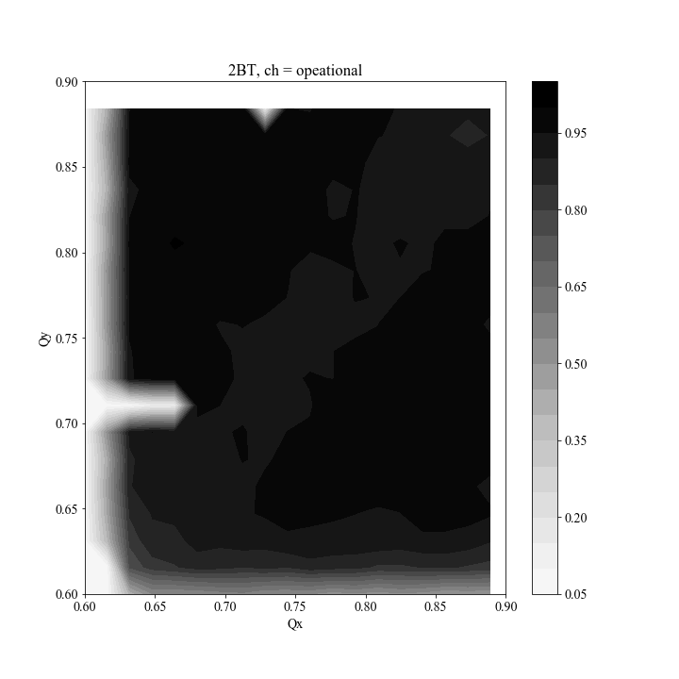
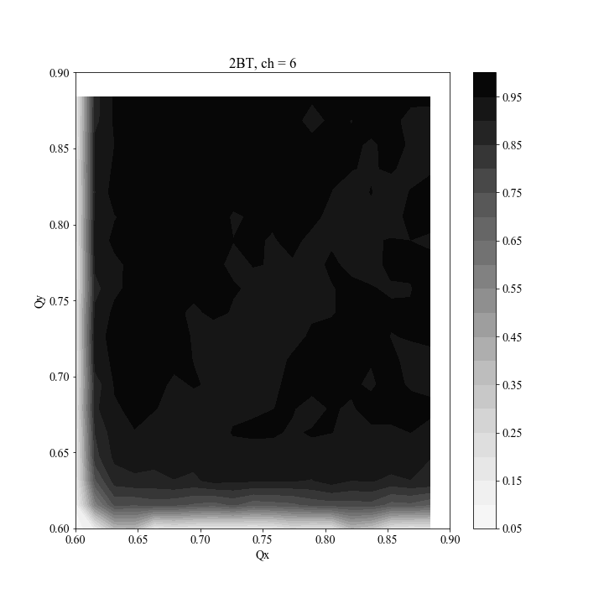
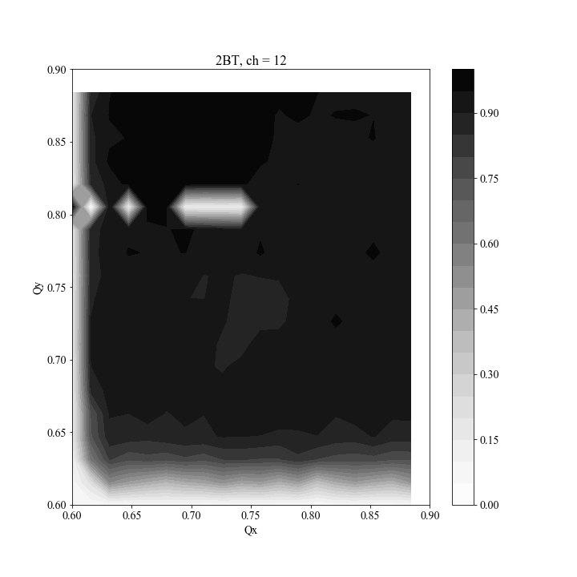
2BT

Slide 34
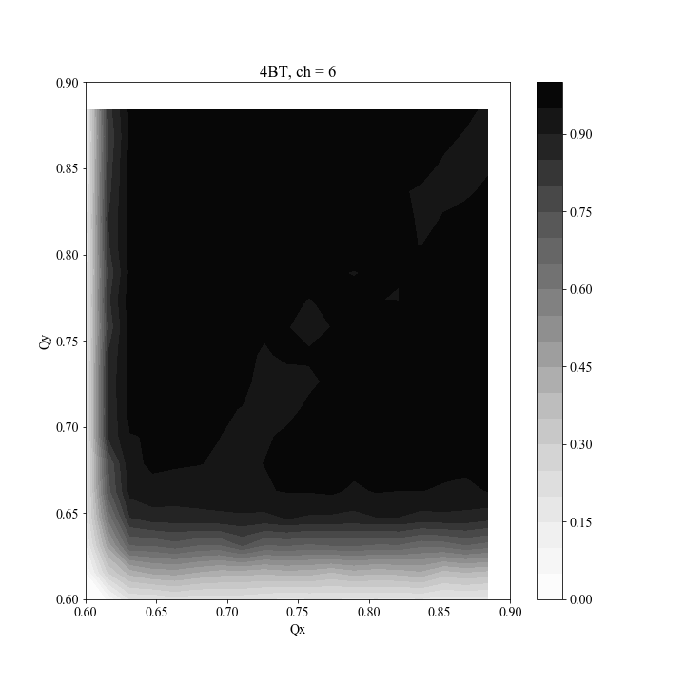
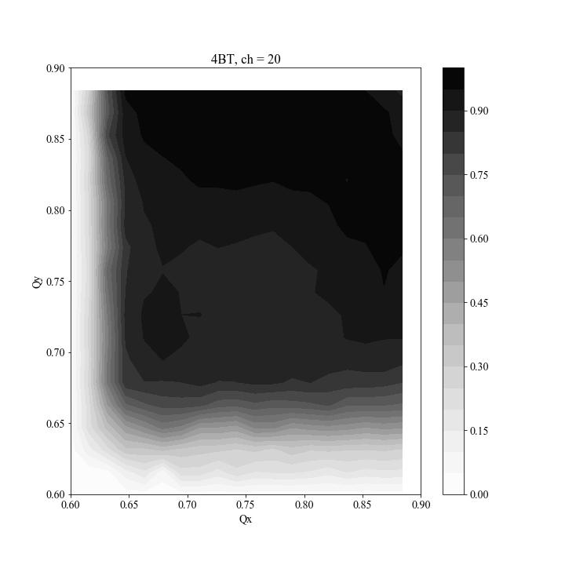
4BT

Slide 35
9BT

Slide 36
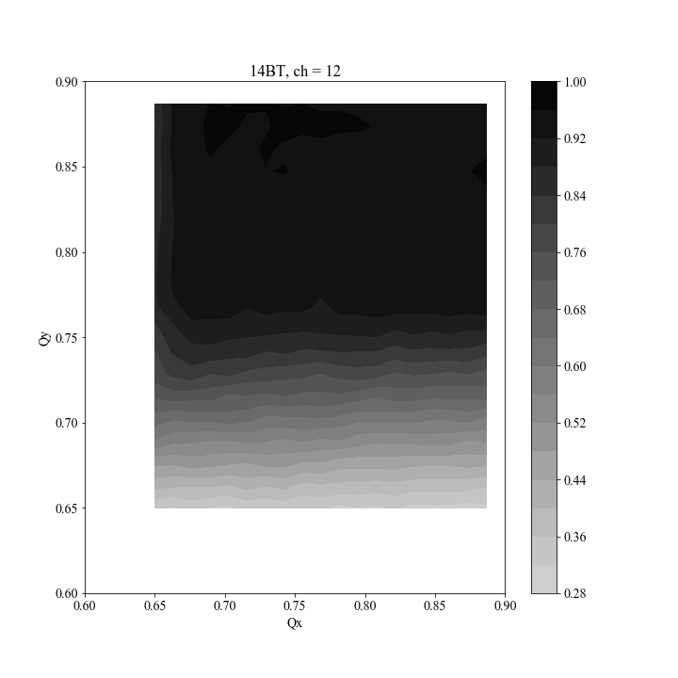
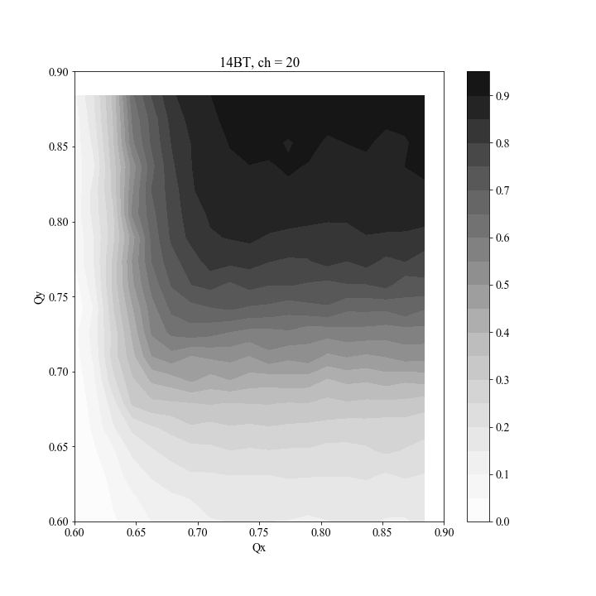
14BT

Slide 37
Jeff Slides

Slide 38
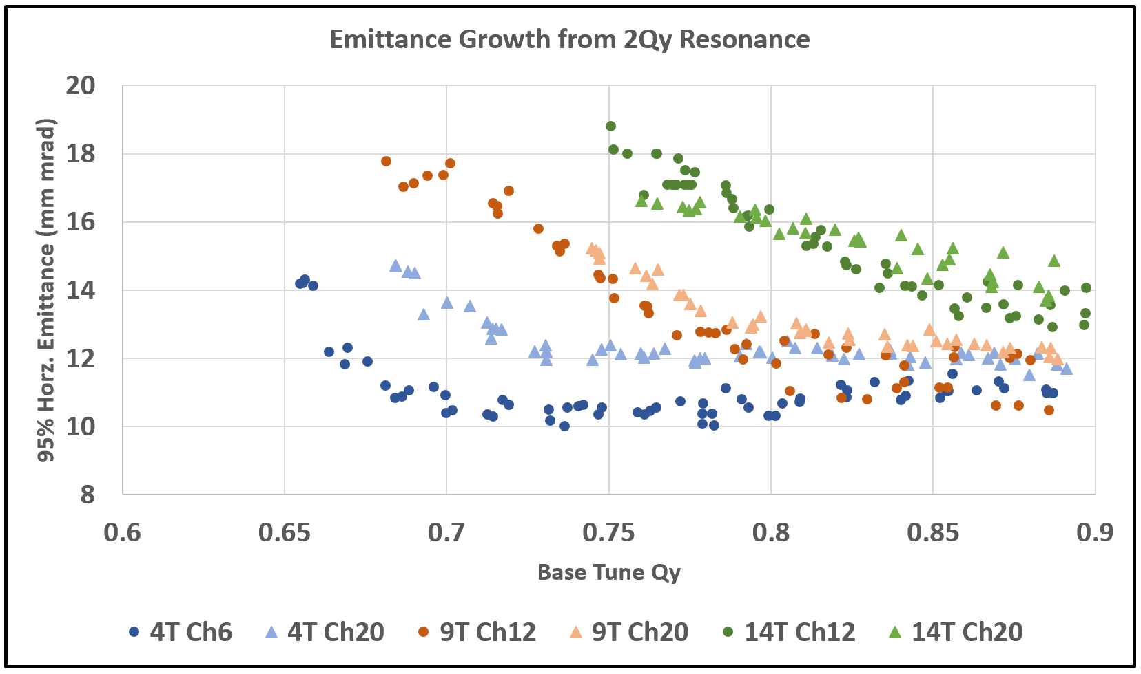
Emittance & Losses, Nominal Chromaticity
Emittance increases near half-integer, no tune-space is left.
At high-intensity, emittance growth not very sensitive to chromaticity.

Slide 39
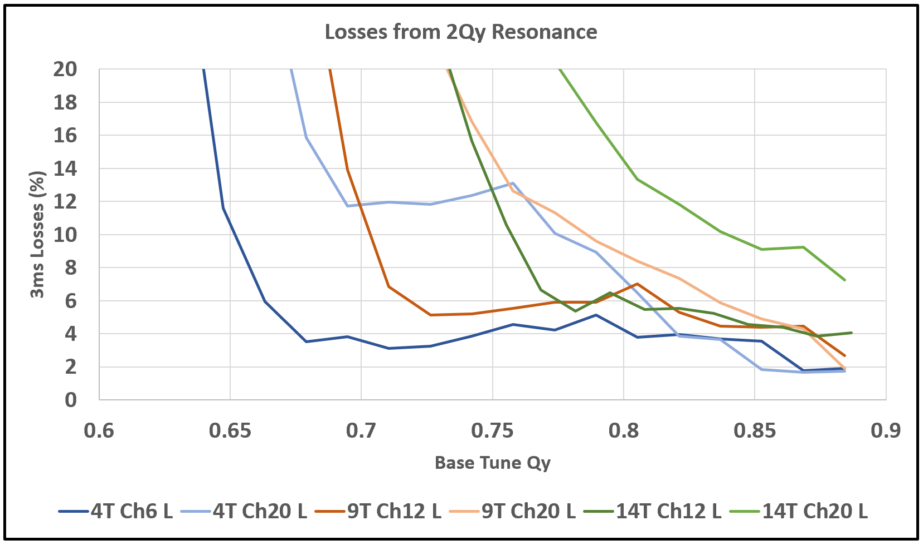
Emittance & Losses, Nominal Chromaticity
Practical loss limits are encountered immediately, dramatic losses follow.
Losses are much more sensitive to chromaticity.

Slide 40
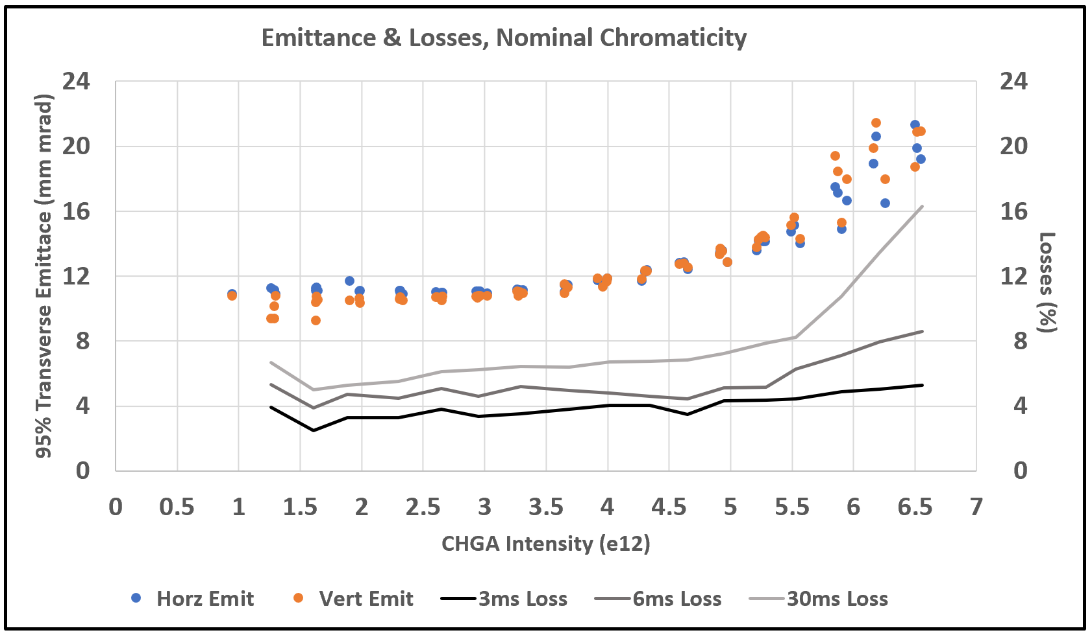
Emittance & Losses, Nominal Chromaticity

Slide 41
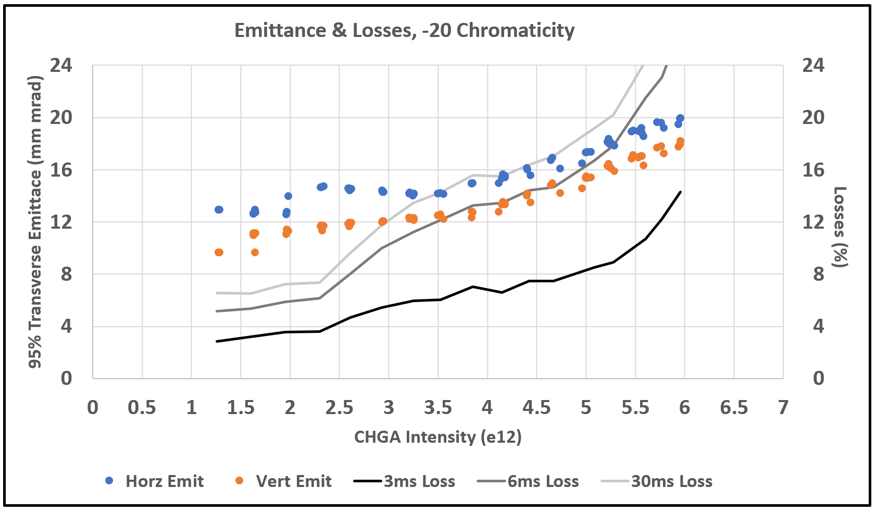
Emittance & Losses, -20 Chromaticity

Slide 42
Nominal Chromaticity – Emit Loss vs Charge Density

Slide 43
Nominal Chromaticity – Emit Loss vs Charge Density
Emittance blow-up
with aperture loss.
Emittance at
half-integer
resonance limit.
Slow emittance growth.

Slide 44
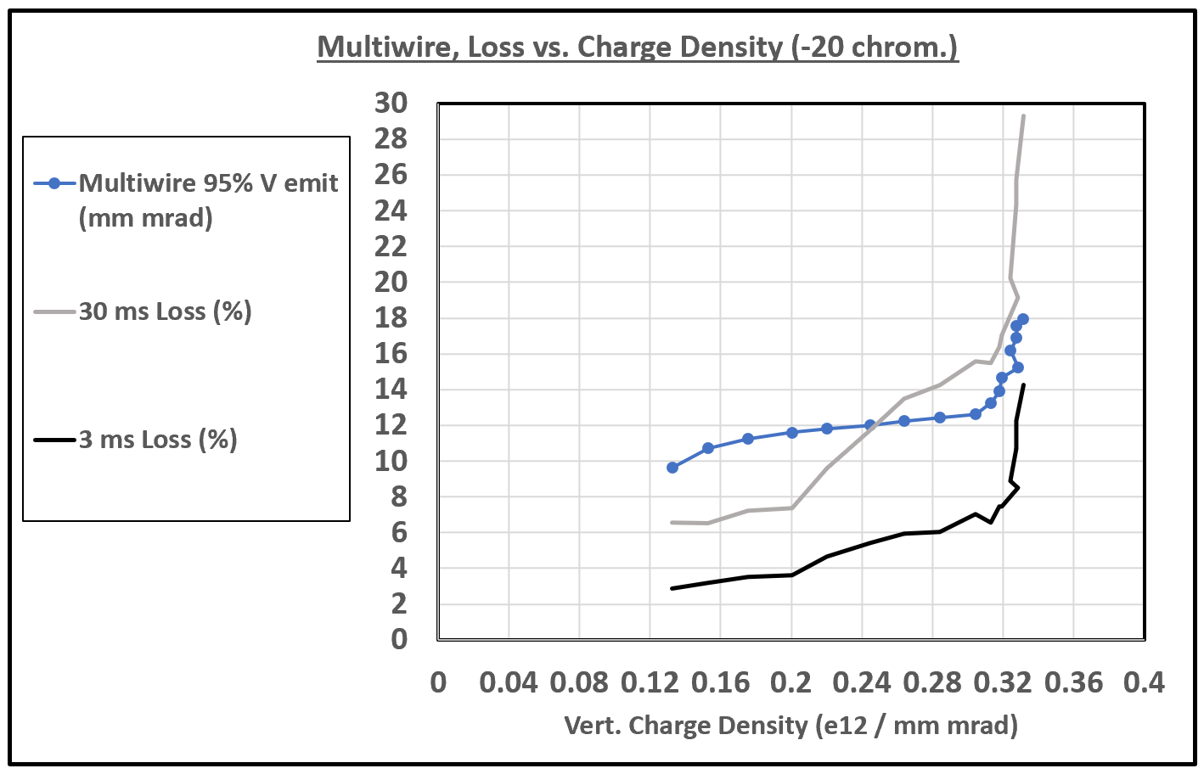
-20 Chromaticity – Emit Loss vs Charge Density
Half-integer
resonance limit
encounted earlier.
Faster emittance growth?

Slide 45
Kyiomi analysis #2

Slide 46
Looked at 9BT CH=-20, IPM data from 0 to 512 turns (first 1msec)
1: I looked at first 512 turn IPM data.
2: The data is the beam size (sigma) which is averaged over 6 turns.
3: I fixed Qx=0.76 and scanned vertical tune and plotted BPM data in horizontal and vertical in slide2.
4: I fixed Qy=0.86 and scanned horizontal tune and plotted BPM data in slide3
5: Beam size was increased first 200 turns in Horizontal and vertical probably due to multiturn injection and adiabatic capture.
6: Intensity kept decreasing from 0 turn to 512 turn.
*I have not made this plot, but slide 4 show an example.
7: The slide4 shows the horizontal position moved more than 5 mm in 512 turns
*I have not made this plot
8: * I have to do same analysis with different chromaticity.
**Question**
If beam size is not increasing, why are we loosing beam for 1 msec?
Why is the horizontal position moving?

Slide 47
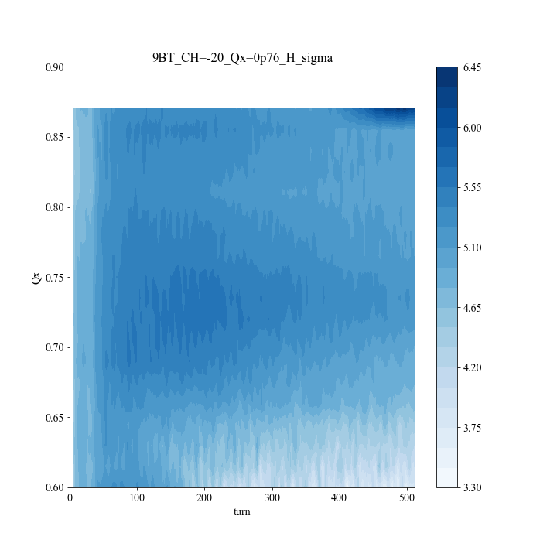
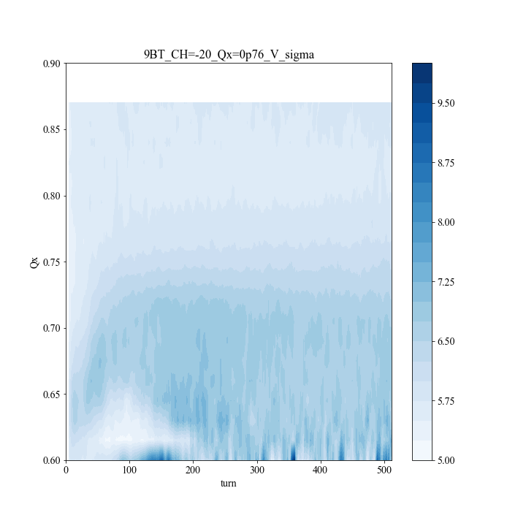
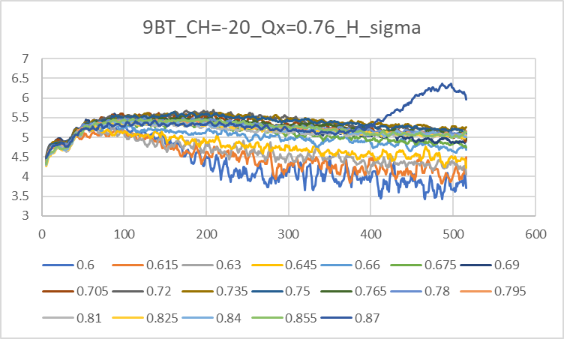
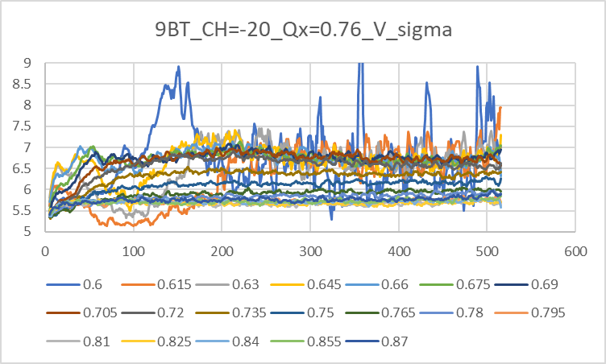

Slide 49
Example of IPM signals

