Slide 1
Lattice Periodicity &
Emittance Growth (part I)
Y. Alexahin, H. Bartosik, C. Bhat, D. Bruhwiler, M. Carlà, S. Chaurize, J. Edelen,
J. Eldred, A. Huschauer, A. Saa Hernandez, V. Kapin, V. Kornilov, F. Schmidt, K. Seiya, V. Shiltsev, C.Y. Tan, K. Triplett, A. Valishev,
with support from the beam instrumentation group
Capstone event, 5 August 2019

Slide 2
Outline
Introduction and considerations on space charge
Observations from IPM and bunch length data
Comparison of IPM data with MI8 wires
Vertical tune scans
Summary and conclusions

Slide 3
Outline
Introduction and considerations on space charge
Observations from IPM and bunch length data
Comparison of IPM data with MI8 wires
Vertical tune scans
Summary and conclusions

Slide 4
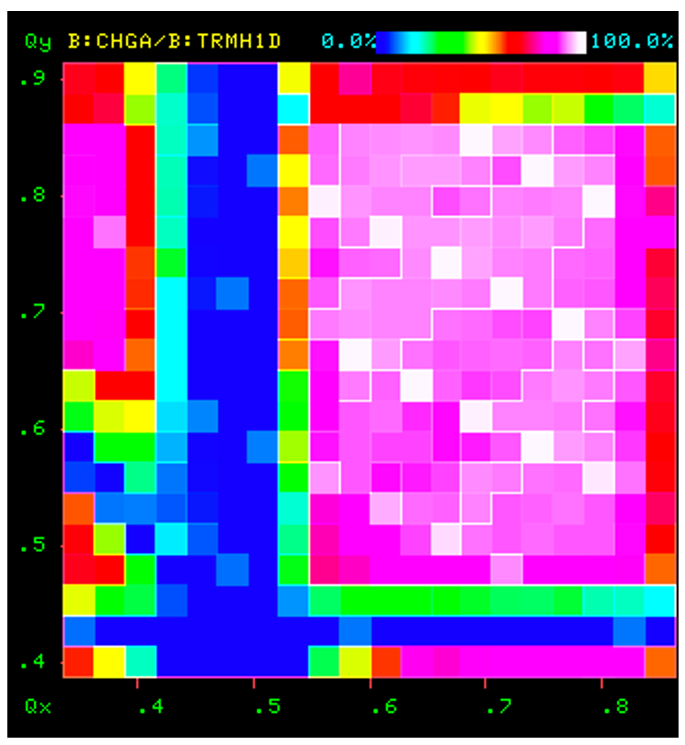
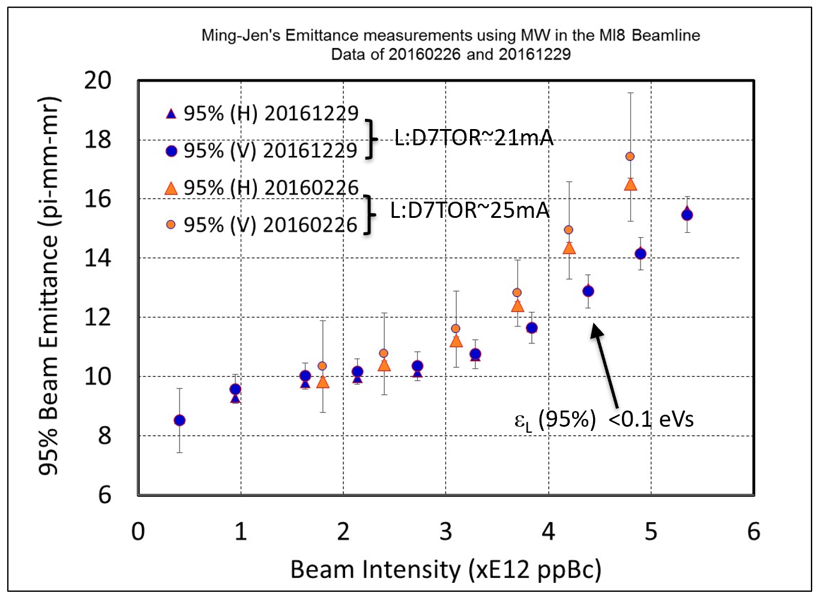
3
S.09 Study: Tune Scan - Emittance Growth
Tune scan:
Emittance Growth:
Can we synthesize these two pictures?
Seiya
Yang
3
Jeffrey Eldred | Fermilab Booster Studies
J. Eldred, FAST/IOTA Collaboration Meeting 2019
Notes:
3
3
3

Slide 5
Placement of the loss plot in the tune diagram is arbitrary, what is important is shrinkage of the good area with intensity
Y. Alexahin, space charge collaboration meeting, CERN 2018

Slide 6
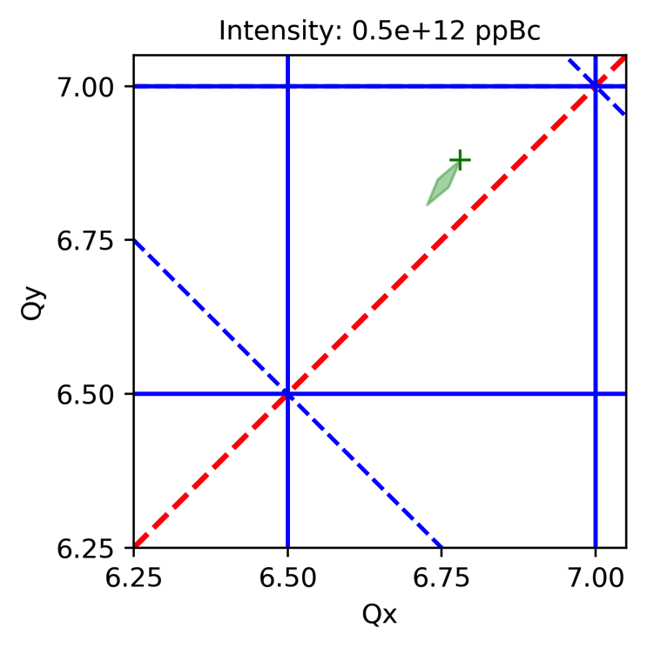
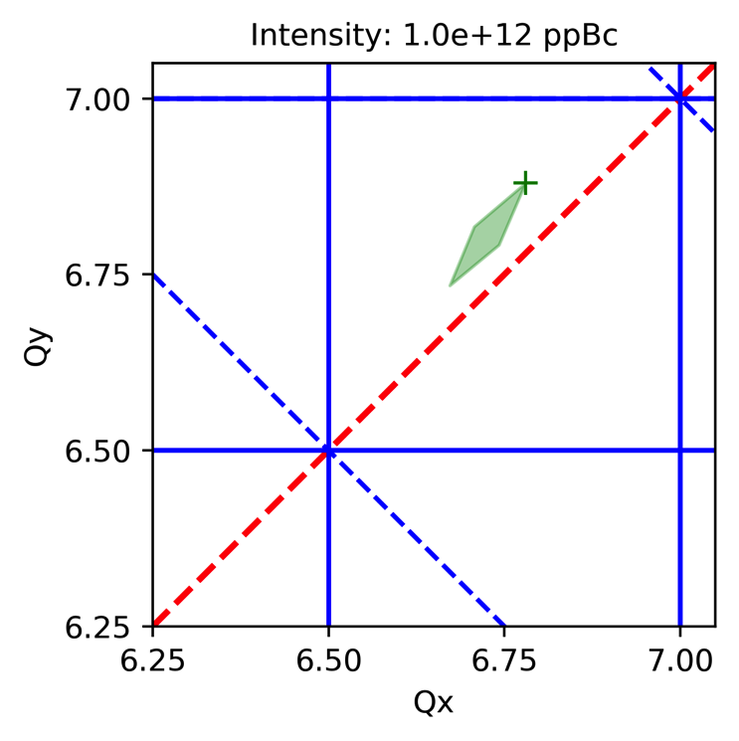
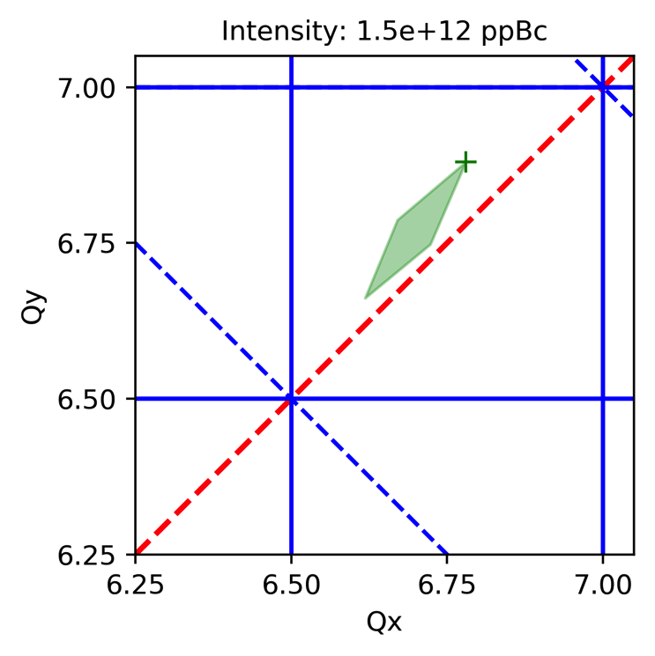
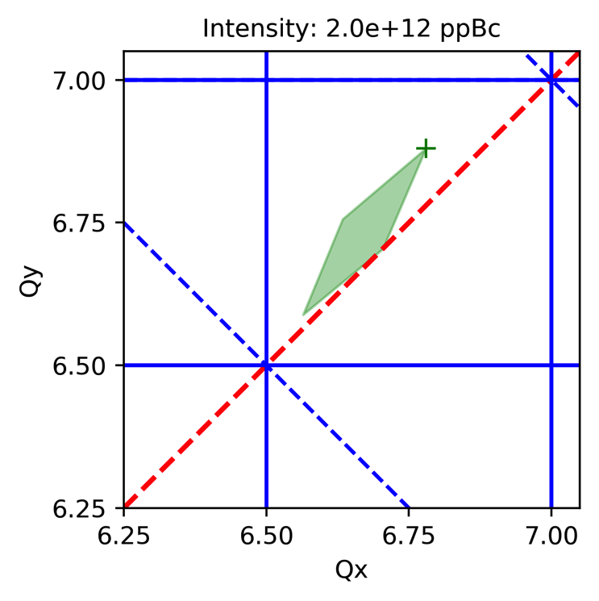
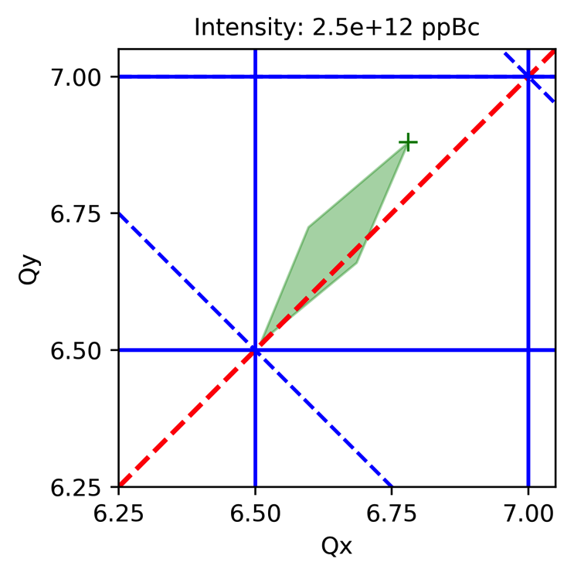
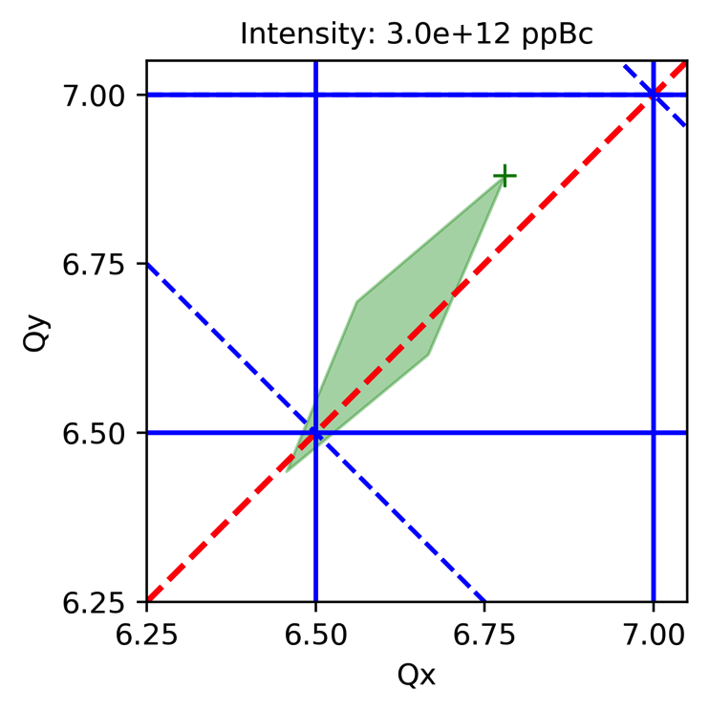
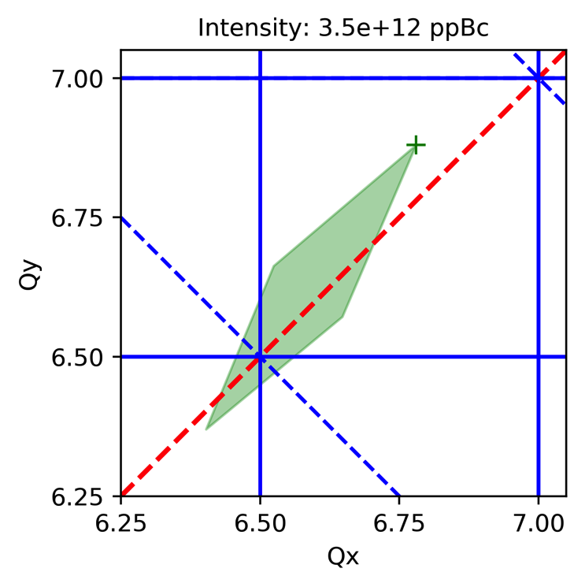
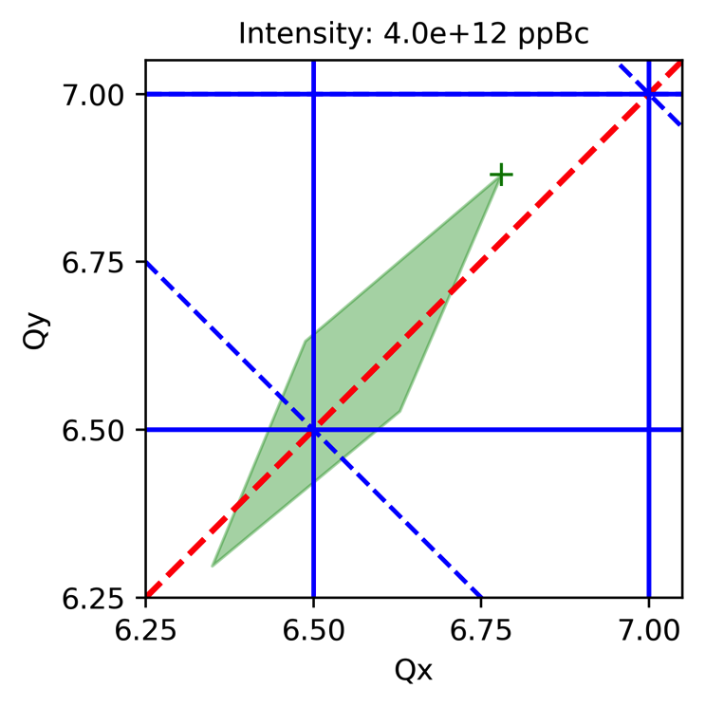
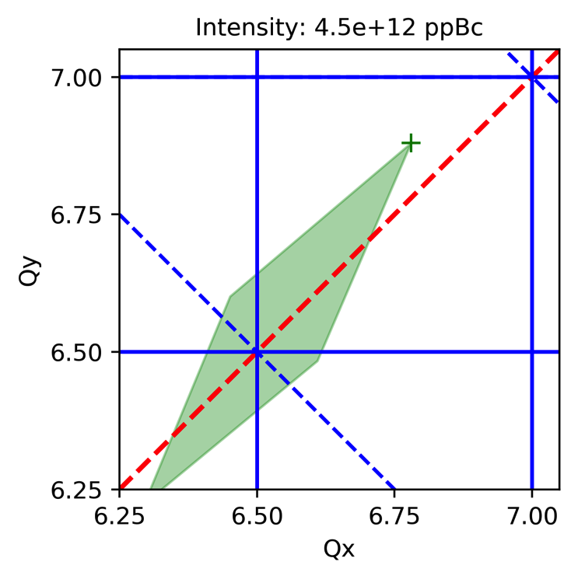
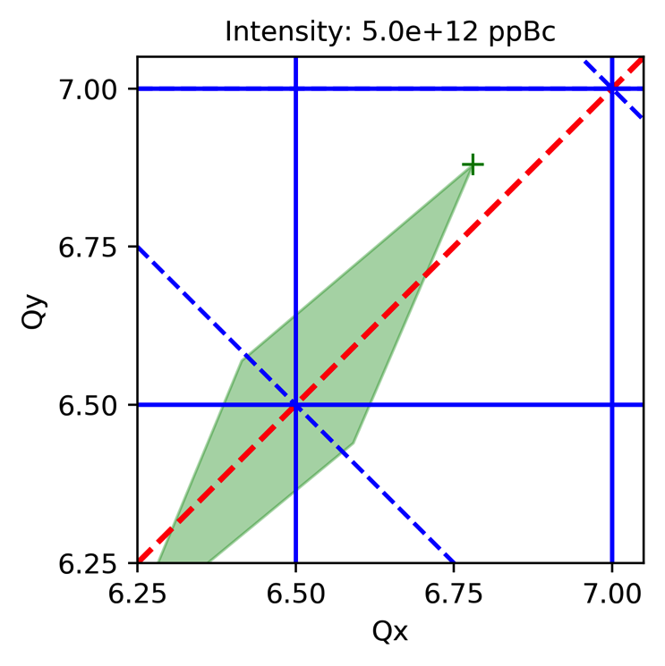
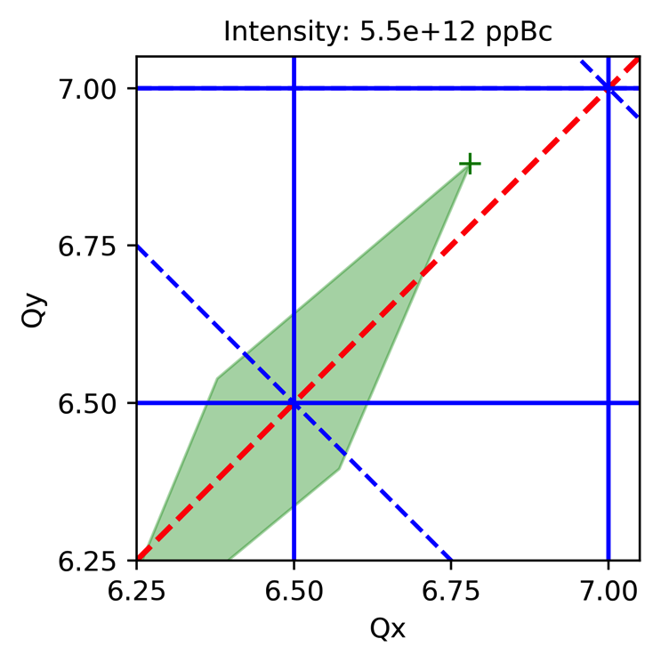
Considerations on space charge
Beam and machine parameters considered
  Number of bunches: 81 (harmonic number: 84)
  4 sigma bunch length: 18 ns (assuming Gaussian bunch profile)
  95% transverse emittance from linac: 7 pi mm mrad (rms: 1.16 mm mrad)
  Injection energy: 400 MeV (kinetic), HEP lattice
… slope of emittance at extraction as a function of intensity changes at ~3.5e+12 ppBc

Slide 7
Outline
Introduction and considerations on space charge
Observations from IPM and bunch length data
Comparison of IPM data with MI8 wires
Vertical tune scans
Summary and conclusions

Slide 8
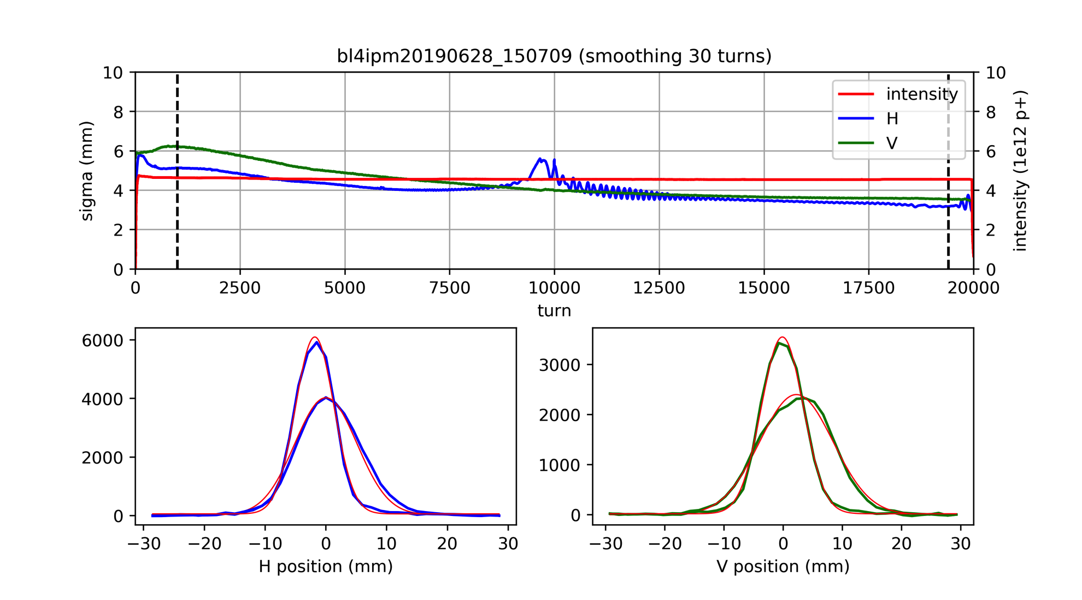
IPM data – beam size along the cycle
Many thanks to Valery K. and colleagues from the beam instrumentation group for enabling the automatic data acquisition mode!
  Each data set also includes intensity along the cycle
IPM provides turn-by-turn profiles along the entire cycle
  Lots of interesting information to be extracted …
  Performed averaging over 30 turns for analysis shown in the following

Slide 9
IPM data – profiles
@19400 turns
@19400 turns
@1000 turns
@1000 turns

Slide 10
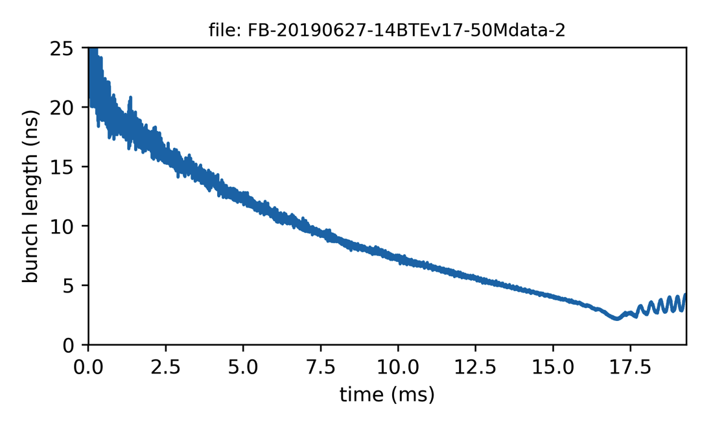
IPM data – dispersive contribution
  dispersive contribution to horizontal profile clearly visible around transition
bunch length (of a single bunch) extracted from wall current monitor acquisition
(4 sigma of Gaussian fit)
14 booster turns

Slide 11
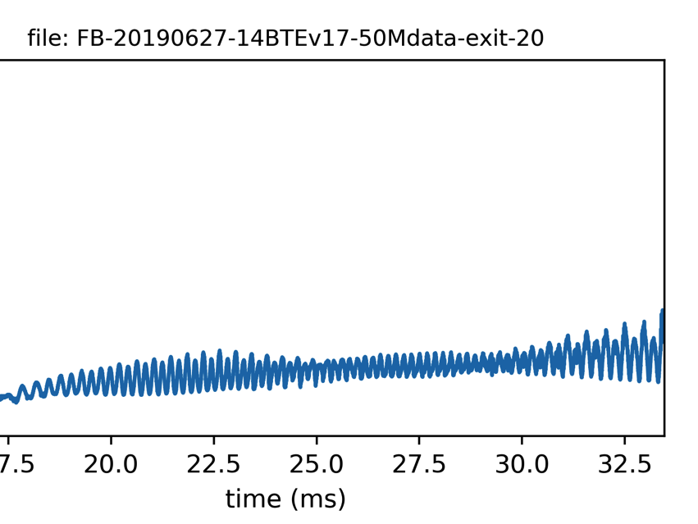
IPM data – dispersive contribution
bunch length (of a single bunch) extracted from wall current monitor acquisition
(4 sigma of Gaussian fit)
bunch length oscillation persists from transition crossing until extraction
14 booster turns

Slide 12
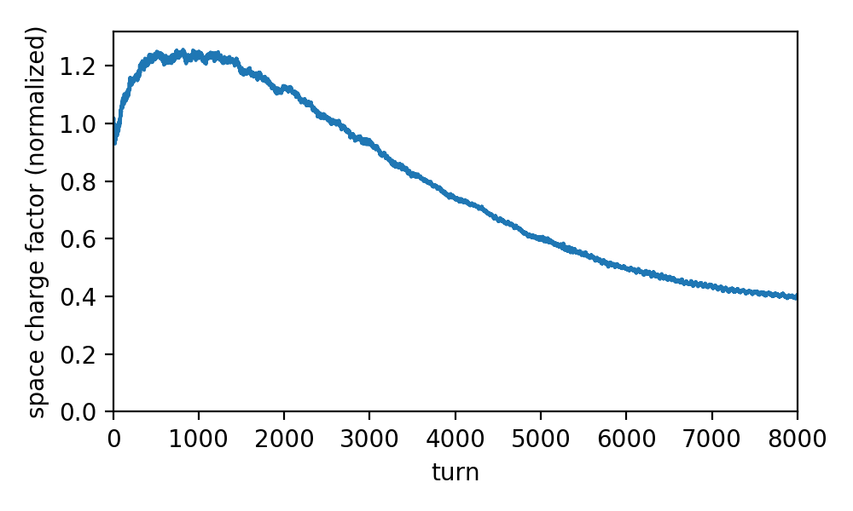
Evolution of space charge along the cycle
For given transverse emittances and intensity, space charge scales like
Bunch length measurement shows that first 1000 turns are the most critical wrt space charge (bunch length reduction, while beam energy only slowly rising)

Slide 13
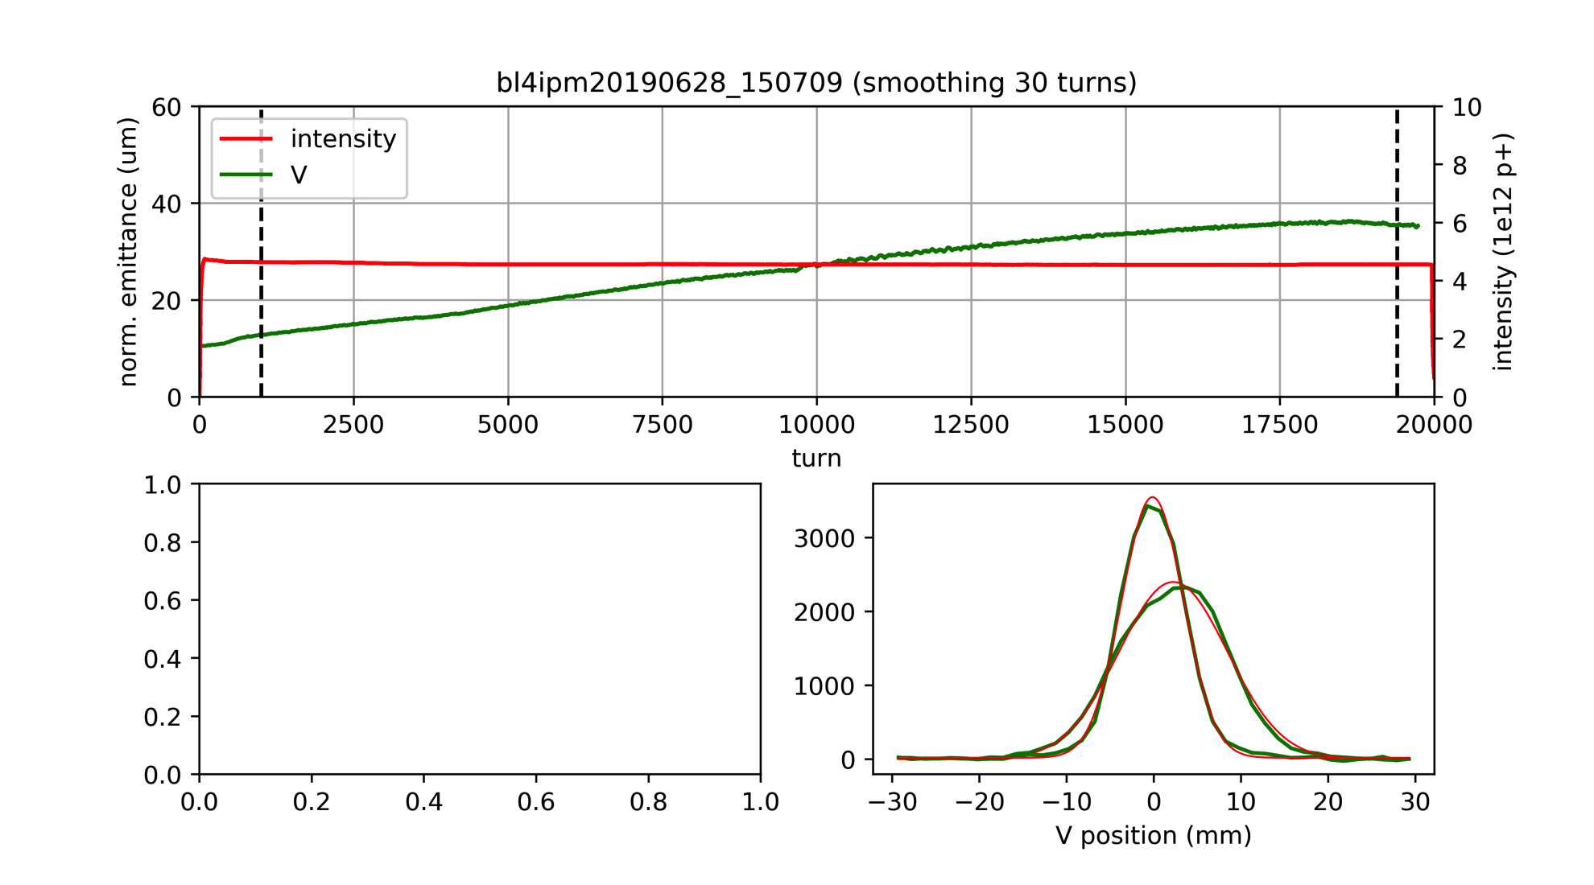
IPM data – normalized emittance (vertical)
Normalized emittance (95%) at injection seems relatively reasonable
Some indication for emittance increase during the first 1000 turns
Along the cycle the emittance appears to increase to very large values
  Much larger compared to measurements in MI8 line
  Probably due to an instrumental effect of the IPM (see following slides)
  Small part of it possibly due to real emittance growth along the cycle

Slide 14
Outline
Introduction and considerations on space charge
Observations from IPM and bunch length data
Comparison of IPM data with MI8 wires
Vertical tune scans
Summary and conclusions

Slide 15
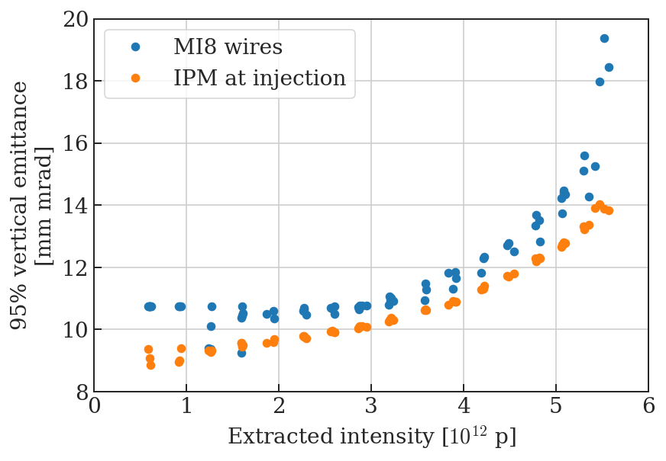
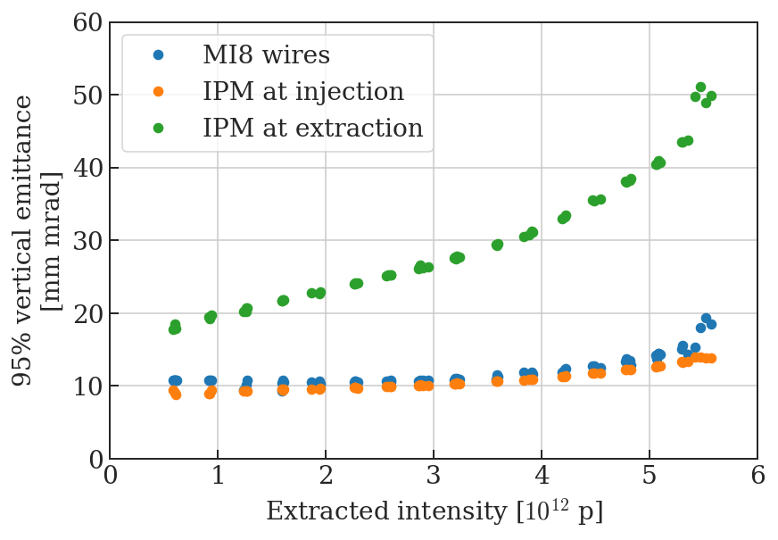
IPM versus MI8 wires – intensity scan
IPM data at 1000 turns relatively close to MI8 wires (by chance)
IPM data at extraction shows strong intensity effect
  Beam field affecting ions → to be modeled and taken into account
Additional emittance blow-up along the cycle for 18 turns injected?

Slide 16
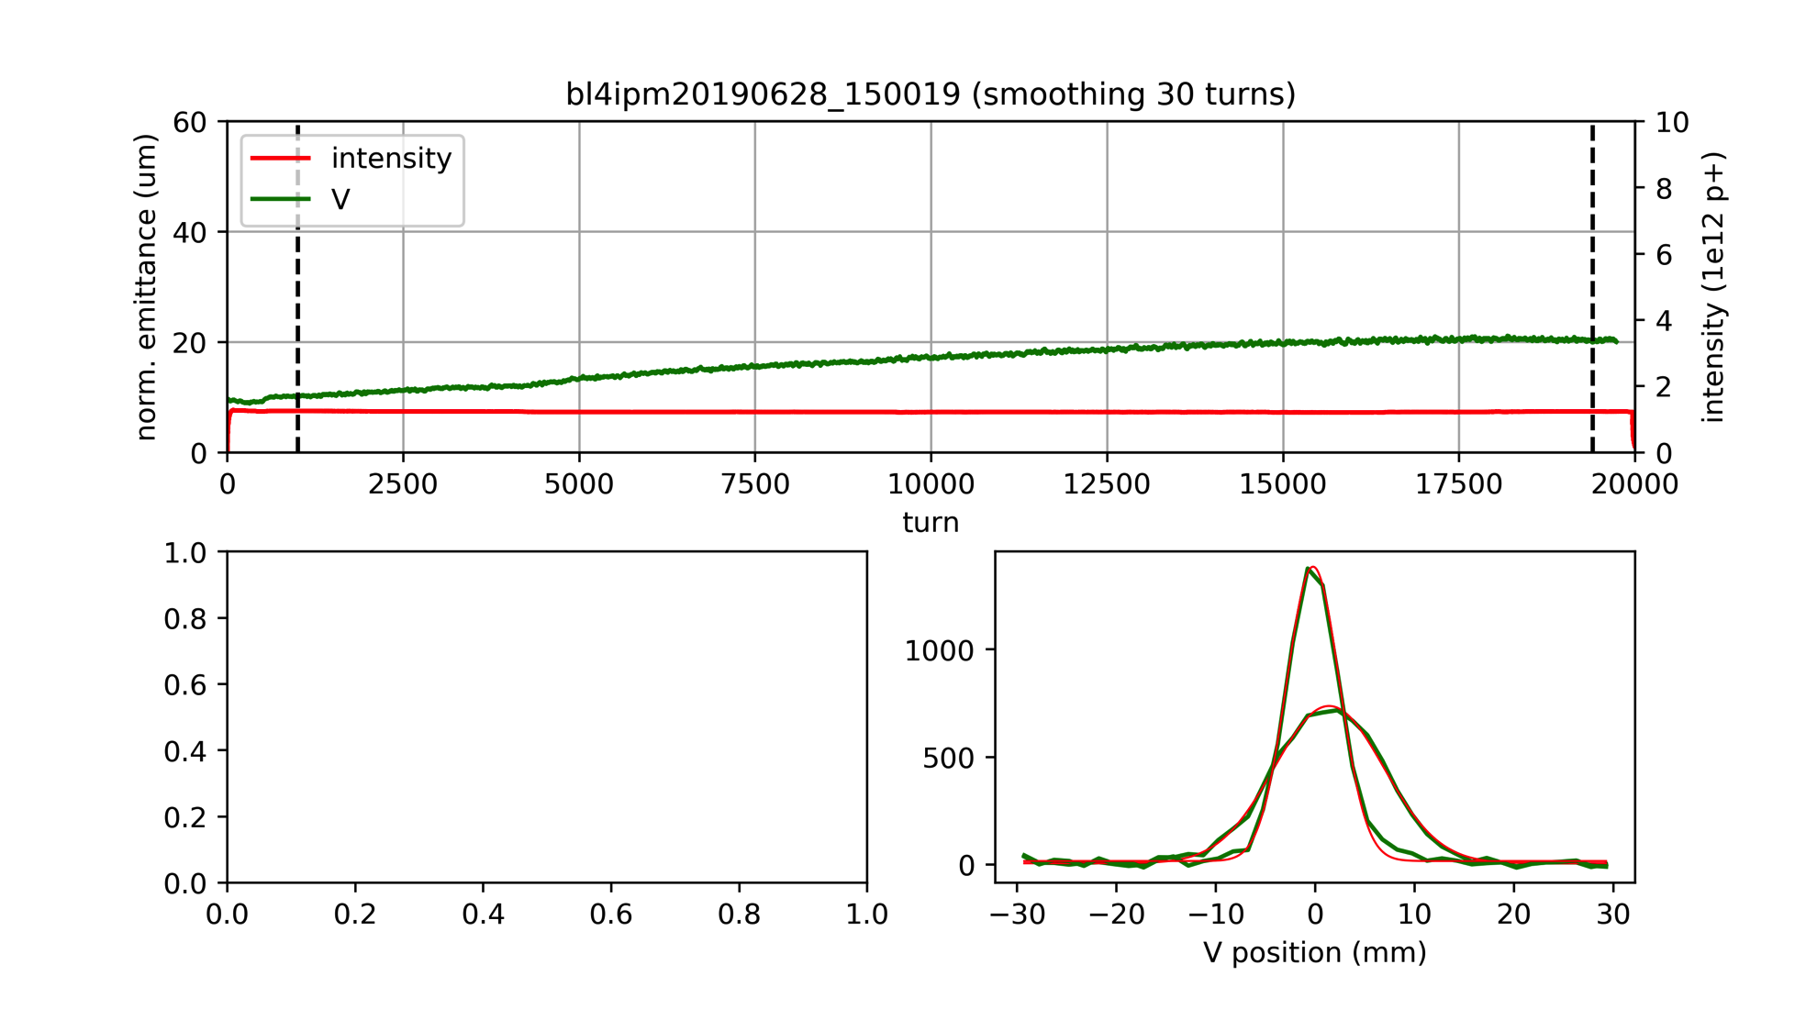
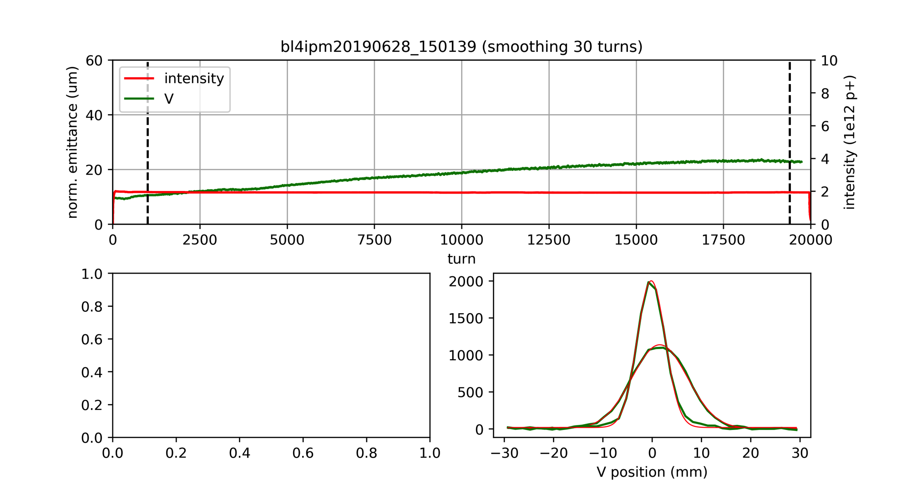
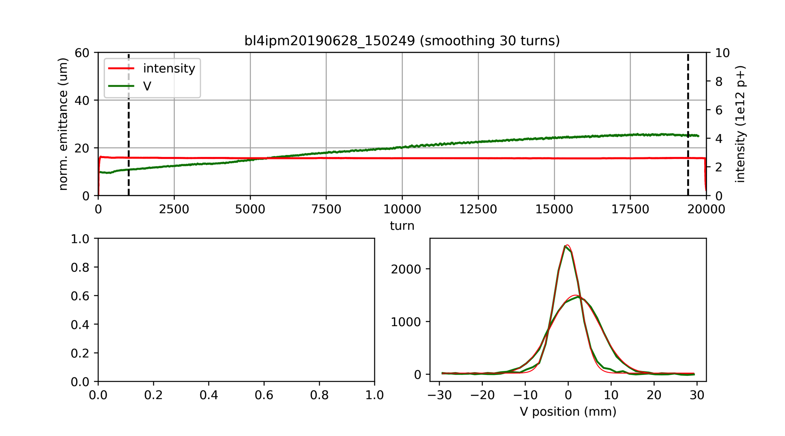
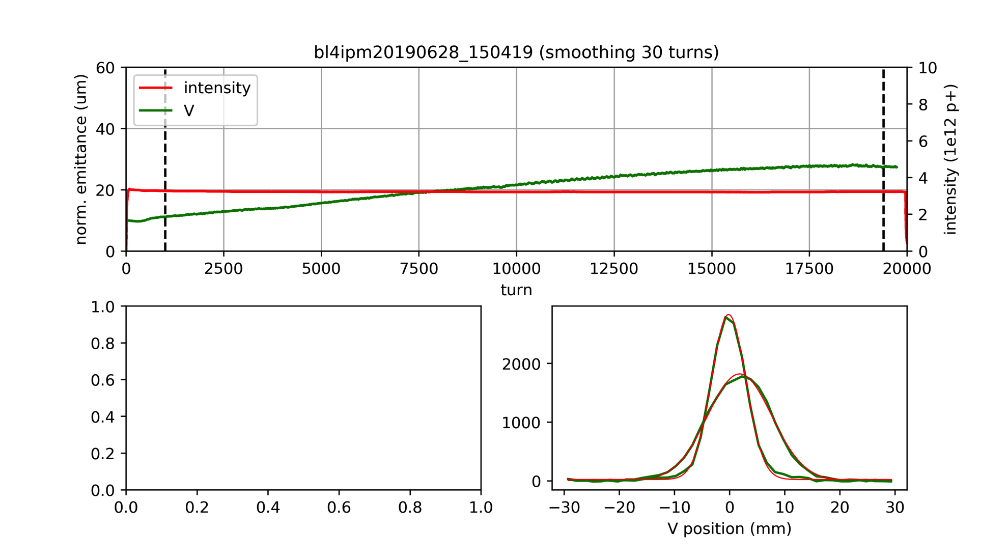
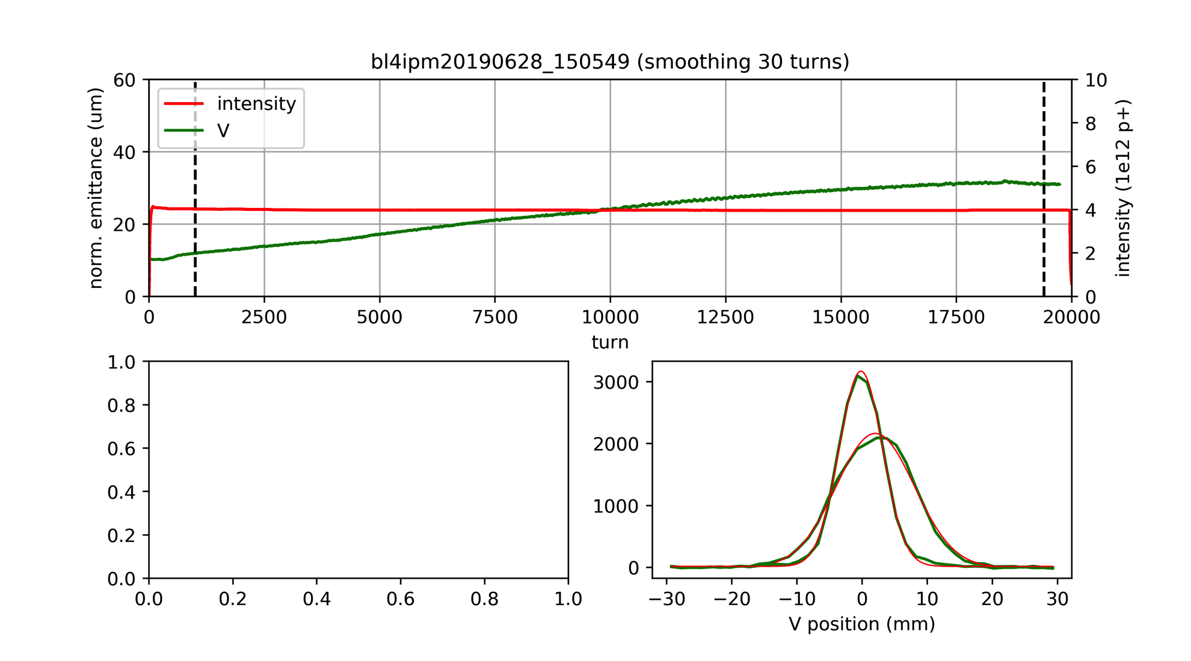

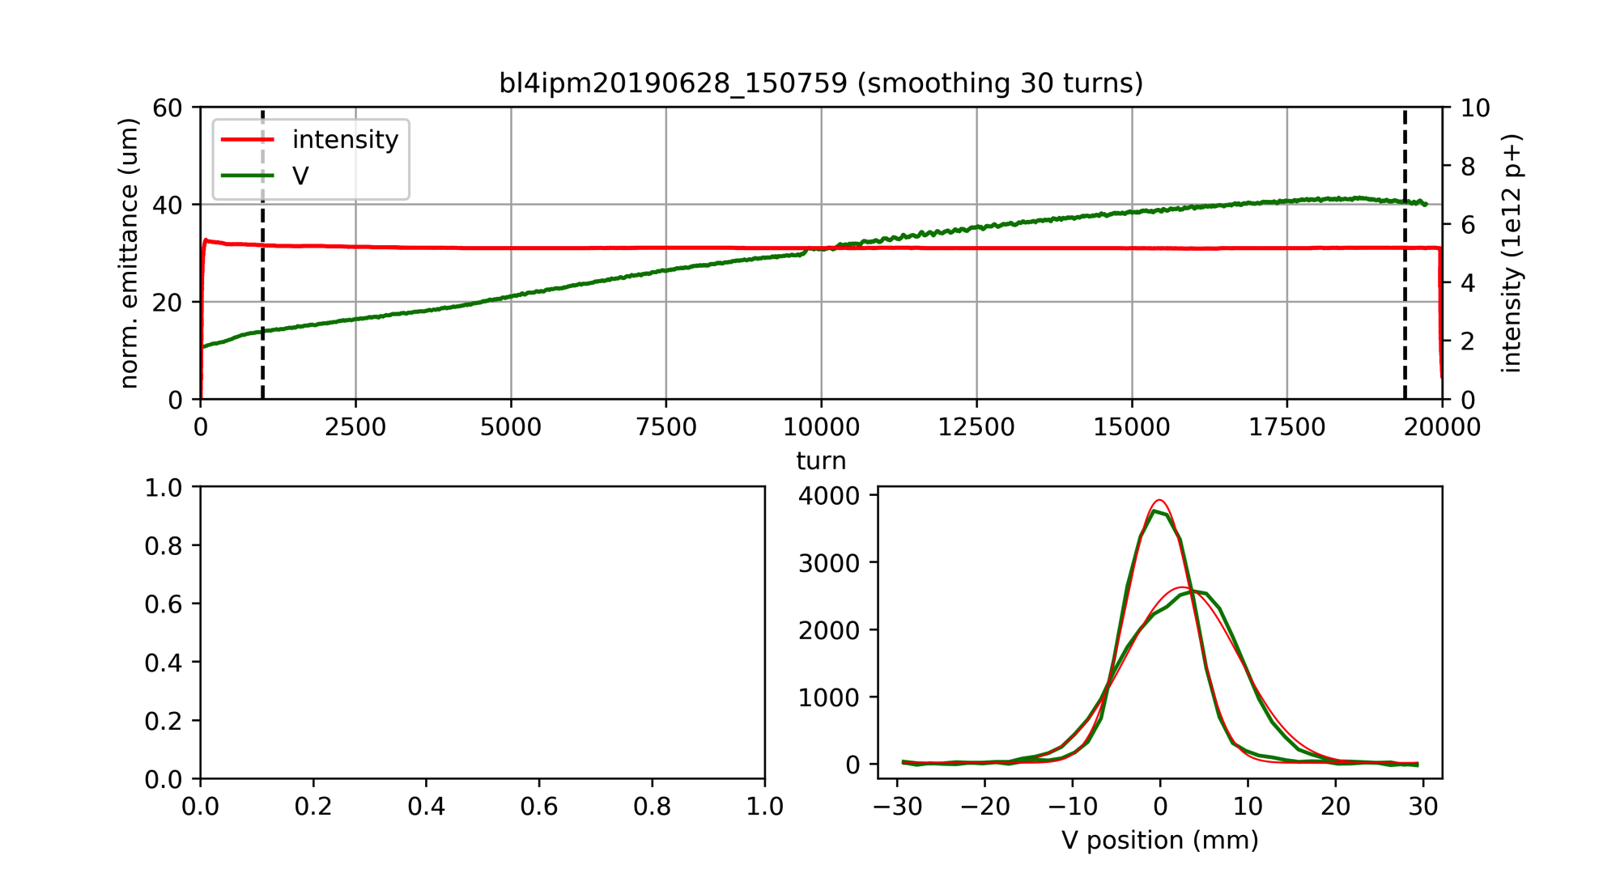
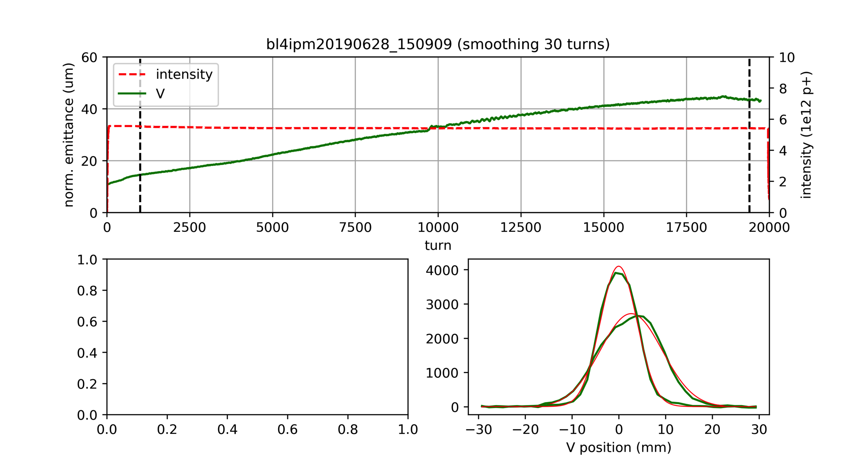
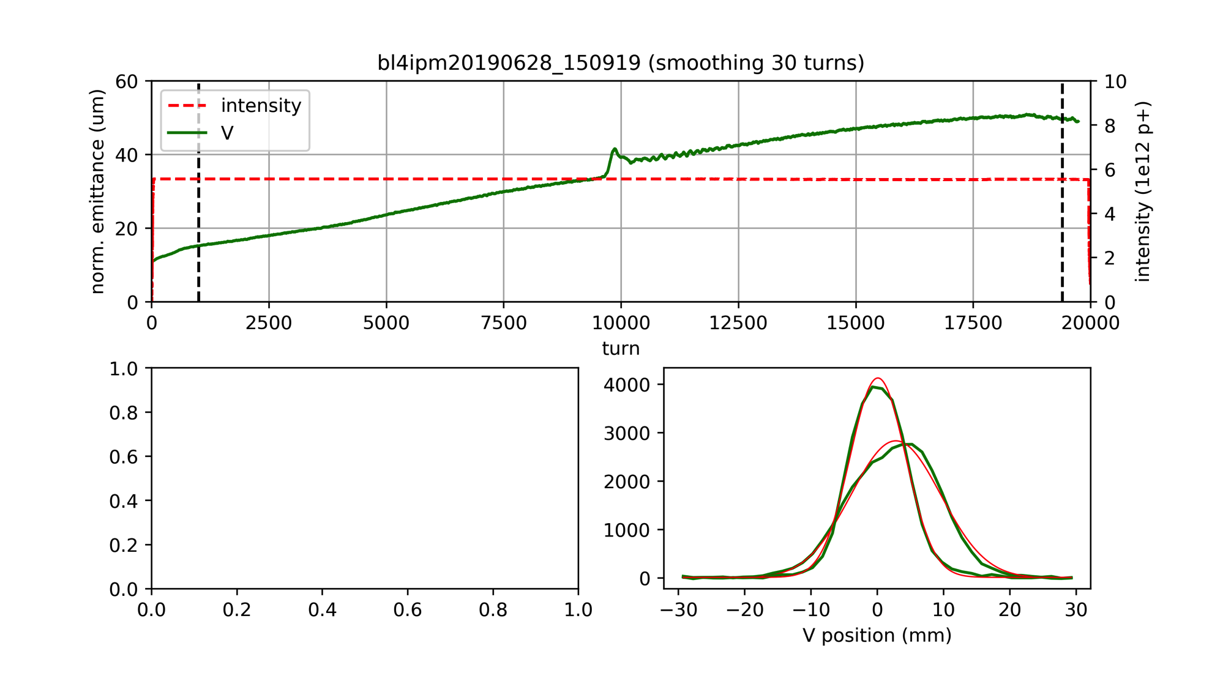
IPM data – normalized emittance for different intensities
intensity data saturation level
Difficult to interpret before compensating for instrumental effects
Intensity data included in IPM files is saturated above 5.5e12
  Can it be corrected for future studies?
Emittance blow-up after transition crossing with 18 turns injected?
  Could explain step in MI8 measurements and IPM at extraction which is not observed with IPM at 1000 turns

Slide 17
Outline
Introduction and considerations on space charge
Observations from IPM and bunch length data
Comparison of IPM data with MI8 wires
Vertical tune scans
Summary and conclusions

Slide 18
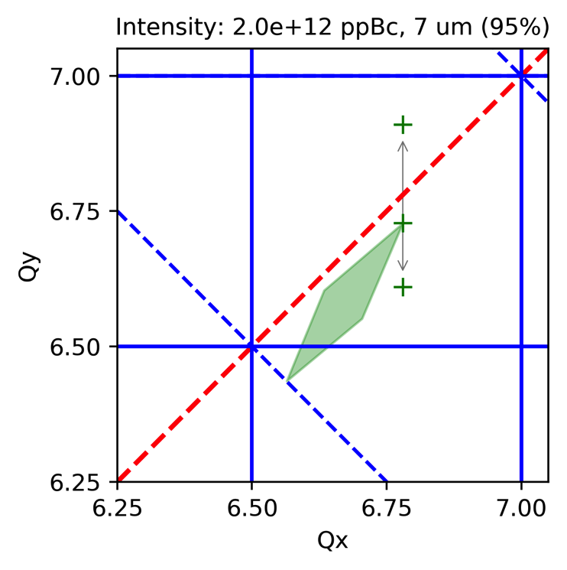
Vertical tune scan for different intensities
Different working points at injection
When approaching half integer
  Emittance blow-up
  Losses (when reaching aperture)
Onset of blow-up
Onset of losses
IPM data
@1000 turns
@injection
Onset of blow-up

Slide 19
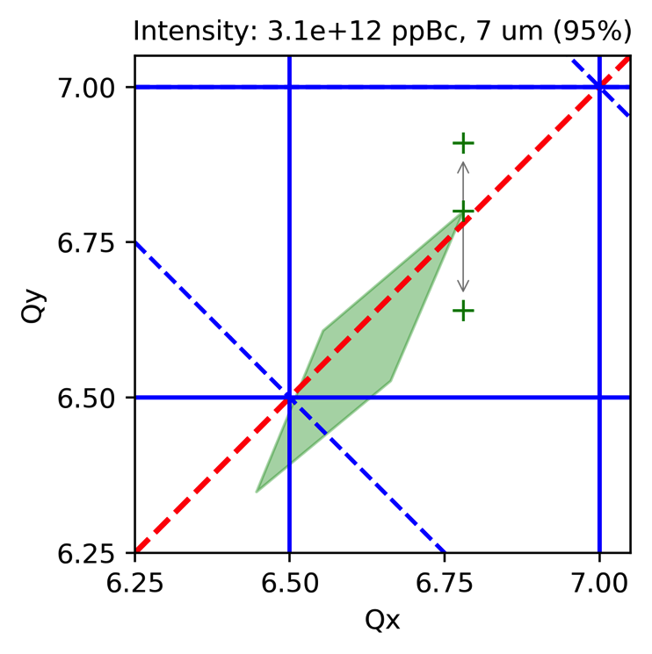
Vertical tune scan for different intensities
Different working points at injection
When approaching half integer
  Emittance blow-up
  Losses (when reaching aperture)
Onset of blow-up
Onset of losses
IPM data
@1000 turns
@injection
Onset of blow-up

Slide 20
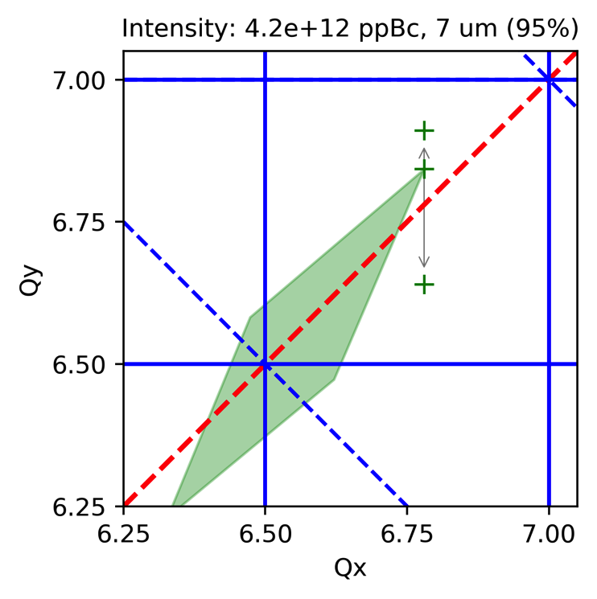
Vertical tune scan for different intensities
Different working points at injection
When approaching half integer
  Emittance blow-up
  Losses (when reaching aperture)
Onset of losses
Onset of blow-up
IPM data
@1000 turns
@injection
Onset of blow-up

Slide 21
Vertical tune scan for different intensities
Different working points at injection
When approaching half integer
  Emittance blow-up
  Losses (when reaching aperture)
Seems to explain shrinkage of
stable tune area for higher intensity
Expected space charge limit
  When losses due to emittance blow-up
  occur on operational working point
  “Power point” extrapolation gives
  about 5.5e+12 ppBc for the present
  400 MeV injection energy
  Compensating half integer resonance
  might allow pushing this limit
IPM data
@1000 turns
SC limit?
operational
working point

Slide 22
Outline
Introduction and considerations on space charge
Observations from IPM and bunch length data
Comparison of IPM data with MI8 wires
Vertical tune scans
Summary and conclusions

Slide 23
Summary and conclusions
Space charge tune spread attains large values for high intensities
  First 1000 turns after injection are most critical due to bunch length reduction
IPM data very useful, but instrumental effects need to be treated
  Could be used to check if there is emittance blow-up along the cycle
Shrinkage of stable tune area with higher intensity seems linked to
space charge
  Measured emittance blow-up for tunes closer to the half integer resonance
  Onset of losses when too close to half integer resonance
  Simplified extrapolation gives space charge limit of about 5.5e+12 ppBc
  Could be possibly improved by compensating half integer resonance
More details on dependence on chromaticity and flat lattice in part 2

