Slide 1
Laser – HVS Interface
Bo Yu
June 18, 2019

Slide 2
DUNE SP

Slide 3
Instrumentation Ports Above the SP TPC
https://edms.cern.ch/file/2060543/1/Detector_Views_Center_2060543.pdf

Slide 4
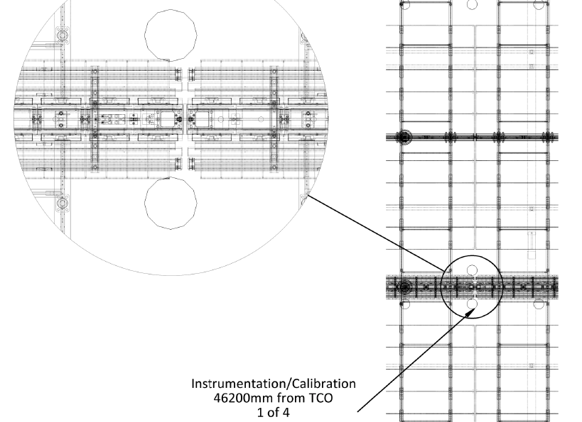
Laser Point Position 1
https://edms.cern.ch/file/2060543/1/Detector_Views_Center_2060543.pdf

Slide 5
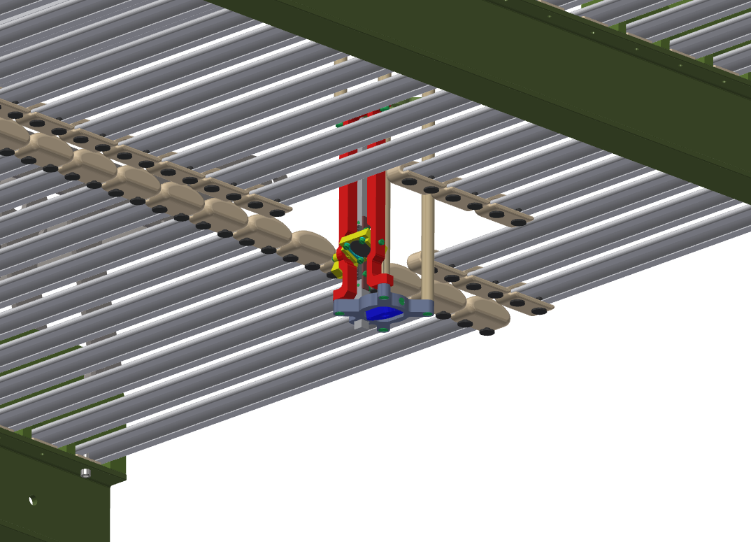
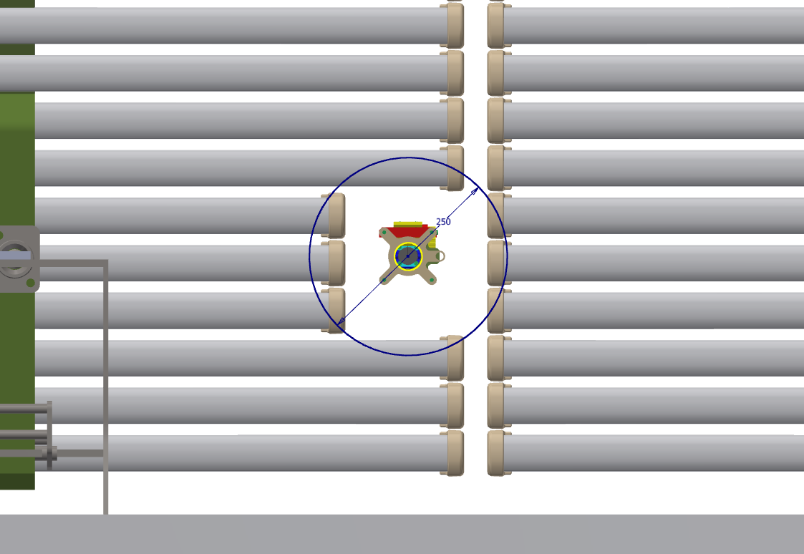
Laser Point Position 1
This is the easiest location to create an opening in the FC: simple shortening a few profiles on one side of the field cage module. No other changes are needed.

Slide 6
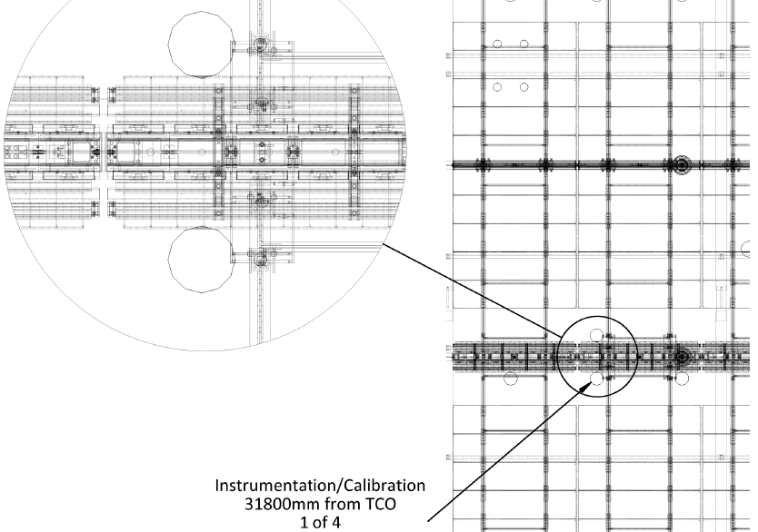
Laser Point Position 2
https://edms.cern.ch/file/2060543/1/Detector_Views_Center_2060543.pdf

Slide 7
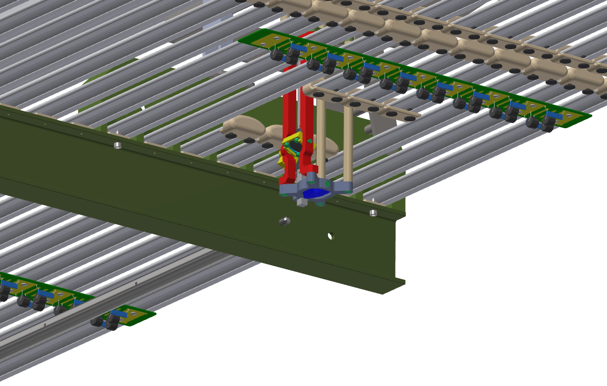
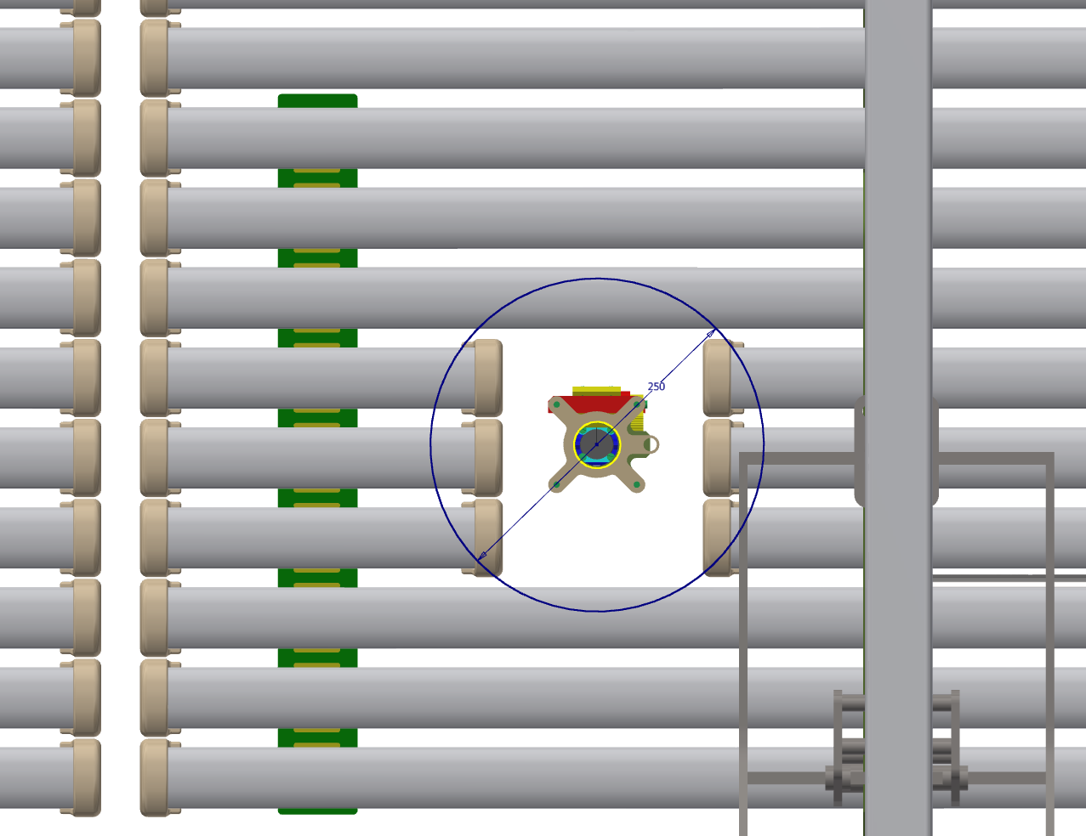
Laser Point Position 2
Cut the profiles on FC module into a long, and a short sections. The long pieces are mounted on the I-beams as usually. The shorted pieces are supported locally by the uncut profiles. In fact, a special R divider board may be used for both the mechanical support and electrical connections. This divider, and the one it is connected to in parallel must have double per tap resistance. No change to the neighboring module.

Slide 8
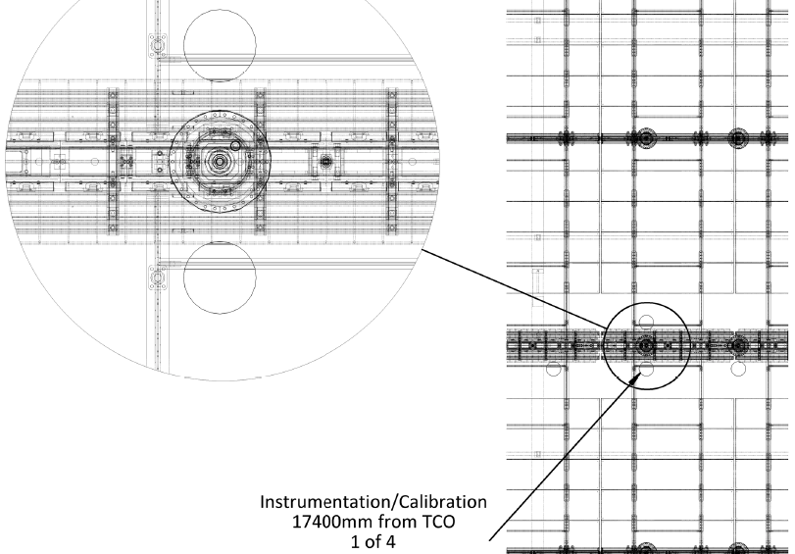
Laser Point Position 3
https://edms.cern.ch/file/2060543/1/Detector_Views_Center_2060543.pdf

Slide 9
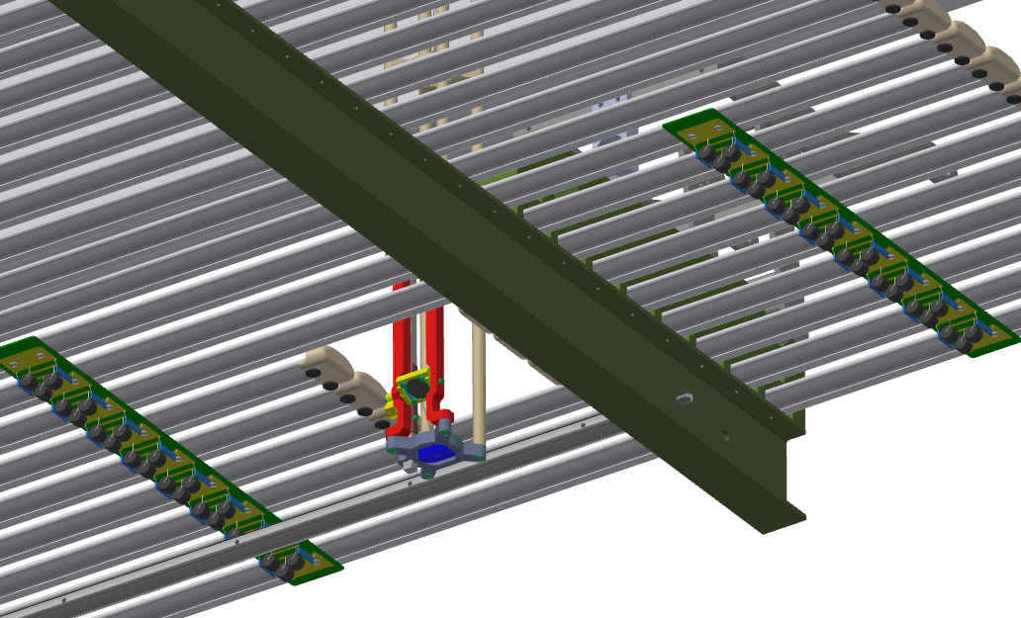
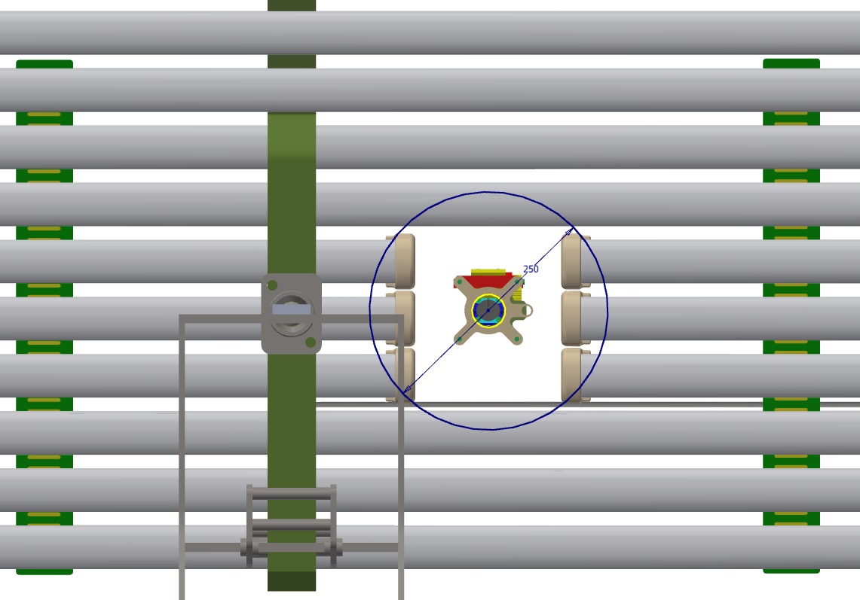
Laser Point Position 3
Cut the profiles on FC module into two sections. Both sections are mounted on one I-beam, and stabilized by special double value R divider boards.

Slide 10
E Field Around the FC Opening
A graph of the E field map on the FC surfaces

Slide 11
Impact on Electron Drift
A new figure

Slide 12
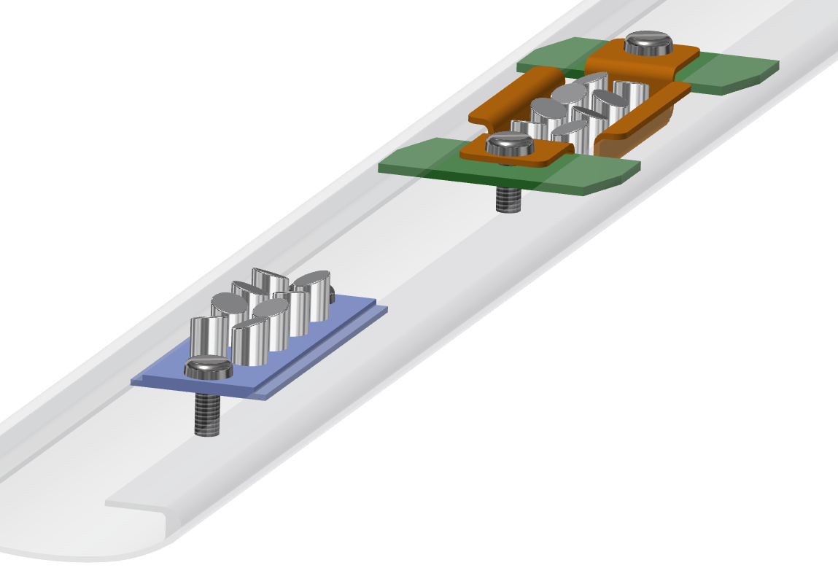
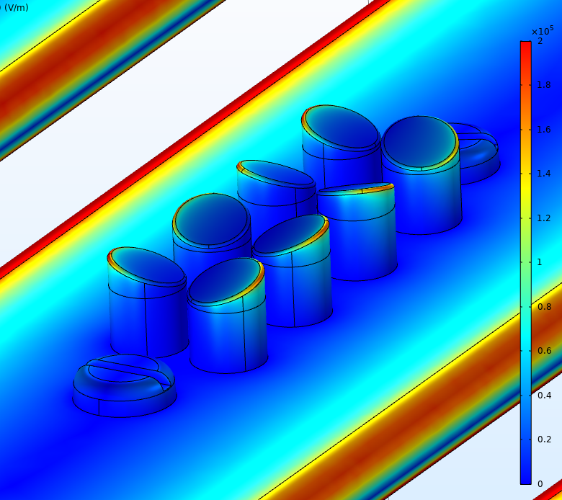
Target Mirrors in FC Profile
Two concepts for mounting the 5mm aluminum mirrors inside a FC profile:
Both concepts can be installed after the FC deployment if needed. The upper right one has the mirror surfaces recessed for their protection. The green pieces are our standard slip nuts used to mount the profiles to the I-beams.
Mirror edge radius: 0.25mm
Emax < 2kV/cm @ 100kV

Slide 13
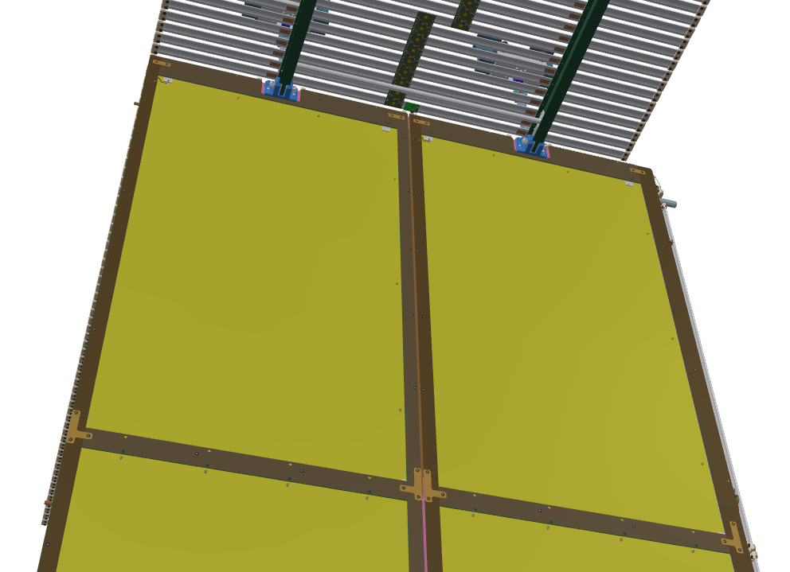
Photoelectric Effect
A photoelectron laser system is described in the TDR. It shines diffused UV light over a large area on the cathode with some predefined metallic target pattern, and aims to generate bursts of electrons drifting toward the wire planes.
We don’t see problem of having small metallic targets securely mounted on the cathode surfaces. Large targets (metal strips) weakens the resistive nature of the cathode and should be avoided.
There are a number of metal objects on cathode/FC that would contribute.
The resistive Kapton does respond to UV light. Its QE is about 2 orders of magnitudes lower than Ag in vacuum. This means if one knocks off a large number of electrons from a small target, a greater number of electrons will also be emitted on the Kapton surface being illuminated. They will arrive simultaneously with those from the targets, on a large number of wires.
Hinge block
FC frame stiffening bar
Screws holding FSS
FSS interconnects

Slide 14
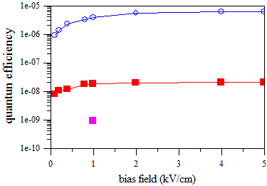
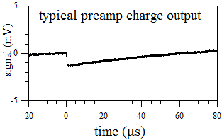
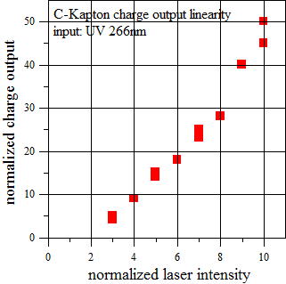
Dec. 28, 2017 Is there any electron emission from carbon-loaded Kapton?
in vacuum (not yet in LAr) at room temperature & ~85^{O}K
Experimental setup
Cathode
(bias up to -500V)
anode mesh
(+ve bias)
reference: silver
carbon loaded
Kapton on hot/cold finger
C-Kapton, room temp.
266 nm UV laser
60 ps, 10 Hz
a few µJ/pulse
<1 mm² spot on photocathode
C-Kapton, 85K
gap: ~1 mm
Vacuum cell
Cremat
preamp+shaper
Electron emission from carbon-loaded Kapton is low but non-zero.
At UV 266nm, electron emission is linear with laser intensity
At room temp in vacuum, its quantum efficiency (QE)
is ~10⁻⁸ drops to below ~10⁻⁹ in cold, its QE is expected to continue drop in LAr.
From T. Tsang, BNL

Slide 15
DUNE DP

Slide 16
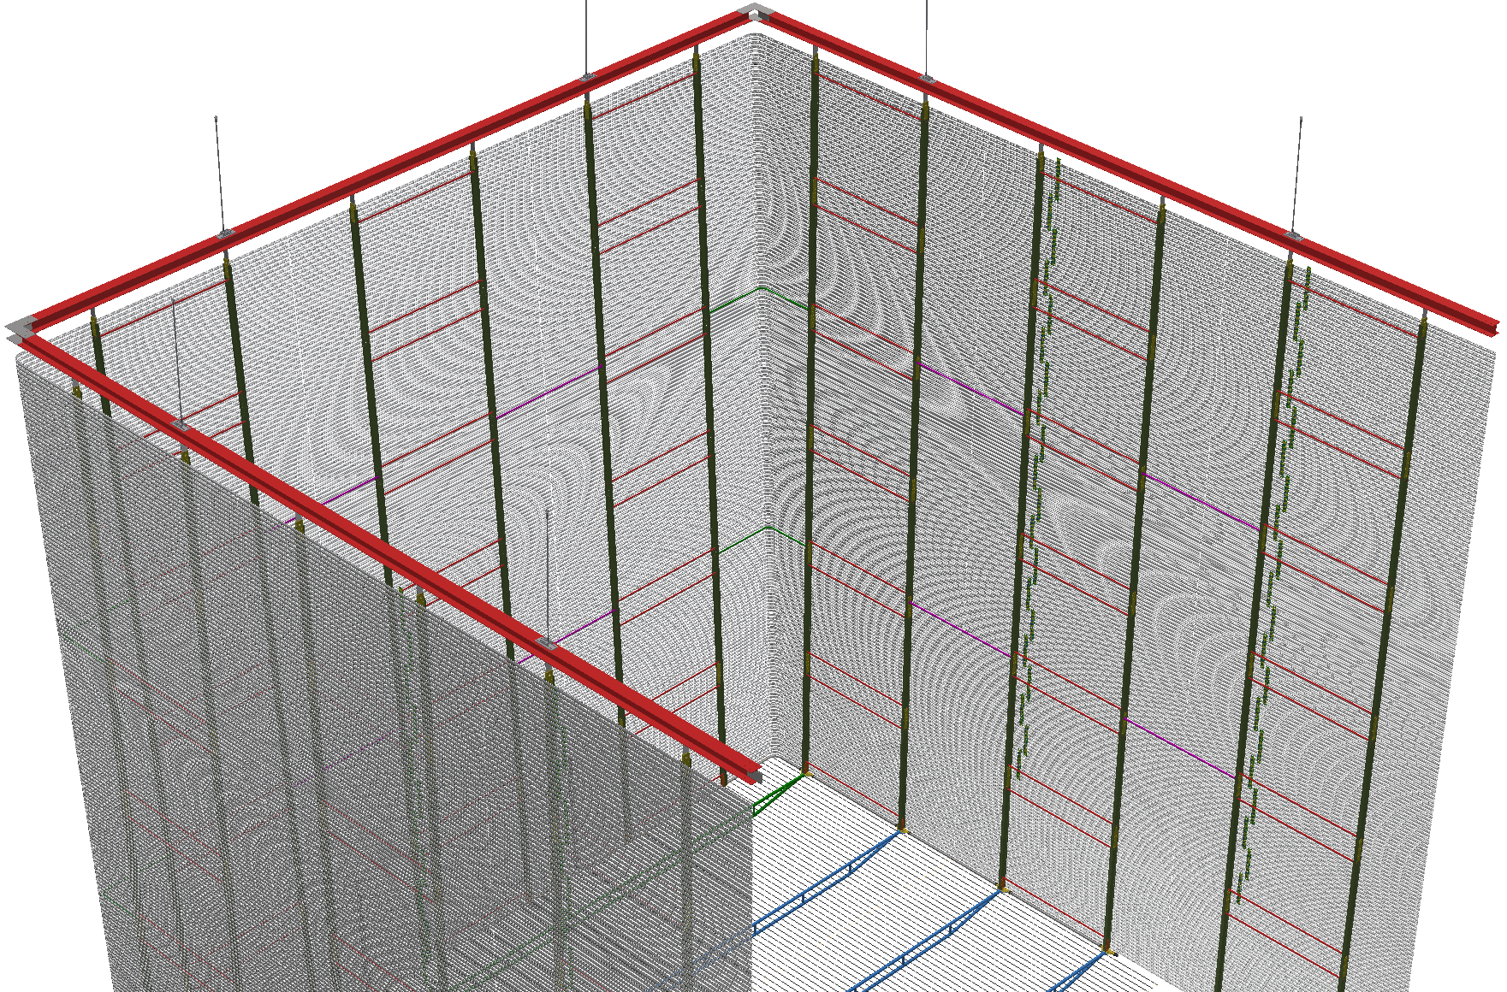
A Fully Assembled End of a DP Module

Slide 17
Preferred Locations for Laser Heads
We have a 15cm nominal gap between the inner FC profile surface and the CRP outer edges when cold. Lasers in this gap will not interfere with FC profiles and CRPs. But the top FC beams need to be modified for this: best at beam joints.
Preferred locations for the laser ports: ~12m apart forming a rectangle. Position the port at the joints of two 12m long FC support beams.
Since the FC and its support beam shrink about 0.3% in the cold, the opening through the beams must account for the shrinkage.
The reflector panels may need to be notched for the laser heads as well.

Slide 18
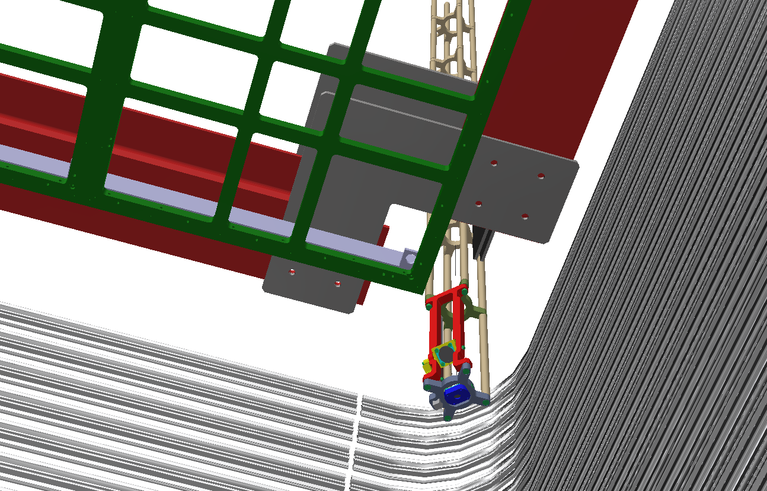
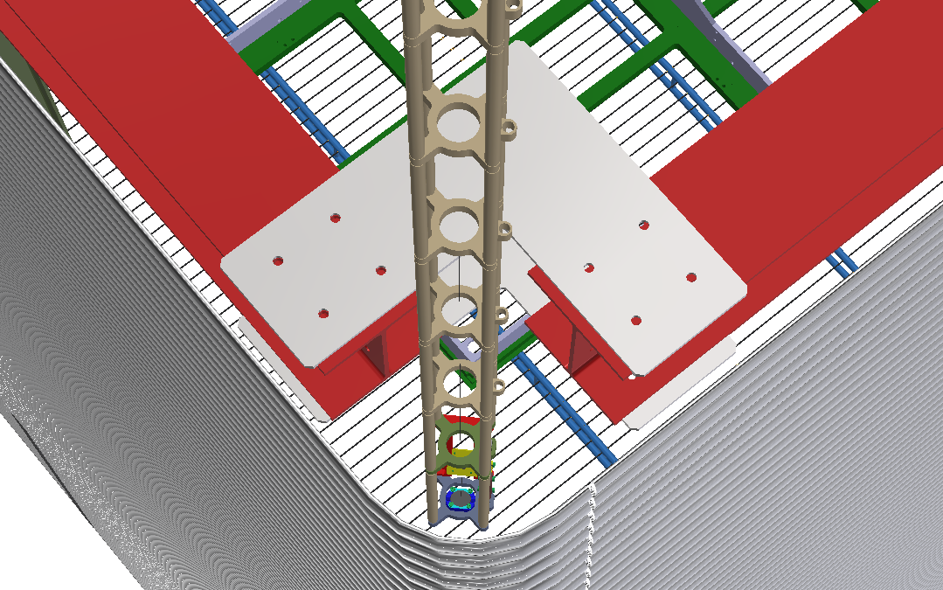
Possible Location Example: Corner
In a FC corner, the FC support beams have no load, therefore it is easy to make a hole for the laser head.
However, a laser head in the corner will see the most movement between warm and cold relative to the other TPC structures: CRPs have invar frames so their shrinkage is minimal. However, it is not clear if the shrinkage is accumulative. FC will shrink ~ 9cm in the long direction and 2cm in the other. This relative movement must be considered.

Slide 19
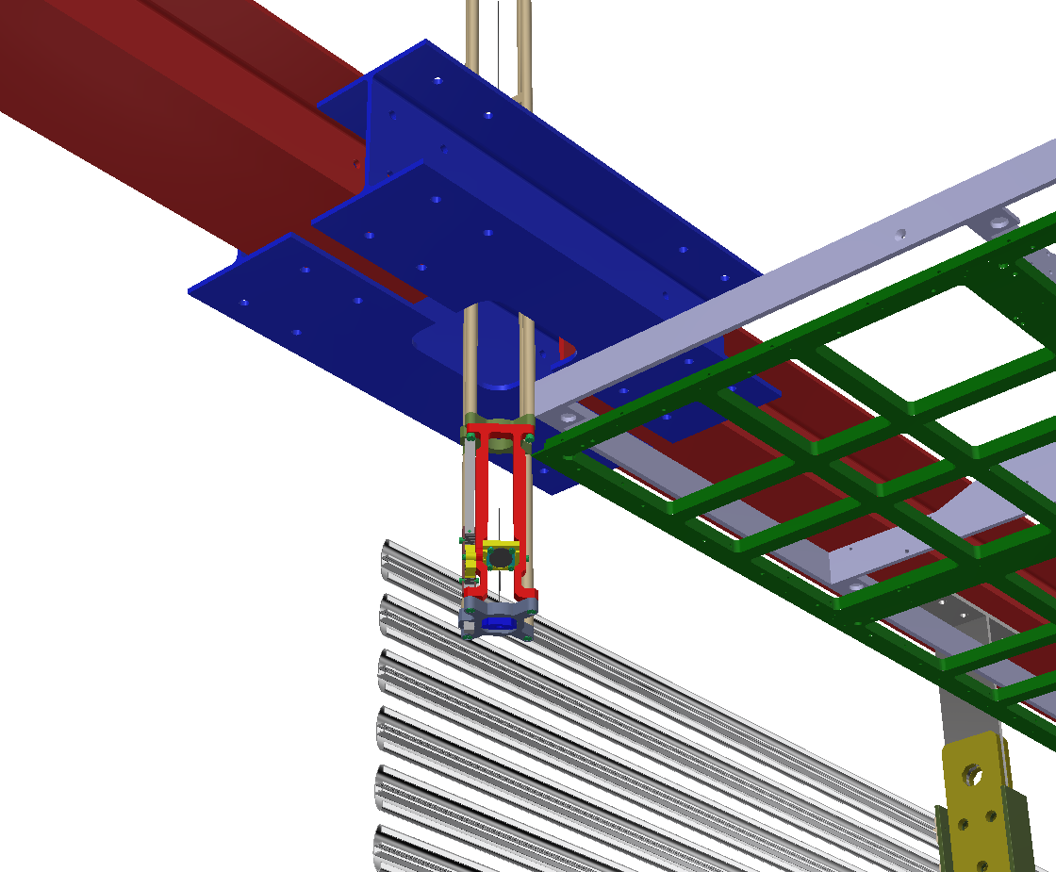
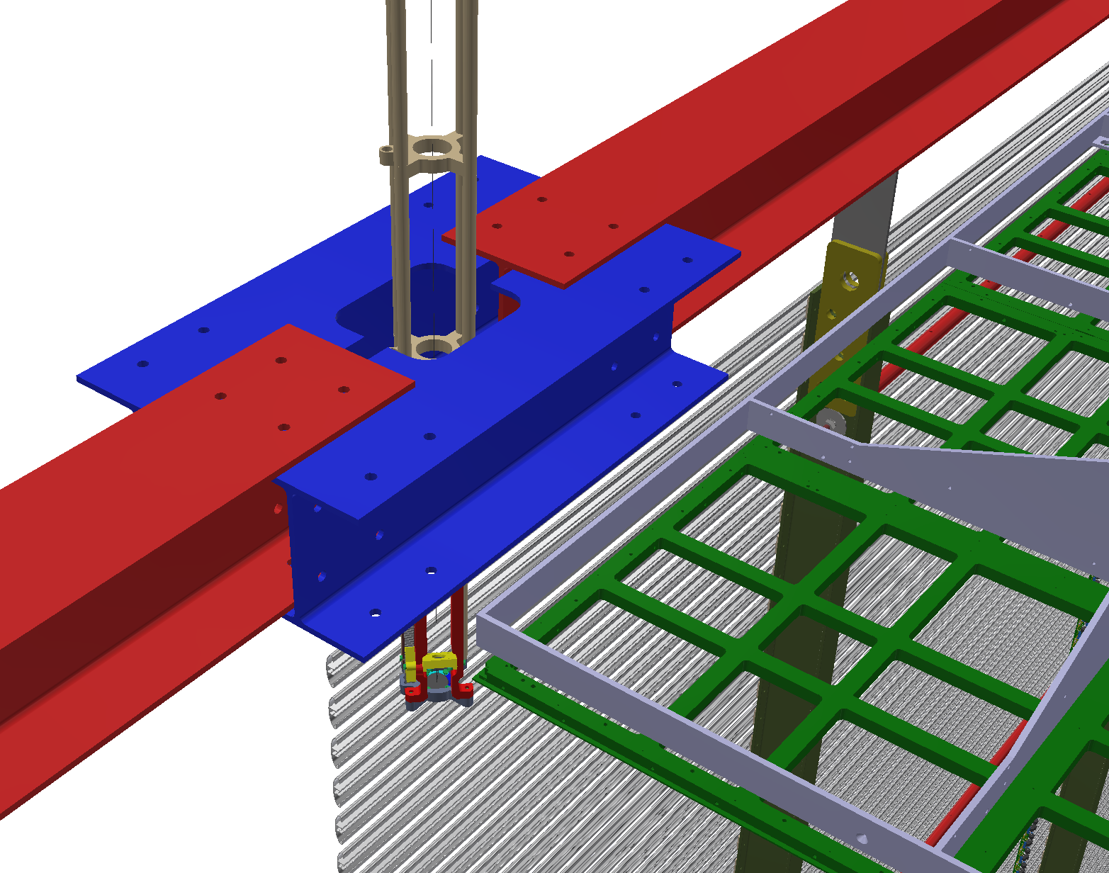
Possible Location Example: Long Side
Along the two long walls of the TPC, there are 4 breaks in the FC super module suspension beams. These are the natural locations for laser heads to pass through.
The FC suspension beams are 12m long. The 4 locations are @ ±6m, ±18m from the middle of the long FC array. The expected shrinkages of the FC at these 4 locations are ±16mm, and ±49mm along the wall, and 16mm toward the CRP. These shifts need to be accommodated in the laser openings on the beams.

Slide 20
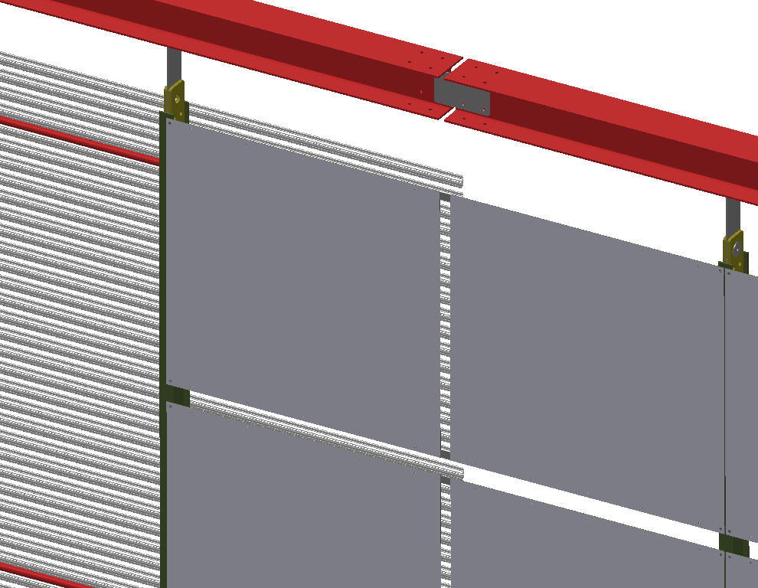
Reflector Foil Panels from the PDS
The PDS in the baseline design added WLS coated reflector panels mounted on the inside of the field cage to cover the upper half of the FC surfaces to improve light collection efficiency.
These panels may block the laser heads penetrating through the FC beams.
Either adding notches to the some panels or lower some/all panels a few cm is needed.
Damage to the WLS coating by the laser beams needs to be evaluated, unless the lasers can be steered only to the gaps between reflector panels.

Slide 21
Summary
Several design options to accommodate calibration lasers through the SP top ground plane modules are introduced. None of the openings are currently in the HVS baseline design. However, it is reasonably straightforward to implement these features.
The locations of the openings are for the centered TPC inside the cryostat, which seems to be the preferred configuration for providing FC openings: no major interferences to key FC support structures.
In the examples, 3 FC profiles were removed to create the openings. This may be necessary to account for the additional contraction of the TPC in the cold. Previous electrostatic simulation was done on a 2 profile opening.
The resistive Kapton film does emit electrons from UV light in vacuum. If this is confirmed in LAr, it may be difficult to distinguish electrons emitted from the targets or from the surrounding Kapton surface.
For the DP, the preferred laser locations are in between the FC and the CRPs. Along the FC, it might be easier to make the openings at the joints of the 12m FC support beams: 12 ports at 12m spacing.

