Slide 1
DUNE Far Detector Calibration with Cosmic Rays
Tom Junk
DUNE Far Detector Calibration Workshop
June 18, 2019
Many thanks for materials stolen without permission: David Adams,
Jonathan Asaadi, Bruce Baller, Sowjanya Gollapinni, Kevin Ingles, Vitaly Kudryavtsev,
Kendall Mahn, Mike Mooney, Ajib Paudel, Jen Raaf, Aidan Reynolds, Hannah Rogers,
Michelle Stancari, Matt Thiesse, Filippo Varanini, Erik Voirin, Mike Wallbank, Karl Warburton,
Leigh Whitehead, Tingjun Yang

Slide 2
Early Years of DUNE
Most data from most interactions will be from cosmic rays.
~1.3 million useful interactions per year per module
Schedules shown so far have at least one FD module up and running at least one year before there is beam
Commissioning, calibrating, atmospherics, exotics, possibly a SNB during that early period

Slide 3
Uses of Cosmic Rays
Check the channel map
Identify disconnected channels. The pulser only tests up to preamp input. Need to see physics signals. ³⁹Ar serves this role too.
Calibrate pulse shapes – field response of the detector
Measure electron lifetime (maybe ³⁹Ar can do this too)
Measure dQ/dx uniformity across APA faces (channel calib). (³⁹Ar too)
Calibrate dQ/dx --> dE/dx using known MIPs (³⁹Ar too)
Measure drift velocity using Cathode-Anode Piercing Tracks
Align the APAs and CPAs
Calibrate charge and drift response in inter-APA gaps

Slide 4
Uses of Cosmic Rays
Characterize electric field nonuniformity
  space charge (not expected for FD-SP but FD-DP will need to check)
  field cage nonuniformities
Test relative timing of TPC and photon detectors
Explore saturation characteristics of front-end and ADC
Measure long-range induction effects in the APAs (and FEMB effects)
Michel electrons test the low-energy EM response

Slide 5
Muon Flux at the 4850' Level
See DocDB 5505 for an approximate calculation based on Vitaly Kudryavtsev, Martin Richardson, J. Klinger, and Karl Warburton LBNE DocDB 9673-v1, and the calibration concept study document, DUNE DocDB 4769-v2
Estimate 4 cosmic rays
per day per square
meter at the 4850'
level (DocDB 4769)
Syst. Uncertainty
is ±20% in total rate.
Shapes are uncertain
too!

Slide 6
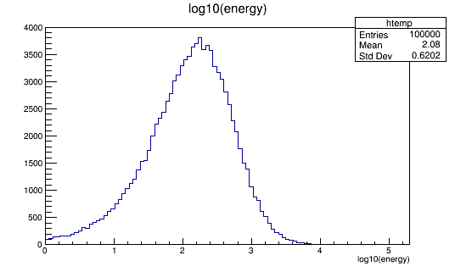
Fraction of Showering Muons
No-shower cut: Critical Energy (energy at which radiative effects are more important than ionization) is 485 GeV in LAr. log₁₀(485) = 2.7
Vitaly's plot was
in muons per GeV (linear)
on a log scale (!)
Estimate that 60% of muons
don't shower significantly.
MUSUN Generator-Level Run: prodMUSUN_DUNE10kt.fcl with 100000 events

Slide 7
Rates For One DUNE Far Detector Module (SP)
Collection-plane channels get hit 10x per day. Induction-plane channels are hit more.
Some studies like checking for dead channels can use looser selections.

Slide 8
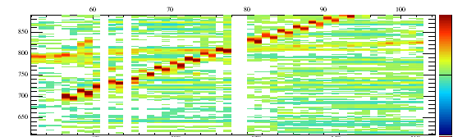
Validating/Fixing the Channel Map
Some flaws in the channel map are obvious once you have straight tracks.
Example from 35-ton running: even and odd collection-plane channels were swapped (ribbon cable?)
Not the only possible flaw. If we get all the channels backwards, straight tracks may still look straight.
Swap U and V views – can test with timing.
Tick
Channel Number
ProtoDUNE-SP channel map was correct on Day 1 of operations due to good communication
and hard work.
DUNE FD-SP map is likely just a scale-up. Cable swaps like this may be unlikely (all boards)
Two days of cosmic ray data should suffice for this and also spot dead channels that
stay dead. Intermittent channels are more difficult.

Slide 9
Staging Cosmic-Ray Measurements
Cosmic ray rates are low at the 4850' level. 10x per collection-plane wire per day.
For rapid measurements and stability checks, we will have to loosen up cuts. E.g. use photon detector timing to locate an event in x and not rely on anode-cathode piercing tracks
Some measurements can be done inclusively by assuming uniformity of the detector.
  e.g. assume lifetime is the same everywhere – get a number within an hour.
  Relax the assumption to get a more differential measurement takes more data.
Looking at average hit response on a channel takes a few days' data. Looking along length for shadows of other wires takes thousands of times more data.

Slide 10
Lifetime Measurement
Tracks that leave hits at different distances from the APA provide a calibration sample for the lifetime.
ICARUS:
https://arxiv.org/abs/1409.5592 (JINST 9 (2014) no.12, P12006)
MicroBooNE:
https://arxiv.org/abs/1710.00396 (Varuna Meddage conf. proceedings, DPF 2017)
  DUNE lifetime analysis module implemented for ProtoDUNE-SP for running in the nearline monitor
  Uses APA-CPA piercers
LArIAT: Single-track and multi-track methods – see Jen's talk at the January 2018 collab meeting.
35-ton prototype: Matt Thiesse's Ph.D. Thesis: very difficult due to low signal/noise). Multi-track method.

Slide 11
ICARUS Lifetime Measurement
Truncated means get more
information out of
Landau (convoluted with Gaussian)
hit charges

Slide 12
Precision of Lifetime Measurement
𝜆=1/𝜏 is a more
natural variable as
the uncertainties
don't depend on 𝜏
For a 3 ms lifetime, one gets about a ±30%
measurement of the lifetime for each track
Five muons per day per APA, 1/day if you want
the muon to go in the opposite CPA panels.

Slide 13
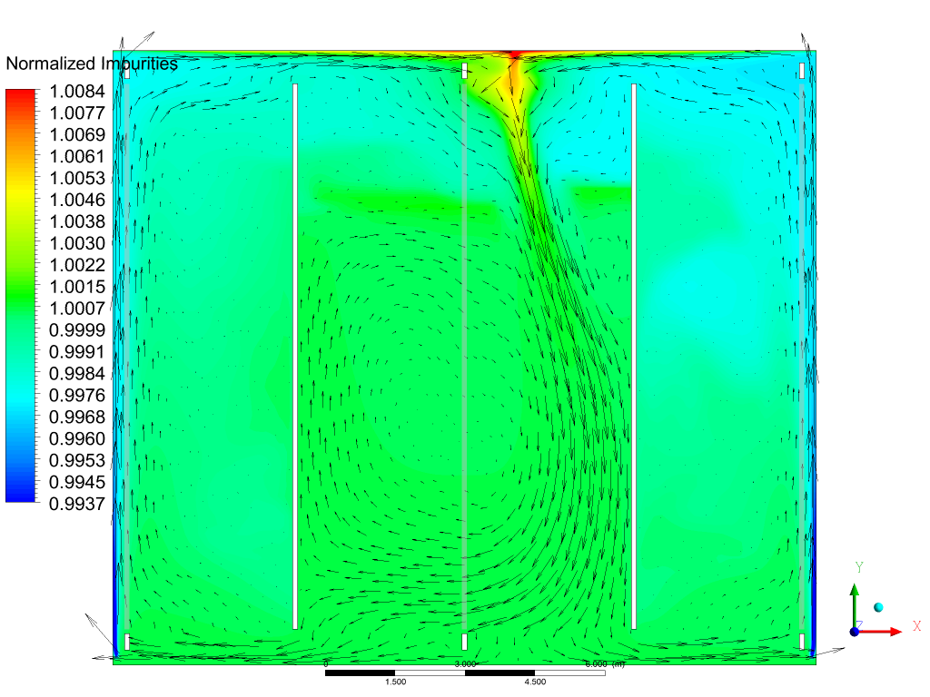
Impurity Contour and Velocity @ Z=0
FD-SP
Near Mid-Plane
Erik Voirin
Max. variation
~2%
124 discharge ports

Slide 14
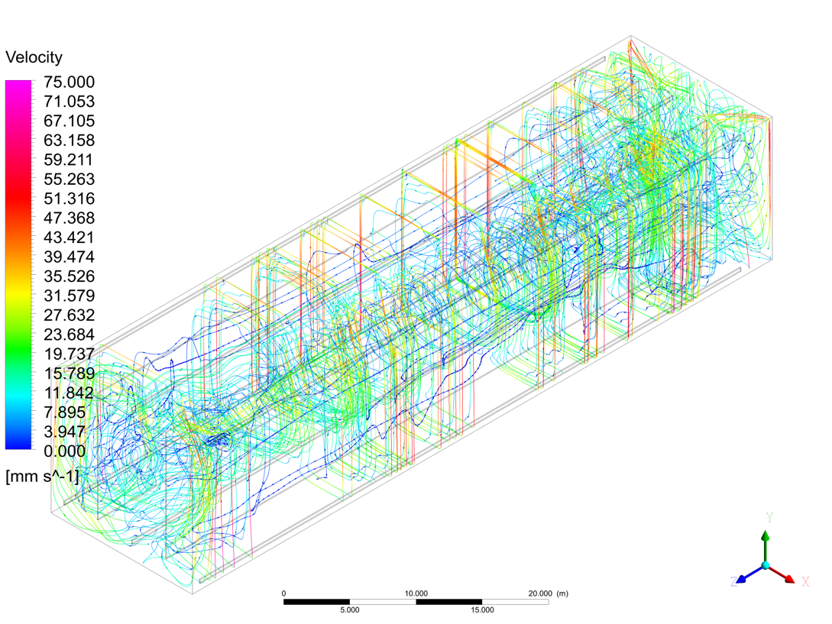
Velocity Streamlines
Erik Voirin,
DUNE DocDB 1046-v2
(high res image – zoom for detail)
124 discharge ports

Slide 15
Pulse Shape Measurement
Undershoot correction for AC-coupled electronics
  can do with a pulser but better with cosmic-ray data
  needs very little data to check – just need a few big signals
  Electronics model is
  reliable, just need to
  check each channel
  Imperfect pole-zero
  cancellation seen in
  MicroBooNE's preamp
  causing under- and
  overshoot.
MIP response needs tracks perpendicular to wires. Easy for induction-plane wires, harder for collection-plane wires.

Slide 16
MicroBooNE Example – Calibrating Pulse Shapes
C. Adams et al., JINST 13 (2018) no.07, P07007
MicroBooNE has no grid plane, so U is
special.

Slide 17
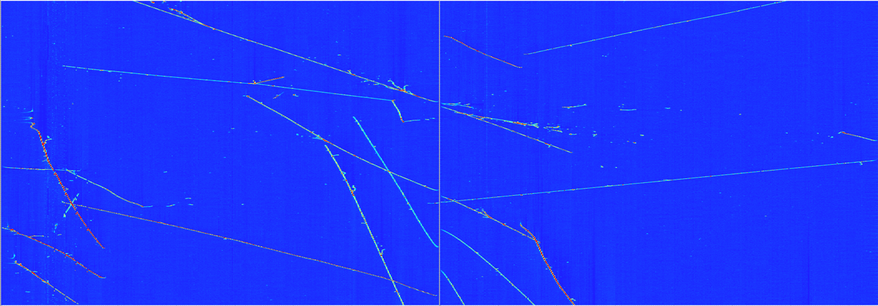
An Event in ProtoDUNE-SP
APA 3
APA 2
Time (tick)
Collection Plane Wire Index
T. Yang
DUNE DocDB 10842

Slide 18
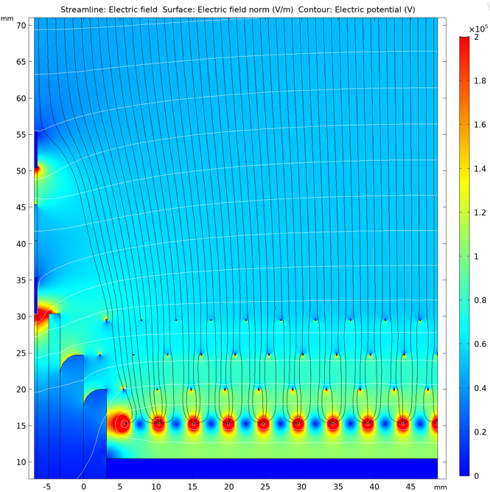
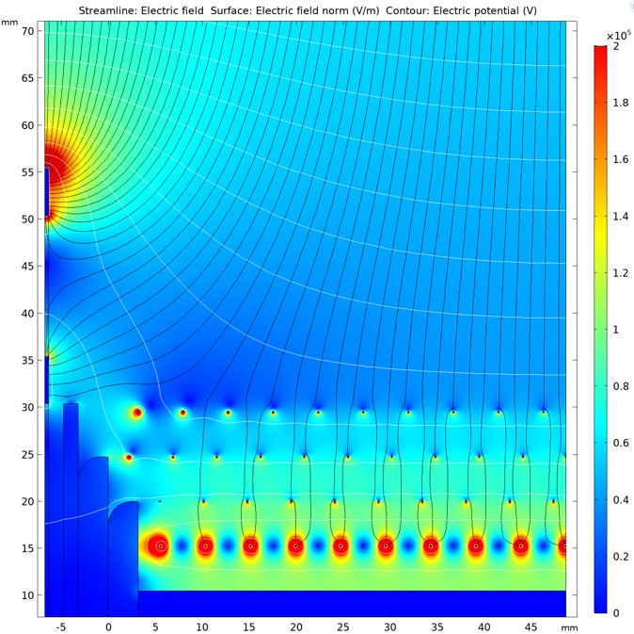
ProtoDUNE-SP Electron Diverter Field Predictions
Biased as designed
Grounded outer electrode

Slide 19
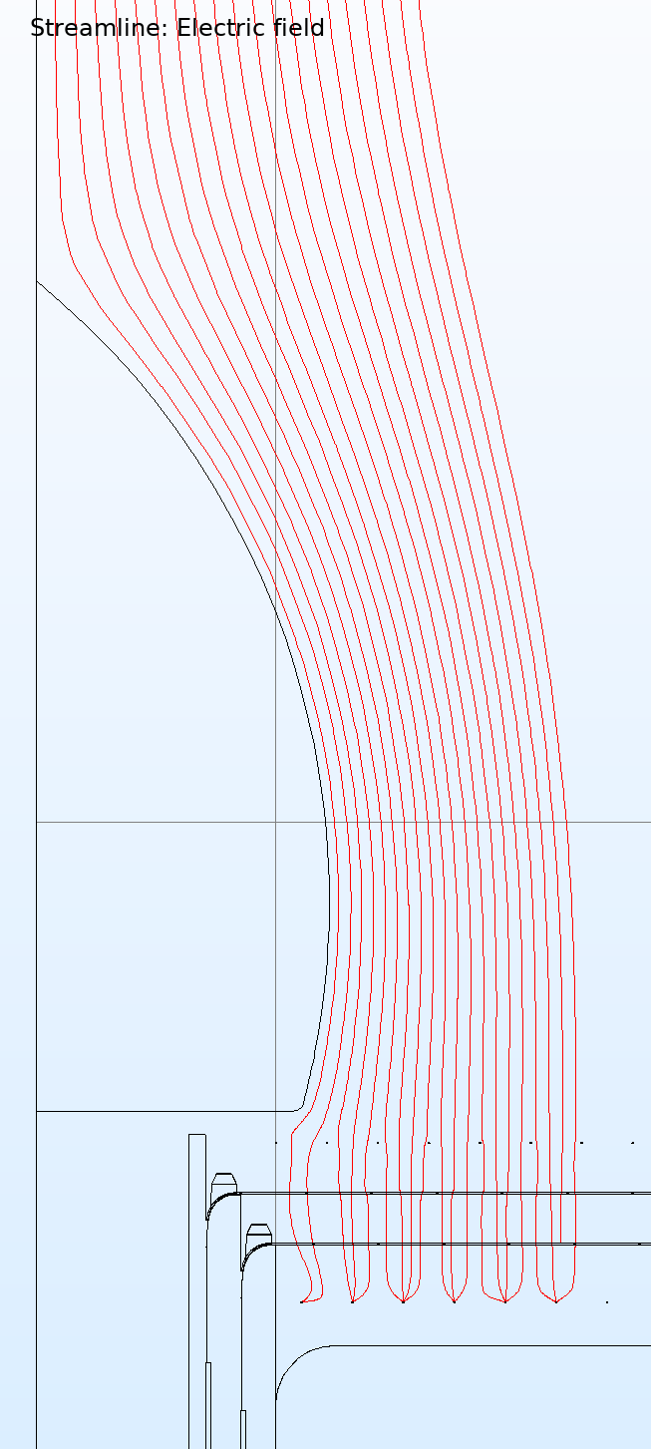
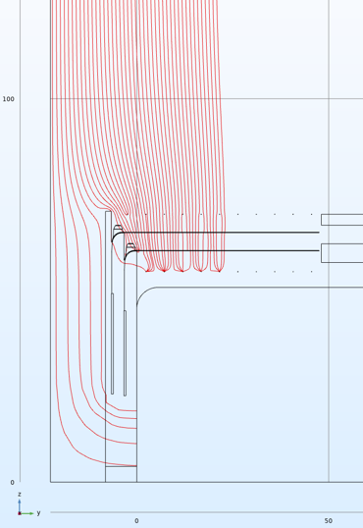
Passive Diverters or No Diverters
Options under consideration

Slide 20
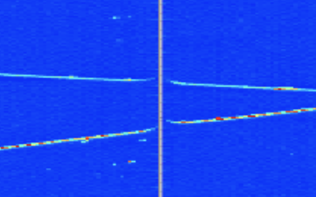
Calibrating Response in Gaps
Isochronous tracks – measure time delays
Tilted tracks – measure spatial distortions
Electron Diverters
grounded in this
event.

Slide 21
dQ/dx uniformity near gaps
Diverter at nominal voltage.
note: APA 3's grid plane is charging up
Grounded Diverter
Note: One ASIC is a little different
from the others.

Slide 22
Ajib's Median dQ/dx Z plane (y,z)
Beam Right
APA 3
APA 2
APA 1
80,000 events used to fill histograms with
this granularity in ProtoDUNE-SP
Calculated using Anode-Cathode Piercing Tracks

Slide 23
Ajib Paudel, June 12, 2019
dE/dx in data scaled to MC
~a few thousand events should suffice if we assume detector is uniform

Slide 24
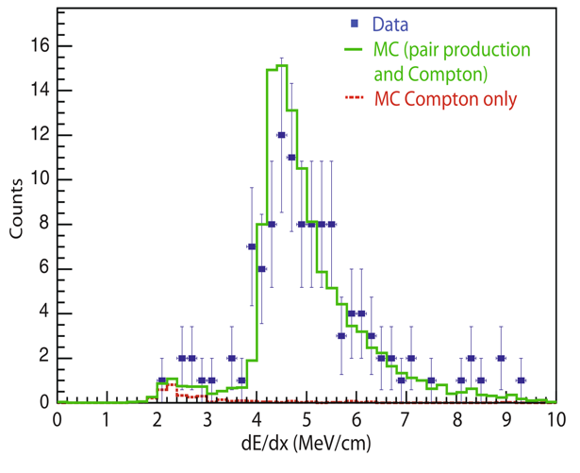
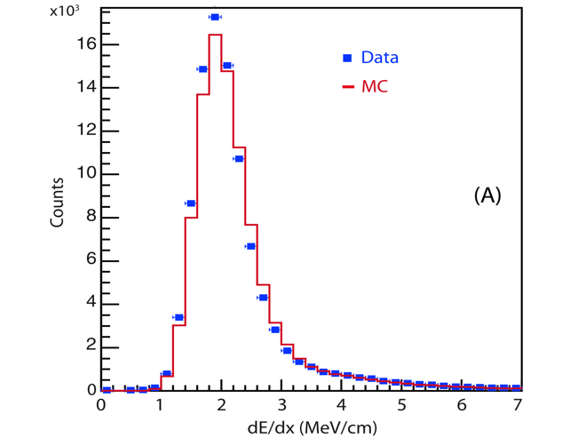
dE/dx comparison
  Ionization density distributions from different physical samples in CNGS data are compared with MC expectations:
    Low energy showers from isolated secondary π⁰ show good agreement
    Stopping muons from ν_{μ}CC interactions of CNGS neutrinos show a small (~2.5%) underestimation
F. Varanini
π⁰
μ
Beam neutrino data, not cosmic rays!
Trying to do this
with cosmic rays
is harder – energy spectrum
is less well known
M. Antonello et al., Eur. Phys. J. C (2013) 73:2345

Slide 25
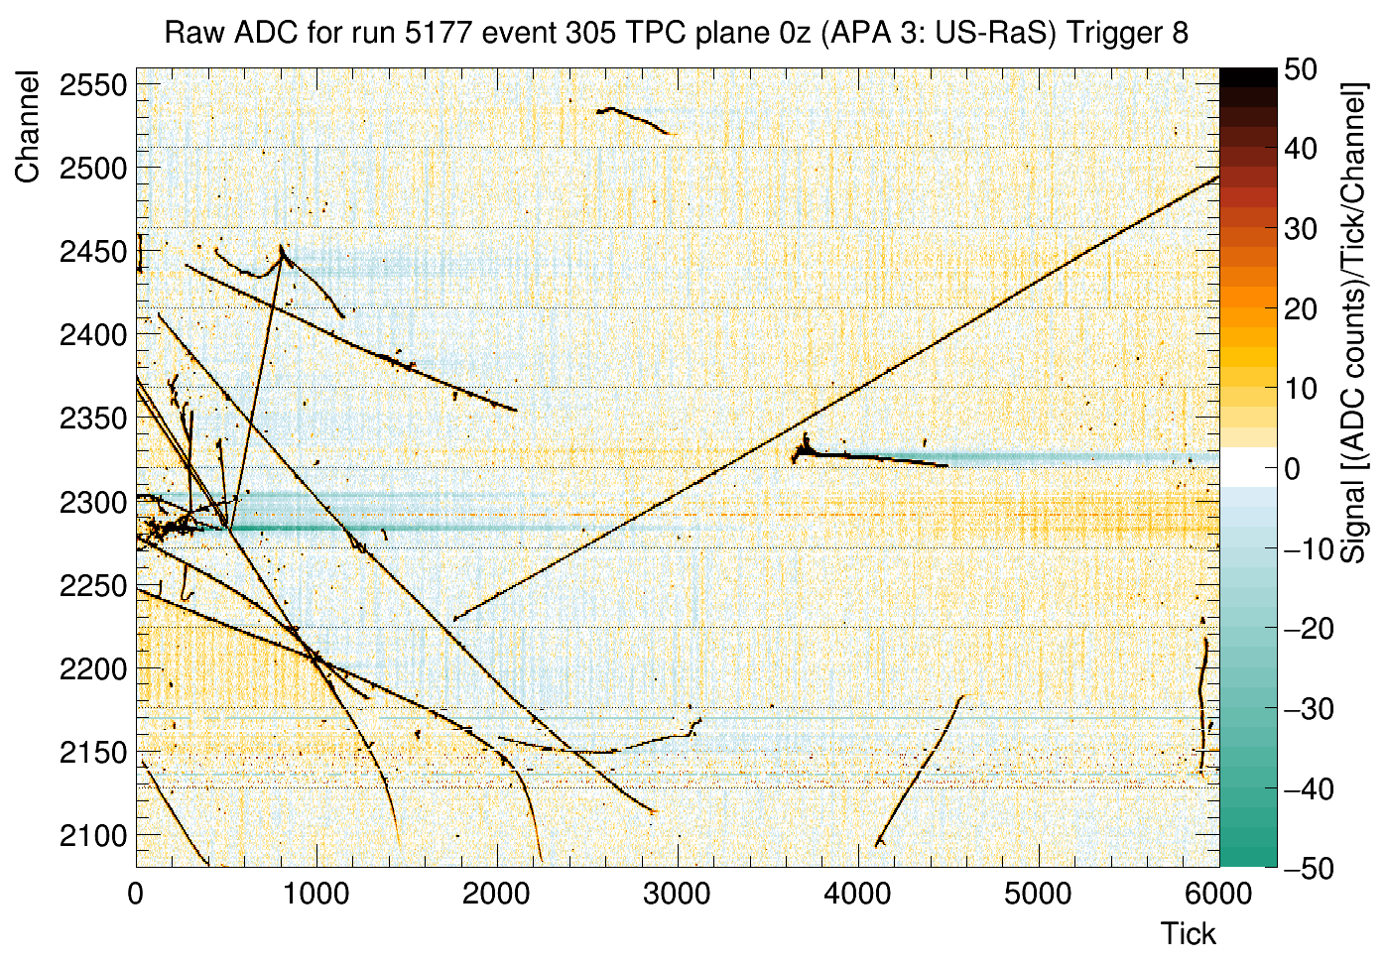
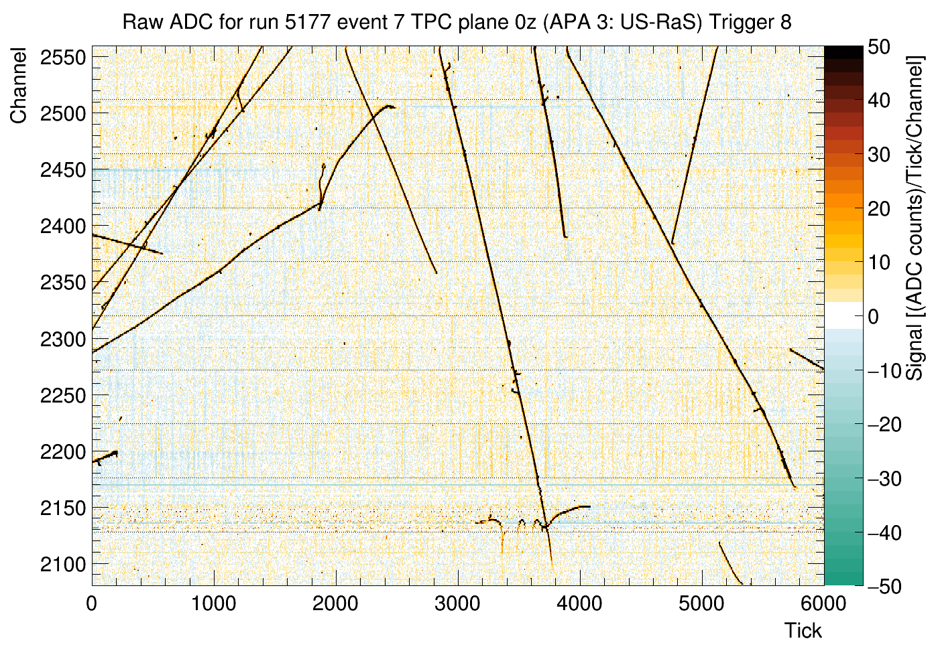
Electric Field Nonuniformities – Apparent in Individual Events

Slide 26
Average dQ/dx vs Y
Four
Wire
Support
Combs
Three
Field
Cage
box-beam
Pairs

Slide 27
Ajib Paudel found the CPA pattern in his dQ/dx analysis
Shows expected pincushion distortion

Slide 28
Need for Faster Monitoring
ProtoDUNE-SP had an issue with APA 3's grid plane not being connected
Charge-up time of several days in ProtoDUNE-SP. Grid not perfectly transparent while charging up.
Affects dQ/dx means in a time-dependent way.
Underground: fewer cosmic rays, and more capacitance on the grid plane (to reduce an induction effect seen in ProtoDUNE-SP)

Slide 29
David Adams, March 2019

Slide 30
Alignment
Nearly every detector in HEP is aligned with cosmic rays
Elaborate examples:
  CMS: http://arxiv.org/abs/0911.4022
  ALICE: http://arxiv.org/abs/1001.0502
  An ATLAS Ph.D. Thesis: Vincente Lacuesta Miquel
  http://inspirehep.net/record/1429422/
  And another: Regina Moles-Valls
  http://inspirehep.net/record/1339828/
  No specific mention of cosmic rays in either of these, but the idea's the same. Tracks from the collision point are copious at the LHC, but there are "weak directions"

Slide 31
"Strong" Directions in DUNE
Local deviations from nominal for inter-APA gaps
APA's seen from above, looking down a vertical gap
M. Wallbank
Need positive 𝛥x or positive 𝛥z
to fix this track (really a combination)
Need positive 𝛥x or negative 𝛥z
to fix this track (really a combination)

Slide 32
Alignment results – ProtoDUNE-SP
100% Biased
Diverter
No Diverter
Shorted
Diverter
No Diverter

Slide 33
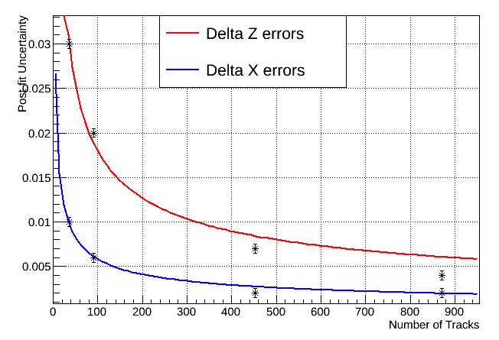
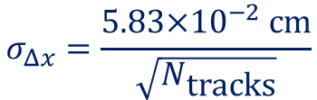
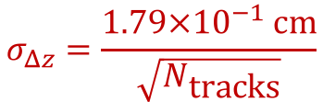
Vertical Gap Measurement Precision: 35-ton experience
From Mike Wallbank's work on
35-ton measurements.
Some gaps had more crossing
tracks than others and are thus
better measured.
Assumes: 𝛥x and 𝛥z are
constant along the length of the gap
Stat errors of order 10-50 microns
cm
Error bars
on these points
are arbitrary
$$σ_{Δz}=\frac{1.79×{10}^{−1} \text{cm}}{\sqrt{N_{\text{tracks}}}}$$
$$σ_{Δx}=\frac{5.83×{10}^{−2} cm}{\sqrt{N_{\text{tracks}}}}$$

Slide 34
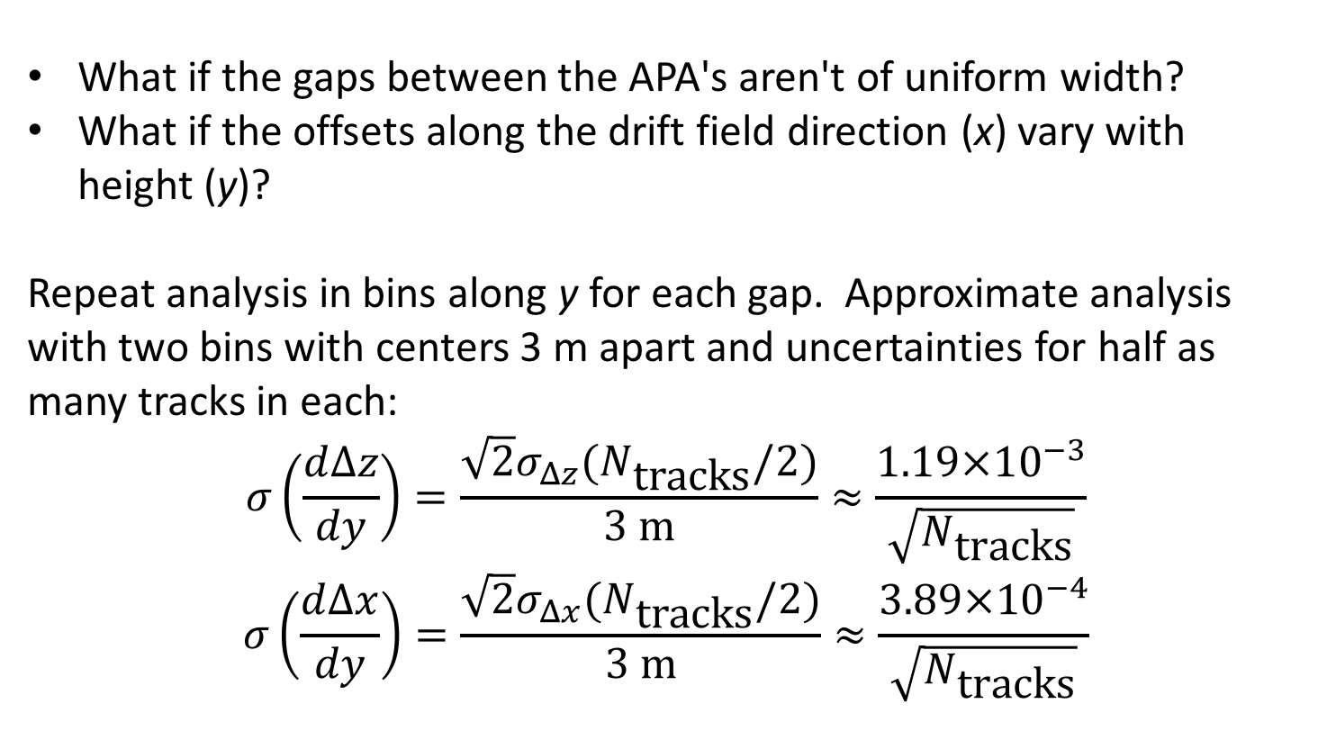
Measuring Angles
What if the gaps between the APA's aren't of uniform width?
What if the offsets along the drift field direction (x) vary with height (y)?
Repeat analysis in bins along y for each gap. Approximate analysis with two bins with centers 3 m apart and uncertainties for half as many tracks in each:
$$σ\left(\frac{d∆z}{dy}\right)=\frac{\sqrt{2}σ_{Δz}(N_{\text{tracks}}/2)}{3 \text{m}}≈\frac{1.19×{10}^{−3}}{\sqrt{N_{\text{tracks}}}}$$
$$σ\left(\frac{d∆x}{dy}\right)=\frac{\sqrt{2}σ_{Δx}(N_{\text{tracks}}/2)}{3 \text{m}}≈\frac{3.89×{10}^{−4}}{\sqrt{N_{\text{tracks}}}}$$

Slide 35
Examples of "Weak" Directions (ATLAS alignment)
From Moles-Valls'
thesis.

Slide 36
Difficult Distortions to Constrain
Bent APA's: Will a "flat" APA stay flat when cold?
Bending of APA's:
More difficult with cosmics than steps at the gaps
Does not violate alignment pin constraints (others do, but manufacturing
imperfections can result in systematic offsets)
Multiple scattering means that single tracks cannot be relied on to extract
bending information. A large ensemble of them might be able to tease
something out. But more z coverage per track helps.
Cosmic rays are good at measuring local relative changes in positions (local in X, Z)
and not good at absolute positioning
What is the magnitude of this that would escape our notice?

Slide 38
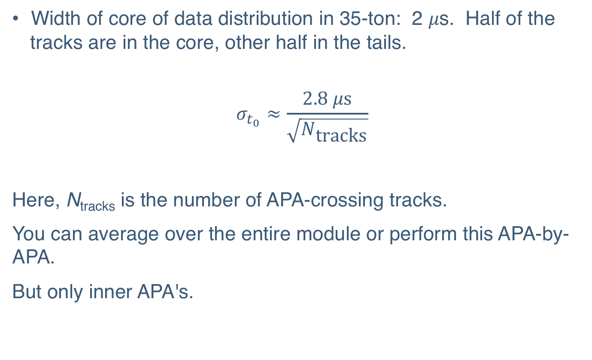
Estimate of Uncertainty on t₀
Width of core of data distribution in 35-ton: 2 𝜇s. Half of the tracks are in the core, other half in the tails.
$$σ_{t_{0}}≈\frac{2.8 μ\text{s}}{\sqrt{N_{\text{tracks}}}}$$
Here, N_{tracks} is the number of APA-crossing tracks.
You can average over the entire module or perform this APA-by-APA.
But only inner APA's.

Slide 39
Outer APA's Contribution (ProtoDUNE-SP) and FD
With a mesh, you get a couple of hits on the far side
We will see only these on the outer APA's
These hits will be gone

Slide 40
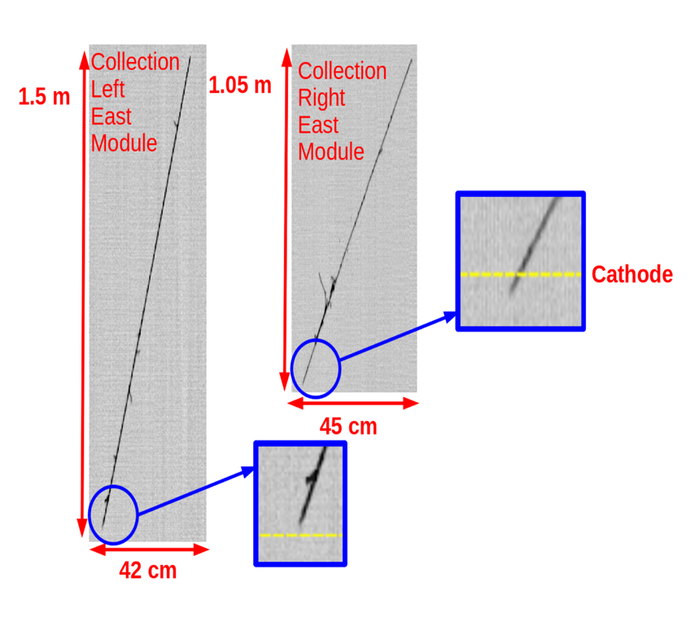
Measurement of cathode distortions in ICARUS
  Cathode non-planarity can also be measured from data: cosmic μs crossing the cathode plane
  Measurement can be performed during run but takes a long time underground (results shown here refer to ~6 months)
  This measurement refers to a full and cold TPC
  The apparent drift coordinate of the point where the muon crosses the cathode plane in both TPC is considered
  The difference Δt_{d}=t_{dR}-t_{dL} is approximately proportional to the cathode distortion Δy in that point:
Filippo Varanini
Jan 2017 DUNE
Collab meeting
t_{dR}
t_{dL}
t_{dR} ,t_{dL}
Yellow line marks nominal cathode
position(Δy=0)
Δy ≈ 1/3 v_{d}Δt_{d}
σ_{Δy} ~ 2mm

Slide 41
Once you know how far the cathode is from the anode, you get:
J.Raaf, J. Asaadi, LArIAT

Slide 42
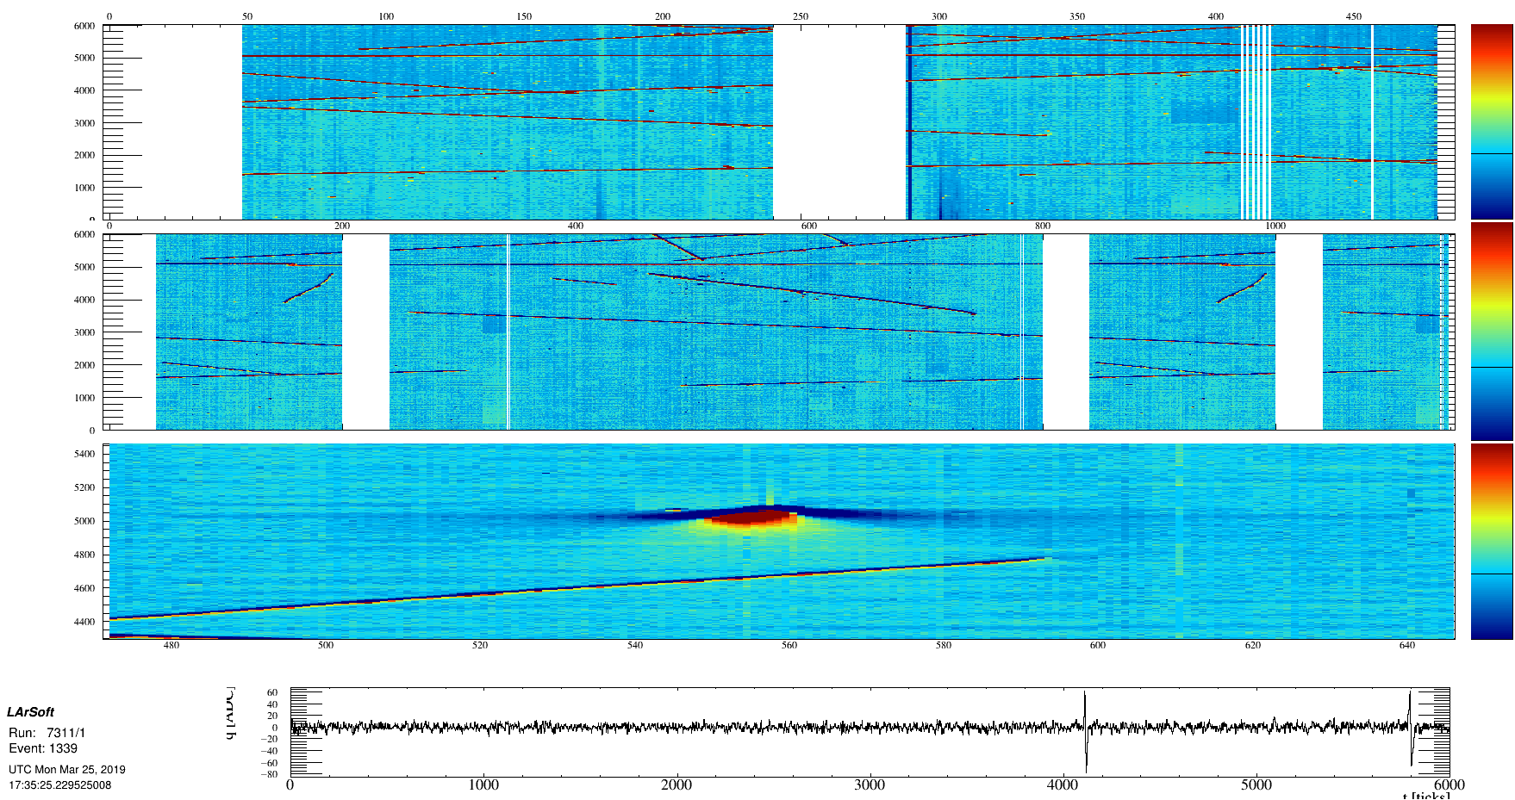
A Track in ProtoDUNE-SP that runs along U Wires
Unipolar induced charge over a span of hundreds of wires.
Can be used to calibrate 2D field response.

Slide 43
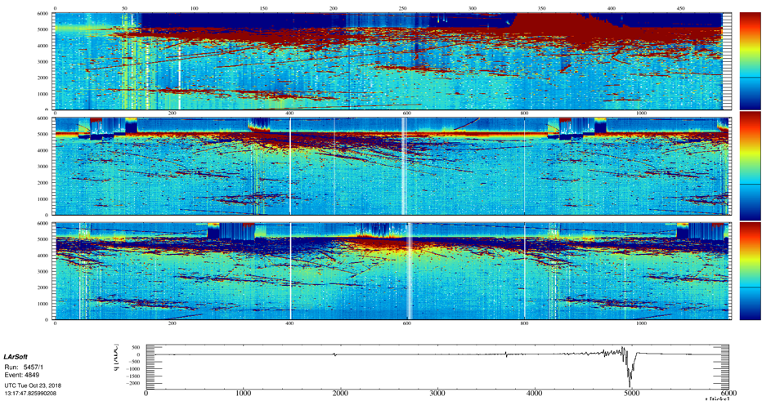
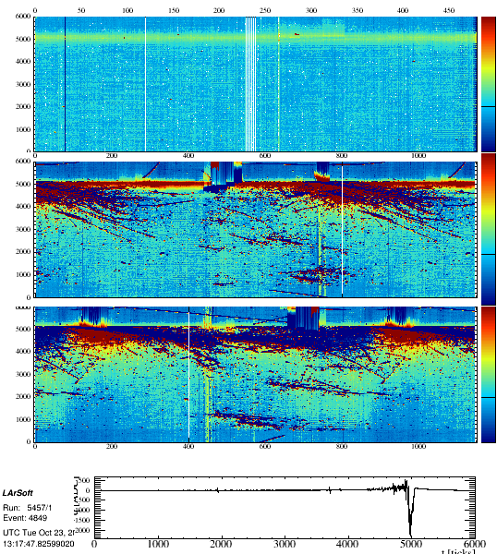
We can learn from big showers
Front-end saturation, induction on back-side collection-plane wires due to wrapping
of induction-plane wires, FEMB-localized effects.

Slide 44
Space Charge
Space charge from cosmogenic sources not expected to be
significant in FD-SP
Space-charge effects in ProtoDUNE-SP and ProtoDUNE-DP are large – proportional to the cosmic-ray rate and the cube of the drift time
More than 20 cm of lateral distortion in hits in ProtoDUNE-SP
Beam-induced space charge not yet estimated.
Calibration of space charge in ProtoDUNEs needed to be able to extrapolate measurements to the FD (e-field distortions affect recombination for example, and thus the EM energy scale). Mike Mooney and Hannah Rogers have done a great job calibrating this with cosmics.
Broken Field Cage resistor has an effect on the field that can be
measured in a similar way to space charge

Slide 45
More Speculative: EM Showers
K. Ingles: 10 TeV horizontal muon simulated in the FD

Slide 46
EM Showers
Cosmic rays will be the most abundant source of EM showers in the DUNE FD – mostly bremsstrahlung
Some 𝜋⁰'s: 1300/module/year
Spectrum of EM energy loss is model dependent.
  energy spectrum of cosmic rays entering detector not perfectly known
  interactions of high-energy muons with argon atoms
Michels from stopping muons (11000 stopping muons per module per year) can help constrain EM energy reco
Delta rays

Slide 47
ICARUS 𝜋⁰ Invariant Mass Reco
ICARUS Collab.
arXiv:0812:2373
212 Candidate
Events, Pavia
Surface Run

Slide 48
Extras

Slide 49
Muon Momentum from Multiple Scattering
Recent examples:
  ICARUS: https://arxiv.org/abs/1612.07715 (JINST 12 (2017) no.04, P04010)
  MicroBooNE: https://arxiv.org/abs/1703.06187 (JINST 12 (2017) no.10, P10010)
A DUNE FD module is 12 meters top to bottom, taller than MicroBooNE is long. 2.5 GeV muon or less will stop in DUNE.
Selected
beam neutrino-
induced muon
candidate tracks

Slide 50
Recombination vs Angle
Same analysis as the MIP scale analysis, except binned in
the angle with respect to the electric field.
Cosmic rays are depleted at horizontal angles
Even rock muons from the beam are depleted at angles that point along the electric field.
Energy spectrum of cosmic rays will depend on angle though!
Need stopping muons if you want precise, absolute scale.
Michels provide electron information, but are tricky – a fraction the energy is scattered about in little deposits not connected to the track. Should be do-able.

Slide 51
dE/dx Calibration with MIPs
MicroBooNE has an analysis of the uniformity of detector response using tracks
Need t₀-tagged tracks
  shouldn't be a problem in the FD. Tricky in ProtoDUNE-SP; even harder in ProtoDUNE-DP
Absolute precision
calibration of MIP
scale complicated by the
energy dependence and
need to model the energy
spectrum.
Better measurement from
stopping muons
30/day/10 kt (Sowjanya)
Michels -> stopping electron dE/dx
K. Ingles

Slide 52
Example: Radial Expansion is a Weak Direction
Tracks from the center of
the detector don't constrain
the radial size of
the detector.
Expand the detector, and all
the hits still fit!
Moles-Valls

Slide 53
Extra Constraint from Cosmics
These tracks are no longer
straight when you expand
the detector.
Moles-Valls

Slide 54
An Elaborate Example: CMS muon tracker
http://arxiv.org/abs/0911.4022
Essentially a sum of track-fit chisquareds as a function of alignment parameters
(offsets and angles). Add to that survey constraints which keep the fit from
wandering off in "loose" directions.
The total chisquared is quadratic in its parameters and minimizing it is a matrix inversion.
Another method in the paper uses non-Gaussian constraints and runs MINUIT.
Some hints at selecting well-formed track segments may be clues of things we have to
do too.
This example has only two displacements and two angles per rigid detector piece due to
the strip geometry. We'll probably do ours in 3D.

Slide 55
Local vs. Global Alignment
We measure gap offsets in x and z easily.
But muons only sample a small amount of x and z at a time – mostly travel in the y direction.
How to tell these kinds of distortions apart with cosmics? Cosmic rays sample local patches of (x,z)
and are best at seeing step discontinuities
x
z
APA's viewed from top – distortions exaggerated
A

Slide 56
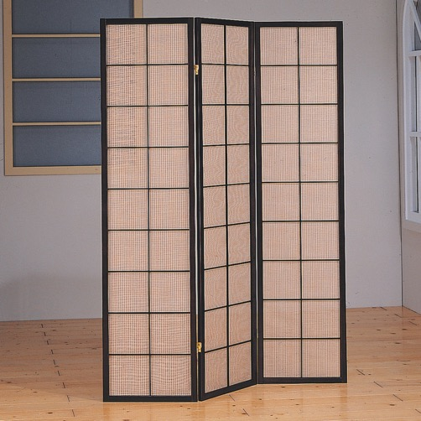
APA Alignment Pin and Slot
x
Hopefully constrain this sort
of distortion
z
  From the ProtoDUNE-SP TDR
Provides a One-Dimensional Position Constraint (X but not Y or Z, unless they are locking).
Provides a One-Dimensional Angular constraint if the slot is tight (roll in the above picture)
A series of pins provides an additional angular constraint (pitch)
On the figure above, roll and pitch are constrained but not yaw.
Manufacturing tolerances: With the pins engaged, wires can still be offset in ways
we can measure.
35-ton Prototype was assembled without Alignment pins and slots

Slide 57
Hits on the Outer Side
Electric field drifts electrons away from the APA, towards the cryostat wall
Hits made inside the wire planes will still be there, but they will have different pulse shapes (asymmetric induction-plane signals)
Samples of these hits can be selected for study

Slide 58
Wire Support Combs
Support combs placed so that the maximum unsupported run is 1.6 m.
ProtoDUNE-SP
TDR
Ed. comment: Thermal expansion of comb vs. APA frame could cause deviations larger than
150 microns

Slide 59
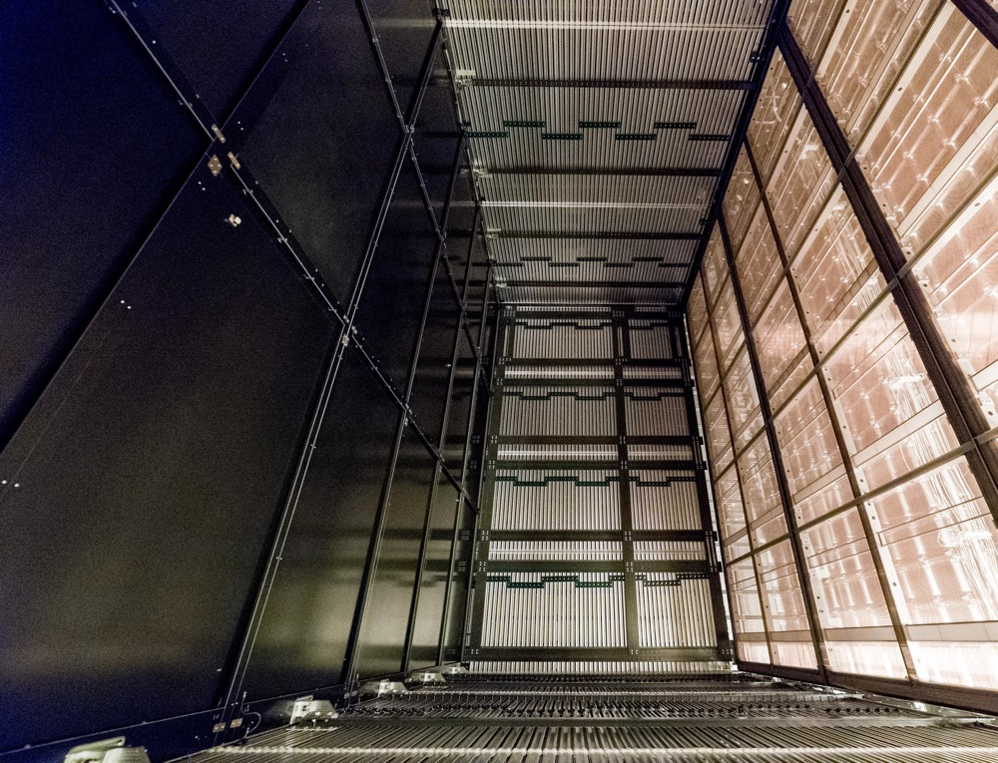
Field Cage Beams and Wire Support Combs
From Kevin
Wood's
Collab
Meeting
Talk
Sep 2018

