Slide 1
Quench Antenna Status and Plan in AUP MQXFAP 1b Magnet
H. Song, Sonny, J. Muratore, P. Joshi
For AUP quench antenna coordination efforts
6/10/2019

Slide 2
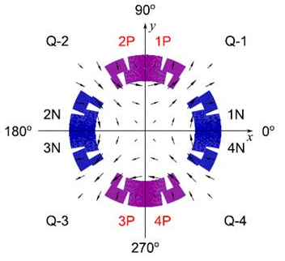
Quench Antenna Orientation - 1
Orientation check
  Antenna coils are facing magnet midplanes (not magnet coil centers!) @ Maxim
  there was slight misorientation when magnet/quench antenna center vertically realigned by 100 mm in quench 23, but has been corrected in quench 24.
    Coil in 1b magnet is ~200 mm shorter than AP2

Slide 3
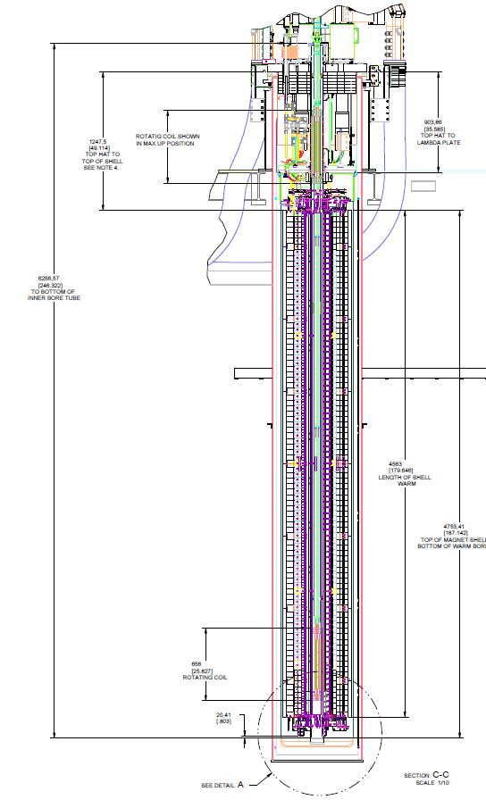
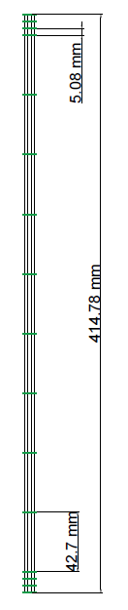
Quench
Antenna
Elements
Location
-2
Top of Warm Bore Tube
1b Magnet center elevated/realigned by 100 mm in quench #23, because 1b coil is 200 mm shorter than AP2 coil.
903.86
[35.585]
Top hat to Lambda plate
Rotating coil in MAX UP Post
Top of Magnet Shell
6256.57 mm
[246.322 in]
4563 mm
[179.646 in]
8 Elements in middle
4753.61 mm
[187.142 in]
Inside of bottom of warm bore tube below end of magnet support rods = 20.4 mm
656
25.827
Rotating coil
Bottom of Magnet Shell
Bottom of Warm Bore Tube

Slide 4
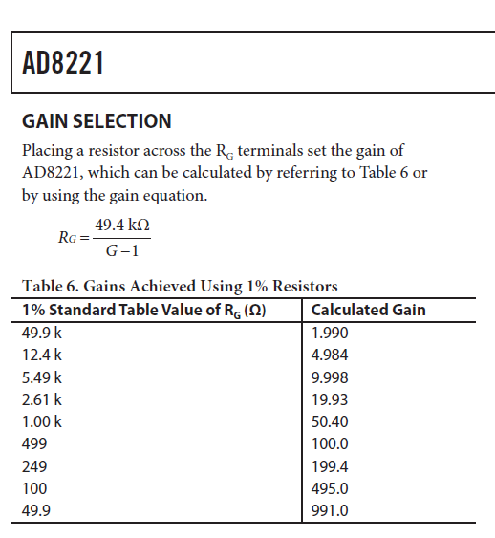
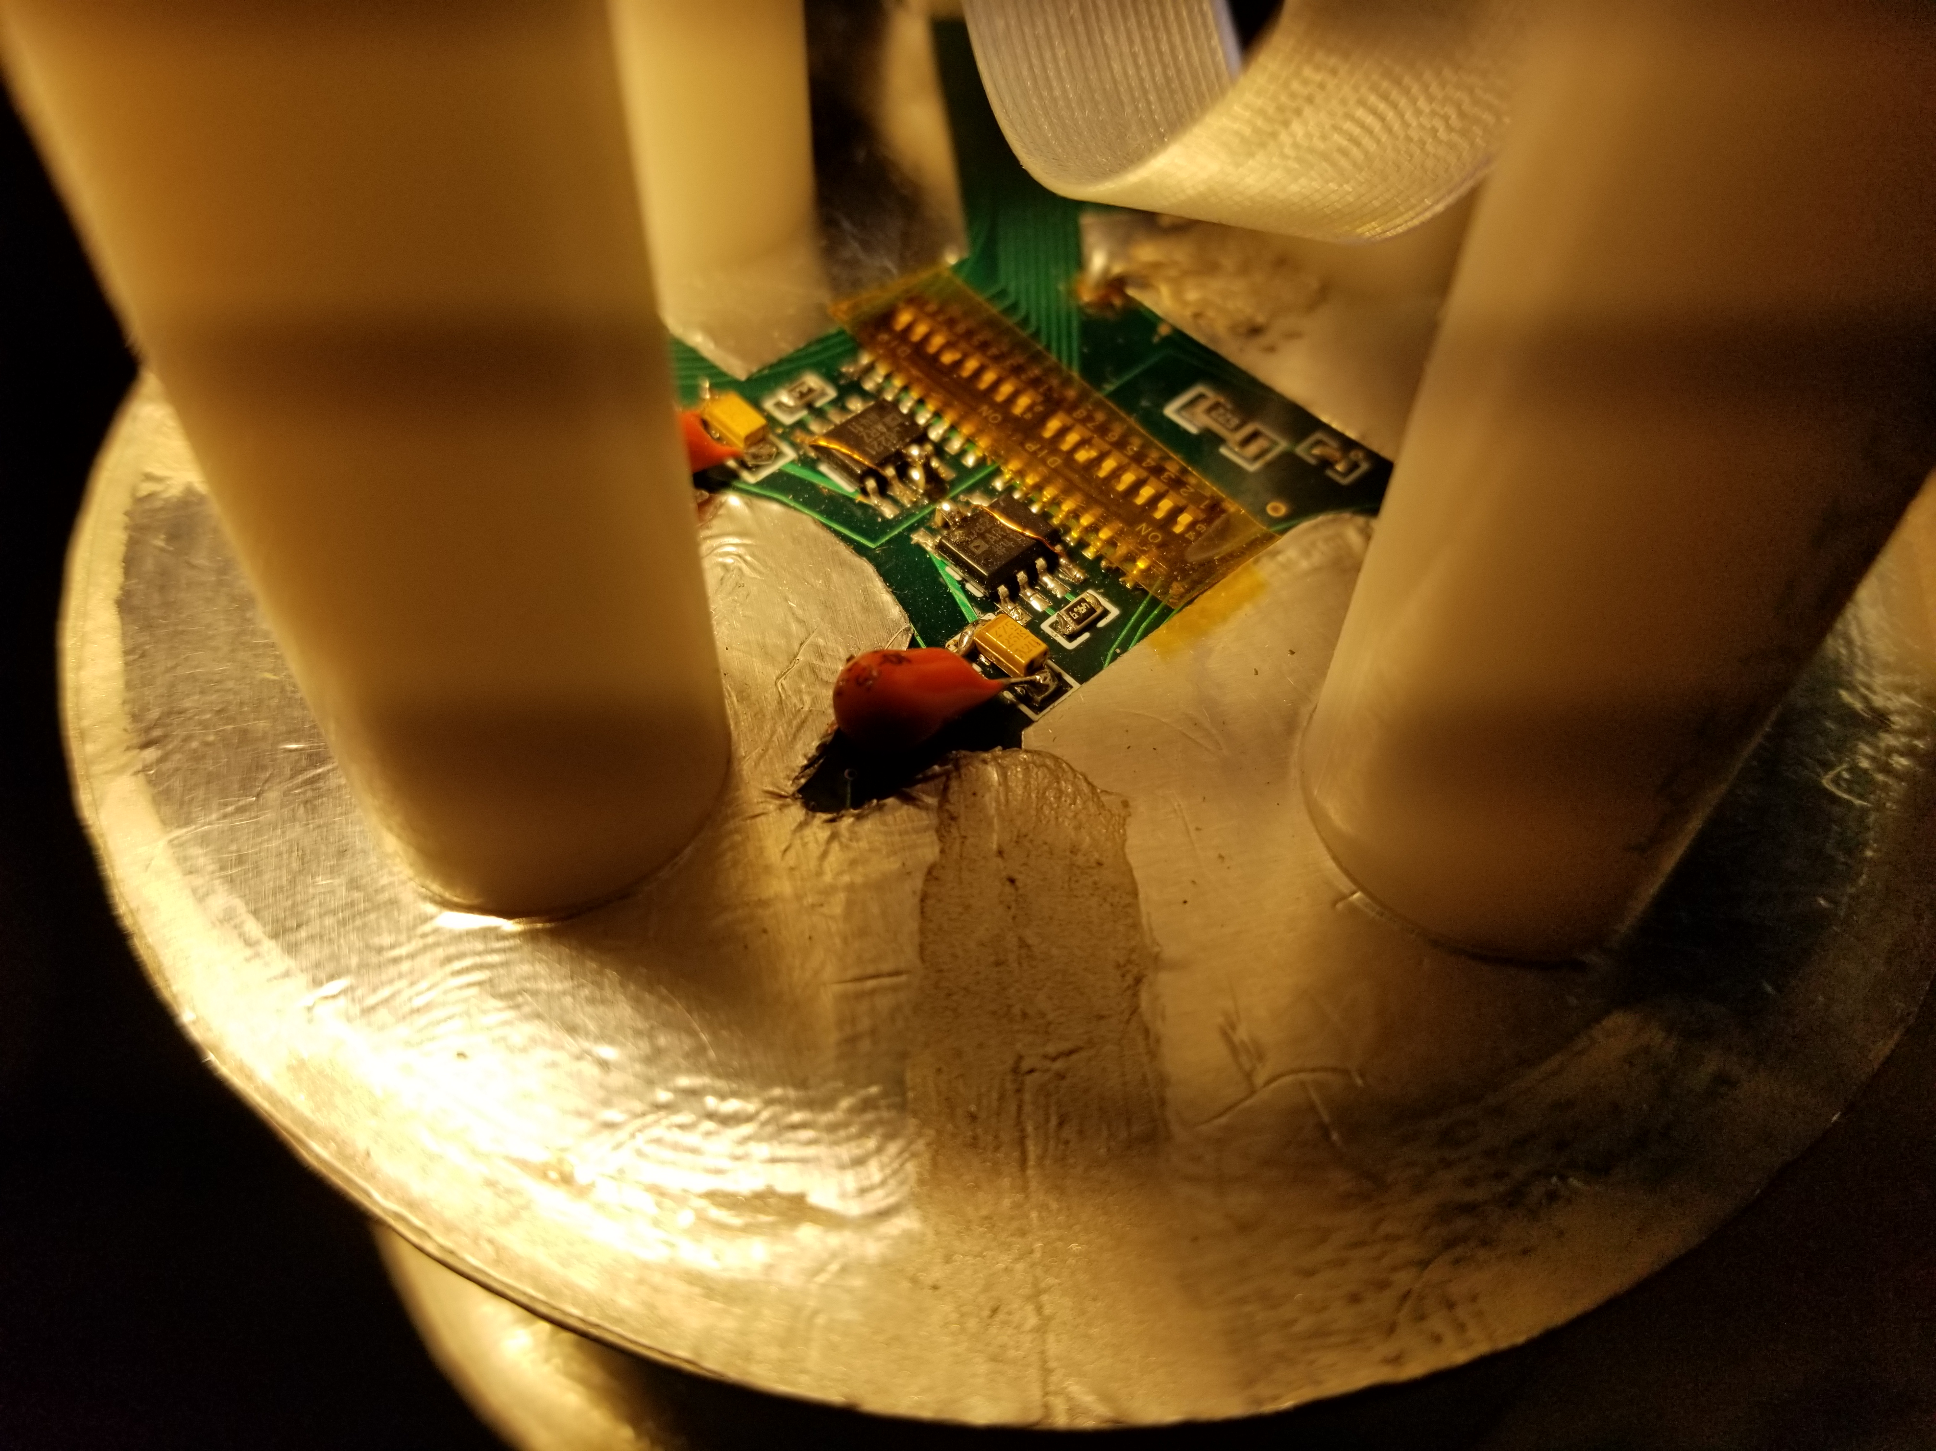
Quench Antenna Gain - 3
Quench antenna gain check
R = 49.9 ohm
Actual Gain = ~991.
Is this correct? As designed? @Maxim
There were paper document which indicate Gain of 50 or 650, not 991. not consistent.
How to check the interface box – to ensure it works functionally? @Maxim
And the power supply? @Maxim

Slide 5
DAQ cards PXIe 4300
Confirm the channel numbering in DAQ and Antenna (BNL)
  Existing 4 slots of cards, 32 channels for 16 elements in the chassis (Quench Antenna)
  The acquisition voltage range was (+/- 10 V), changed to +/1 V - today as of 6/11/2019.
    Available range, +/- 10 V, 5 V, 2 V, 1 V, (no +/- 0.1 V)
  4 more slots of cards can be added
    Need formal approval? Just go ahead order? At $9036
    @AUP Team
(lead time 5-10 days)
http://www.ni.com/pdf/manuals/375476c.pdf
http://www.ni.com/en-us/support/model.pxie-4300.html

Slide 6
Plan to add 9 more elements to the existing quench antenna
4 more PXIe 4300 cards will be ordered – Go ahead submit the order? 5 -10 days @AUP Team
When the 9 more elements will be delivered to BNL? (from LBNL?) @Maxim and Thomas
  Will the interface box included? @Maxim and Thomas
Additional labor/time
  More cabling (underground) and wiring to accommodate the 9 more elements – 10-15 days labor based Sonny’s feedback
Turn-around time for 2nd thermal cycle – 8-9 days – based on B. McKeon
  Shall we wait for the quench antenna modification to be completed? @AUP Team

Slide 7
Conclusions
Orientation checked and corrected
Drawing and quench antenna elements –compared.
Gain checked = 991
PXIe 4300 voltage range changed to +/- 1 V - today
Plan to add 9 more elements to the existing quench antenna
  A few decisions and/or approvals are needed.

Slide 8
Backup slides

Slide 9
Meeting summary – quench antenna discussions meeting (6/7/2019) – T. Strauss
Top priority:
  Overlay drawing of the QA with mechanical structure is top priority to identify quench location on structure.
To Do
  Confirm the channel numbering in DAQ and Antenna (BNL)
  QA disk distance measurement with tape measure (BNL)
  Generate an assembly drawing (BNL)
  Check the gain settings (BNL)
  Determine the mechanical center of the magnet w.r.t. QA location
  Check interface box has capacitors or not, have them identical.
  Check orientation, idea is the coil looks at the inner layer
  Quench propagation in low field region estimate (Giorgio) Inner layer: 8mm/ms - done
  This will determine the QA distance needed

Slide 10
Short term plan,
  Next test in next Thermal cycle with better coverage of QA. 8mm/ms with ~10ms: 16cm spacing or 25 elements needed, e.g. 50 channels.
Maxim
  Send existing PCB boards and parts to BNL, and schematics for assembly.
  Send interface board drawing to BNL
BNL
  Assemble PCB boards
  Assemble interface box
  Assemble a cable for 8 channels
  32 more channels available, cards would need to be bought, 4 more cards ($2.2k/card).
  Measure the extra resistors on the boards to ensure is everything is the same
  Change DAQ range from 1V to 100mV
Plastic spacer manufacturing and procurement - get the right length (maybe Maxim has spares).
Before next test
  Confirm QA gain settings, and test of full assembly with long cables before insertion.
  Fermi
  Investigate how more elements can be added. Check if alternative to PCB antenna exists, can be made or re-used (suggestion Stoyan/Joe DiMarco design).

Slide 11
Medium Term goal
  Update the schematic drawings (Maxim)
  Goal a 64 channel QA - 32 elements
  64 channel interface box
Long term plans
  Plan for Test Stand 4 QA
  QA on trace on the coil, possibilities at BNL and FNAL

Slide 12
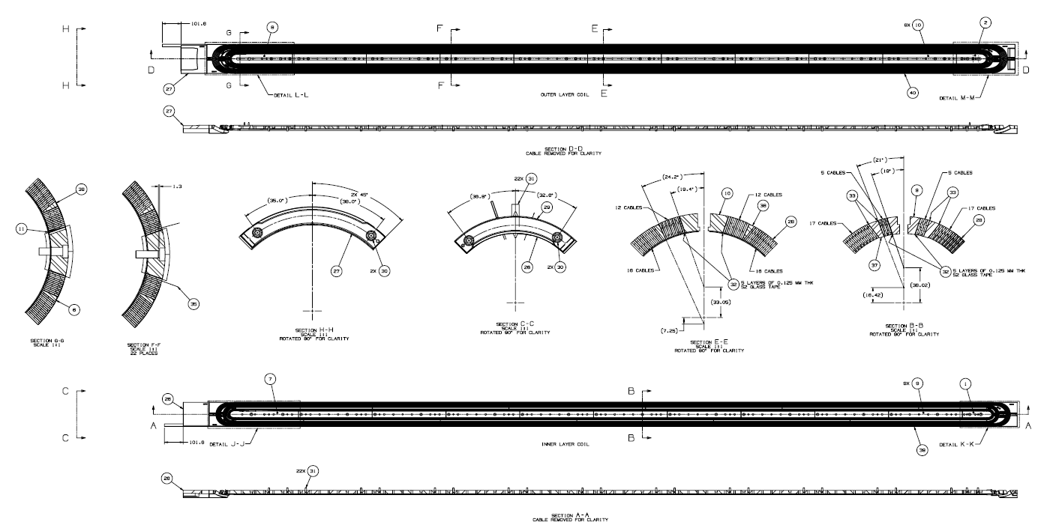
Coil drawing
Jesse Schmalzle, Michael Anerella,

Slide 13
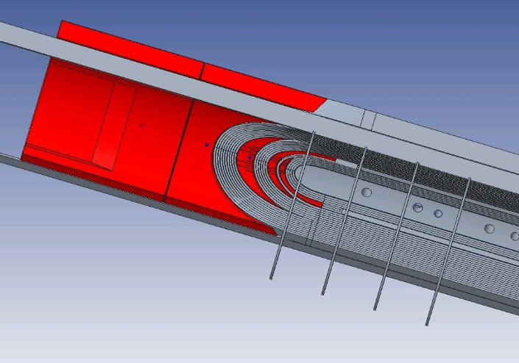
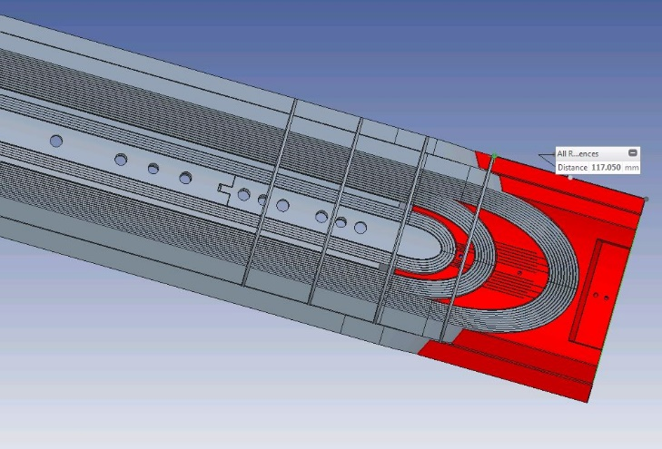
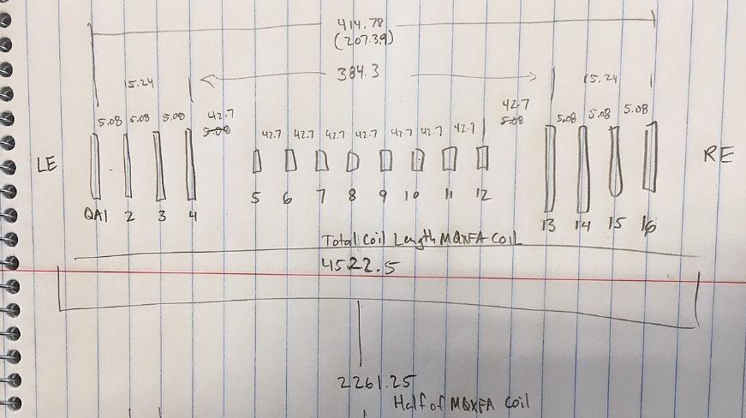
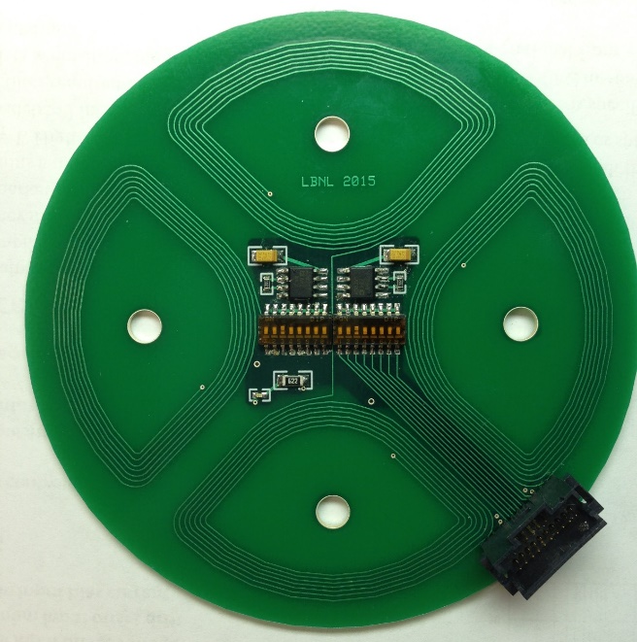
Antenna configuration and positioning
By Maxim, Joe, Sonny,
QA1
QA2

Slide 15
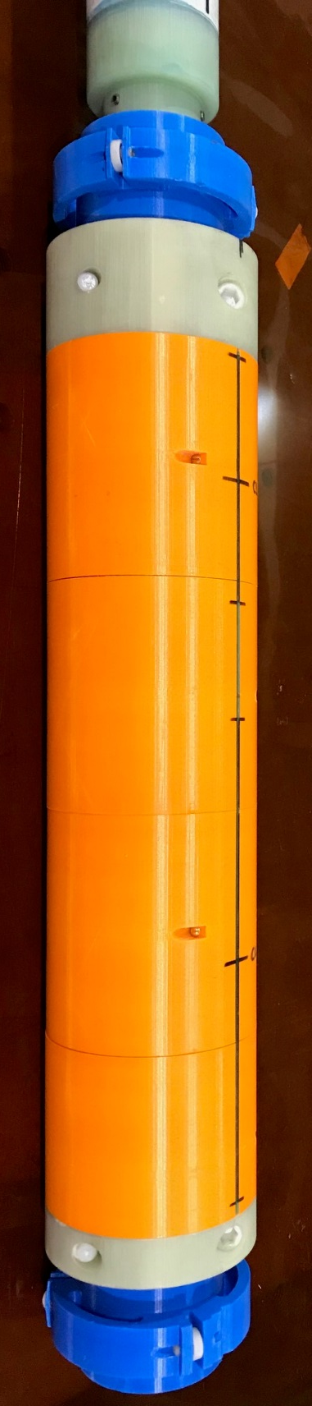
Top of Warm Bore Tube
Warm Length
903.86
[35.585]
Top hat to Lambda plate
Rotating coil in MAX UP Post
Switch_UL
4730mm
331.99mm
Top of Magnet Shell
6256.57 mm
[246.322 in]
MagCent → Coil220_Cent
2281.5 – 200.8 – 164.99
=1915.71 (mm) →Half_L
→Half_U = 2814.29 mm
4563 mm
[179.646 in]
4753.61 mm
[187.142 in]
~220 mm
200.8 mm
Inside of bottom of warm bore tube below end of magnet support rods = 20.4 mm
656
25.827
Rotating coil
Home
Bottom of Magnet Shell
164.99mm
355.6 mm
[14’’]
Bottom of Warm Bore Tube
190.61mm

