Slide 1
MQXFAP1b Quench Antenna and Coil Images
Dan Cheng, et al.
6/14/2019
LBNL

Slide 2
Outline
Possible Quench Antenna locations and wedge gaps
Pre-MQXFAP1b assembly Coil Images
Virgin Coil Images of Coil P03

Slide 3
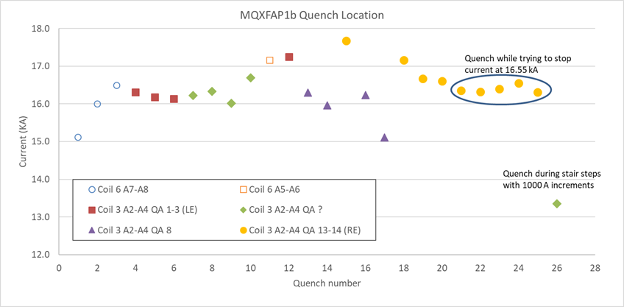
P03 Wedge Gaps and Possible QA Location based on MQXFAP2 placement
Non Transition Side
Wedge Gap
NTS Wedge Gap
NTS Wedge Gap
Wedge-Spacer Gap
Wedge-Spacer Gap
Transition Side
Wedge Gap
TS Wedge Gap
TS Wedge Gap
QXFP Coil Length
QXFA Coil Length (ref)
QA 1-4
QA 5
QA 6
QA 7
QA 8
QA 9
QA 10
QA 11
QA 12
QA 13-16
Quench Antenna positions based on presumed location from MQXFAP2 test campaign

Slide 4
P03 Wedge Gaps and Possible QA Location based on MQXFAP1 placement
NTS Wedge Gap
NTS Wedge Gap
NTS Wedge Gap
Wedge-Spacer Gap
Wedge-Spacer Gap
TS Wedge Gap
TS Wedge Gap
TS Wedge Gap
QXFP Coil Length
QXFA Coil Length (ref)
QA 1-4
QA 5
QA 6
QA 7
QA 8
QA 9
QA 10
QA 11
QA 12
QA 13-16
Quench Antenna positions based on presumed location 100 mm from MQXFAP2 test campaign

Slide 5
Pre-MQXFAP1b Coil Images

Slide 6
Pre-MQXFAP1b Coil Images (P03 LE)
Significant cracks/delamination
visible
Visible “Interface” crack
VTA02
VTA05
VTA03 (was lost during MQXFAP1 testing)
VTA04

Slide 7
Pre-MQXFAP1b Coil Images (P03 ~2150 mm)
NTS Wedge Gap
~2143 mm from coil end
TS Wedge Gap
~2290 mm from coil end

Slide 8
Pre-MQXFAP1b Coil Images (P03 RE)
Significant delamination
visible
Significant “Interface” cracking evident
VTA06
VTA07

Slide 9
Pre-MQXFAP1b Coil Images (P02 LE)
Some cracks/delamination
visible

Slide 10
Pre-MQXFAP1b Coil Images (P02 RE)
Some cracks/delamination
visible

Slide 11
Pre-MQXFAP1b Coil Images (P04 LE)
Some cracks/delamination
visible

Slide 12
Pre-MQXFAP1b Coil Images (P04 RE)

Slide 13
Pre-MQXFAP1b Coil Images (P06 LE)

Slide 14
Pre-MQXFAP1b Coil Images (P06 RE)

Slide 15
Virgin Coil P03 Images

Slide 16
Virgin Coil Images of Coil P03
Non-Transition Side (NTS) Wedge Gap
~285 mm from coil end
VTA02
VTA05
VTA03
VTA04
VTA08
Transition Side (TS) Wedge Gap
~285 mm from coil end

Slide 17
Virgin Coil Images of Coil P03
NTS Wedge Gap
~1138 mm from coil end
TS Wedge Gap
~1295 mm from coil end

Slide 18
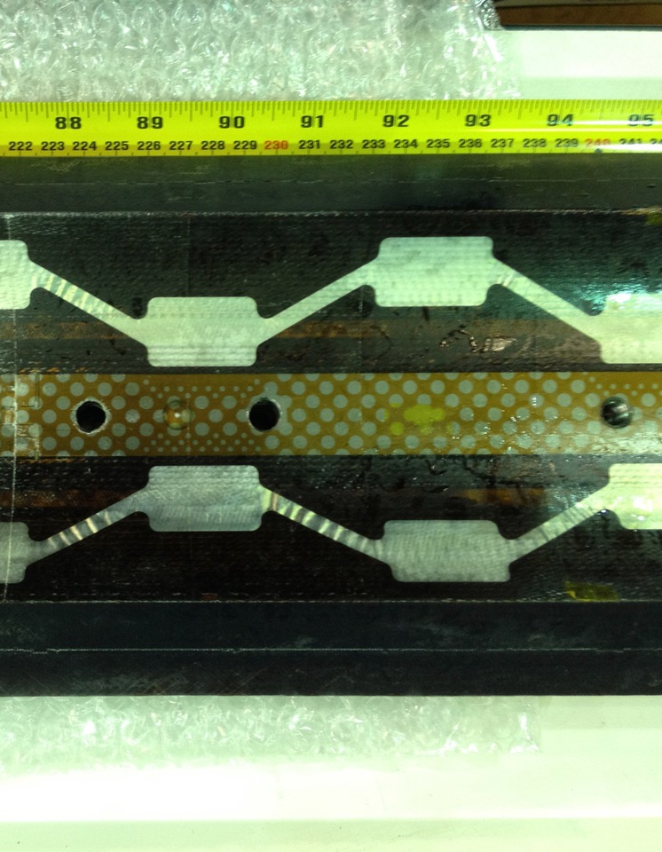
Virgin Coil Images of Coil P03
NTS Wedge Gap
~2143 mm from coil end
TS Wedge Gap
~2290 mm from coil end

Slide 19
Virgin Coil Images of Coil P03
NTS Wedge Gap
~3140 mm from coil end
TS Wedge Gap
~ 3290 mm from coil end

Slide 20
Virgin Coil Images of Coil P03
NTS Wedge Gap
~4148 mm from coil end
VTA06
VTA07
TS Wedge Gap
~4148mm from coil end

Slide 21
Summary
Quench Antenna array shown based on preliminary understanding of its location during both MQXFAP2 and MQXFAP1 tests
These were combined with wedge and spacer gap locations in Coil P03
Significant cracking and delamination of epoxy was observed in Coil P03 after the MQXFAP1 test
RE region had evidence of more “interface” cracking than seen in the LE
Virgin P03 appears to have significant bubbles in the RE region
Coils P02 and P04 showed minimal epoxy cracking and/or delamination of traces after MQXFAP1 test

Slide 22
Additional Info

Slide 23
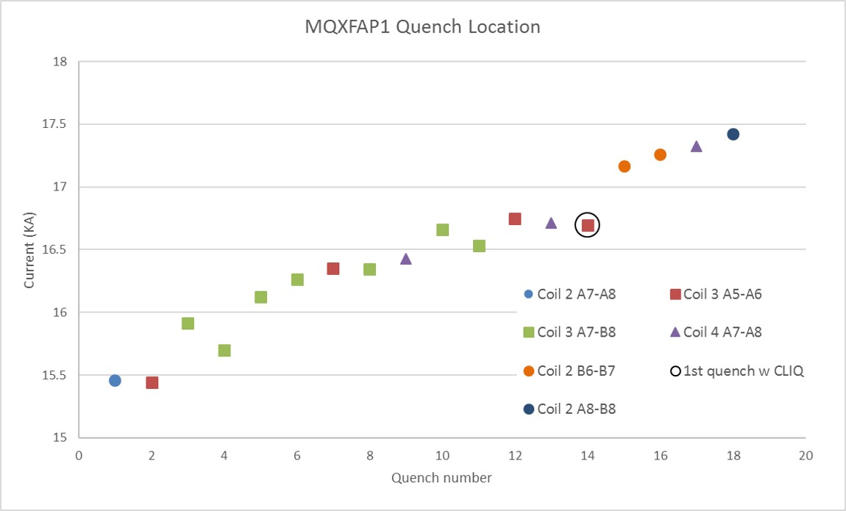
MQXFAP1 Training
Notes:
P03 quenches appeared in pole turns and/or transition (VTA08 was lost)

Slide 24
Coil P03 VTA08 Virgin

Slide 25
Coil P03 VTA08, Pre-MQXFAP1b
Notes:
P03 quenches appeared in pole turns and/or transition (VTA08 was lost)

