Slide 1
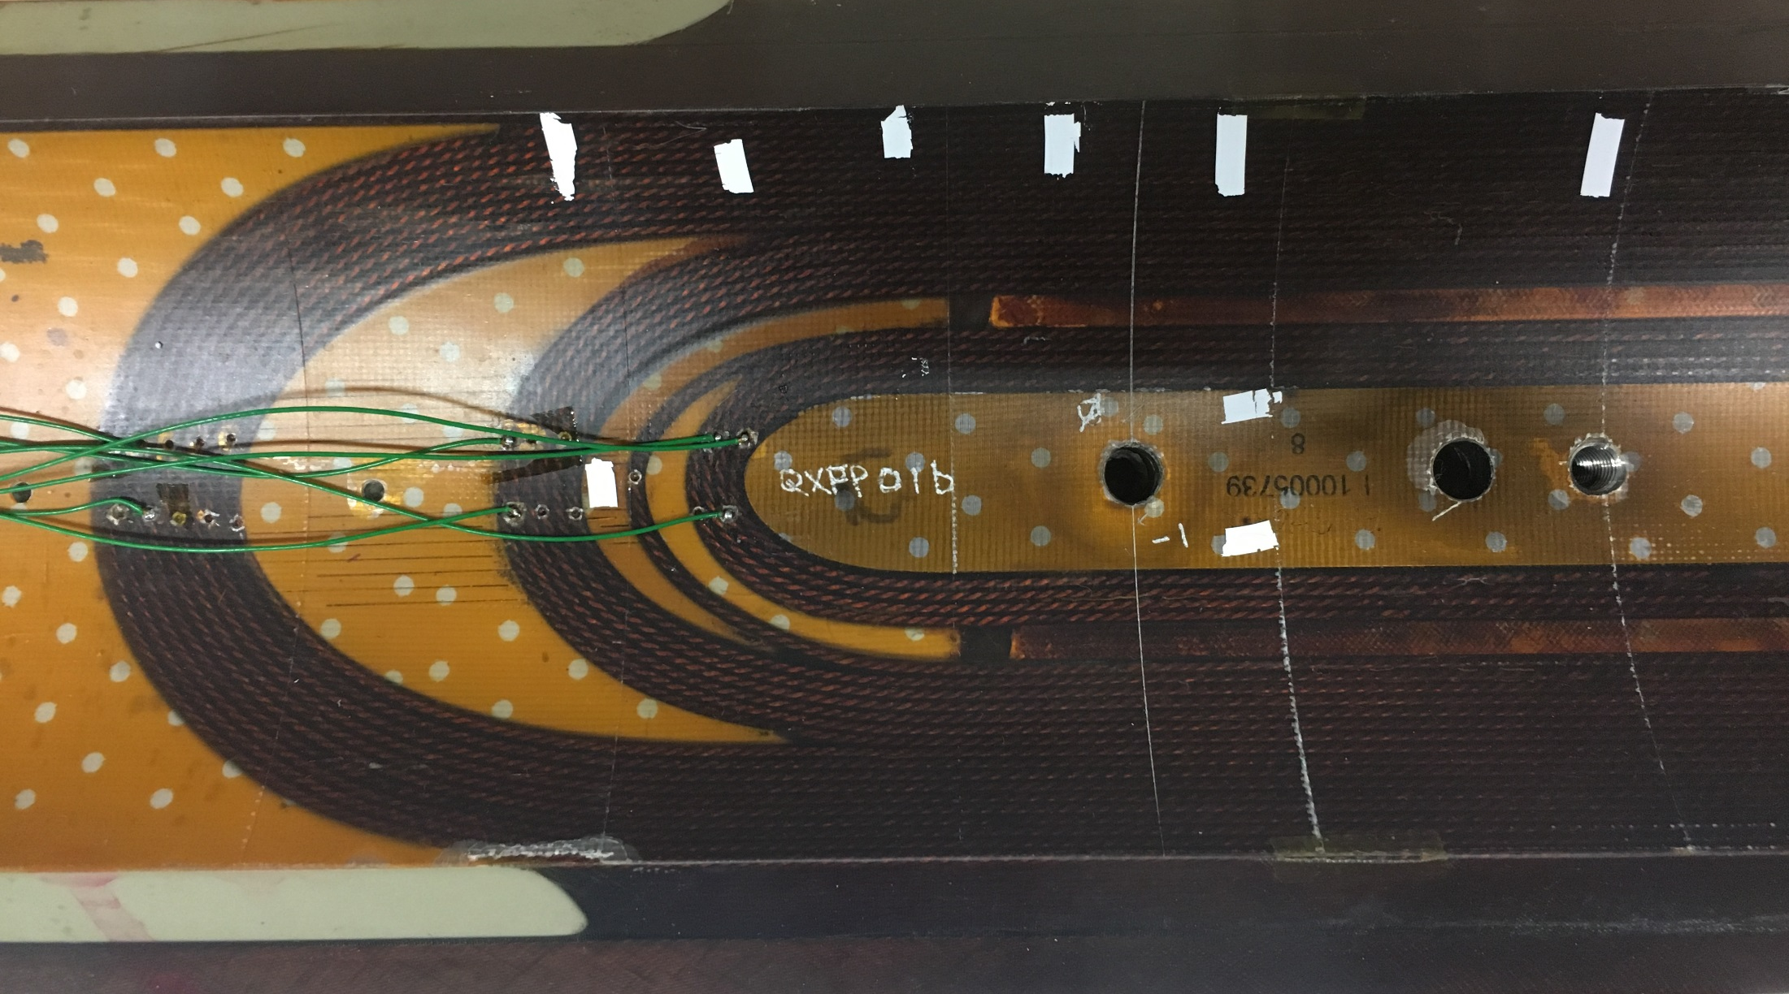
From voltage tap signal we see no propagation from a4_a3 into any other segments.
With 20ms delay between quench and dump at 2cm/ms – we are about 15” away from VT04,03
Additionally we see a multi-turn quench, making the origin unlikely outside the wedge
Thus we only look at 4 layers next to the wedge on either transition or non-transition side for most quenches
1
2
3
4
5
6
7
11/11 19:23
QA 4-5, 104
11/22 11:02
QA 4-5, 03
11/23 19:25
QA 3-4, 03
11/30 11:53
QA 3-4, 03
11/30 15:18
QA 3-4, 03
11/30 19:23
QA 4-5, 03
12/01 11:34
QA 4-5, 03
11/22 14:51
QA 5-6 – 6, 03
11/23 14:48
QA 5, 03

