Slide 1
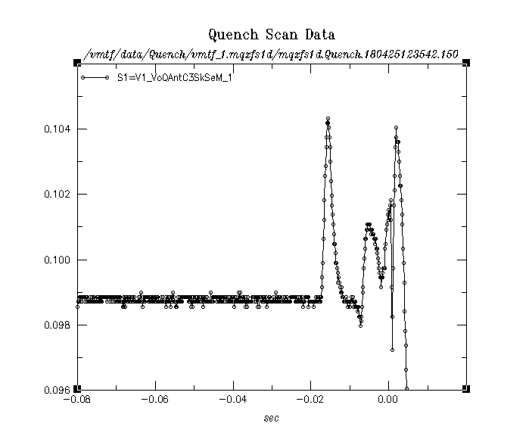
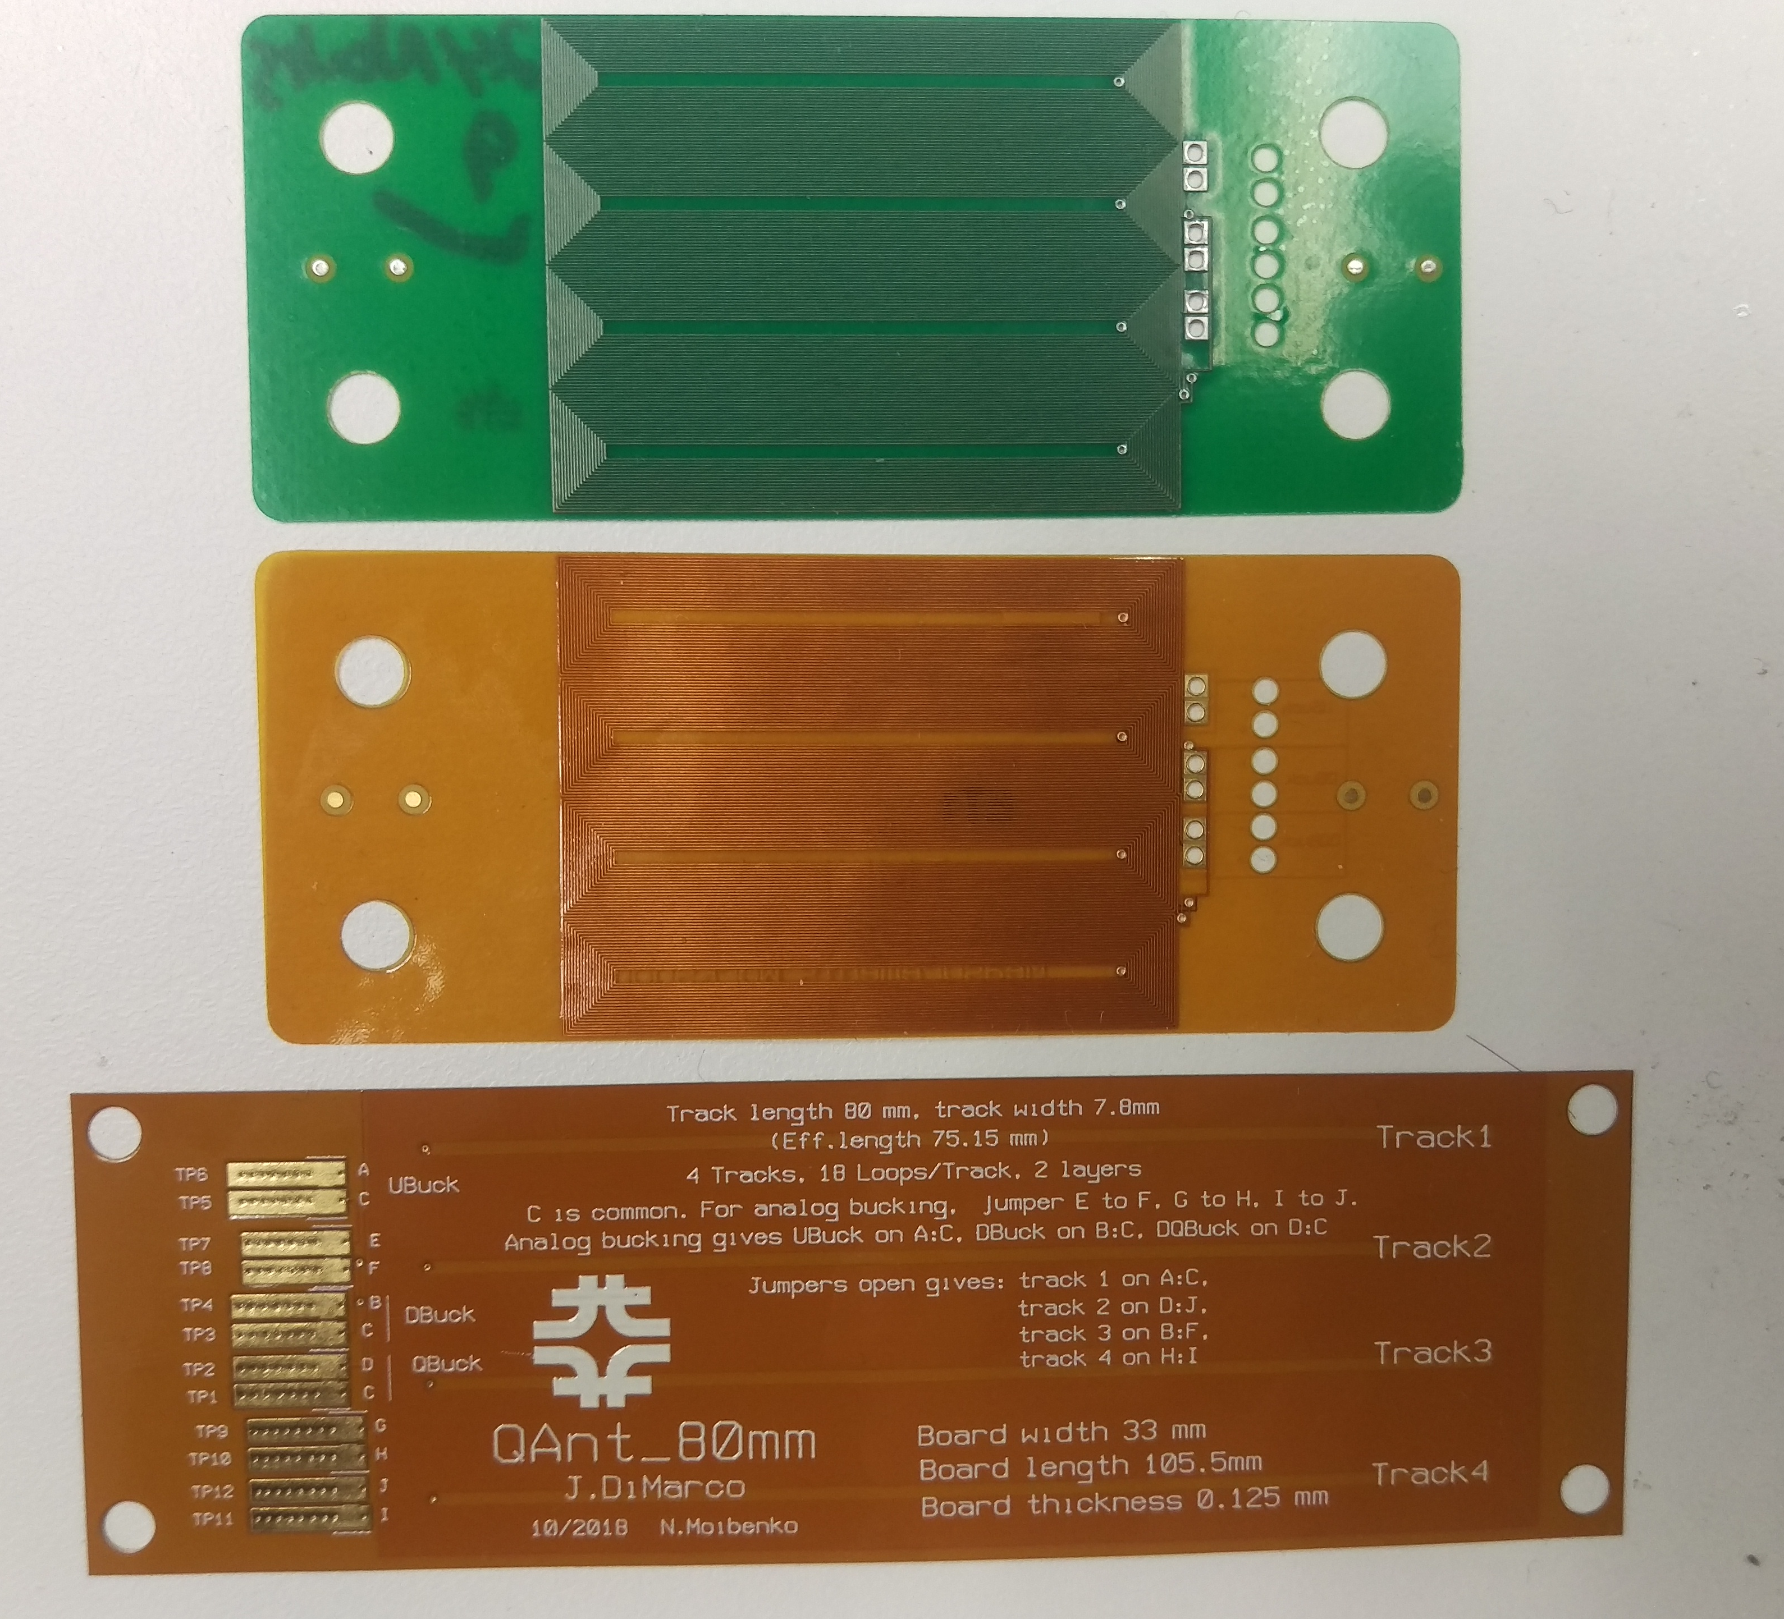
Quench Antennas (QA)
Inductive stationary pickup loops to detect magnetic transients
Diagnostic for determining quench start location and development.
Have worked well for longitudinal localization of quench.
Original rigid version
Quench detection trigger
Original flex version
(tested last year– data sample at right)
Latest version of QA
80 mm track length (105 mm overall)
Track width 7.8 mm, overall width 33 mm
Thickness 0.125 mm
4 loops of 18 turns, 2 layers
Can be used as 4 individual tracks, or ‘Jumpers’ can be connected to combine loops so that signals ‘buck’ dipole or dipole + quadrupole main fields.
Latest flex version (Nov 2018)

Slide 2
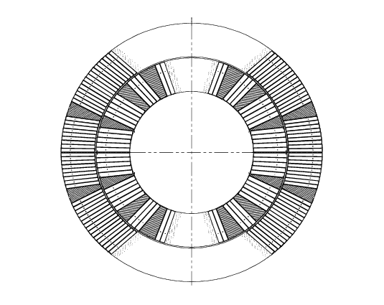
During quench, current redistributes in cable – magnetic field changes slightly. How much change is detected depends on dB/dt, geometry, number of turns of device, etc.
Quench event (fast current redistribution (large dI/dt) as current redistributes in strand)
Quench Antenna
Flux change at antenna is $dφ=dB∗A$
Voltage on antenna is $V=−\frac{dφ}{dt}=−\frac{dB}{dt}∗A$

Slide 3
So far, QA used mostly for longitudinal quench detection – series of QA along length of magnet, can detect which shows a signal first
Would like to make progress on getting more spatial resolution on start localization longitudinally as well as azimuthally and possibly also track the propagation.
QA grid array: crossed flexible PCBs that can be applied over region to obtain pixelated view of quench
Magnetic measurements probe array: multi-vertex probe and deconvolution analysis to determine radius and angle from probe

Slide 4
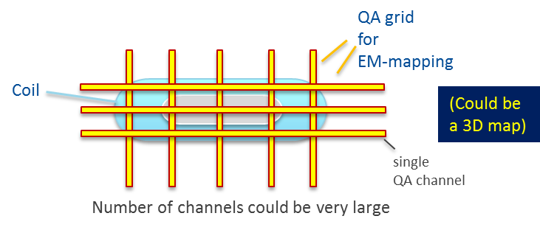
Grid array approach:
Flex QA can be installed within magnet - on the “trace” layer which has heaters and wiring – brought out with instrumentation wires on trace (can be soldered directly to pads on trace – still to be worked out).
Or can be installed within aperture (within WBT or on outer surface of WBT)
Can be put between layers for detecting outer (or multiple) layer quenches.
Arrays are crossed for localizing quenches in greater detail
S. Stoynev

Slide 5
Features of QA grid (depending on density of grid)
Determine localization more precisely axially
Localize also in azimuth
Can be used in ‘mirror magnet’ (no aperture) single coil tests
Can be installed in aperture, but also between layers – perhaps detect outer layer quenches
Disadvantage
May have lots of channels for fine and/or extensive coverage

Slide 6
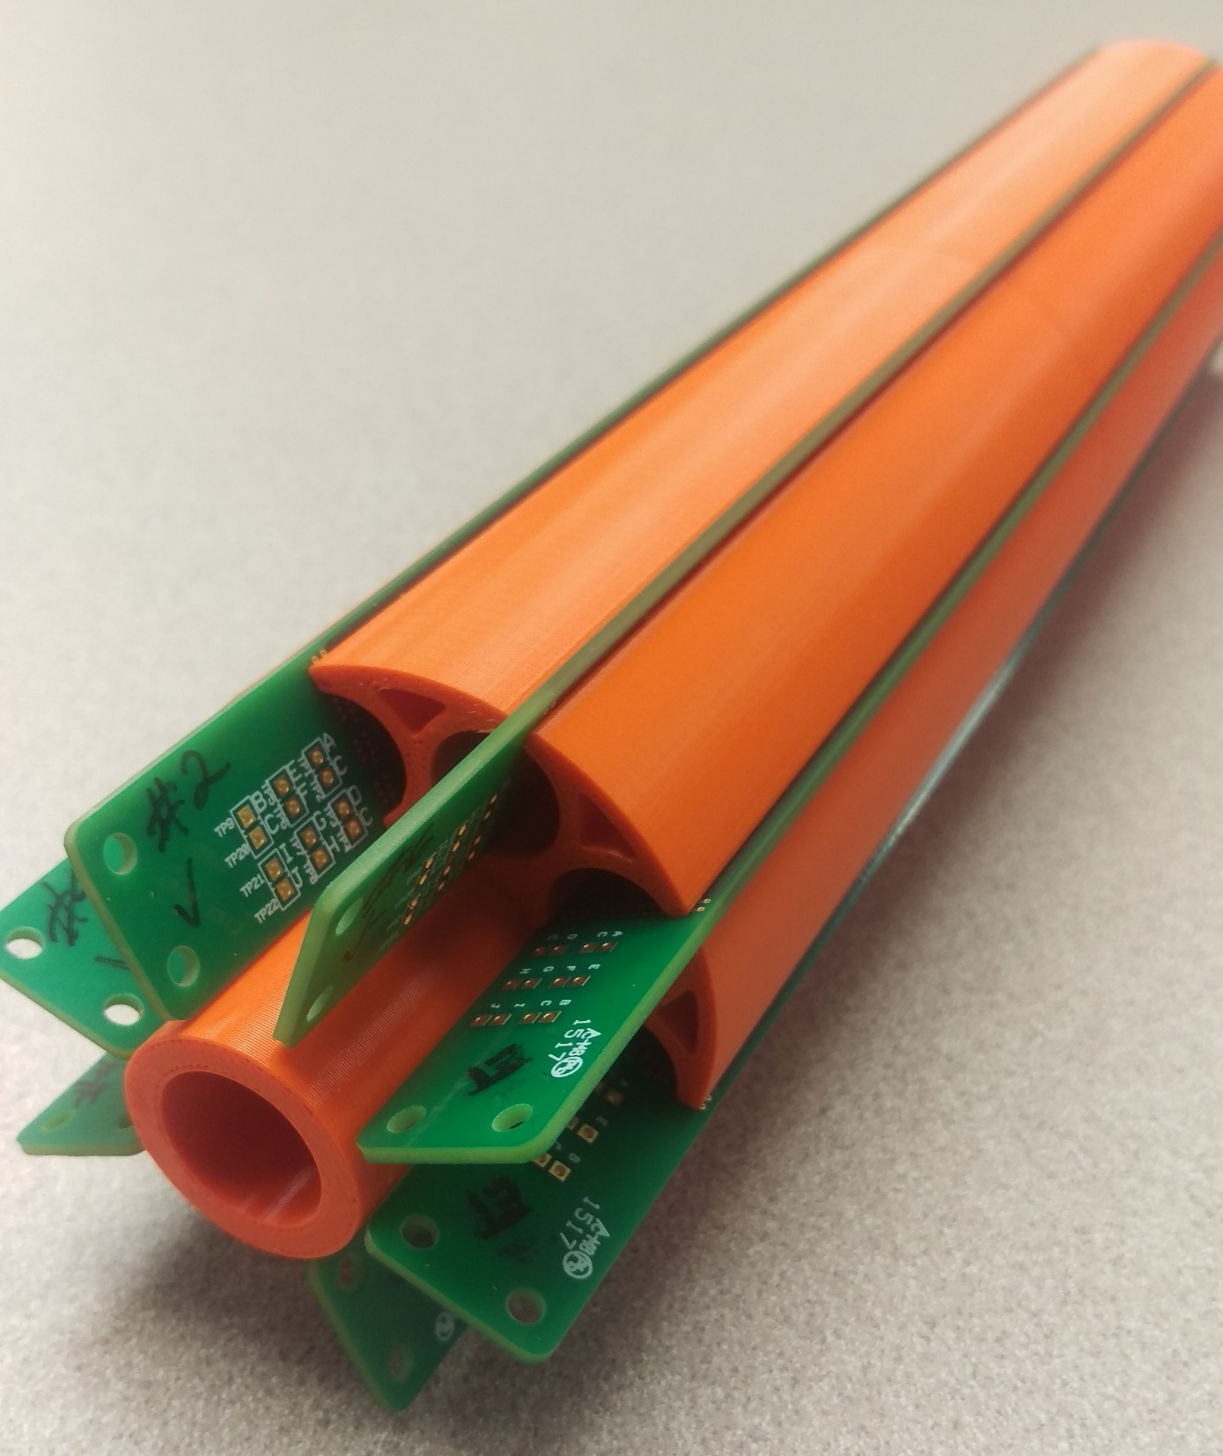
‘Rigid’ MV magnetic meas array
Mag. Meas. probe array approach:
Stationary coil which can be used for quench detection
Multivertex (MV) system of (bucked, radial) PCB probes used in aperture (trying 8, but can be higher number).
Each PCB has radial bucking of dipole and quadrupole at level > 100
Prototype MV array currently being tested for field quality measurements
Radial configuration of QA probes (can be either rigid or flex PCBs mounted on stiff radial supports)

Slide 7
How to use MV probes to detect quench (both Radial and Tangential configurations):
Simultaneous sampling at 10-100kHz.
Quench event detected as field disturbance in all coils (or some subset if mounted between layers)
May be able to locate quench in azimuth and radius by solving for voltage response of set of probes*
Model the field distortions picked-up by the quench antenna as being produced by a current line parallel to the z-axis and moving along z.
Write parameterized expressions for the response of various vertices to the flux change based on angle, radial distance, etc.
Consider first order terms and solve for radius, angle, velocity direction
Longitude quench location found by having multiple sets of MV antennas
* Following idea of T. Ogitsu, et al., “Quench Antennas for Superconducting Particle Accelerator Magnets”

Slide 8
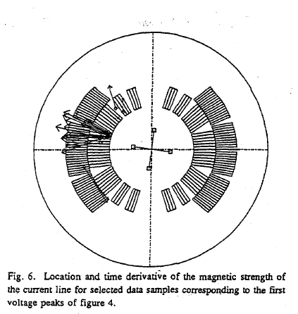
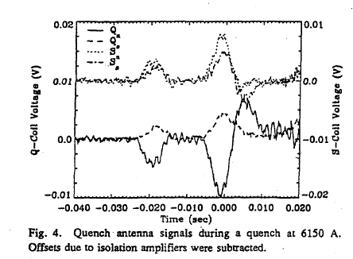
Using MV probes to detect quench
Example of quench location results with 4 multipole coils from T. Ogitsu paper
The response of four quench antennas to quench event.
Based on the geometry and a simple model of quench development, the quench location in radius and azimuth, and its direction of motion are solved for. The various arrows are different time slices in the region circled on the left-hand plot – and so shows the consistency/uncertainty

Slide 9
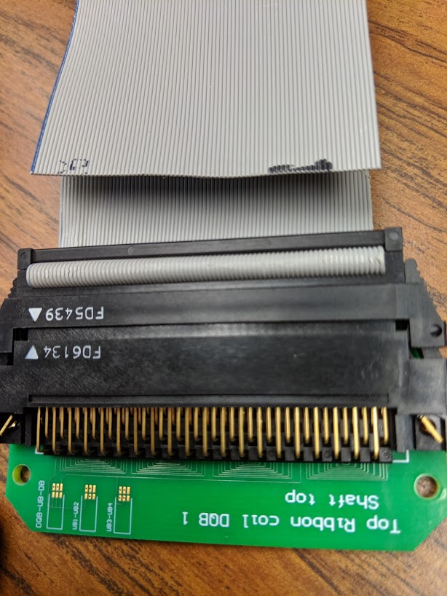
Proposal for MQXF would be to have “full-length” MV array of DQ bucked ribbon cable probes
PLUS
Diagonal wrap of short QA flex pcbs covering the MV cylinder
➔ MV array would give angular and radial position of quench, and the flex PCBs would provide longitudinal resolution of about 75mm
A parameterization for the QA layout suggests that we need ~20 flex QA channels per meter for 75mm resolution
The MV array would need at least 8 channels over the full length (unless we segment the probe in e.g. 1m lengths, etc.)
PCBs create bucked loops from the ribbon cable

Slide 10
A 1 meter prototype could be built and tested during next short model test.
Need:
Flex PCB array
PCBs which are used to create ribbon cable probes.
Cabling, etc.
Data acquisition channels?
Design, assembly, testing, etc.
Costs:
PCBs ~$5k
Structure ~$5k
Cabling $1k
Data acq $30k (?) (could use existing daq channels for 1m test?)
electrical tech
mech tech
engineer/physicist

