Slide 1
Welcome to Fermilab
T.I. Meyer | Deputy Director for Administration, Fermilab
Summer Undergraduate Lecture Series
18 June 2019

Slide 2
Humility
People with opinions just go around bothering one another.
Buddha
Science is a wonderful thing if one doesn’t have to earn one’s living at it.
Einstein

Slide 3
What is Fermilab?

Slide 4
What is Fermilab?
A place…

Slide 5
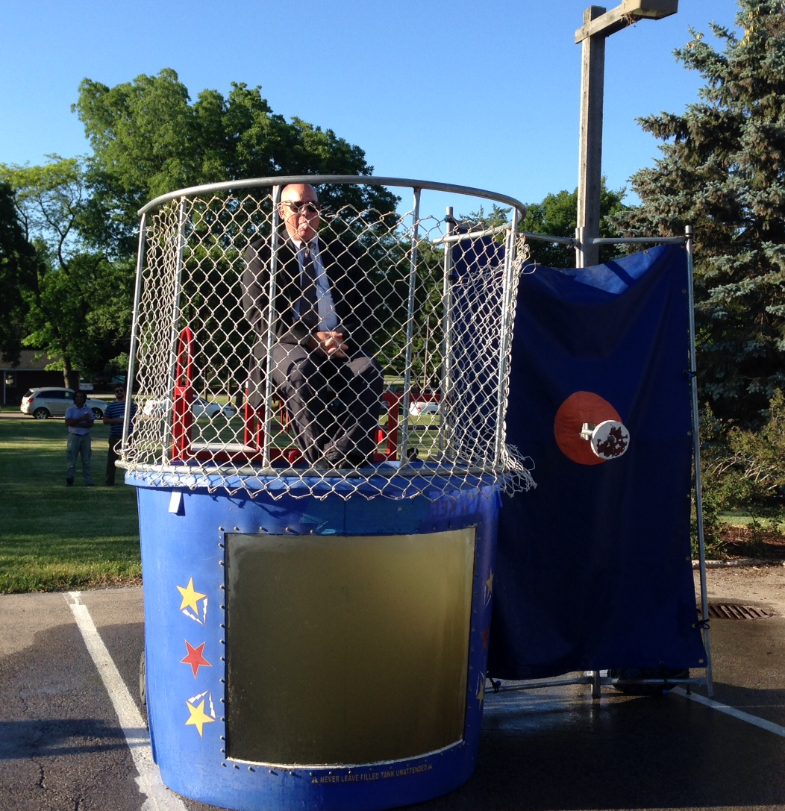
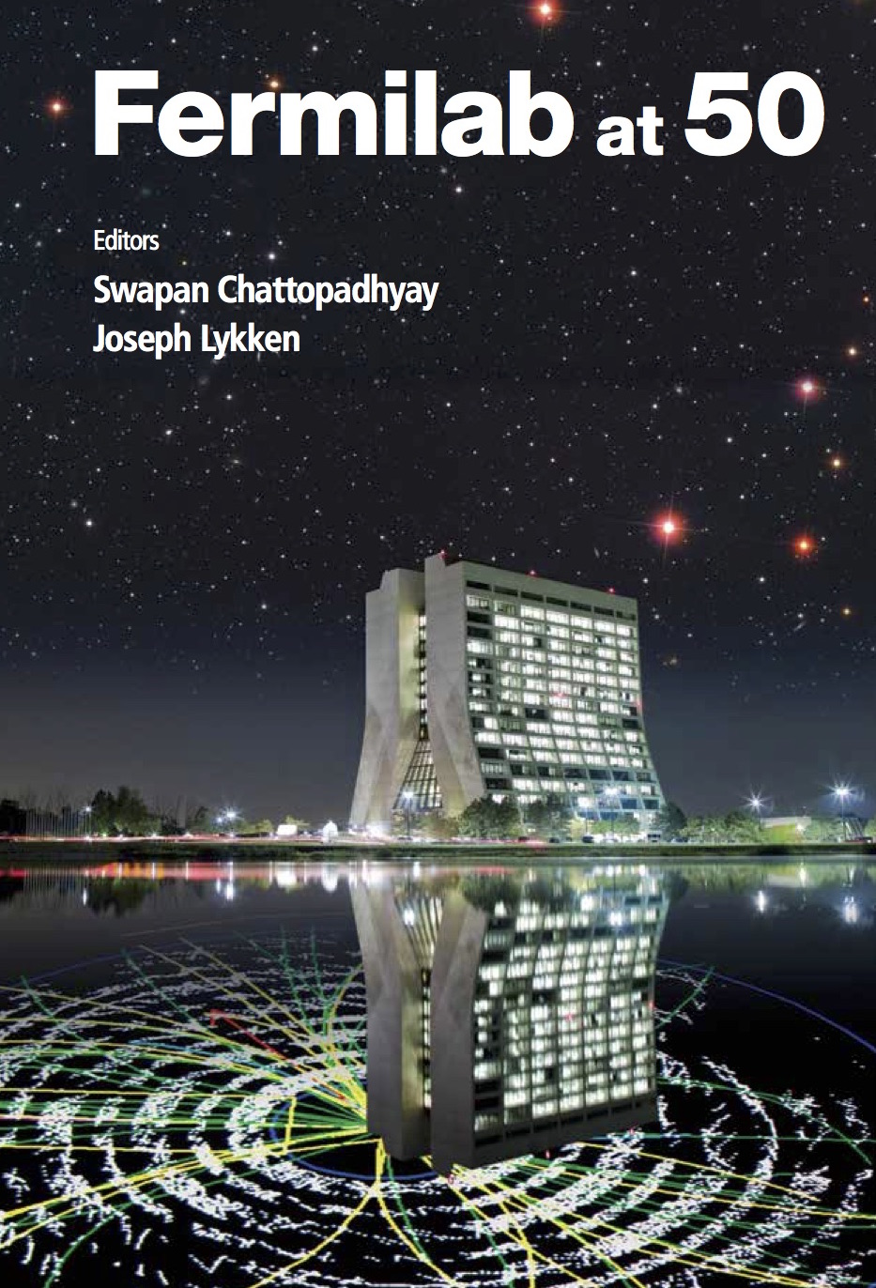
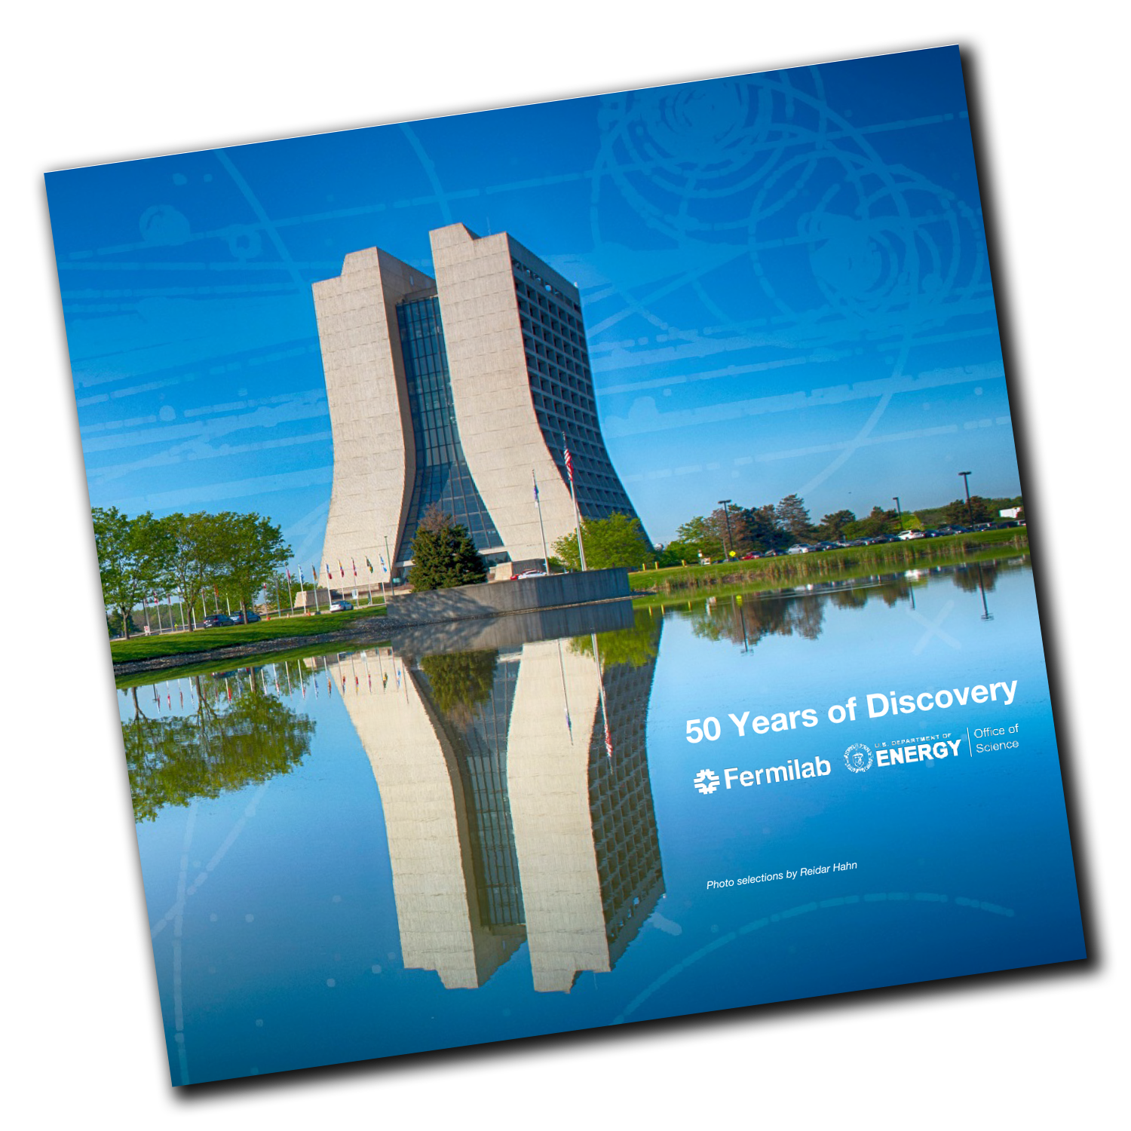
50 Years (1967 – 2017)

Slide 6
Before…

Slide 7
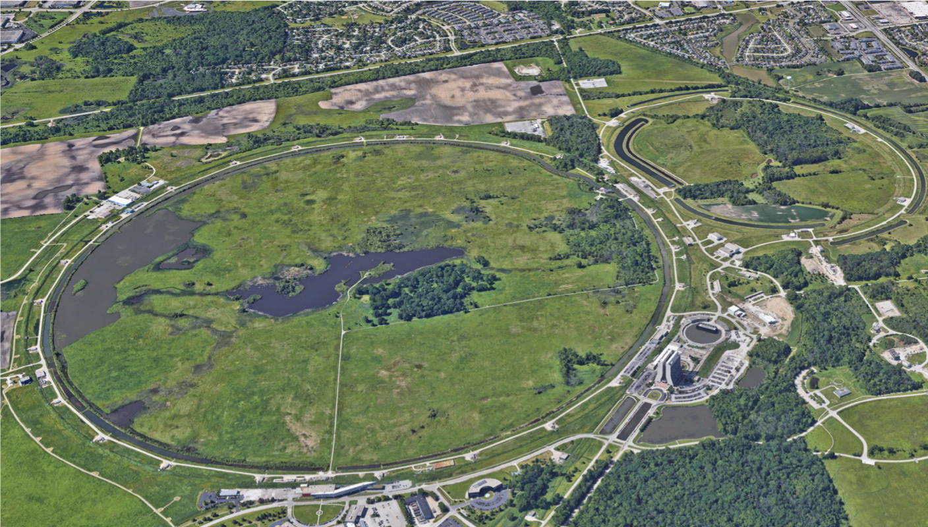
June 12, 2019

Slide 8
…
Notes:
Any questions?

Slide 9
What is Fermilab?
A place that is a national lab…

Slide 10
What is a national lab?
Motivated scientists and students are available at any university…so why do we need national laboratories?
Distinctions of a national laboratory:
Combination of talents: scientists, engineers, technicians, computing professionals … and a back office that knows safety and govm’t contracting
Colocation of people w/ world-class facilities: people go where the action is, and the action is alongside the tools
Every lab has a powerful network of partners, and together the labs are perhaps the greatest S&T network on the planet

Slide 11
Department of Energy National Labs

Slide 12
As a national lab…
America’s laboratory for particle physics & accelerators
Discovery of three of the elementary particles
1,800 employees; $550M annual budget
Federal land & facilities
2.4M GSF across 360 buildings + 19.8k GSF leased space (South Dakota)
3,500+ users of Fermilab’s two Scientific User Facilities
Proton Accelerator Complex
CMS
M&O Contractor: Fermi Research Alliance
Univ. of Chicago + Univ. Research Assoc. (URA, founder of Fermilab)

Slide 13
What is Fermilab?
A place that is a national lab and does science…

Slide 14
What is Science?
What is science?
A scientist hears a thumping noise in the middle of the night. What does he/she/they do?
A. Gets afraid
B. Try to explore and understand
C. Goes back to sleep
“If you let your emotions rule your thinking, you might think a thumping noise was a ghost. If you think like a scientist, however, you ask questions and make observations. You'd observe the shutters are loose and blowing in the wind.”

Slide 15
What is Science? (one of my favorite answers)
The British Science Council is a professional society for scientists in the UK; it organizes conferences, sets standards for scientists, and promotes science in society and government.
They wrote:
“Science is the pursuit and application of knowledge and understanding of the natural and social world following a systematic methodology based on evidence.”
What do you notice about this definition?
Notes:
“Science is a way of understanding the physical world, based on observable evidence, reasoning, and repeated testing. That means scientists explain the world based on their own observations. If they develop new ideas about the way the world works, they set up a way to test these new ideas.”

Slide 16
What is Fermilab?
A place that is a national lab and does the science of particle physics…

Slide 17
What is particle physics?

Slide 18
What is Fermilab?
A place that is a national lab and does the science of particle physics using accelerators and computers…

Slide 20
What is Fermilab?
A place that is a national lab and does the science of particle physics using accelerators and computers with the whole world…

Slide 21
“If you want to go fast,
go alone.
If you want to go far,
go together.”
-- African proverb
Progress in particle physics requires the resources, talents, and participation of the entire world
We cannot do this alone, nor would we want to

Slide 22
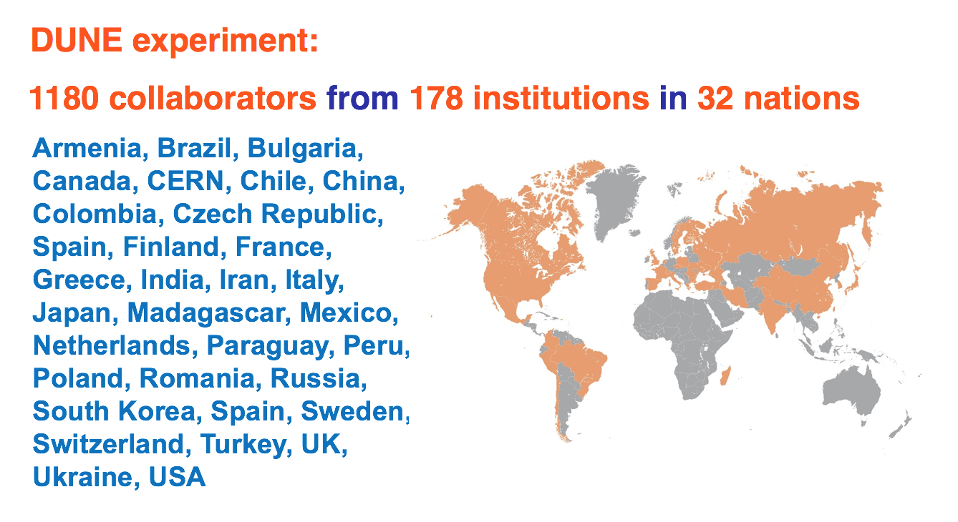
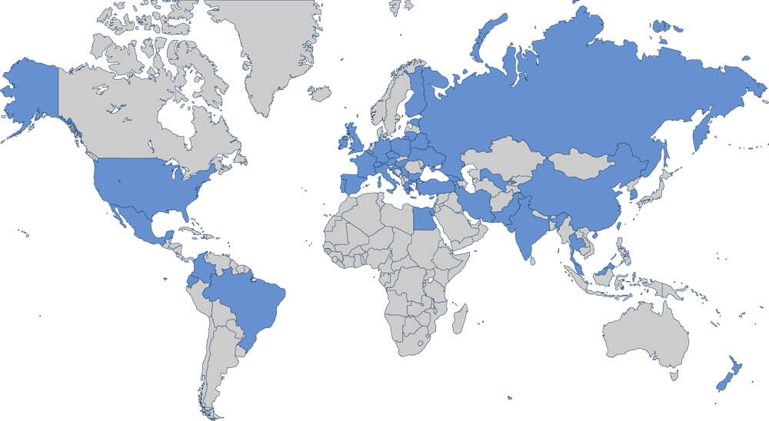
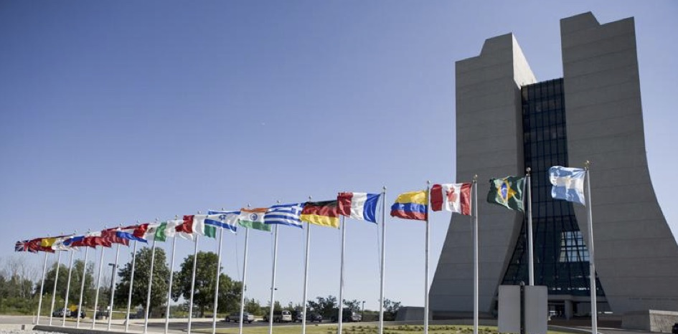
Fermilab hosts large international collaborations
Agreements from 55 countries and growing
Scientists from over 100 countries do research here
U.S. host of CMS

Slide 23
Long-Baseline Neutrino Facility / Deep Underground Neutrino Experiment (LBNF/DUNE)
LBNF/DUNE is the world’s flagship neutrino project and an international experiment that could change our understanding of the universe.
The project will send particles from the world’s most powerful neutrino beam, located at Fermilab in Illinois, to the world’s most precise neutrino detectors, located a mile underground at Sanford Lab in South Dakota.
The LBNF/DUNE project will be the first internationally conceived, constructed, and operated mega-science project hosted by the Department of Energy in the U.S.

Slide 24
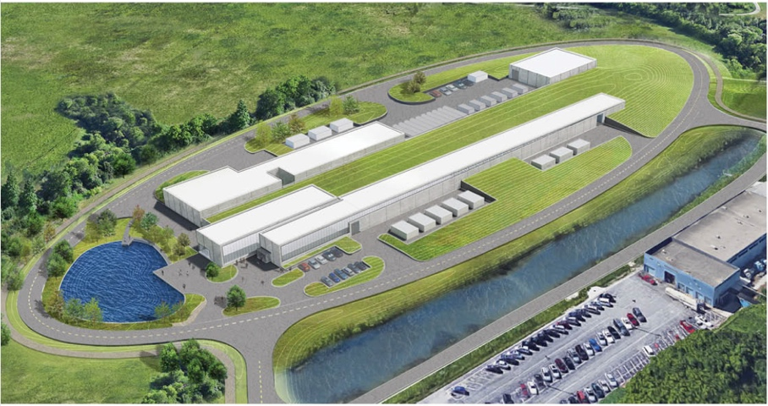
PIP-II Mission
PIP-II will enable the world’s most intense beam of neutrinos to the international LBNF/DUNE project, and a broad physics research program, powering new discoveries for decades to come.
PIP-II will provide:
Beam Power
Meeting the needs for the start of DUNE (1.2 MW proton beam);
Upgradeable to multi-MW capability;
Flexibility
Compatible with CW-operations which greatly increases the Linac’s output;
Customized beams for specific science needs;
High-power beam to multiple users simultaneously;
Reliability
Fully modernizing the front-end of the Fermilab accelerator complex.
June 12, 2019

Slide 25
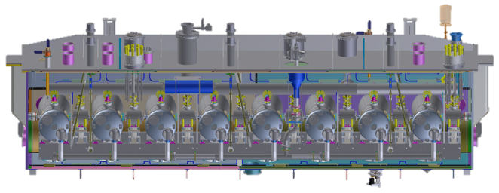
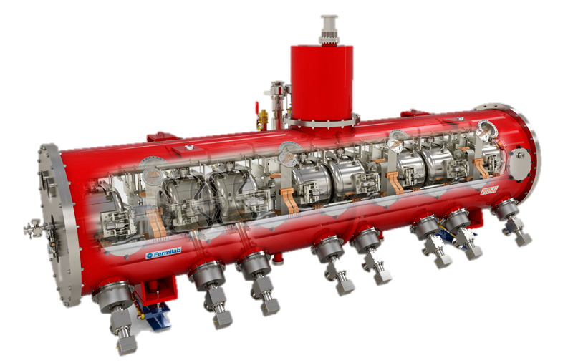
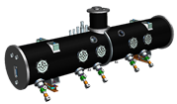
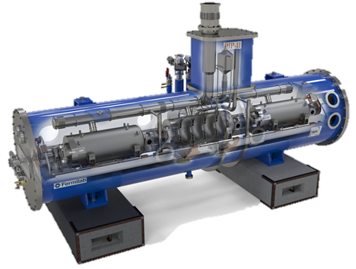
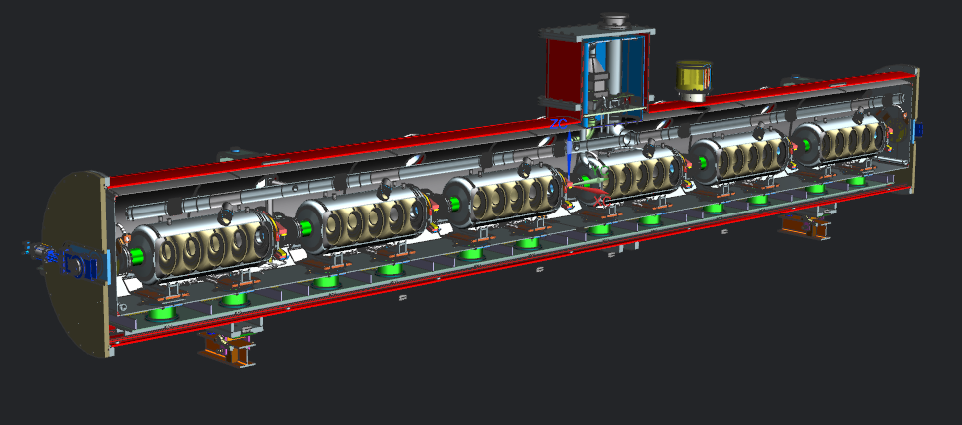
PIP-II Partner Contributions
IS
LEBT
RFQ
MEBT
HWR
β=0.11
SSR1
β=0. 22
SSR2
β=0.47
LB650
β=0.61
HB650
β=0.92
June 12, 2019

Slide 26
What is Fermilab?
A place that is a national lab and does the science of particle physics accelerators and computers with the whole world and supported by the American taxpayer.

Slide 27
Why should taxpayers invest in science?
Investment in scientific research yields
…discoveries
…inspiration and training for the next generation
…breakthroughs in technology that drive economic growth
These things don’t happen by themselves and they won’t happen in corporate America
Public funding is a transformative ingredient
Advancing Knowledge
Driving Growth
Creating Leaders

Slide 28
The distinct benefits of particle physics
Advancing Knowledge
Driving Growth
Creating Leaders
What it studies
Building blocks, interactions, space/matter, energy/time, …
The tools and techniques it uses most often
Interesting & inspiring to people outside of STEM
Statistics & data mining, theoretical models & experiment, large instruments & teams, …
How it pushes technology
Radiation detection & control
Particle beams (i.e., accelerators)
Stretches technology in unusual fashion
Advancing Knowledge
Driving Growth
Creating Leaders
Advancing Knowledge
Driving Growth
Creating Leaders

Slide 29
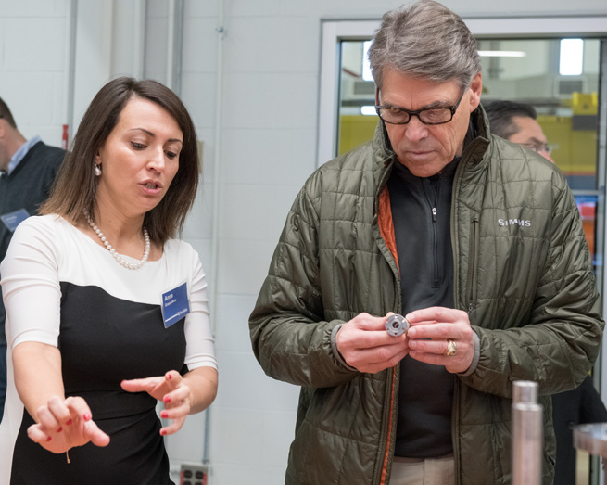
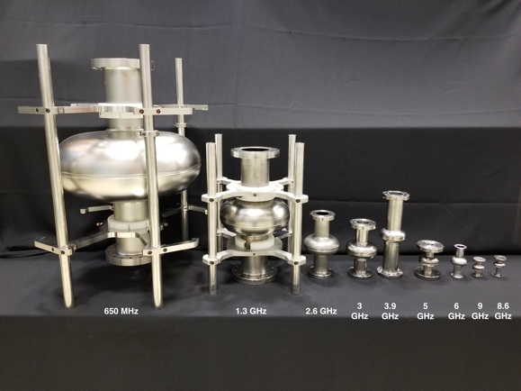
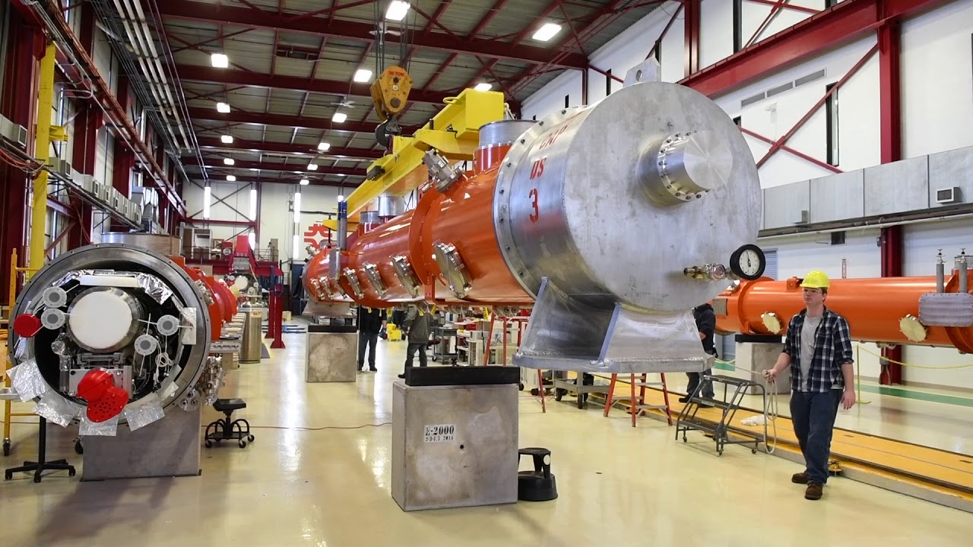
Example: accelerators and quantum computing
Fermilab has world-leading expertise in superconducting accelerators
Larger cavities for accelerators, smaller ones for quantum computers

Slide 30
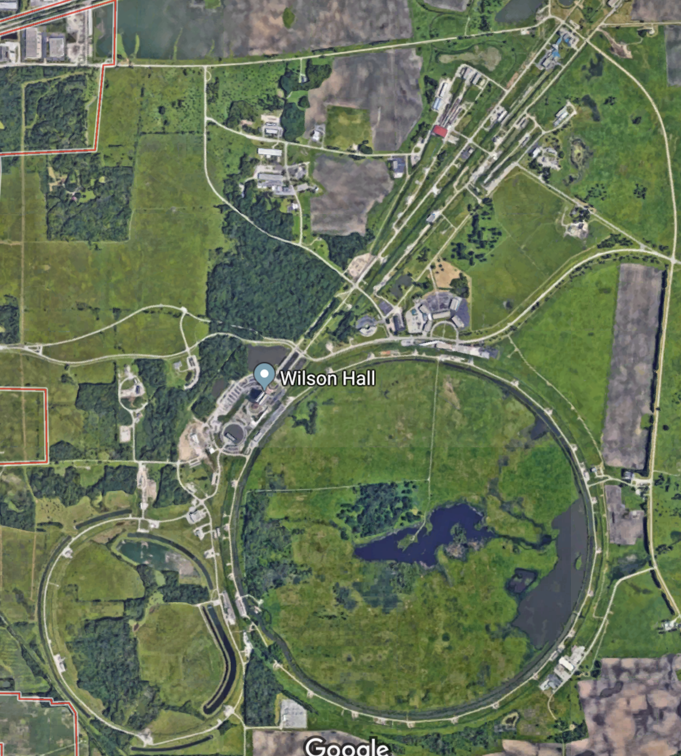
Quantum sensors at SiDet
Fermilab quantum science program
Quantum sensors at SiDet
Superconducting quantum systems lab at ICB
FQNET quantum communications at two sites
Quantum Theory Center in Wilson Hall
MAGIS-100 in the MINOS shaft
SC quantum systems
FQNET at FCC
MAGIS-100
Quantum Theory Center
FQNET at DAB
FQNET at DAB

Slide 31
Example: Illinois Accelerator Research Center
Mission is to explore where research-driven advances in accelerators can have impacts in industry
Two-pronged strategy
Technology push: Compact, next-gen accelerator
Market pull: feasibility studies for partners
Potential market areas
Pavement & coating applications
Water resources
Food & medical-device sterilization
Energy

Slide 32
Outlook
So, that’s Fermilab
Who are you?
We think EACH of YOU are bright, aspiring students capable of leading the world
We want you to work hard, enjoy, and grow
Ask us questions, challenge our assumptions
Have a great summer!

Slide 33
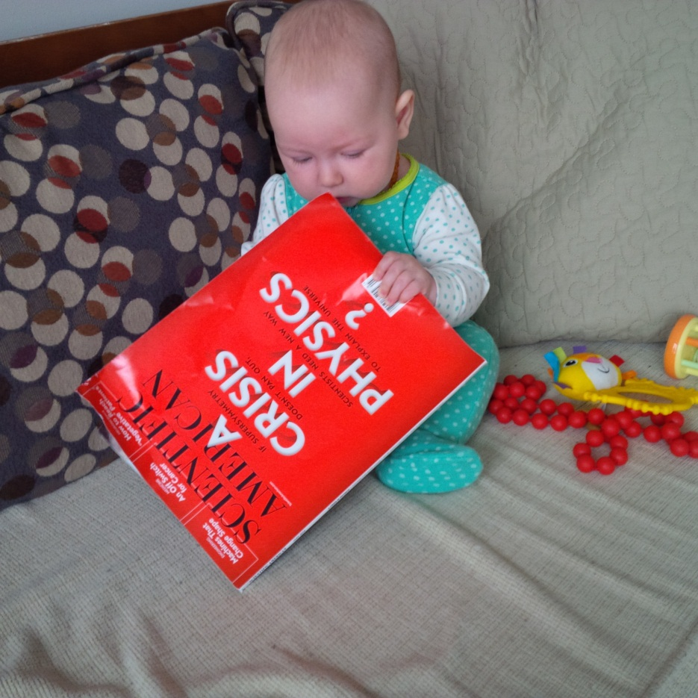
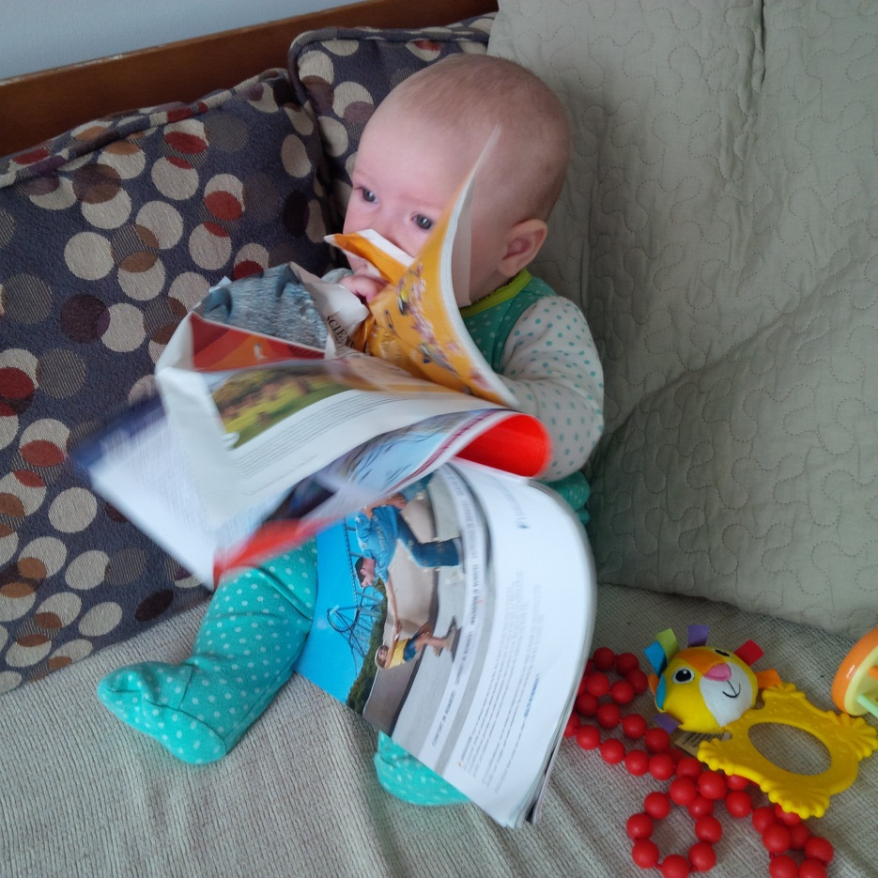
Thank you to the many people who contributed to this talk

